Slide 1
MESSENGER observations of the low-latitude boundary layer in Mercury’s magnetosphere
Elisabet Liljeblad¹, Tomas Karlsson¹, Jim Raines², Anita Kullen¹, James Slavin², Torbjörn Sundberg³
¹ Space and Plasma Physics, School of Electrical Engineering, Royal Institute of Technology, Stockholm, Sweden
¹ Department of Atmospheric, Oceanic and Space Sciences, University of Michigan, Ann Arbor, Michigan, USA
³ School of Physics and Astronomy, Queen Mary University of London, London, UK

Slide 2
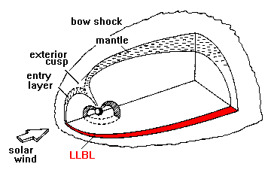
The low-latitude boundary layer
LLBL – region where constant transfer of mass and energy takes place
Studied extensively on Earth (more statistics on the flank)
Definition: mix of magnetosphere and magnetosheath plasma just inside the magnetopause at low latitudes.
Mercury LLBL:
Two observations from M1 and M2
Analyzed in a few articles (Wang et al. 2010; Anderson et al., 2011; Müller et al 2012)
Similar characteristics during both flybys

Slide 3
The study
Study and motivation
Three groups: LLBL, non-LLBL, KH waves
Characterize the Hermean LLBL
Location (dawn-dusk asymmetry?)
Thickness
Surrounding conditions
IMF/magnetic shear
Plasma Beta
Reconnection rates
KH on Mercury, clear dawn-dusk asymmetry - LLBL correlation?
Possible formation processes

Slide 4
Data analysis
Data: MAG and FIPS from MESSENGER’s first orbital year (2011)
Plasma Beta of MSH near MP, β = nk_{B}T/(B²/2μ₀), through direct measurements:
Reconnection rates: B_{N}/|B| - B_{N} through MVA on the MP crossing

Slide 5
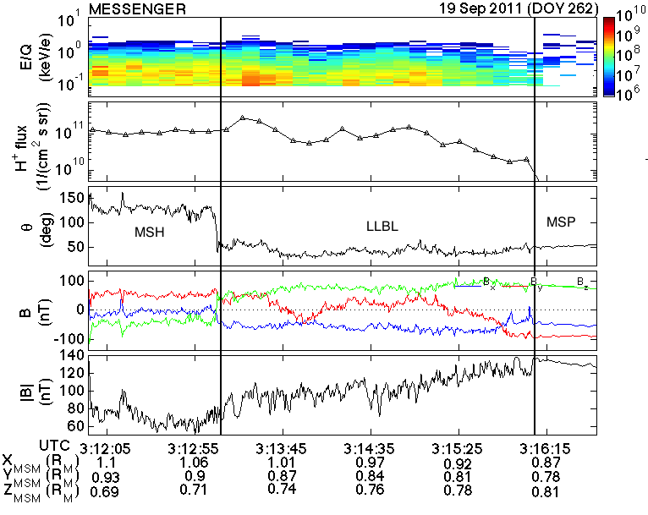
LLBL example

Slide 6
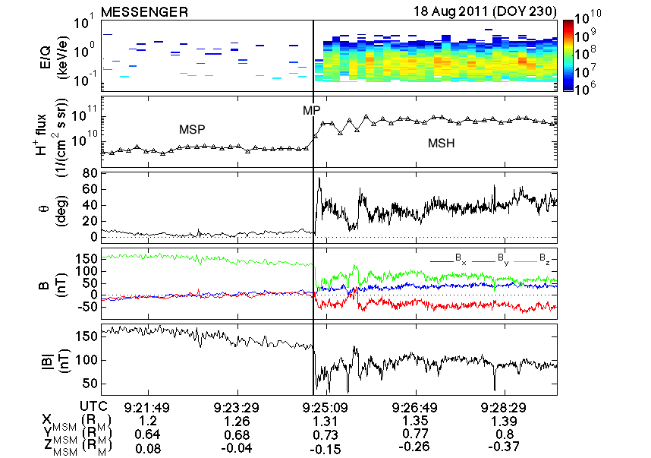
Non-LLBL example

Slide 7
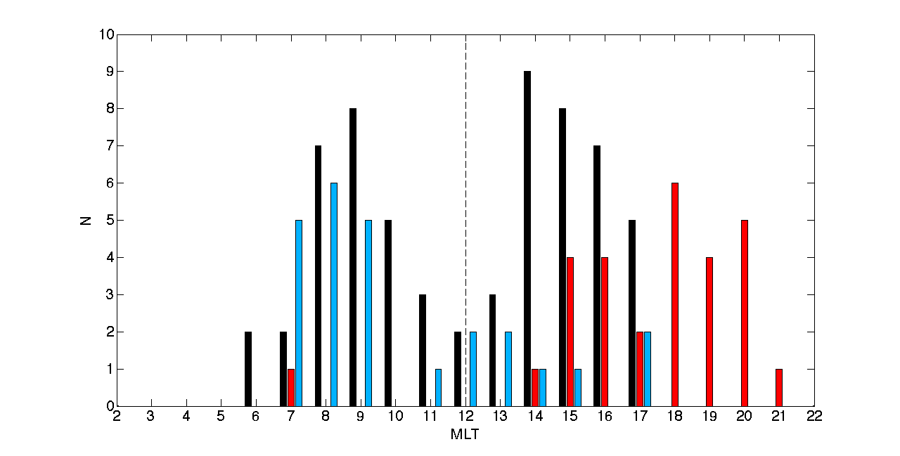
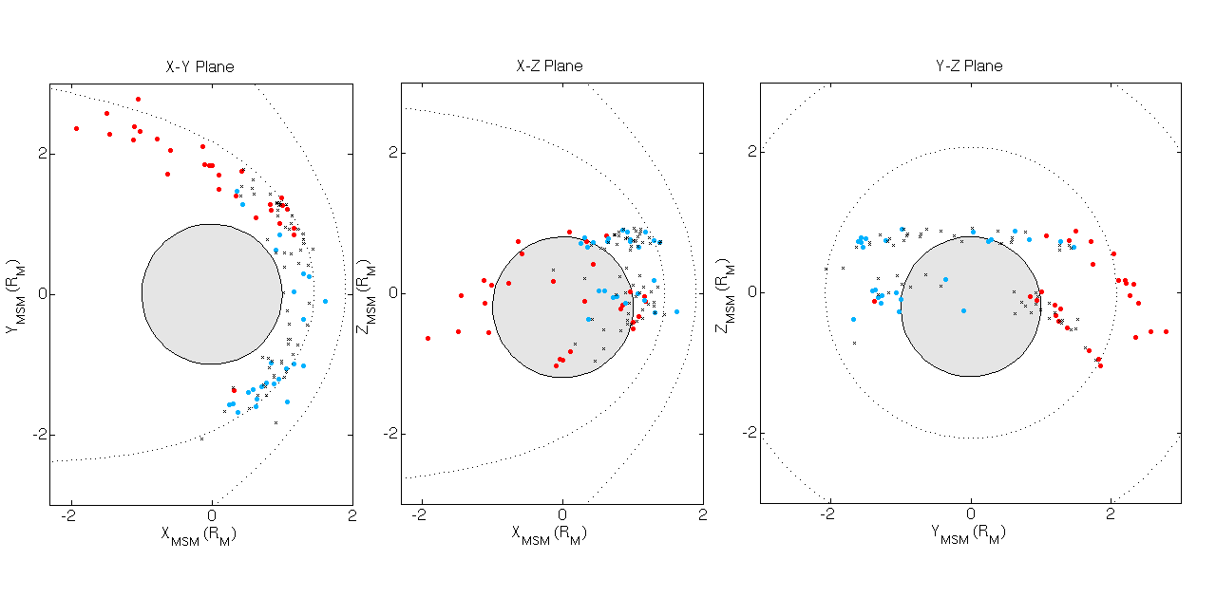
Results
25 LLBL, 61 non-LLBL
Anti-correlation LLBL/KHI

Slide 8
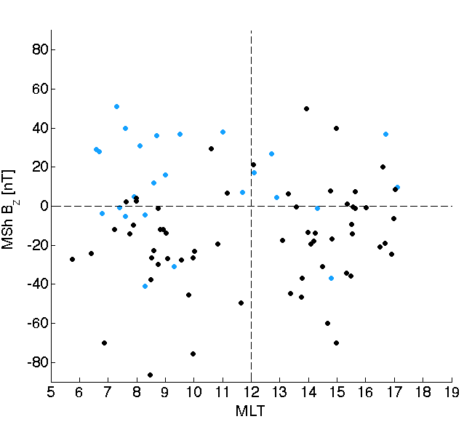
Results
Reconnection rates > 0.1 for non-LLBL only
LLBL smaller shears, mainly > Bz
Non-LLBL, mainly < Bz
<β>: 4.4±0.7 (non-LLBL) 2.0±0.4 (LLBL)

Slide 9
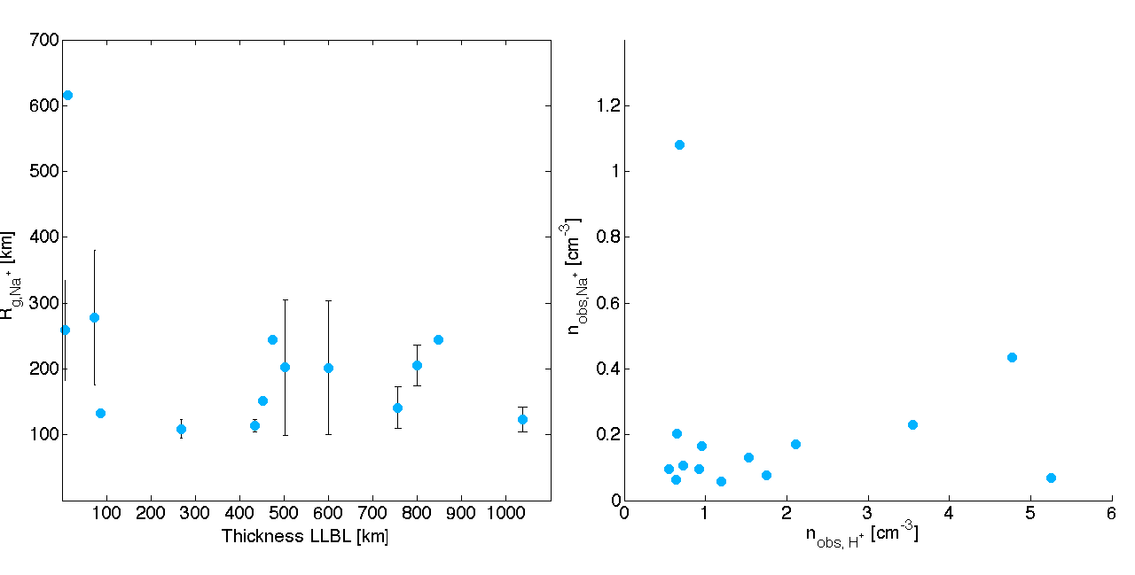
Results
Average thickness of LLBL: 450±56 km
Average Na⁺ gyroradius in LLBL: 220±34 km
Average H⁺ gyroradius in LLBL: 40±4 km
Number density of Na⁺ ~22% of H⁺

Slide 10
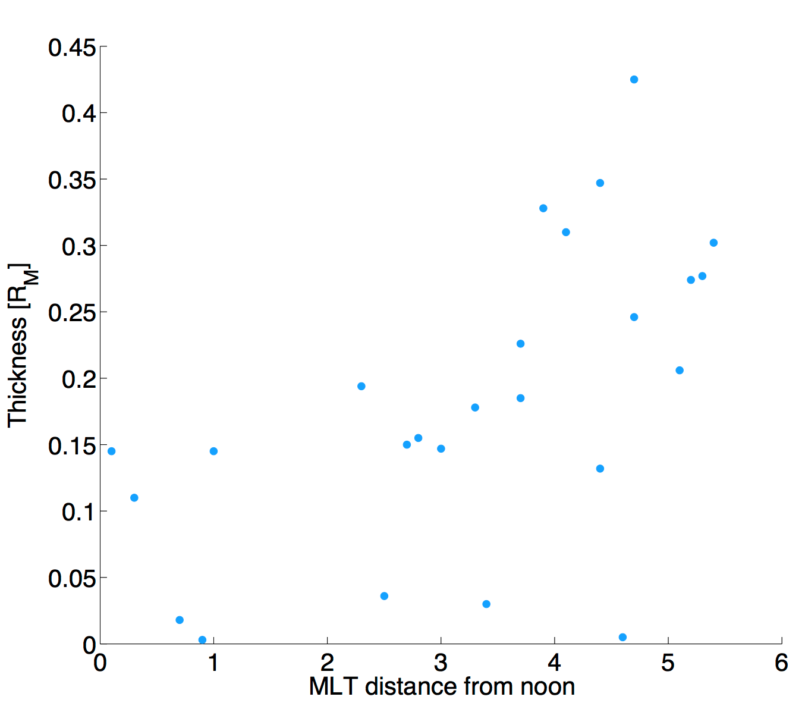
Results
LLBL thickness increases with distance from noon
No dependence on distance to equatorial plane
No dependence on magnetic shear
No dependence of LLBL H⁺ density
In agreement with Earth observations (Mitchell et al. 1987; Eastman and Hones 1979)

Slide 11
Results: summary
Majority found on the dawnside ➔
Anti-correlation KHI/LLBL – LLBL responsible for the KHI asymmetry?
Lower reconnection rates and magnetic shear, high β ➔ Slower reconnection or other formation process?
Thickness increases with distance from noon ➔ Some kind of diffusion process ongoing?
<Na⁺> gyroradius in the same order of magnitude as LLBL thickness ➔ Responsible for both LLBL & KHI asymmetry?

