Slide 1
Future observations of Mercury with the Mercury Imaging X-ray Spectrometer
Adrian Martindale
(on behalf of MIXS team)
University of Leicester

Slide 2
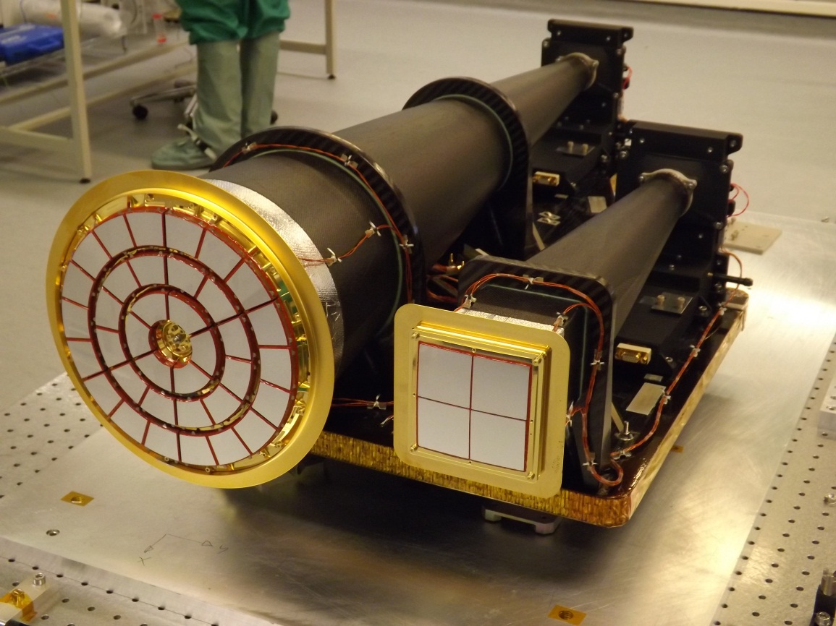
Contents
MIXS Flight Model
Instrument
Science themes
MIXS / XRS
“XRS baseline”
Complementarity
Combination of data
Performance
Spectral
Coverage
Key questions

Slide 3
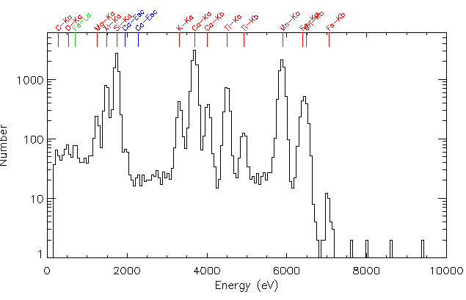
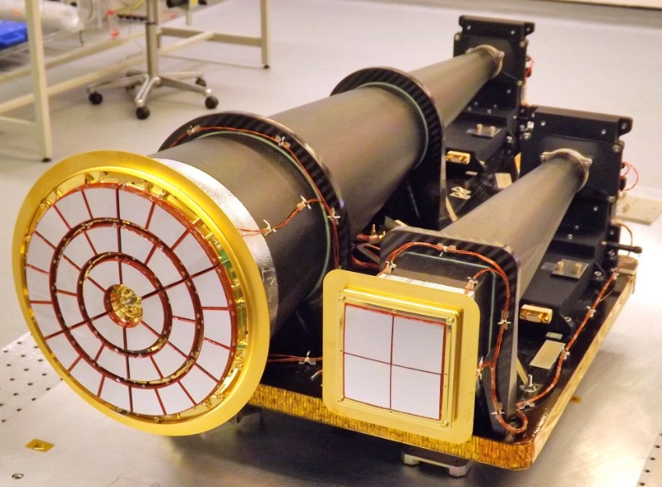
MIXS Instrument
MIXS is a dual-channel X-ray imaging spectrometer designed to operate at two spatial resolutions to measure the:
1) – Global/local surface composition
2) – Surface-magnetosphere/ magnetosphere-exosphere interactions
MIXS-T is a Wolter-I X-ray telescope with high spatial resolution (~few km)
MIXS-C is a profiled collimator designed for large grasp (high signal) on 100s km scales

Slide 4
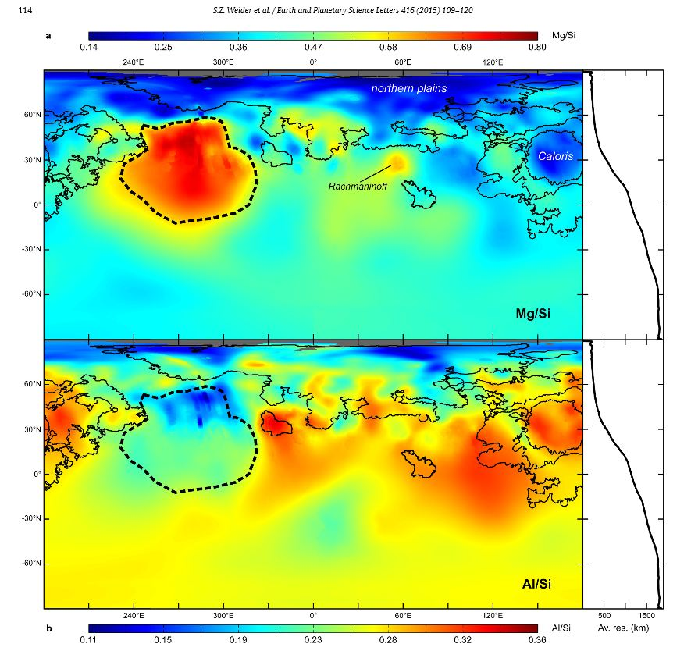
MIXS / XRS
MIXS and XRS are complementary
XRS has provided:
Excellent coverage in the N-hemisphere
Strong constraints on major rock-forming elements
ID of unexpected species (e.g. 2-5wt% S)
MIXS will provide:
Global coverage at improved resolution (orbit & instrumentation)
Provide higher sensitivity (reduced background and better spectral resolution)
Provide high resolution and/or higher sensitivity during bright flares
More measurable elements
Lower energies & more resolvable lines

Slide 5
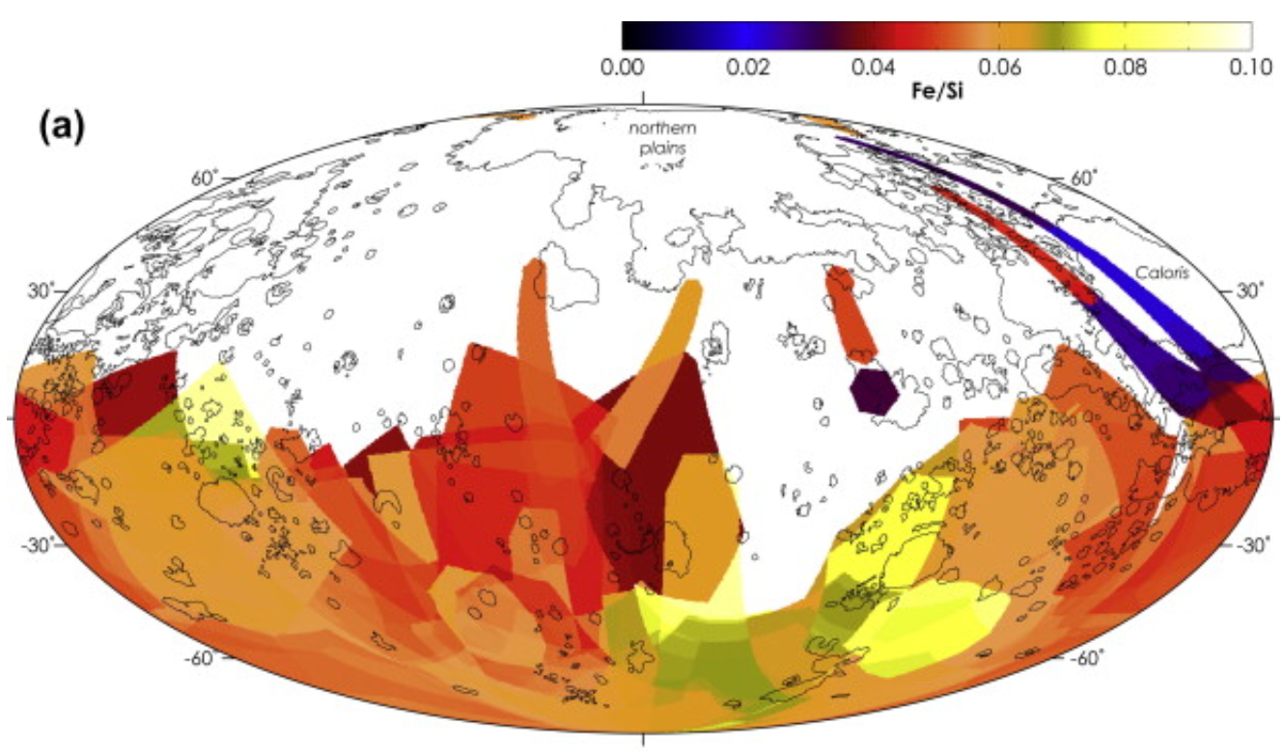
Cross-calibration of data sets
Discussing with MERTIS calibration on same samples
We are interested to try to link the MIXS and XRS datasets by experimentation with ground reference models.
Observe common sample(s) in controlled conditions.
Discussion with XRS team needed.
Wieder et.al. Icarus 235 (2014) 170–186

Slide 6
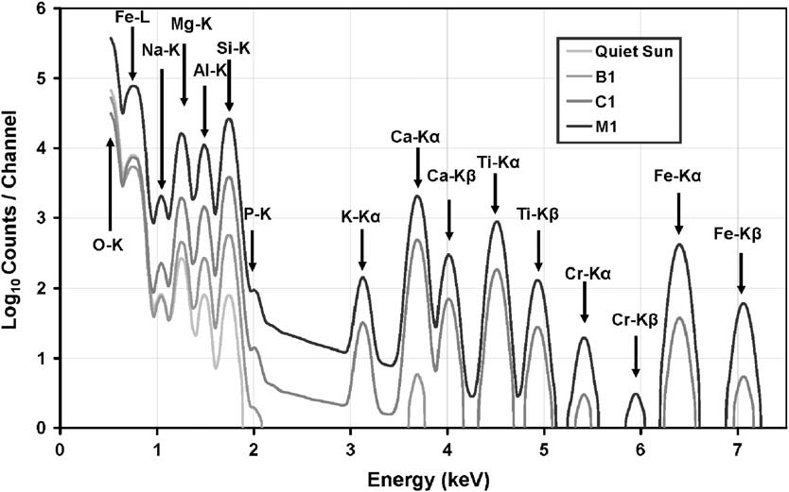
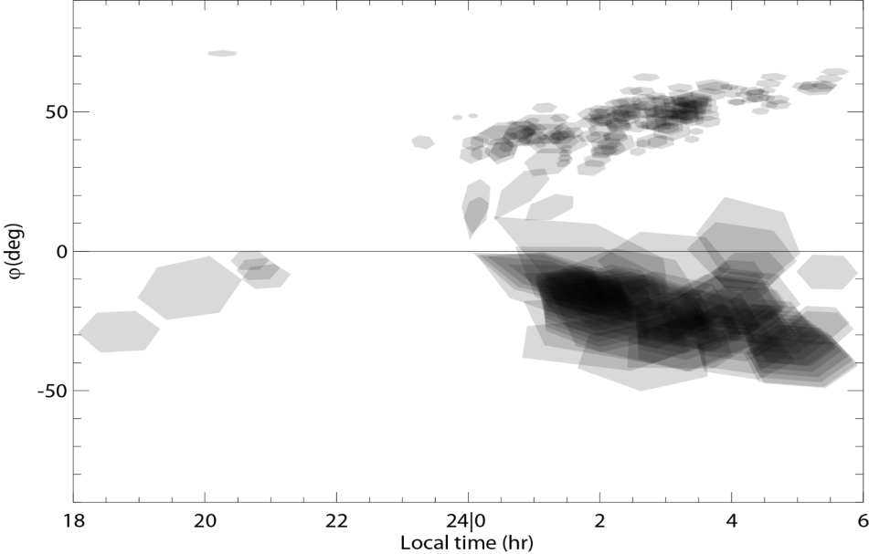
Science themes
Surface elemental composition mapping
More elements
More spatial resolution, particularly in S (orbit & design)
Remote sensing the Environment
Magnetospheric effects
Night-side observations offer major science
SWCX
Off-pointings
Magnetic equator
Equator

Slide 7
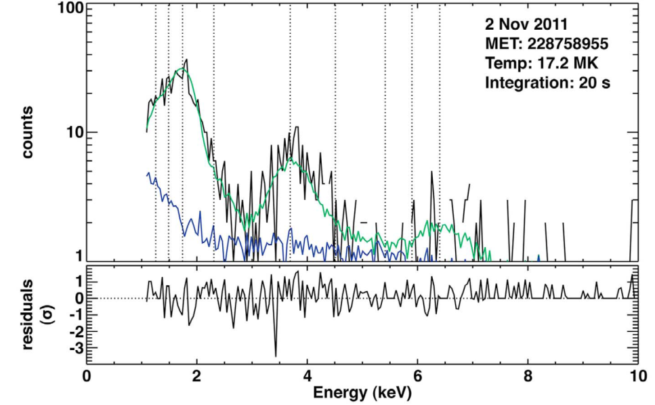
Science Performance
MESSENGER XRS (gas proportional counter) spectrum of Mercury
MIXS flight model spectrum of terrestrial basalt sample from recent calibration tests
Weider et.al. 2012 (JGR)
The novelty of the MIXS optics and mechanical design allows use of a state-of-the-art silicon detector with greatly improved sensitivity to geological composition.
Notes:
Note here on main points to make…

Slide 8
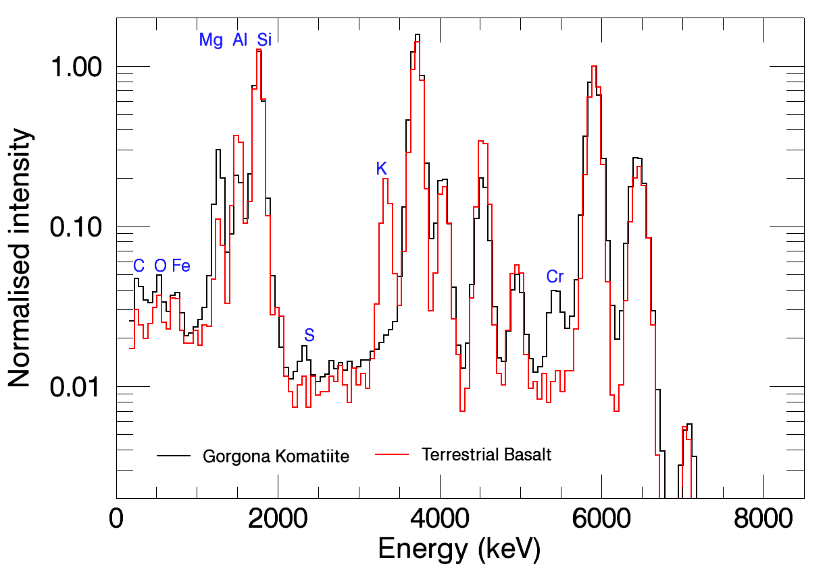
Science Performance
Notes:
Note here on main points to make…

Slide 9
Key questions - surface
What is the composition distribution in the S-hemisphere?
How does elemental abundance vary within single geological units?
What does this tell us about variation in magma sources?
High resolution imaging & high sensitivity we want to build on XRS results
What is the darkening agent in LRM? Cometary carbon proposed…
What composition changes occur at the edges of the perplexing high magnesium region?
What volatile species are implicated in;
hollow formations?
explosive volcanic eruption?
What is the distribution of lower abundance elements?
E.g. is there a strong spatial distribution of the 2-5% S revealed by XRS?
Is there evidence of surface modification? e.g. polar Na abundance changes reported by Peplowski.
What is the elemental composition of the diffuse red spots associated with volcanic vents?
Can we confirm the presence of Cl (~0.1-0.3wt%) and the planetary scale variations in Cl and K observed by GRS (e.g. Evans 2015)

Slide 10
Trace elements?
Na P Cl
Data up to 15keV available
Requires adjustment of instrument configuration

Slide 11
Key questions - Environment
What is the mechanism that leads to “magnetospheric (a)symmetries” in the night-side X-ray signal?
MIXS will offer higher sensitivity
More comprehensive coverage of the S-hemisphere.
More “uncontaminated” X-ray lines making it easier to distinguish instrumental background from planetary signal (e.g. no Mg filter).
Can we make multi-point measurements of the precipitating particles e.g. with particle instruments on MPO and MMO as well as the remote location on the planet?
Can we get composition of permanently shadowed craters from precipitating ions?
Can we observe the X‐ray spectrum originating from the exosphere in tangential geometry over the limb?
Off-pointings needed
Exospheric species via absorption lines in background-sky measurements?
Solar wind ions → charge exchange lines ~0.57keV
Energy range currently extends down to <200eV with good spectral resolution but the tight spectroscopy requirements to measure CX mean success depends on radiation damage.

