Slide 1
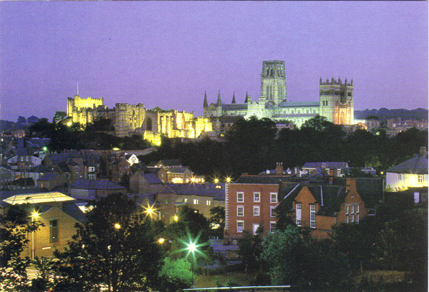
The disc-jet-spin connection: 3C273
Chris Done
Charles Finn, Emma Gardner…
University of Durham

Slide 2
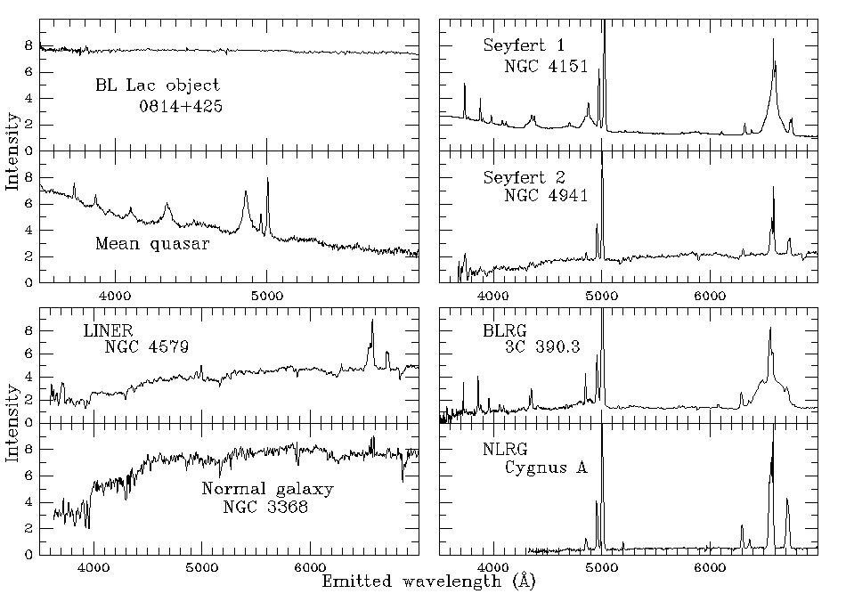
AGN/QSO Zoo!!! Optical
Mass, mass accretion rate, spin and inclination….

Slide 3
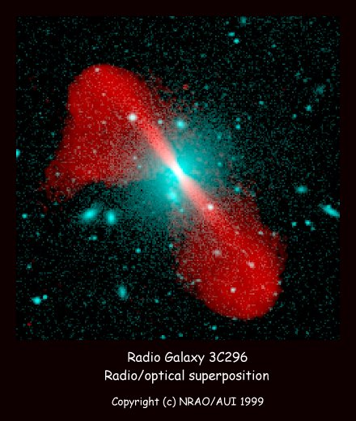
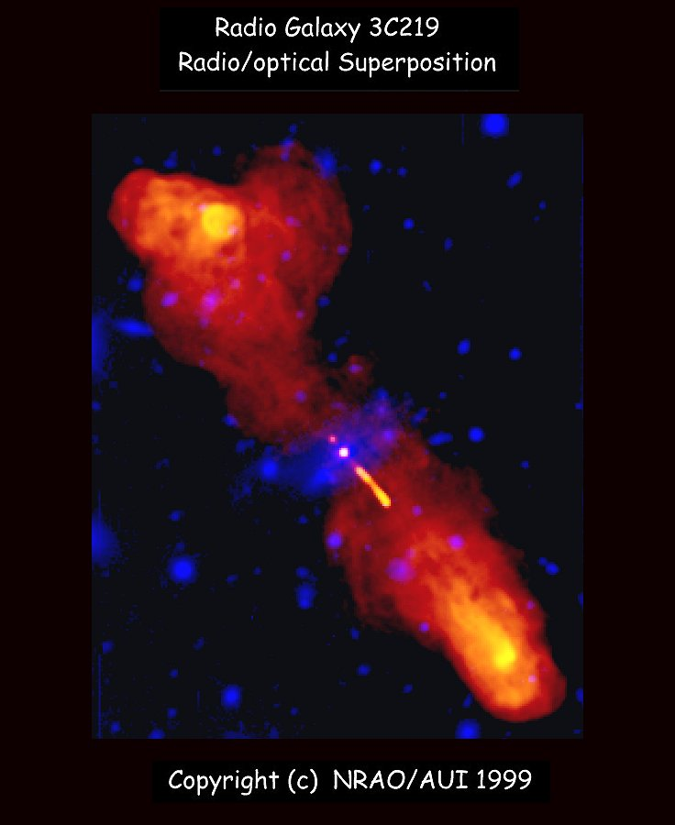
AGN/QSO Zoo!!! Radio loud
Enormous, powerful, relativistic jets on Mpc scales
FRI (fuzzy) - BL lacs FRII (hot spots) – FSRQ
Urry & Padovani 1992; 1995
Notes:
Scaling these models up to the supermassive black holes in quasars, the only change should be that the disc emission is in the UV rather than X-ray region. The problem is knowing how far to scale them for an individual qso, knowing the BH mass. This has only recently become possible with the discovery of the relationships between the BH mass and the properties of the galaxy as a whole. Big BH live in big galaxies, little BH live in small ones. Also, only recently that enough high s/n data has become available to test these models – xmm-newton database

Slide 4
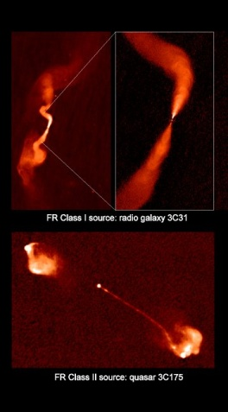
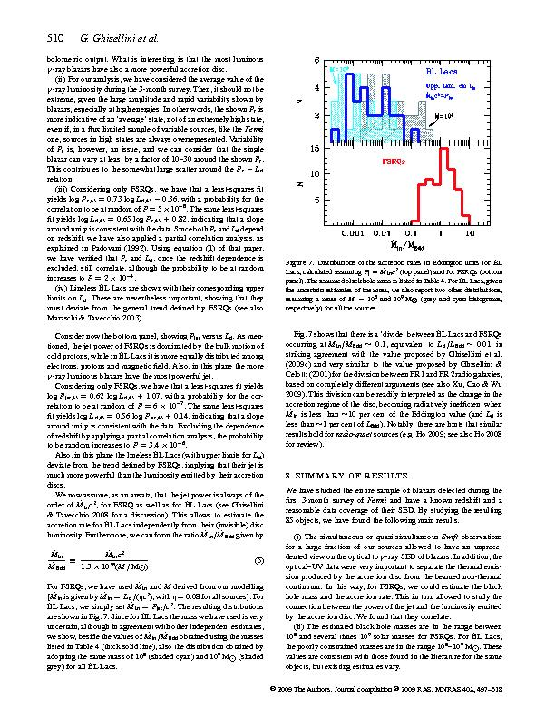
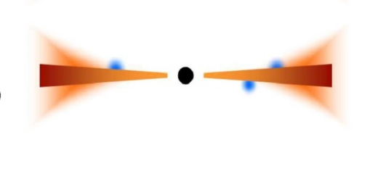
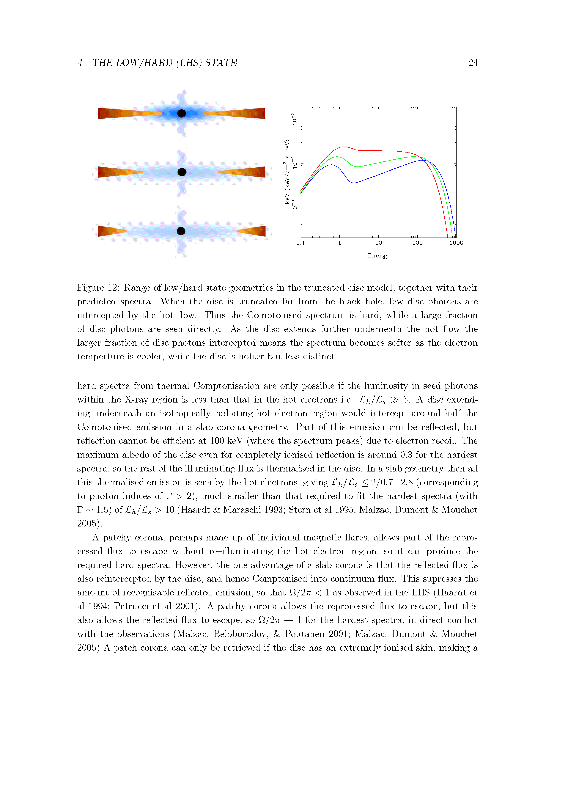
FRI is top of ADAF branch
(low/hard state BHB) but Γ=15!
L/LEdd
BHB
Ghisellini et al 2010

Slide 5
FRI is top of ADAF branch
(low/hard state BHB) but Γ=15!
No UV inner disc – no BLR
Sync-self compton (SSC)
UV bright, BLR
SSC+External compton
Ghisellini et al 2010

Slide 6
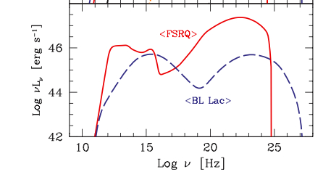
FRI is top of ADAF branch
(low/hard state BHB) but Γ=15!
No UV inner disc – no BLR
Sync-self compton (SSC)
UV bright, BLR
SSC+External compton
Ghisellini et al 2010

Slide 7
Spin-jet paradijm
Uncontroversial – very high spin to get Γ=10-15?
Ghisellini et al 2010

Slide 8
Spin-jet paradijm
Uncontroversial – very high spin to get Γ=10-15?
Mdot<0.01
Ghisellini et al 2010

Slide 9
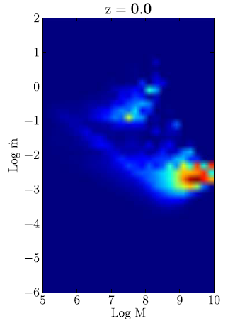
Black hole mass & mdot
Cosmological simulations gives number densities (M, mdot)…
…As a function of cosmic time
Colours are luminosity density
ASSUME all RIAF (mdot<0.01) produce BL Lac jet
Log mdot
Log M

Slide 10
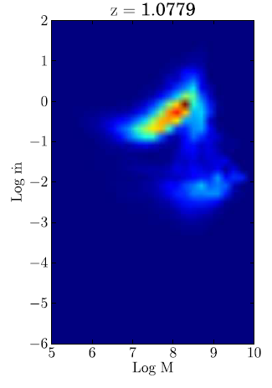
Black hole mass & mdot
Cosmological simulations gives number densities (M, mdot)…
…As a function of cosmic time
Colours are luminosity density
ASSUME all RIAF (mdot<0.01) produce BL Lac jet
Log mdot
Log M

Slide 11
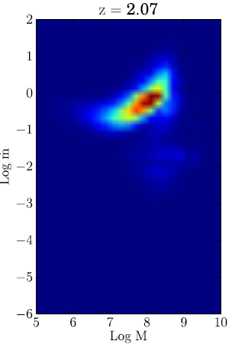
Black hole mass & mdot
Cosmological simulations gives number densities (M, mdot)…
…As a function of cosmic time
Colours are luminosity density
ASSUME all RIAF (mdot<0.01) produce BL Lac jet
Log mdot
Log M

Slide 12
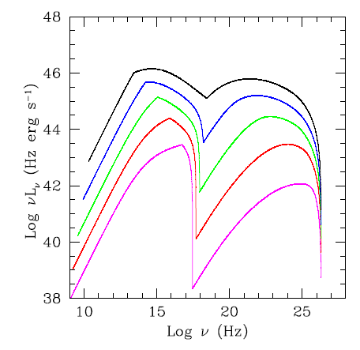
Black hole mass & mdot
Gardner & Done 2013
Sync-self-Compton (SSC)
Inject e⁻, cool
Average jet parameters (Ghisellini et al 2010) Γ=15
Scale jet kinetic power to M and mdot - LBL to HBL (Heinz & Merloni 2004)
L/L_{Edd}

Slide 13
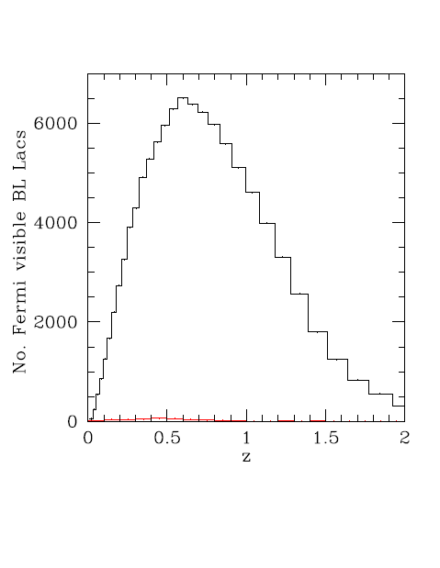
1000x more Fermi BL Lacs!!
Paste scaled jet onto all mdot<0.01 AGN
Random direction
Predicted Fermi numbers of BL Lacs
Gardner & Done 2013

Slide 14
1000x more Fermi BL Lacs!!
WRONG!!
Gardner & Done 2013
Observed!!

Slide 15
Spin-jet paradijm BL Lacs
So high Γ jets RARE
High spin rare (chaotic accretion, a*>0.8)
High spin common, B flux rare (Sikora & Begelman 2013)
Retrograde spin rare eg Garofalo et al 2014
BL lacs – no inner disc so hard to get spin constraints
Ghisellini et al 2010

Slide 16
Spin-jet paradijm: FSRQ
So high Γ jets RARE
High spin rare (chaotic accretion, a*>0.8)
High spin common, B flux rare (Sikora & Begelman 2013)
Retrograde spin rare eg Garofalo et al 2014
BL lacs – no inner disc so hard to get spin constraints
FSRQ – retrograde thin disc or prograde large H/R flow?
Ghisellini et al 2010

Slide 17
Spin-jet paradijm
Can’t use Fe line as the jet dominates the X-ray flux
But can use disc continuum...
Ghisellini et al 2010

Slide 18
Spectra of accretion flow: disc
Thermal emission:
L = AσT⁴
Last stable orbit sets maximum temperature
Tmax - (mdot/M)^{-1/4}
X-ray for NLS1 ~ 10⁷ M
FUV for ~ 10⁹ M FSRQ
Log ν f(ν)
Log ν
Notes:
Accretion discs are the most well known form of the accretion flow. Inner radii rotate faster so there is viscous friction (a magnetic dynamo) which converts gravitational energy to heat. If this thermalises then at large radii there is not much gravitational energy and a lot of area, so producing low temperature, while at small radii there is lots of energy and not much area, so high temperature. There is a minimum radius – the last stable orbit which is a GR prediction – so there is a maximum temperature. At LEdd this is of order 1keV, or 10 million degrees for GBH, or 10eV, a hundred thousand degrees for a supermassive BH.

Slide 19
Spectra of accretion flow: disc
Thermal emission:
L = AσT⁴
Last stable orbit sets maximum temperature
Tmax - (mdot/M)^{-1/4}
X-ray for NLS1 ~ 10⁷ M
FUV for ~ 10⁹ M FSRQ
Depends on spin!
Log ν f(ν)
Log ν
Notes:
Accretion discs are the most well known form of the accretion flow. Inner radii rotate faster so there is viscous friction (a magnetic dynamo) which converts gravitational energy to heat. If this thermalises then at large radii there is not much gravitational energy and a lot of area, so producing low temperature, while at small radii there is lots of energy and not much area, so high temperature. There is a minimum radius – the last stable orbit which is a GR prediction – so there is a maximum temperature. At LEdd this is of order 1keV, or 10 million degrees for GBH, or 10eV, a hundred thousand degrees for a supermassive BH.

Slide 20
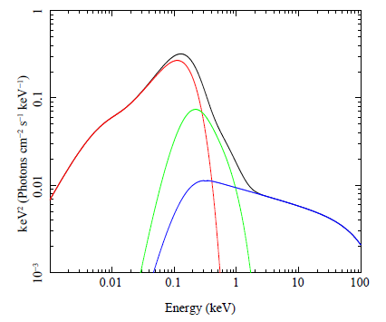
Optxagnf: conserving energy!
R_{corona}
Outer standard disc with colour temp correction down to R_{corona} – quick way to model full photosphere results
Then luminosity not completely thermalised to make soft X-ray excess ?
Inner corona as in BHB
NLS1: R_{corona} small so disc dominated, and Γ steep
Mdot
M
Done et al 2012

Slide 21
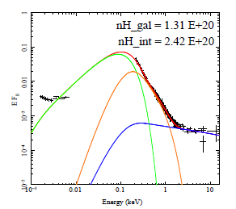
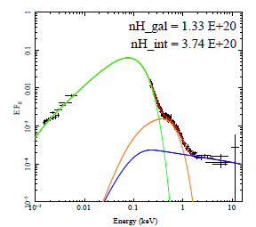
Simple NLS1
Smaller R_{corona} means spectra are dominated by disc!
NLS1 have small SX and big disc - NOT huge SX
Jin et al 2012

Slide 22
Optxagnf: conserving energy!
R_{corona}
Outer standard disc with colour temp correction down to R_{corona}
Then luminosity not completely thermalised to make soft X-ray excess ?
Inner corona as in BHB
NLS1: R_{corona} small so disc dominated, and Γ steep
Mdot
M
Done et al 2012

Slide 23
Relativistic effects
Relativistic effects (special and general) affect all emission (Cunningham 1975)
Emission from the side of the disc coming towards us is blueshifted and boosted by Doppler effects, while opposite side is redshifted and suppressed.
Also time dilation and gravitational redshift
Broadens spectrum at a give radius from a narrow blackbody
flux
Energy (keV)
Fabian et al. 1989
Notes:
Another area where Astro e2 will give major progress in an independent test of the accretion flow models. The accretion disc moves fast in a strong gravitational field, so both special and general relativistic effects modify its spectrum. Doppler shifts and length contraction mean that the emission from the disc moving towards us is blueshifted and boosted, while that moving away is redshifted and suppressed. Then time dilation and gravitational redshift drag everything redwards. The strength of these all effects decrease with radius. All emission from the disc is affected, but its much easier to see on intrinsically narrow features – lines. X-ray illumination of the disc gives iron Kalpha line. Moving inner disc models predict broader line in softer spectra. But the measured line profile can be distorted by narrow absorption features superimposed on the emission. The high spectral resolution of Astro e2 will unambiguously show these, enabling the intrinsic line profile to be measured.

Slide 24
Optxconv: spin PG1244+026
‘Simple’ NLS1
Dominated by disc
So can get spin!
M: 0.2 - 2×10⁷
Inclination 0-60
But low spin a<0.8
Done, Jin, Middleton Ward 2013

Slide 25
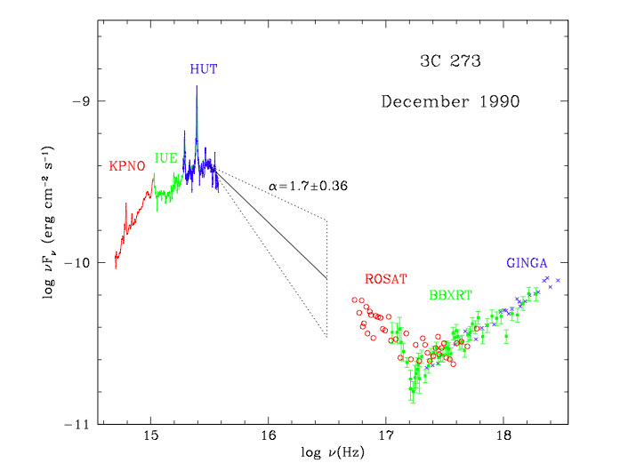
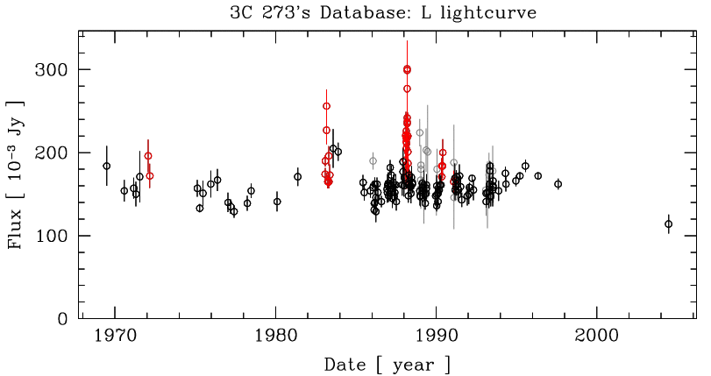
Nearest FSRQ – 3C273
Dec 1990 Astro-1 (Shuttle) mission UV and X-ray with simultaneous optical + soft and hard X-rays
Very low Nh and E(B-V) so see peak of disc (Sembach et al 2000)
Kriss 2000

Slide 26
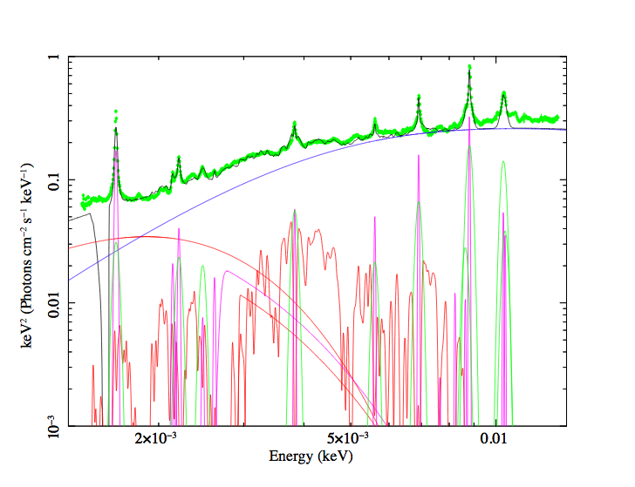
3C273: Amazing data
Is it disc dominated?
Reverb. mass 8.9±1.9 x10⁸ M (Peterson et al 2004)
i=6±1 from jet VLBA (Jorstad et al 2005)
a*=0: rcor=6, plus broad and narrow lines and FeII and Balmer continuum….

Slide 27
3C273: Amazing data
Is it disc dominated?
Reverb. mass 8.9±1.9 x10⁸ M (Peterson et al 2004)
i=6±1 from jet VLBA (Jorstad et al 2005)
a*=0: rcor=6, plus broad and narrow lines and FeII and Balmer continuum….

Slide 28
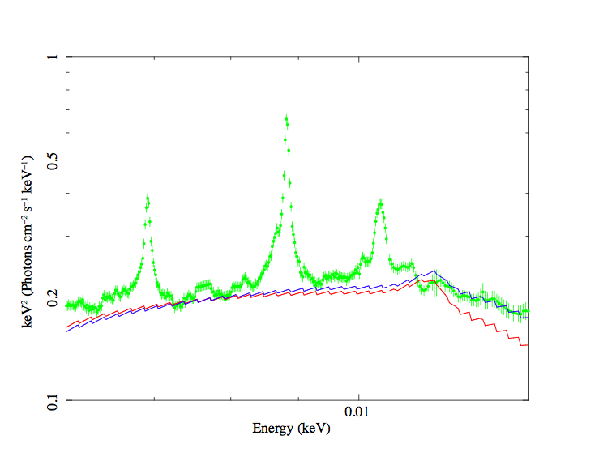
3C273: Amazing data
disc dominated as need Rcor<6Rg to get through FUV data
Hubeny – full disk models
a*=0
Underpredicts FUV
a*=0.9 better
Need mdot constant from R<6-100 Rg

Slide 29
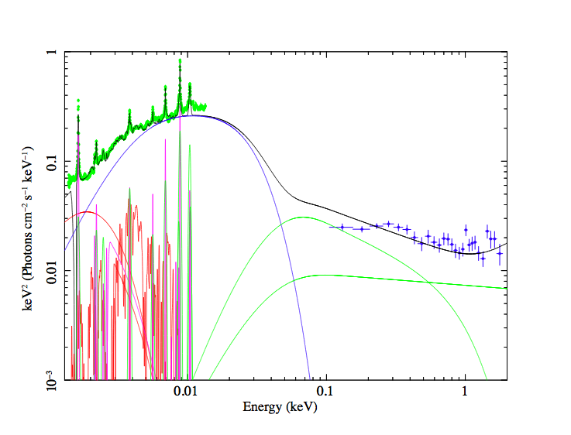
3C273: Amazing data
But Rcor>Rmsco to make Lx
Mdot = 9e26 though outer disc
L=ηMdot c²
L_opt-UV+L_x =6-8e46 requires a*=0.7 (η=0.1)
Black hole is spinning!! As expected from jet

Slide 30
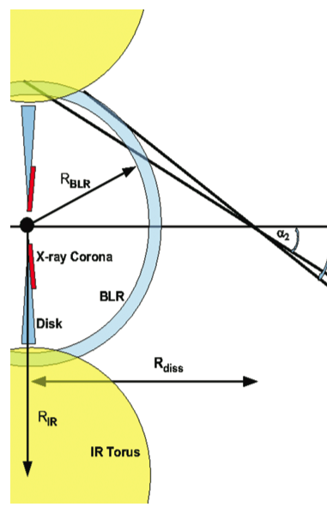

FSRQ jets
Add a jet!! Standard FSRQ from Ghisellini et al 2010
Cooling by Sync, and Compton scattering of sync and BLR photons (and torus)
make spectrum from self consistent N(γ) after cooling
Γ=10±2 from VLBA
Γ
Ghisellini & Tavecchio 2009

Slide 31
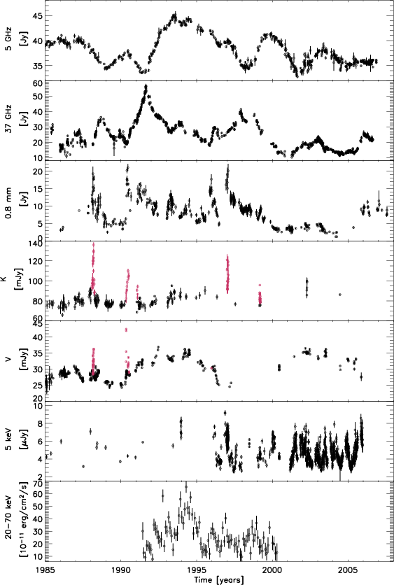
Amazing data (>20 years)
Radio
interpolate on other wavelengths – comes out very close to mean level
Soldi et al 2008
Hard X

Slide 32
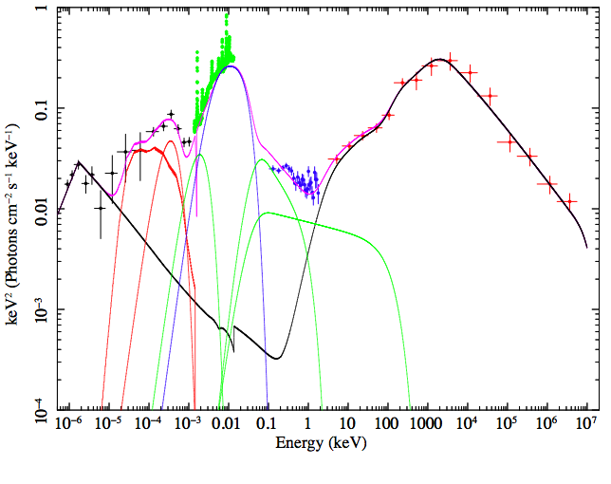
3C273: radio-TeV!
Add a jet EC+SSC
Ljet>3x10⁴⁶ ergs/s
Ltot=1.1x10⁴⁷
=ηMdot c²
η>0.15 i.e
a*>0.9
Very high spin…
Done, Jin, Middleton Ward 2013

Slide 33
Spin-jet paradijm
Ljet =
∑_{i} π rdiss² Γ² β U_{i}’
Dominated by protons with energy density U_{p}’=m_{p}c²∫N(γ) dγ – depends on γmin
Ghisellini had Ljet=3e47!!!
10x larger as γmin ~ 1 (ours 40)
Ghisellini et al 2010

Slide 34
Conclusions: 3C273
Fermi BL lacs show Γ~15 jets rare
Spin rare, spin common but B flux rare, retrograde rare?
FSRQ Accretion flow – optical gives Mdot
Total accretion power L=ηMdot c² (Davis & Laor 2009)
Observed L(UV+X) already requires a*>0
And have L(jet) ≥ L(UV+X) - need a*>0.9 in order to power both accretion flow radiation and jet (and wind?)
FSRQ 3C273 is high spin, spin-jet paradijm (not retrograde!) but doesn’t say if B field + spin or just spin
There is actually enough accretion power to power the flow and the jet….
….but the MHD models all tap spin at these high a*

Slide 35
Optxagnf: conserving energy!
R_{corona}
Outer standard disc with colour temp correction down to R_{corona} – quick way to model full photosphere results
Then luminosity not completely thermalised to make soft X-ray excess ?
Inner corona as in BHB
NLS1: R_{corona} small so disc dominated, and Γ steep
Mdot
M
Done et al 2012

Slide 36
Simple NLS1
Smaller R_{corona} means spectra are dominated by disc!
NLS1 have small SX and big disc - NOT huge SX
Jin et al 2012

Slide 37
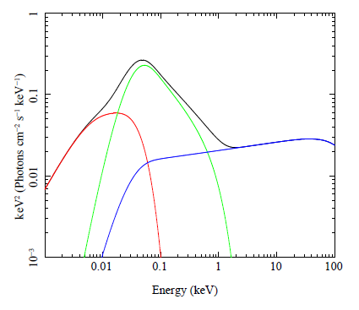
Models conserving energy!!
R_{corona}
Outer standard disc with colour temp correction down to R_{corona}
Then luminosity not completely thermalised to make soft X-ray excess ?
Inner corona as in BHB
difference is R_{corona} larger and Γ flat
Mdot
M
Done et al 2012

Slide 38
Optxagnf: conserving energy!
R_{corona}
Outer standard disc with colour temp correction down to R_{corona} – quick way to model full photosphere results
Then luminosity not completely thermalised to make soft X-ray excess ?
Inner corona as in BHB
NLS1: R_{corona} small so disc dominated, and Γ steep
Mdot
M
Done et al 2012

Slide 39
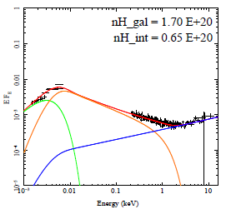
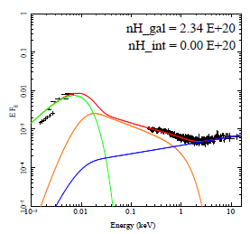
So what do AGN look like?
More standard BLS1/QSO <M>~10⁸, <L/LEdd>~0.1
Not disc dominated so can’t use to get BH spin
Jin et al 2012

Slide 40
So what do AGN look like?

Slide 41
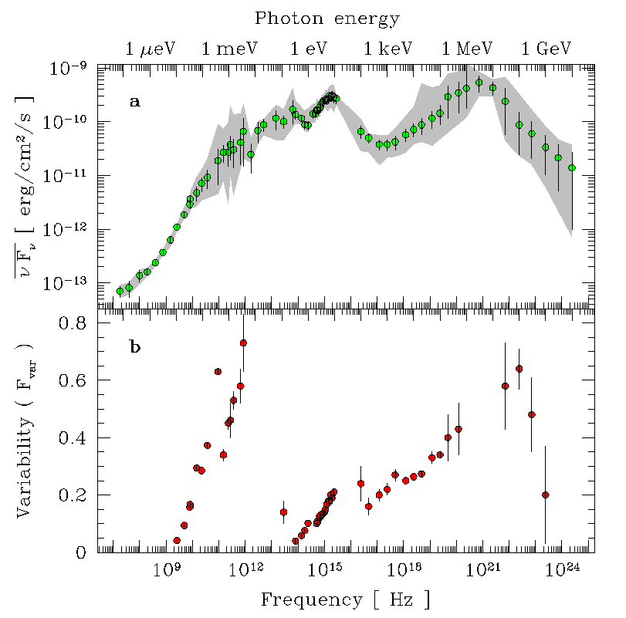
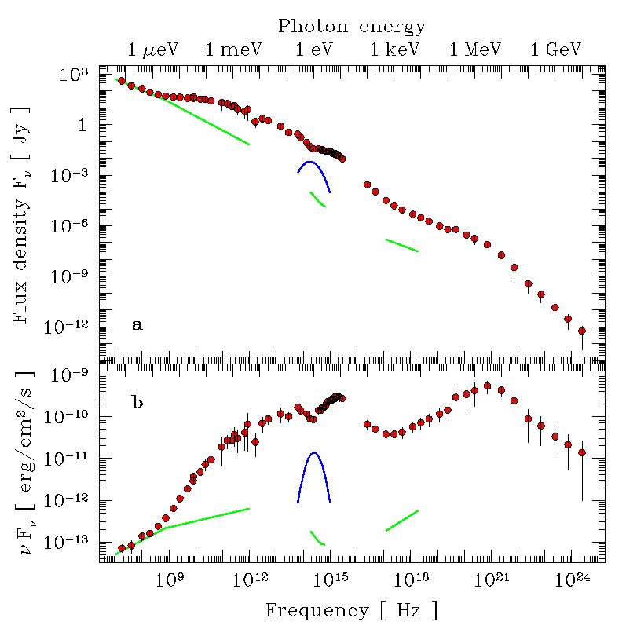
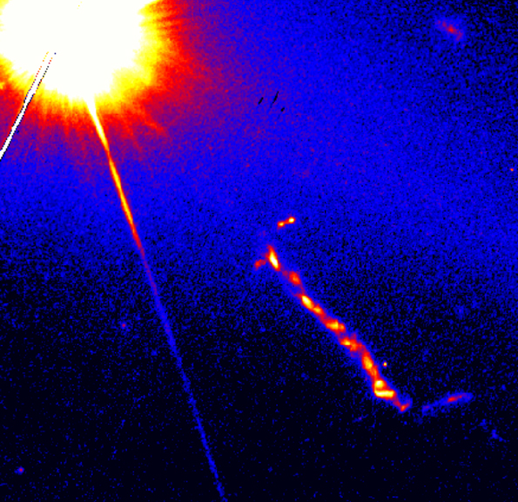
3C273 Nearest bright QSO with jet
Accretion disc
IR dust
Soldi et al 2008

Slide 42
3C273 Nearest bright QSO with jet
Accretion disc
IR dust
Base of compact jet
Soldi et al 2008

Slide 43
3C273 Nearest bright QSO with jet
Accretion disc + flow
IR dust
Base of compact jet
Soldi et al 2008

Slide 44
3C273 Nearest bright QSO with jet
Accretion disc + flow
IR dust
Base of compact jet
Conical compact jet
Soldi et al 2008

Slide 45
3C273 Nearest bright QSO with jet
Accretion disc + flow
IR dust
Base of compact jet
Conical compact jet
Host galaxy (E4)
Extended jet
Soldi et al 2008

