Slide 1
Metal distribution in sloshing galaxy clusters: the case of A496
Simona Ghizzardi
Sabrina De Grandi
Silvano Molendi

Slide 2
Sloshing cold fronts and metals
Several clusters host cold fronts. Cold fronts in cool core clusters are thought to be induced by minor mergers and to develop through a sloshing mechanism.
Cold fronts and sloshing studies have focussed mainly on dynamics and thermodynamics, while the relationship between the sloshing and the cluster chemical properties has enjoyed relatively little attention.
Metallicity jumps across the cold fronts have been detected for a handful of clusters. A general picture for the metal behavior during the evolution of sloshing is still missing. This is a signiﬁcant limitation as sloshing may play a crucial role in redistributing metals in the ICM.
CC clusters have prominent metallicity peaks at their centers. The metal distribution may trace the history of the central gas motions during the sloshing.

Slide 3
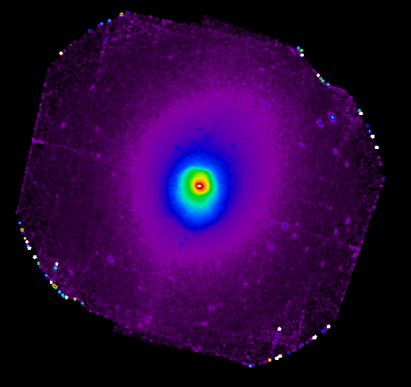
XMM observation of A496
We analyzed a long (120 ksec) XMM-Newton observation of A496 to study the metal distribution in this cluster and its correlation with the cold fronts and sloshing evolution.
A496 is a nearby (z ~ 0.0329) bright cool core cluster.
It hosts 4 cold fronts, within the central
r < 250 kpc.

Slide 4
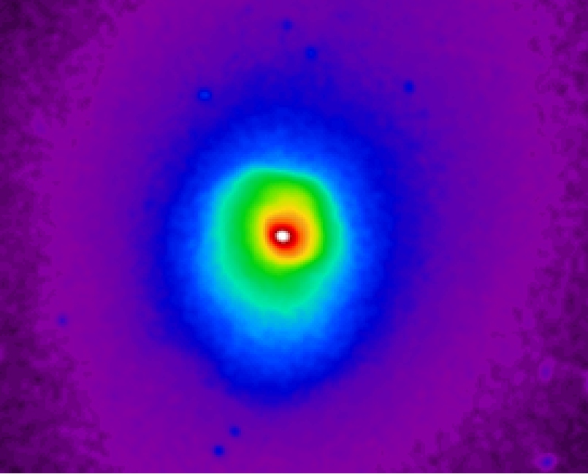
A496 surface brightness map
The XMM surface brightness map reveals a number of discontinuities.
The most prominent SB jump is
at ~100’’ (~60 kpc)
in the NNW direction
(30º-120º).
In the S (240º-285º) direction two fronts are detected
- at ~55’’ (~35 kpc, S1)
- at ~240’’ (~160 kpc, S2)
75º-120º
NNW
30º-75º
E
S1 240º-330º
S2 240º-285º
In the E (Chandra) direction at ~ 16 kpc

Slide 5
Thermodynamical maps
We use the WVT + Broad Band Fitting method (Rossetti + 2007) to build the thermodynamical maps for the cluster.
T, P, K maps show that the cluster is a cool core cluster.
Maps show that the gas inside the fronts is colder than the gas outside the fronts.
Temperature
Pressure
Entropy

Slide 6
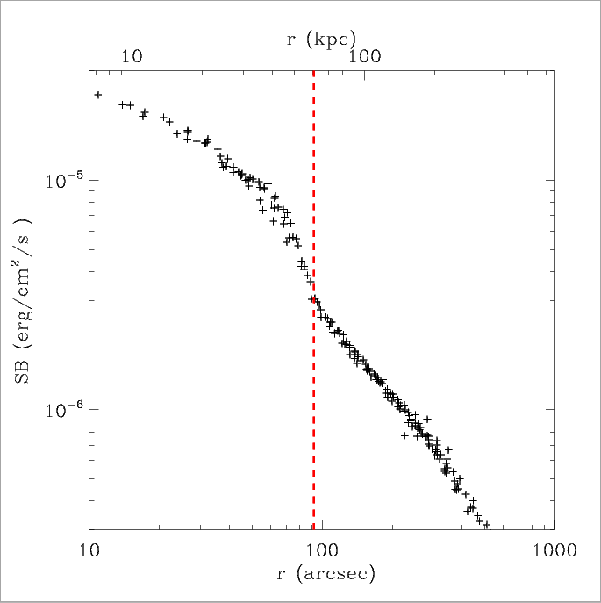
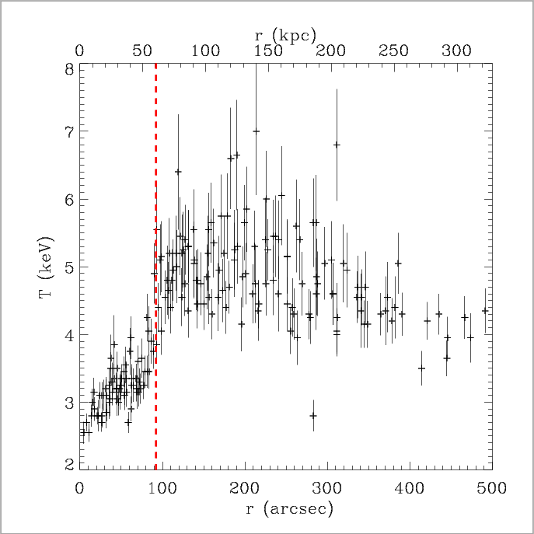
The NNW discontinuities: sector 30º-75º
We built the profiles in the sectors of interest. The temperature sharply increases across the front.
r_{cf} ~ 100 arcsec (~ 60 kpc)

Slide 7
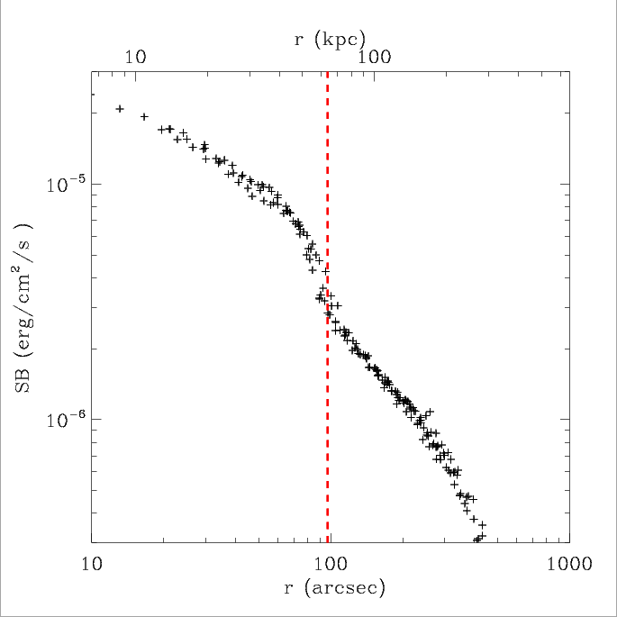
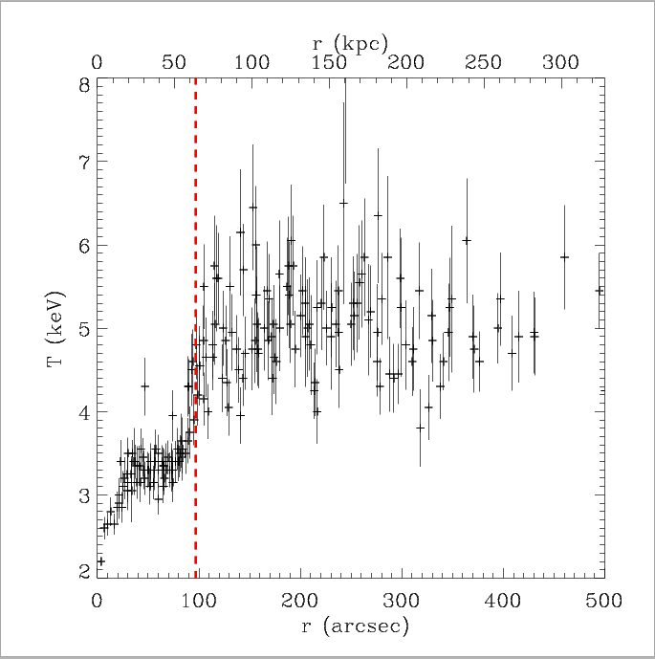
The NNW discontinuities: sector 75º-120º
We built the profiles in the sectors of interest. The temperature sharply increases across the front.
r_{cf} ~ 100 arcsec (~ 60 kpc)

Slide 8
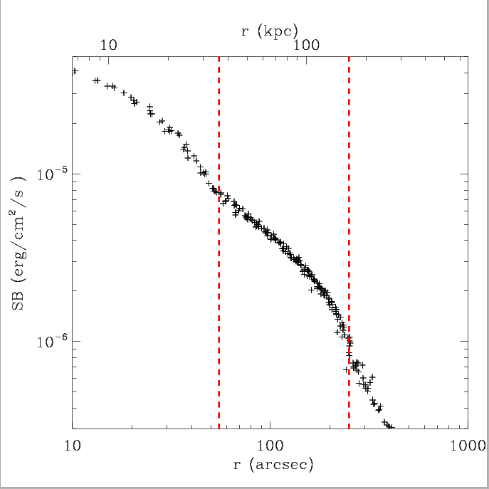
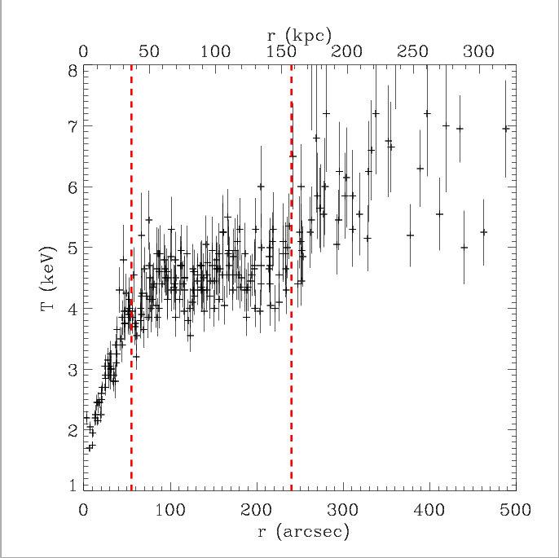
The S discontinuities: sector 240º-285º
The S sector (240º-285º) hosts two cold fronts. (S1 and S2)
The temperature sharply increases across the fronts.
r_{S1}~ 55 arcsec (~ 40 kpc)
r_{S2} ~ 240 arcsec (~ 160 kpc)

Slide 9
4 cold fronts in r < 250 kpc
So far, this is one of the few clusters where more than 3 cold fronts have been detected, together to A2142 (Rossetti + 2013) and Perseus (Simionescu + 2012).
Among this handful of clusters, A496 is the only one hosting 4 cold fronts in the central 250 kpc, since A2142 and Perseus farthest cold fronts lie at distances > 0.5 Mpc.
This characteristic makes A496 a unique cluster to investigate the sloshing properties.

Slide 10
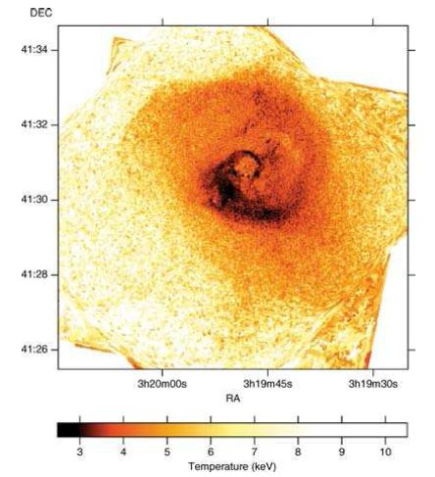
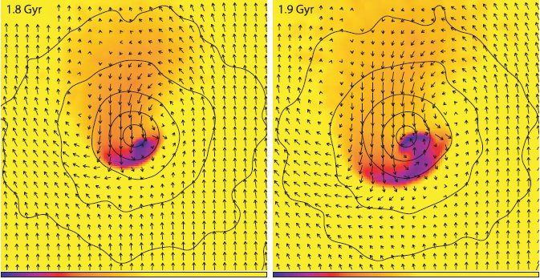
Spiral patterns in sloshing
A typical signature of the sloshing is the presence of spiral patterns in the clusters temperature maps.
Spirals in T maps are abserved in the central regions of some cool core clusters.
Simulations show that sloshing takes a spiral appearance after experiencing an off-axis merger
Ascasibar & Markevitch 2006
Perseus cluster T map, Fabian + 2006

Slide 11
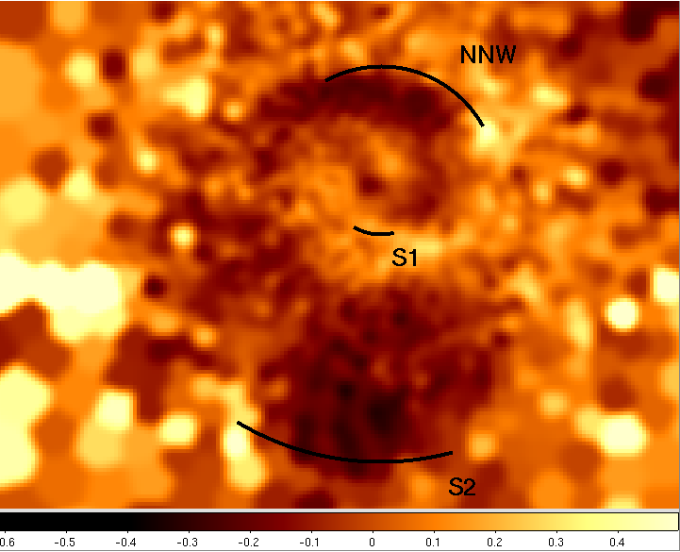
Spiral pattern in the entropy residual map
The entropy residual map shows the typical spiral-like pattern which can be found when a sloshing cold front is developing in a cool core.
The detected cold fronts correspond to the edge of the spiral. The outermost southern S2 cold front is placed at the tail of the spiral.

Slide 12
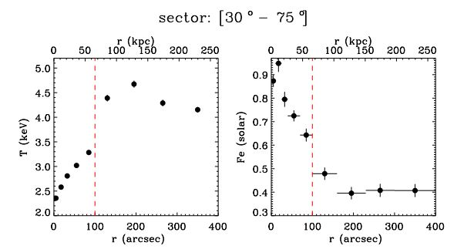
Fe abundance across NNW cold fronts
The abundance drops across the NNW front similarly to what has been observed in other cool core clusters.
The Fe abundance shows a decrease signiﬁcant at more than 5σ
We extracted the spectra in the sectors hosting cold fronts and fitted them with a vapec 1T model.

Slide 13
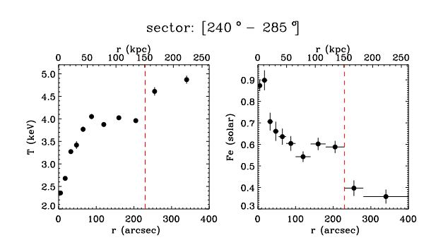
Fe abundance across the S2 cold front
In the southern sector the Fe abundance drops across the external front.
The abundance reaches the value 0.3-0.4 in the outskirts. The metallicity profile in the region within the front (50-150 kpc from the peak) is roughly constant Z ~ 0.6 before dropping at the cold front position.
Z_{in}=0.59 ^{+0.03} – _{0.03}
Z_{out}=0.40^{+0.04}_{-0.03}

Slide 14
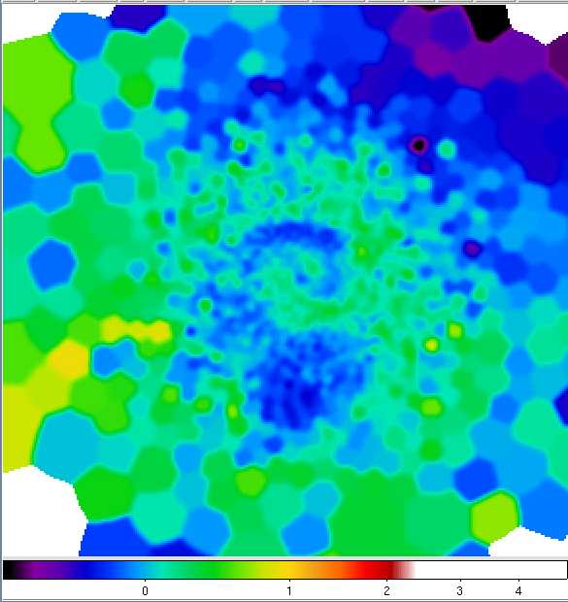
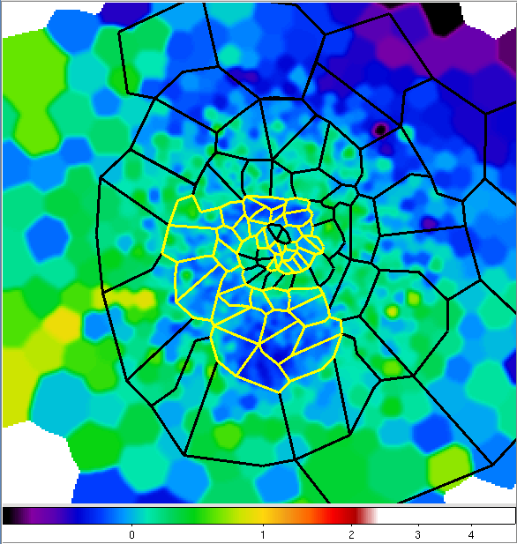
Metals on the spiral
To study the possible correlation between the spiral pattern and the metal distribution, we selected a number of polygons following the spiral configuration.
We divided the polygons into two classes: IN (regions on the spiral) and OUT (regions outside the spiral).

Slide 15
Metallicity
The Z map shows that the metallicity follows the same spiral pattern: Z is higher in all the regions lying on the spiral
Metallicity map

Slide 16
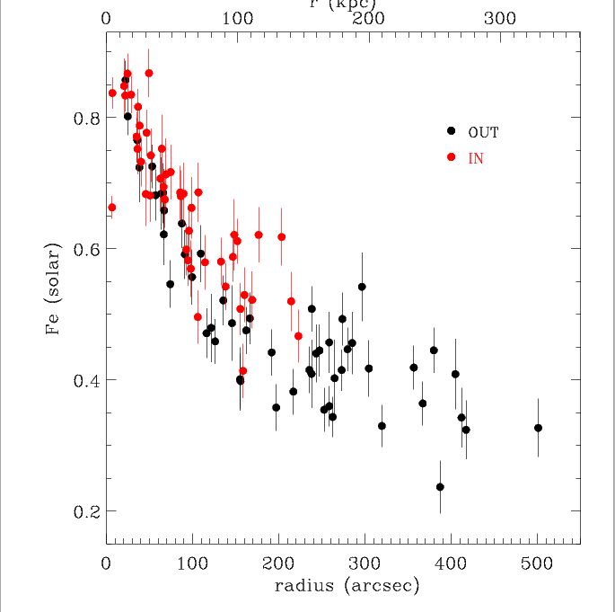
Metal excess along the spiral
Metals in the OUT regions follow the standard behavior of a cool core cluster.
The metallicity in the IN regions shows a similar trend but is offset high.
The discrepancy between the metallicity of the IN gas and of the OUT gas increases with distance: mixing processes are not very efficient. The mixing would wash
out the differences.
Notes:
Indeed if mixing were efficient, the cold gas will progressively tend to homogenize with the surrounds. In this scenario, the gas currently residing in the spiral tail would be initially located in the very central
regions (say< 50 kpc) where environment metallicity is > 0.6Z⊙; the higher the mixing efficiency the higher the starting metal
content. Though the mechanism would involve all the gas of the spiral, the gas of the tail would cover the largest distance and
would undergo the mixing process for a longer time. Hence in presence of efficient mixing processes, the gas of the tail is expected to experience a higher level of mixing and reach a higher degree of homogenization with the ambient gas.

Slide 17
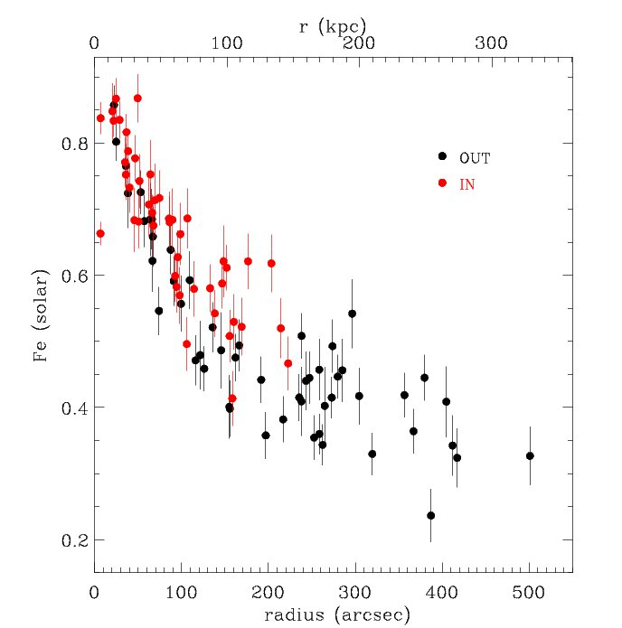
Measuring the displacement of the gas
If we assume that mixing is negligible we can estimate where the gas at a given radius on the spiral originally came from.
The metallicity profile shows that the gas on the tail does not come from the center of the cluster but from an intermediate region, at ~ 100 arcsec (~60 kpc) from the peak.
This is expected from simulations:
sloshing displaces the gas along the radial coordinate by up to a factor of 2-3.

Slide 18
Entropy-metallicity correlation
Excluding the outskirts regions, points lying outside the spiral show a correlation between the entropy and the metallicity.
The outskirts regions deviate from the correlation since the entropy continues to increase and the metallicity reaches a constant value.

Slide 19
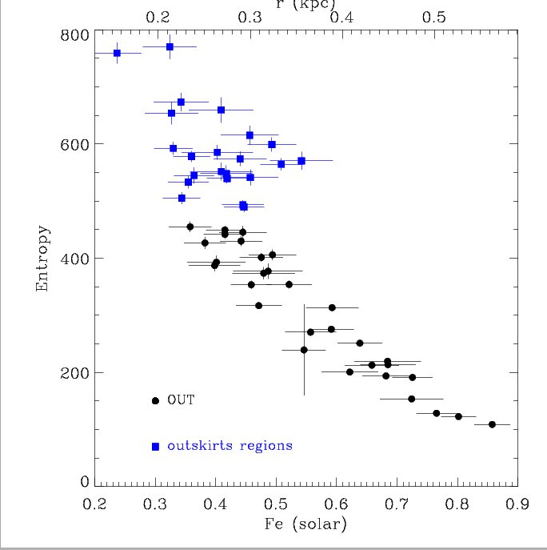
Entropy-metallicity correlation
Points from IN regions fall on the K-Fe relationship defined by the OUT points.
The IN regions follow the same strict correlation and there is no segregation between the two classes of regions.
This can be readily explained if we assume that evolution of the sloshing gas is such that neither matter nor heat is exchanged in significant quantities with gas outside the spiral.

Slide 20
Entropy-metallicity correlation
If conduction is at work, it would rapidly transfer heat from the hotter environment to the colder sloshing gas.
Effective heating would therefore move gas in the spiral away from the K-Fe correlation .
Unless, heating were accompanied by dilution of the IN gas with OUT gas at just the right rate to maintain the IN points on the K-Fe correlation deﬁned by OUT points.

Slide 21
Metallicity-entropy correlation
If conduction and mixing are at work in the ICM, they should be adequately ﬁne tuned to keep the points on the K-Fe correlation.
Moreover, from the metallicity profiles, we can infer that mixing must be inhibited to preserve a higher metal abundance on the spiral.

Slide 22
Metallicity-entropy correlation
The most likely and natural scenario is the one where both mixing and heat exchange are heavily suppressed.
Sloshing is capable of uplifting signiﬁcant amounts of gas.
The limited heat exchange and mixing implies that this mechanism is not at all effective in permanently redistributing metals within the core region (the cooler metal richer gas will eventually fall back to the center).

Slide 23
Metallicity-entropy correlation
The most likely and natural scenario is the one where both mixing and heat exchange are heavily suppressed.
We also find that the conduction must be suppressed by more than one order of magnitude with respect to Spitzer conductivity otherwise the spiral-like feature would be quickly destroyed.

Slide 24
Summary
We analyzed a long XMM observation of A496. Metal abundances drop across the cold fronts.
An excess of metallicity has been detected in the regions lying on the low-entropy spiral feature.
Both gas lying on the spiral and outside the spiral show a correlation between the metallicity and the entropy. There is no segregation between the polygons IN and OUT. This favors the scenario where both metal mixing and heat exchange are highly inefficient.
The limited heat exchange and mixing between gas in and outside the spiral implies that this mechanism is not at all effective in permanently redistributing metals within the core region.
Conduction between the gas in the spiral and the ambient medium must be suppressed by more than one order of magnitude with respect to Spitzer conductivity
Sloshing provides little or no contribution to staving off catastrophic cooling in cool cores.

Slide 25
Conduction
t _{S} ~ k ℓ ² n_{e} / κ_{S} ~ 1.3 x 10⁻² n_{e;2} ℓ ²₁₀₀ (T₁₀) ^{-5/2} Gyr
n_{e;2} = electron density in units of 2. x 10 ⁻³ cm ⁻³
ℓ₁₀₀ = region width in units of 100 kpc
T₁₀ = temperature in units of 10 keV
For a cold front ℓ ~ few kpc
The spiral reaches the maximum width in the tail, with a radius of ℓ ~ 60 kpc
The cold fronts would be erased within t _{S} = 3.3 x 10⁻⁴ Gyr
The gas in the spiral would reach the thermal equilibrium with the environment within t _{S} = 3.3 x 10 ⁻² Gyr

Slide 26
Sloshing and heating
A possible way to quench the cooling in a sloshing picture is
through mechanical energy transferred to the ambient ICM via
pdV work.
During the sloshing, the central cold gas is progressively lifted upwards and will expand adiabatically to achieve pressure equilibrium with the surrounds.
While expanding the gas does pdV work on the surrounding atmosphere.
The gas currently residing in the tail of the spiral must have originally resided some 60 kpc from the center.
The work done by the gas rising from 60 kpc to 150 kpc, is about W ~ 8.08 x 10⁵⁸ erg. The sloshing timescale is ~0.7 Gyr.
Power = W/t ~ 3.66 x 10⁴² erg/s.
L_{cool} (75 kpc) ~ 5.16 x 10⁴³ erg/s.
The cooling cannot be quenched by the sloshing mechanism.

