Slide 1
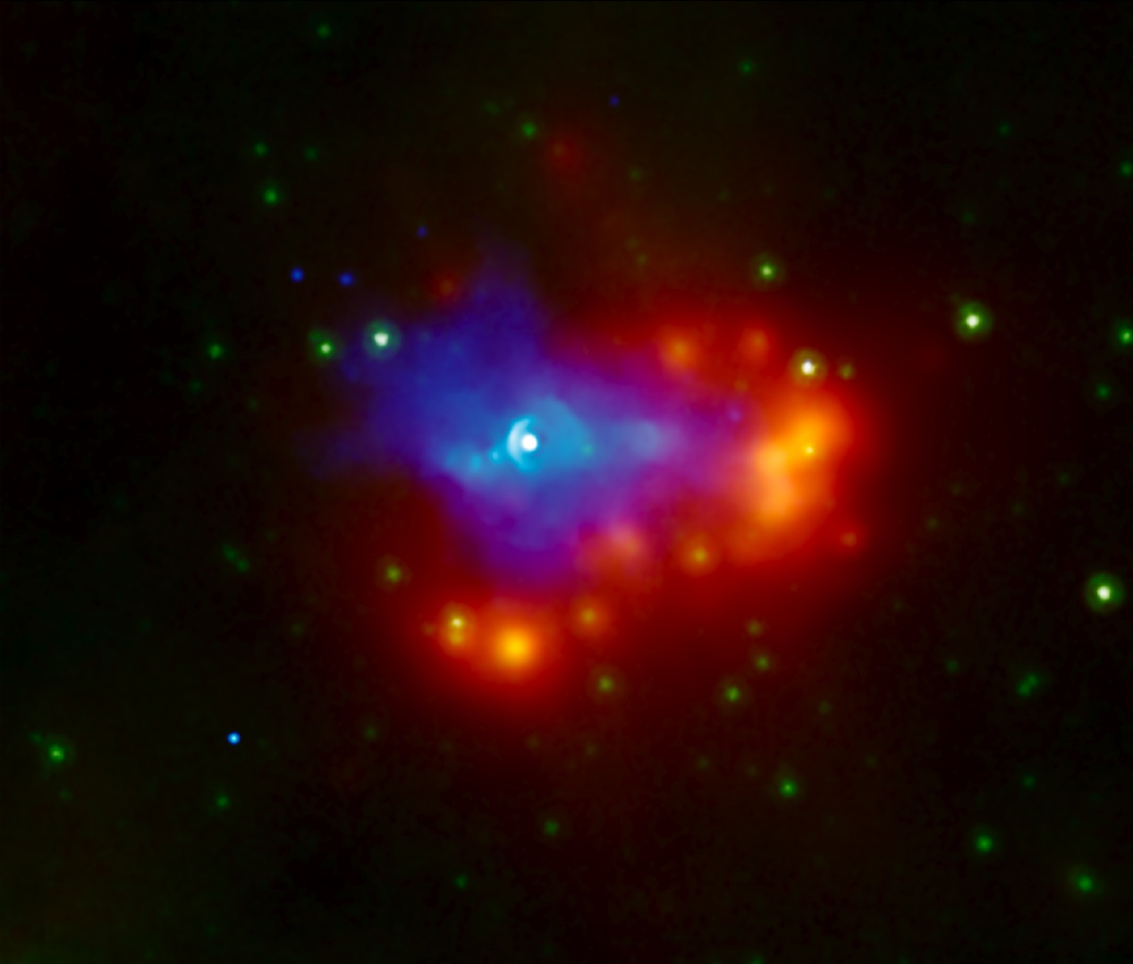
Supernova Dust and Ejecta Illuminated by Pulsar Wind Nebulae
Tea Temim
(GSFC/ORAU)
European Space Astronomy Centre (ESAC) May 23, 2013

Slide 2
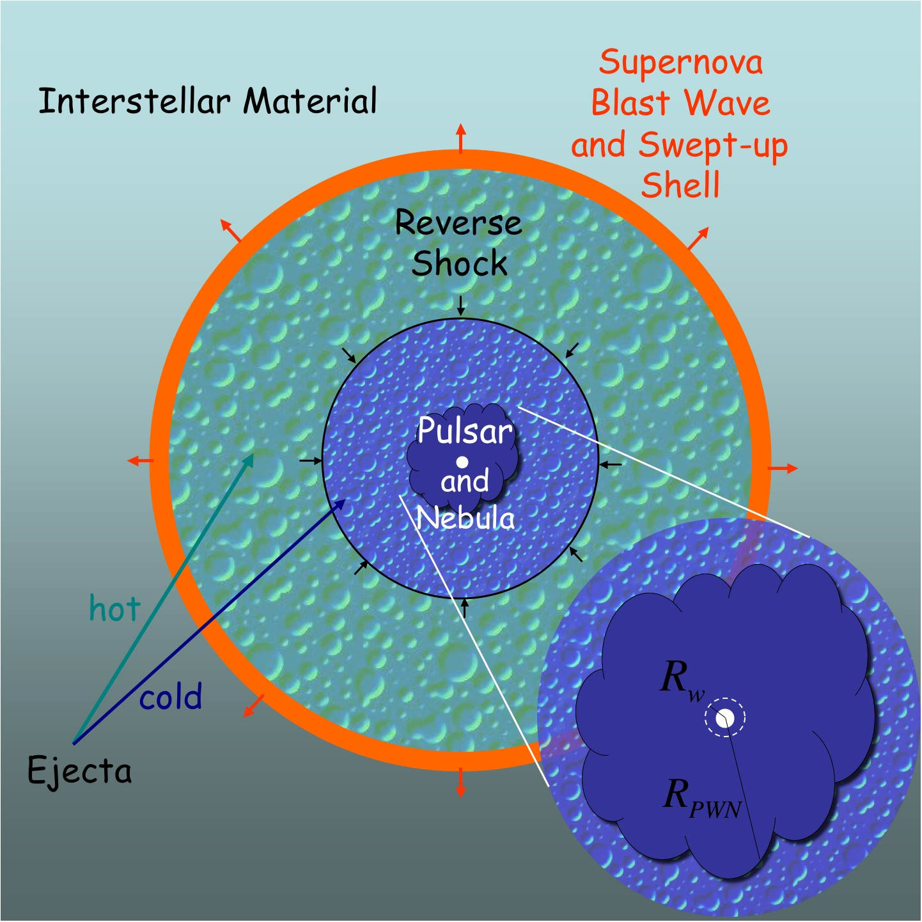
Evolution of PWNe inside SNRs
Ejecta/Dust Emission:
The PWN shocks the inner SN ejecta and dust that have not been re-heated by the reverse shock
After the SN explosion, dust particles condense out of the cooling SN ejecta
Unprocessed dust grains inside of the reverse-shock are heated by the expanding PWN and warmed enough to emit in the IR
Gaensler & Slane 2006
PWNe provide a heating source for inner SN ejecta and unshocked SN dust – important for characterizing ejecta/SNR properties in systems with high absorbing column density (IR), and where ejecta cannot be separated from swept-up ISM

Slide 3
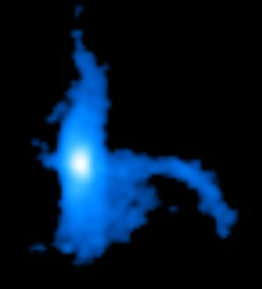
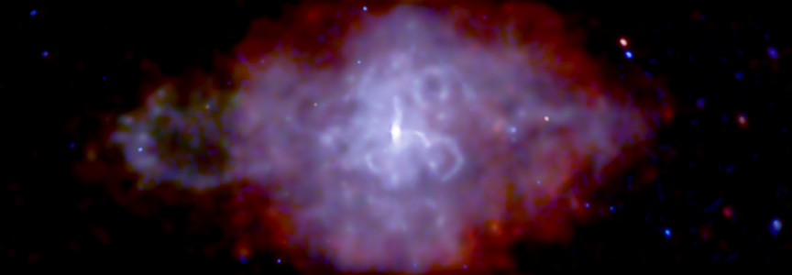
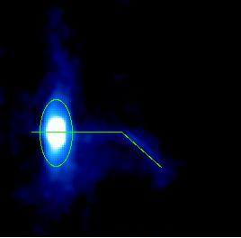
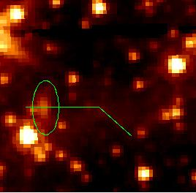
The Surrounding Ejecta: 3C 58
nonthermal emission
Chandra
Slane et al. 2004
shell of swept-up ejecta
Slane et al. 2004
IRAC 3.6 μm
10 arcmin across, d = 3.2 kpc,
Chandra
Mass and temperature of swept-up ejecta in 3C 58 (~ 0.8 M and 0.23 keV) suggests an age of > 2000 yr and a Type IIP progenitor, similar to the Crab
(Bocchino et al. 2001, Slane et al. 2004, Chevalier 2005, Gotthelf et al. 2007)
Slane et al. 2004
Slane et al. 2008

Slide 4
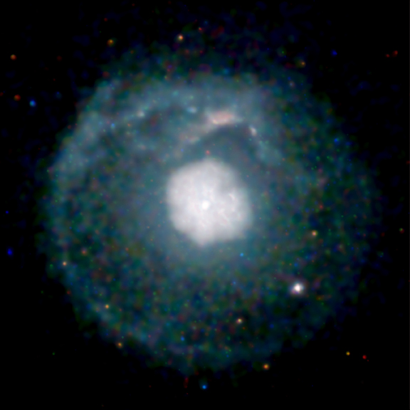
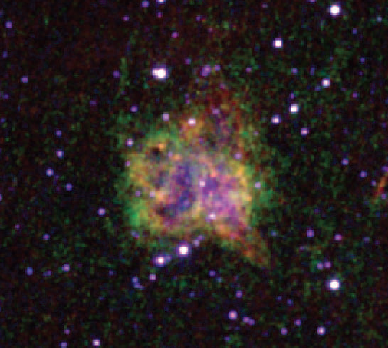
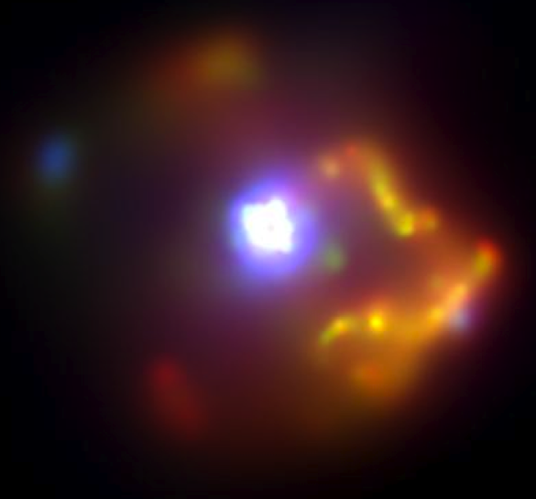
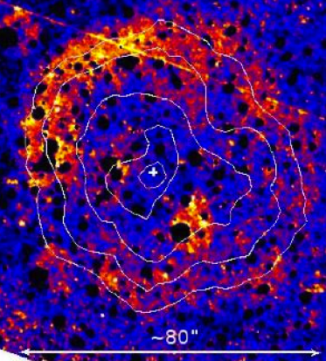
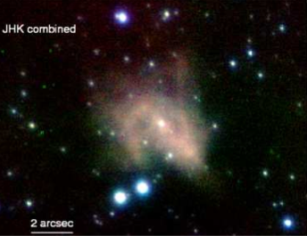
G21.5-0.9
B0540-69.3
Continuum, OIII, SII
Hubble WFPC2 (Morse et al. 2006)
[Fe II]
Zajczyk et al. 2012
VLT JHK (Mignani et al. 2012)
Chandra X-ray image
Spitzer IRS spectra of PWN show emission line widths of ~ 1000 km/s
PWN driving a slow (20 km/s) into dense clumps of inner ejecta
Small amount (10⁻³ M) of warm (~60K) dust heated by the PWN
Ejecta abundances favor a low-to-medium mass progenitor, consistent with a Type IIP scenario
Interaction of ejecta with hydrogen -> Type IIP explosion (Bocchino et al. 2005, Matheson & Safi-Harb)
[Fe II] 1.64 μm emission traces the outer boundary of the PWN – shock driven into the surrounding cold SN ejecta (Zajczyk et al. 2012)
Herschel spectroscopy of PWN
Williams et al. 2008

Slide 5
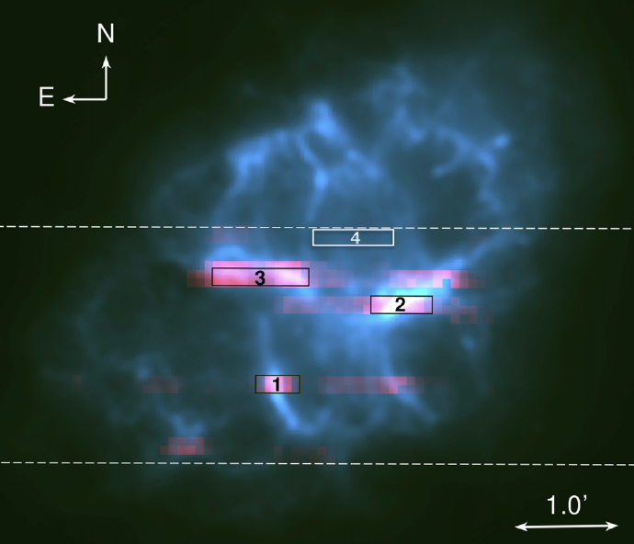
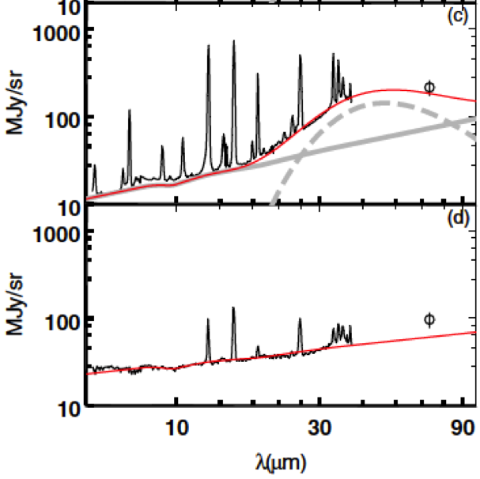
Surrounding Ejecta and Dust: Crab Nebula
Temim et al. 2012
Spitzer 24 μm, dust emission
Filaments in the Crab are composed of 2- 5 M masses of SN ejecta – finger like structures are produced by Rayleigh-Taylor instabilities as the synchrotron nebula encounters the denser ejecta
Gas in the filaments is photoionized by the synchrotron emission from the PWN
Dust emission concentrated along the ejecta filaments
Notes:
.

Slide 6
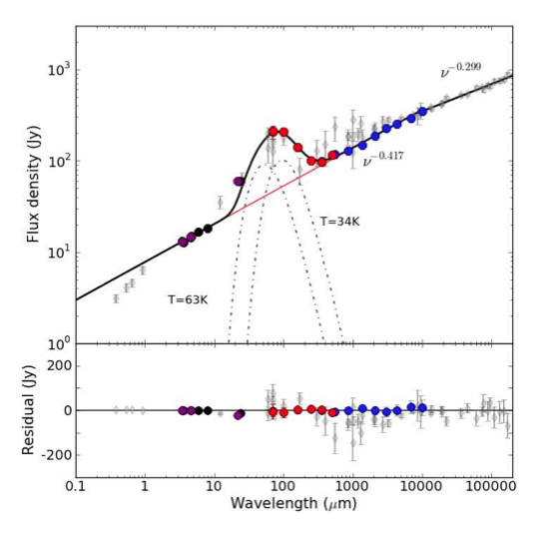
Surrounding Ejecta and Dust: Crab Nebula
M_{dust} = 0.13-0.25 M
Gomez et al. 2012
Spitzer 24 μm, dust emission
Filaments in the Crab are composed of 2- 5 M masses of SN ejecta – finger like structures are produced by Rayleigh-Taylor instabilities as the synchrotron nebula encounters the denser ejecta
Gas in the filaments is photoionized by the synchrotron emission from the PWN
Dust emission concentrated along the ejecta filaments
Notes:
.

Slide 7
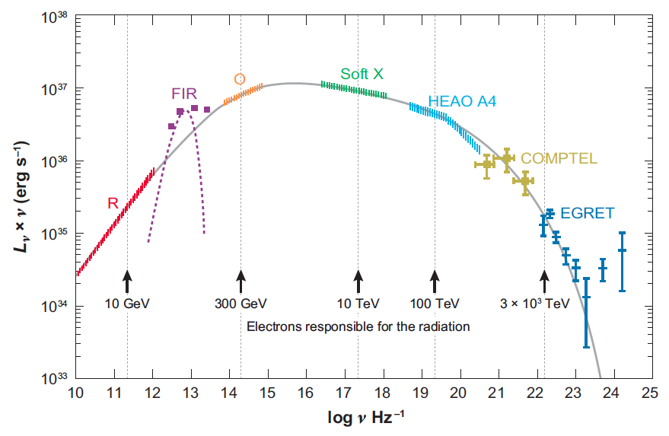
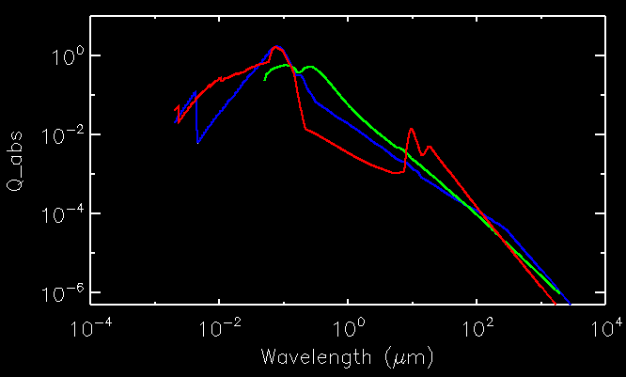
Crab Nebula: PWN-Heated Dust
Power-law grain size distributions of the form
F(a) = a^{-α}
a_{min} = 0.001 μm
a_{max} = 0.03-5.0 μm
α = 0.0-4.0
Distance = 0.5-1.5 pc
(location of the ejecta filaments in 3D models of Cadez et al. 2004)
Q_{abs} → silicates, carbon (Zubko et al. 2004), carbon (Rouleau & Martin 1991)
Hester 2008
H
Heating rate
Cooling rate
L_{ν} → non-thermal spectrum of the PWN
Carbon (ac)
Carbon (be)
Silicates
Model spectra were used to fit the Spitzer and Herschel data to find the best fit a_{max}, α, and normalization (mass)
Temim & Dwek 2013

Slide 8
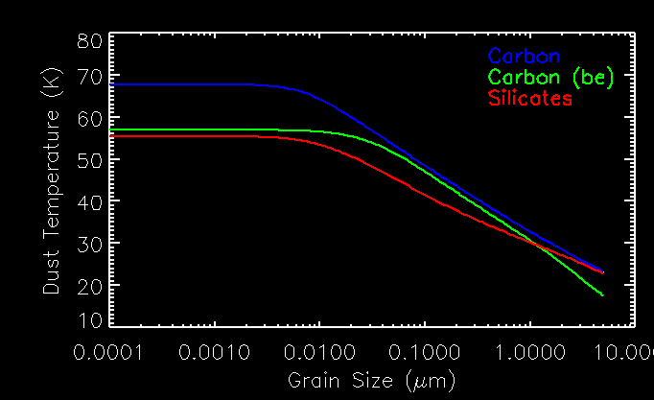
Crab Nebula: PWN-Heated Dust
Power-law grain size distributions of the form
F(a) = a^{-α}
a_{min} = 0.001 μm
a_{max} = 0.03-5.0 μm
α = 0.0-4.0
Distance = 0.5-1.5 pc
(location of the ejecta filaments in 3D models of Cadez et al. 2004)
Q_{abs} → silicates, carbon (Zubko et al. 2004), carbon (Rouleau & Martin 1991)
Hester 2008
H
Heating rate
Cooling rate
L_{ν} → non-thermal spectrum of the PWN
Carbon (ac)
Carbon (be)
Silicates
Modeled dust temperature as a function of grain size (20-70 K range)
Model spectra were used to fit the Spitzer and Herschel data to find the best fit a_{max}, α, and normalization (mass)
Temim & Dwek 2013

Slide 9
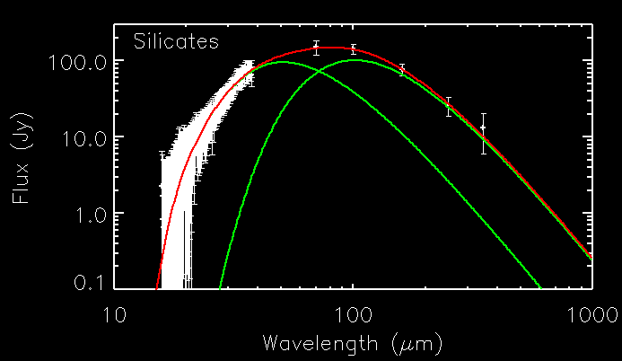
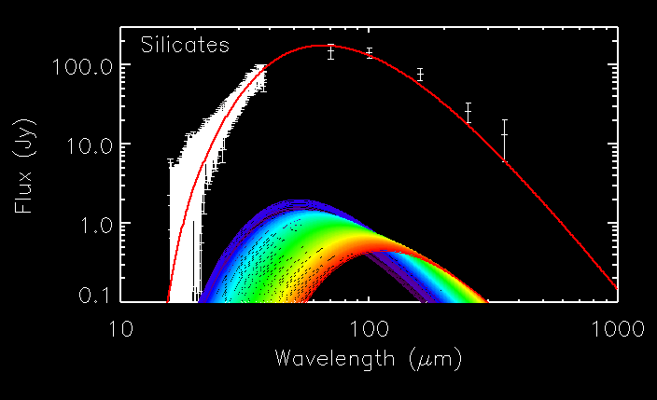
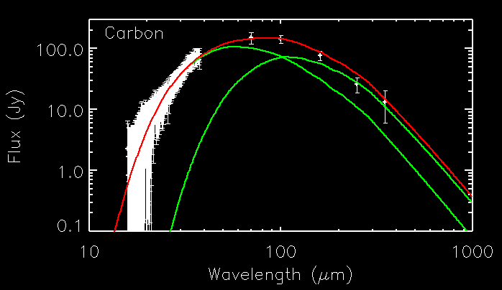
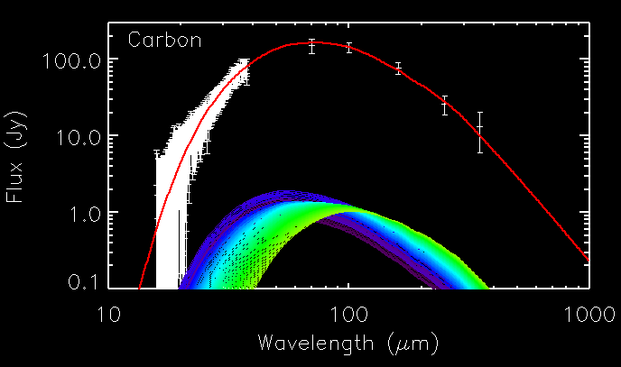
Two temperature model
Best-fit models for continuous size and temperature distribution
Total Dust Mass:
M_{d} = 0.13 + 0.01 M for silicates
M_{d} = 0.02 – 0.04 M for carbon
A factor of two to six less dust than the previous models
Best-fit parameters:
Size distribution index of 3.5-4.0 and larger grain size cut-offs are favored
Larger grains are consistent with a Type IIP SN – Mass dominated by grains with radii larger than 0.03 μm in Type IIP, and less than 0.006 μm in Type Iib SNe (Kozasa,Nozawa et al. 2009)
Silicates: Carbon:
α = 3.5 α = 4.0
a_{max} > 0.6 μm a_{max} > 0.1 μm

Slide 10
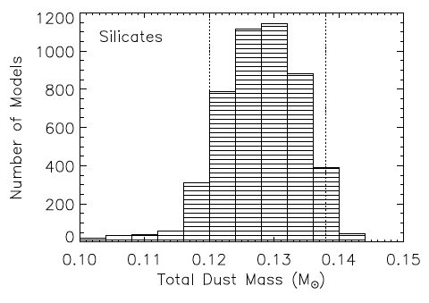
Two temperature model
Best-fit models for continuous size and temperature distribution
Total Dust Mass:
M_{d} = 0.13 + 0.01 M for silicates
M_{d} = 0.02 – 0.04 M for carbon
A factor of two to six less dust than the previous models
Best-fit parameters:
Size distribution index of 3.5-4.0 and larger grain size cut-offs are favored
Larger grains are consistent with a Type IIP SN – Mass dominated by grains with radii larger than 0.03 μm in Type IIP, and less than 0.006 μm in Type Iib SNe (Kozasa,Nozawa et al. 2009)
Silicates: Carbon:
α = 3.5 α = 4.0
a_{max} > 0.6 μm a_{max} > 0.1 μm

Slide 11
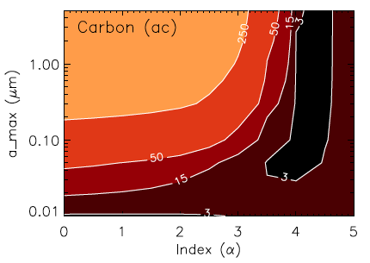
Two temperature model
Best-fit models for continuous size and temperature distribution
Total Dust Mass:
M_{d} = 0.13 + 0.01 M for silicates
M_{d} = 0.02 – 0.04 M for carbon
A factor of two to six less dust than the previous models
Size distribution index of 3.5-4.0 and larger grain size cut-offs are favored
Larger grains are consistent with a Type IIP SN – Mass dominated by grains with radii larger than 0.03 μm in Type IIP, and less than 0.006 μm in Type Iib SNe (Kozasa,Nozawa et al. 2009)

Slide 12
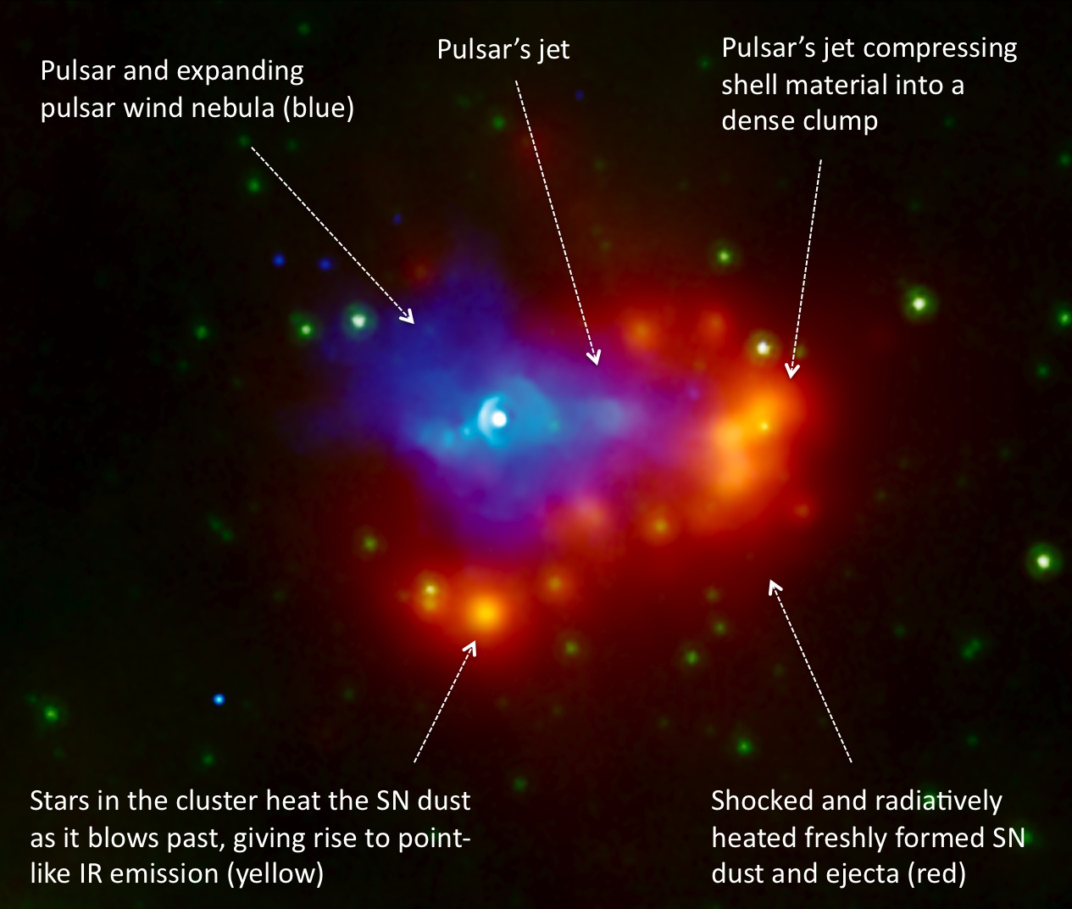
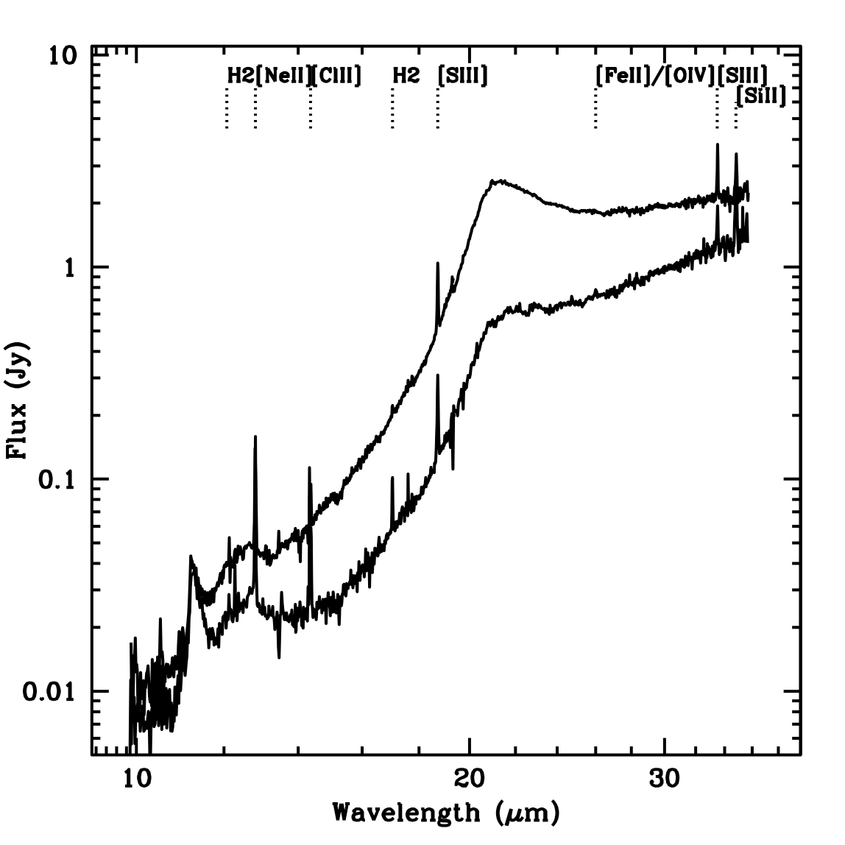
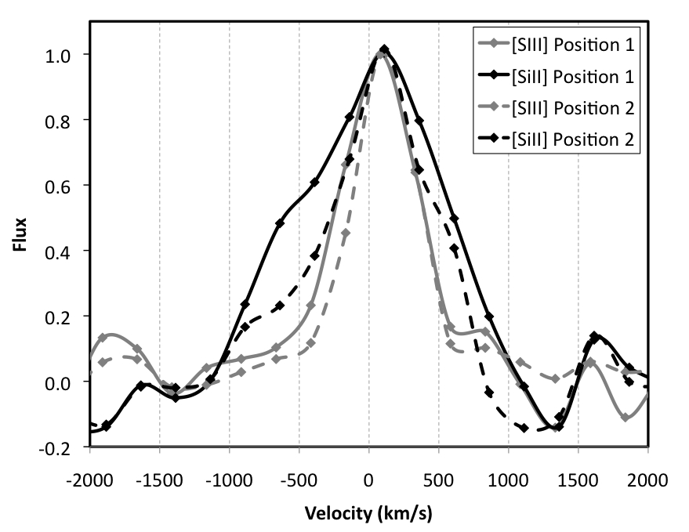
Surrounding Ejecta and Dust: G54.1+0.3
Spitzer IRS Spectrum
Simple dust heating model implies ~ 0.2 M - modeling of Herschel data to constrain dust composition, mass, and grain size
Emission lines broadened to 1000 km/s
→ evidence of SN ejecta
PWN overtakes ejecta with v_{s} ~ 25 km/s
Chandra X-ray (blue) IRAC 8 μm (green) MIPS 24 μm (red)
Temim et al. 2010

Slide 13
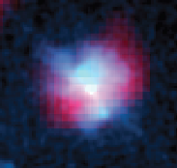
Kes 75: Searching for SN ejecta
PWN heated dust and/or ejecta
Pulsar age ~ 800 yr, one of the youngest known pulsars in the Galaxy (Gotthelf et al. 2000)
d = 10.6 kpc
R ~ 6 pc
Herschel 70 μm,Chandra X-ray
X-ray data are well fitted by a 1.5 keV thermal model, but no clear evidence
for enhanced abundances expected from metal-enriched ejecta
MIPS 24 μm
Chandra X-ray
Nature of the progenitor unknown - large expansion velocity, and clumpy CSM material characteristic of a WR progenitor (e.g Helfand et al. 2003)
No evidence for SN ejecta in Chandra data
Evidence for PWN-heated dust and ejecta in Herschel data – will help characterize ejecta properties
Temim et al. 2012

Slide 14
Summary
Study of PWN-heated inner SN ejecta is important for characterizing ejecta/SNR properties, placing limits on the mass and dynamics of the SNR, and providing clues about the SN progenitor type
Infrared signatures of the PWN/SNR interaction are particularly important since high absorption along the line of sight prohibits optical and X-ray searches for SN ejecta in many composite SNRs
Studies of PWN/SNR interaction may prove to be an efficient way of probing the properties of ejecta and freshly formed SN dust before reverse shock interaction and mixing with the ISM (e.g. G54.1+0.3, Crab, Kes 75) – grain size distribution may also provide information on the SN progenitor
Collaborators:
Patrick Slane (CfA) Eli Dwek (GSFC) Bob Gehrz (UMN)
Richard Arendt (GSFC) George Sonneborn (GSFC) John Raymond (CfA)
Yosi Gelfand (NYU Abu Dhabi) Steve Reynolds (NC State) Kazik Borkowski (NC State)

