Slide 1
The high mass accretion rate spectra of GX 339-4: Black hole spin from reflection?
Mari Kolehmainen & Chris Done,
Durham University
Maria Diaz Trigo, ESO
The X-ray Universe 2011
Berlin, Germany
27 - 30 June 2011
Notes:
I’ll tell you all about the work I’ve been doing with my supervisor Chris Done with the help of Maria on modelling the high mass accretion rate spectra of GX 339-4. we’ll be approaching the subject in terms of the black hole spin and whether or not reflection is the answer.

Slide 2
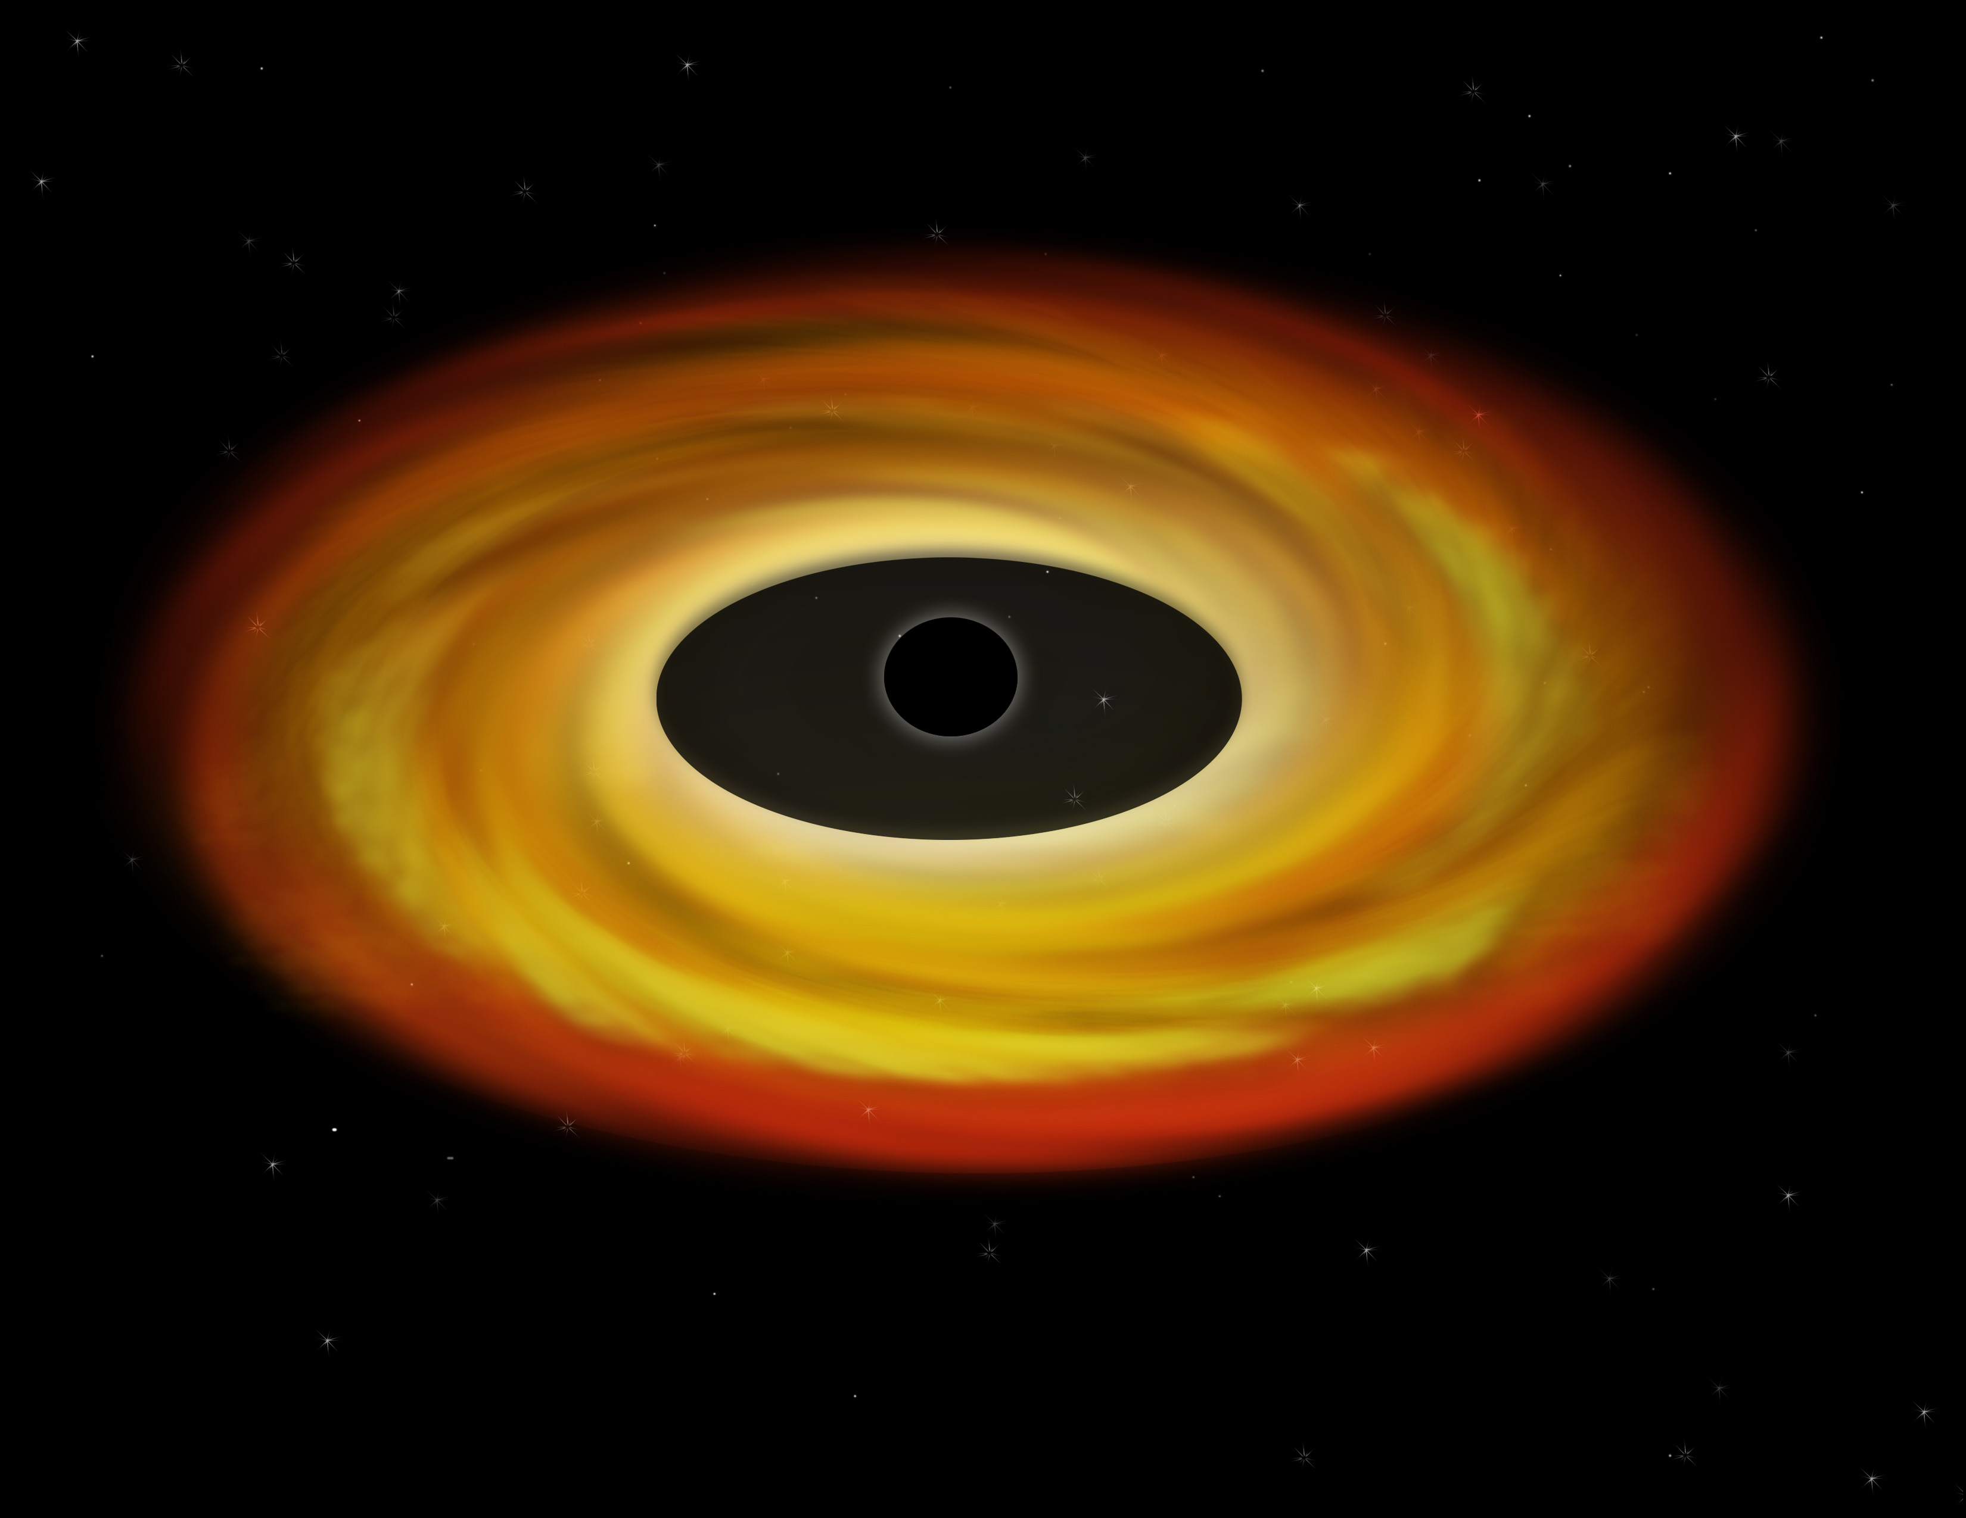
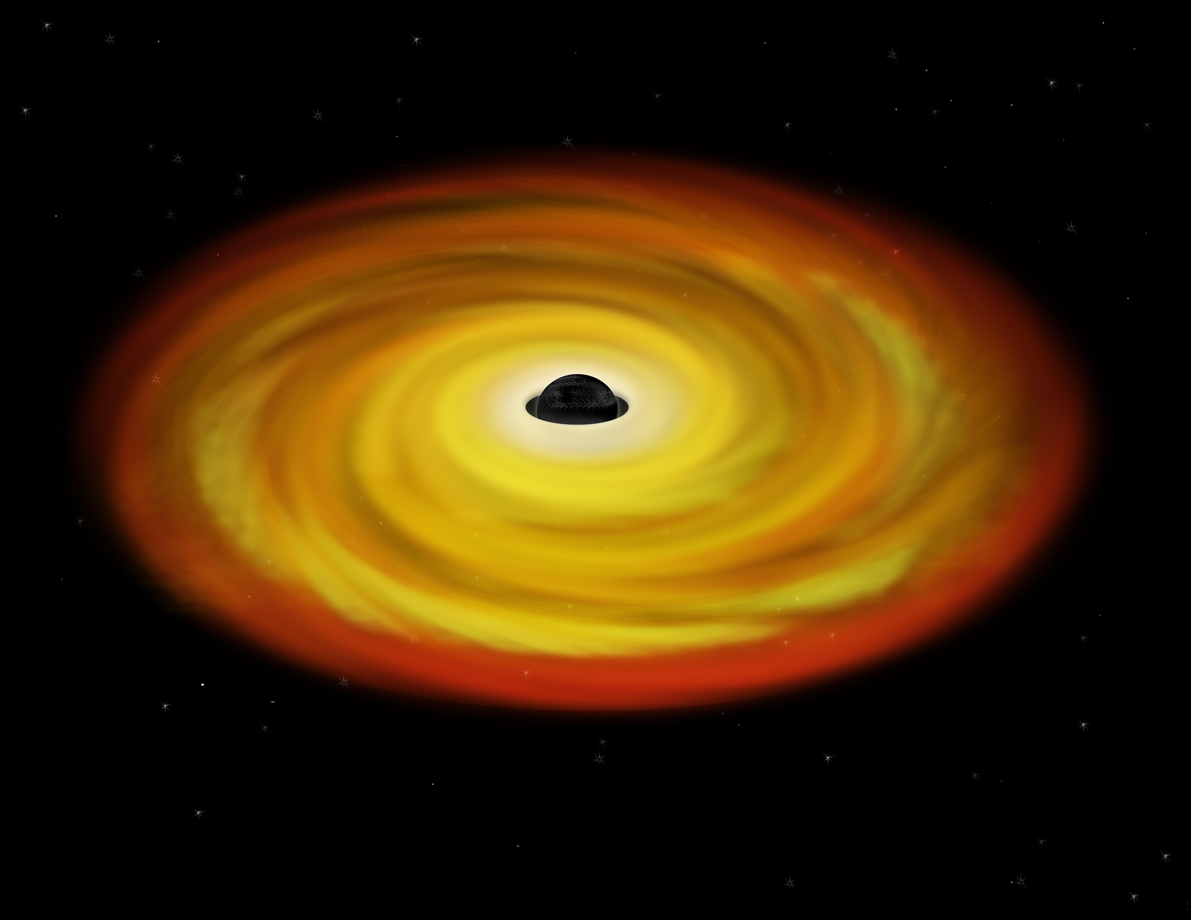
Black hole spin
Specific angular momentum,
described as a dimensionless parameter a*
a* : 0 - 0.998
R_{in} : 6 - 1.24 R_{g}
currently 2 ways to determine
disc fitting
Fe line
a*=0
a*=0.998
Notes:
first a one slide introduction to black hole spin, which Is the specific angular momentum
it’s a fundamental characteristic of a black hole and it drags the accretion disc inwards
(its physical relevance becomes clear only close to the black hole, as it drags the accretion disc inwards)
There’s currently 2 ways to measure the spin: by fitting the intrinsic continuum from the disc, and as we’ve heard before, looking at the reflection features

Slide 3
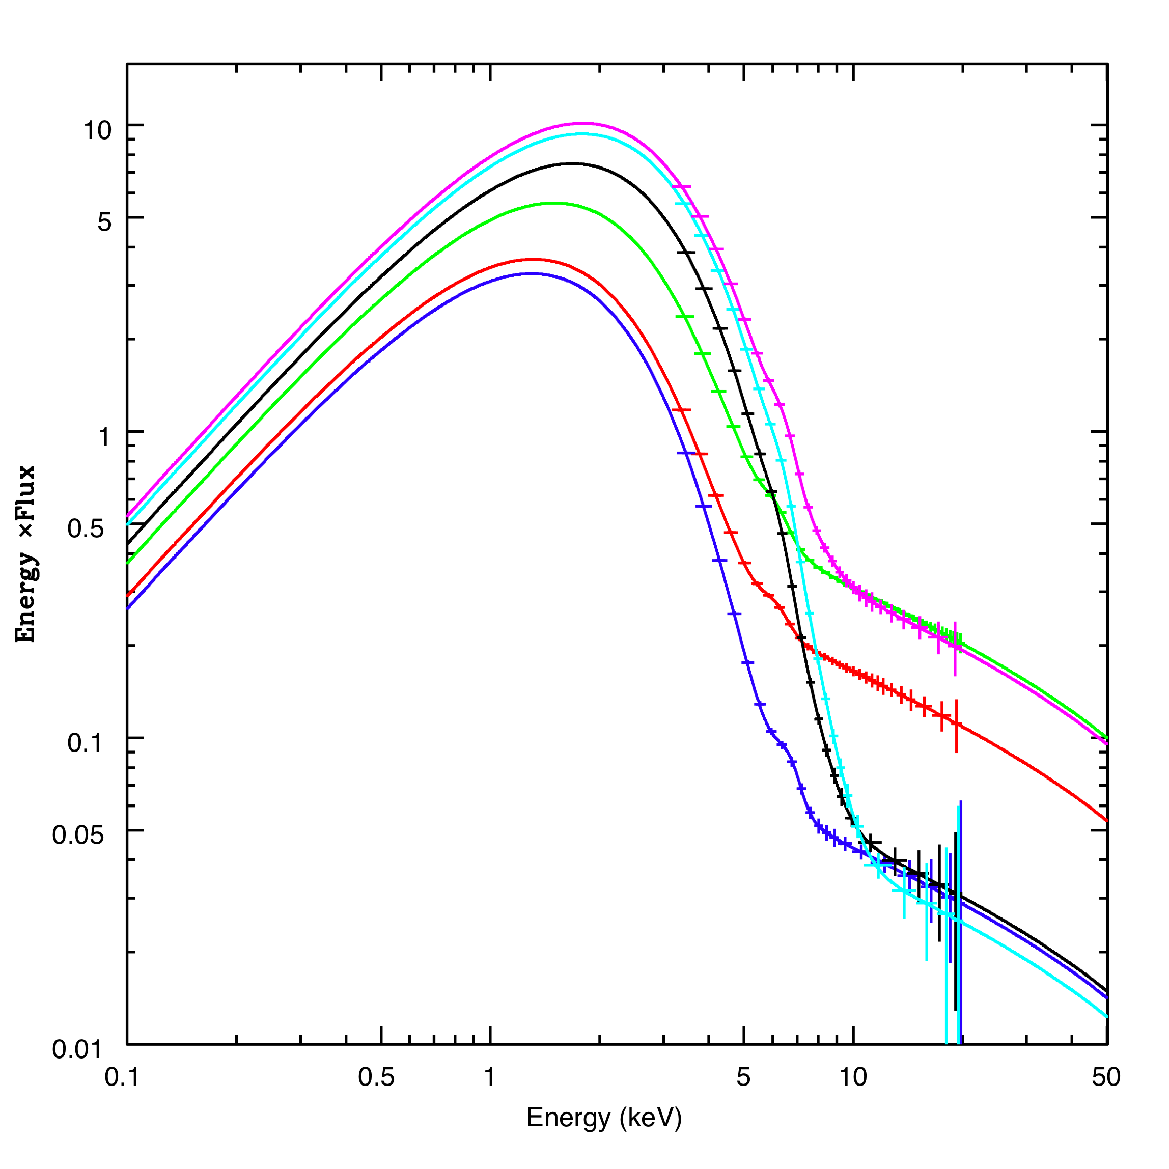
Black hole spin: disc fitting
R_{in}
GX 339-4
log ν f(ν)
log ν
Notes:
So how does disc fitting work then?
the accretion disc can be approximated as a multicolour blackbody, where the temperature gets higher as you go inwards in the disc.
from these disc dominated spectra we can measure the peak temperature and luminosity

Slide 4
Black hole spin: disc fitting
R_{in}
GX 339-4
log ν f(ν)
log ν
Notes:
and we can see that the data follow the L-T^4 relation, which indicates that the innermost emitting region stays constant at different mass accretion rates

Slide 5
Black hole spin: disc fitting
R_{in}
GX 339-4
log ν f(ν)
log ν
Notes:
and from this constant inner radius we can infer the black hole spin quite robustly IF the binary parameters are known

Slide 6
Black hole spin: Fe-line profile
Iron emission line from reflected emission
Fabian et al. 2000
Notes:
but in cases where the disc is not dominant,
a portion of the comptonised emission will most likely be down-scattered back to the disc and what we see then are the atomic features from that interaction, most prominantly the iron emission line
and this is a schematic of how the relativistic line profile is formed from Fabian et al. 2000
in the top panel we’ve got a newtonian, non-relativistic double peaked line profile, that gets more and more distorted when we add special and general relativistic effects, that in the end form this skewed broad line profile

Slide 7
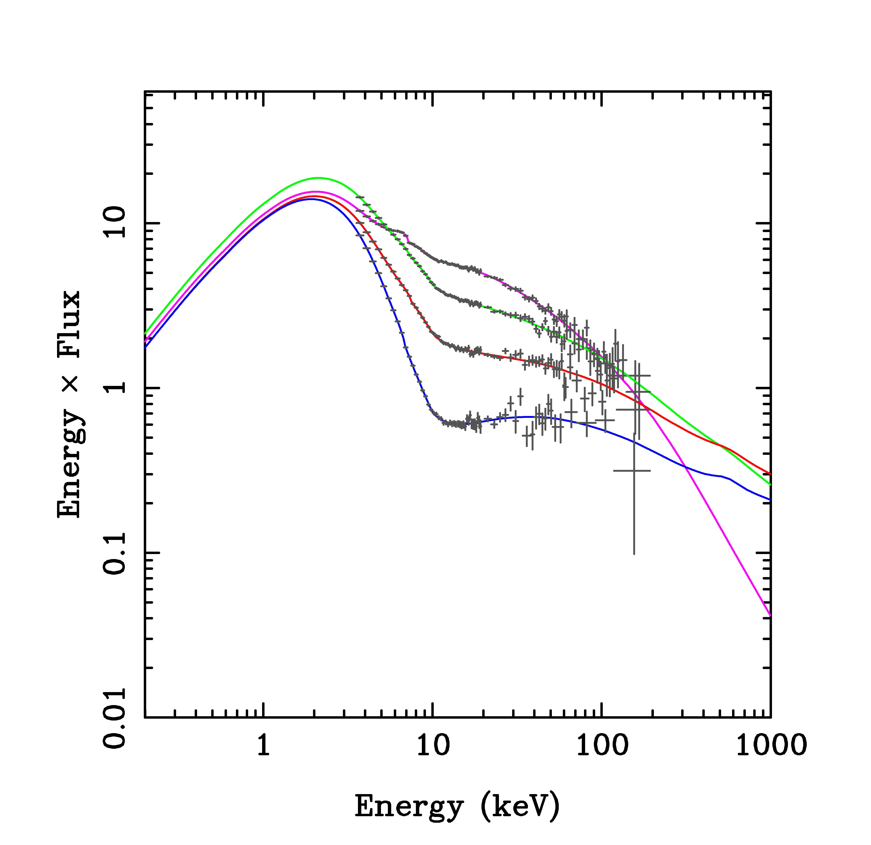
Comparing spin measurements: High mass accretion rate spectra
Disc continuum fitting
disc dominated spectra
classical high/soft state
Fe line profile
strong hard X-ray tail
very high/soft intermediate
states
Notes:
well what would give us more confidence in this whole spin business would be to compare these two methods and hopefully get consistent results.
well, bad news is we can’t really do that, as these two observations come from very different conditions.
disc fitting needs disc dominated spectra, also known as the classical high/soft state spectra
iron line profile needs a power law tail, which can be seen in the very high/soft intermediate states

Slide 8
Comparing spin measurements: GX 339-4
Disc fitting gives upper limit
a* < 0.9 from RXTE spectra
(Kolehmainen & Done 2010)
Fe line values higher
a* = 0.94 from XMM-Newton
Burst mode soft intermediate state (Miller et al. 2004)
a*= 0.89 from Suzaku intermediate state
(Miller et al. 2008 vs. Yamada et al. 2009)
a*= 0.94 from XMM-Newton LHS
(Reis et al. 2008 vs. Done & Diaz Trigo 2010)
Notes:
we need a source that shows both the disc and the hard tail and
this is where GX 339-4 comes into play. it’s a low-mass x-ray binary that goes through major outbursts and state transitions.
now the second piece of bad news is that even when we have a source we can use for both methods, the derived spin values don’t agree. Last year we derived an upper limit of 0.9 from disc dominated RXTE spectra ,
but the iron line results tend to give higher values
There’s one burst mode soft intermediate state observation for which we can say that it’s not piled up, so miller et 2004 derived a value of 0.94. the other two, from suzaku intermediate state and xmm-newton low/hard state have already been disputed due to effects such as pile up.
the thing about this source is that it’s extremely bright and we’re looking at it at it’s brightest state. we’re talking thousands of counts per second here so pile up is a real issue. most of the observations tend to be severy piled up
there’s an existing xmm-newton low/hard state and a suzaku intermediate state estimate on spin which both suffer from pile up

Slide 9
XMM-Newton EPIC pn Burst mode
Time resolution 7μs
Pileup limit 60,000 counts/s
Timing mode 30μs (800 counts/s)
Duty cycle 3 %
photon collecting time/readout time
Notes:
luckily enough epic pn has a science mode just for these kinds of sources. the burst mode.
this kind of time resolution comes with a price though, as the live cycle is only 3 per cent

Slide 10
High mass accretion rate spectra of GX 339-4
4-7 keV
Joint EPIC-pn/RXTE
observations (0.7-25 keV)
Fast timing mode data,
not piled up!
3 disc dominated states
2 soft intermediate states (SIMS)
Notes:
nevertheless, we analysed all the burst mode observations of GX 339 and combined them with rxte to get the hard tail
out of these 5 observations we identified 3 dd states and 2 sims. the 4-7 kev lines demonstrate how the iron line is in a region where the continuum changes drastically in these kind of spectra.
we’ll start our analysis with the disc dominated spectra

Slide 11
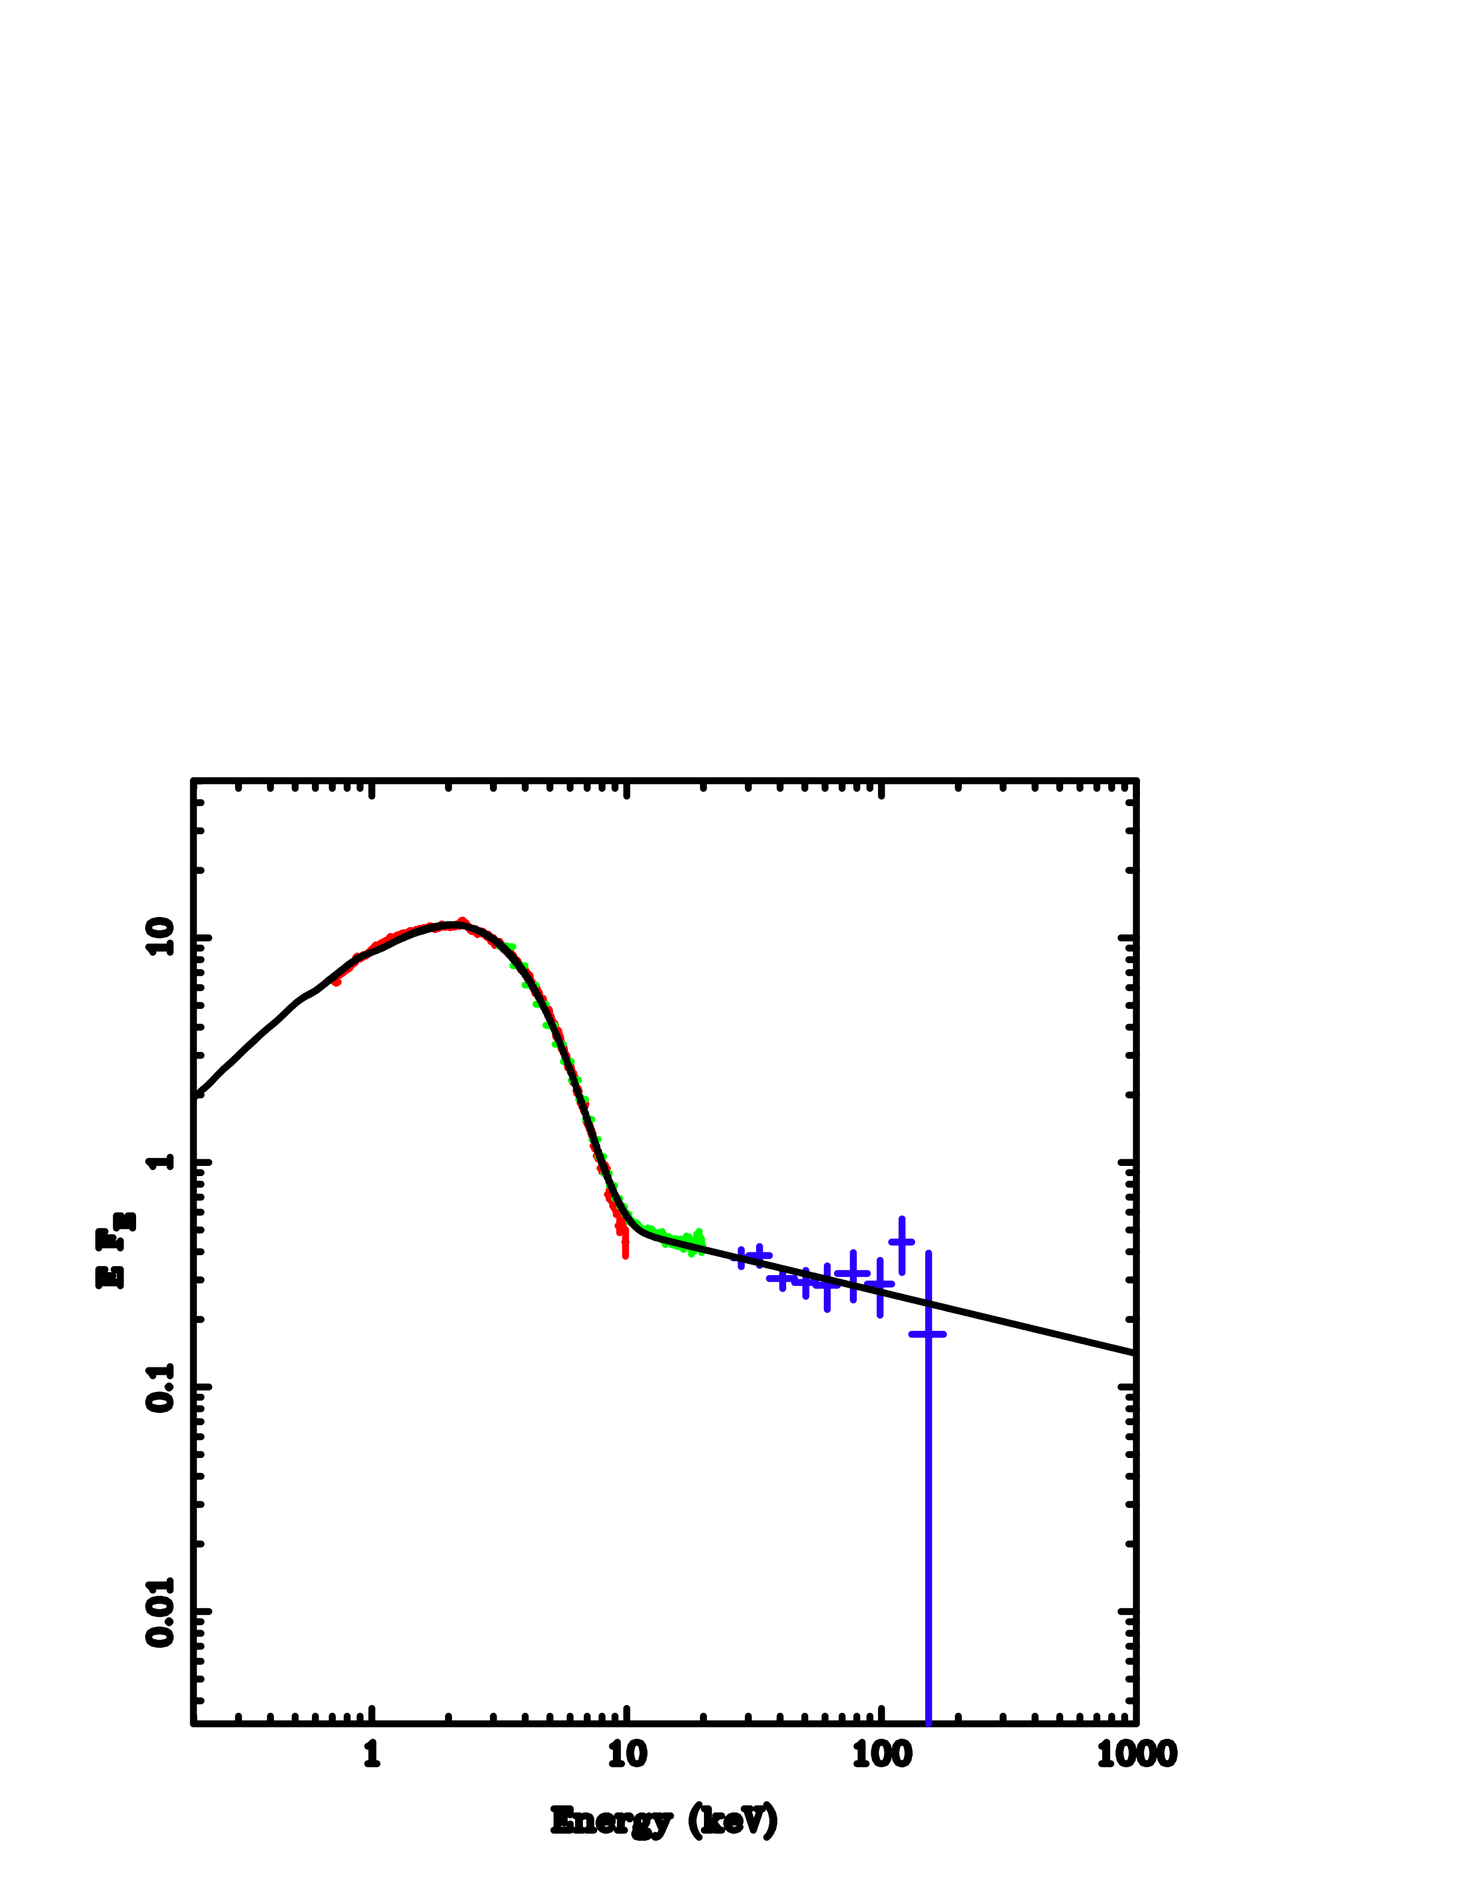
Below the RXTE energy band
3 keV
GX 339-4
Notes:
this is what the situation was before, we couldn’t see the actual peak of the disc, but now we’ll move below the rxte bandwitdth with xmm-newton’s epic and hope to get a better look at the disc

Slide 12
Continuum fitting below 3 keV: Disc dominated state
DISKBB
simplest multi-colour disc blackbody
KERRBB
stress-free inner boundary condition, colour- temperature correction and relativistic smearing
BHSPEC
calculates radiative transfer
through each disc annuli
includes all the relativistic
corrections
assumes R_{in}=R_{ISCO}
Notes:
first thing we need is a disc model. there are currently 3 widely used ones

Slide 13
Continuum fitting below 3 keV: Disc dominated state
DISKBB
simplest multi-colour disc blackbody
KERRBB
stress-free inner boundary condition, colour- temperature correction and relativistic smearing
BHSPEC
calculates radiative transfer
through each disc annuli
includes all the relativistic
corrections
assumes R_{in}=R_{ISCO}
Notes:
first thing we need is a disc model. there are currently 3 widely used ones

Slide 14
Continuum fitting below 3 keV: Disc dominated state
DISKBB
simplest multi-colour disc blackbody
KERRBB
stress-free inner boundary condition, colour- temperature correction and relativistic smearing
BHSPEC
calculates radiative transfer
through each disc annuli
includes all the relativistic
corrections
assumes R_{in}=R_{ISCO}
Notes:
first thing we need is a disc model. there are currently 3 widely used ones

Slide 15
Continuum fitting below 3 keV: Disc dominated state
Disc model
use this as seed photons for Comptonisation to make X-ray tail
(convolved with Simpl (Steiner et al. 2009))
Reflection of Comptonised continuum
using ionised reflection models of
Ross & Fabian
Relativistic smearing (kdblur)
Notes:
so we’ve got a disc now, which we’ll use as seed photons for comptonisation to make the hard tail
we add reflection of the comptonised continuum and smear it with kdblur

Slide 16
Continuum fitting below 3 keV: Disc dominated state
BHSPEC+reflected continuum
very steep continuum to make disc broader
high reflection fraction
misses high energies
residuals around 1 keV
Notes:
so we started the analysis with what we thought was going to be the best possible combination of models
but then it needs to push the reflection ridiculously high to reach the pca data
what is optical depth in the fits???

Slide 17
Continuum fitting below 3 keV: Disc dominated state
BHSPEC+reflected continuum
very steep continuum to make disc broader
high reflection fraction
misses high energies
residuals around 1 keV
Notes:
and when we add the high energy hexte data as a sanity check, we see that the model misses the higher energies completely
what is optical depth in the fits???

Slide 18
Continuum fitting below 3 keV: Disc dominated state
(diskbb+compTT)+reflected continuum
reasonable reflection fraction+continuum
extrapolates to high energies
fit for different mass accretion rates
Notes:
so the disc clearly wants to be broader than even bhspec. we thought we’d let it, by using a phenomenological combination instead.
not surprisingly at all, it fits better than the more physical one. both the reflection and the continuum are very reasonable,
what is optical depth in the fits???

Slide 19
Continuum fitting below 3 keV: Disc dominated state
(diskbb+compTT)+reflected continuum
reasonable reflection fraction+continuum
extrapolates to high energies
fit for different mass accretion rates
Notes:
the extrapolation to higher energies fits and what else is nice is that this model doesn’t have an inbuilt assumption of the inner radius
what is optical depth in the fits???

Slide 20
Continuum fitting below 3 keV: Disc dominated state
DATA
vs.
BHSPEC
Notes:
so why doesn’t the best physical model give us the answers we’re looking for?
for one, it doesn’t seem to be quite as broad as the phenomenological model implies. secondly, there seem to be atomic features in the model that are not there in the data.
this is telling us something about the detailed vertical structure in the disc that we don’t yet understand

Slide 21
Continuum fitting below 3 keV: LMC X-3
DATA
vs.
BHSPEC
Notes:
another excellent example of this is LMC X-3, where absorption is not really an issue as the galactic column density is an order of magnitude smaller than for
your average galactic black hole binary. again we can see that the model doesn’t accurately describe the data below 2 kev

Slide 22
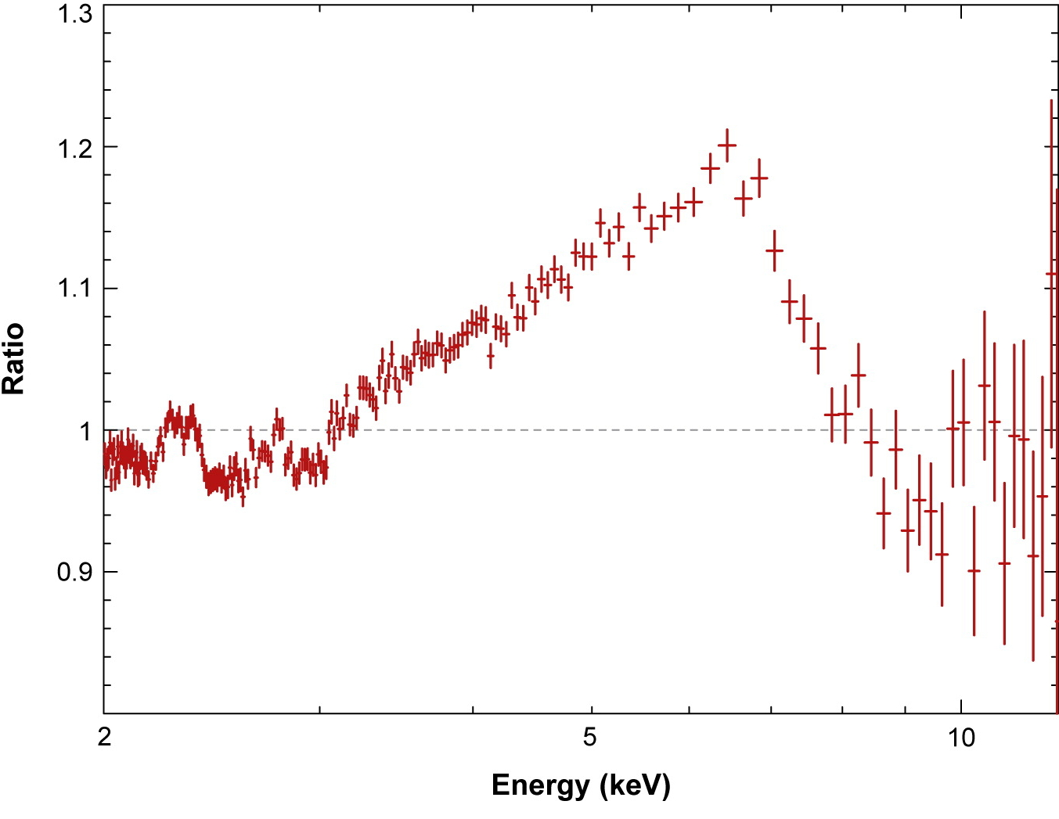
Soft intermediate state: the Fe line
Previously derived a strict upper limit for the spin in
GX 339-4 from continuum fitting of disc dominated RXTE
spectra (Kolehmainen & Done, 2010)
a* < 0.9 for any reasonable mass (<15M), distance (>6 kpc) and inclination (i > 45°)
GX 339-4 widely studied in
terms of Fe-line
burst mode spectrum gave a*= 0.935
(e.g. Miller et al. 2004; Reis et al. 2008)
Miller et al. 2004
Notes:
so what does this all mean in terms of the black hole spin?
as I said before we’ve previously derived a strict upper limit …
why are the iron line results so different then?
in search of a broad line we re-traced the steps taken in Miller et al. 2004 and try to reproduce the results

Slide 23
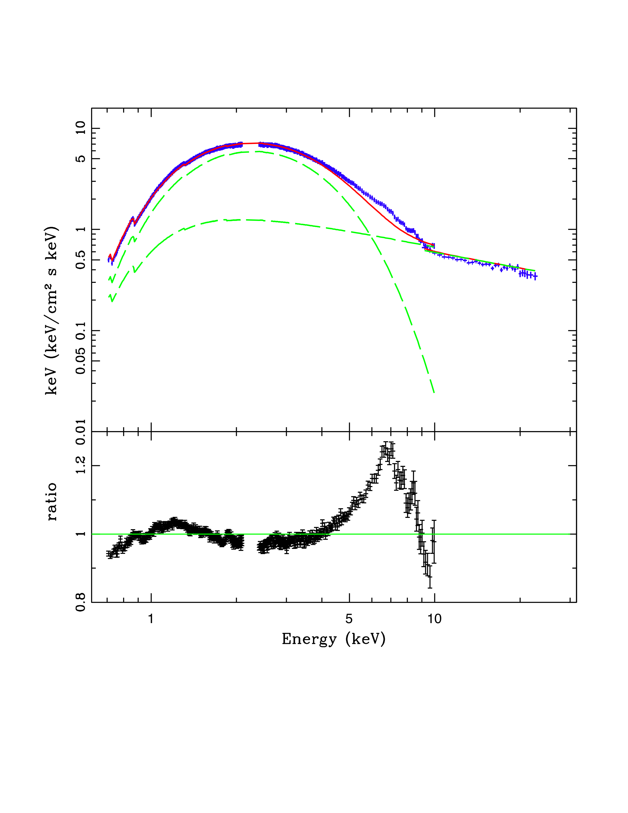
Soft intermediate state: the Fe line
diskbb+po
disc, power law tail
continuum modelled by ignoring
4−7 keV
➔ Residuals show a broad iron line
Obsid 0156760101
Notes:
this was done using epfast I might add
we take another look at the same data set, apply the phenomenological model used and model the continuum by ignoring 4-7keV.
and there it is.
as you can see the iron line is in the region where the disc and power law continuum cross, which is a bit concerning since if your model is wrong here, then you’re forcing these residuals in the data

Slide 24
Soft intermediate state: the Fe line
(diskbb+compTT)+reflected continuum
convolved disc+thermal Comptonisation, ionised smeared reflection
Narrow line does not constrain
BH spin
Obsid 0156760101
Notes:
we demonstrate the effect by using our more detailed model on the same spectrum and this is what happens.
the line pretty much collapses.
now, we’re not saying that the line is not there, quite the contrary it’s clearly there. what we’re saying is when your line is in an area where the continuum changes dramatically you have to be very sure about your continuum model
since by using a narrow disc model you’re forcing a broad residual into the data

Slide 25
Conclusions
What we ARE saying:
Burst mode good
Real disc spectra broader than diskbb or even BHSPEC
Changing the continuum model changes the shape of the Fe line profile (and black hole spin)
What we are NOT saying:
The Fe line does not exist
Calibration issues are in the past
Notes:
in conclusion to avoid any misunderstandings, what we are saying and what we aren’t
burst mode is excellent for looking at bright sources, and the well known calibration issues are finally at a level where we can use it to make nice science with
we’re not saying that calibration issues are in the past, they are very much ongoing, but the good people at esac have been working hard on resolving these issues, so a special shout out to matteo and his team to keep on doing an excellent job so that we can do cool science with these data!

Slide 28
Conclusions
The XMM-Newton Burst mode can actually be used to make science
can look at the disc below 3 keV even with the brightest objects
Real disc spectra are much broader than diskbb
Changing the continuum model changes the shape of the iron line (and the BH spin)

Slide 29
Continuum fitting below 3 keV: Disc dominated state
Disc model
use this as seed photons for Comptonisation
(convolved with Simpl (Steiner et al. 2009)) to make X-ray tail
Relativistic smearing (kdblur)
Reflection of Comptonised continuum
using ionised reflection models of
Ross & Fabian

Slide 30
Continuum fitting below 3 keV: Disc dominated state
DISKBB
simplest multi-colour disc blackbody
KERRBB
stress-free inner boundary condition, relativistic smearing and the colour- temperature correction
BHSPEC
calculates radiative transfer
through each disc annuli
includes all the relativistic
corrections
assumes R_{in}=R_{ISCO}

Slide 31
Continuum fitting past the disc dominated state: The model
tbabs ×
simpl*(diskbb+compTT) +
kdblur*refxion*(simpl*(diskbb+compTT))
the major advantage comes from being able to fit for different mass accretion rates

Slide 32
Continuum fitting below 3 keV: Disc dominated state
DATA
vs.
BHSPEC
Kerrbb

Slide 33
Burst mode observations of GX 339-4
M = 10 M
D = 8 kpc
i = 60°
0093562701 (discy)
0156760101 (SIMS)
0410581201 (discy)
0410581301 (SIMS)
0410581701 (discy)
Kolehmainen & Done 2010
Notes:
here we’ll see what happens if we assume that the disc goes all the way down to the last stable orbit in these observations. we’ve got all our previous rxte data plotted here to show the l-t-relation, with the luminosity calculated for these parameters and the correction lines calculated for 0 spin.

Slide 34
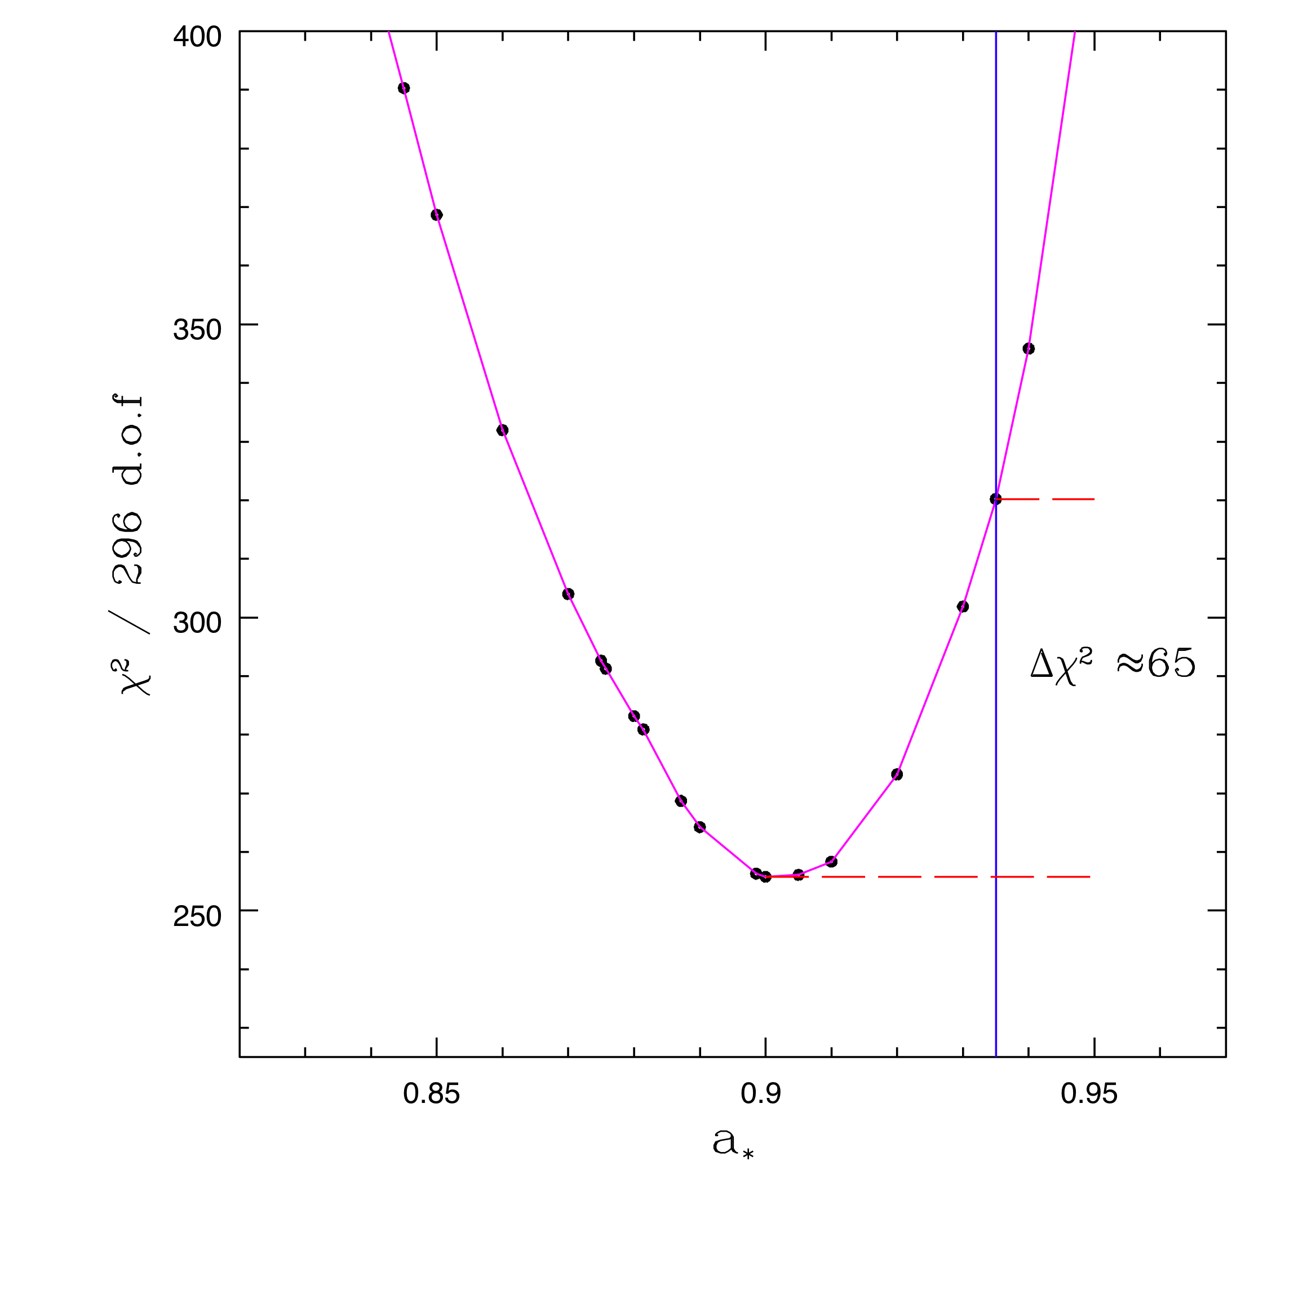
The Fe-line and the BH spin
Previously derived a strict upper limit for the spin in
GX 339-4 from continuum fitting of disc dominated RXTE
spectra (Kolehmainen & Done, 2010)
a* < 0.9 for any reasonable mass (<15M)
distance (>6 kpc) and
inclination (i > 45°)
Notes:
well it wouldn’t be us if we didn’t talk about the spin.
Lower mass and/or larger distance and/or higher inclination will give lower spin

Slide 35
Black hole spin: the Fe line profile
Broad iron emission line
profile a self consistent way
to determine BH spin
Miller et al. 2004
Notes:
As we’ve already seen today, this is what we’re looking for when we’re looking at reflection features

