Slide 1
Asteroid Framing Camera Near-Earth Commissioning Phase
Jean-Baptiste Vincent, Gabor Kovacs
Hera SOWG
19 November 2024

Slide 2
Summary
Everything OK with the AFCs, both instruments performing as expected !
All requested SCI data has been acquired and verified (except bias/dark ?)
A few surprises, we will request minor updates to Cruise and Mars activities
Communication with ESOC can be improved, especially regarding scheduling. This is already being discussed
Remaining issues with data processing and distribution are being resolved
Attended PDS4 workshop, can generate valid labels, now waiting for ESA support

Slide 3
Operations report
Activity | Pointing | Exposures (ms) | Date | # expected | # received | Status
AF1 Earth-Moon | 3x3 +-1° raster Earth & Moon in FoV | 0.5, 1, 2, 5 | 2024-10-10T14:08 | 36 | 36 | OK
AF2 Earth-Moon | 3x3 +-1° raster Earth & Moon in FoV | 0.5, 1, 2, 5 | 2024-10-11T01:48 | 36 | 36 | OK
AF1 Dark/Bias | any, even slew no bright object in FoV | 5x 0.224, 5x 1000 | 2024-10-16T14:45 | 10 | 20 bias 4 darks | OK for bias Darks acquired with 4s exposure instead of 1s
AF2 Dark/Bias | any, even slew no bright object in FoV | 5x 0.224, 5x 1000 | 2024-10-17T03:55 | 10 | ? | Not yet acquired
AF1 Saturation Vega | 3x3 +-1° raster RA: 18h 37m DEC: 38d 47m | 8, 12, 16, 20, 24 | 2024-10-25T15:30 | 45 | 45 | OK
AF2 Saturation Vega | 3x3 +-1° raster RA: 18h 37m DEC: 38d 47m | 8, 12, 16, 20, 24 | 2024-10-25T16:50 | 45 | 45 | OK
AF1 Distortion StarField1 | 3x3 +-1° raster RA: 07h 21m; DEC:-25d 34m | 500, 1000, 1500 | 2024-10-29T13:20 | 27 | 27 | OK
AF2 Distortion StarField1 | 3x3 +-1° raster RA: 07h 21m; DEC:-25d 34m | 500, 1000, 1500 | 2024-10-29T14:40 | 27 | 27 | OK
AF1 Radiometry Vega | 3x3 +-1° raster RA: 18h 37m DEC: 38d 47m | 3x 10 | 2024-11-07T12:05 | 27 | 27 | OK
AF2 Radiometry Vega | 3x3 +-1° raster RA: 18h 37m DEC: 38d 47m | 3x 10 | 2024-11-07T13:25 | 27 | 27 | OK
AF1 Distortion StarField2 | 3x3 +-1° raster RA: 04h 25m; DEC:+15d 10m | 500, 1000, 1500 | 2024-11-10T11:20 | 27 | 27 | OK
AF2 Distortion StarField2 | 3x3 +-1° raster RA: 04h 25m; DEC:+15d 10m | 500, 1000, 1500 | 2024-11-10T12:40 | 27 | 27 | OK

Slide 4
Earth/Moon
4x
AF1_NAV_241010T212506_0
First image acquired in space !
45 images acquired over 1.5 hours
Dist: 1.6 million km, Res: 150 km/px

Slide 5
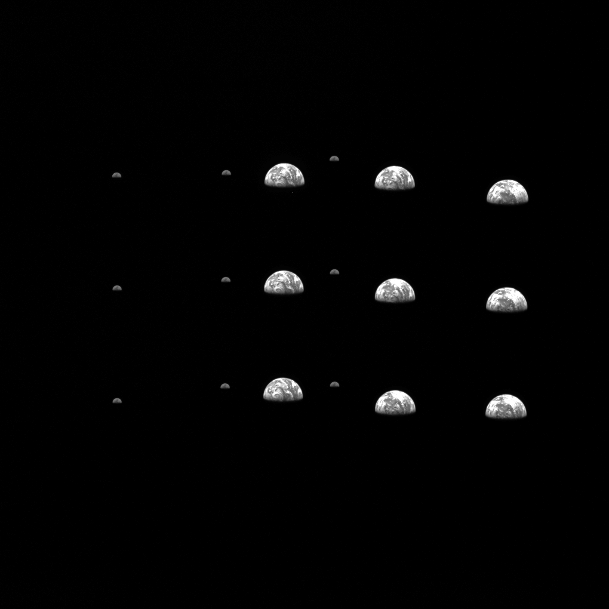
Earth/Moon
Used to place the Earth and Moon at different positions across the sensor. 18 distinct locations, with no overlap.
Intentional under- and over-exposure to account for weather (clouds are super bright!), uncertainties on phase angle, and to test detector staturation at long exposures
Cameras performing as expected, very sensitive
Weather on Earth worries me for Mars: we need to carefully check for extent of polar caps, and eventual dust storms, when defining exposure times.
Discussion to start with WG4 and colleagues from HRSC on Mars Express (camera PI works at DLR)
3x3 raster, 0.4ms exposure, 9 images stacked in single frame on ground

Slide 6
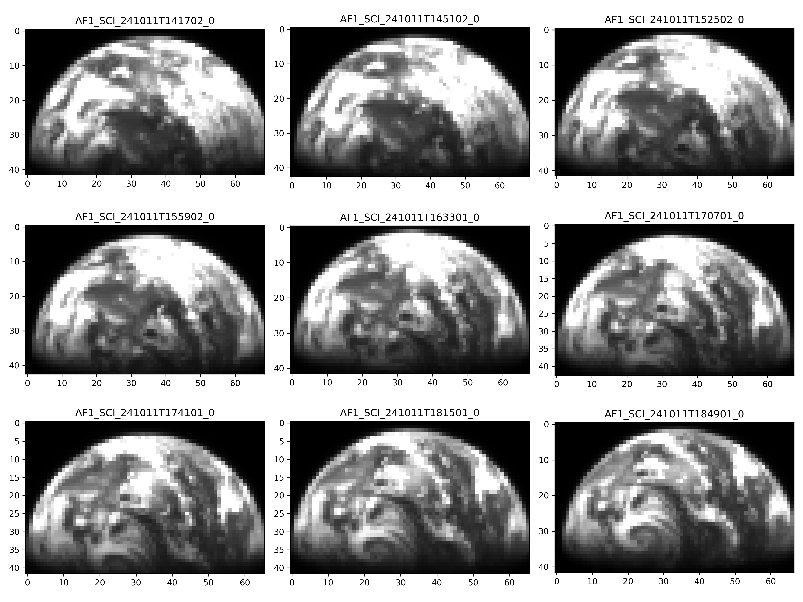
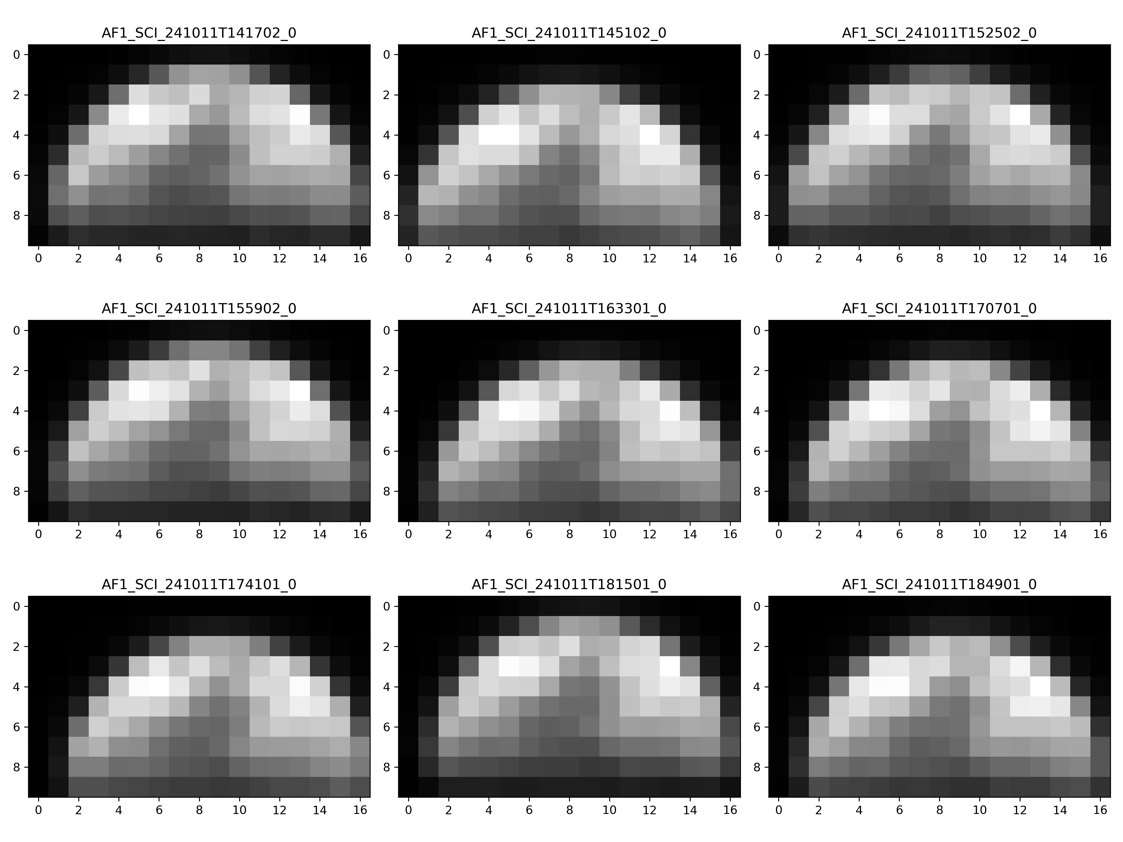
Earth/Moon
Earth, 0.4 ms exposure
clouds are bright !
Moon, 0.4 ms exposure. Clear difference maria vs highlands, to be analysed by WG4
Consistent signal across detector

Slide 7
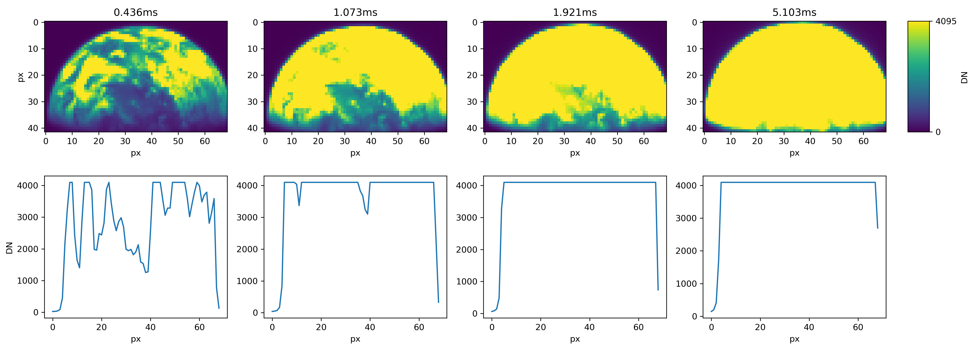
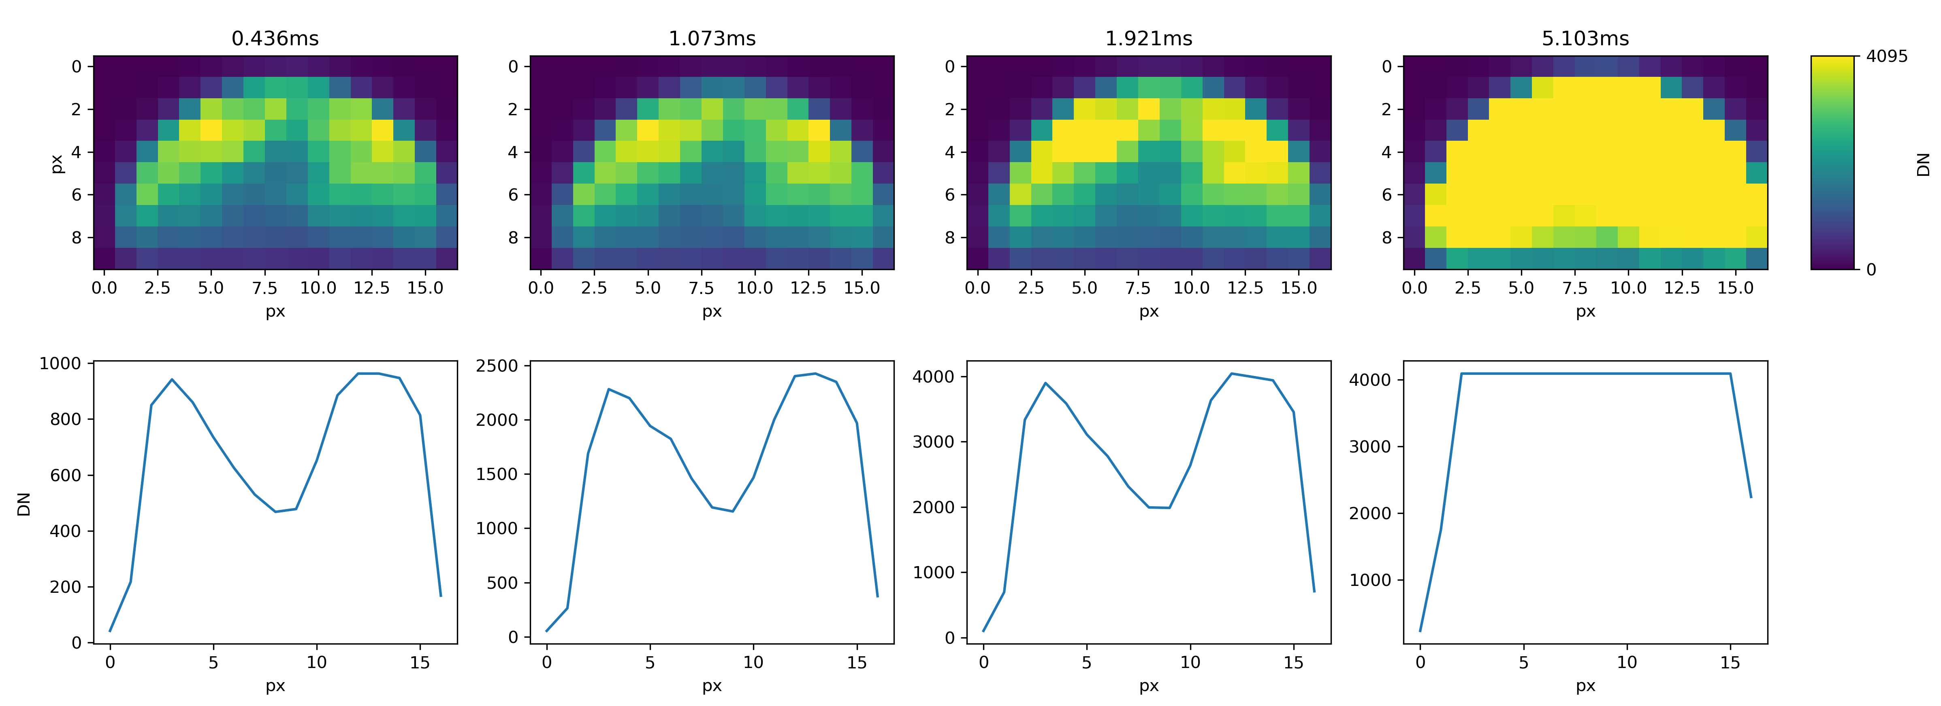
Raster position #1, 4 exposures
Line plot shows pixel values across all columns in the middle row of the subframe
EARTH:
saturated pixels even at 0.224ms, shortest possible exposure.
Good data at 0.4ms exposure
long exposures very useful to look for ghost and stray light
MOON:
Good data at 0.4ms, 1ms, 2ms, saturated pixels at 5 ms
Maria DN level ~50% less than highlands. Looks good, to be studied by photometry experts in WG4
Earth, 0.4 ms exposure
clouds are bright !

Slide 8
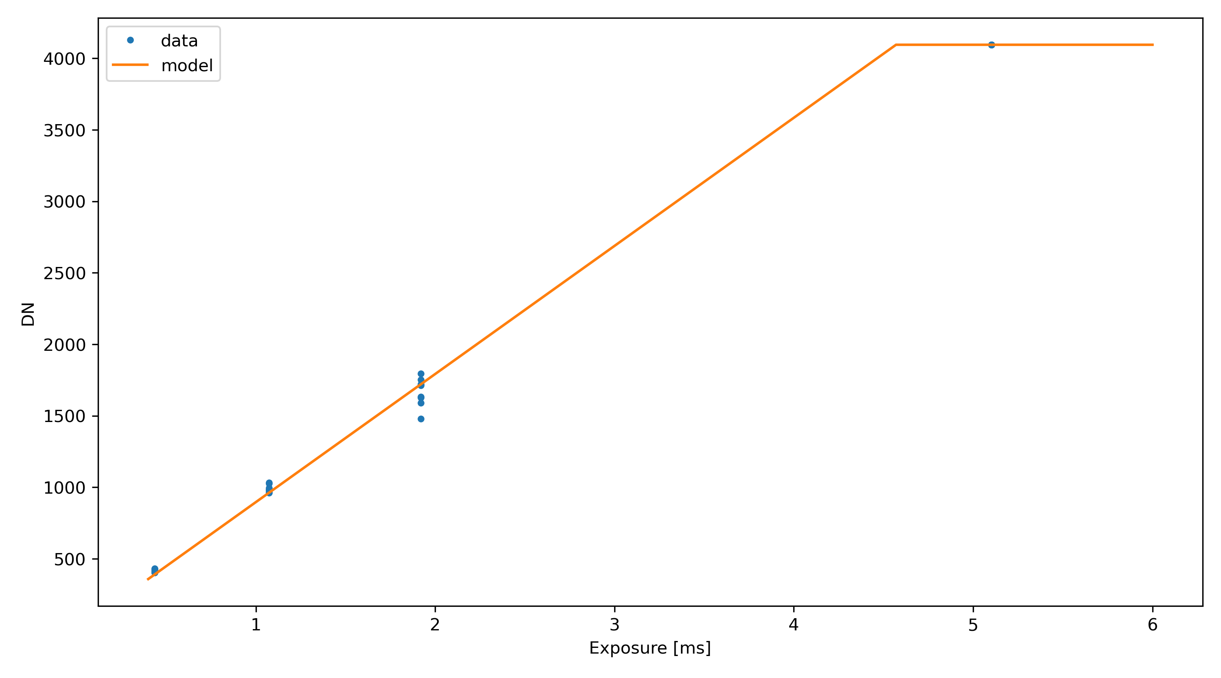
Moon: simple radiometric verification
Data: average DN around center of illuminated area
Model: brightness from ground-calibration exposure calculator, assuming 12% albedo, multiplied by cos(80°) to account for phase (very dumb model, please do better!)

Slide 9
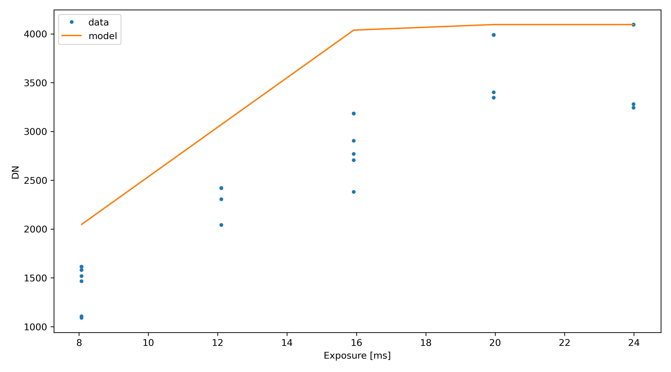
Vega (Radiometric calib + saturation)
3x3 raster (9 positions on detector)
Radiometric calibration: 3x 10ms exposure (2500 DN, 60% max DN)
Saturation tests: expose at 50%, 75%, 100%, 125%, 150% max DN (8, 12, 16, 20, 24 ms)
???

Slide 10
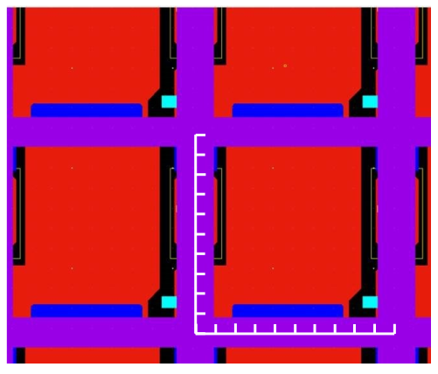
Vega (Radiometric calib + saturation)
Extended sources show consistent DN level for same exposure at different locations on detector
Why so much variability with Vega ? Not an issue with our model, well tested in the lab.
Current understanding: CMOS design + excellent optics (PSF < 1 px)
The detector sensitive area is limited by components and conductors on the top layer of the silicon chip (front-side illumination)
The PSF is < 10 um (1px)
This results in a 50-80% fill factor for point sources
Possible solution: acquire a very large number of frames and let the pointing inaccuracy do the averaging
Pixel layout (with 10x10 um scalebars)

Slide 11
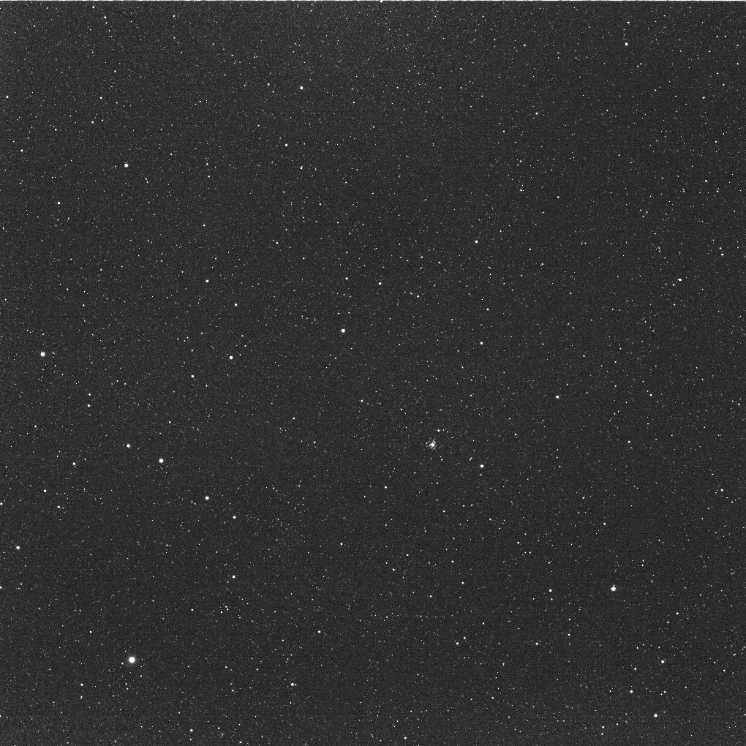
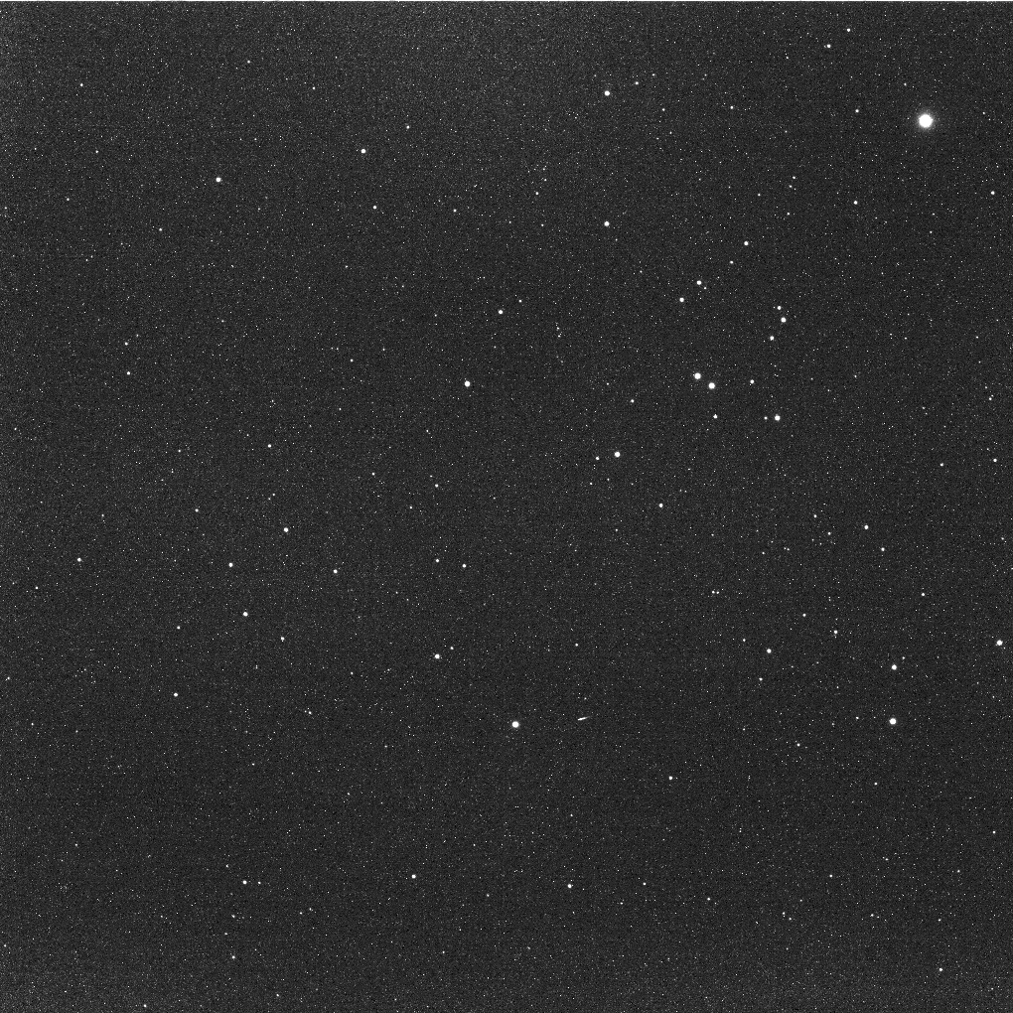
Star Fields
RA: 07h 21m
DEC: -25° 34’
RA: 04h 25m
DEC: 15° 10’

Slide 12
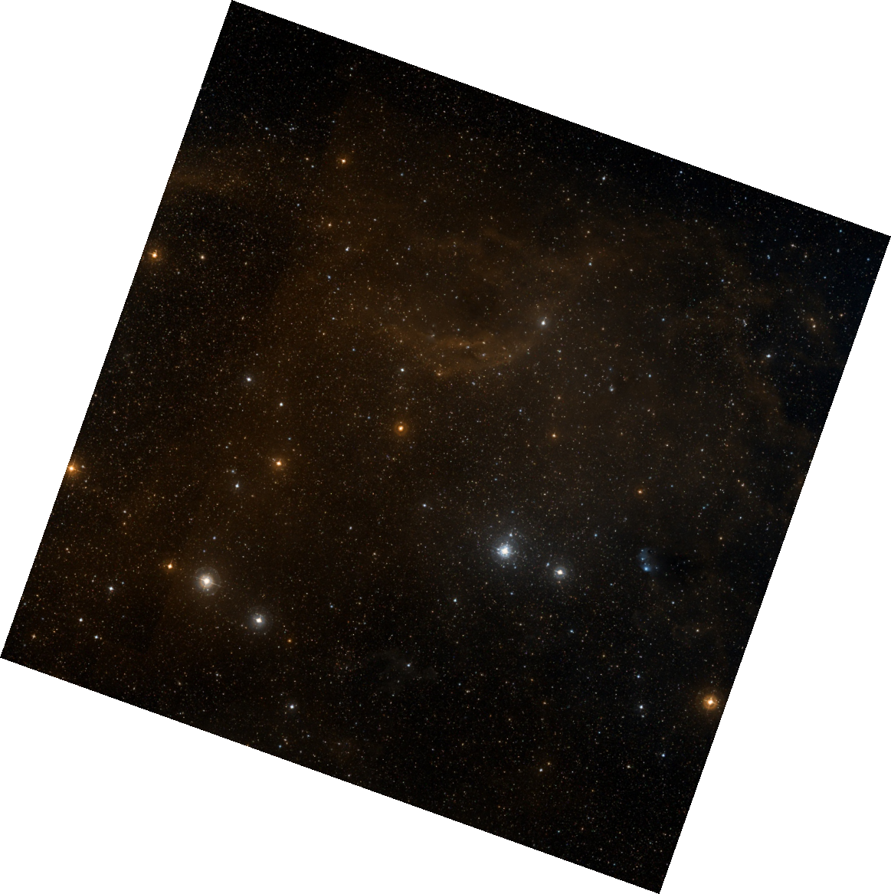
Star Field #1
RA: 07h 21m
DEC: -25° 34’
Source: ESASky

Slide 13
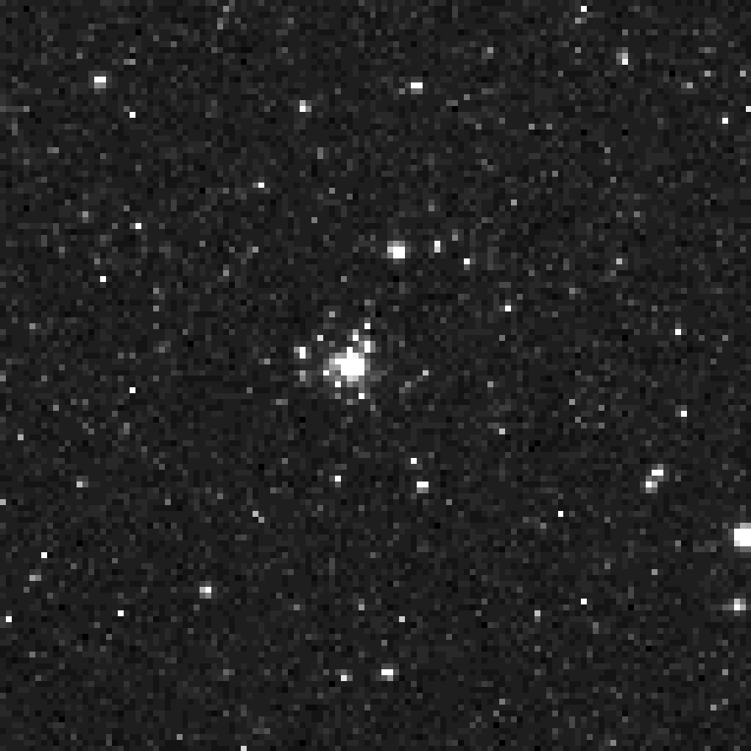
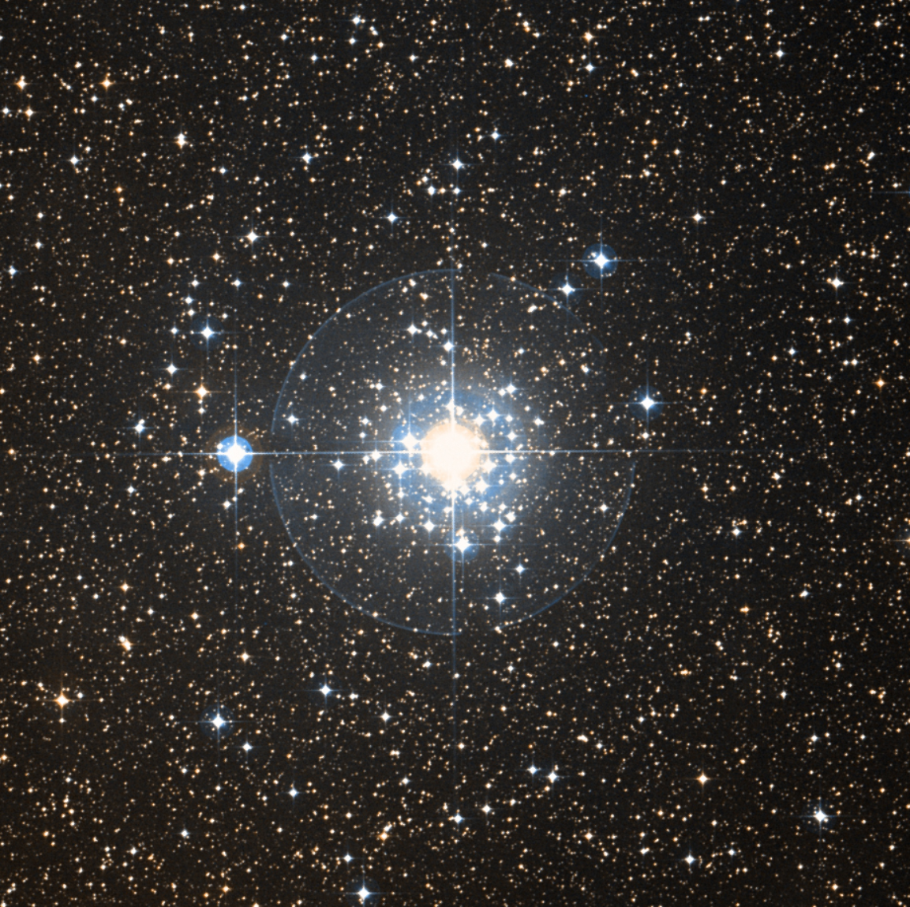
Open cluster NGC 2362
RA: 07h 18.8m
DEC: -24° 57’
Distance: 4.8 kly
Source: ESASky

Slide 14
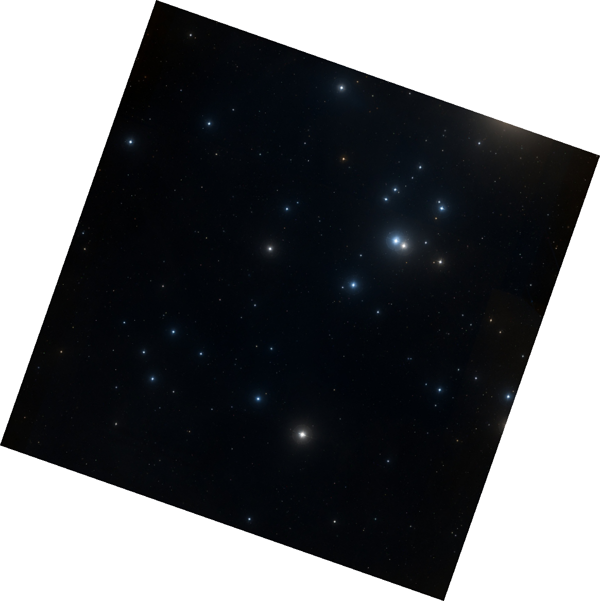
Star Field #2
RA: 04h 25m
DEC: 15° 10’
Source: ESASky

Slide 15
NECP data processing
DLR & MOGI have independent telemetry decoding pipelines for redundancy and cross-validation
Level 0 images available as FITS (raw data, minimal headers, DLR pipeline)
Level 1 images to be distributed asap, see Gabor’s talk
Calibrated data is being produced, we will likely distribute a first version based on ground calib, to be updated afterward
Some technical issues are being resolved (e.g. temperature measurements)
Would be useful to receive a notification when SCOS-2000 data base is updated
AFC team can now produce valid PDS4 labels for the data. Process not yet automated
Need a Hera-team agreement on how to build PDS4 dictionaries for the mission, and support from PSA (no archiving scientist for Hera at the moment)

Slide 16
Workflow/Communication
Science team / WG4 defines observing requirements to fulfil mission objectives
PI integrates requirements and proposes operational sequences as set of constraints and triggers
PI iterates with ESOC and WG4 until all requests and limitations are understood
ESOC implements an operational timeline
PI should have the opportunity to review the timeline
Commands sent to spacecraft and executed
Team downloads data (manual process, waiting for ESOC to greenlight the automated interaction)
Team verifies data and should notify ESOC of inconsistencies

Slide 17
Next steps
Data distribution between DLR-MOGI and to Hera team
Radiometric calibration using images of the Moon
Assessment of optical distortion with star fields
Update plan for cruise phase
Revise observations of stars
Finalise timeline of Mars/Deimos observations, plan for multiple exposures

Slide 18
Summary
Everything OK with the AFCs, both instruments performing as expected !
All requested SCI data has been acquired and verified (except bias/dark ?)
A few surprises, we will request minor updates to Cruise and Mars activities
Communication with ESOC can be improved, especially regarding scheduling. This is already being discussed
Remaining issues with data processing and distribution are being resolved
Attended PDS4 workshop, can generate valid labels, now waiting for ESA support

