Slide 1
SPICE, el servicio de información geométrica para ciencias planetarias
Marc Costa Sitjà
SPICE and Auxiliary Data Engineer
ESAC, ESA, Villanueva de la Cañada, Spain
07/06/2017

Slide 2
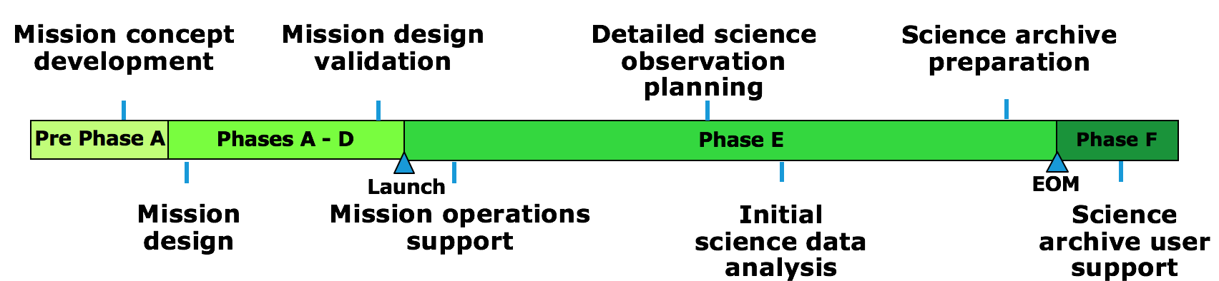
SPICE Introduction
SPICE is an information system that uses ancillary data to provide Solar System geometry information to scientists and engineers for planetary missions in order to plan and analyze scientific observations from space-born instruments. SPICE was originally developed and maintained by the Navigation and Ancillary Information Facility (NAIF) team of the Jet Propulsion Laboratory (NASA).
Space flight projects need a set of “ancillary data” to support:
  Mission design
  Science Ground Segment design, development and testing
  Flight engineering operations
  Science observation planning
  Quick look science data analysis
  Science data archive preparation
  And maybe most important of all: science data analysis!

Slide 3
Ancillary Data
“Ancillary data” are those that help scientists and engineers determine:
  where the spacecraft was located
  how the spacecraft and its instruments were oriented (pointed)
  what was the location, size, shape and orientation of the target being observed
  what events were occurring on the spacecraft or ground that might affect interpretation of science observations
Ancillary data also includes:

Slide 4
Cosmographia & WebGeocalc DEMO
Cosmographia
  Open Cosmographia
  Load JUICE 3_1 Script
  Load JANUS and another instrument
  Show reference frames and vector to Jupiter
  Show JUPITER-JUICE-GANYMEDE angle
WebGeocalc
  Load JUICE 3_1 Scenario
  Science Opportunity analysis: Europa Closest Approach
Cosmographia
  GoTo the Europa CA
  Unload JUICE
  Load MEX Scenario
PSA UI
  Go to the PSA UI Select Phobos and HRSC
  Retrieve the picture of interest
Cosmographia
  GoTo the Time of the Picture of interest
  Load the HRSC FoV
  Put the distance parameter to Phobos

Slide 5
SPICE in a nutshell
SPICE provides users a large suite of SW used to read SPICE ancillary data files to compute observation geometry
SPICE is multi-mission and can be used in any kind of planetary mission* (orbiter, lander, rover…)
SPICE is open, well tested, extensively used and with tons of resources to learn it and implement it.
SPICE is the recommended means of archiving ancillary data by NASA’s PDS and by the IPDA
SPICE ancillary data (kernels) comes from:
  The Spacecraft
  MOC/SGS
  Spacecraft manufacturer and Instrument teams
  Science Organisations
SPICE is used to organise and package these data in a collection of files called “kernels”
SPICE includes SW for writing, reading kernels and computing observation geometry from kernels
Additional Services
WebGeocalc (WGC) is a web-based graphical user interface to SPICE. Many observation geometry computations available in SPICE through a standard web browser. See:
Cosmographia is an interactive tool; 3D visualization of S/C trajectory, orientation and instrument field-of-views and footprints. Open source. SPICE-enhanced version of Cosmographia available at: https://naif.jpl.nasa.gov/naif/cosmographia.html

Slide 6
SPICE kernels
Components
Data Files
Contents
Producers
Source*
S
MOC provides data, SGS generates kernels.
Science institutions for natural bodies.
Fdyn & Mission Analysis’ OEM
SPK
Spacecraft and target
body ephemerides
Binary files
Spacecraft
P
PcK
Target body size,
shape and orientation
Text and binary files
Science institutions
Planet
I
IK
Instrument field-of-view size,
shape and orientation
Text files
ESA SPICE Service
Instrument
C
Orientation of spacecraft and
any articulating structure on it
Binary files
SGS with ESS
MOC provides data, ESS generates kernels for ops
Fdyn AEM
SC HK data
SGS
CK
Camera-matrix
FK
LSK
SCLK
DSK
Reference frames
SGS and Science Institutions
NAIF
MOC provides data. SGS generates kernels
TBD
SC HK data
SGS
E
Others
Leapseconds
Events
Spacecraft clock
Text files
Digital Shape model
EK
Binary files
No longer used
*For binary data. Text files are manually produced.

Slide 7
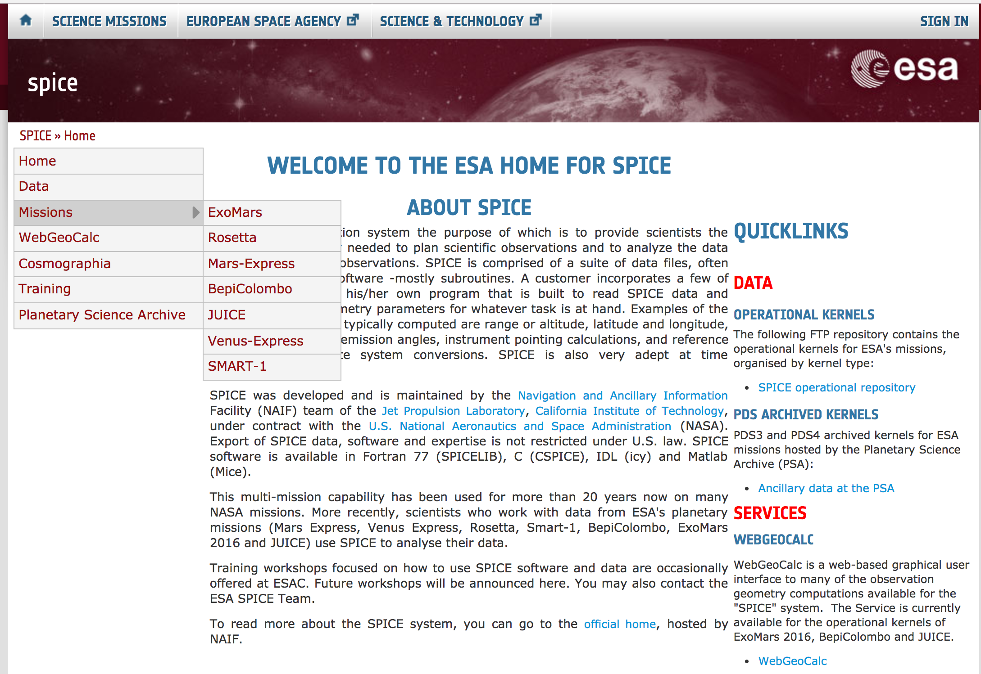
The ESA SPICE Service
The ESA SPICE Service leads the SPICE operations for ESA missions.
The group is responsible for the generation, development, maintenance and archive of the SPICE Kernel Datasets for the ESA Planetary Missions (and Solar Orbiter)
It develops and operates software to convert orbit, attitude, telemetry and spacecraft clock correlation data into the corresponding SPICE formats.
Provides consultancy and support to the Science Ground Segments and the Science Community of the planetary missions for SPICE and ancillary data management.
Everything is accessible from:
spice.esac.esa.int
Kernel Datasets are available via FTP:
ftp://spiftp.esac.esa.int/data/SPICE/
Contact the service via e-mail
  esa_spice@sciops.esa.int
  marc.costa@esa.int
Join the OpenPlanetary Slack Community

Slide 8
Missions using SPICE

Slide 9
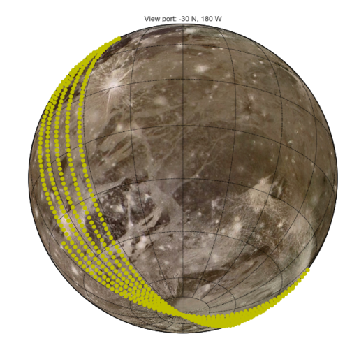
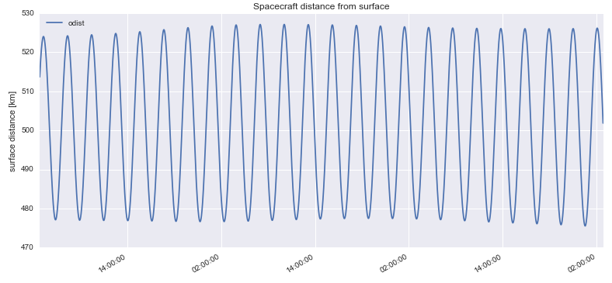
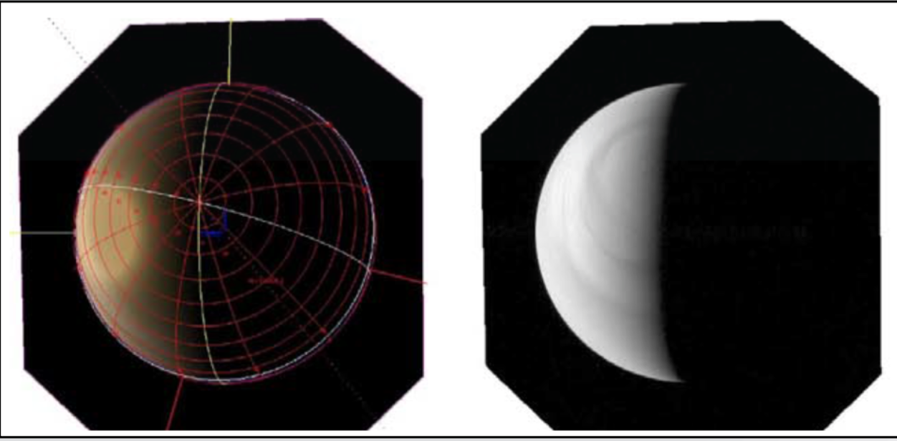
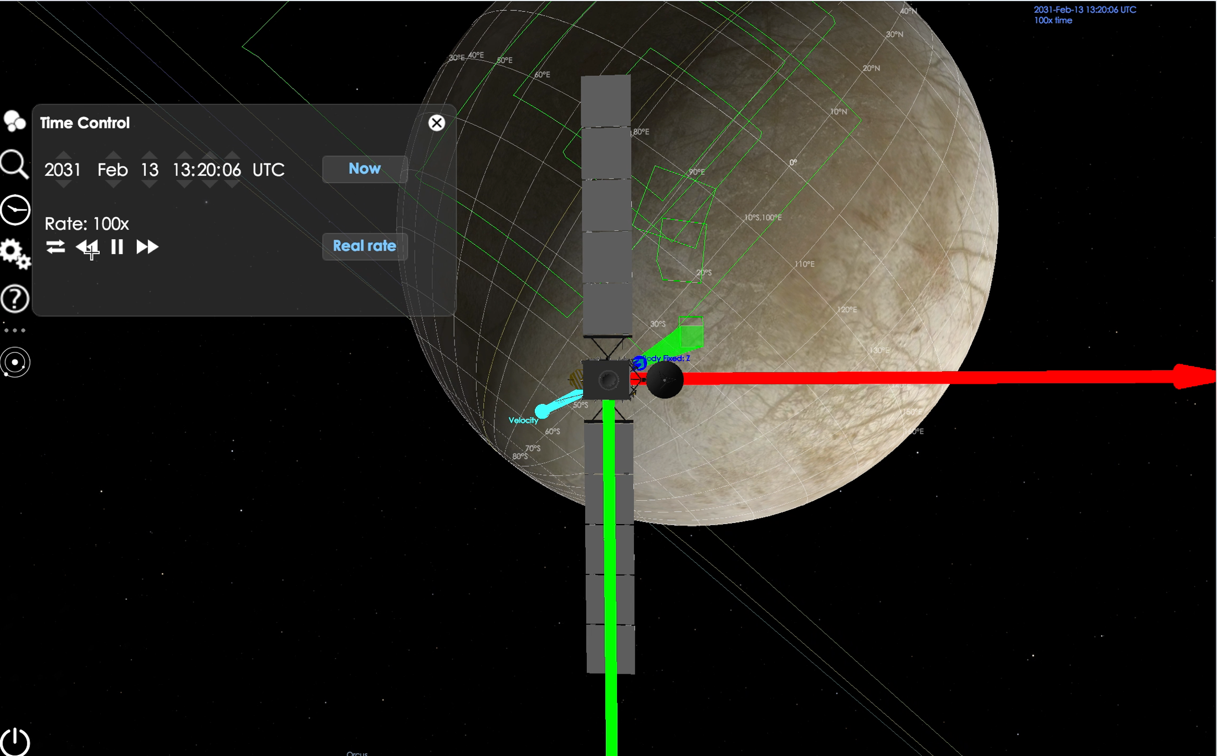
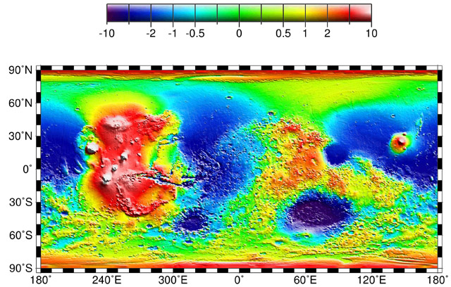
Conclusion
Evaluation of a
planned trajectory
Spacecraft Visibility
Station #1
Mission engineering
analyses
Station #2
Station #3
Planning an instrument
pointing profile
Observation geometry
visualization
Elevation
Science data archiving
and analysis
Latitude
Longitude
Notes:
Stalk Ruben for a disk and a virtualisation.
Main thing is the netapp. We need netapp space for them. Mounting a netapp volume.
Setup the overall working environment with a Technical Note.

Slide 10


BACKUP: SPICE for ESA Missions
SPICE kernels can be found in different places and can be of three different nature
  Pre-operational / operational / archived
  ESA SPICE Server / PSA & NAIF (PDS Node)
Kernel Dataset | ESA server | NAIF server | PSA Archive | Mission status | Kernel status
ExoMars 2016 |  |  | PDS4 | Operational | Consolidated
Rosetta |  |  | PDS3 | Operational | Consolidated*
Mars Express |  |  | PDS3 | Operational | Consolidated*
Venus Express |  |  | PDS3 | Post Operations | Final Review*
BepiColombo |  |  | PDS4 | Studies | In development
JUICE |  |  | PDS4 | Studies | Consolidated
Solar Orbiter |  |  |  | Studies | Early development
SMART-1 |  |  |  | Legacy | Not reviewed
Chandrayaan-1 |  |  |  | Legacy | Not reviewed
Huygens |  |  |  | Legacy | Aware of existence
Giotto |  |  |  | Legacy | Aware of existence
N/A
Present
Changing
soon
Not present

Slide 11
BACKUP: SPICE kernel Dataset Production
NAIF
ESA SPICE Service (with SOC)
MOC
Tools / Processes / Manual Work
File Transfer Systems
Generic quantities
SC and instrument Frames
Derived products
Pipeline
Orbit ephemeris
Attitude ephemeris
Time correlation data
Planetary constants
Instrument kernels
Derived Products
Orbit kernels
Attitude kernels
Spacecraft clock kernels
Leapseconds kernels
Frame kernels
FTP / User interface
PI teams
SOCs
Community

