Slide 1
ESAC 2017 JWST Workshop
“Mastering The Science Instruments and Observing Mode of JWST”
- Get Set -
Marco Sirianni

Slide 2
Welcome !
On your Mark!
JWST observing modes
2016
Get Set
Proposal tools
Go !
Data Analysi tools
2017
2018

Slide 3
Goal of the Workshop
JWST Cycle 1 call for proposal is approaching
Proposal Preparation Tools are being finalized
This is the opportunity to get hands on experience on all the tools and learn the process

Slide 4
Workshop Structure
Update on the Project Status
Science timeline and policies
Gradual introduction of the various tool
demonstration
hands on experience
Bringing all together
Science cases (all tools used to plan, design and implement a program)

Slide 5
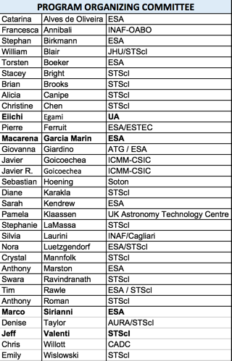
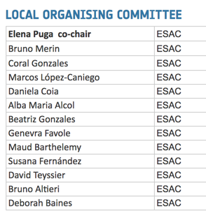
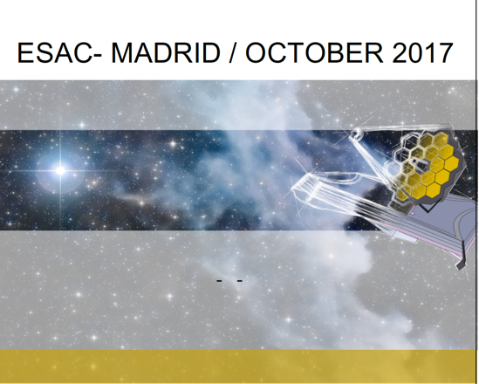
Workshop Organization

Slide 6
Training course approach
At each table:
~8 prospective JWST users
1 Facilitator
1
2
3
6
5
4
Facilitators will change depending on the topic of the hands on session
Experts on that topic will be available in the room to provide additional support
7
8

Slide 7
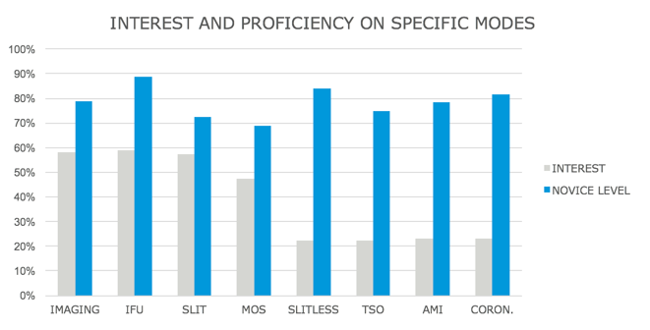
Workshop content - your inputs:

Slide 8
Workshop content – Roles and Responsibilities
You
Facilitators/Experts
Tool introductions and demonstrations:
Follow presentation
Give presentation
Hands on Sessions:
Follow provided guidelines
Work with other people in the table
Ask questions to the experts
re-try
Provide feedback
provided guidelines and clarifications
Help out as needed
Collect and Receive feedback

Slide 9
Workshop Requirements and Material
APT – download
ETC (web tool) MyST account recommended to save/share workbooks
Target Visibility Tool (astroconda)
If not done yet, come back at 1:20 after lunch
All material needed for the hands on will be provided
All material, for all science cases will be provided at the end of the workshop (web page)

Slide 10
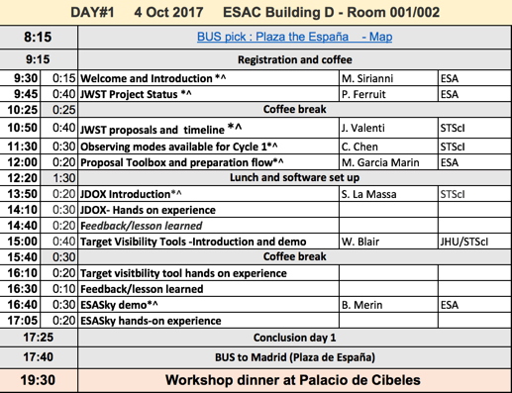
Day 1
General Presentations
Lunch and Software setup
(APT, TVT, accounts)
First 3 tools
Introduction
Hands on:
everyone has the same
study case

Slide 11
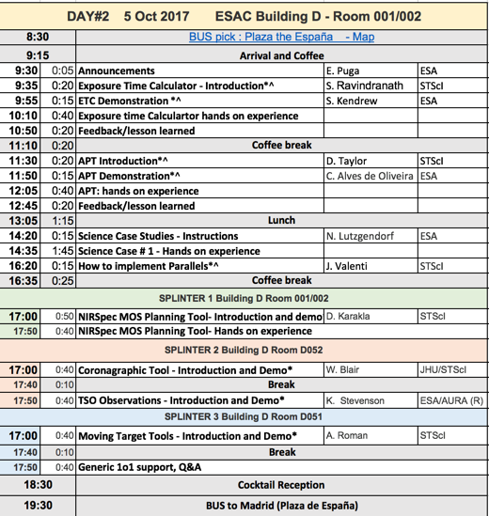
Day 2
ETC
Each pair of tables has a common
study case
APT
1ST science case: putting everything together
Parallel Splinters – SIGN IN SHEET OUTSIDE
Chance for 1o1 support – SIGN IN SHEET OUTSIDE

Slide 12
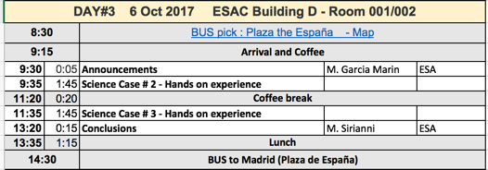
Day 3
Two more science cases

Slide 13
Some Logistics
Coffee breaks and lunches
Water
Restrooms
Posters
Dinner tonight
you will be dropped in Plaza de España around 18:30
Nice walk (20 min) – cocktail served at 19:30
Dinner 20:00 (bring your menu ticket)
For any questions see LOC/POC registration desk

Slide 14
On behalf of the POC and LOC, we wish you a good workshop Let’s get started….

