Slide 1
Observing Modes Available for Cycle 1
Christine Chen (STScI)

Slide 2
Near Infra Red Camera (NIRCam)
Imaging
Prime science imager at 0.6 – 5 μm
Expected to be popular for parallel imaging
Wide Field Slitless Spectroscopy
Prime instrument for WFSS at 2.4 – 5 μm
High spectral resolution (R~1400-1800) needed to measure kinematics and de-blend lines
Coronagraphic Imaging
Prime coronagraphic imager at 1.8 – 5 μm
Time-Series Imaging
Prime TSO imager at 0.6 – 5 μm
Grism Time Series
Expected to be popular for grism observations at 2.4 – 5 μm
Provides simultaneous SW imaging

Slide 3
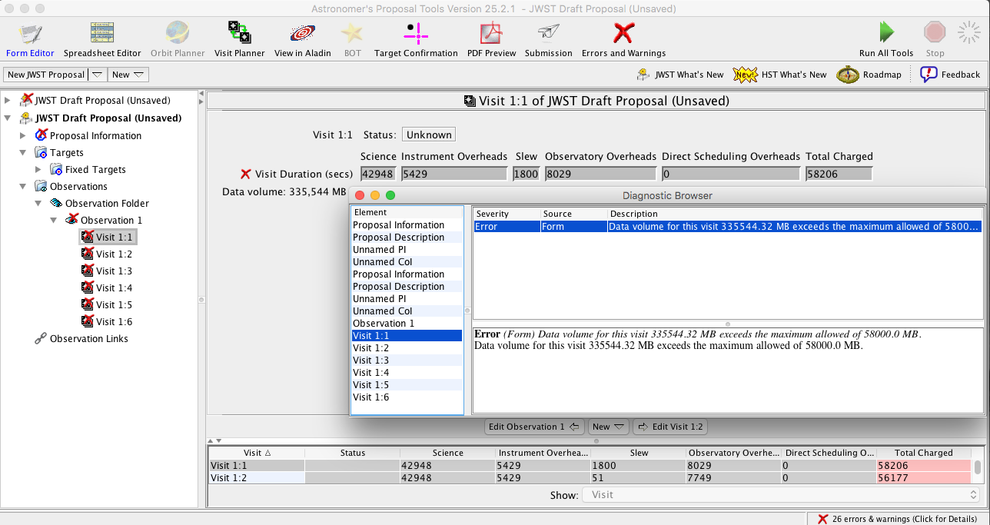
Data Volume Considerations
Data recorder has a storage capacity of 58.8 Gbytes
Maximum downlink rate is 28.6 Gbytes per 12 hour period
APT will create an error if a visit exceeds the capacity of the solid state recorder in which case the proposal must be modified to successfully submit
Accepted proposals with high but allowable may need to be modified to comply with data volume and data rate limits in order to be scheduled

Slide 4
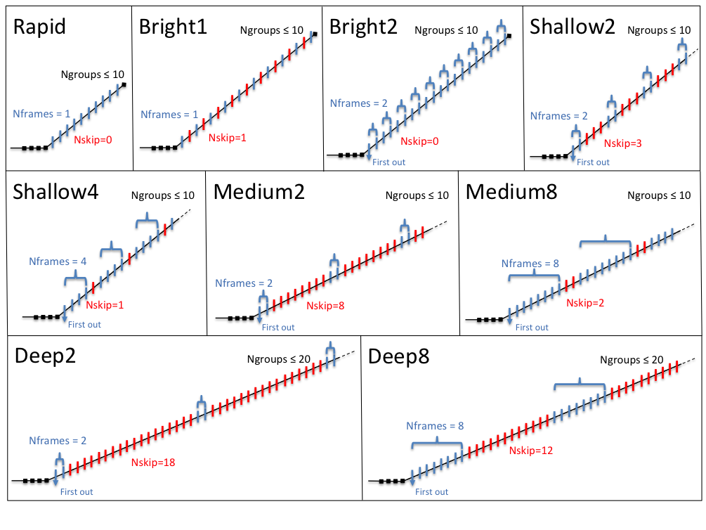
NIRCam Readout Patterns
Readout patterns consist of groups with 1, 2, 5, 10 or 20 frames
On-board electronics can average 2, 4, or 8 frames within a group
Notes:
Deep8 may have an advantage in fewer cosmic rays compared with Medium8

Slide 5
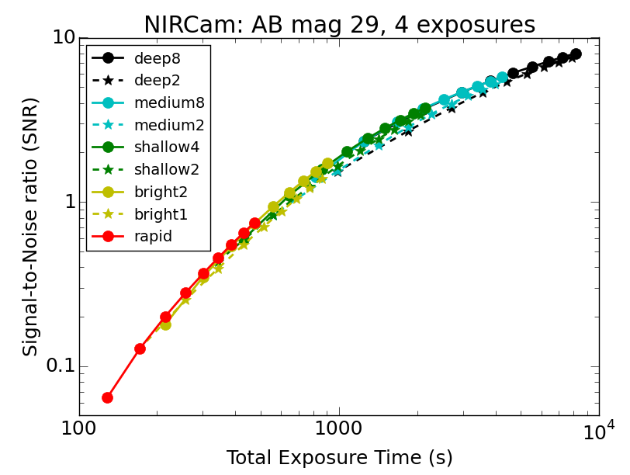
Readout Pattern Recommendations
Select the readout pattern that gives
the most number of groups for the integration time you need and
the largest number of averaged frames/group (i.e. DEEP8 is better than DEEP2)
consistent with saturation and data volume
For more information about NIRCam Imaging Sensitivity:
https://jwst-docs.stsci.edu/display/JTI/NIRCam+Imaging+Sensitivity

Slide 6
Mosaic Considerations for Cycle 1
Proposers are required to submit complete APT files of programs requesting mosaics
At this time, the Guide Star Catalog may be insufficient to find guide stars for all of the mosaic tiles at a single time.
If tile splitting is required, proposers should set the Position Angle at a value that allows the largest number of tiles to be scheduled simultaneously. Such a fixed position angle imposes scheduling constraints on the Long Range Plan. STScI may adjust the Position Angle to minimize disruptions to the schedule.
If tile splitting is required, observations of the problematic tiles will be made at a different Position Angle from the majority of the mosaic.

Slide 7
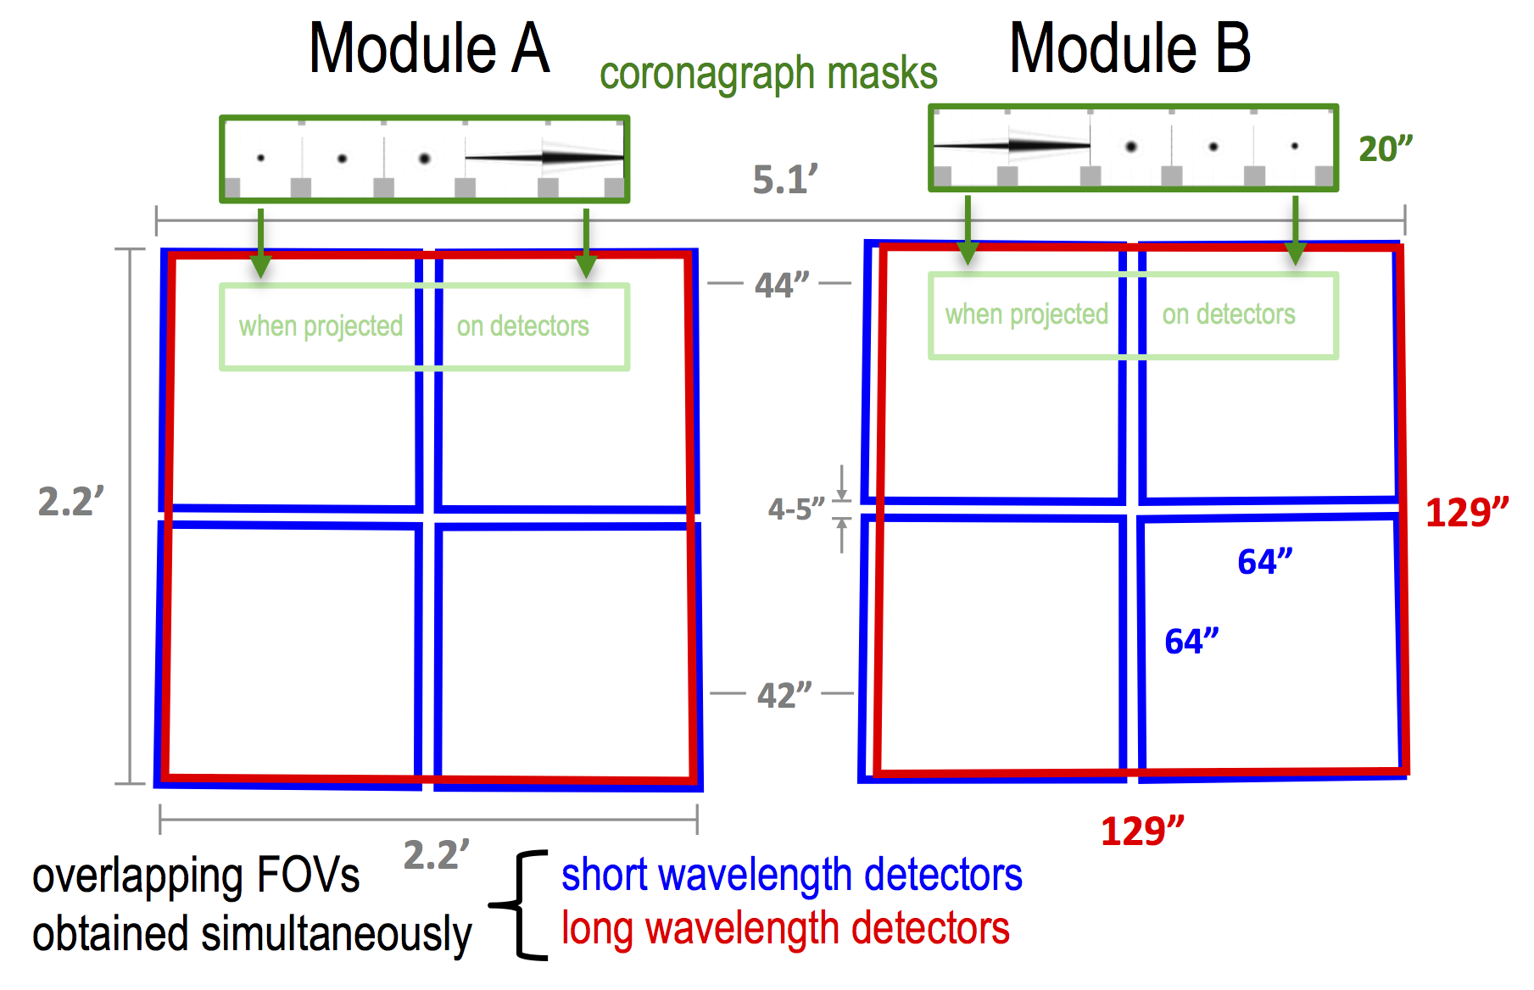
Upcoming Features in APT v25.4: NIRCam Dither Patterns
New dither patterns incorporate a better understanding of the slewing capabilities of the observatory to minimize the overheads associated with dithering.

Slide 8
Near Infra Red Imager and Slitless Spectrometer (NIRISS)
Wide Field Slitless Spectroscopy
Prime instrument for WFSS at 0.8 – 2.2 μm
Low spectral resolution (R~150)
Expected to be popular for parallel WFSS
Single Object Slitless Spectroscopy
Expected to be popular for Time Series Observations of bright sources at 0.6 – 2.8 μm
Medium resolution (R~700)
Aperture Mask Interferometry
Highest spatial resolution imaging (using NRM) at 2.8 – 4.8 μm
Provides a contrast 10⁻⁴ for separations 70 – 400 mas
Imaging
Secondary science imager at 0.8 – 5 μm
Can only be used for parallel imaging

Slide 9
Upcoming Features in APT v25.4: Longer TSO Observations
Time Series Observations (TSO) modes are similar to Imaging and Slitless Spectropscopy modes but include additional features
Target acquisition
No dithering or mosaicking
No selection of dispersion direction
NIRCam TSO allows simultaneous LW grism and SW weak lenses observations
Upcoming TSO Capabilities
Allow very long (>10,000 sec) exposures, up to 50 hours (180,000 sec)

Slide 10
Near Infra Red Spectrograph (NIRSpec)
Multi Object Spectroscopy (MOS)
Provides spectra of up to ~190 objects in a 3.6′x3.4′ field-of-view
Uses tiny configurable shutters in the micro-shutter assembly (MSA)
Integral Field Unit (IFU)
Provides 3D imaging spectroscopy over a 3″x3″ field-of-view
Uses image slicer to disect field into 30 slices with 0.1″ spaxels
Fixed Slit (FS)
Provides high contrast single object spectroscopy
Uses slits that are cut into the metal MSA support structure mounting plate
Bright Object Time Series (BOTS)
Optimized for high precision spectro-photometry of bright targets
Uses Wide Aperture Fixed Slit with 1.6″x1.6″ field-of-view
Notes:
0.6-5.3 micron
R~100, 1000, 2700

Slide 11
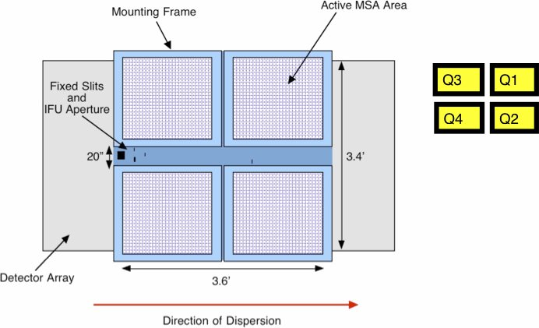
NIRSpec Micro Shutter Array (MSA)
MOS observations can accommodate ~190 targets at R~100 and ~55 targets at R~1000 and 2700, respectively. Large input catalogs with source densities ~720 arcmin² and 240 arcmin² (or ~7000 and ~2400 targets within the NIRCam field) maximize the efficiency of MOS observing

Slide 12
MOS Observation Planning
Do NOT specify the exact orient and MSA configuration in the proposal. Preferred orient can be specified within a range (±15˚)
Include a target catalog covering an area with a radius of at least 3 arcmin for any particular pointing. If possible, the catalog should be oversized to maximize MOS multiplexing.
Approved proposals do NOT have exclusive access to a field. Thus, the full list of targets can not be reserved; however, some high priority targets may be flagged. There is no guarantee than any one target will be observed.
Proposals may be submited with source catalogs that overlap with previously accepted proposals. Proposals must identify duplications. Previously accepted proposals will have priority in target selection.
Multiple proposals using overlapping source catalogues may be proposed and accepted by the Telescope Allocation Committee during the same cycle. In such cases, the TAC will provide a clear specification of the relative priority of those proposals with regard to target selection.

Slide 13
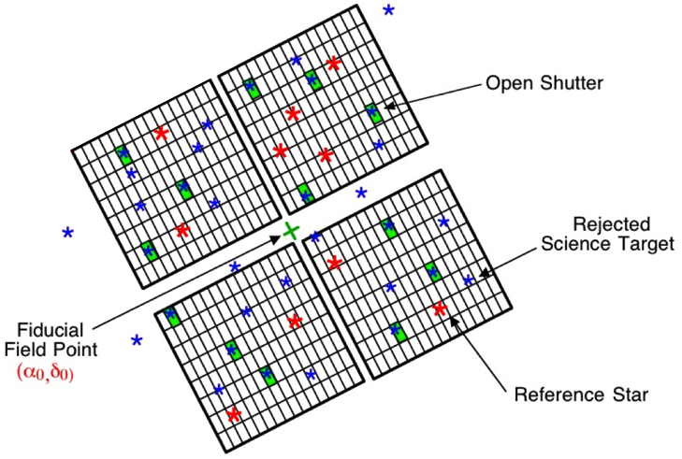
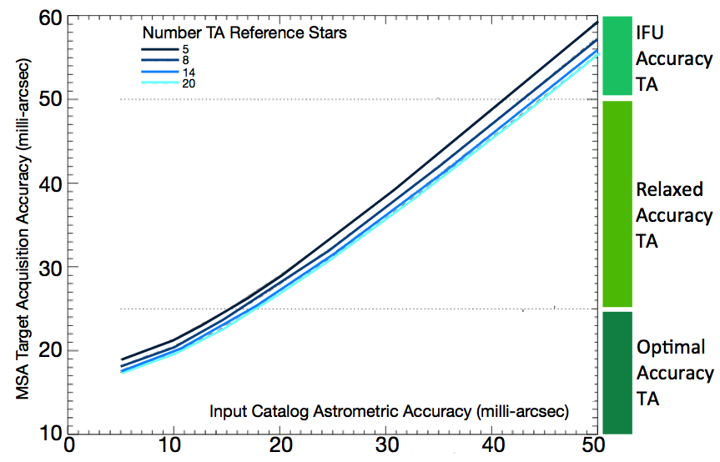
Astrometric Requirements for Target Acquisition Sources
Well flux-calibrated MOS observations require 5-10 mas astrometric accuracy of target catalog
HST ACS WFC3 and JWST NIRCam observations have sufficient astrometric precision
https://jwst-docs.stsci.edu/pages/viewpage.action?spaceKey=JTI&title=NIRSpec+Standard+Target+Acquisition+-+TACQ
Notes:
Gives 20 mas (1/10th shutter width) precision for Target Acquisition
2 exposures to centroid reference targets
measure centroids of 5–20 reference objects in full-frame imaging exposure obtained through the all open MSA quadrants (or a protected configuration to block bright stars), using both detectors NRS1 and NRS2.
filters available: F110W, F140X, or CLEAR
NIRSpec TA images are only acquired in full frame readout with NGroups=3 and detector readout pattern options of NRSRAPID, NRS or the NRSRAPIDD1 and NRSRAPIDD2, the latter two are only used in TACQ .
The exposure will be repeated at a second dither position which is offset by one-half MSA shutter-pitch in both coordinates.
Subsequently, a reference image of the centered target field is automatically obtained to conclude the TACQ operational process.

Slide 14
Follow-up Observations of JWST Pre-Imaging
Same-cycle follow-up spectroscopic observations of sources identified through JWST imaging programs are permitted.
Example Science Use Case 3: NIRSpec MOS observations of IC 348 brown dwarfs identified via NIRCam pre-imaging (GTO Alves de Oliveira) including overview talk and APT and ETC demonstrations
https://jwst.stsci.edu/news-events/events/events-area/stsci-events-listing-container/jwst-proposal-and-planning-workshop?mwc=4

Slide 15
Upcoming Features in APT v25.4: Expanded Target Acquisition Capabilities
Current Target Acquisition (TA)
Standard TA: A set of reference objects are observed through the micro-shutters and the spacecraft pointing and position angle are computed from their centroids (FS, IFU, MOS)
Verify Only: Acquires image so that pointing can be determined after observation executes (IFU, MOS, Moving Targets)
Bright Object TA: A reference object is observed at the center of the S1600A1 wide aperture and the spacecraft pointing is computed from its centroid (BOTS)
Upcoming TA capabilities
Wide Aperture Target Acquisition: A reference object is observed at the center of any of the FSs or IFU and the spacecraft pointing is computed from its centroid (FS, IFU)
No Target Acquisition

Slide 16
Mid Infra Red Instrument (MIRI)
Imaging
Prime science imager at 0.5 – 25 μm
Expected to be popular for parallel imaging
Coronagraphic Imaging
Prime coronagraphic imager at 10.65 – 23 μm
One Lyot and three 4 Quadrant Phase Masks (4QPMs)
Low Resolution Spectrometer (R~100)
Prime spectrometer for observations of faint targets at 5 – 12 μm
Includes Slitless mode for high precision spectro-photometry
Medium Resolution Spectrograph (R~3000)
Prime spectrometer at 4.9 – 28.8 μm
Not recommended for high precision spectro-photometry in Cycle 1

Slide 17
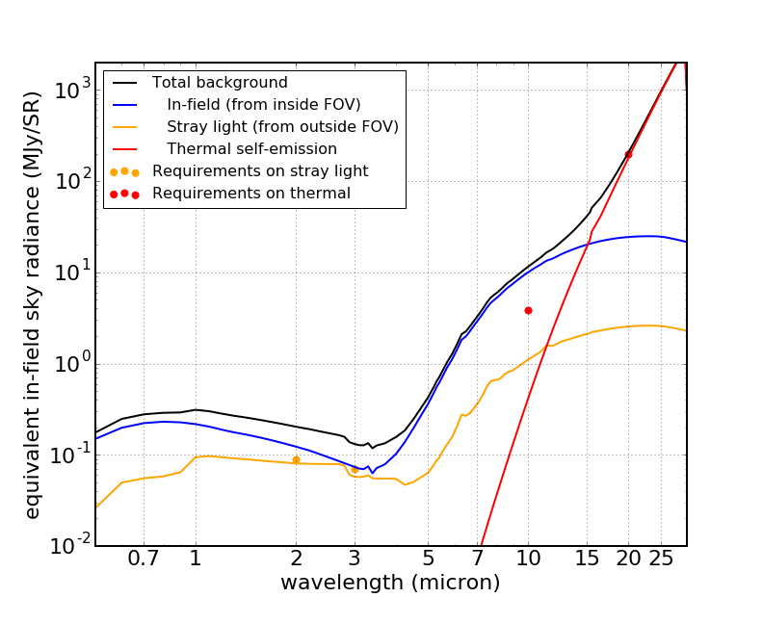
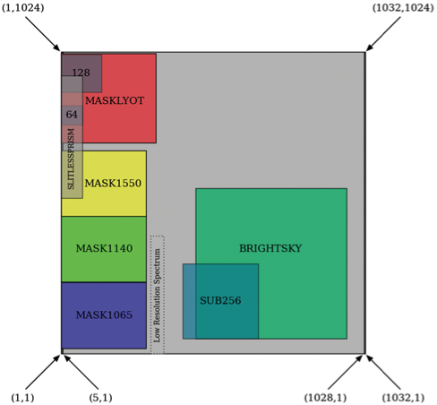
JWST Backgrounds
https://jwst-docs.stsci.edu/display/JPP/JWST+Backgrounds
ecliptic Long, Lat = 266.3°, -50.0°;
RA, Dec [J2000] = 17^{h}26^{m}44^{s}, -73°19'56"
Thermal emission from the telescope is expected to dominate the diffuse astronomical backgrounds at long wavelengths
Long wavelength MIRI observations will require the use of a subarray to avoid saturation on this background

Slide 18
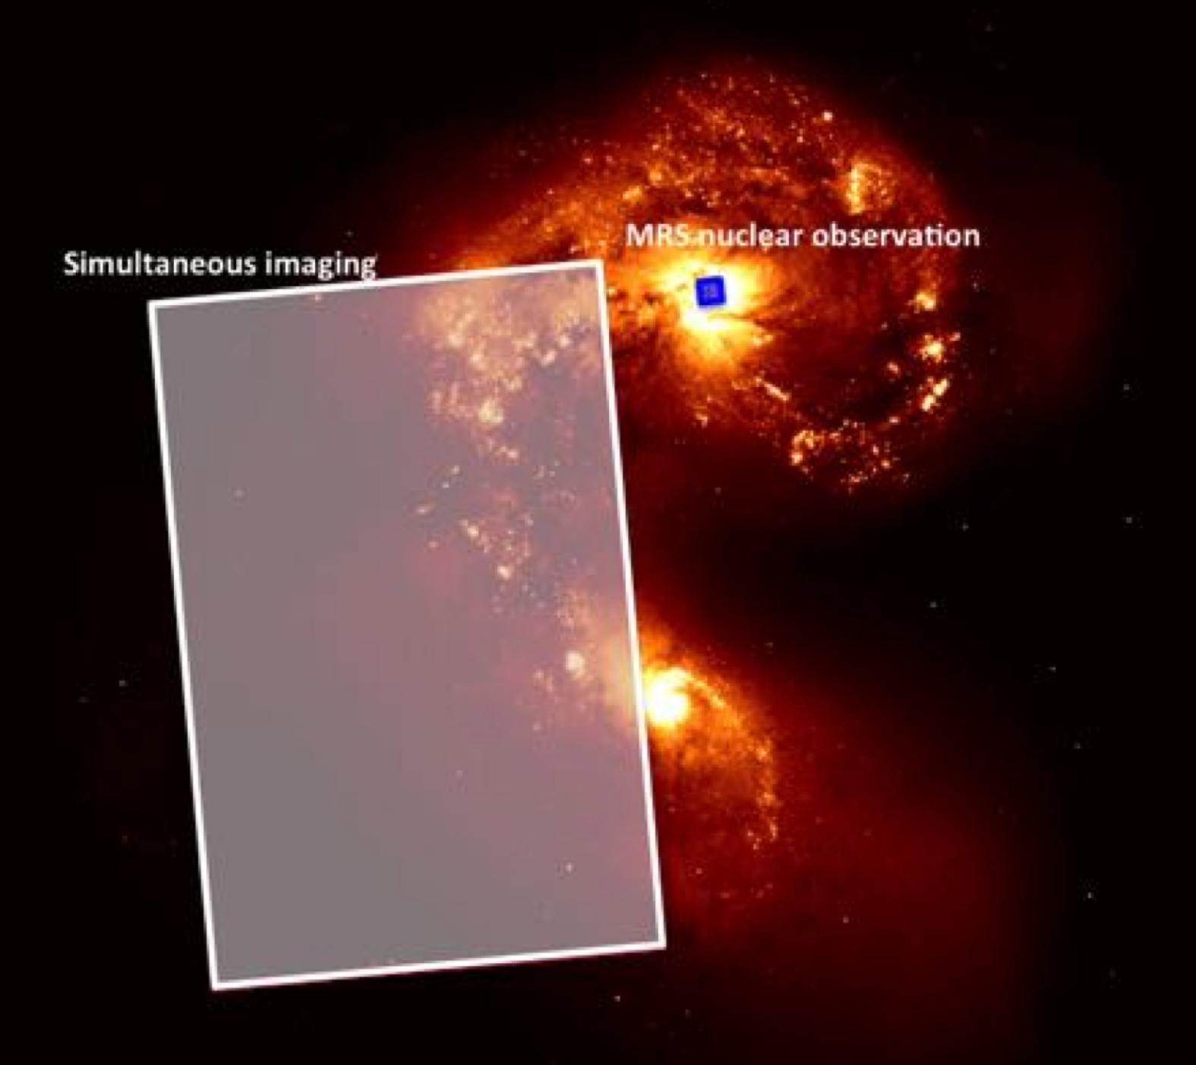
MRS-Imager Simultaneous Observations (SIMO)
[≠ parallel]
MRS template provides simultaneous Imaging observations
User selects Imager filter and readout pattern
Imager observations provide the opportunity to obtain
Deep simultaneous observations of an adjacent field
Accurate measurement of the positions of stars in the field and therefore the telescope pointing for improved mosaicking of IFU fields of view
Notes:
Are overheads TBC?
More details on Macarena and Alistair talks

Slide 19
Coordinated Parallel Observations
NIRCam Imaging and MIRI Imaging
NIRCam Imaging and NIRISS Wide-Field Slitless Spectroscopy (WFSS)
NIRCam Imaging and NIRISS imaging (NIRCam must be the prime instrument)
NIRCam Imaging and NIRSpec MOS (NIRSpec must be the prime instrument)
MIRI Imaging and NIRISS WFSS
Only direct imaging with standard narrow, medium, or broad-band filters is allowed for NIRCam and MIRI observations in these coordinated parallel modes.
https://jwst-docs.stsci.edu/display/JPP/JWST+Parallel+Observations

Slide 20
Survey Proposals
The JWST schedule has a Long Range Plan (LRP) with a duration of at least ~1.25 year
There may be gaps in the LRP based upon the RA distribution of approved targets
To increase observing efficiency, short observations, drawn from “Survey” programs, are needed to fill these gaps
Accepted Surveys will be allocated time to cover observations of a specific number of targets drawn from a larger sample
Observations of any particular target can not be guaranteed
Survey proposals must target sources over a wide range of Right Ascension (>12 hours)
Individual observations should be limited to 30 min of science integration time
Surveys can be Small, Medium, Large (150+ targets), Treasury, or Calibration and are subject to the same proprietary periods as regular proposals

Slide 21
GTO Cy1
obs. spec.
public by
06/15
(no new
targets
allowed)
≈
≈
GTO Cy1
prop. due
04/01
JWST Science Planning Timeline
GTO Cy1
APT files:
GTO Cy1
call for prop. 01/06
due
11/15
(25.2)
public by
12/15
(25.4)
2017
TODAY
2018
2019
DD ERS
call for NoI
01/06
DD ERS
call for prop.
05/19
GO Cy1
call for
prop.
11/30
Launch
2019Mar
DD ERS
Notices of Intent
due 03/03
DD ERS
prop. due 08/18
(25.2)
GO Cy1
prop due
03/02
(25.4)
DD ERS
TAC meets 10/16
DD ERS
APT files public
11/30 (25.4)
GO Cy1
TAC 05/31
TAC results
GO Cy1 TAC results 06/30
APT 25.1
06/01
≈
APT 25.2
06/20
APT 25.4
11/20

Slide 22
For more information…
JWST Documentation
https://jwst-docs.stsci.edu/
GO Cycle 1 Call For Proposals (To be released November 30, 2017)
https://jwst-docs.stsci.edu/display/JSP/James+Webb+Space+Telescope+Call+for+Proposals+for+Cycle+1

Slide 24
Upcoming Features in APT v25.4: Deeper Direct Images In AMI Template
Increased number of integrations (NINTS) for the ancillary “direct” images obtained in the context of the AMI template
Among other things, provides a work-around to enable kernel-phase imaging

