Slide 1
The JWST Target Visibility Tools: Overview and Background Demo of General TVT
Bill Blair
JWST Project Scientist for User Support
STScI/JHU
ESAC JWST Proposal Planning Workshop
Wed. Oct. 4, 2017

Slide 2
Why separate Target Visibility Tools?
APT assesses individual observation requests in detail, checking all constraints, links, special requirements and guide star availability (i.e. full “schedulability” of an observation). BUT…
It is a fair bit of effort to open APT, enter each target, enter a provisional observation, and run the Visit Planner function to check schedulability. Only then can one access the diagnostic plots in APT that show schedulability details.
What if you just want a quick overview? (The “big picture” of visibility for your targets?)

Slide 3
Why separate Target Visibility Tools?
The target visibility tools are intended as “quick look” or “pre-planning” aids prior to performing detailed schedulability checks in APT.
They provide insight but do not assess the full range of constraints that APT does.
For a given target, the TVTs calculate available visibility windows AND the available position angles versus time for the various JWST instruments.
Both tools report back the ecliptic coordinates of the target, which is important for JWST visibility but not something most observers are used to paying attention to.

Slide 4
Why separate Target Visibility Tools?
Examples where insight into target visibility is useful:
ToO: a supernova goes off; is it visible to JWST now, and how long can I monitor it before losing visibility? (Is it worth activating my ToO program?)
Timing possibilities for NIRCam pre-imaging and NIRSpec MSA follow-up spectroscopy: What windows are available for my target and how long are they?
Mosaic planning and/or coordinated parallels: “What position angles are available for my target?” “Where might the coordinated parallel field lie with respect to the primary instrument FoV?”
Many coronagraphy applications, or any other observation that involves the need for specific angles and/or angular offsets between observations.

Slide 5
Total Visibility vs. Ecliptic Latitude
(Figure courtesy of Jane Rigby, NASA/GSFC, adapted.)
(One long observing window >=6 months)
(Two observing windows separated by ~6 months)
POSITION
ANGLES
(FLEXIBLE)
(RESTRICTED)
(FLEXIBLE)

Slide 6
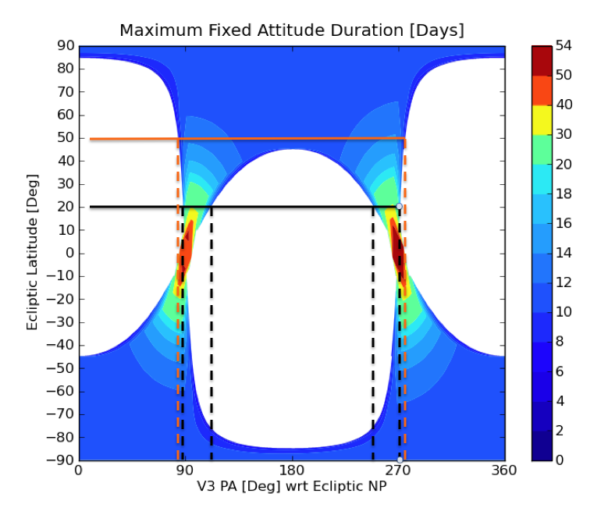
Position Angle Restrictions
(Figure courtesy of Wayne Kinzel, STScI (adapted).)
MORE FLEXIBLE
POSITION ANGLE
RANGES
TIME AT GIVEN
POSITION
ANGLE
(days)
LIMITED
POSITION
ANGLE
RANGES

Slide 7
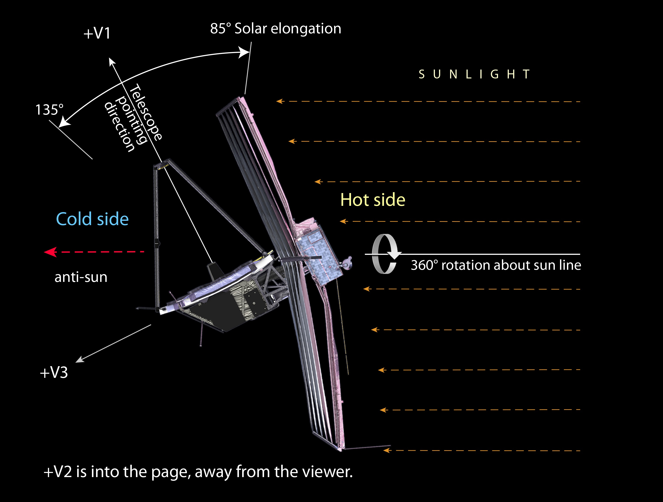
JWST Pointing Restrictions
Allowed Solar elongation angles

Slide 8
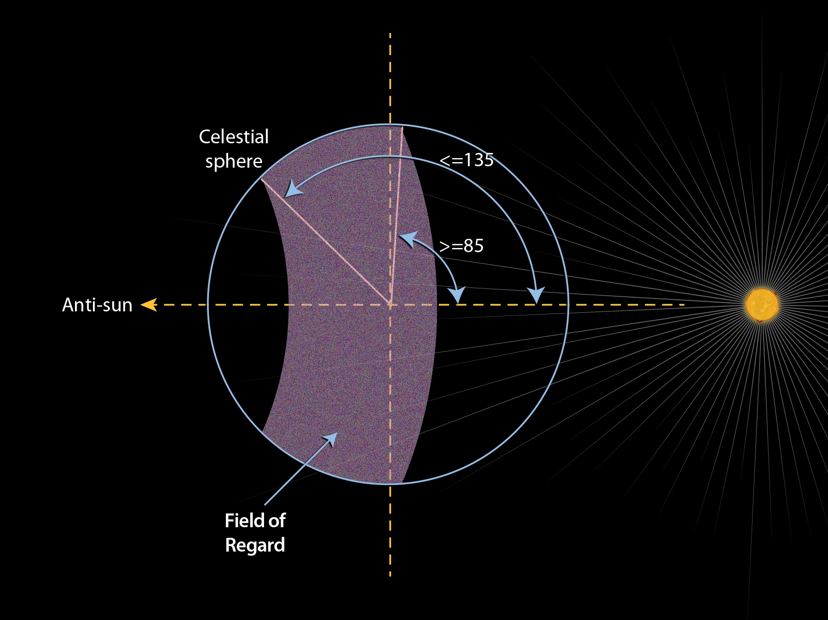
JWST Pointing Restrictions
JWST Field of Regard
At any one time, ~40% of the Celestial sphere is available for JWST observations
The FoR moves ~1º per day along the ecliptic equator

Slide 9
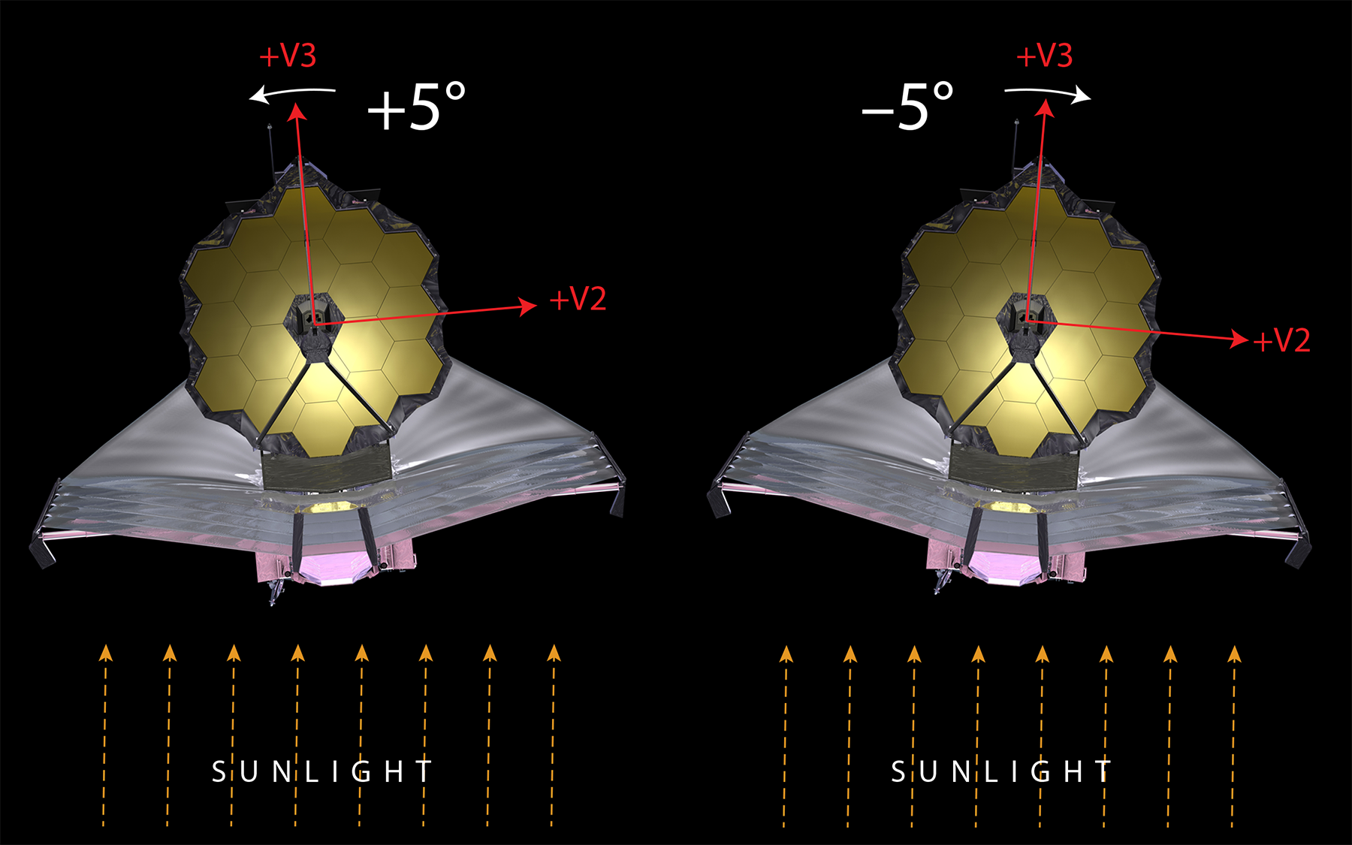
JWST Pointing Restrictions
Angle available for off-nominal roll angle
Roll about the bore sight
(really +/-3.5 to +/-7degrees)

Slide 10
JWST Target Visibility Tools
There are currently two tools available:
General Target Visibility Tool – a command-line tool that provides visibility windows and reference PAs for all four science instruments (plus FGS and observatory V3 axis) all in one go.
Coronagraphic Visibility Tool – a GUI-based tool that provides general visibility windows for NIRCam and MIRI plus additional coronagraphic instrument mode support.
Coronagraphs have instrumental structures that can obscure portions of the field of view.
APT visualization doesn’t provide this level of detail.
(This will be discussed tomorrow afternoon.)

Slide 11
Running the TVTs
These tools have been packaged as part of the standard STScI Astroconda environment. When users have installed Astroconda, no separate download and install will be necessary.
Running a simple command for each of the tools will install within your Astroconda environment.
Tools can then be run as shown in the examples.
Instructions, help files, examples are available on the JWST User Documentation site:
https://jwst-docs.stsci.edu/
Look specifically for the articles on “JWST Target Visibility Tools”:
https://jwst-docs.stsci.edu/display/JPP/JWST+Target+Visibility+Tools
https://jwst-docs.stsci.edu/display/JPP/JWST+General+Target+Visibility+Tool+Help
https://jwst-docs.stsci.edu/display/JPP/JWST+Coronagraphic+Visibility+Tool+Help

Slide 12
General Target Visibility Tool (GTVT)
This is a flexible python-based command-line tool.
Simplest usage: jwst_gtvt RA Dec where RA and Dec can be given in (hh:mm:ss.s dd:mm:ss.s) or decimal degrees.
Various command-line flags can be added to send output to files instead of the screen, add a target name to plots, etc.
Default outputs include an ASCII text file of angles versus time and a six-panel plot (for each science instrument plus FGS and observatory V3PA).
By default, these show on your screen, with the plot in a separate interactive window.
Plot controls allow pan and zoom within each individual panel, as desired to see details.
Alternatively, the plot and/or the text can be sent to files instead.
This tool can be used for batch processing multiple targets by simply calling the command line tool multiple times and redirecting outputs to appropriately named output files.

Slide 13
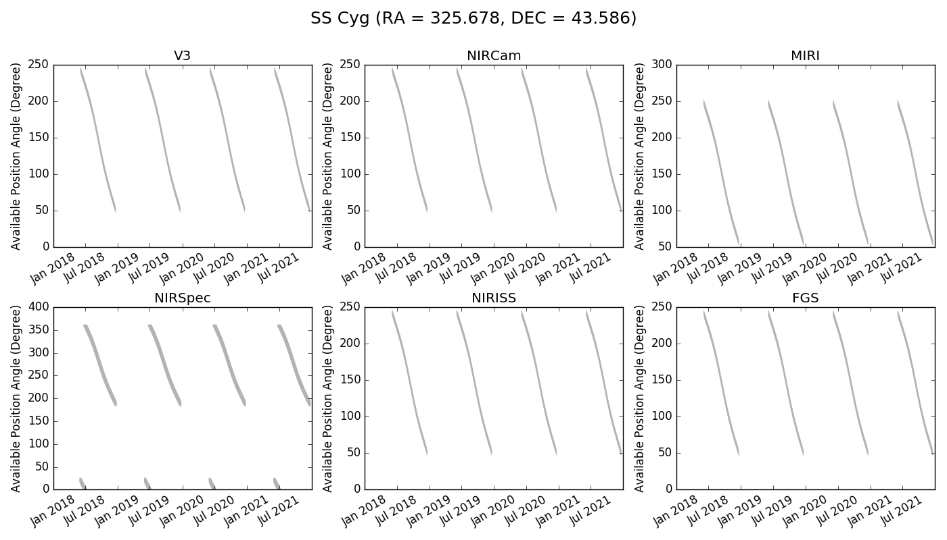
GTVT Examples
jwst_gtvt 325.678 43.586 --name "SS Cyg"
(Runs and produces a plot on the screen for all six instruments that can be interacted with. No save file produced. Close plot window to exit program.)
jwst_gtvt 325.678 43.586 --name "SS Cyg" --save_plot SSCyg_all.png
(Just saves plot file, does not provide interactive plot.)

Slide 14
GTVT Examples, con’t.
jwst_gtvt 325.678 43.586 --name "SS Cyg" --save_plot SSCyg_all.jpg --save_table SSCyg1.dat
(Saves both outputs to the files specified; no interactive.) Here is what the top of the Table looks like:
Target ecliptic
RA Dec latitude
325.678 43.586 52.656
Checked interval [2019-06-01, 2021-12-31]
| Window [days] | Normal V3 PA [deg] |
Start End Duration Start End RA Dec
2019-06-02 2019-12-21 201.93 244.06365 50.05444 325.67800 43.58600
2020-06-02 2020-12-20 201.00 243.55157 50.26286 325.67800 43.58600
2021-06-02 2021-12-21 202.00 243.75011 49.65785 325.67800 43.58600
V3PA NIRCam NIRSpec NIRISS MIRI FGS
Date min max min max min max min max min max min max
2019-06-03 240.63 247.46 240.60 247.44 18.11 24.95 240.06 246.89 245.64 252.48 239.38 246.21
2019-06-04 239.50 247.06 239.47 247.03 16.99 24.54 238.93 246.49 244.51 252.07 238.25 245.80
2019-06-05 238.37 246.65 238.34 246.63 15.86 24.14 237.80 246.08 243.39 251.67 237.12 245.40
…etc.
Ecliptic latitude reported in output file

Slide 15
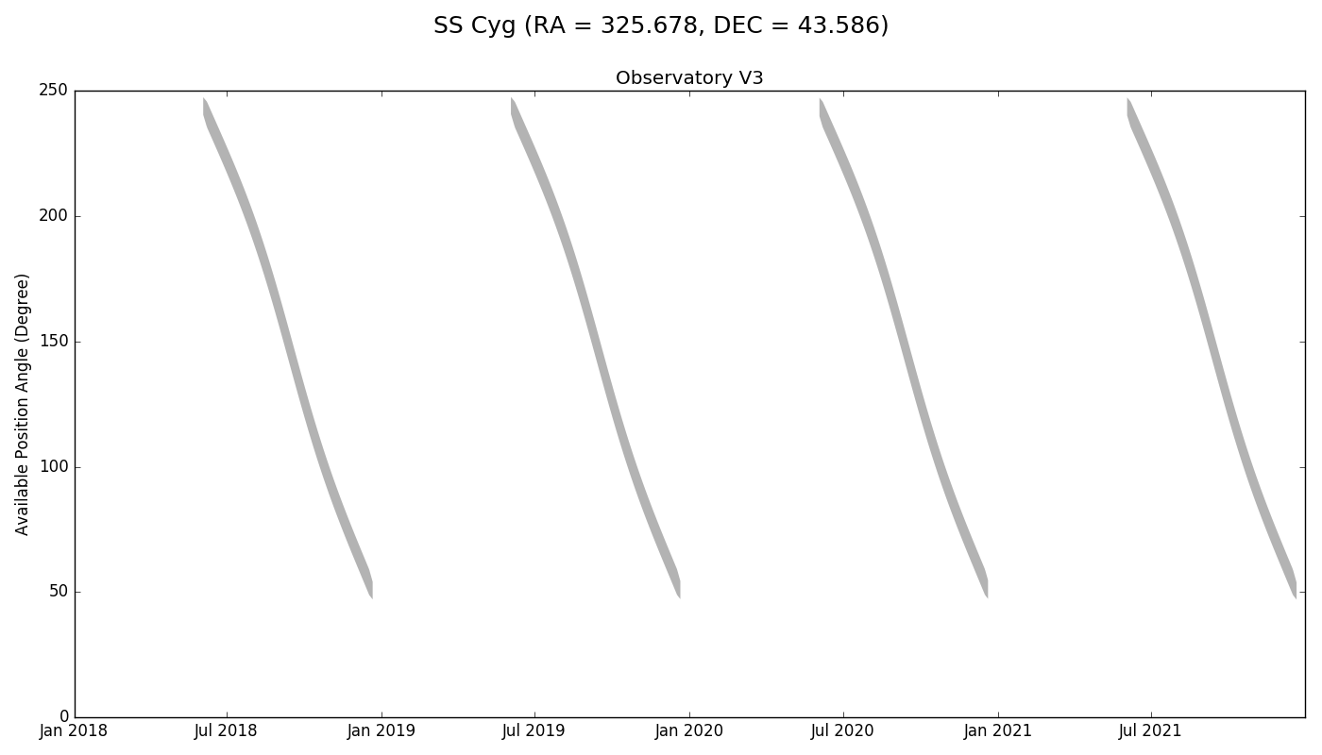
GTVT Examples, con’t
If you choose, you can plot a single panel to screen or save to a file; it looks like this:
This is the default time range; Of course, one could choose to restrict the plot to a narrower time range if desired. Or one can do a screen grab from an enlarged section of the interactive plot.

Slide 16
Impacts for Background-limited Observations
(Figures courtesy of Jane Rigby, NASA/GSFC)
Zodiacal light is the most variable component of the background and dominates below about 10 μm. It is also time variable.
For background-limited observations, scheduling at low backgrounds is an additional constraint that can impact observing windows.

Slide 17
Impacts for Background-limited Observations
(Figures courtesy of Jane Rigby, NASA/GSFC)
Full Visibility
Low Bkgd
The TVTs do not currently include a low background option.
APT has a special requirement that can limit scheduling to low background periods.
An effort is underway to make a separate background assessment tool available. (Stay tuned.)

Slide 18
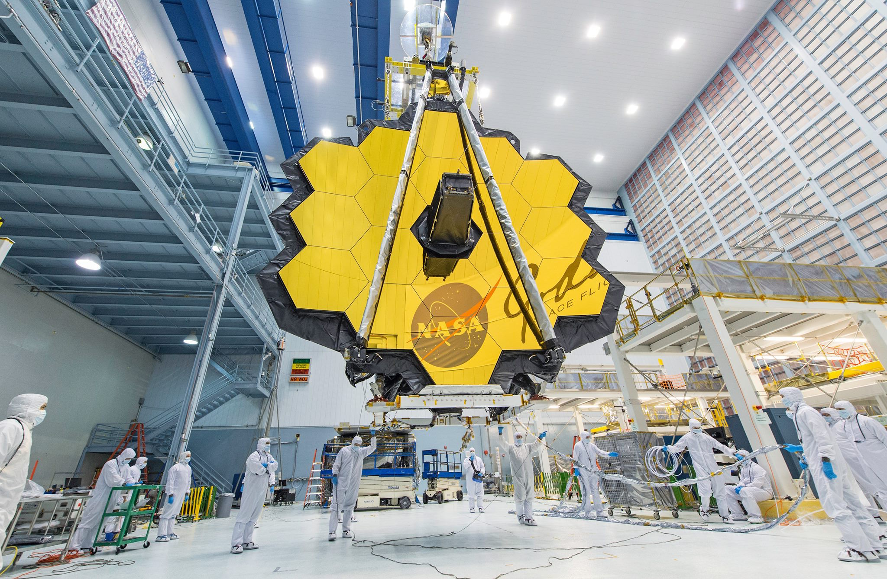
Questions?
April 2017 at NASA/GSFC
JDox help here: https://jwst-docs.stsci.edu/display/JPP/JWST+Target+Visibility+Tools
Help Desk: jwsthelp.stsci.edu

Slide 19
Short Demo of GTVT
(Hands-on Experience
after the Coffee Break)

