Slide 1


ESAC 2017 JWST Workshop
General Target Visibility Tool
Hands on experience

Slide 2
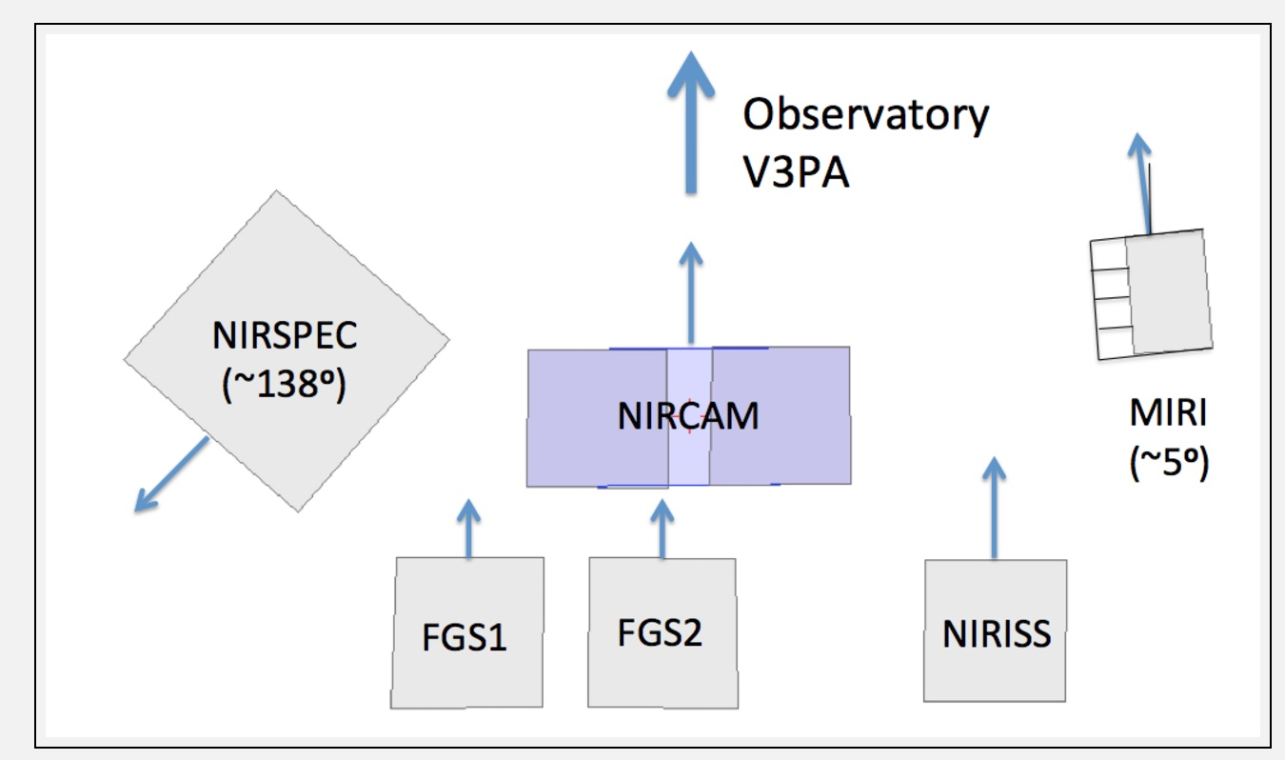
Things to remember
This tool provides an overview of visibility windows and PA availability for each SI as a function of time
The schedulability of a given observation is more complex than just the target visibility as it also involves the availability of guide stars and possible other constraints imposed at proposal level. APT should be used to provide the schedulabilty of the final observations.
NIRSpec and MIRI instruments have their y axis offset from the observatory V3 axis
User should be careful when linking different observations with
the “Same PA as” special requirement since different Instruments
have different PAs
Documentation : https://jwst-docs.stsci.edu/display/JPP/JWST+Target+Visibility+Tools

Slide 3
Syntax
usage: jwst_gtvt [-h] [--v3pa V3PA] [--save_plot SAVE_PLOT]
[--save_table SAVE_TABLE] [--instrument INSTRUMENT]
[--name NAME] [--start_date START_DATE] [--end_date END_DATE]
ra dec
positional arguments:
ra Right Ascension of target in either sexagesimal
(hh:mm:ss.s) or degrees.
dec Declination of target in either sexagesimal
(dd:mm:ss.s) or degrees.
optional arguments:
-h, --help show this help message and exit
--v3pa V3PA Specify a desired V3 (telescope frame) Position Angle.
--save_plot SAVE_PLOT
Path of file to save plot output.
--save_table SAVE_TABLE
Path of file to save table output.
--instrument INSTRUMENT
If specified plot shows only windows for this
instrument. Options: nircam, nirspec, niriss, miri,
fgs, v3 (case insensitive).
--name NAME Target Name to appear on plots. Names with space
should use double quotes e.g. "NGC 6240".
--start_date START_DATE
Start date for visibility search in yyyy-mm-dd format.
Earliest available is 2018-01-01.
--end_date END_DATE End date for visibility search in yyyy-mm-dd format.
Latest available is 2021-12-31.
REMEMBER:
Type
source activate astroconda
at the terminal prompt before
running this session
Cheat sheet of available command line flags

Slide 4
Case 1
Find the visibility and available Position Angles for an object in the ecliptic plane
NGC4579 : 2:37:43.597 +11:49:05.12
Just for the period Oct 1st 2019 – Oct 1st 2020

Slide 5
Case 2
Find the visibility and available Position Angles for
NGC4151 : 12:10:32.5834 +39:24:21.031
Just for for the period Oct 1st 2019 – Oct 1st 2020

Slide 6
Case 3
Find the visibility and available Position Angles for
NGC 1850 : 05:08:45.79 -68:45:38.6
for the period Jun 1st 2019 – Jul 31st 2020
For NIRCam only
Save the plot to a file instead

Slide 7
Solutions
Case 1:
jwst_gtvt 12:37:43.597 +11:49:05.12 --start_date 2019-10-01 --end_date 2020-10-01 --name 'NGC4579'
NOTES: Overall very limited visibility and limited PAs separated by ~6mos. (Ecliptic latitude is 14.6 degrees)
Case 2:
jwst_gtvt 12:10:32.5834 +39:24:21.031 --start_date 2019-10-01 --end_date 2020-10-01 --name "NGC 4151"
NOTES: different PAs between NIRCAM and NIRSpec. Overall very limited visibility and limited PAs. NIRCam pre-imaging + MOS could be quite difficult to schedule in the same visibility window, but could be done in the cycle (pre-imaging first window, MOS in second window. (Ecliptic latitude is 36 degrees)
Case 3:
jwst_gtvt 05:08:45.79 -68:45:38.6 --name "NGC 1850" --instrument NIRCAM --start_date 2019-06-01 --end_date 2020-07-31 --save_plot ./test
NOTES: the plot will not be displayed on screen, just saved on disk as test.png in the local directory
Target close to the galactic pole, continuous visibility, all PAs available. (Ecliptic latitude is -85 degrees)

