Slide 1
Proposal Toolbox and Preparation Flow
Macarena Garcia Marin (ESA @ STScI)

Slide 2
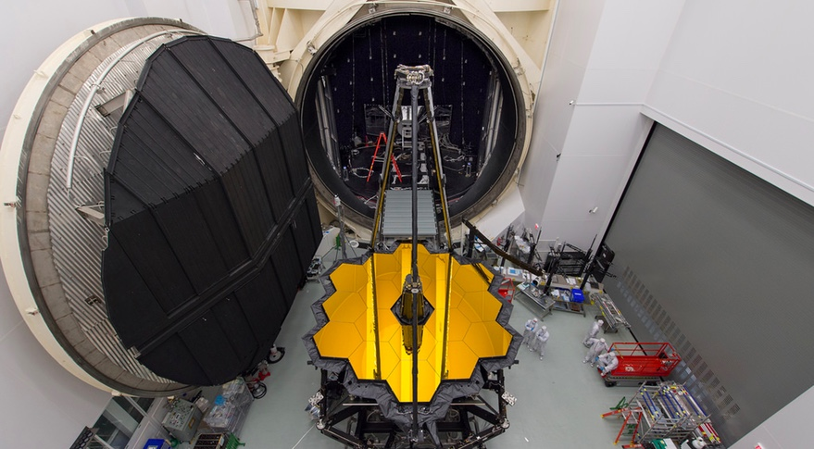
JWST is getting ready
Launch planned Spring 2019.
Call for proposals will be in
November 2017.
We have to prepared.
Image Credit: NASA

Slide 3

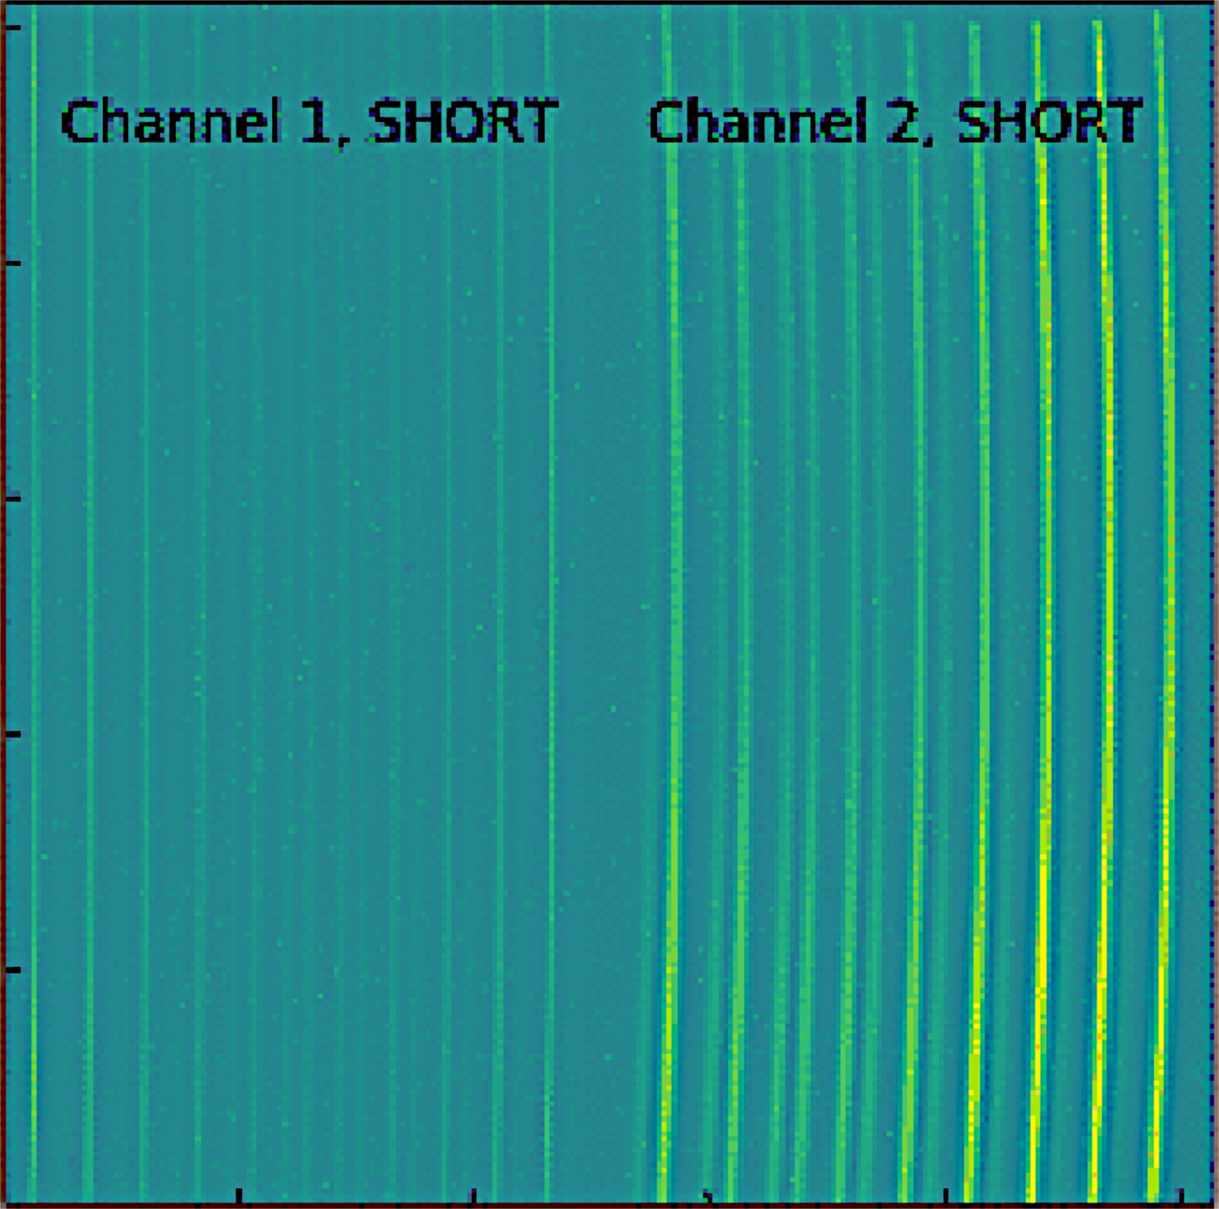
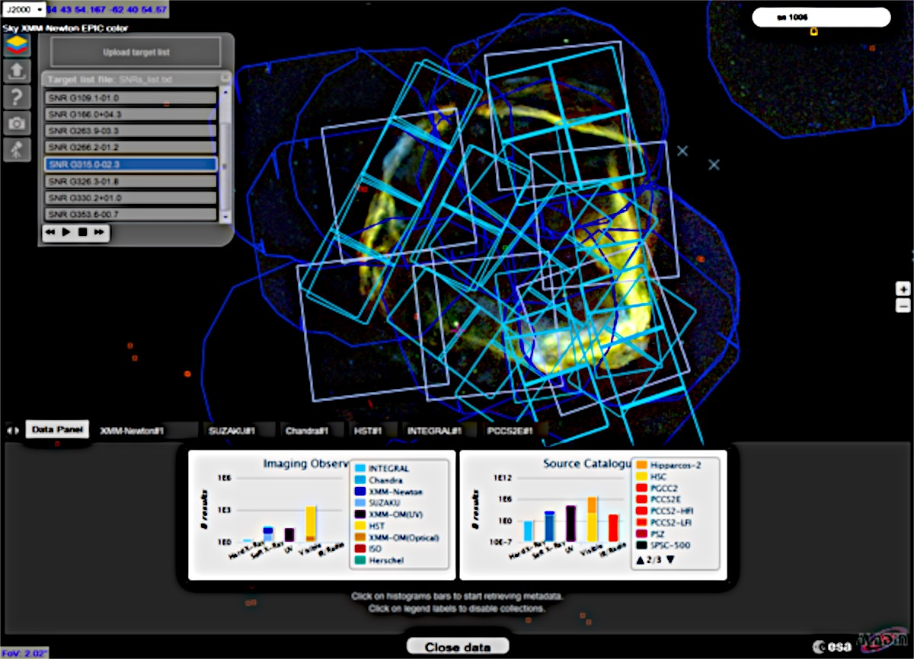
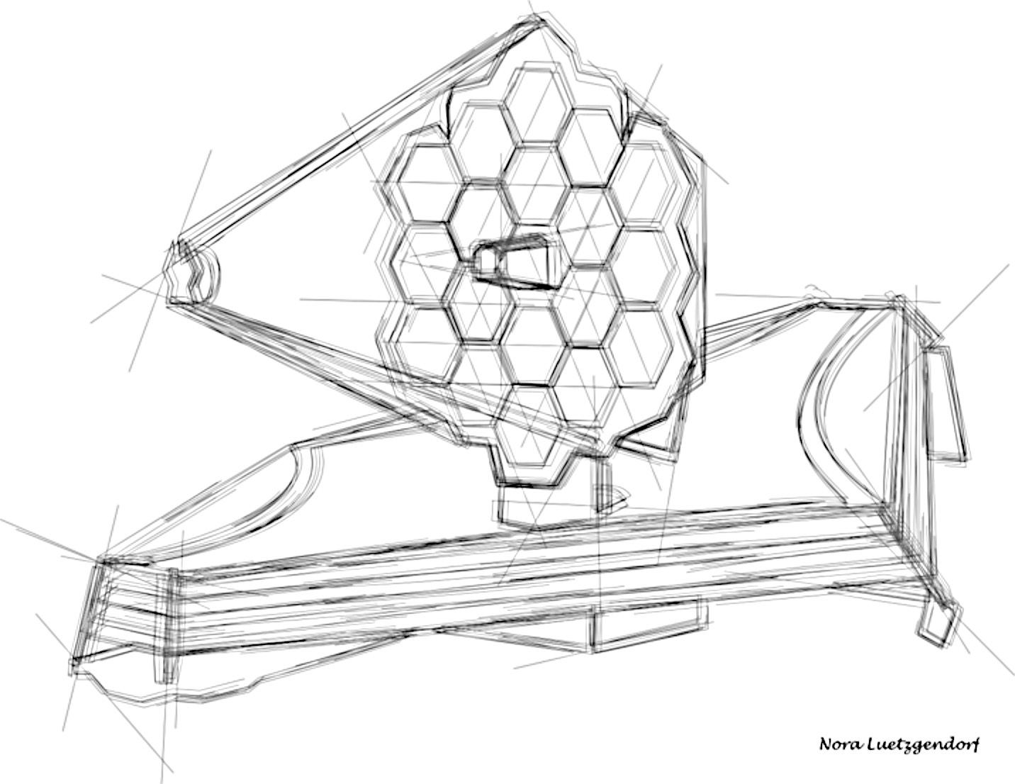
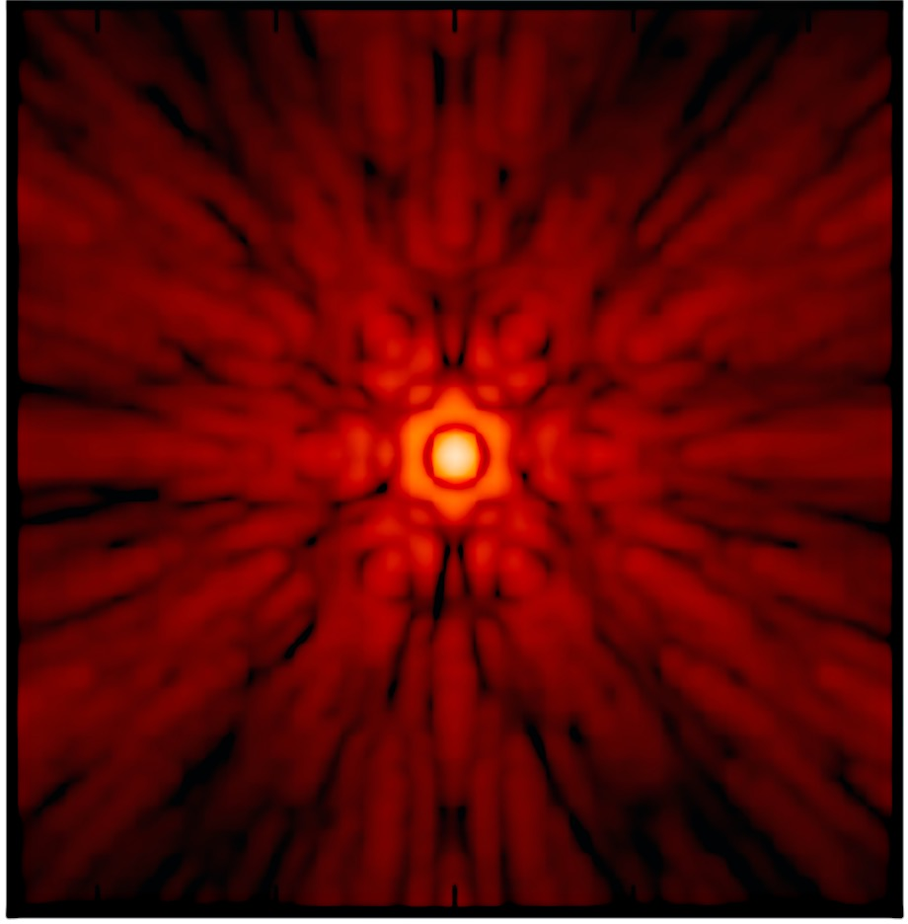


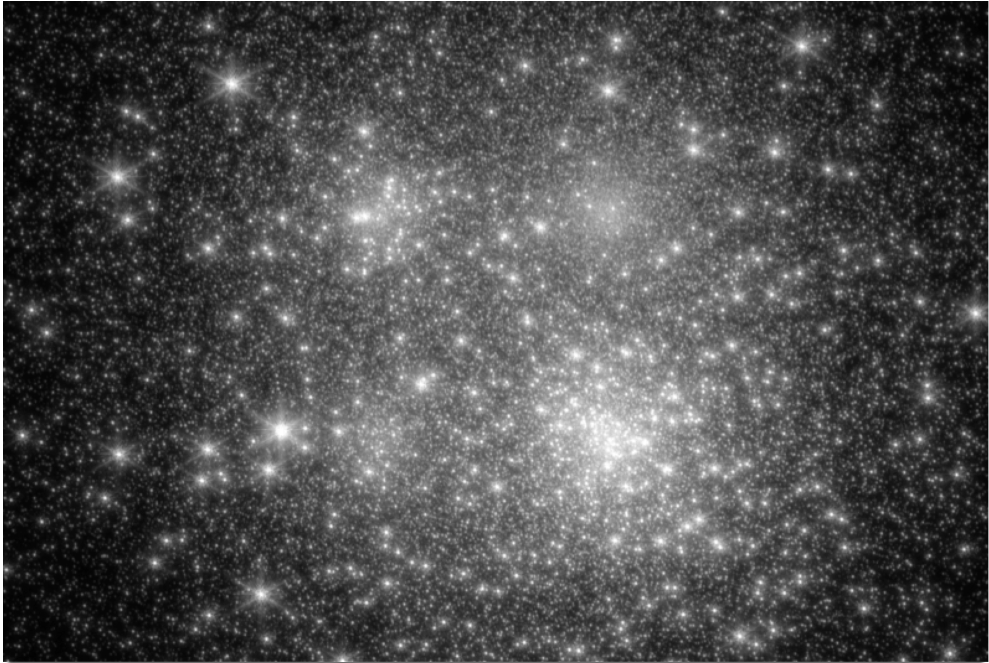
“Toolbox” for proposal preparation
APT
Astronomer’s Proposal Tool
MIRISim
ESASky
WebbPSF
Simulated Data for all instruments
Proposals Preparation
Toolbox
Target Visibility Tool
ETC
Exposure Time Calculator
STIPS

Slide 4
“Toolbox” for proposal preparation
APT
Astronomer’s Proposal Tool
ESASky
Proposals Preparation
Toolbox
Target Visibility Tool
ETC
Exposure Time Calculator

Slide 5
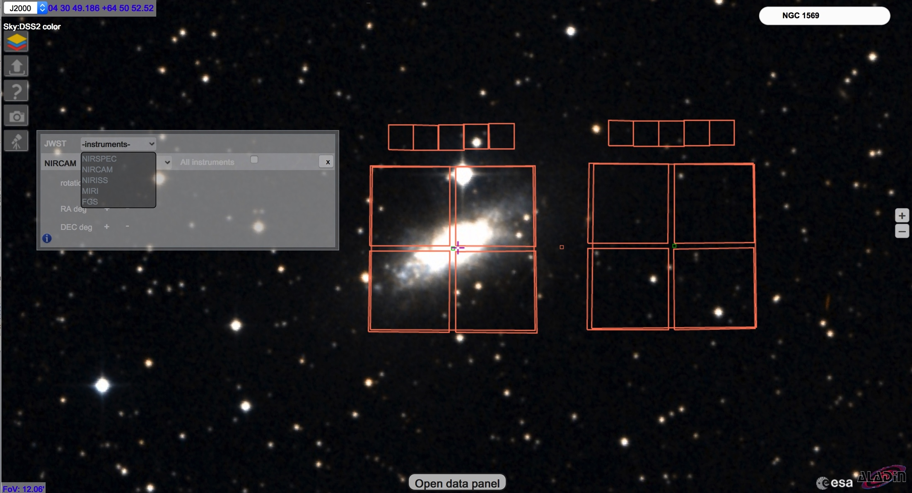

“Toolbox” for proposal preparation
ESASky: is a science driven discovery portal providing full access to the entire sky as observed with ESA missions.
Two standalone target visibility tool: General TVT and Coronagraphy VT. Can be used to obtain insight about the visibility of targets and their allowed position angles on the sky, for JWST observations.
Proposals Preparation
Toolbox

Slide 6
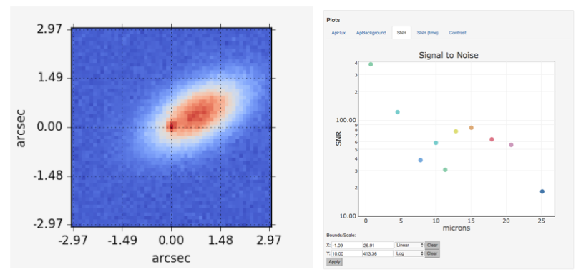
Exposure Time Calculator
ETC: Exposure Time Calculator. calculates the detailed performance of the observatory by modeling astronomical scenes consisting of single or multiple point and extended sources in three dimensions
Proposals Preparation
Toolbox

Slide 7
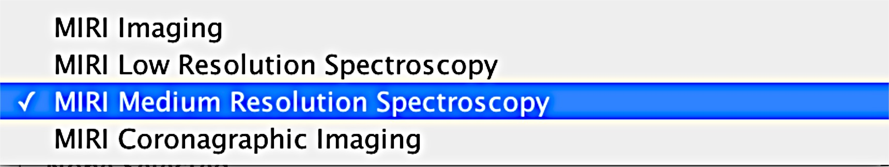
Astronomer’s Proposal Tool
The Astronomer’s Proposal Tool (APT) is developed at STScI; it is used to write, validate and submit proposals for the HST, and it will be used for JWST as well.
APT uses a template approach: for each instrument/mode gives access to a certain allowed set of parameters.
Proposals Preparation
Toolbox

Slide 8
A suggested path
ESASky
TVT
ETC
APT

Slide 9
A suggested path
ESASky
TVT
ETC
APT

Slide 10

A suggested path
ESASky
TVT
ETC
APT

Slide 11
Links
NIRSpec and MIRI simulated data: https://www.cosmos.esa.int/web/jwst/simulations
Simulated data: https://jwst.stsci.edu/science-planning/proposal-planning-toolbox/simulated-data
Stips: https://jwst.stsci.edu/science-planning/proposal-planning-toolbox/image-and-spectroscopy-simulator
MIRISim: Please see demo by Pamela Klaassen
WebbPSF: https://jwst.stsci.edu/science-planning/proposal-planning-toolbox/psf-simulation-tool-webbpsf
ESASky: http://sky.esa.int
Target visibility tools: https://jwst-docs.stsci.edu/display/JPP/JWST+Target+Visibility+Tools
ETC: https://jwst.etc.stsci.edu
APT: http://www.stsci.edu/hst/proposing/apt
Jdocs: https://jwst-docs.stsci.edu/display/HOM/JWST+User+Documentation+Home

