Slide 1
“JDox”: modern, user-friendly documentation system
web-based, agile, searchable, integrated
Ori Fox (STScI) – lead
Stephanie LaMassa (STScI) – deputy
Shireen Gonzaga, Susan Rose (STScI) – technical editors
Lead authors:
MIRI – Brendan Hagan, Ori Fox, Dean Hines, + MIRI Consortium
NIRCam – Dan Coe, Bob Brown, Martha Boyer, Matteo Correnti, + ESA Consortium
NIRISS – Stephanie LaMassa, Swara Ravindranath, Alex Fullerton
NIRSpec – Tracy Beck, Leonardo Ubeda, Emily Wislowski, David Soderblom
FGS – Sherie Holfeltz, Ed Nelan
ETC – Swara Ravindranath, Klaus Pontoppidan
APT – Ron Downes, Karla Peterson, Bill Blair
JWST – Bill Blair, Harry Ferguson, Jeff Valenti
High Contrast Imaging – Bob Brown
ITSD - Alex Yermolaev, Phil Grant, Paul Mulgrew
NASA - Jane Rigby, George Sonneborn
SMO – Amaya Moro-Martin, Lou Strolger, Neill Reid , Brian Williams

Slide 2
“JDox” goals
user-friendly, accurate web-based JWST documentation
“agile” process/infrastructure (easy to update)
searchable via Google and internally
heavily cross-linked across topics
integrated with software tools (APT)
ensure a happy and well-informed JWST community

Slide 3
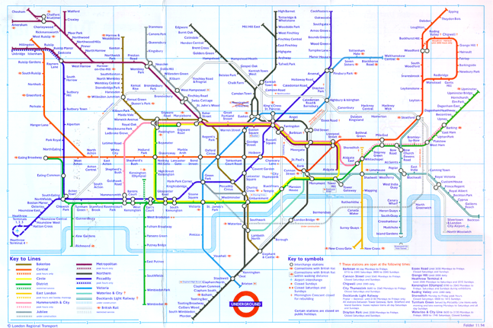
JDox philosophy: “Every Page is Page One”
similar to public transportation with “hubs” and “lines” but not linear

Slide 4
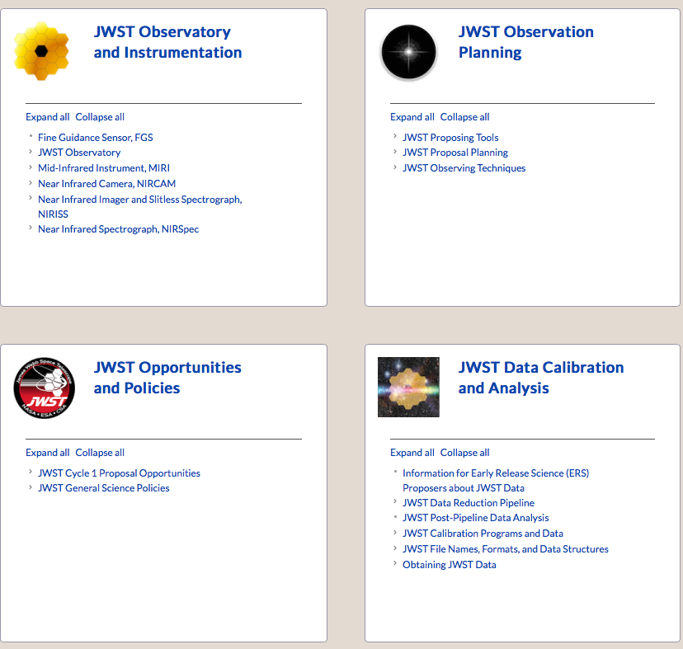
JDox Organization

Slide 5
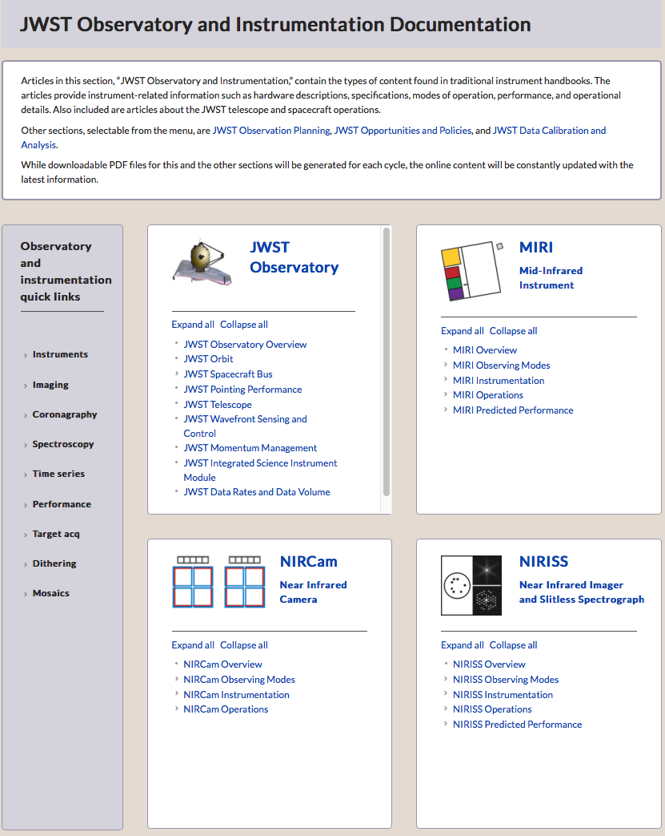
summarizes
article in
section
quick links

Slide 6
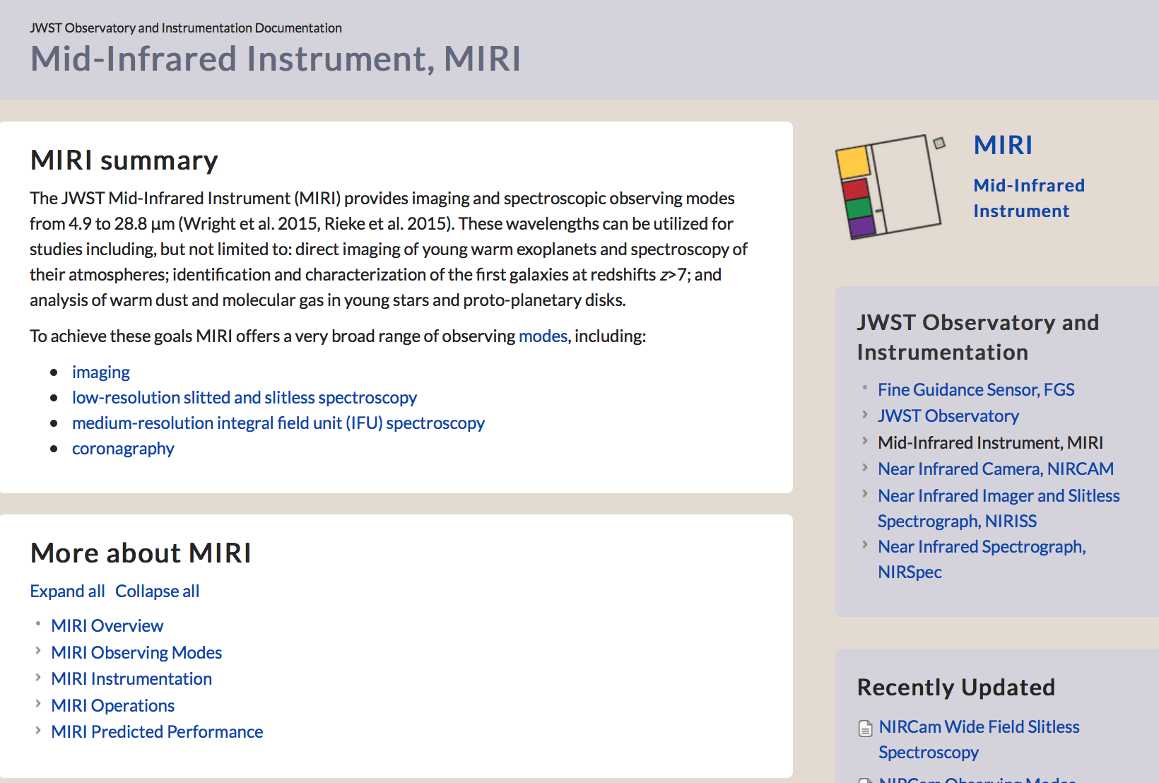
Instrument Handbooks

Slide 7
Instrument Handbooks

Slide 8
Instrument Handbooks

Slide 9
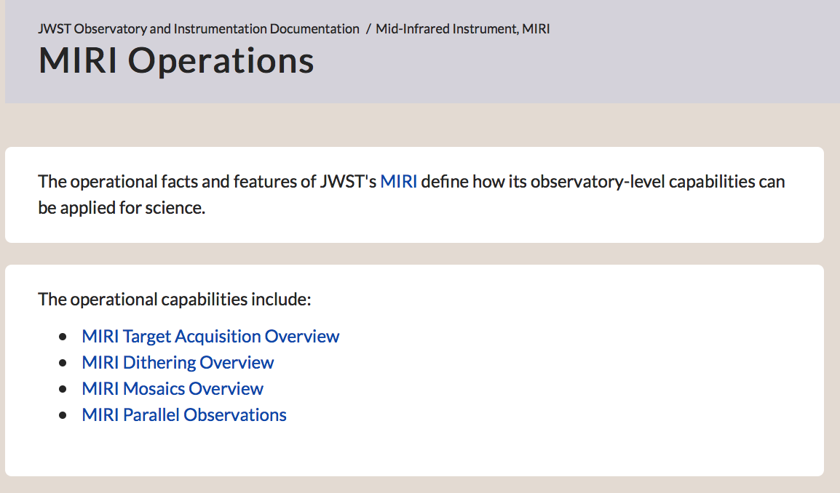
Instrument Handbooks

Slide 10
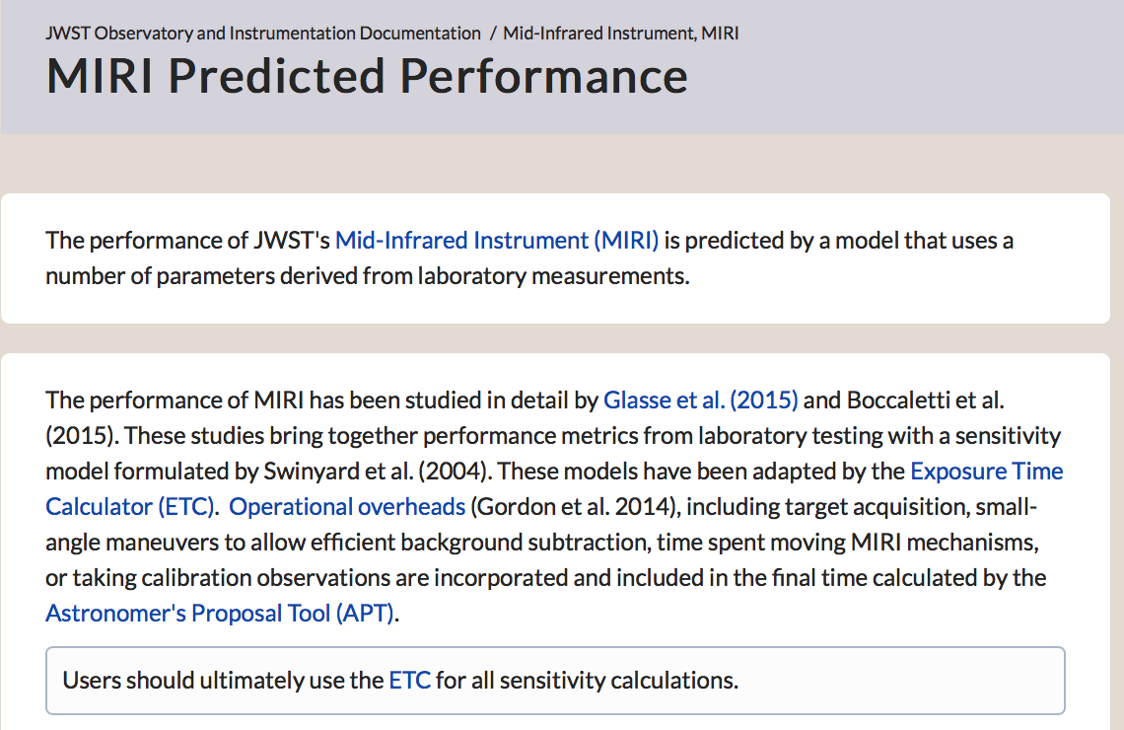
Instrument Handbooks

Slide 11
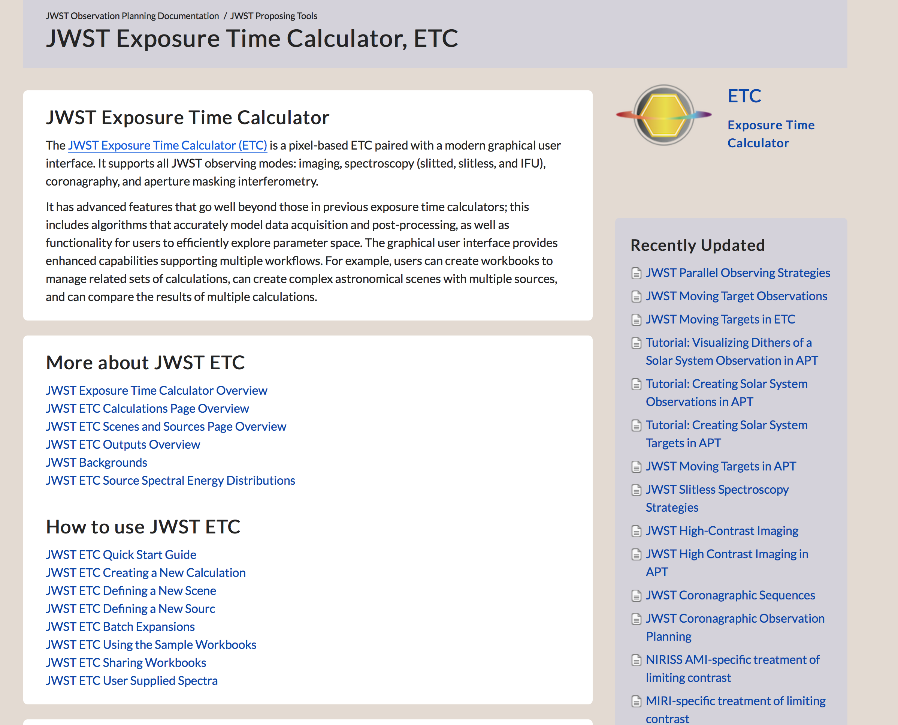
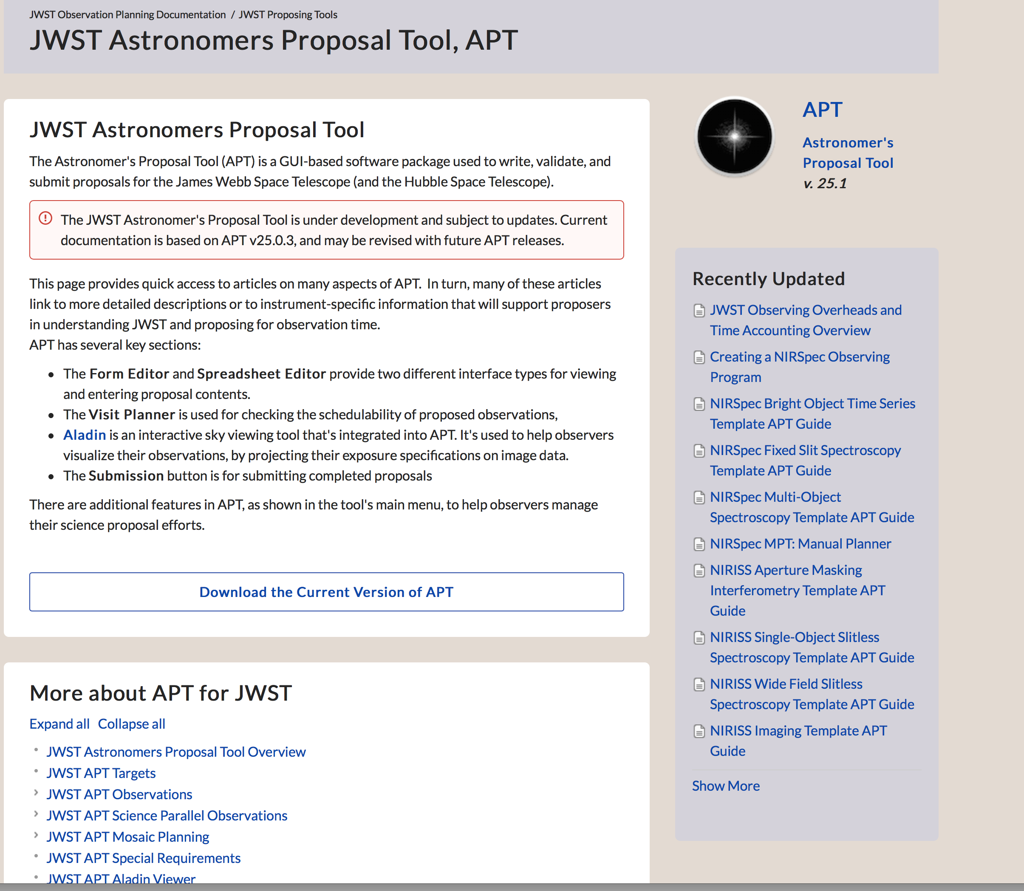
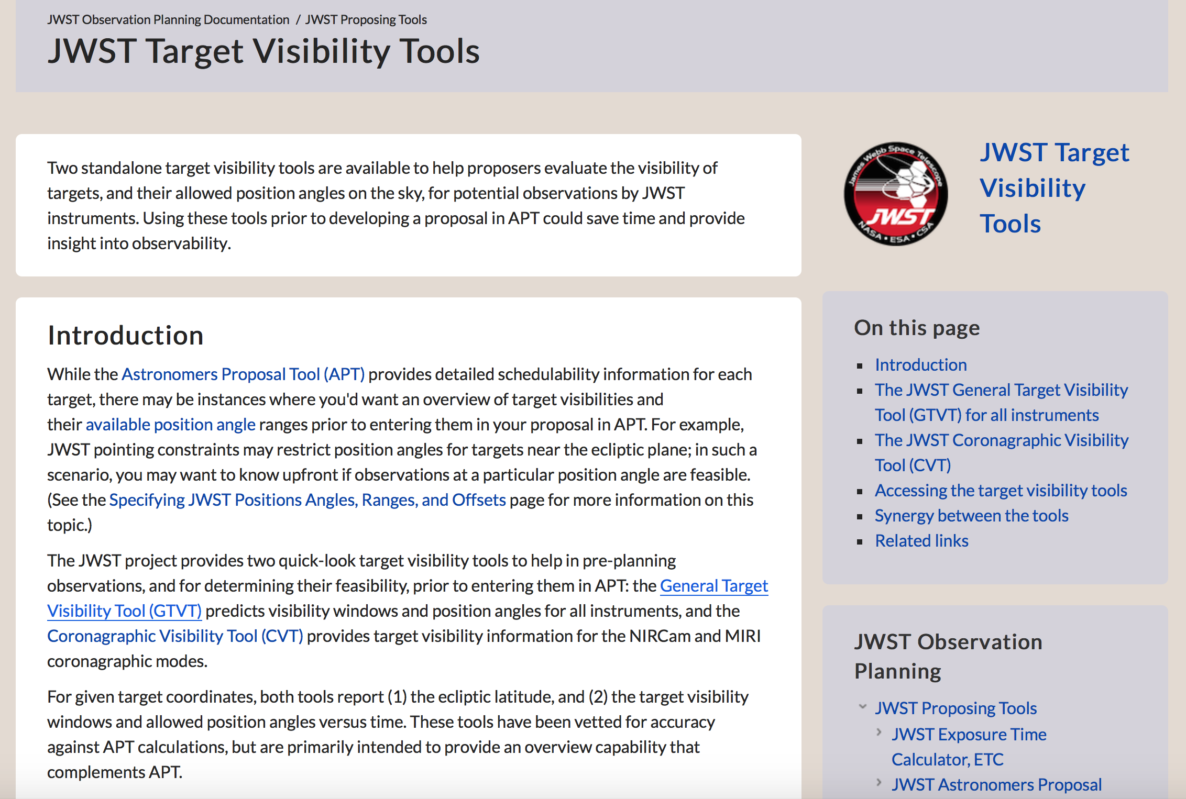
Planning Handbook

Slide 12
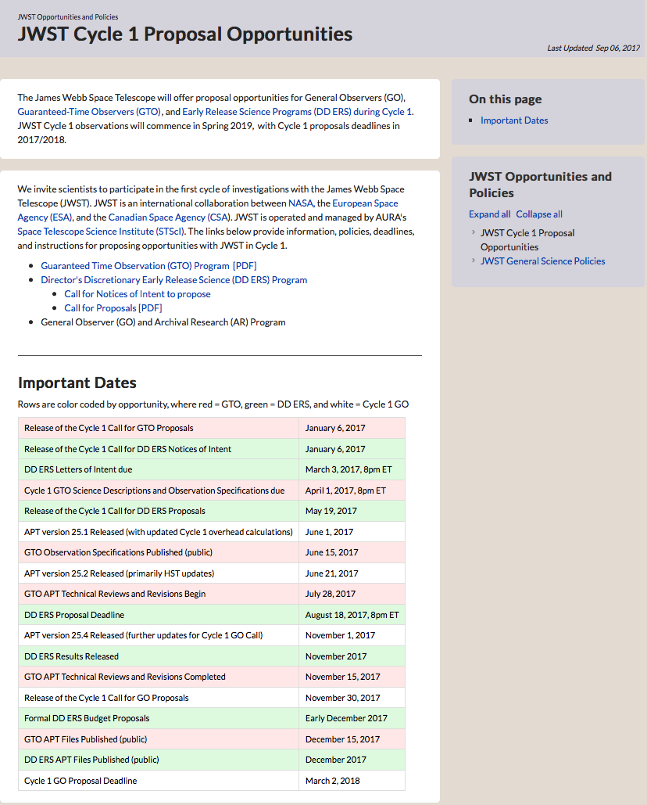
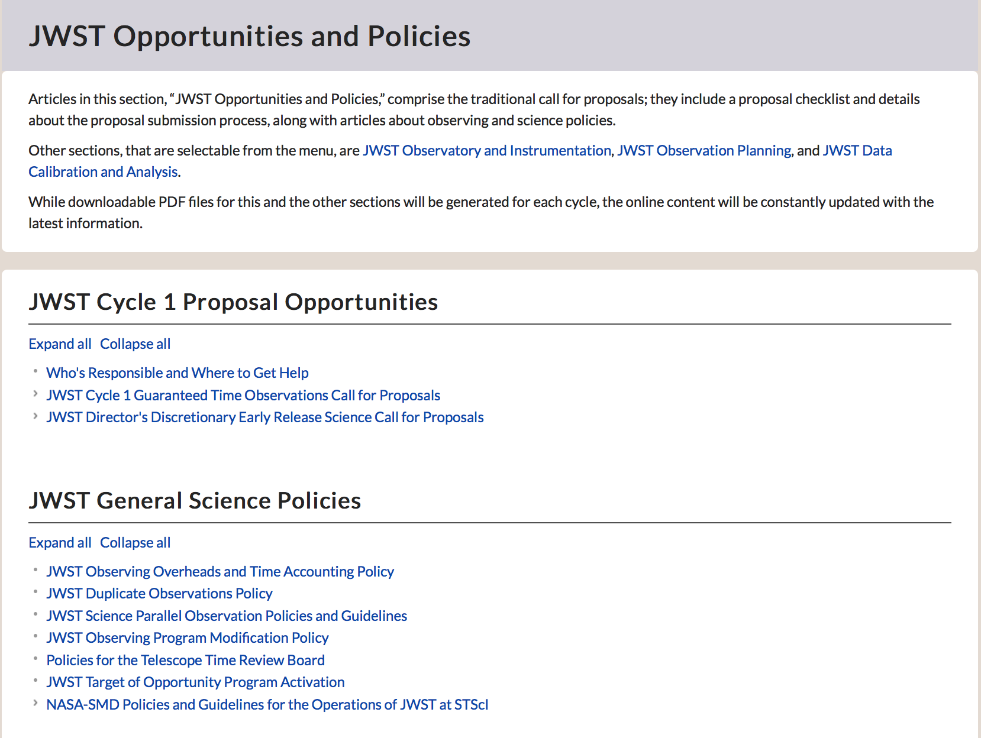
Call for Proposals

Slide 13
Data Handbook

Slide 14
JDox Quick Start Instructions

Slide 15
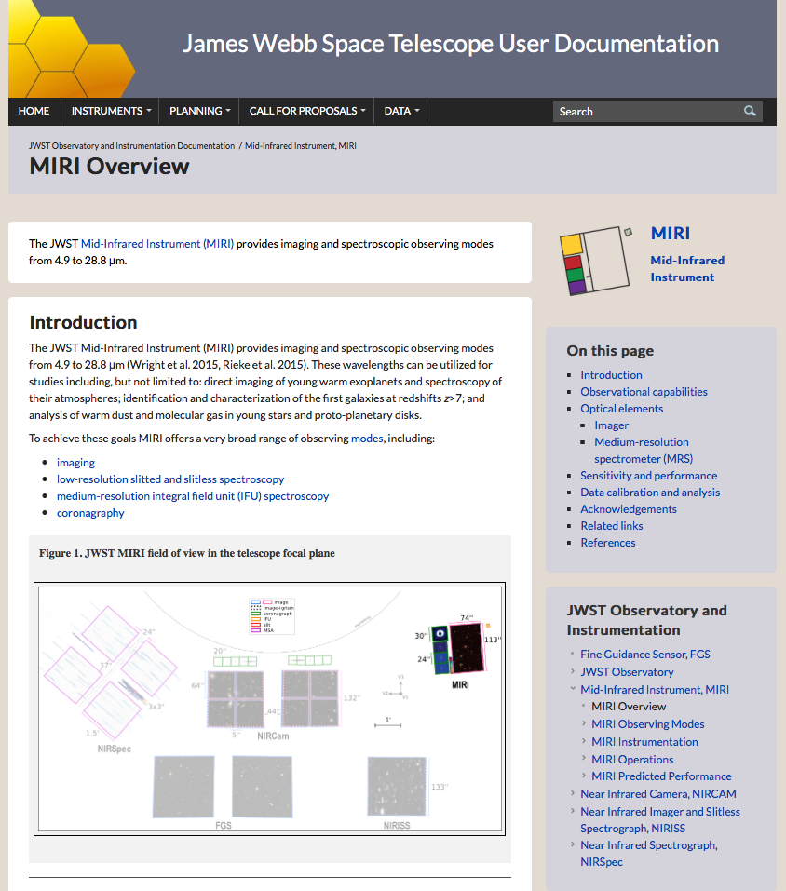
JDox site navigation
search bar
summary (appears in Google)
page
contents
links to other pages
links to other pages
(page tree)
figures (click to enlarge)

Slide 16
JWST Observatory and Instrumentation
background articles on telescope & instrumentation
MIRI
- ”Landing Page” (hub with little content)
- Overview
- Observing Modes (Imaging, Coronagraphy, LRS, MRS)
- Instrumentation/Hardware (Optics/Focal Plane, Detectors, Filters, etc)
- Operations (Dithers, Target Acq, Mosaics)
- Predicted Performance (Bright Source Limits, Sensitivity)

Slide 17
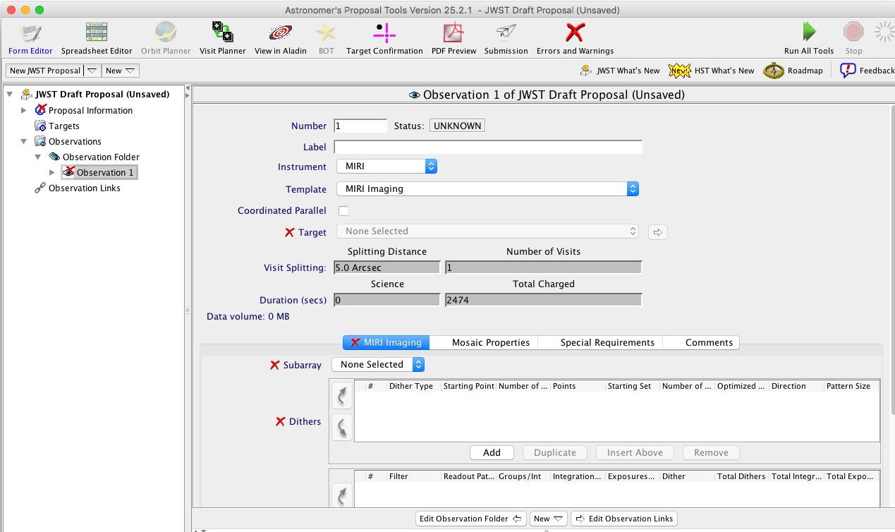
Access JDox via Context Sensitive Help in APT
APT (25.1 and greater): blue text represents context sensitive links

Slide 18
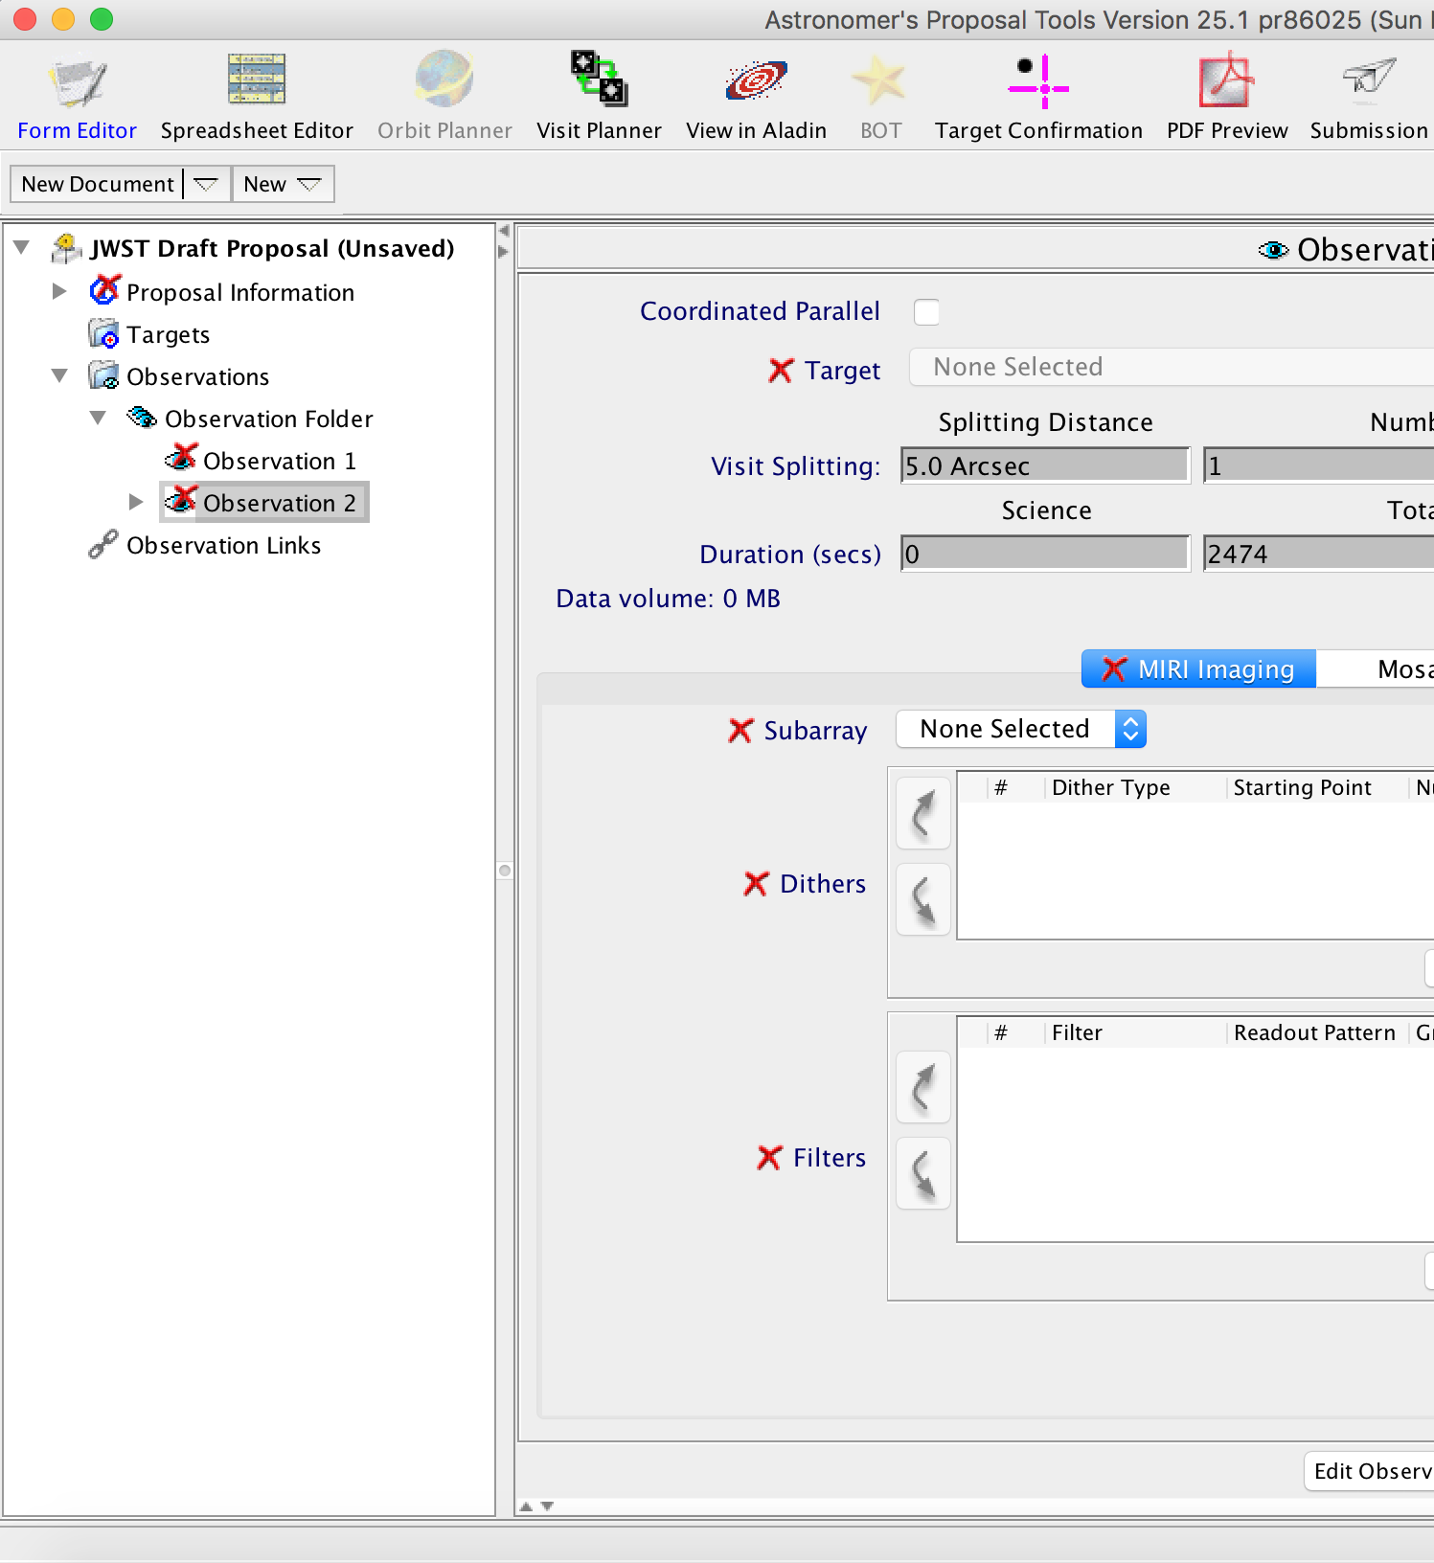
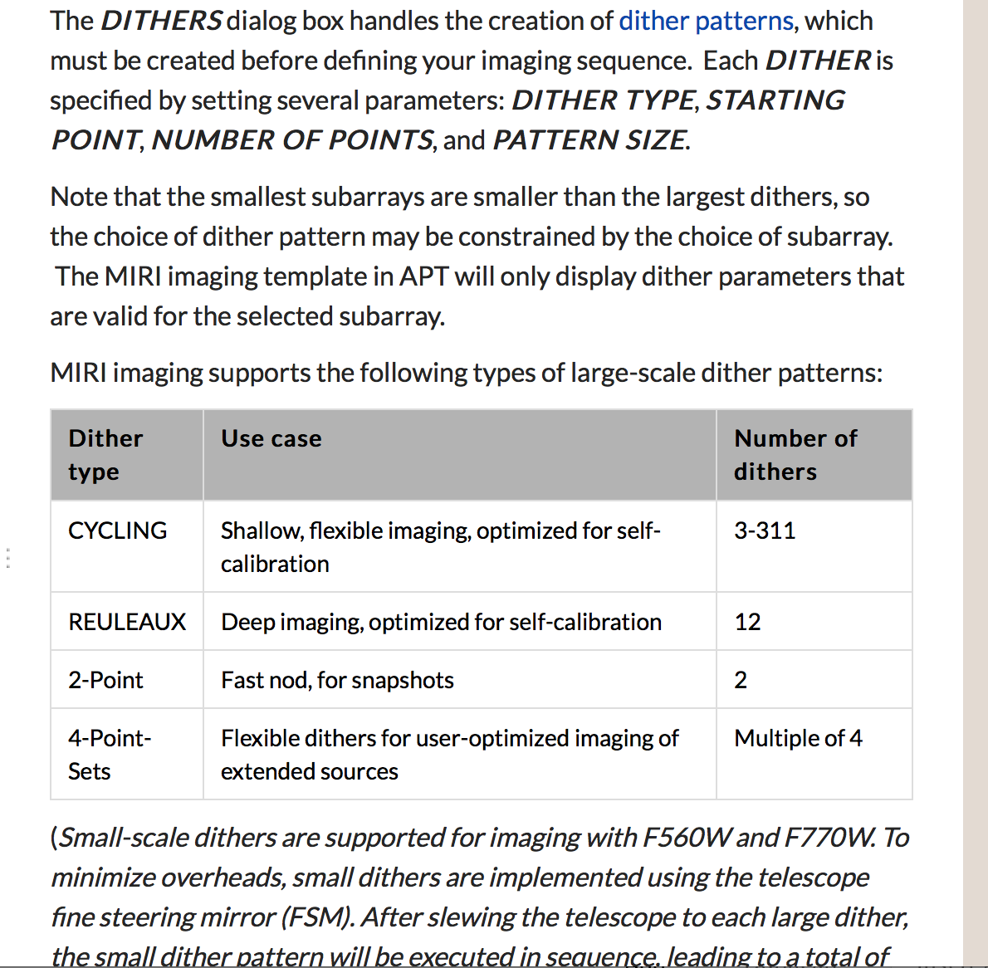

Slide 19
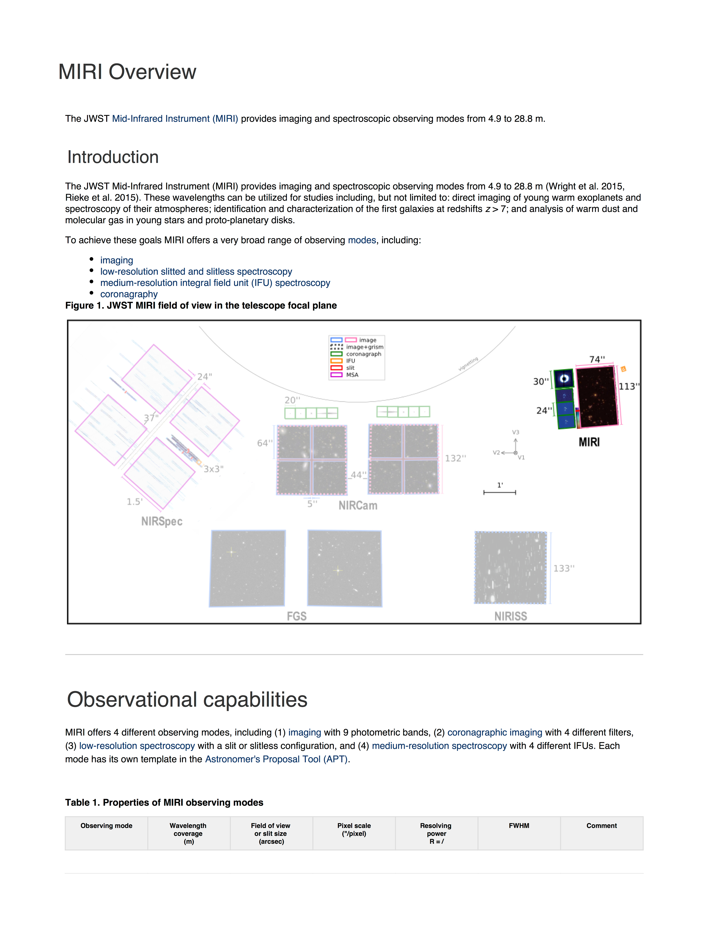
PDFs will also be available
generated periodically for subsets of documentation (“instrument handbook”, “Cycle1 Call for Proposals”)
(may be slightly out of date)

Slide 20
> 521 articles published
more in pipeline for GO CfP

Slide 21
Information planned to be released before GO CfP
Baseline Cycle 1 calibration program
Observing Techniques (slitless spectroscopy, time series observations, moving targets)
Science Use Cases (walk user through instrument specific considerations, ETC simulations, setting up proposal in APT)
Instrument Best Practices
Additional Video Help (ETC, APT/Aladin)

Slide 22
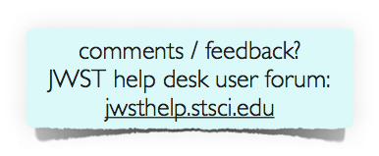
Progress: jwst-docs.stsci.edu (> 521 articles published)
Published:
✓ GTO Call for Proposals
✓ DD-ERS Call for Proposals
✓ ETC
✓ APT
✓ Target Visibility Tools
✓Context Sensitive Help
✓ Instrument Handbooks
Preliminary publications (subject to revisions and additions):
✓ Data Handbooks
✓ Observing Techniques
Coming later this year:
– Science use cases
– more APT & ETC instructional videos
Timeline
Aug 2017: Cycle 1 DD-ERS proposal deadline
Nov 2017: Cycle 1 GO Call for Proposals and supporting articles
Mar 2018: Cycle 1 GO proposal deadline Apr 2018 – : frequent JDox updates through launch / commissioning / Cycle 1

Slide 23
JDox Scavenger Hunt Instructions
List of questions (don’t need to answer everything)
Provide feedback to table facilitators at end

