Slide 1
ESASky
Christophe Arviset
Deborah Baines
Fabrizio Giordano
Juan González
Raúl Gutiérrez
Belén López Martí
Bruno Merín
Henrik Norman
Elena Racero
Jesús Salgado
María Henar Sarmiento
Pilar de Teodoro
Thanks to : Mark Allen, Pierre Fernique and Thomas Boch (CDS), Roberto Prieto, Alejandro Lorca and Rubén Álvarez (CSG), Pedro Rodriguez, Nora Loiseau, Antonio Talavera & María Santos Lleó (XMM-Newton SOC), Guillaume Belanger & Peter Kretschmar (INTEGRAL SOC), Eva Verdugo , Göran Pilbratt & Pedro García-Lario (Herschel SOC) and Marcos López-Caniego, Jan Tauber (Planck SO), Anthony Marston (JWST) and Daniel Durand (CADC HST team)

Slide 2
ESASky concept
Goal: to facilitate data discovery and archival science for ALL users
Multi-wavelength
Project agnostic
Exploration

Slide 3
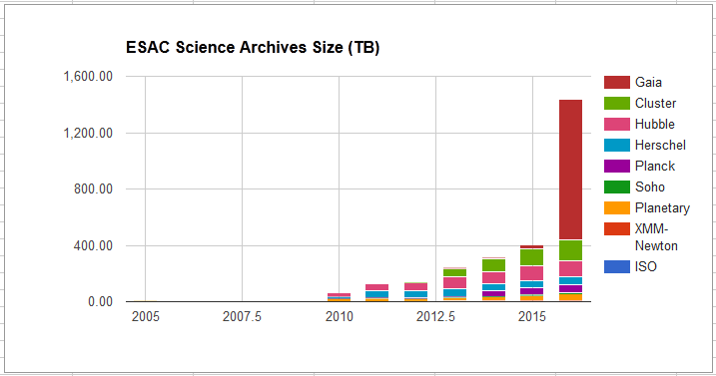
Astronomy evolving to a data-rich field
While the amount of data is growing exponentially, the number of scientists working with it is growing linearly.
This means that in the future data might compete to get users to look at them, and not viceversa as it happens now. (!)

Slide 4
ESASky concept
Goal: to facilitate data discovery and archival science for ALL users
Multi-wavelength
Project agnostic
Exploration
Interface to all astronomy archives
First release in May 2016: http://sky.esa.int
ESASky
Legacy:
IUE, ..
XMM-Newton
HST
Planck
EXOSAT
Integral
ISO
Herschel
Future: Gaia, JWST, Euclid, ..

Slide 5
ESASky data contents roadmap
Prototype
(summer 2014)
First Release
(May 2016)
Second release
(24 October 2017)
All-sky HiPS mosaics:
All-sky HiPS mosaics:
All-sky HiPS mosaics
HST (CDS)
Planck (CDS)
Herschel-SPIRE (ESA)
Science ready data (imaging):
XMM-Newton
HST (core)
Herschel-SPIRE
XMM-Newton (CDS)
Catalogs:
3XMM-DR4
XMM Slew
XMM OM
EXOSAT (ESA)
HST (ESA)
ISO (ESA)
Science ready data (imaging):
XMM-Newton
HST
Catalogs:
3XMM-DR5
XMM Slew
XMM OM
ISOCAM
Hubble Source catalog
Hipparcos
Planck catalogs
INTEGRAL
INTEGRAL (ESA)
XMM-Newton (ESA)
Herschel (ESA)
Planck (ESA)
Science ready data (imaging and spectra):
EXOSAT
INTEGRAL
XMM-Newton
HST
ISOCAM
Catalogs:
3XMM-DR6
XMM Slew
XMM OM
Hubble Source Catalog v2.1
Hipparcos
Planck catalogs
Herschel Point Source Catalogs
Gaia
AKARI (ESA)
AKARI catalogs
Herschel
Herschel
AKARI catalogs
IUE
JAXA/SUZAKU
JAXA/SUZAKU
Spitzer
Aim: continuous integration, testing and releasing

Slide 6
ESASky feature roadmap
Prototype
(summer 2014)
First Release
(May 2016)
Second release
(fall 2016)
Scientific validation of footprints and ESA all-sky HiPS by ESA
Download management
Interoperability with VO tools
Documentation
Helpdesk Support
Hardware scaling requirements
Refactoring of prototype into robust and stable application
Web interface
Detailed footprints (imaging)
Multi-target functionality
Link to Vizier/Simbad
All-sky HiPS mosaics from CDS
Generation of detailed footprints (spectra)
Online visualization of data
Multi-target summary table
Imaging and spectroscopic data
Third release (2017)
Sample manipulation
Time-series
Observation planning
State-fullness
Massive data visualization
Link to publications?
Mobile app?
On demand overlaying of footprints for pre-planning
Aim: continuous integration, testing and releasing

Slide 7
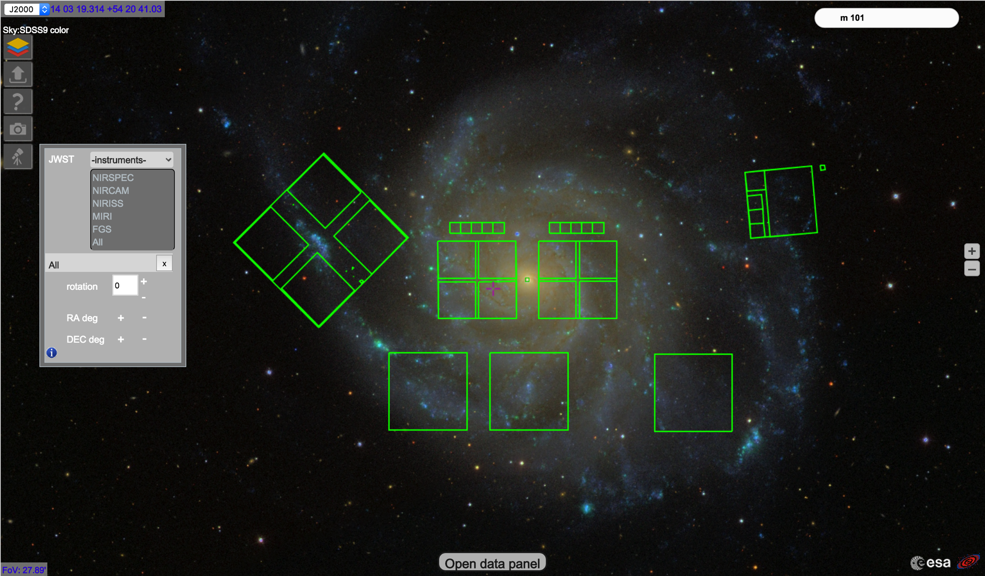
JWST footprints on ESASky

Slide 8
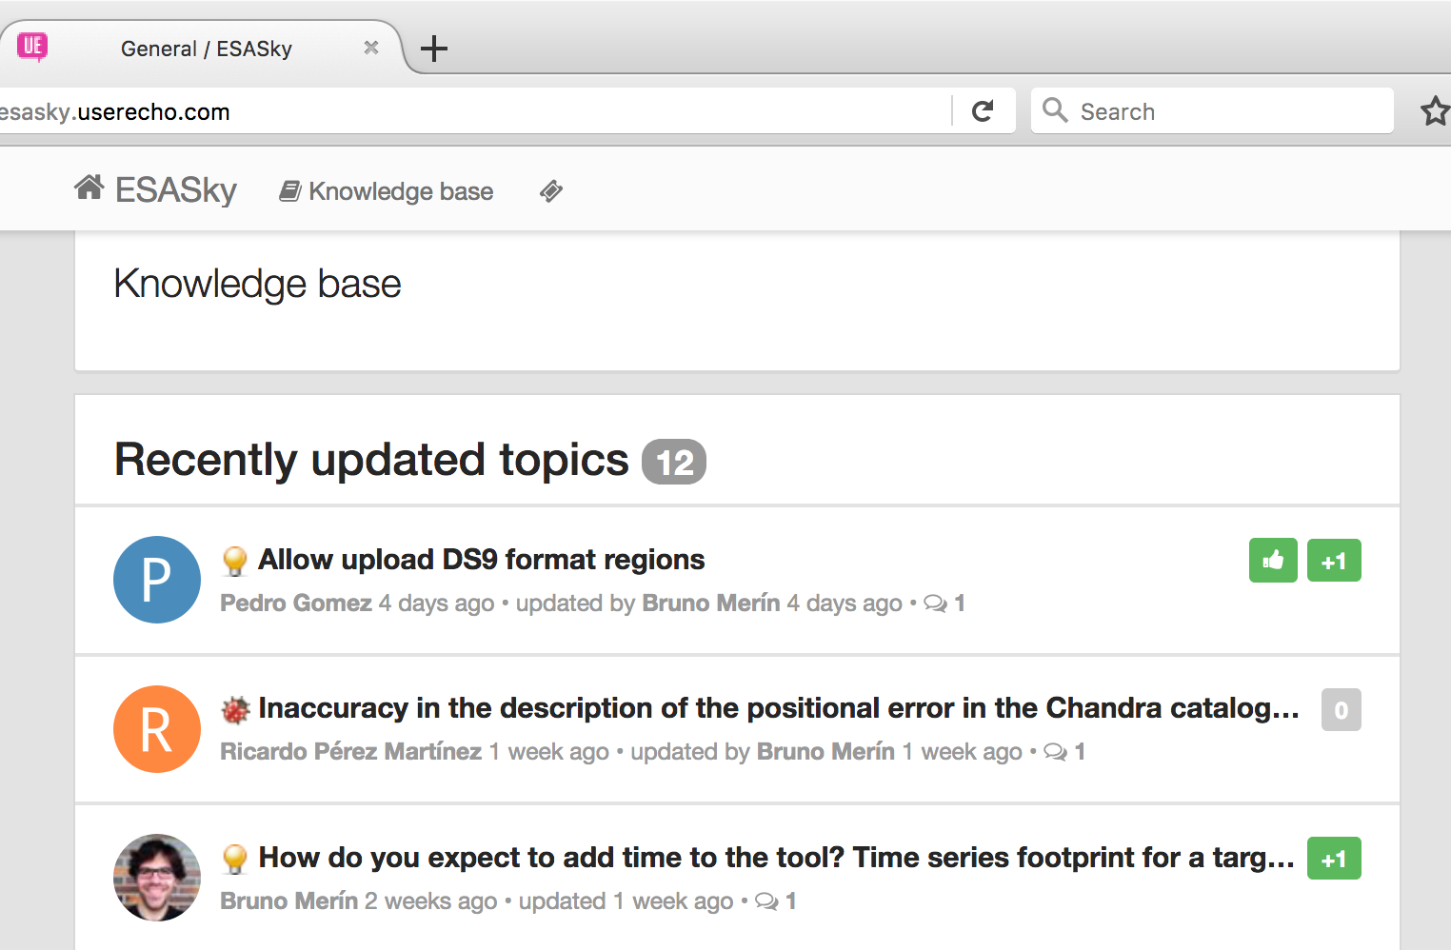
Your feedback is appreciated!
Please give us your suggestions, ideas or tell us about the bugs you find at:
http://esasky.userecho.com

Slide 9
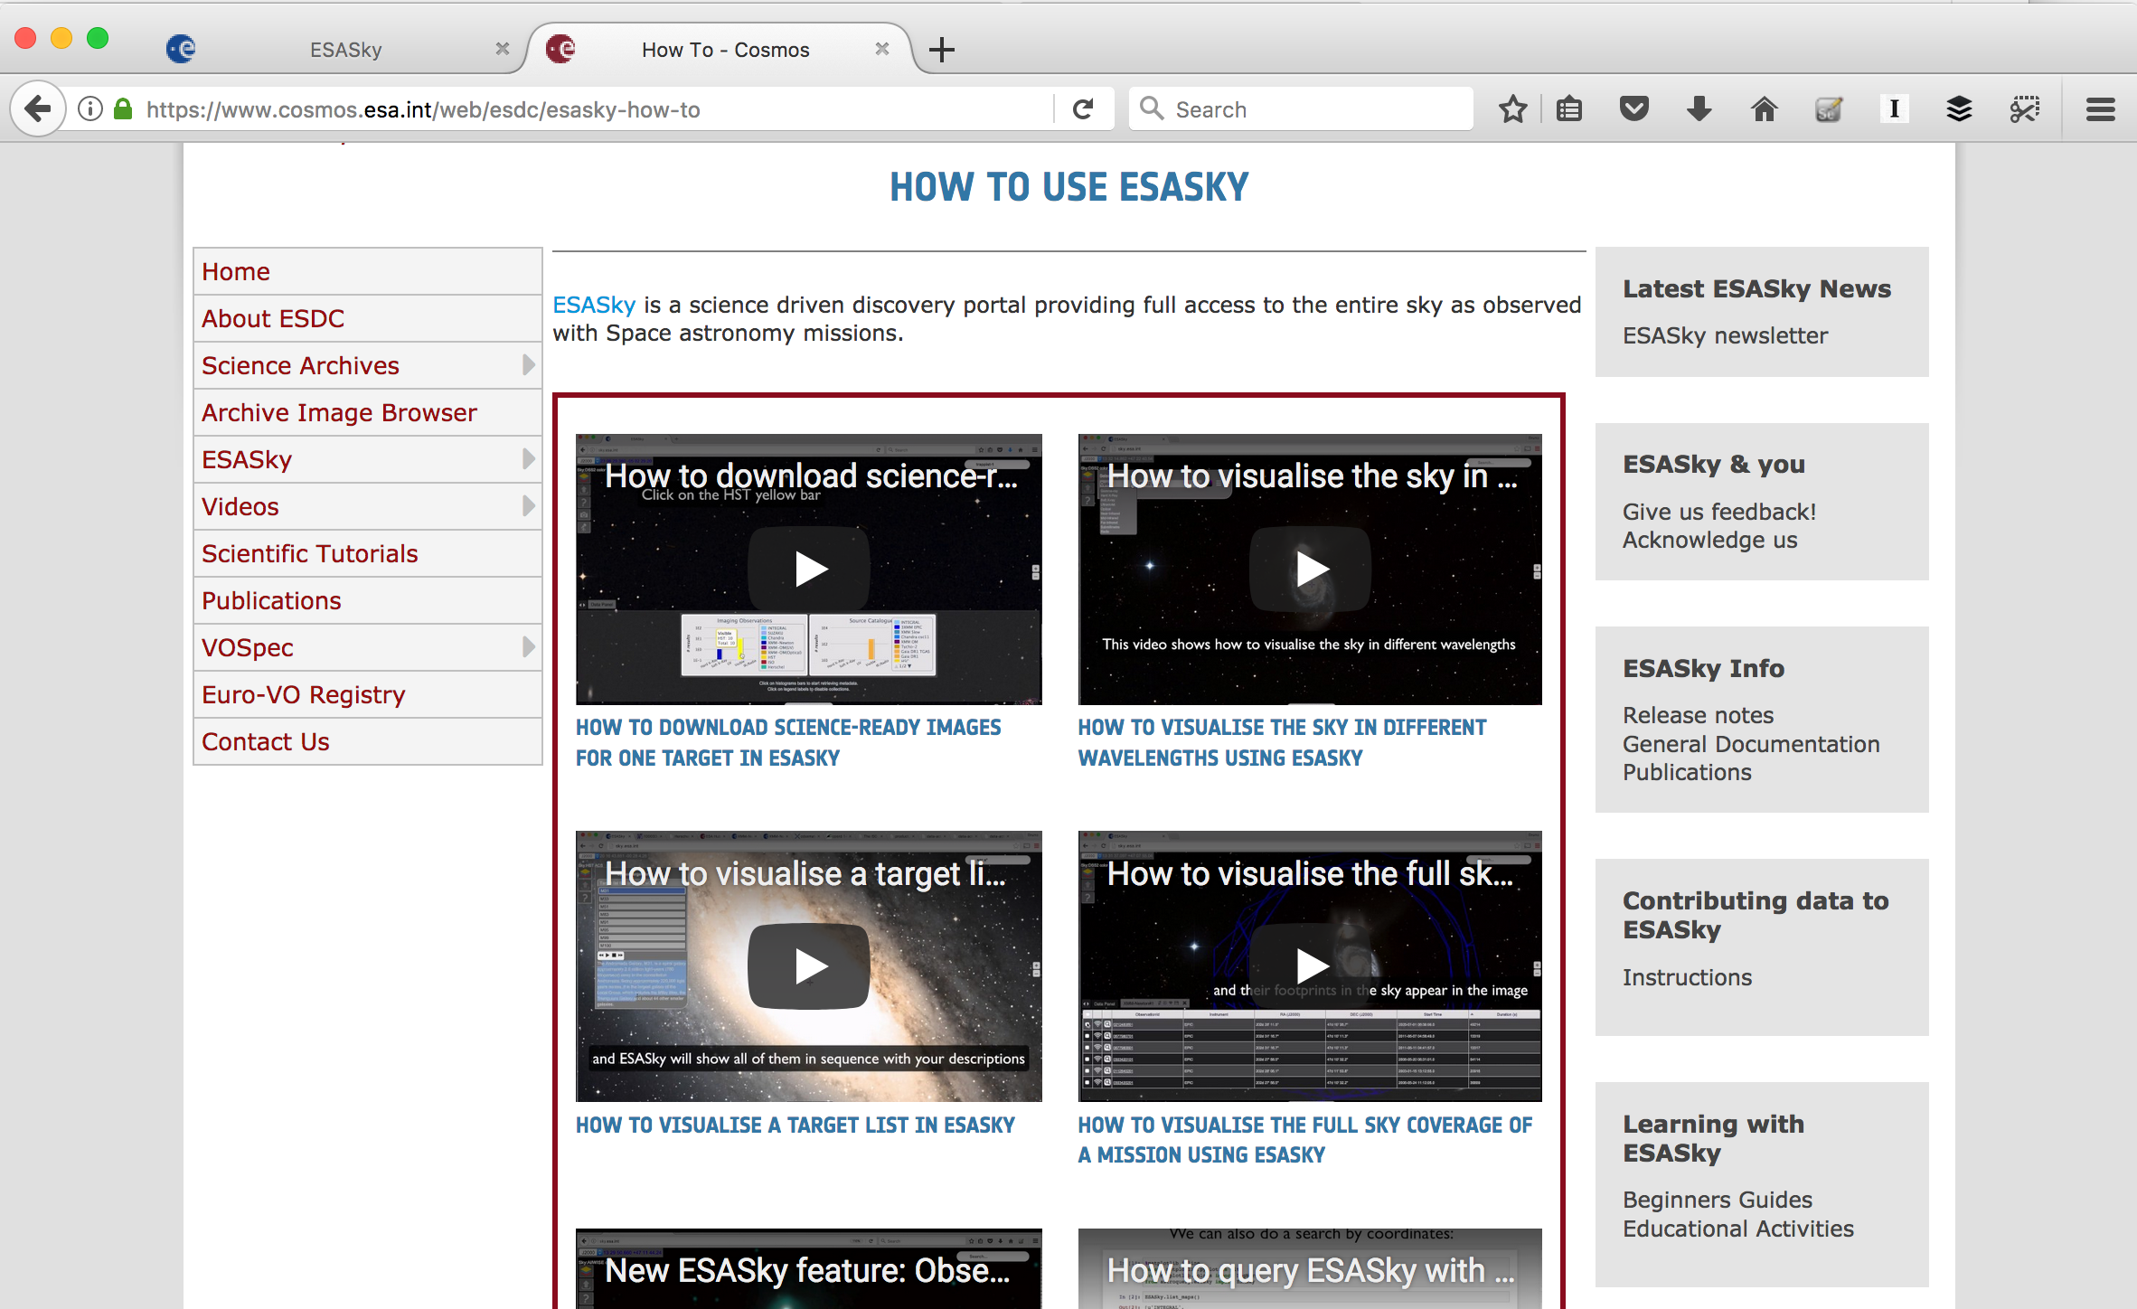
All video tutorials can be found at
https://www.cosmos.esa.int/web/esdc/esasky-how-to

Slide 10
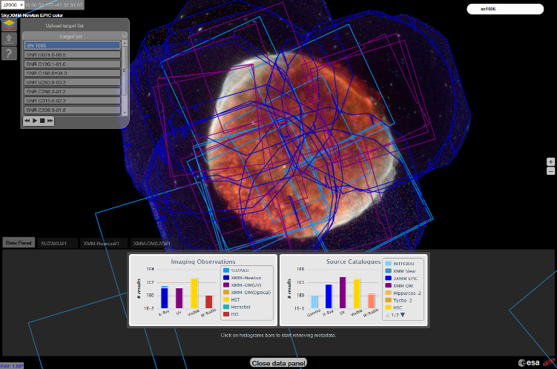
Thanks!
http://sky.esa.int
Bruno.Merin@esa.int
BrunoMerin
Videos at
https://www.cosmos.esa.int/web/esdc/esasky-how-to
Forum site: http://esasky.userecho.com

Slide 11
Additional slides

Slide 12
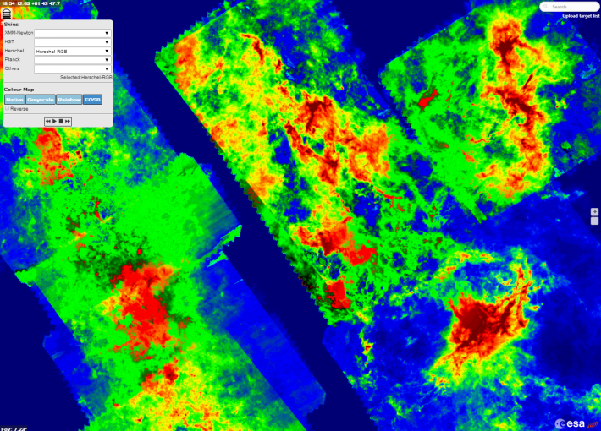
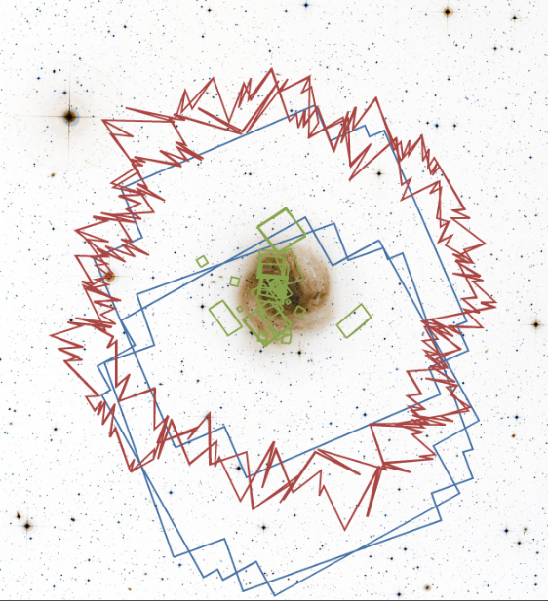
ESASky v1.0 - Backend Data Generation
HiPS: Hierarchical Progressive Survey
HEALPix sky tessellation
Number of levels depend on pixel angular resolution
Planck (low) 3 levels
Herschel(medium) 7 levels
HST(high) 14 levels
Footprints
HST: Provided by project
Herschel: Footprint Finder (ST-ECF)
XMM: Instrumental + pointing

Slide 13
ESASky v1.0- Backend Data Access
Apache HTTP Server
Serves HiPS requests
Java Servlet container
Serves TAP & Target Resolver requests
Database
PostgreSQL DB
Spherical data types library (PgSphere)
Footprints -> Spherical data types
Usage of IVOA Protocols & Standards
TAP requests
ADQL translation to SQL + PgSphere
Storage of STC-S footprint information

Slide 14
ESASky v1.0 - Frontend
Running on a Web Browser (HTML5/CSS3)
Google Web Toolkit
Aladin Lite wrapper (JSNI)
Data Visualization (Highcharts)
Usage of IVOA Protocols
TAP accessing archive metadata
ADQL describing complex FoVs
Astronomical services access
Target coordinates resolver
Angular size resolver

Slide 15
ESASky team
Fabrizio Giordano (key person, full-time)
María Henar Sarmiento (part-time, GUI)
Elena Racero (part-time, HiPS and footprints)
Belén López Martí (full-time EXPRO, HiPS development)
Pilar de Teodoro (part-time, DB)
Sara Nieto (part-time, DB ingestion)
Raúl Gutiérrez (part-time, backend)
Juan González (part-time, DB optimization)

