Slide 1
ESAC 2017 JWST Workshop
ESASky Hands on experience
ESASky

Slide 2
Overview
Goal: Familiarization with ESASky as a tool for quick assessment of the spatial coverage of instruments FOV, possible parallel observations, and looking for the existence of suitable pre-images and catalogs.
Disclaimer: ESASky should be used only as preliminary tool in the early phases of the science program definition. The Astronomer Proposal Tool is the formal tool to be used for the detailed planning, implementation and submission of JWST proposals.
ESASky Link: http://sky.esa.int/
ESASky

Slide 3
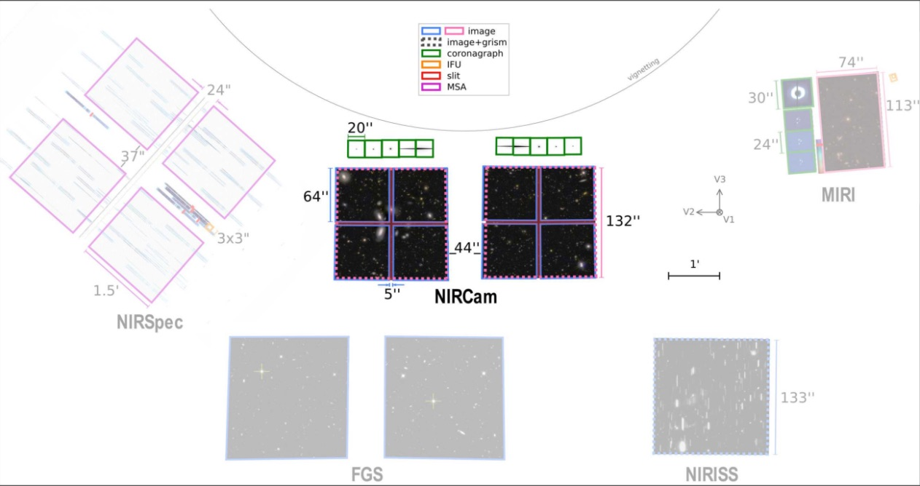
JWST Field of View
ESASky

Slide 4
Case 1
Goal: Estimate the number of pointings needed for imaging M51 using NIRcam ALL and overlap as much as possible with existing HST-ACS observations
Step 1 – search M51
Step 2 – load HST/ACS images for M51
Step 3 – Load one or more NIRCAM ALL FOV and design an ‘optimal’ coverage
Possible extensions
Is there a position angle PA that allow an optimal coverage ?
How many pointing would be needed to cover the same area with MIRI ?
ESASky

Slide 5
Case 2
Goal: Certain combinations of instruments can be used in parallel already in Cycle 1, e.g. NIRCAM and MIRI imaging. Consider the pillars in the region of M16– pick MIRI as prime instrument and select an optimal PA to have NIRCAM FOV in parallel in another star forming.
Step 1 – search for M16
Step 2 – load the Far Infrared Herschel image
Step 3 – load MIRI Imager footprint
Step 3 – adjust RA and DEC to center the MIRI imaging FOV in the main pillar
Step 4 – activate the ”all instrument FOV” to identify the optimal PA for suitable parallel observations with NIRCam that will allow NIR imaging of other pillars in this region
ESASky

Slide 6
Case 3
Goal: compare NIRCAM and NIRSpec FOV to plan pre-imaging. Consider what NIRCAM imaging mosaic will suitably cover a region where you will later be looking at with NIRSpec. An example region would be the fingers of the ‘hand of God’ in M16.
Step 1 – search for M16
Step 2 – load NIRSpec FOV
Step 3 – load NIRCAM FOV
Step 4 – add more NIRCAM FOVs as needed to cover a region were targets can be identified that cover the whole area of the NIRSpec MSA.
ESASky

Slide 7
Case 4
Goal: Similarly, we can do parallel imaging and spectroscopy on a galactic target. An example would be the Antennae region where NIRSpec MOS can be used to obtain MOS spectroscopy of the several super star clusters while NIRCam can image the external arms
Step 1 – search the antennae
Step 2 – load NIRSpec MOS FOV and click to add JWST FOV all instrument
Step 3 – rotate the FOV to identify an optimal PA for the parallel NIRCam observation
ESASky

