Slide 1



JWST Exposure Time Calculator
Overview
Swara Ravindranath
STScI
ESAC 2017 JWST Workshop
Madrid, Spain
05 October, 2017

Slide 2
JWST ETC: Introduction
Imaging
NIRCam SW+LW
NIRISS
MIRI
NIRSpec TA (through MSA mesh)
Slit spectroscopy
NIRSpec FS
MIRI LRS
IFU spectroscopy
NIRSpec IFU
MIRI MRS
Multi-object spectroscopy
NIRSpec MSA
Slitless spectroscopy
NIRISS WFSS
NIRISS SOSS
MIRI LRS
Coronagraphy
NIRCam spots + wedges
MIRI Lyot
MIRI FQPMs
Aperture Masking Interferometry
NIRISS AMI
  Originally, it was envisioned that JWST ETC would be similar to the HST ETC
  Basic design of HST ETC found not viable for advanced observing modes of JWST, and to handle JWST detector noise properties and readout patterns
  New features required to support modern user interaction and collaborations
Reference:
JWST Community Lecture Series - Pandeia: the JWST Exposure Time Calculator (Klaus Pontoppidan)

Slide 3
JWST ETC: Recommendations
  ETC should use 3-dimensional (2 spatial + 1 spectral) framework
  ETC should use a PSF library, such as generated by the WebbPSF tool
  Noise propagation should include correlated noise
  Post-observation additions of multiple exposure, background subtraction, extraction of photometry and spectroscopy should be explicitly modeled under unifying concept of "observing strategy"
  ETC should be sufficiently fast to support efficient comparative parameter studies, as well as inverse problems
  ETC should be template-based for all 3 main inputs (instrument config., target design, observing strategy)
Reference:
JWST Community Lecture Series - Pandeia: the JWST Exposure Time Calculator (Klaus Pontoppidan)

Slide 4
The Pandeia Project : JWST ETC
ETC engine
Python library
JWST reference database
Throughputs noise properties PSFs
Web application
@
jwst.etc.stsci.edu
User interface for users of the ETC collaborative functionality
JWST Background Model
Currently only available through the web application
Reference:
Pontoppidan, K.M., et al. 2016, Proceedings of SPIE 9910, Observatory Operations: Strategies, Processes, and Systems VI, 991076; (arXiv: 1707.02202)

Slide 5
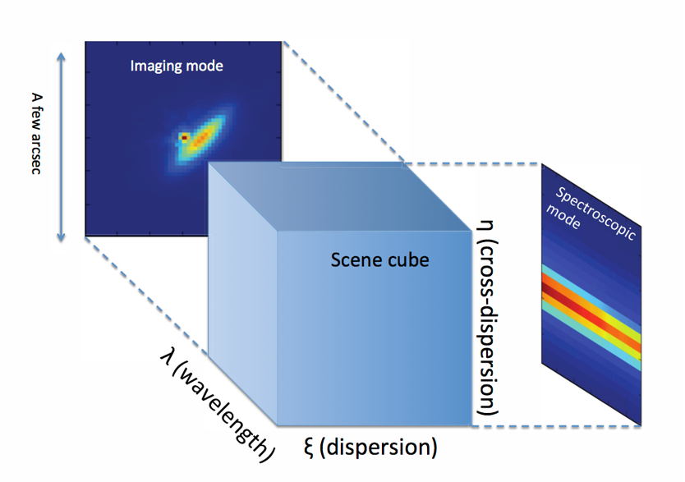
JWST ETC: ETC Engine
  JWST code project called "Pandeia", has generality to use with any observatory with appropriate configuration files and reference data.
  Under the hood: 3D sensitivity engine
  Includes PSFs, correlated noise and detector effects, effects of background subtraction and extraction
  Pointing and time dependent JWST background model
  100 % data driven
Reference:
Pontoppidan, K.M., et al. 2016, Proceedings of SPIE 9910, Observatory Operations: Strategies, Processes, and Systems VI, 991076; (arXiv: 1707.02202)

Slide 6
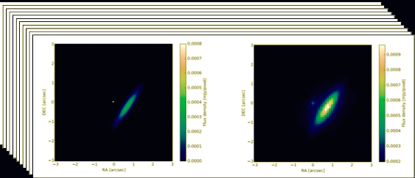



JWST ETC: Engine algorithm
Scenes build at each wavelength, and convolved with PSFs
Slitted Spectroscopy
Imaging projection
Slitless Spectroscopy
Reference:
Pontoppidan, K.M., et al. 2016, Proceedings of SPIE 9910, Observatory Operations: Strategies, Processes, and Systems VI, 991076; (arXiv: 1707.02202)

Slide 7
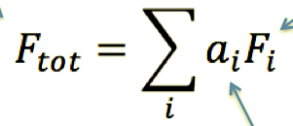

JWST ETC: Strategies
ETC Strategies specify how and where the SNR has to be computed.
The calculation of SNR involves calculating the flux rate and computing the total flux over the selected region with appropriate weighting of the pixels.
Total flux
Flux per pixel
Scalar weight of pixel
Variance in the
measurement
Covariance matrix
Reference:
Pontoppidan, K.M., et al. 2016, Proceedings of SPIE 9910, Observatory Operations: Strategies, Processes, and Systems VI, 991076; (arXiv: 1707.02202)

Slide 8
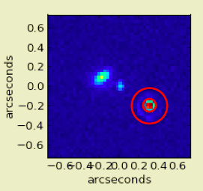


JWST ETC: Strategies
Example: Aperture Photometry
A = aperture for source
B = background region
Pixel weights
Reference:
Pontoppidan, K.M., et al. 2016, Proceedings of SPIE 9910, Observatory Operations: Strategies, Processes, and Systems VI, 991076; (arXiv: 1707.02202)

Slide 9
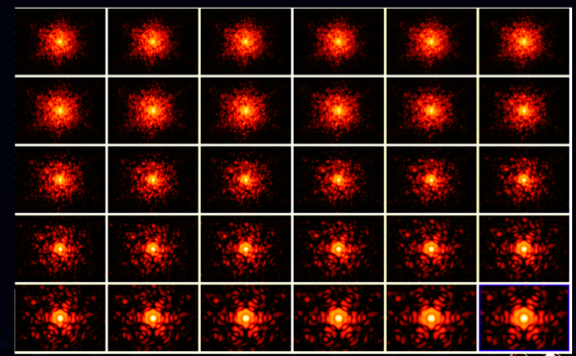
JWST ETC: PSFs
Uses Webbpsf to compute point spread functions with realistic wavefront errors.
Calculates almost 3000 individual monochromatic PSFs
Subsampled by integer factor of the detector pixel size
The observed PSF depends on the color of the astronomical source.
Reference:
Pontoppidan, K.M., et al. 2016, Proceedings of SPIE 9910, Observatory Operations: Strategies, Processes, and Systems VI, 991076; (arXiv: 1707.02202)

Slide 10
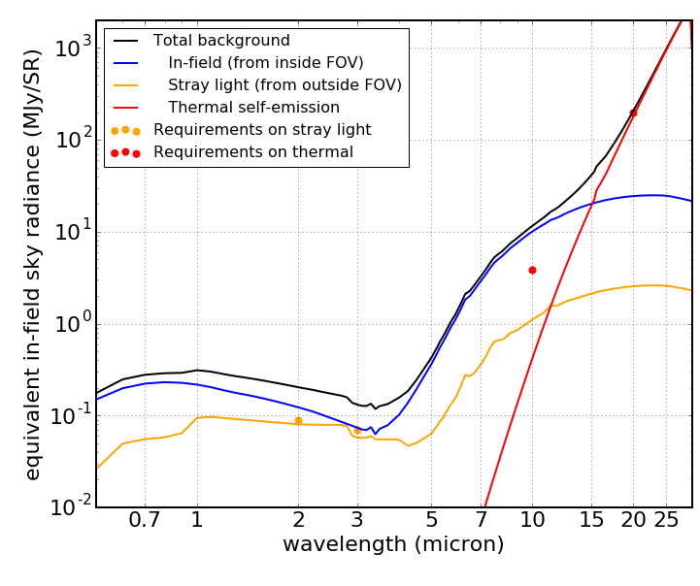
JWST ETC: Backgrounds
JWST ETC uses a dynamic background model generator (BMG)
Zodi + ISM “cirrus” emission (in-field)
Stray light scattered into the FOV
Thermal emission from JWST itself which is the dominant background component at > 15 microns.
Zodi and Galactic emission is calculated for a given RA and Dec in two ways:
For a given date: “Dated background”
As percentile of the background for those coordinates over the visibility: “Dateless Background”
Reference:
Pontoppidan, K.M., et al. 2016, Proceedings of SPIE 9910, Observatory Operations: Strategies, Processes, and Systems VI, 991076; (arXiv: 1707.02202)

Slide 11
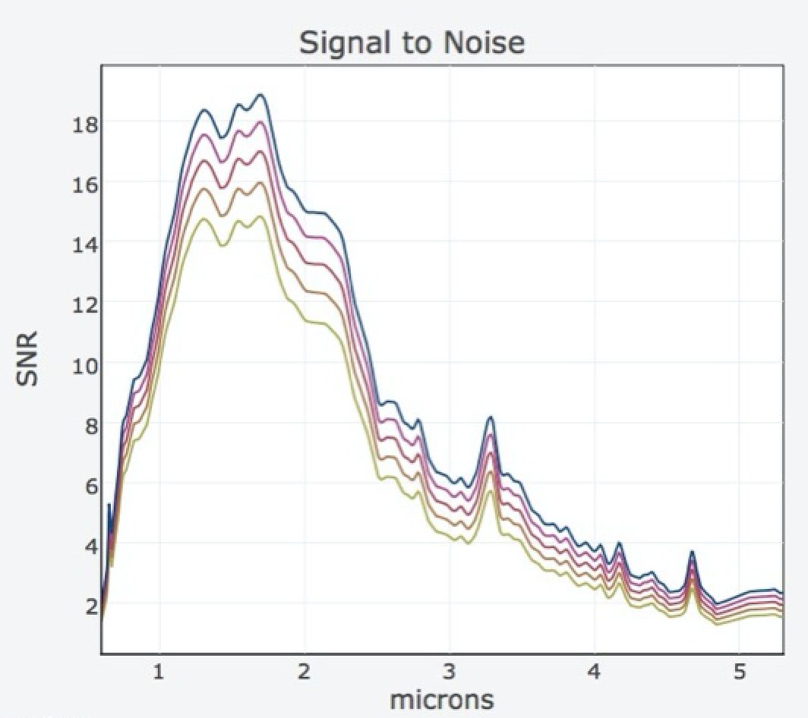
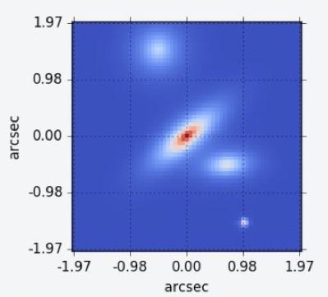
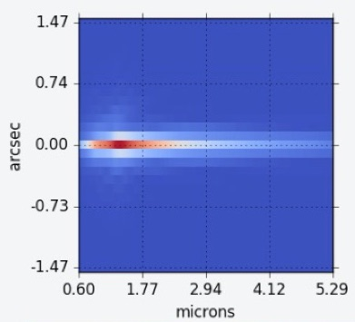
JWST ETC: Web Application
  Workbooks: Organize and save your ETC calculations
  Build your own re-usable sources and
  scenes library
  Efficiently analyze and compare different instruments and modes
  Share ETC calculations and work
  collaboratively with your team
  Download images and plots for detailed analysis

Slide 12
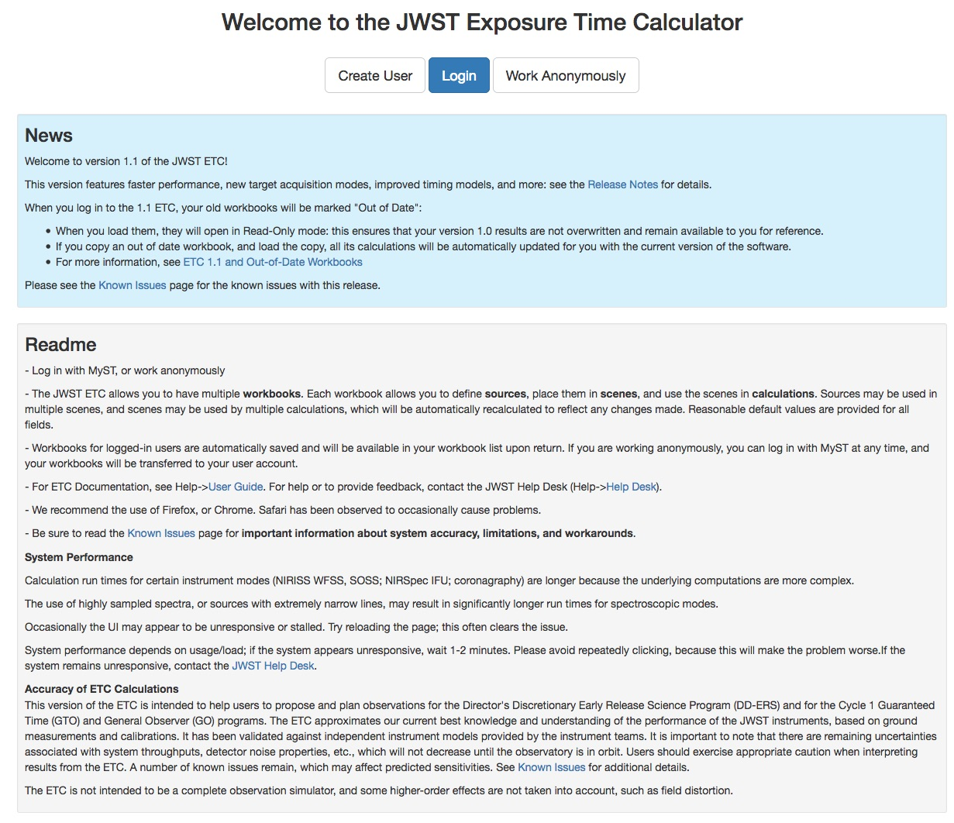
JWST ETC: User Interface https://jwst.etc.stsci.edu
Use MyST user account (https://proper.stsci.edu/proper/authentication/auth)
Release notes
How to open old workbooks
Known issues
Login with MyST user account:
Preserves workbook after logout
Helps to recover lost workbooks
Anonymous user workbooks are lost after logout or when session is terminated

Slide 13
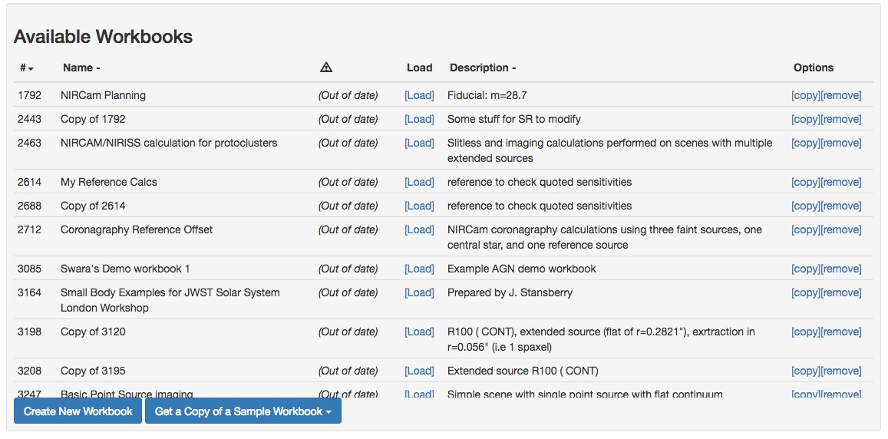
JWST ETC UI: Key Features
Organize and save your ETC calculations
Can contain multiple sources, scenes, and calculations
Are persistent in your MyST account and shareable
Sample workbooks are provided for all instrument modes
Workbooks

Slide 14
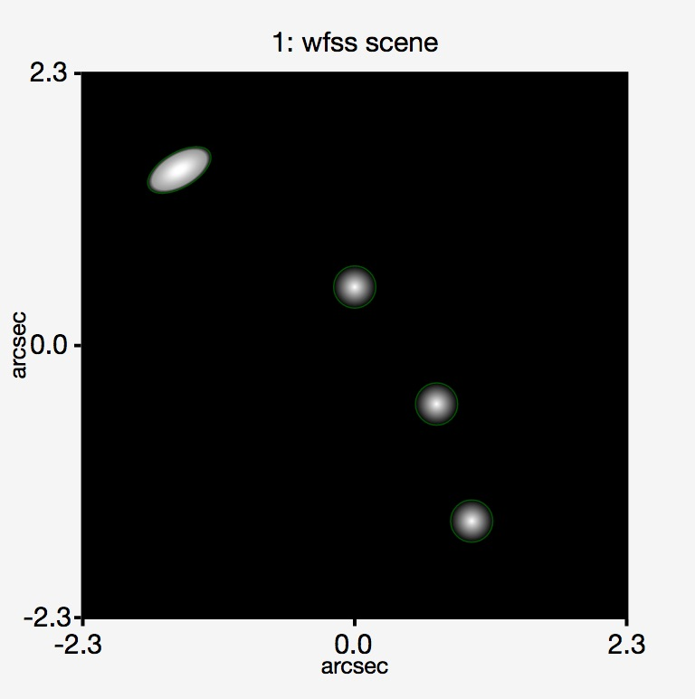
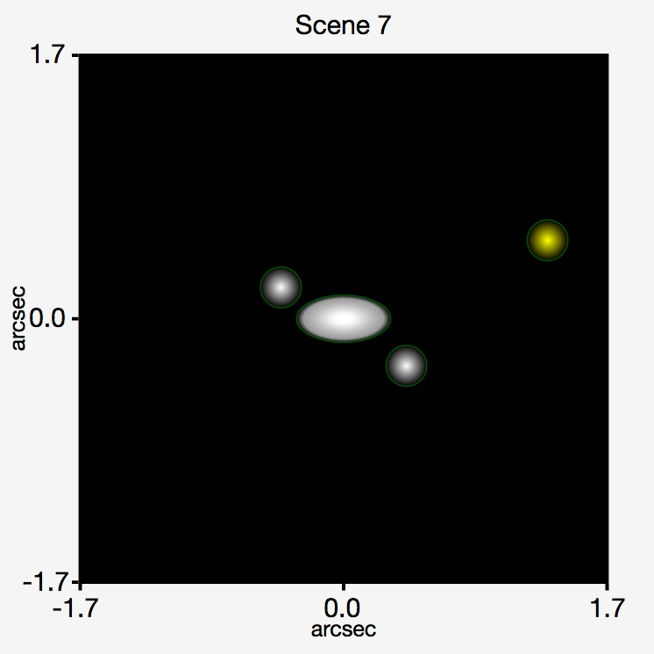
JWST ETC UI: Key Features
Reusable Scenes and Sources
  Scene is a postage-stamp of the sky, few arcsecs on a side
  A scene can have no source, single or multiple sources
  Sources and scenes can be defined once, used many times

Slide 15
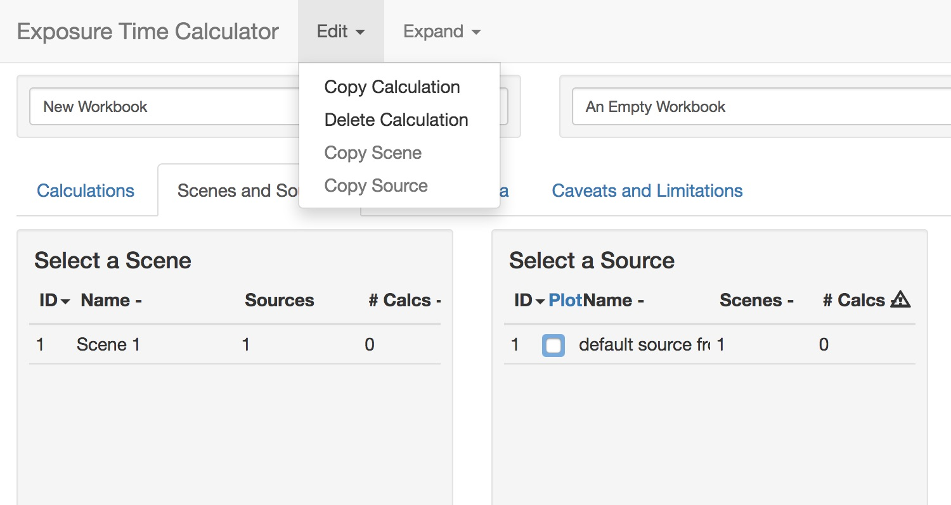
JWST ETC UI: Key Features
  Users do not have to start from scratch
  Calculations in a workbook start with reasonable defaults
  Users can simply copy the calculation, modify inputs as desired, and recalculate
  Users can copy and modify Scenes and Sources
Copy and Modify Workflow
Copy calculation, copy scene, and copy sources options are in Edit menu

Slide 16
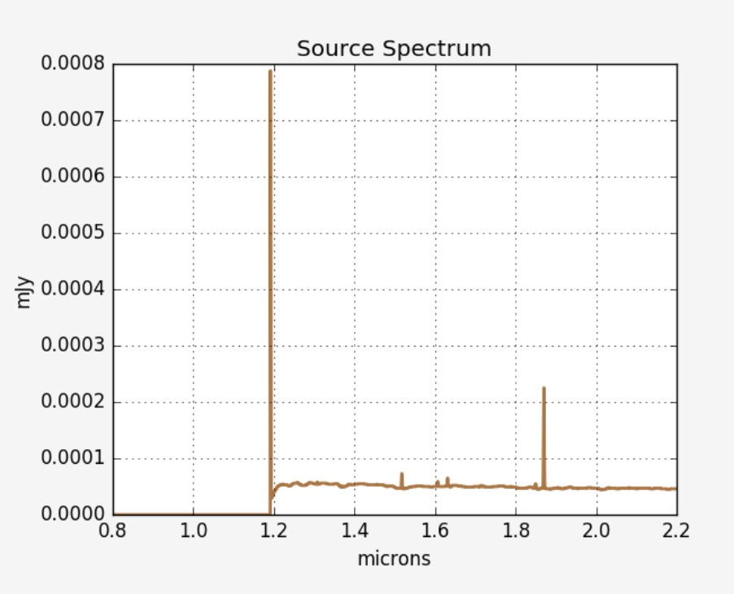
JWST ETC UI: Key Features
Upload spectra
  Can upload user-supplied spectrum and assign to sources
  2-column ascii format (wavelength, flux) or FITS files
  Uploaded spectrum file must be compatible with PySynphot
  Uploaded spectra will appear in the "continuum" tab
> import pysynphot as psyn
> sp = psyn.FileSpectrum(’ 9160_newunits.dat’)

Slide 17
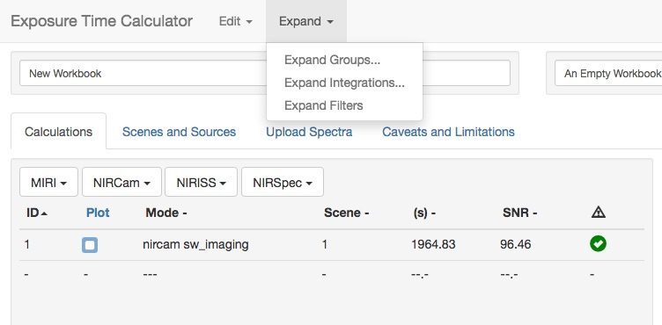
JWST ETC UI: Key Features
  Duplicate calculation N times varying only selected parameter
  Can run multiple calculations by only varying filters
  Batch calculations by varying either Ngroups, Nintegrations
  Useful to see how SNR changes with exposure specification
Batch Expansion

Slide 18
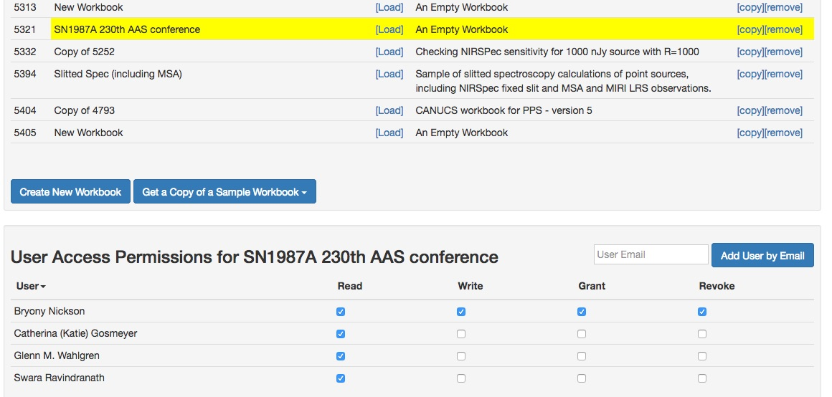
JWST ETC UI: Key Features
Collaborative work
  Workbook sharing is enabled and strongly encouraged
  Can assign user access permission to selected workbooks
  Shared workbook appears in available workbooks list of collaborator
  Advice to coordinate with collaborator to avoid accidental clobbering
Select workbook
Provide MyST email address

Slide 19
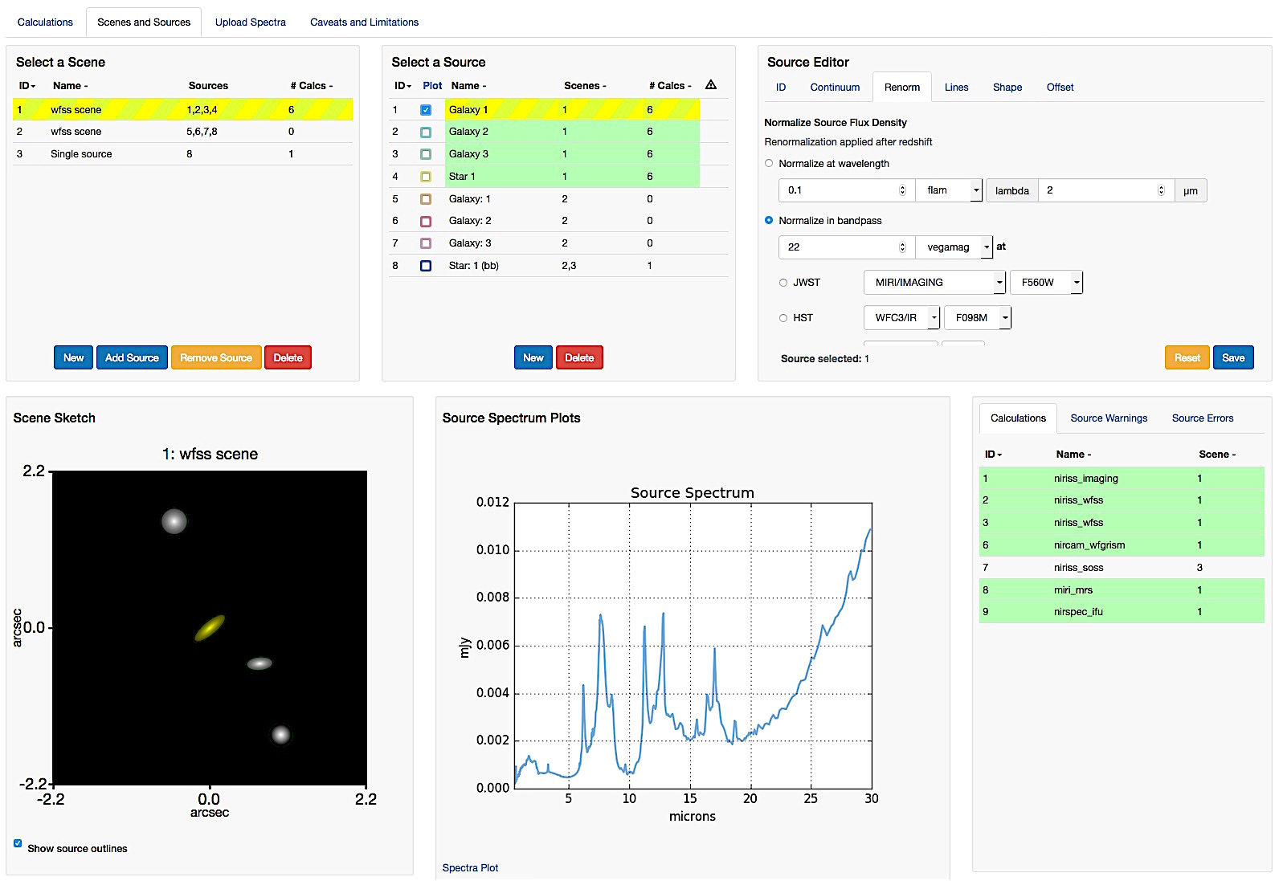
Scenes and Sources page

Slide 20
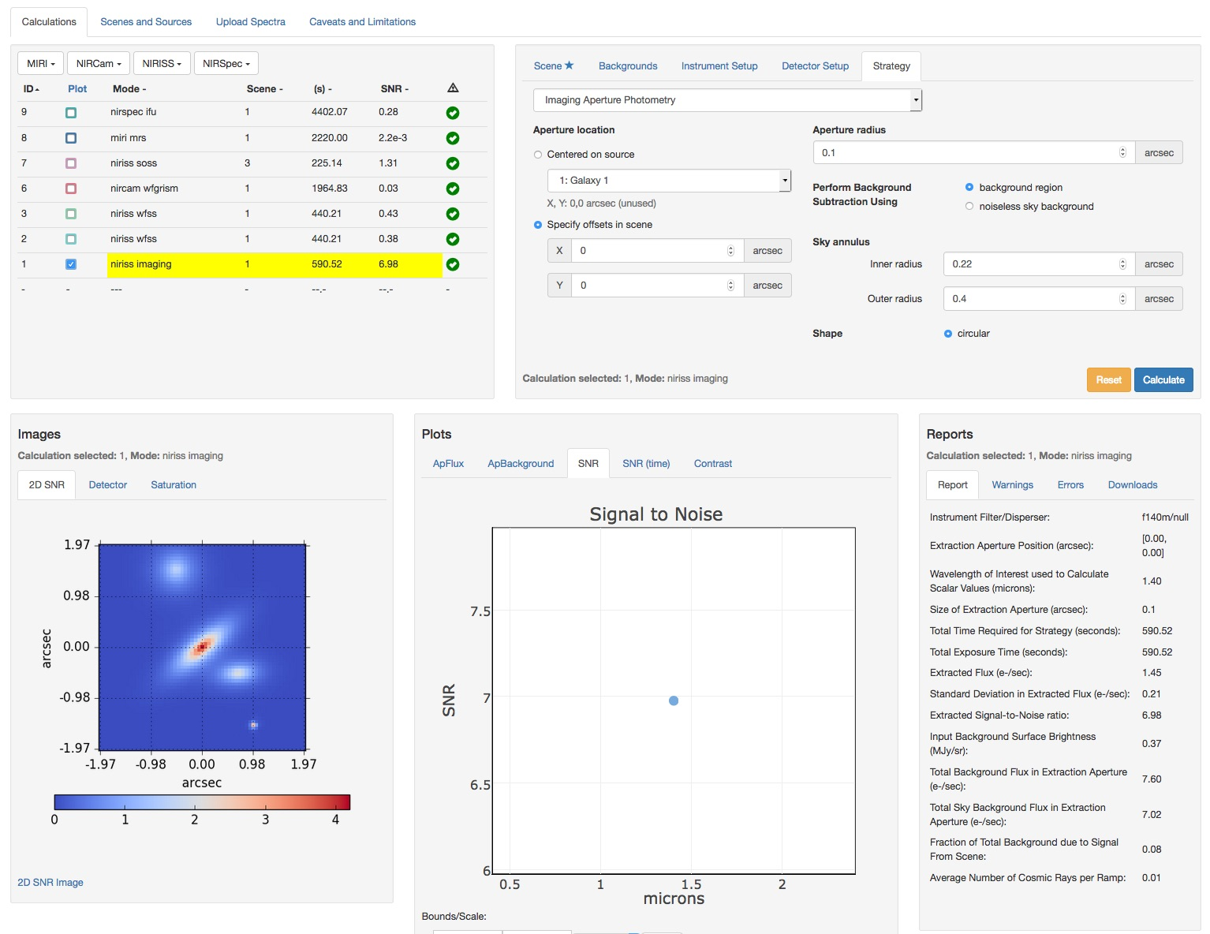
Calculations page
Calculations table
Configuration pane
Outputs

Slide 21
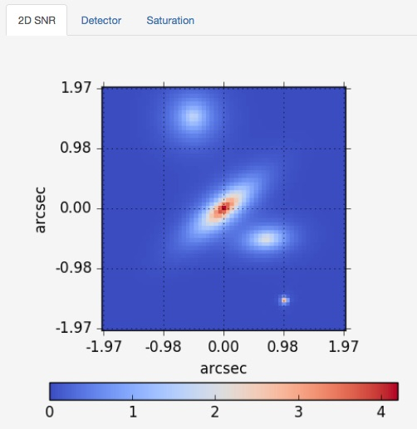
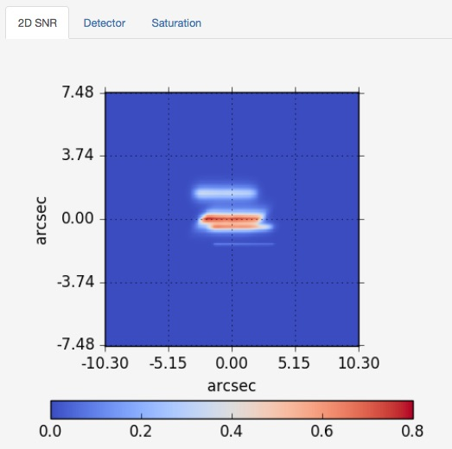
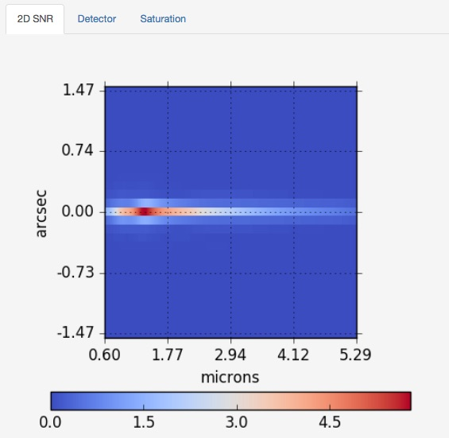
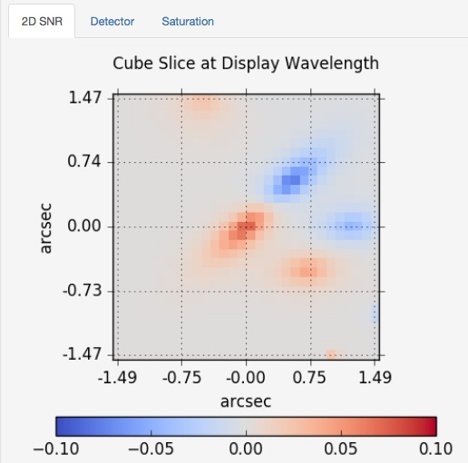
JWST ETC Outputs: Images
NIRCam Imaging
NIRISS WFSS
ETC outputs 2D SNR and Detector images for different observing modes
All image products are available for downloads as FITS images for further analysis
NIRSpec Fixed Slit
NIRSpec IFU

Slide 22
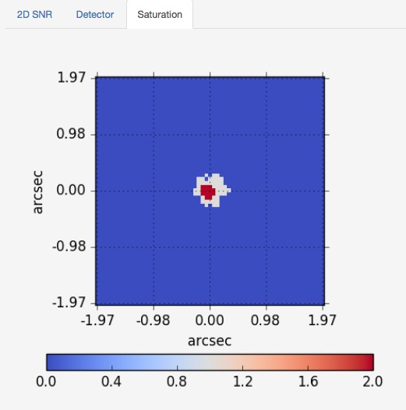
JWST ETC Outputs: Images
Color map shows value of 1.0 for partial saturation and 2 for full saturation.
Partial saturation implies some of the pixels are saturated at the end of a ramp. Partial ramps may still be useful.
Full saturation implies there are pixels that are saturated at the end of the first group and cannot be recovered.
Saturation Map

Slide 23
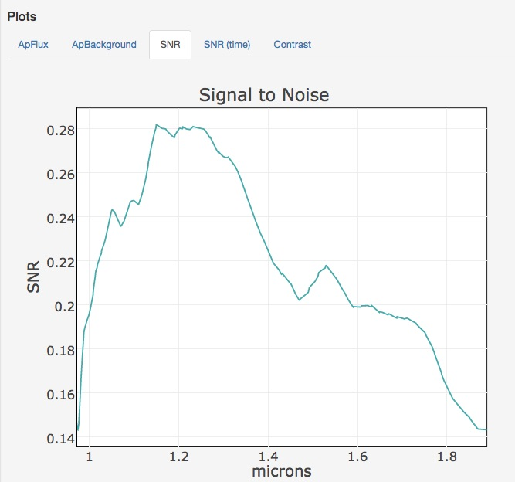
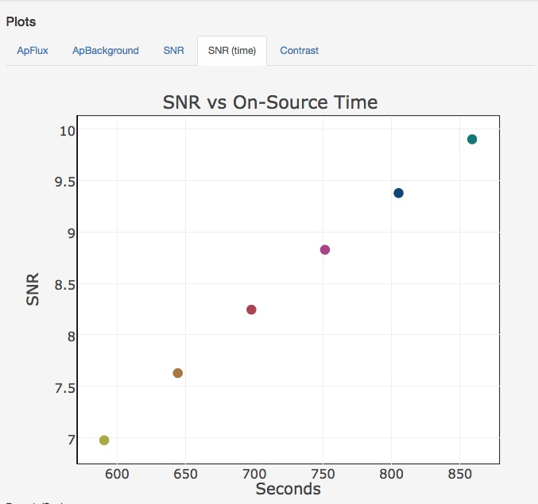
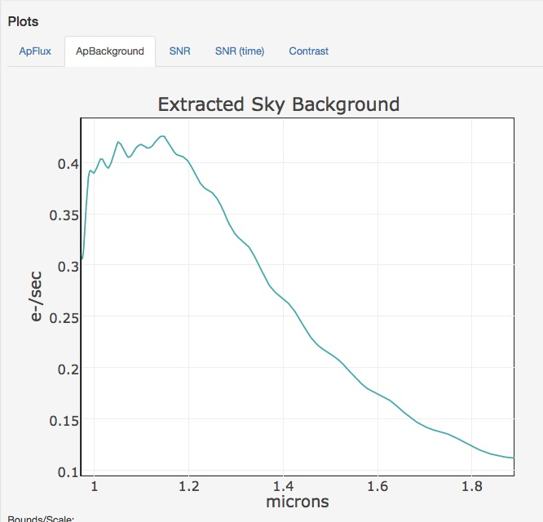
JWST ETC Outputs: Plots
ETC outputs 1D plots for extracted flux, sky background and SNR for different calculations
All data used for plots are available for downloads as FITS tables for further analysis

Slide 24
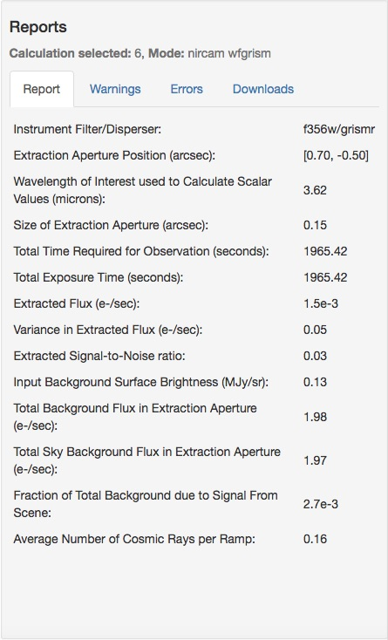
JWST ETC : Reports
Report: Calculated scalar values, summary of inputs
Warnings: Information that might affect the accuracy or otherwise influence science decisions
Errors: Information about why the calculation did not complete
Downloads: tar file of intermediate & output products includes
- FITS files of 3D data cube for IFU
- 2D images and spectra
- extracted flux, combined backgrounds,
and SNR as FITS tables

Slide 25
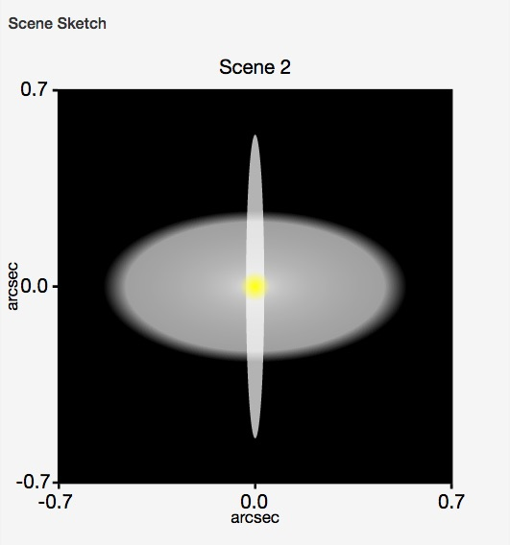
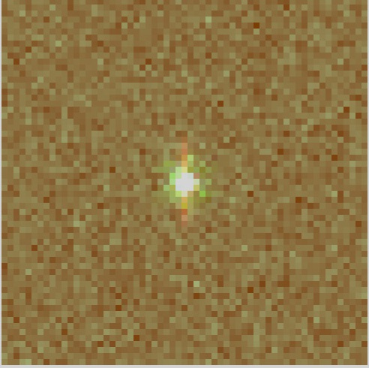
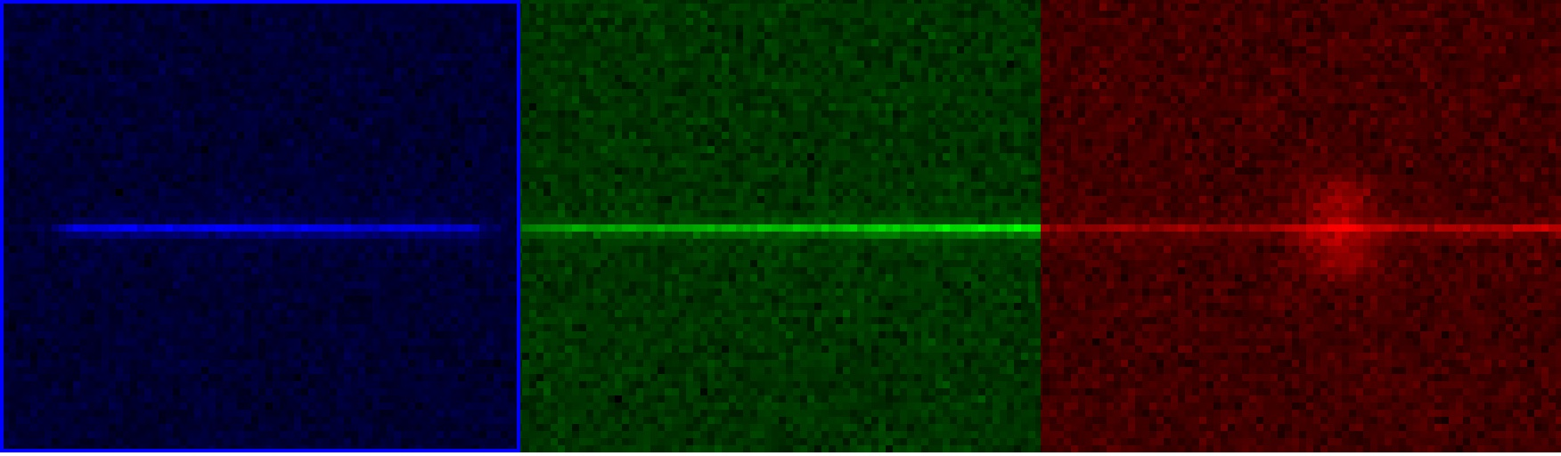
JWST ETC: Downloads
Slitless Spectroscopy of z=3 galaxy with central AGN and outflow
Left: NIRISS imaging in F200W, F150W, F090W.
Lower Panel: NIRISS WFSS calculation in F200W, F150W, F115W. The F200W filter contains the H-alpha emission shown by red color in the image and spectrum.
Created from FITS files in ETC Output Downloads.
Direct image
F115W,F150W,F200W
GR150R+115W
GR150R+150W
GR150R+200W

Slide 26
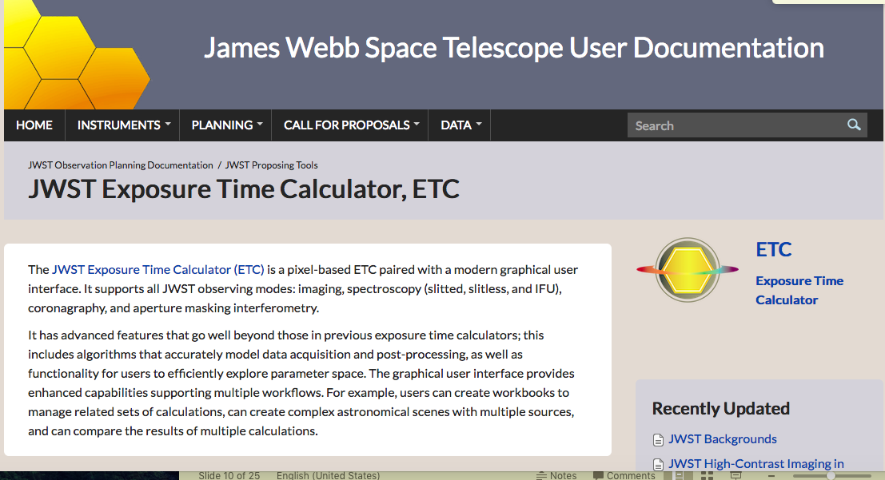
JWST ETC: Helpful links
ETC Documentation: jwst-docs.stsci.edu
JWST Help Desk: jwsthelp.stsci.edu

