Slide 1
APT
Denise Taylor – Observation Planning

Slide 2
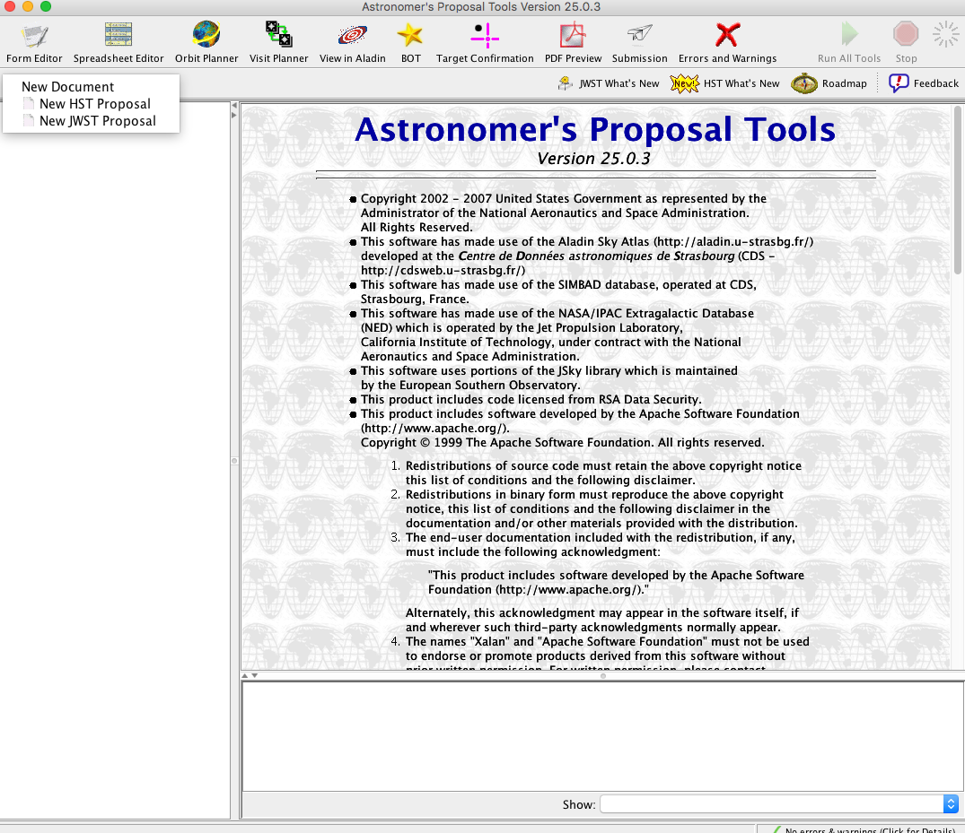
New JWST Proposal

Slide 3
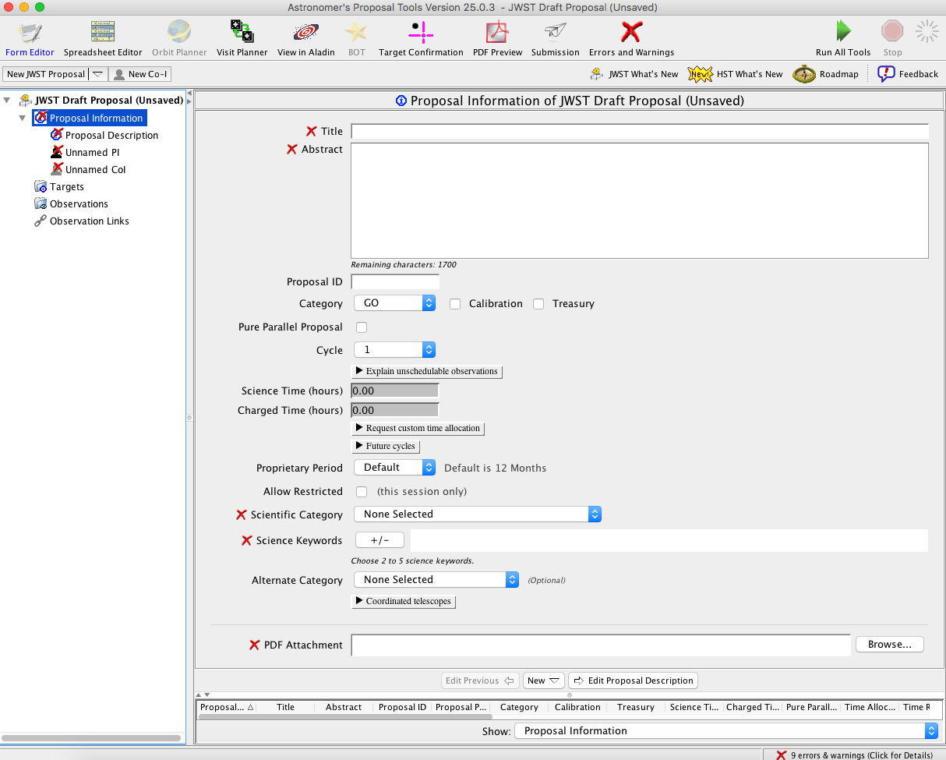
Proposal Information

Slide 4
Proposal Information – GUI Sections
Tool Bar

Slide 5
Proposal Information – GUI Sections
Tree Editor

Slide 6
Proposal Information – GUI Sections
Tool Interface

Slide 7
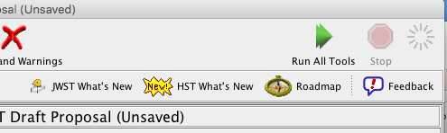
Proposal Information - Roadmap
Link to step-by-step instructions for writing an observing proposal
Currently, shows only instructions for HST
JWST instructions coming

Slide 8
Proposal Information

Slide 9
Proposal Information

Slide 10
Proposal Information – PDF Attachment

Slide 11
Proposal Information – PDF Attachment
Templates will be available at jwst-docs.stsci.edu
Word, LaTeX, etc.

Slide 12
Proposal Information – PDF Attachment

Slide 13
Observing Description

Slide 14
Investigators

Slide 15
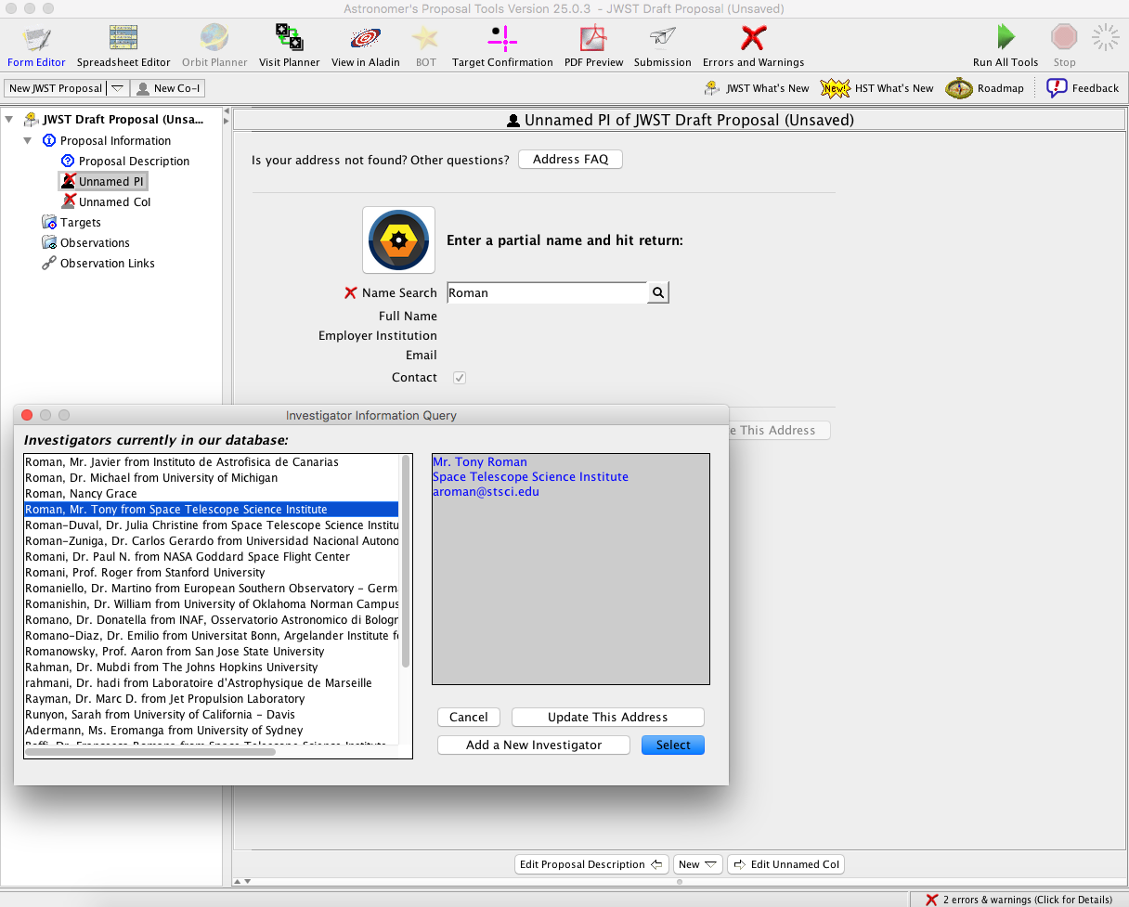
Investigators

Slide 16
Create Targets

Slide 17
Create Observations

Slide 18
Other Tools

Slide 19
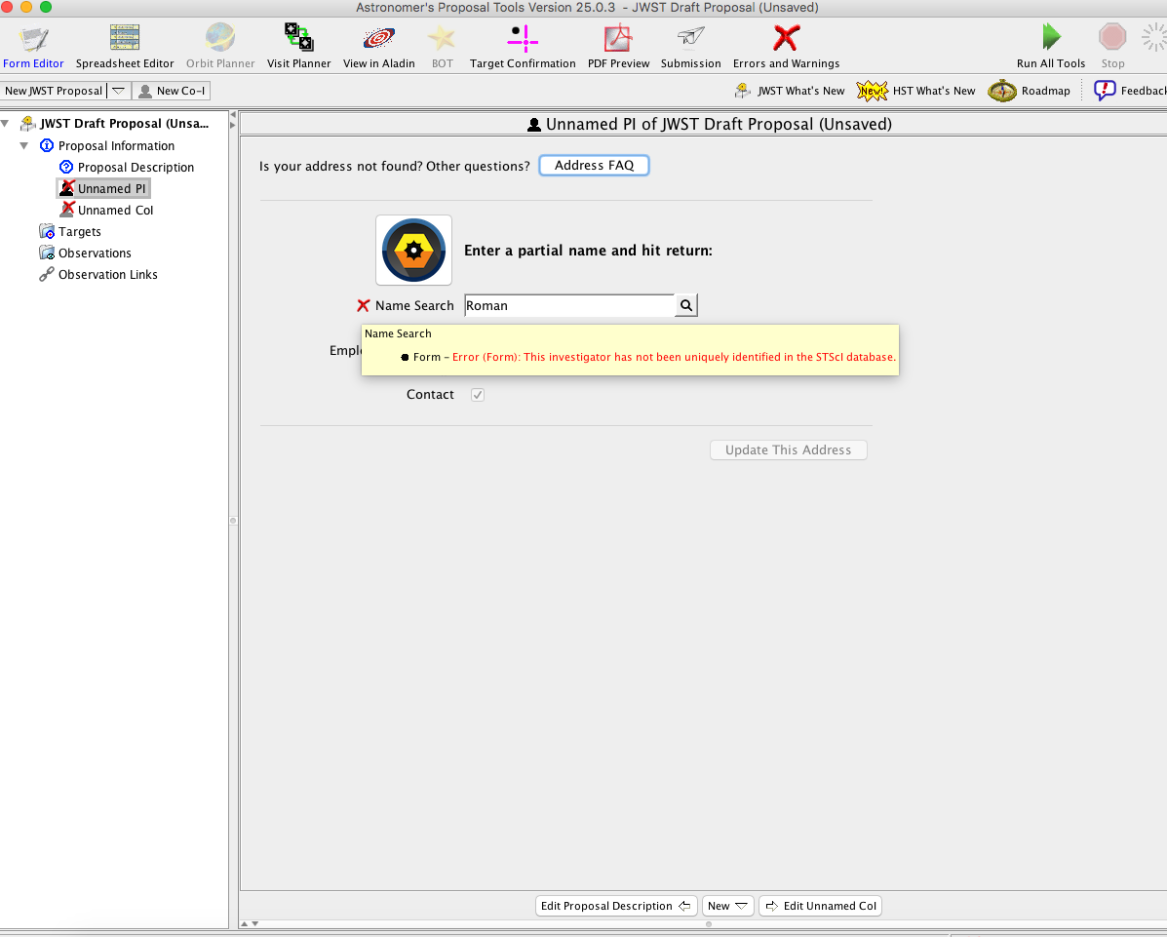
Diagnostics

Slide 20
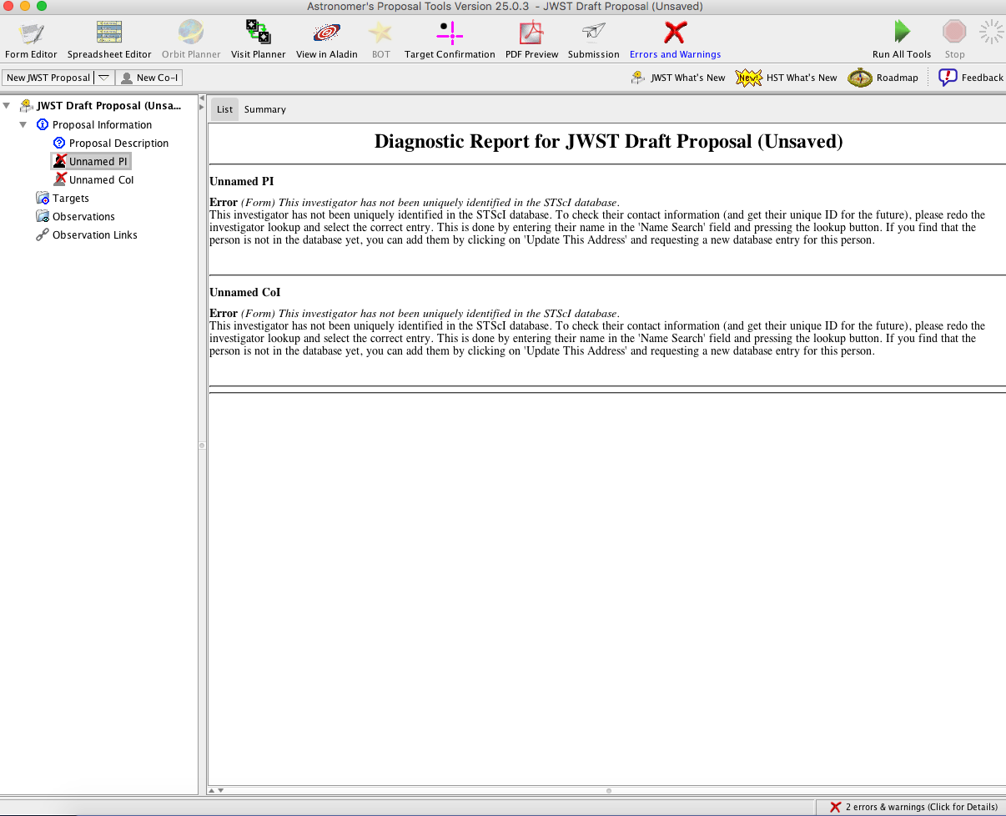
Diagnostics

Slide 21
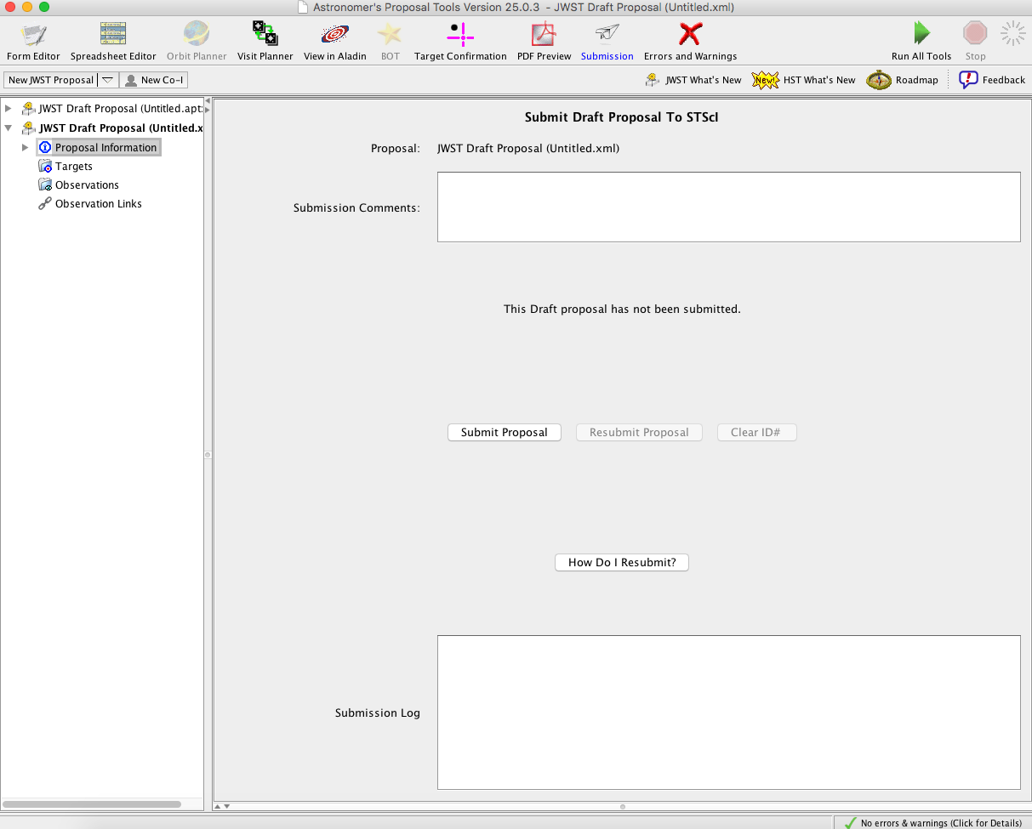
Submit

