Slide 1
How to implement coordinated parallels
Jeff Valenti
JWST mission scientist at STScI

Slide 2
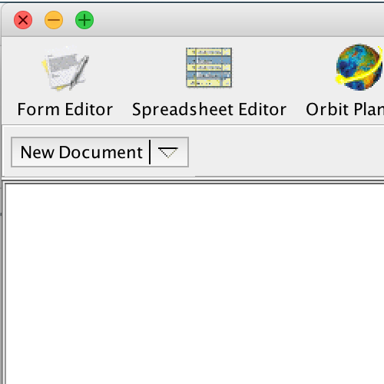
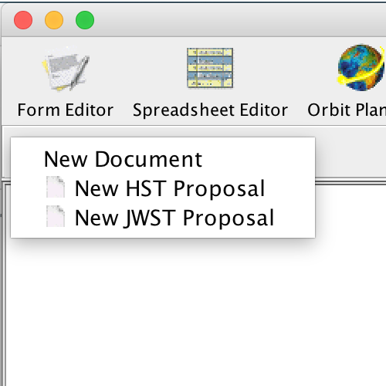
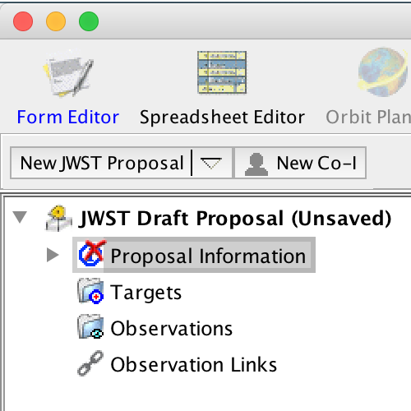
Create a new JWST proposal
1
2
3
4

Slide 3
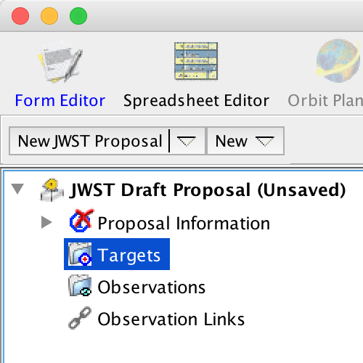
Specify a target (optional)
6
5
7
8
9
10

Slide 4
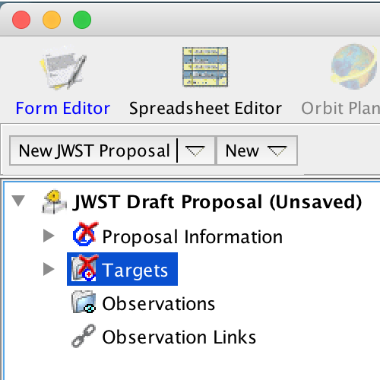
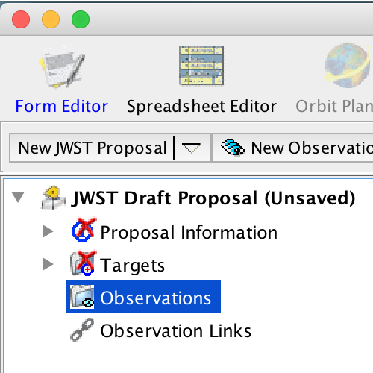
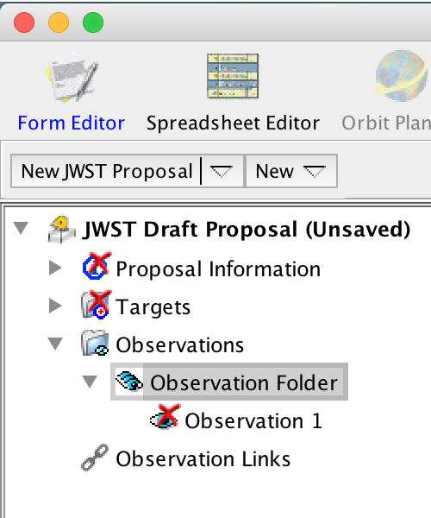
Create new observation folder containing new observation
11
12
14
13

Slide 5
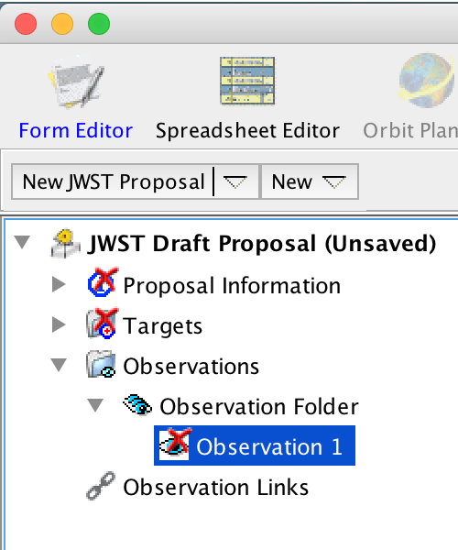
Select instrument
16
17
15
18

Slide 6
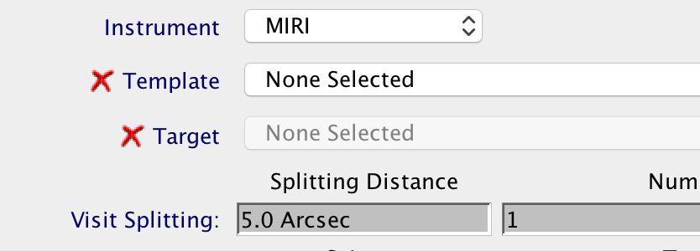
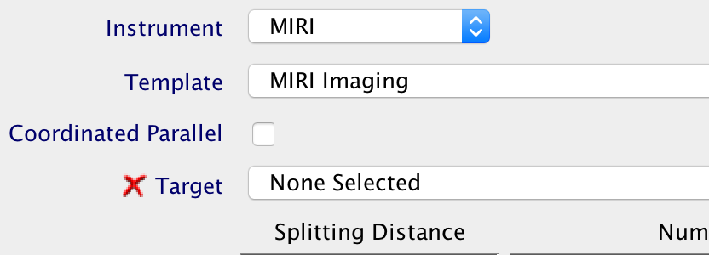
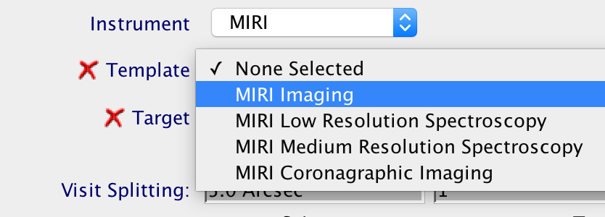
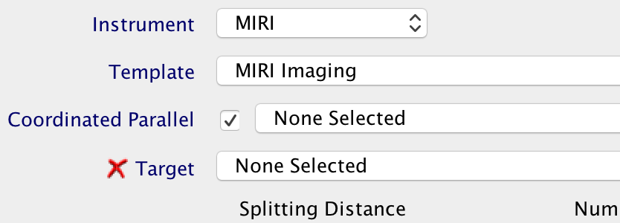
Select a template and enable coordinated parallel (if available)
19
21
20
22

Slide 7
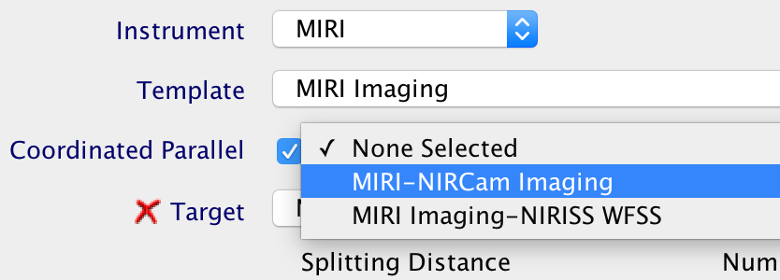
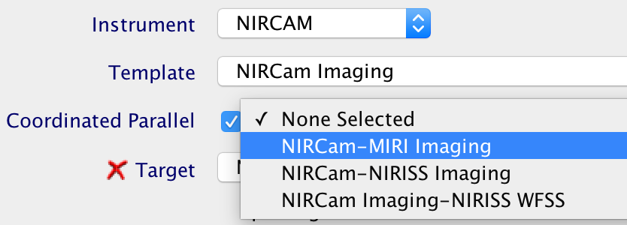
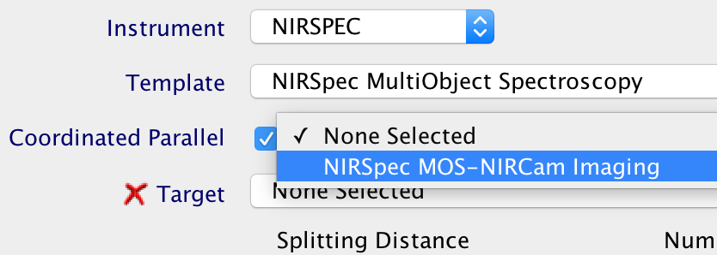
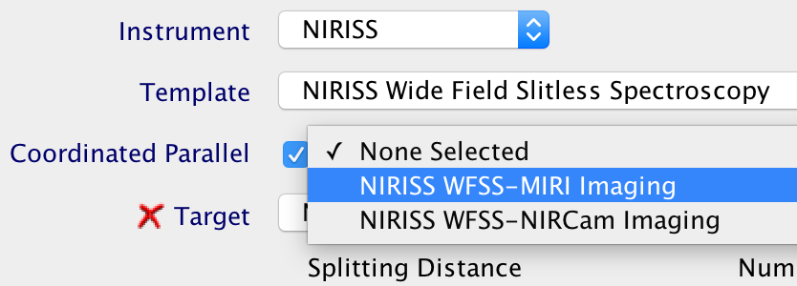
Available coordinated parallels
23

Slide 8
Select target
24
25
26

Slide 9
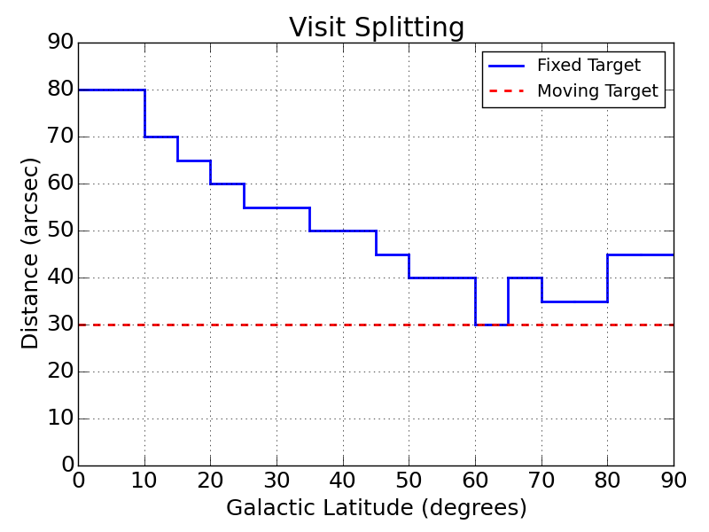
Visit splitting distance
An observation is one instance of a template
A visit begins with a guide star acquisition
APT will split an observation into multiple visits, if cumulative dithers exceed the splitting distance

Slide 10
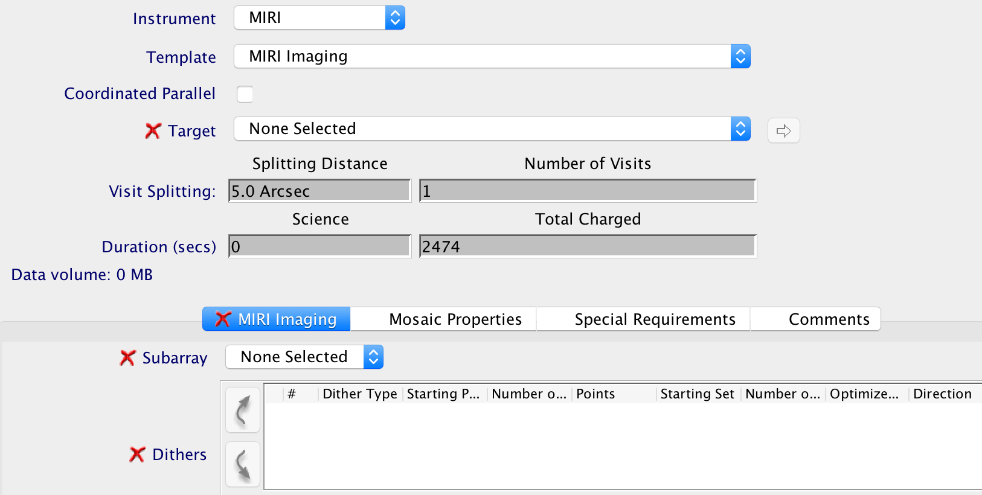
MIRI Imaging template without a coordinated parallel

Slide 11
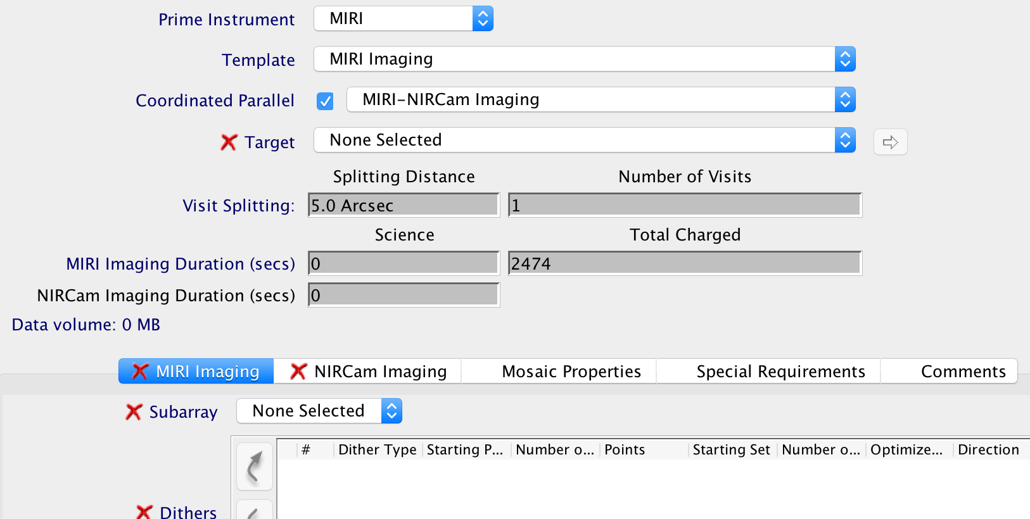
MIRI-NIRCam Imaging coordinated parallel

Slide 12
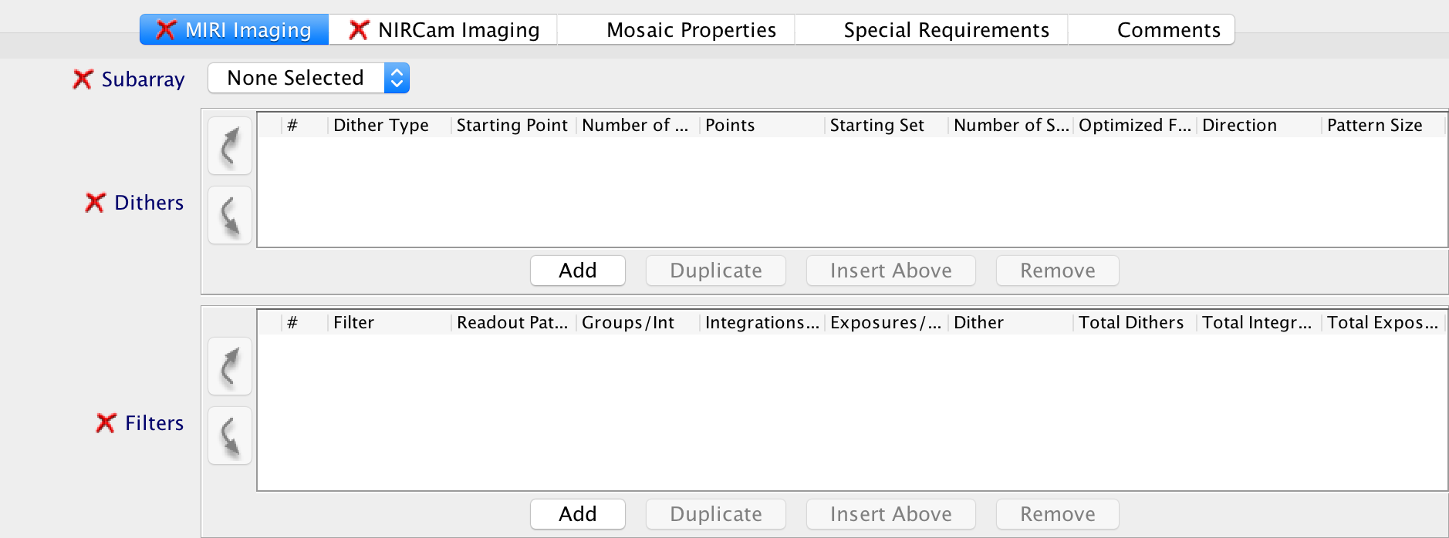
We need to specify template parameters for the prime instrument
27
28

Slide 13
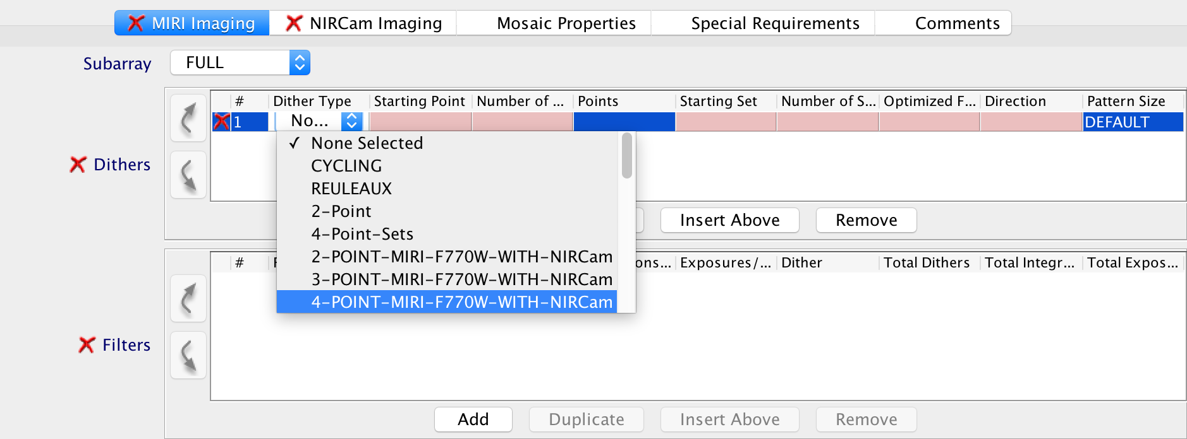
Specify subarray and dither type for the prime instrument
29
30
For parallel imaging, APT offers additional dither options

Slide 14
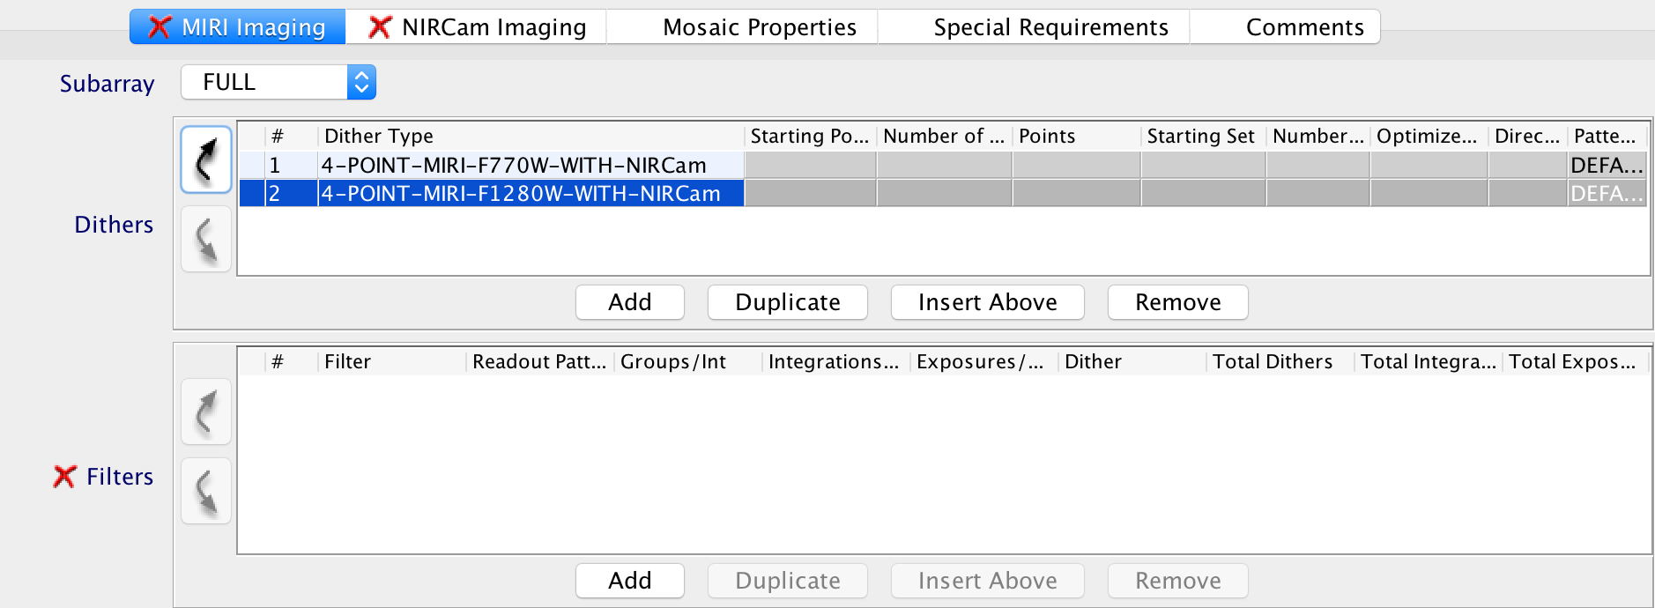
Specify a second dither type optimized for a different wavelength
31
32

Slide 15
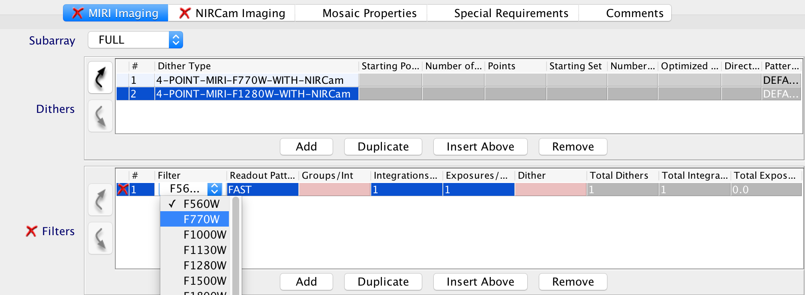
Select filter, groups per integration, and dither specification
34
35
33

Slide 16
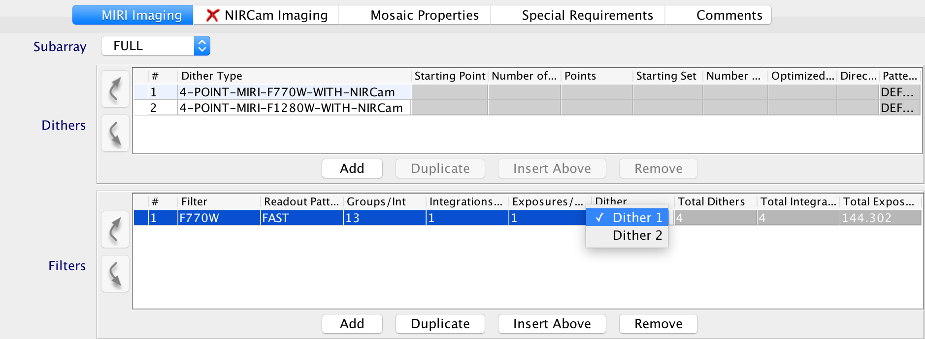
Select dither specification
36

Slide 17
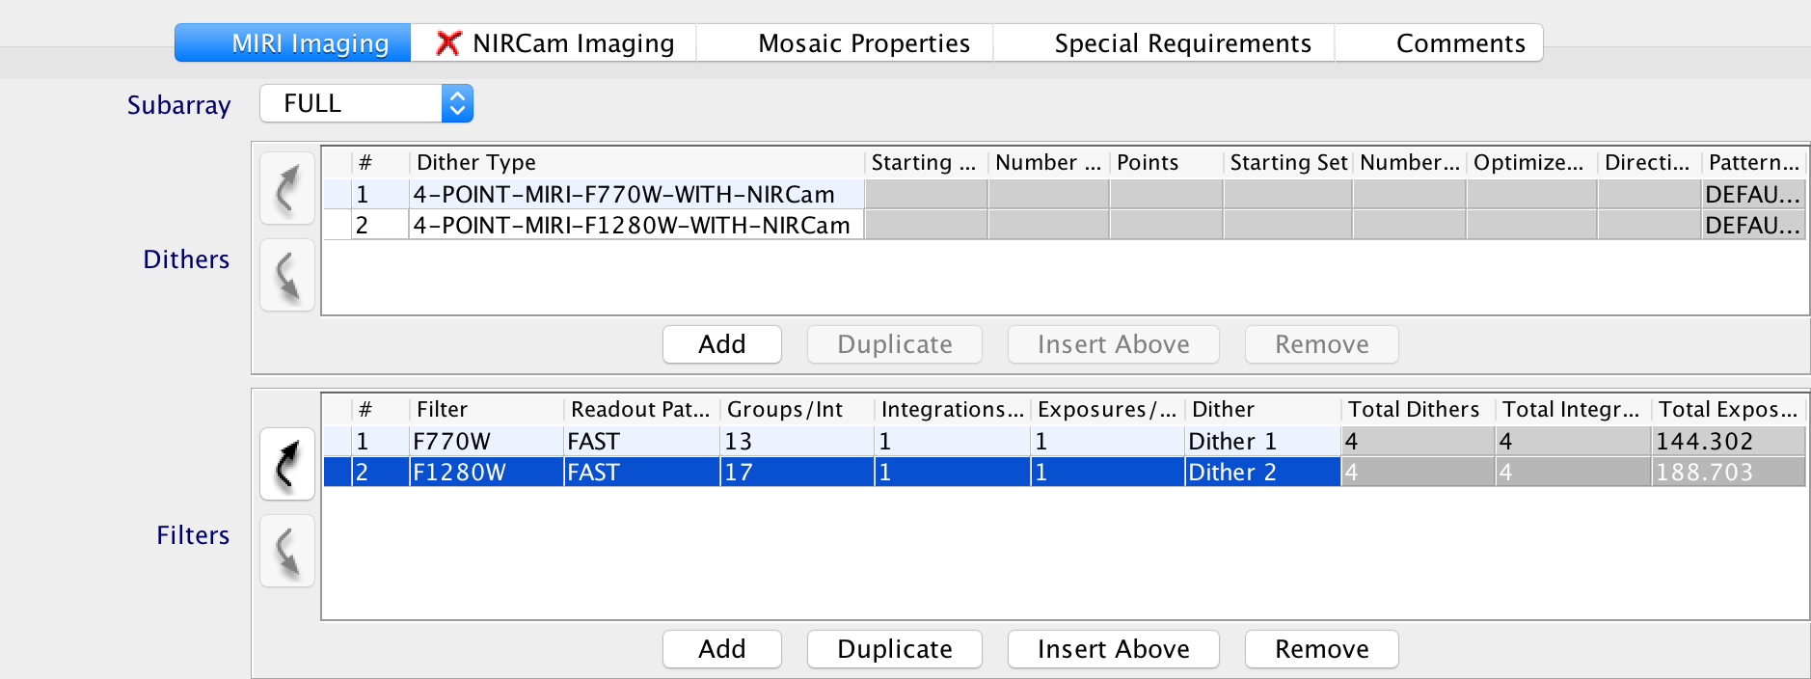
Done specifying template parameters for prime instrument
39
36
37
38

Slide 18
We need to specify parameters for the parallel instrument
37
38
39

Slide 19
Prime and parallel must have same number of exposure specifications
40
41
42
43
44
45

Slide 20
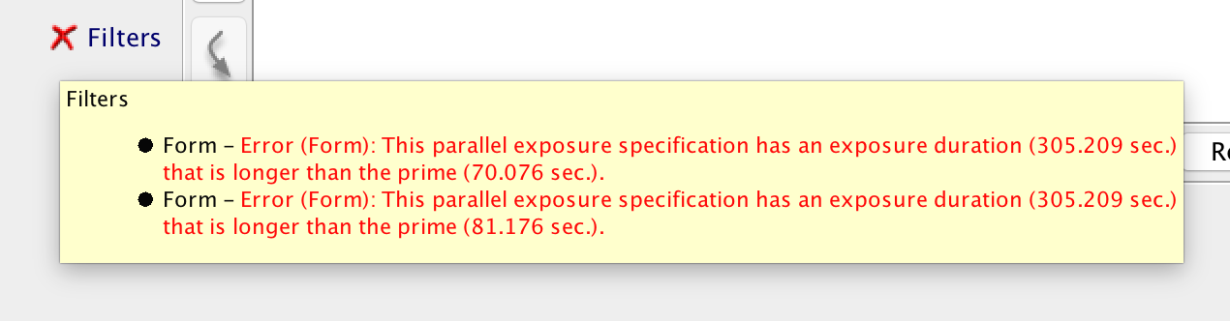
Parallel exposure duration must be shorter than prime
46
47
48
49

Slide 21
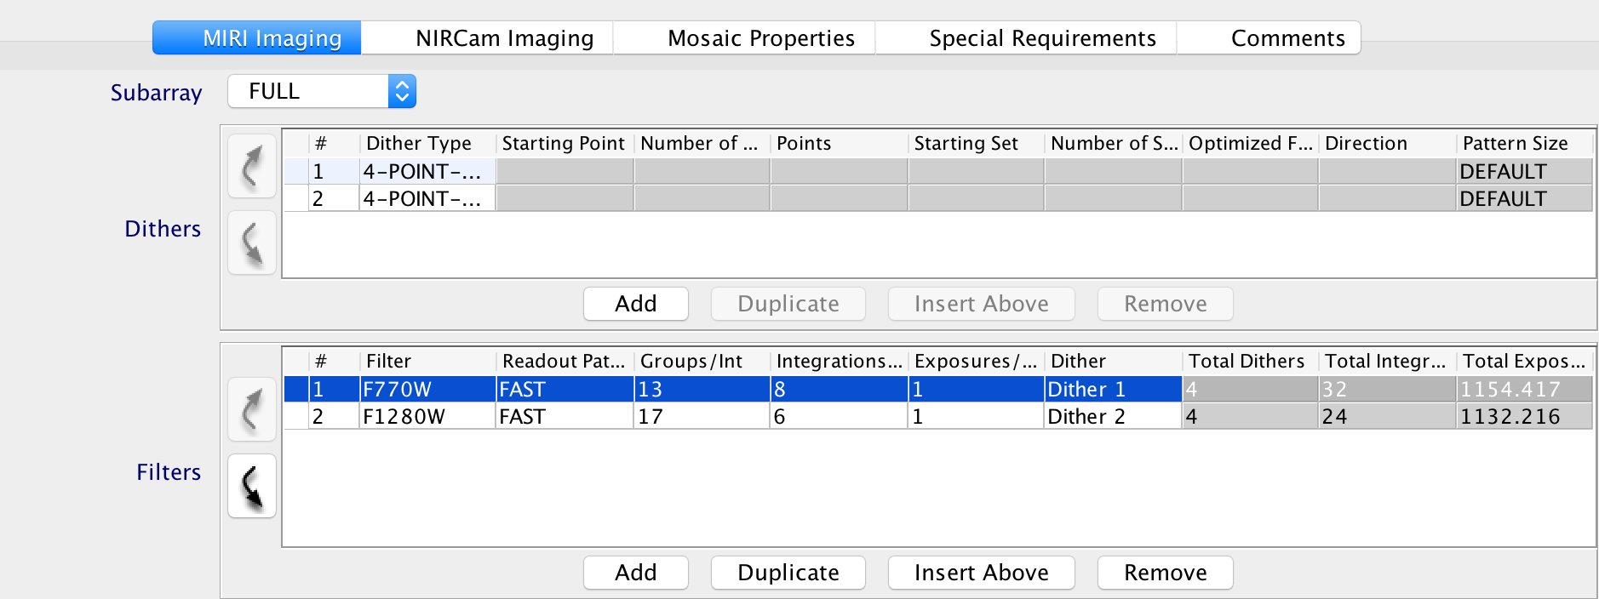
We could increase number of integrations for the prime instrument
50
51 (one way to get rid of the errors)

Slide 22
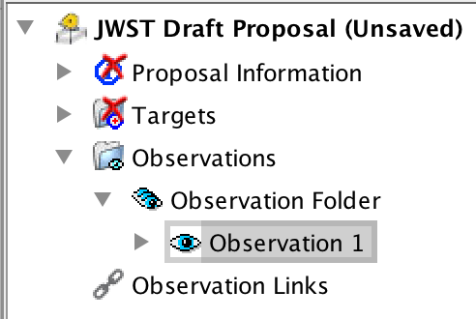
No errors in observation. Check Visit Planner, View in Aladin, …
52
53
54
Questions?

