Slide 1



The MSA Planning Tool (MPT) is a team effort:
Diane Karakla, Gary Curtis (APT), Christine Ritchie (tester), Tracy Beck (NIRSpec team lead), Alaina Henry
Contributors: K. Gilbert, J. Valenti, S. Kassin, D. Soderblom and others based on an IDL prototype by
Klaus Pontoppidan
PLANNING MOS SPECTROSCOPY WITH THE NIRSPEC
MICRO-SHUTTER ARRAY (MSA)
Diane Karakla
Oct 5 2017
2017 ESAC JWST Workshop - “Get Set”

Slide 2
Observing with the MSA - What you need to know
MOS process overview
MSA characteristics that impact MOS observation planning
Target Acquisition and Pre-Imaging considerations
The MSA Planning Tool (MPT)
  Input Catalog and Candidate Lists
  Key planning parameters
Demo: Planning NIRSpec MOS observations
HELP: Tools, Documentation and Helpdesk

Slide 3
Observing with the MSA - What you need to know
MOS process overview
MSA characteristics that impact MOS observation planning
Target Acquisition and Pre-Imaging considerations
The MSA Planning Tool (MPT)
  Input Catalog and Candidate Lists
  Key planning parameters
Demo: Planning NIRSpec MOS observations
HELP: Tools, Documentation and Helpdesk

Slide 4
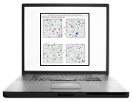


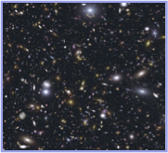
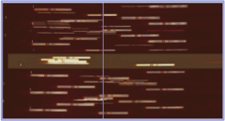
NIRSpec MOS Observation Process
NIRSpec MOS Spectroscopy will require a 2-phase approach:
(NIRCam) and Place-holder NIRSpec spectroscopy planning
Long Range Plan
Optional
NIRSpec spectroscopy planning
(2-4 weeks)
NIRSpec MSA
Fixed-Orient Obs
Plan Window
TAC
acceptance
NIRCam
Pre-Imaging
PC Verification, Scheduling
(4 wks)
Proposal
Submission
Fixed Orient
assigned
Cycle Start
Flight Ready Program Updates Due
Idea for
MOS Survey
Proposal Submission: Users request the total time needed (including overheads) to observe an expected number of targets to desired exposure depths.
The MSA Planning tool (MPT) must be used with simulated or existing catalogs to explore the effects of key observation parameters (dithers, slitlet length, source centering constraint, etc.) on the total time estimate. We need these representative Visits to create a long range plan for your observations.

Slide 5
NIRSpec MOS Observation Process
NIRSpec MOS Spectroscopy will require a 2-phase approach:
(NIRCam) and Place-holder NIRSpec spectroscopy planning
Long Range Plan
Optional
NIRSpec spectroscopy planning
(2-4 weeks)
NIRSpec MSA
Fixed-Orient Obs
Plan Window
TAC
acceptance
NIRCam
Pre-Imaging
PC Verification, Scheduling
(4 wks)
Proposal
Submission
Fixed Orient
assigned
Cycle Start
Flight Ready Program Updates Due
Idea for
MOS Survey
For scheduling flexibility, most MOS observations will be assigned an orient after TAC acceptance.
Flight-Ready Updates: After an Orient is assigned, and pre-imaging becomes available.
Use MPT to create schedulable Visits
Shutter status evolves, you need to update your program close in time to the flight update deadline

Slide 6
Observing with the MSA - What you need to know
MOS process overview
MSA characteristics that impact MOS observation planning
Target Acquisition and Pre-Imaging considerations
The MSA Planning Tool (MPT) in APT
  Input Catalog and Candidate Lists
  Key planning parameters
Demo: Planning NIRSpec MOS observations
HELP: Tools, Documentation and Helpdesk

Slide 7
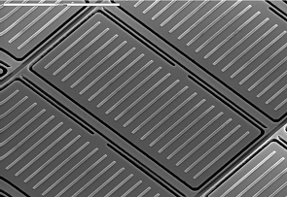
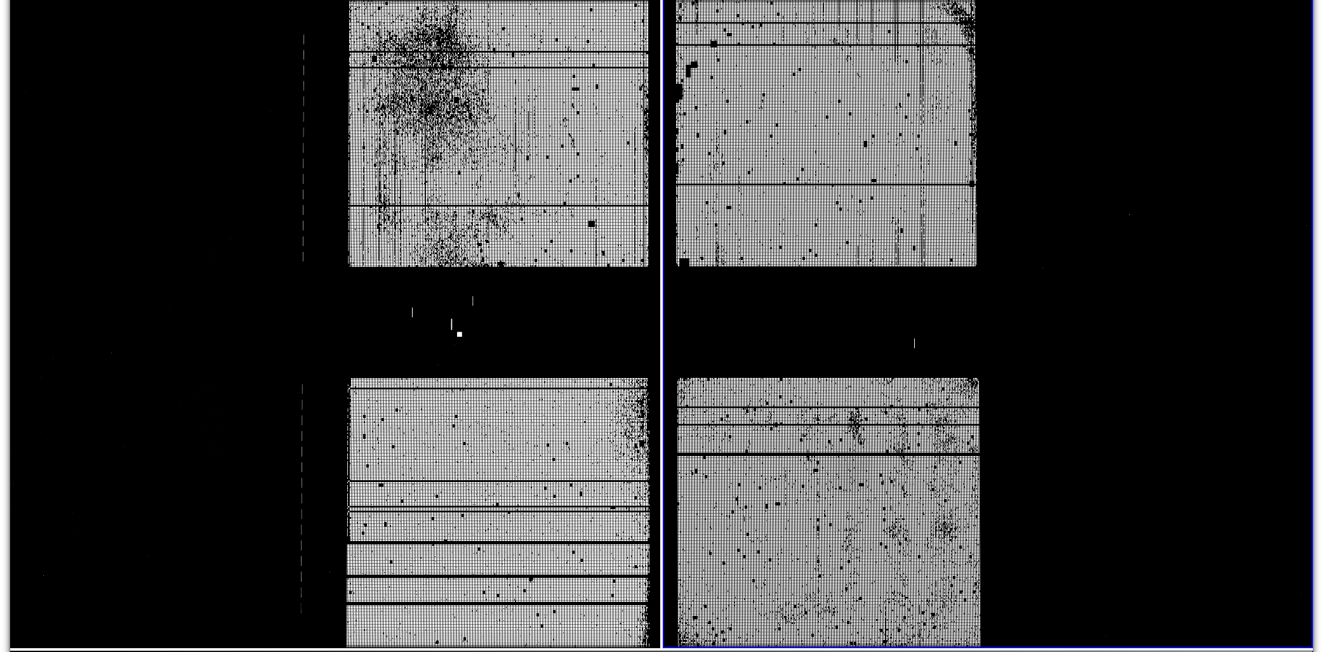
MSA Characteristics that create Observation Planning Challenges
The MSA is a fixed grid (with shutter bars that vignette light from sources behind them)
Gap (~20”)
Gap between the 2 detectors → missing wavelengths.
Source positions in MSA require knowledge of optical distortions/ velocity aberrations at a planned Aperture Position Angle.
Quad 3
Quad 1
Failed Closed Shutters
Quad 4
Quad 2
The MSA has Failed shutters, shorted rows/columns. Shutter status can evolve! STScI will will notify users of updates to shutter status that may affect their program.
→ use MPT!
Dither to cover gap, mitigate detector artifacts, improve resolution, observe sources behind bars or mounting plate.
Typically want to observe as many sources as possible, at all dithers!
MPT deliverables:
optimal pointings
MSA configurations
Observed Targets will be selected from your Primary Candidate and Fillers lists

Slide 8
Observing with the MSA - What you need to know
MOS process overview
MSA characteristics that impact MOS observation planning
Target Acquisition and Pre-Imaging considerations
The MSA Planning Tool (MPT) in APT
  Input Catalog and Candidate Lists
  Key planning parameters
Demo: Planning NIRSpec MOS observations
HELP: Tools, Documentation and Helpdesk

Slide 9
Target Acquisition (TA)
TA Choices:
  NONE (Point and Shoot, ~100 mas delivered, TBD)
  MSATA (Standard TA with Reference stars, ~15-20 mas delivered with NIRCam catalog accuracies)
  VERIFY_ONLY (Point and Shoot with Imaging).
  WATA (Wide Aperture TA) – coming in APT 25.4. Primarily for moving targets. Not compatible with MPT-generated MOS observations.
FOR Standard MSATA:
  Shutters are 200 x 460 mas (open area). Requires pointing accuracy for most cases < ~20mas.
Standard MSATA images the TA reference stars to determine pointing adjustments.
Need 5 to 20 TA reference stars for each Visit (Compact galaxies may be used if needed.)
Reference stars can only be specified in APT after a position angle is assigned —> this must be done at the flight-ready program update stage.
A future dedicated script will be provided to assist in the selection of candidate TA reference stars.
The Catalog should contain as many candidate TA reference stars as possible, over as large a field of view as possible (slightly larger than the MSA FoV). MPT will help select the 20 best (brightest, observable) reference stars for each Visit.
NIRCam pre-imaging may help find point sources suitable as reference stars.

Slide 10
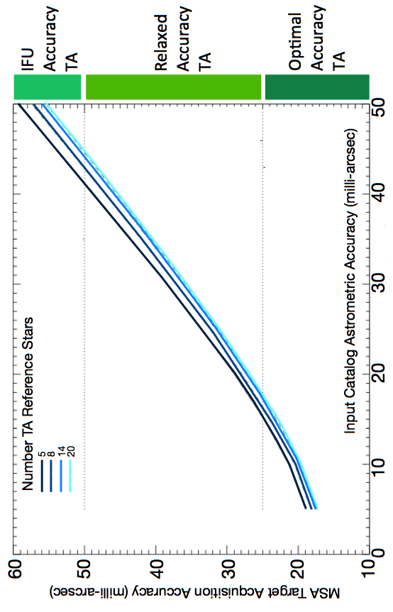
Catalog Astrometric Accuracy Requirements
– Is NIRCAM pre-imaging necessary ?
Pointing accuracy depends on Catalog relative astrometric accuracy.
MSA shutters are small: ~200 milli-arcsec wide.
Normally, HST or NIRCam imaging is required for standard MSA target acquisition
Reduced catalog relative astrometric accuracy will result in loss of throughput for some sources, and a larger flux calibration error
NIRCam & HST
Figure from T. Beck Proc. SPIE 9910 July 15 2016

Slide 11
NIRCam Pre-Imaging Considerations
WHY?
Finest Catalog accuracy
Find new sources
Find suitable reference stars
If NIRCam Pre-imaging is needed, the area should minimally cover the MSA FoV – typically 2x1 mosaic + dithers to cover the gaps to cover an area of about 5’x 5’
3Tight NIRCam dither pattern with 2x1 mosaic
The live JDox page for the NIRSpec Observation Visualization Tool (L. Ubeda) is
https://jwst-docs.stsci.edu/display/JPP/JWST+NIRSpec+Observation+Visualization+Tool+Help

Slide 12
Observing with the MSA - What you need to know
MOS process overview
MSA characteristics that impact MOS observation planning
Target Acquisition and Pre-Imaging considerations
The MSA Planning Tool (MPT) in APT
  Input Catalog and Candidate Lists
  Key planning parameters
Demo: Planning NIRSpec MOS observations
HELP: Tools, Documentation and Helpdesk

Slide 13
General description of MPT
User loads the Catalog and defines Primary and optional Filler candidate lists.
User selects an APA, a slit shape, a centering constraint, and dithers in dispersion and/or spatial directions.
MPT creates a grid of test pointings over the area of your Primary Candidate List.
At each pointing, it sums the weights of all observable sources in an MSA configuration. The order of the Catalog and Candidate lists influences the target selection.
The set of pointings with the largest score is selected.
Products: Pointings, a set of Targets, and MSA configurations.

Slide 14
Observing with the MSA - What you need to know
MOS process overview
MSA characteristics that impact MOS observation planning
Target Acquisition and Pre-Imaging considerations
The MSA Planning Tool (MPT) in APT
  Input Catalog and Candidate Lists
  Key planning parameters
Demo: Planning NIRSpec MOS observations
HELP: Tools, Documentation and Helpdesk

Slide 15
Catalog Format and Content
Observations must be planned using a single Catalog (simulated, or derived from NIRCam or HST observations, or from other observatories). Flight Updates can be made using a refined Catalog. The Catalog should be as complete as possible.
Format: an Ascii file with comma-, tab-, or white-space-separated values
Optional single-line header at the top (marked with a leading pound symbol “#”) showing column labels, minimally needed columns: RA and DEC.
Commonly included column types that are automatically recognized by MPT during ingest:
        ID, RA, DEC, magnitude, magnitude error, redshift, WEIGHT
Extra columns needed for Flight Update program for MSATA with reference stars: Stellarity, NRS_F110W, NRS_F140X, NRS_CLEAR, REFERENCE (TRUE/FALSE)
The NIRSpec team is working on a script to run the ETC with an input catalog to calculate the last 4 columns above from Stellarity plus NIRCam or HST magnitudes.
# RA | DEC | MAG_F160W | MAGERR_F160W | WEIGHT
53.16054039 | -27.79774121 | 17.85 | 0.01 | 300
53.17103742 | -27.78765924 | 19.21 | 0.10 | 100
53.16553235 | -27.77259145 | 20.10 | 0.05 | 50

Slide 16
PRIMARY and filler candidate lists
Primary and Filler candidate lists are subsets of sources derived from the Catalog and used to design a MOS Plan.
These lists can be filtered from the Catalog by filtering values in one or more columns.
Primary Candidate List: These sources are used to find preferable pointings. Source weights are (optionally) used in making this determination. Plans are scored by the summed weights at a given test pointing.
Filler Candidate List: These sources are used to help fill the MSA after any pointings are chosen. Source weights are not used.
Target Sets that are chosen by the tool include sources from these two lists.

Slide 17
Observing with the MSA - What you need to know
MOS process overview
MSA characteristics that impact MOS observation planning
Target Acquisition and Pre-Imaging considerations
The MSA Planning Tool (MPT) in APT
  Input Catalog and Candidate Lists
  Key planning parameters
Demo: Planning NIRSpec MOS observations
HELP: Tools, Documentation and Helpdesk

Slide 18


Key Planning Parameters in MPT: Slitlet Shape
0.2”
Slitlet shape (1, 2, 3, or 5 shutters)
MSA bars ~74 mas
One shutter – perfectly centered point source
0.46”
Multiplexing (the number of observable sources in an MSA configuration) depends on slitlet length
see poster by Emily Wislowski which shows examples of this effect
Background measurements are taken from the shutters without the planned target.
Important to check that no other sources are in the slitlet to avoid contamination of target spectra.
Default configuration, good for compact sources. Provides 2 background measurements per exposure.

Slide 19
Poster on performance with MPT
by Emily Wislowski
https://jwst-docs.stsci.edu/display/JPP/NIRSpec+MPT%3A+Performance+Statistics
Poster on NIRSpec Observation Visualization Tool
by L. Ubeda
https://jwst-docs.stsci.edu/display/JPP/JWST+NIRSpec+Observation+Visualization+Tool+Help

Slide 20
Key Planning Parameters in MPT: SOURCE CENTERING CONSTRAINT (AKA Shutter MARGIN)
Shutter margin helps to limit slit losses (5 choices):
A catalog relative accuracy of ~15 mas is needed to effectively constrain source centering.
0.2”
TA-delivered pointing accuracy
NIRSpec MSA Slit Throughput vs. Source Centering
Perfectly centered
0.46”
Unconstrained
Open Shutter Area
Tightly Constrained
Midpoint
Constrained
Figure from T. Beck
Proc. SPIE 9910 July 15 2016
Shutter Planning Constraints

Slide 21
Key Planning Parameters in MPT:
Nodding, DITHERING, and background subtraction
NODDING
Telescope is moved slightly to place the sources into different shutters in the same slitlets. NO MSA reconfiguration is needed.
Nodding is advised to dither with less overhead – same MSA configuration is used.
3
6
1
4
2
5
DITHERING
Larger telescope moves requiring the MSA to be re-configured.
We recommend Fixed Dithers for obtaining the most matched sources at all dithers. It is appropriate for any size dither.
3-shutter slitlet
BACKGROUND SUBTRACTION
Background spectra are derived from shutters without targets.
Single pointing – spectra from background shutters are co-added and subtracted from target spectrum.
With Nods: Data from 3 nods will be associated and processed by the pipeline to perform background subtraction of target position wrt background shutters from other exposures in the nod set.
3
1
2
5-shutter slitlet with 3 nods

Slide 22
MPT Demo
http://apst.stsci.edu/apt/external/downloads/installers/install.html
2017 ESAC JWST Workshop 10/5/2017

Slide 23
HELPFUL TIPS
Order the input Catalog by target weights prior to ingest into MPT. When building an MSA cpnfiguration, MPT tries adding sources in the order they appear in the Catalog.
Include Primary candidates in the Filler list to obtain extra observations of them.
Only the weights of the primaries matter (not the Fillers), so to help ensure observations of certain sources, include them in the Primary candidate list.
Note that the Fixed Slit algorithm is preferable to Flexible dithers at all dither separations (small or large). It yields the most sources at all dither points. Add Fillers to maximize efficiency/multiplexing. Flexible dithers yields fewer matched sources, but fills the MSA better.
If feasibility windows are large, test several APAs to see if it makes a statistical difference. If so, set conservative limits on requested exposure time. Add an Orient SR only if needed, with a min range of 30 deg.
If using the high-res gratings (G140H, G235H, G395H), attempt to get most sources onto the leftmost quadrants to avoid detector cutoffs.
Use Aladin FoV to show the position of NIRCam paralells wrt NIRSpec MSA.
Your catalog should be complete to be able to check for contaminants getting into Failed Open shutters, or into planned target shutters/slitlets.
The Manual Planner can be used to make changes to your MSA configurations designed automatically with MPT, but it’s tedious.

Slide 24
Observing with the MSA - What you need to know
MOS process overview
MSA characteristics that impact MOS observation planning
Target Acquisition and Pre-Imaging considerations
The MSA Planning Tool (MPT) in APT
  Input Catalog and Candidate Lists
  NIRSpec planning parameters
Demo: Planning NIRSpec MOS observations
HELP: Tools, Documentation and Helpdesk

Slide 25
How to get help
  JWST documentation—> JDOX (much has been written… more coming soon.)
  https://jwst-docs.stsci.edu/
Helpdesk (new— don’t email help@stsci.edu anymore!)
  http://www.jwsthelp.stsci.edu/
Community Lectures
  https://jwst.stsci.edu/news-events/events
Archived talks JWST Proposal and Planning Workshops
https://jwst.stsci.edu/science-planning/workshops-and-lectures/jwst-workshops

Slide 26
Backup Slides

Slide 27
JWST Instrument Apertures on the Sky
FoV footprints are provided in Aladin in APT
NIRSPEC Aperture Position Angle
(angle of Y axis wrt N):
APA = V3PA + 138º
dispersion
2
y
1
4
3
y

Slide 28
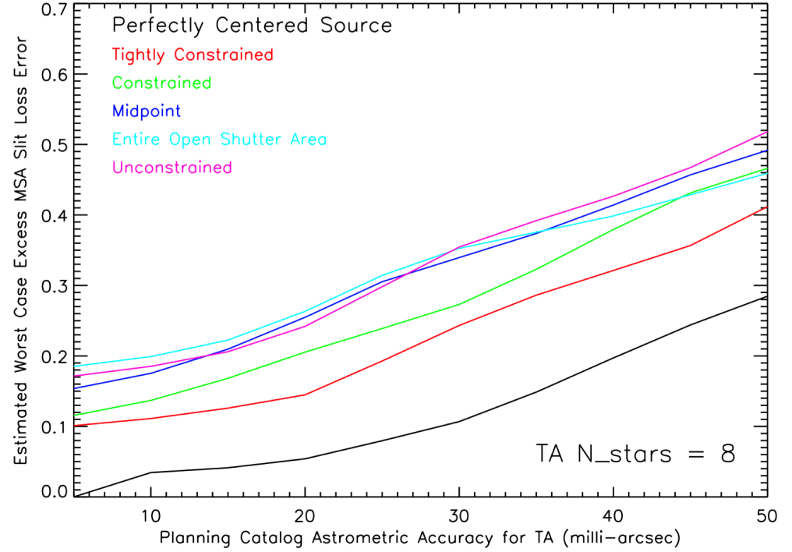
Catalog Astrometric Accuracy and Flux Calibration
The ability to flux calibrate sources depends on the pointing accuracy (=error in slit loss calibration)
MPT provides a way to further limit the Flux Calibration error expected after MSA TA down to ~10% (“Source Centering Constraint”) using HST- and JWST-pedigree catalogs.
HST &
NIRCam

Slide 29
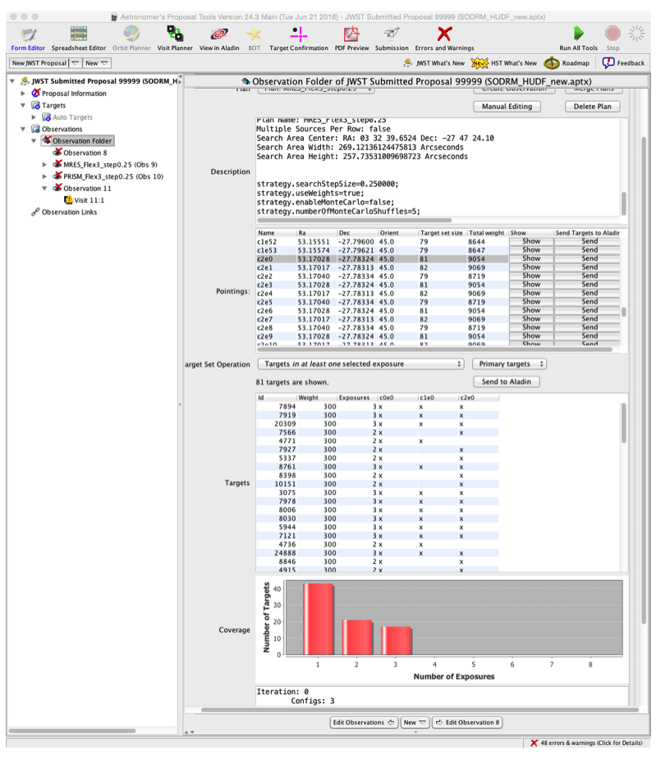
Review Plan Results
Ability to
select one or more exposures and
filter plan results to list primaries (or fillers or contaminants), or all observed sources.
1
2
View successful targets in all selected exposures
Histogram of targets from the selected and filtered results.

Slide 30
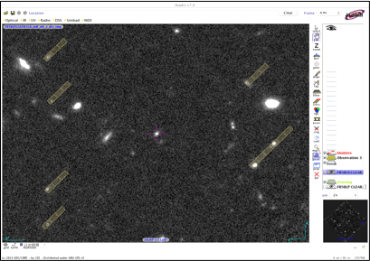
APT/MPT Visualization
MSA slitlets from a single pointing can be displayed on an image of the field in Aladin.
Source positions from one of the following lists
can be plotted in Aladin:
the catalog,
a candidate list made from the catalog, or
the target list from a Plan (observed MSA sources)

Slide 31
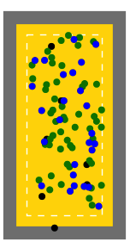
Plan Assessment Tools
There are some nice built-in tools to help assess plans:
Different Exposure views – click “Show” on an exposure to see this view
MSA Shutter View
Collapsed Shutter
View
Right: MSA shutter view. Targets are shown on a sketch of the MSA for one exposure. Users can click on or highlight targets for cross-examination with other views.
Left: Collapsed shutter view showing target centering results
0.”46
0.”06
0.”2
Green=Primaries
Blue=Fillers
Black=contaminants
Magenta shows highlighted targets

Slide 32
Other TOOLS

Slide 33
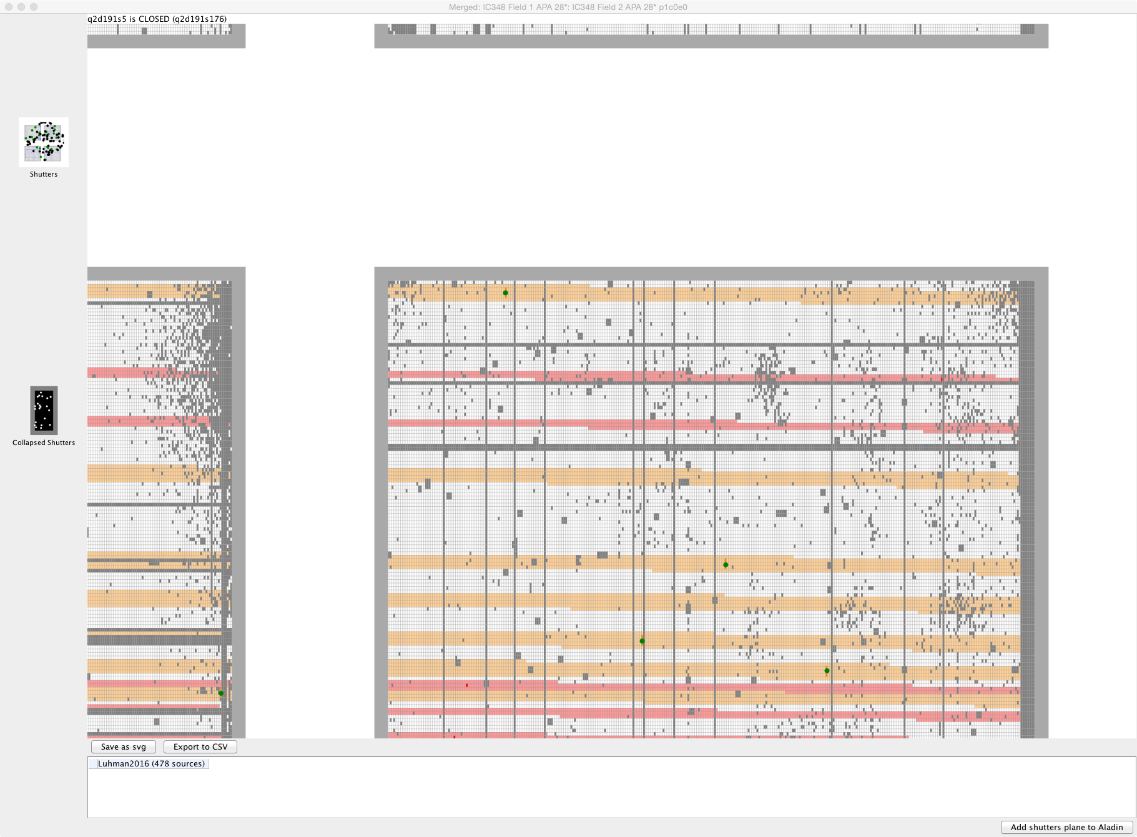
Zoom of MSA Shutter View
Red = masked by a Failed Open shutter
Orange = masked by a planned source slitlet

Slide 34
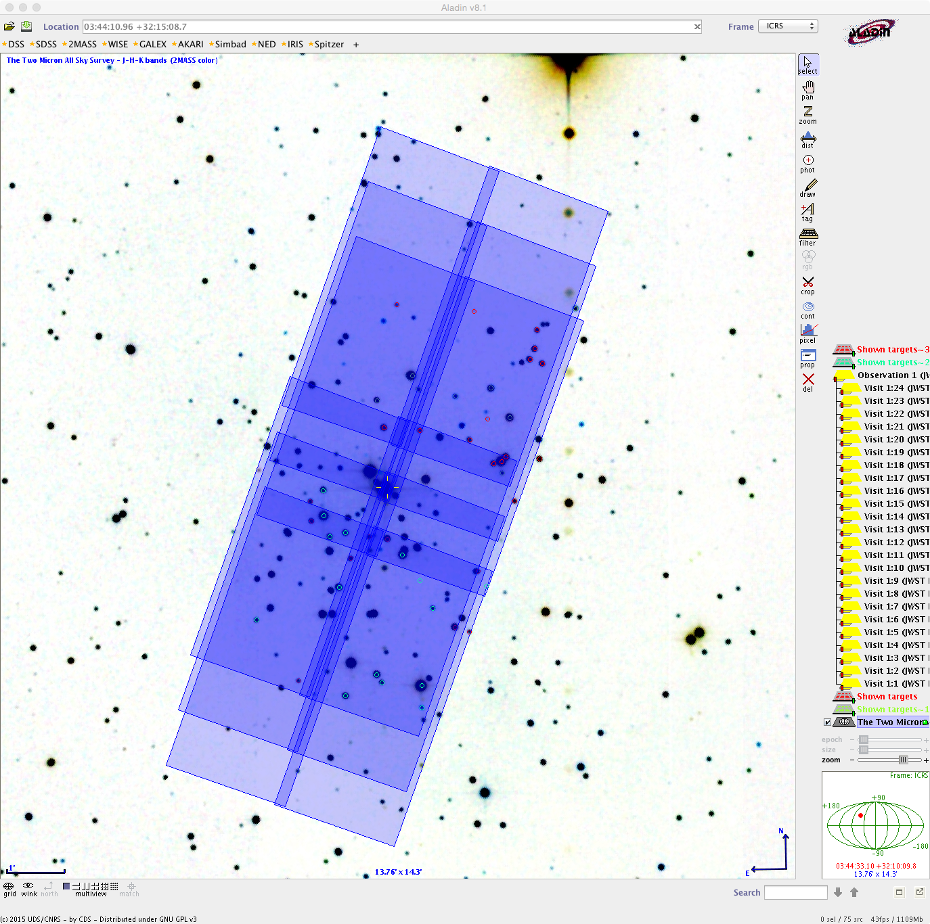
Example
NIRCam Obs
NIRCam Mosaic
2x2 tiles with
3Tight Dither Pattern
APA=240-260 degrees

Slide 35
NIRCam PRE-IMAGE ObsERVATION Summary

Slide 36
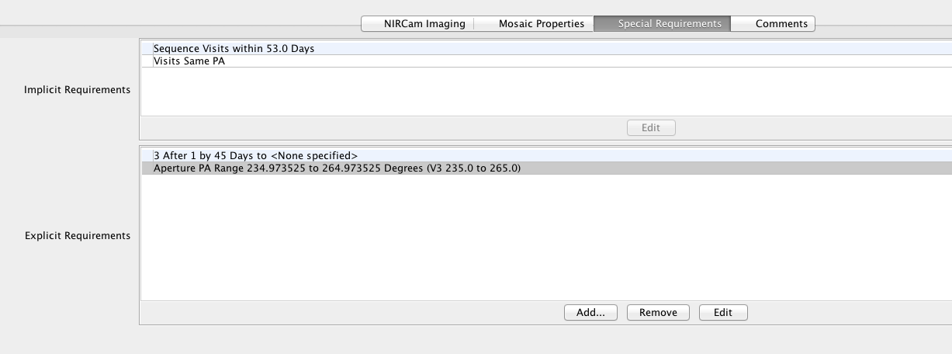
Special Requirements FOR MOS OBSERVATIONS
APA SR: if a particular range of aperture positions angles is required
ON HOLD SR and TIMING SR : If NIRCam pre-imaging is used -
    "ON HOLD for aperture position angle assignment”
    “AFTER <1> By <45 days> to <60 days>”

Slide 37
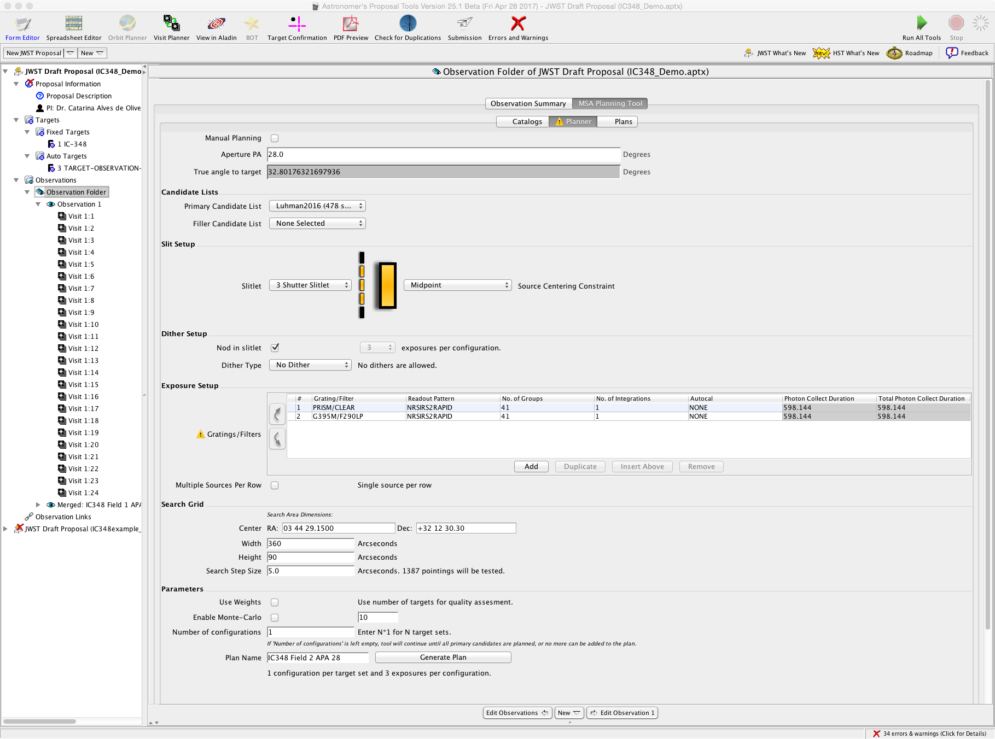
MPT - Planner

Slide 38
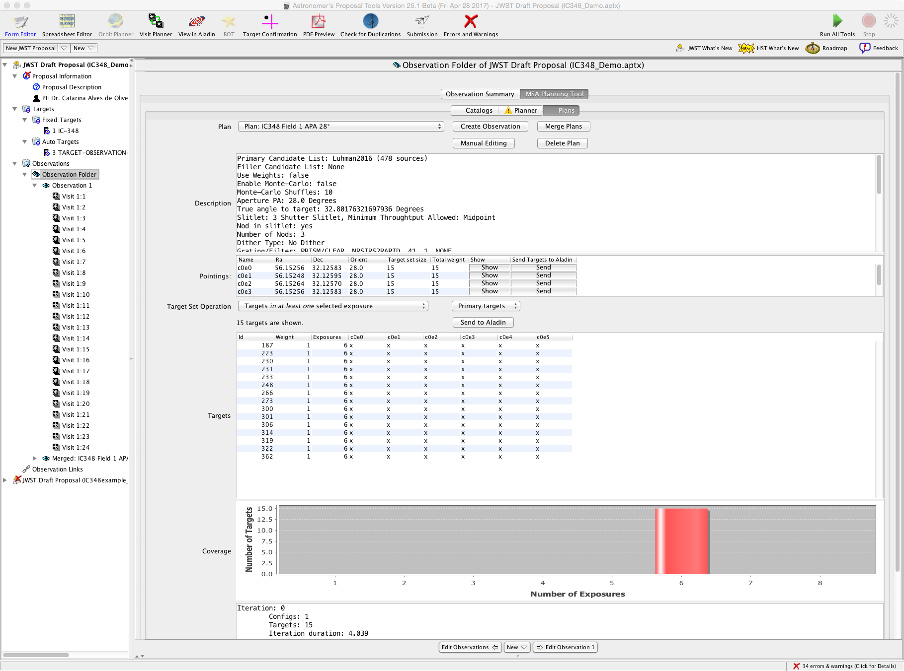
Plan 1

Slide 42
NIRSpec MOS Obs. Summary

Slide 43
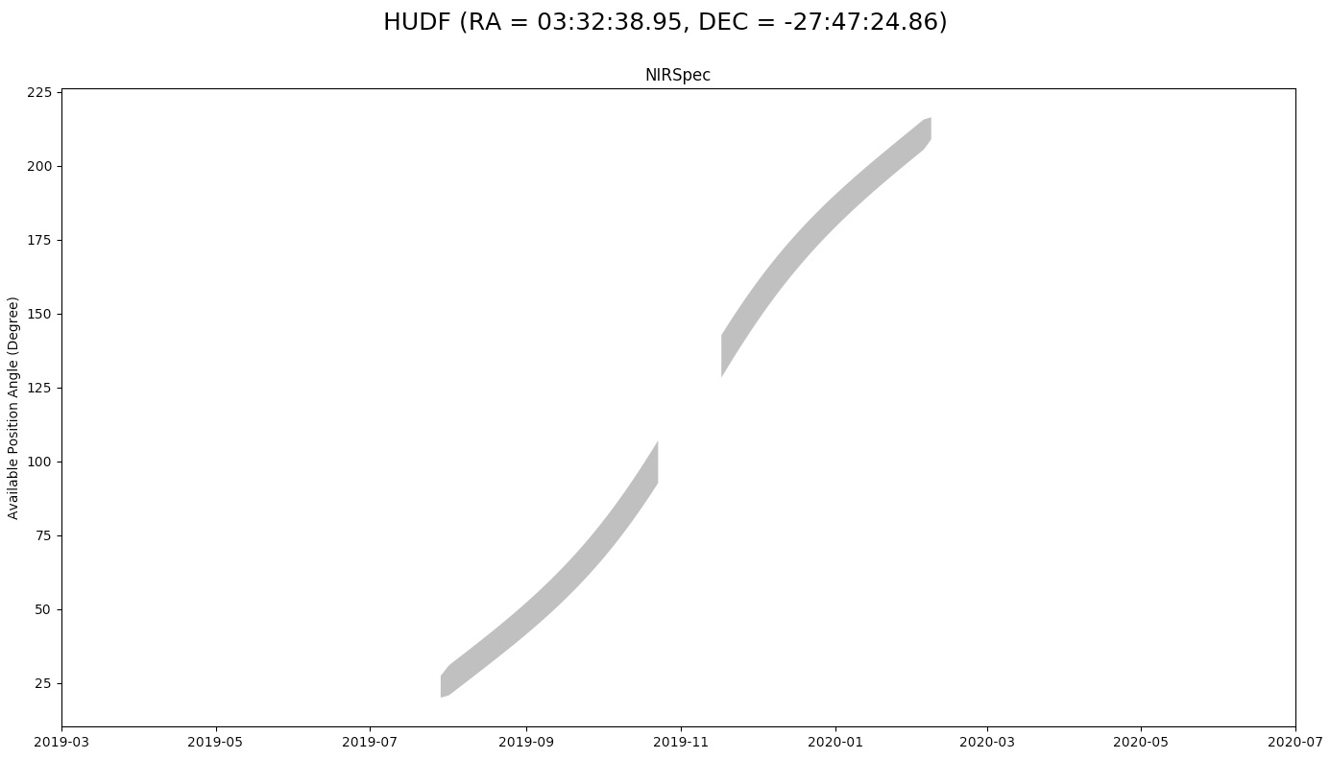
Target Visibility – Aperture Position Angle (APA)
MPT requires an APA for testing – but remember that one will be chosen for you if your proposal is accepted.
It’s best to test several APA (in cases where there is a large range of feasible APAs) to look for any effects on observing efficiency.
If you must restrict orients, a Special Requirement (SR) can be added. A minimum range of 30º is requested.
General Target Visibility Tool (GTVT)
JDOX article: https://jwst-docs.stsci.edu/display/JPP/
JWST+General+Target+Visibility+Tool+Help

