Slide 1
The JWST Coronagraphic Visibility Tool: Overview and Demo
Bill Blair
JWST Project Scientist for User Support
STScI/JHU
ESAC JWST Proposal Planning Workshop
Thur. Oct. 5, 2017

Slide 2
Why a Separate Coronagraphic Visibility Tool?
APT assesses individual observation requests in detail, checking all constraints, links, and guide star availability (i.e. “schedulability”). BUT…
Many coronagraphy applications require specific angles or ranges of angles and/or angular offsets between observations. This is difficult to assess within APT.
The CVT is intended as a “quick look” or “pre-planning” aid prior to APT work.
One can quickly assess what Position Angles, ranges and offsets are available for a given target as a function of time.
Coronagraphs have instrumental structures that can obscure portions of the field of view.
APT visualization doesn’t provide this level of detail.
APT still must be used to perform detailed schedulability checks in your proposal.

Slide 3
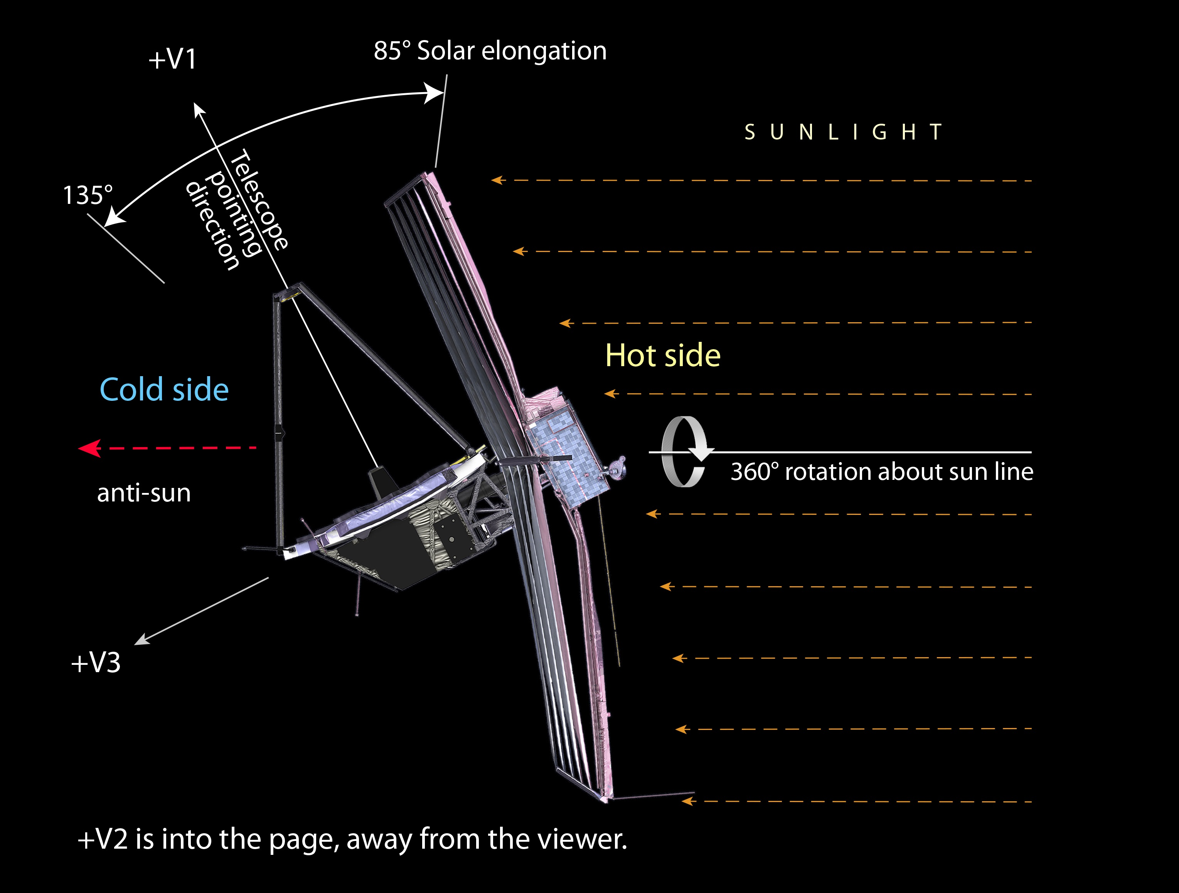
JWST Pointing Restrictions
Allowed Solar elongation angles

Slide 4
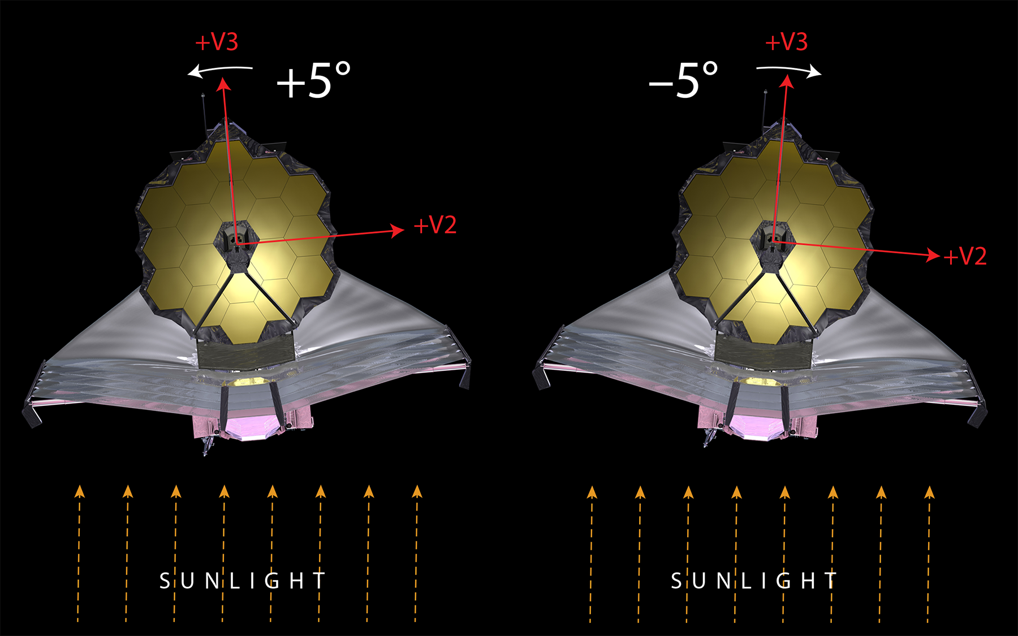
JWST Pointing Restrictions
Angle available for off-nominal roll angle
Roll about the bore sight
(really +/-3.5 to +/-7degrees)

Slide 5
JWST Coronagraphic Visibility Tool
Coronagraphic Visibility Tool – a GUI-based tool that provides general visibility windows for NIRCam and MIRI plus additional coronagraphic instrument mode support.
The tool is written in python, but runs in a GUI window, with a control panel and two plot windows, so no python knowledge needed.
One can install as an app and just click the app to start.
Or in Astroconda environment:
source activate astroconda
jwst-coronagraph-visibility-gui &
Everything else is done from the GUI!

Slide 6
Coronagraphic Visibility Tool (CVT)
User enters RA,Dec of the target (or can use a convenient name resolver to look up a given target automatically).
User selects instrument (NIRCam or MIRI) and the coronagraphic mask of interest, and clicks “Update Plot” to perform the calculation.
Results are displayed in the interactive plot frames.
Left: Target Visibility (as with the GTVT)
Right: Selected coronagraph FoV showing any instrumental obscurations.
Known companions can be added so their positions relative to the FoV can be judged versus time.

Slide 7
CVT Example
Simple example: entered “SS Cyg” and did a search; coords added automatically. Selected MIRI and Lyot coronagraph and hit “Update Plot.”
The fat blue line shows the visibility windows and MIRI aperture PA values over 1 year. The vertical thickness of the line shows the roll range available at any given time.
Note: Ecliptic coordinates reported here!
Visibility Plot
Instrument FoV Plot
“Update Plot”
Button
MIRI Target Acq
Quadrants indicated
Note: Plot controls are here!

Slide 8
Coronagraphic Visibility Tool (CVT), con’t.
As appropriate, the user can enter up to three “companions” to the target in the control panel. The positions of the companions as a function of time will be plotted in the right panel.
This allows the user to judge the positions of objects of interest relative to any obscurations in a particular coronagraph FOV.
For a known disk, enter two diametrically opposed companions at the PA of the disk to indicate the position angle of the disk in the FOV.
Plot controls for panning and zooming in the plots are also available for inspections of details (if desired).
Clicking on a track in the right panel highlights the corresponding point in the left panel, and vice versa.

Slide 9
CVT Example, con’t.
Adding a companion, at astronomical PA=100º and 5.1” away. Update Plot.
The red track at right is the track of the companion over the visibility period.
Click on the position where the track crosses the Lyot support to show the corresponding time in the left plot. One would want to avoid this time in scheduling.

Slide 10
CVT Example, con’t.
Here both panels have been enlarged to show the details.
ZOOM control

Slide 11
CVT Example, con’t.
HINT: To show a disk orientation, place a “companion” on either side at the PA of the disk. Use a different distance for the two companions so the tracks in the right panel will not overlap.
Note: two companions,
Same PA, opposite sides
Disk orientation shown by arrows on day 201

Slide 12
Questions?
JDox help here:
https://jwst-docs.stsci.edu/display/JPP/JWST+Target+Visibility+Tools
https://jwst-docs.stsci.edu/display/JPP/APT+Coronagraphic+Sequence+Examples
https://jwst-docs.stsci.edu/display/JPP/JWST+Coronagraphic+Observation+Planning
CVT Specific JDox article:
https://jwst-docs.stsci.edu/display/JPP/JWST+Coronagraphic+Visibility+Tool+Help
Help Desk:
jwsthelp.stsci.edu
(Demo of CVT.)

Slide 13
Coronagraphic Observation Strategy
Thou shalt observe your science target at 2 roll angles, differing by at least several degrees (a “roll dither”)
Thou shalt observe a reference star to measure the PSF (for PSF subtraction by the pipeline)
Thou shalt make these a non-interruptible sequence.
Figure credit: M. Perrin

Slide 14
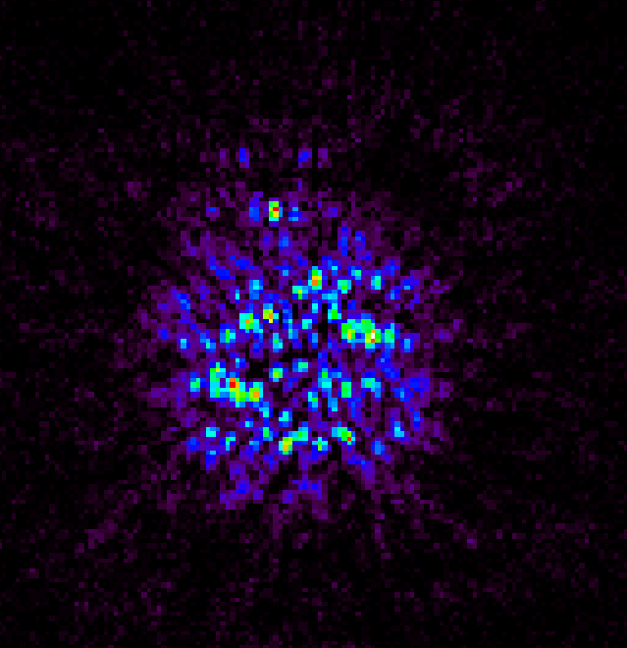
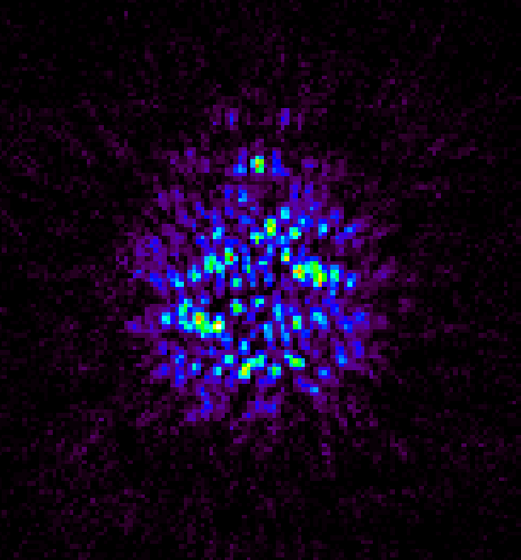
Guidelines to Follow:
Thou shalt observe your science target at 2 roll angles, differing by at least several degrees (a “roll dither”)
(Use PA offset Special Requirement in APT)
Mitigates bad pixels in science image
Rotates speckles wrt astrophysical scene

Slide 15
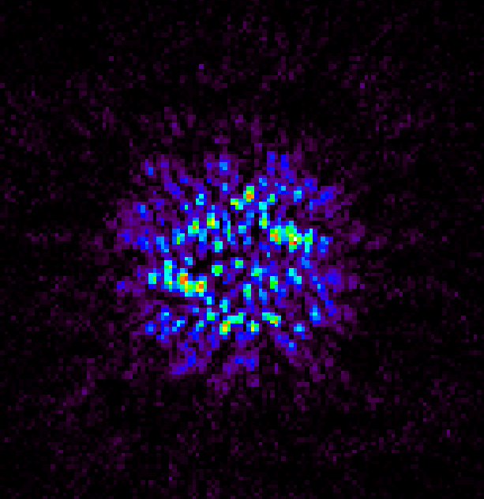
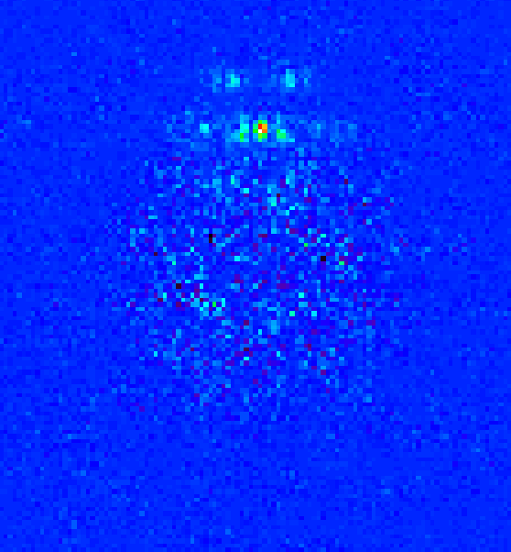
Guidelines to Follow:
Thou shalt observe a reference star to measure the PSF (for PSF subtraction by the pipeline)
Increases contrast by subtracting reference PSF from science image
Reference PSF target should be uncontaminated
Reference PSF target should be reasonably close in spectral type
Reference PSF target should be bright (shorter exposure time)
Reference PSF should be close to the science target (shorter slew time)
NOTE: Reference PSF observations are non-proprietary!

Slide 16
Guidelines to Follow:
Thou shalt make these a non-interruptible sequence.
(This is done in APT using a Special Requirement.)
Reduces PSF changes between science and reference observations by minimizing thermal changes or mirror phasing differences over time; produces higher contrast result
Science target & reference must be simultaneously visible
(Check with GTVT or CVT!)

Slide 17
The Basic Coronagraphic Sequence
Figure credit: M. Perrin
Obs # | Target | Roll | Inst | Mask | Filter
1 | Science | θ₀
2 | Science | θ₀ + Δθ
3 | Reference | N/A
Non-interruptible

Slide 18
A Multi-Filter Coronagraphic Sequence
Obs # | Target | Roll | Inst | Mask | Filter
1 | Science | θ₀ | NIRCam | 210R | F182M, F210M
2 | Science | θ₀ + Δθ | NIRCam | 210R | F182M, F210M
3 | Reference | N/A | NIRCam | 210R | F182M, F210M
Non-interruptible

Slide 19
A Multi-Instrument Coronagraphic Sequence
Obs # | Target | Roll | Inst | Mask | Filter
1 | Science | θ₀ | NIRCam | 210R | F182M
2 | Science | θ₁ | MIRI | LYOT | F2300C
3 | Science | θ₀ + Δθ | NIRCam | 210R | F182M
4 | Science | θ₁ + Δθ | MIRI | LYOT | F2300C
5 | Reference | N/A | NIRCam | 210R | F182M
6 | Reference | N/A | MIRI | LYOT | F2300C
Non-interruptible

Slide 20
A Multi-Epoch Coronagraphic Sequence
Obs # | Target | Roll | Inst | Mask | Filter
1 | Science | θ₀ | NIRCam | SWB | F210M
2 | Science | θ₀ + Δθ | NIRCam | SWB | F210M
3 | Reference | N/A | NIRCam | SWB | F210M
4 | Science | θ₁ | NIRCam | SWB | F210M
5 | Science | θ₁ + Δθ | NIRCam | SWB | F210M
6 | Reference | N/A | NIRCam | SWB | F210M
Non-interruptible
Non-interruptible

Slide 21
APT Examples
APT contains to example coronagraphic programs to play with.
Open APT, and from the File pull down menu, select “JWST Demonstration Proposals”
Then choose “MIRI Coronagraphy Example” or “NIRCam Coronagraphy Example”
There is also a descriptive article in JDox that goes along with these example files:
https://jwst-docs.stsci.edu/display/JPP/APT+Coronagraphic+Sequence+Examples

Slide 22
APT Example Sequence
MIRI Coronagraphic Imaging

Slide 23
APT Example—Special Reqs
Special Requirements

Slide 24
Questions?
JDox APT Coronagraphy help here:
https://jwst-docs.stsci.edu/display/JPP/NIRCam+Coronagraphic+Imaging+Template+APT+Guide
https://jwst-docs.stsci.edu/display/JPP/MIRI+Coronagraphic+Imaging+Template+APT+Guide#MIRICoronagraphicImagingTemplateAPTGuide
APT Specific JDox article:
https://jwst-docs.stsci.edu/display/JPP/JWST+Astronomers+Proposal+Tool+Overview
Help Desk:
jwsthelp.stsci.edu
(Demo of APT for coronagraphy.)

