Slide 1
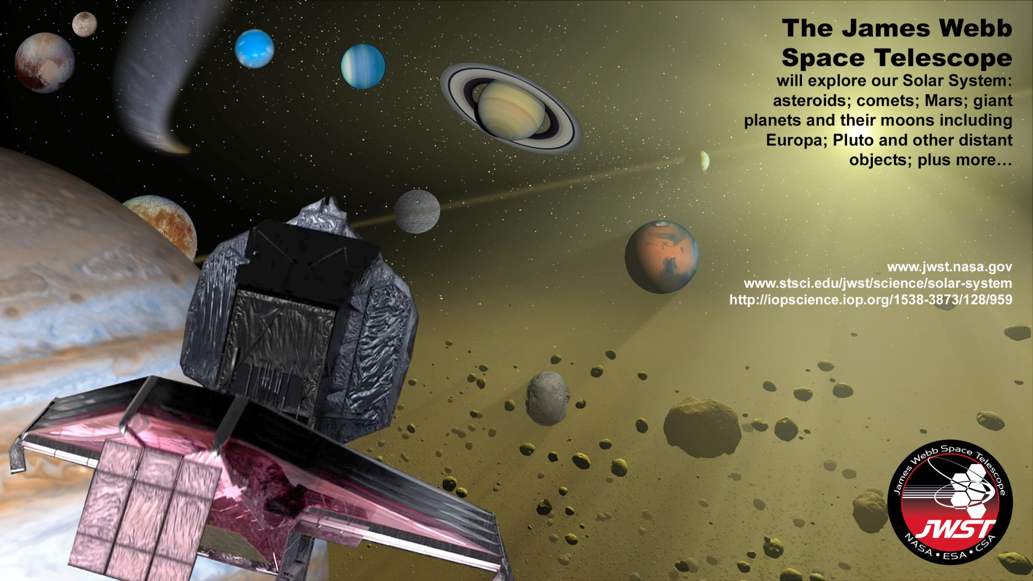
JWST Solar System
Capabilities
ESAC 2017 JWST Workshop
Tony Roman (STScI)
5 October 2017
Stefanie Milam
(GSFC, JWST Deputy Project Scientist for Solar System)
J. Stansberry (STScI)

Slide 2
Overview
Solar System Science with JWST
JWST Moving Target Tracking Performance
Moving Target Commissioning
Field of Regard
Target Acquisition
ETC
APT

Slide 3
Solar System Science Highlights

Slide 4
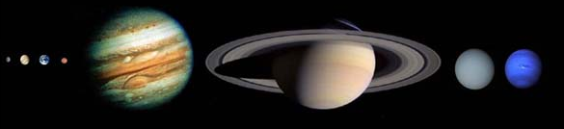
PASP Special Issue
(Jan 4, 2016)
Innovative Solar System Science with the James Webb Space Telescope
Stefanie Milam, Special Editor
http://iopscience.iop.org/1538-3873/128/959
11 topical papers
http://iopscience.iop.org/1538-3873/128/960
1 high-level paper (Norwood et al.)
4

Slide 5
10 JWST Solar System Focus Groups
(and 11 papers! http://iopscience.iop.org/1538-3873/128/959
Asteroids (Andy Rivkin, JHU/APL)
Comets (Chick Woodward, U. Minnesota)
Giant Planets (Jim Norwood, NMSU)
Mars (Geronimo Villanueva, GSFC)
NEOs (Cristina Thomas, GSFC)
Occultations (Pablo Santos-Sanz, IAA-CSIC, Spain)
Rings (Matt Tiscareno, Cornell)
Satellites (Laszlo Kestay, USGS)
Titan (Conor Nixon, GSFC)
TNOs (Alex Parker, SwRI)
JWST Solar System Capabilities (Milam, GSFC)

Slide 6
Performance Overview of JWST for Moving Targets

Slide 7
Moving Targets – Observatory, Flight Software
Non-sidereal tracking – Implemented.
    Rates up to 30 mas/s (108’’/hr) supported (max rate of Mars)
      Modeling shows excellent pointing stability (< 7mas NEA), ~same as fixed targets
    The moving-target is fixed in detector frame while exposing
      Dithers, mosaics supported (slightly higher overheads)
    ~1 mag brighter guide stars required for moving targets

Slide 8
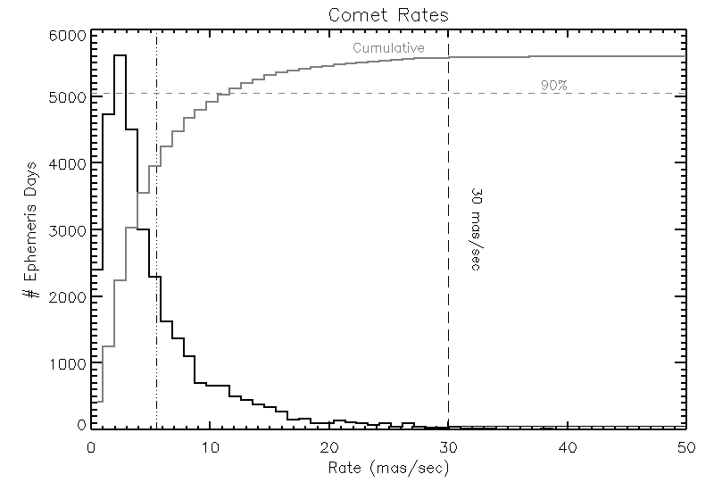
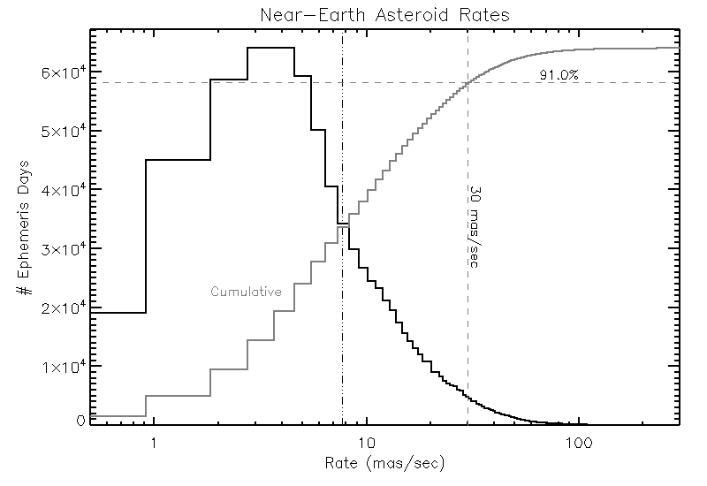
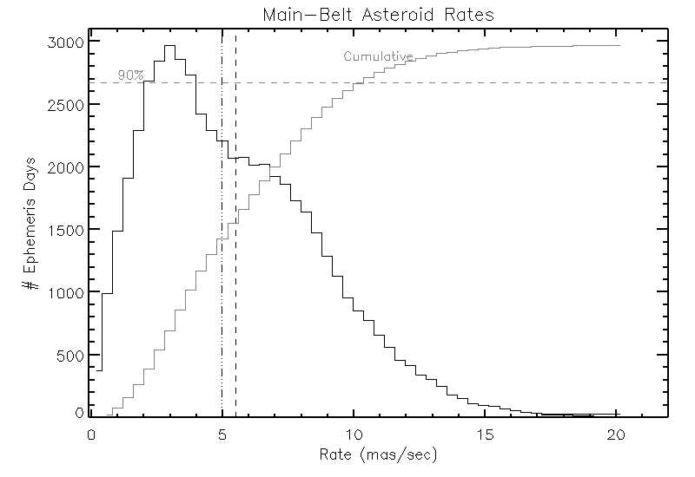
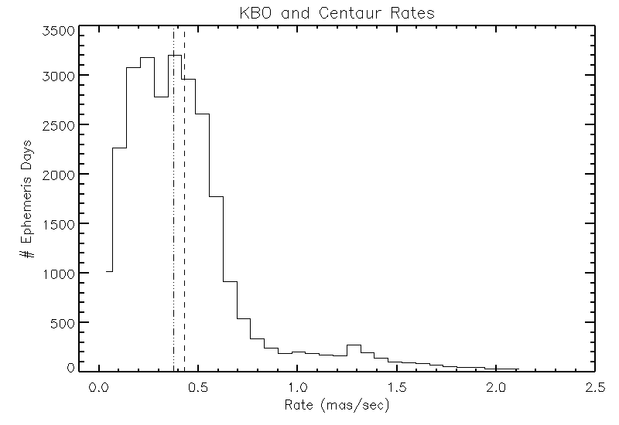
How Fast are Moving Targets Moving?
JWST can track nearly any targets within its field of regard on any given day – even NEOs and Comets.
Notes:
Light grey is fraction of objects vs. 90% line. Most comets and NEAs – although fast means close and interesting. All main belt. All KBOs.

Slide 9
Schematic for Moving Target Observation
  Usable guide star selected from candidate list, identified in field normally
  Slew from acquisition point to target ‘ambush point’ computed and executed
  Guide star position refined, system waits for tracking start time
  Tracking begins: guide star and track subarray move across Fine Guidance Sensor
  Science exposure starts
  Science exposure ends; dithers, mosaics repeat this process
  Target acquisition (peak-up on target) uses the same process
End of Ephemeris
Moving Target GS Track
Commanded Guide Star
position for ID/ACQ
Dithers, mosaics
Acquired
GS position
1
6
Science exposure ends
2
5
Science exposure starts
4
32x32 track box follows guide star
Slew to ambush point
3
GS positioned at ambush point
Remove slew error
Start of Guide Star Ephemeris

Slide 10
Moving Targets – Observatory, Flight Software
Event-driven scheduling / operations
    Each target has many possible guide stars, useable during different windows
    At time of observation, 1st usable guide star selected, acquired normally
    5th order Chebyshev representation of guide-star track
      Primarily enables guide-stars to be used at any time during target visibility window
      Secondarily allows tracking targets with ephemeris accelerations
    Time-constrained observations are supported

Slide 11
Guide Stars for Moving Target Observations
Event-driven operations provide flexibility in use of Guide Stars for moving targets
  Multiple sets of guide stars defined to cover complete visit scheduling window
  Typically 3 guide stars for any time within visit scheduling window
  Up to 200 guide star candidates per moving target observation
Observations with different instruments require separate guide stars (and visits)
E
L
F
  Nominal Visit Scheduling Window
Visit
E
L
F
Guide Star 1 Window
Guide Star 2 Window
Guide Star 3 Window
Visit Start Time
(event-driven):
can use Guide
Star 2 or 3 for
tracking
Guide Star 4 Window
Guide Star 5 Window
Guide Star 6 Window
E = Earliest Start Time, L = Latest Start Time, F = Latest End Time

Slide 12
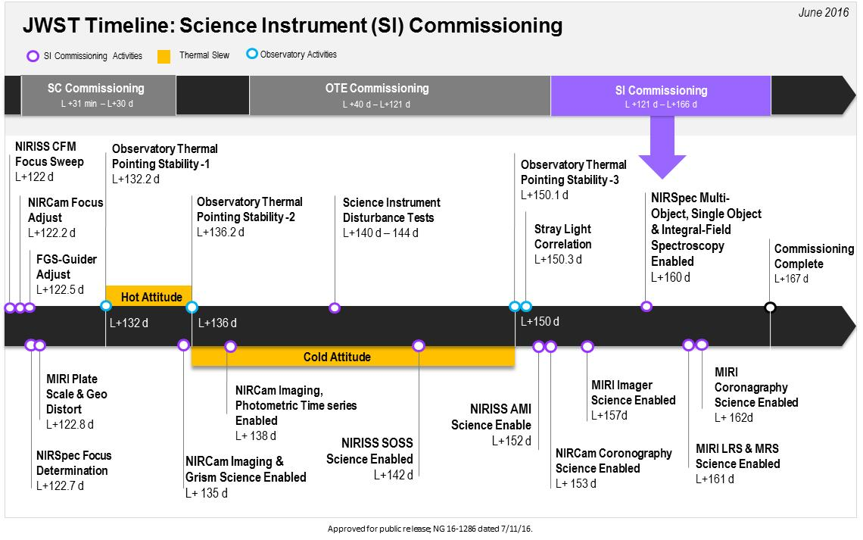
Moving Target Commissioning
MT Commissioning

Slide 13
Moving Targets Commissioning
Will start ~20 days before end of commissioning, after…
    Complete commissioning of the telescope
    Basic instrument commissioning
    Guider to instrument astrometric solution updates
    Target acquisition for fixed targets (NIRSpec)
    Observatory ephemeris is fairly well understood
Basic tracking checkout – NIRCam
    4 targets, rates of ~4, ~20, ~30, and ~45 mas/sec
      Executed in separated observations
    Full-frame imaging, “bright” (15 < Kmag < 17)
    Dithers and mosaics
    2 filter combinations
    Observations long enough to allow ~30’’ of target motion

Slide 14
Moving Targets Commissioning
Other instruments moving target checkout
    Observations long enough to allow >~10’’ of target motion
    MIRI, NIRISS
      1 target each, 10 – 30 mas/sec
      Dithers and/or mosaics
      MIRI imager and IFU
      NIRISS AMI
    NIRSpec
      1 target, 10 – 30 mas/sec
      IFU point-and-shoot (no target acq), dithers, 2 grating settings
      Target acquisition test
        1.6” aperture for TA
        IFU for quick science observation/pointing verification
Pipeline verification is a key goal for all of these tests

Slide 15
Moving Targets Commissioning
Scattered Light checkout
    Jupiter or Saturn as illumination source (assumes no big launch delay)
    Use mosaic patterns to steer instrument FOVs around the source
      NIRCam on-axis stray light will be checked (shortwave channel FPA mask)
    Each SI will undergo this initial stray-light check
    Checkouts will be a severe test of FGS guiding near a giant planet

Slide 16
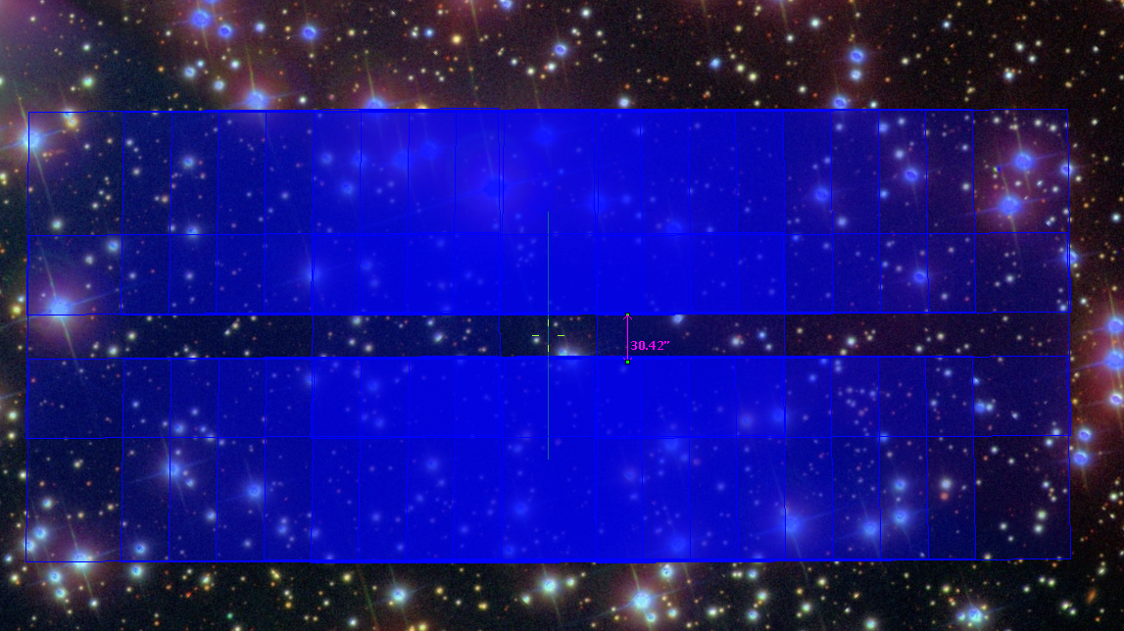
NIRCam Stray-light Test Mosaic

Slide 17
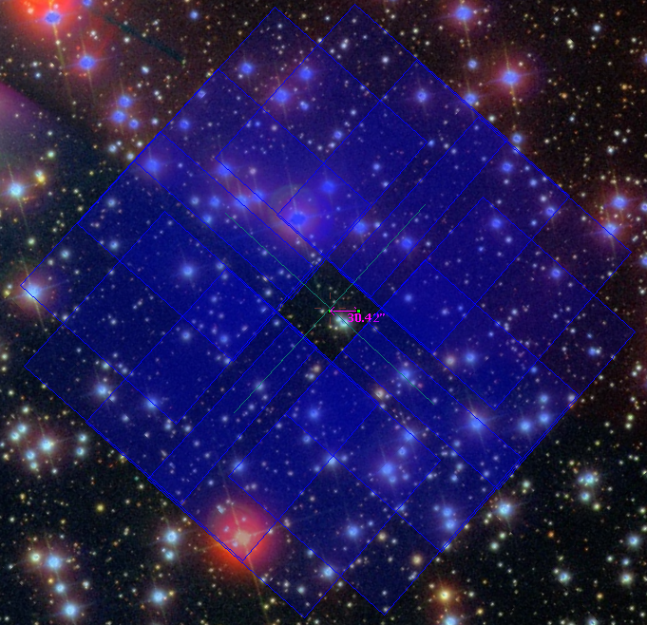
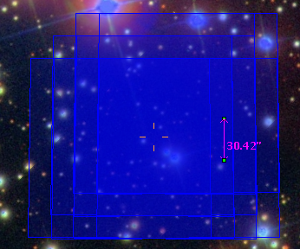
NIRSpec Stray-light Mosaic; NIRCam In-field Check

Slide 18
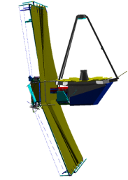
JWST Field of Regard
North Ecliptic Pole
Continuous
Viewing
Zone North
Observatory thermal design defines the allowed Solar orientations
  Solar elongation 85° to 135° (like Spitzer, Herschel)
  Roll ±5° about line of sight
JWST can observe the whole sky every year while remaining continuously in the shadow of its sunshield.
  Instantaneous Field of Regard is an annulus covering 35% of the sky
  The whole sky is covered twice each year with small continuous viewing zones at the Ecliptic poles
85°
5°
135°
45°
V1
360°
V2
V3
Continuous
Viewing
Zone South
Solar System Targets: Observations occur near quadrature, not at opposition
Notes:
Thermal constraints and passive cooling limits the range of solar elongation (cf HST)
No obs within 45 deg of antisun direction (local midnight)

Slide 19
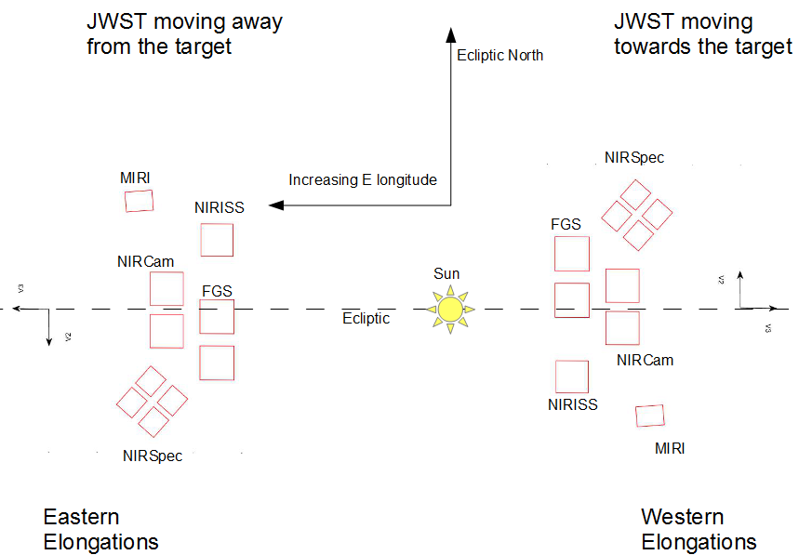
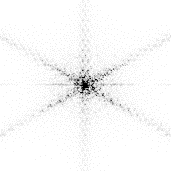
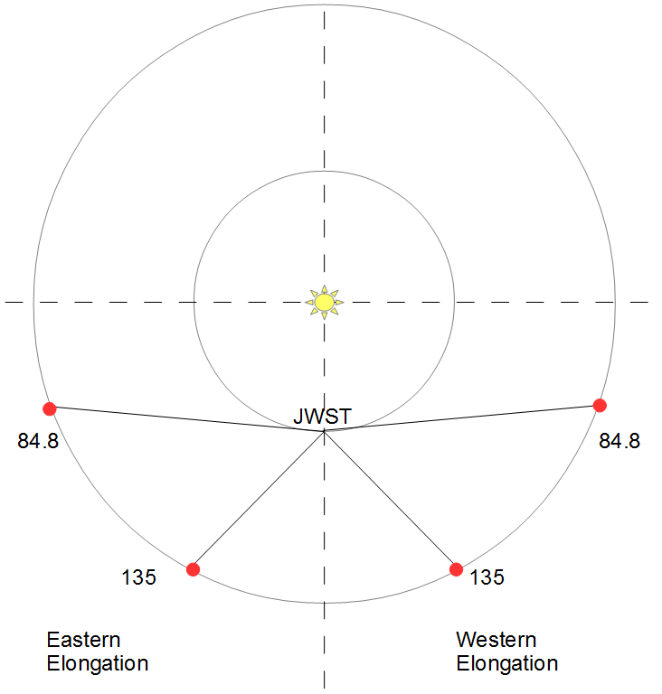
JWST Instrument FOVs for Targets in the Ecliptic Plane
PSF Orient
PSF Orient
V2
V3
V1
V1
V3
V2
Looking S. from NEP
Notes:
Aperture orientation at different times of year

Slide 20
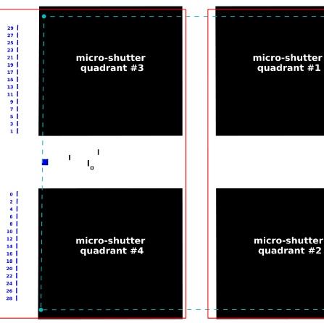
Target Acquisition: NIRSpec
NIRSpec TA for moving targets is not easy
  1.6’’ square aperture
    Ephemeris of target must be accurate!
  Centroid calculated on-board
  Target can be accurately (<10mas) positioned in the IFU, any of the fixed slits, or in a pseudo long-slit in the microshutter array
IFU 3’’
1.6’’ Targ.Acq.
Aperture
Pseudo
Long-slit
0.2’’
Notes:
Target acquisition aperture is small. Need to know the ephemeris well. Target acquisition not needed if precision of 1.6” is OK.

Slide 21
ETC

Slide 22
APT

Slide 23
APT Solar System Capabilities
Target definition
  Standard targets
  Asteroids and Comets
    Orbital elements
Geometric constraints
Ephemeris Report and Visualization

Slide 24
APT Standard Targets

Slide 25
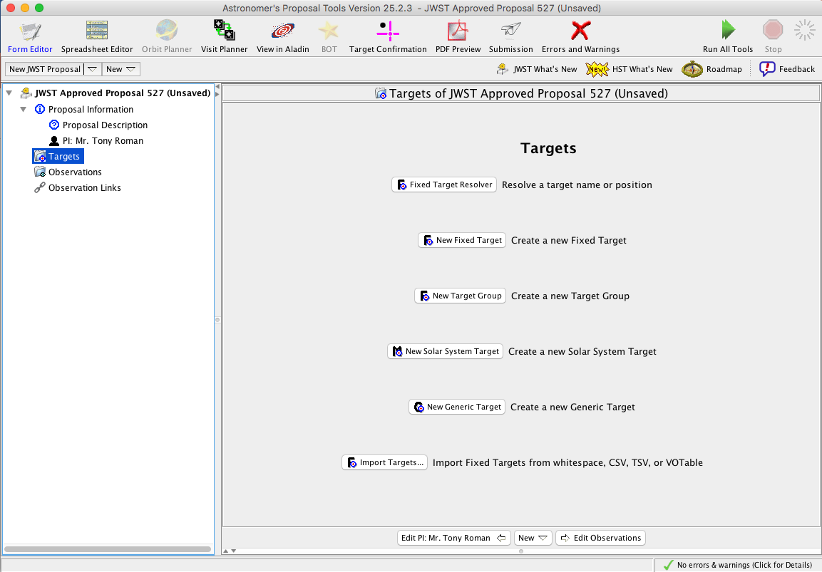

Slide 26
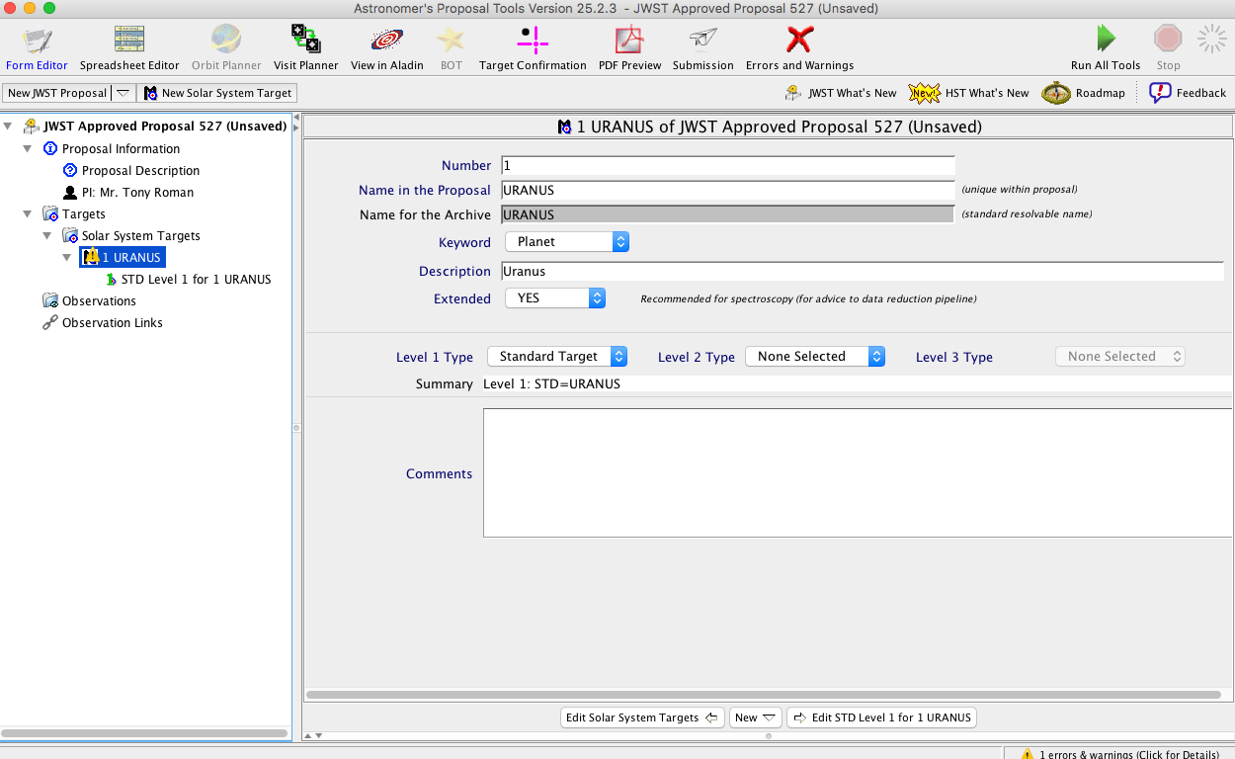

Slide 27
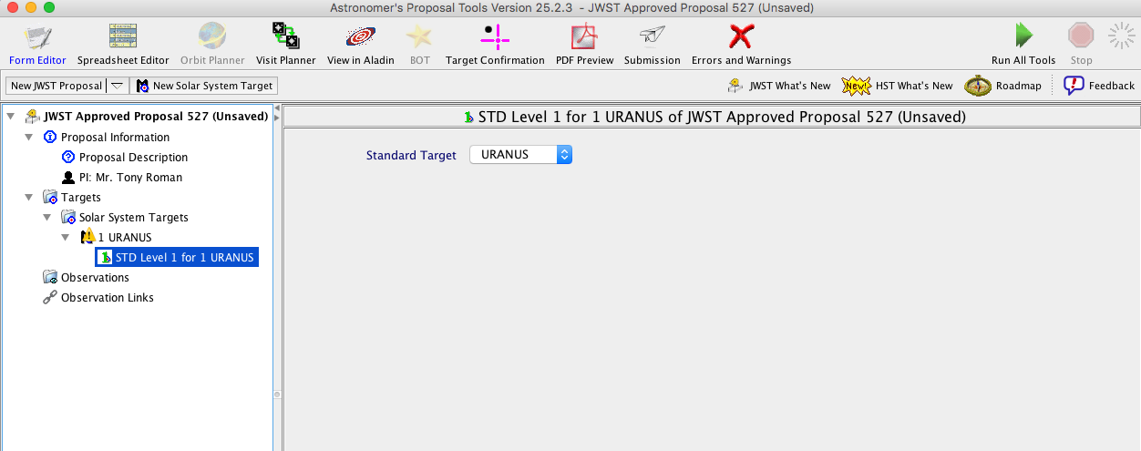

Slide 28
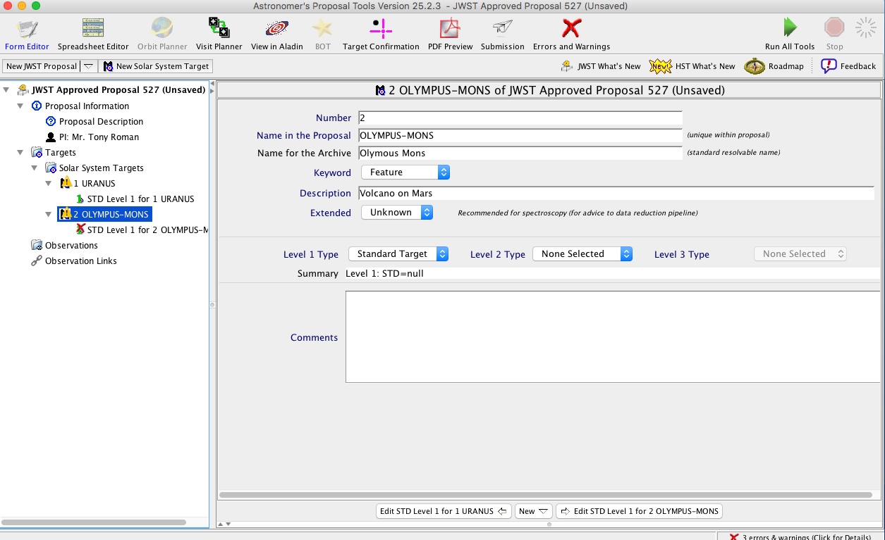

Slide 29
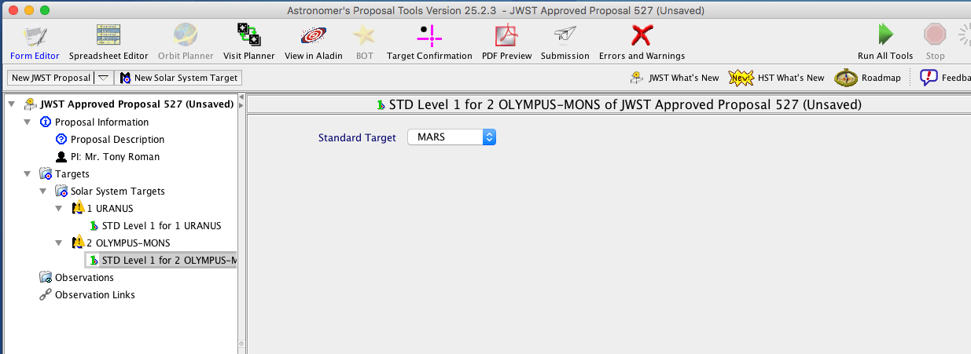

Slide 30
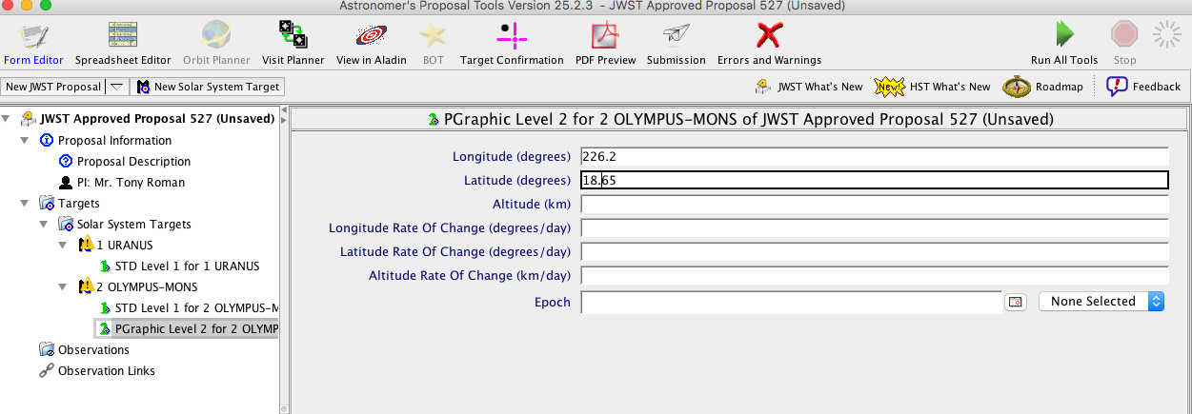

Slide 31
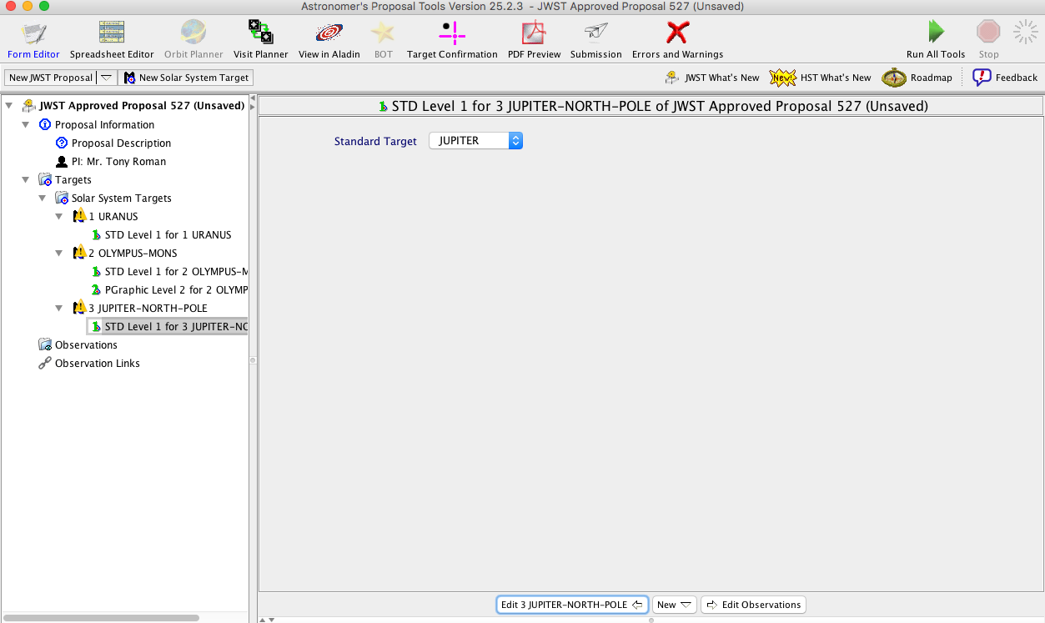

Slide 32
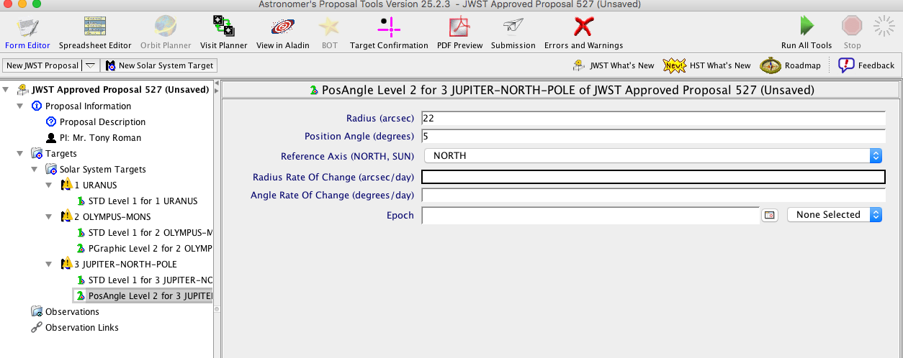

Slide 33
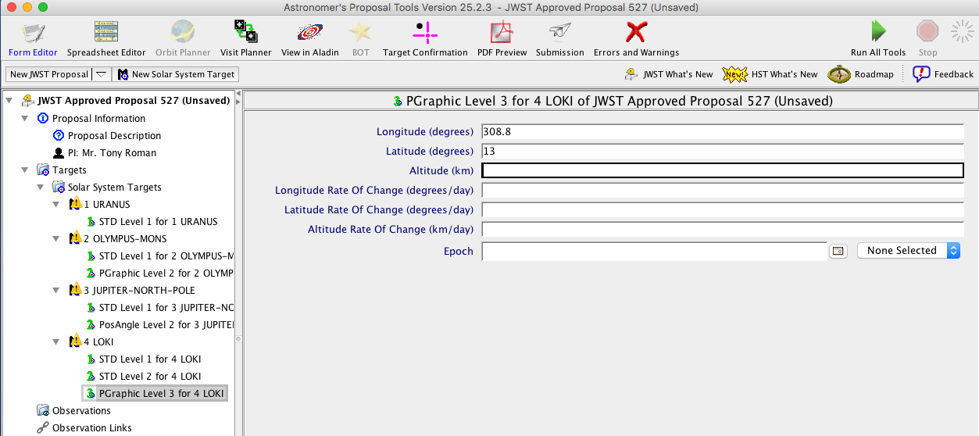

Slide 34
APT Orbital Elements

Slide 35
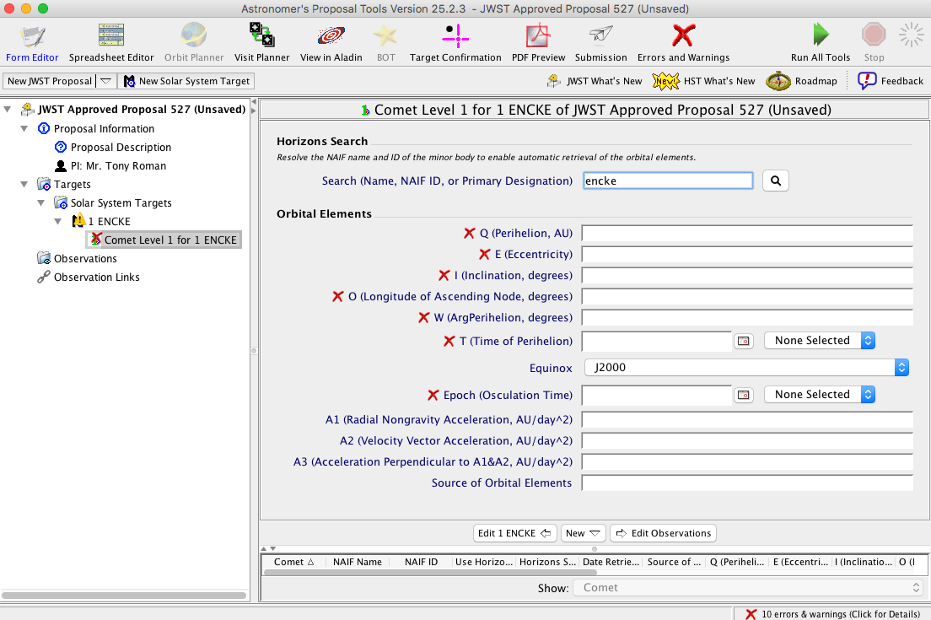

Slide 36
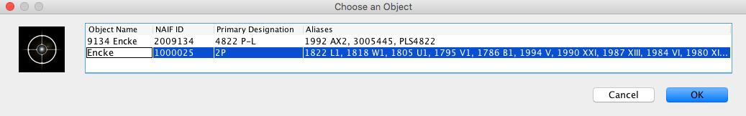

Slide 37
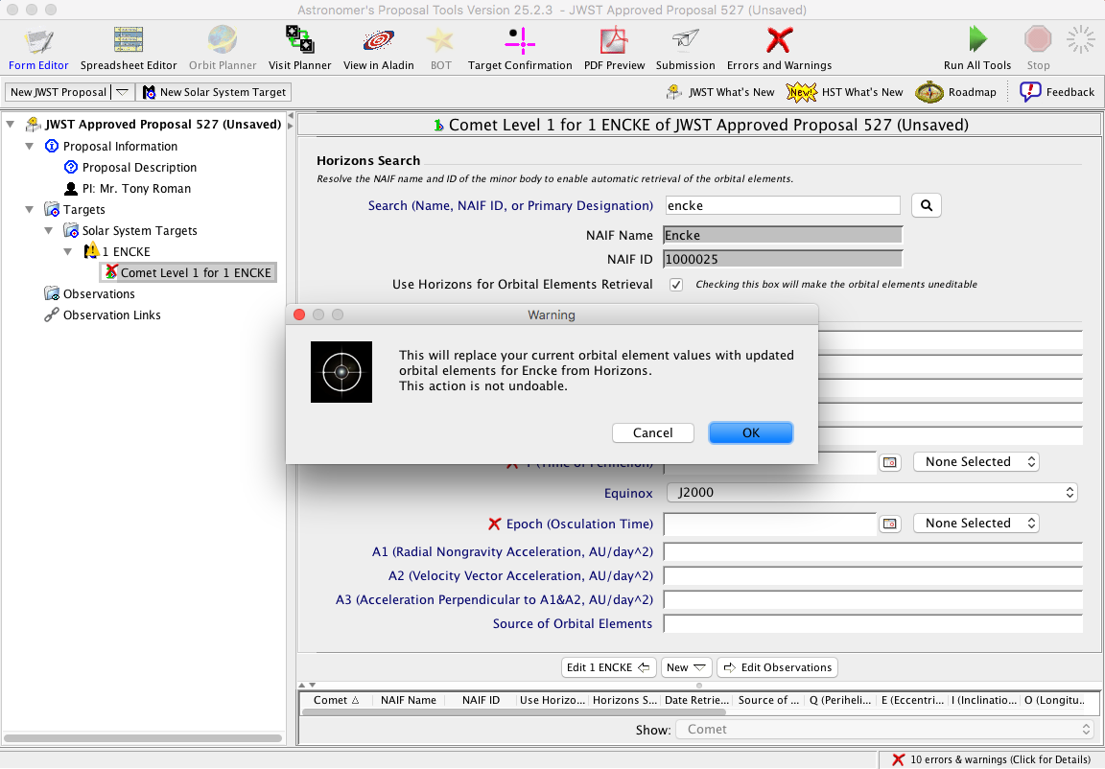

Slide 38
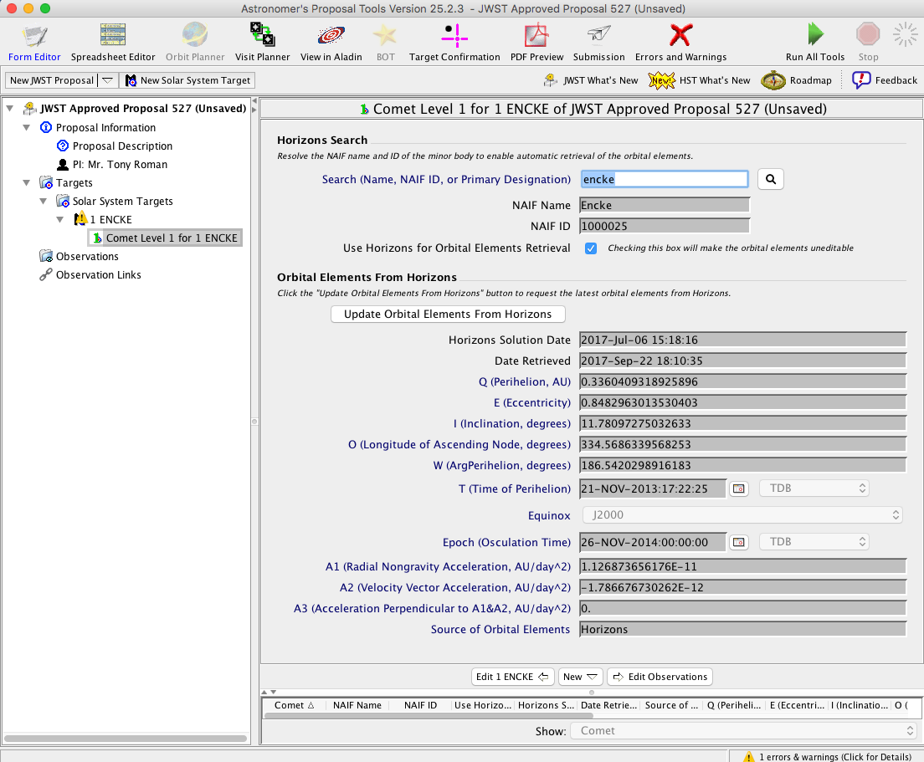

Slide 39
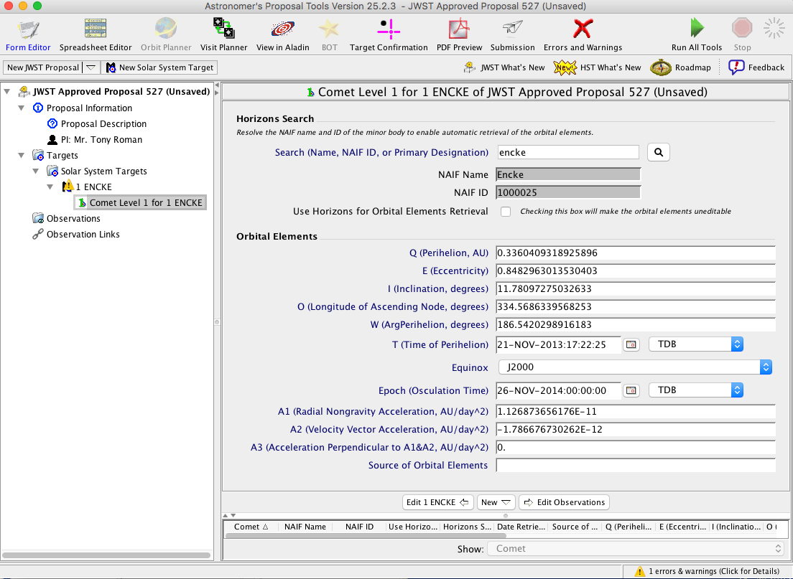

Slide 40
APT Observing Windows

Slide 41
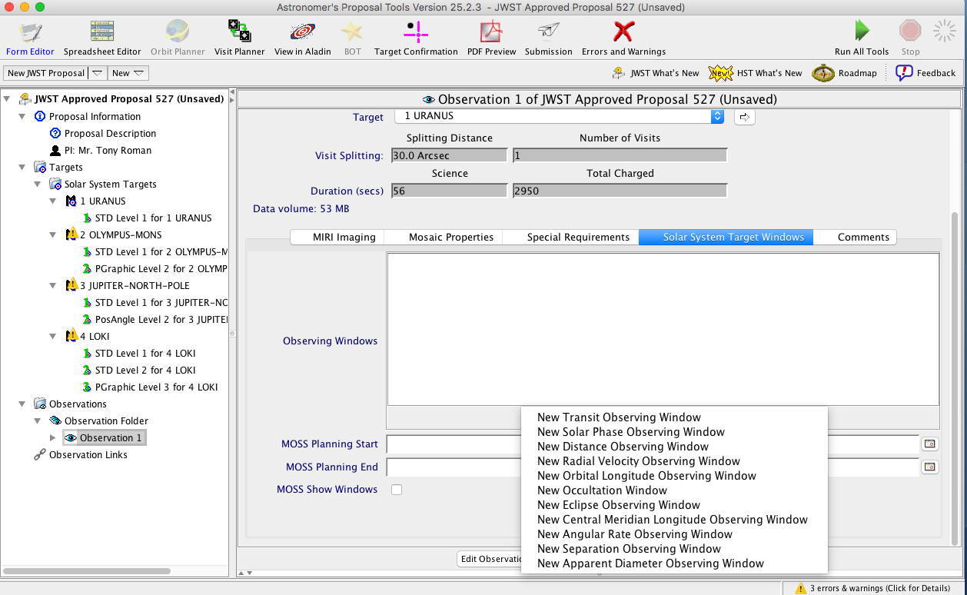

Slide 42
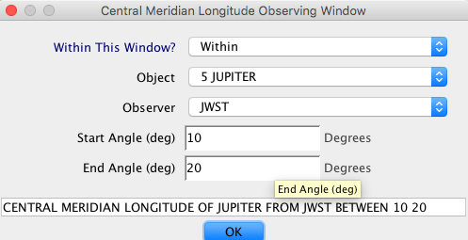

Slide 43
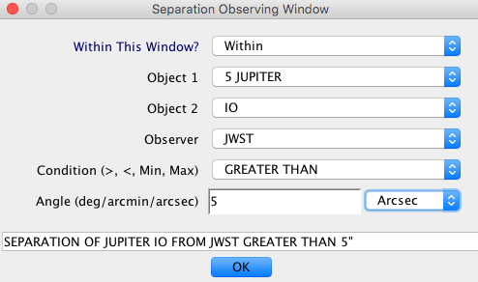

Slide 44
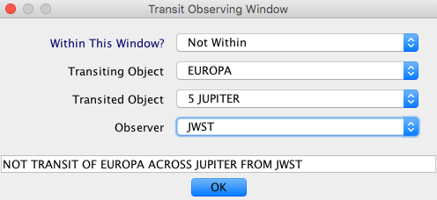

Slide 45
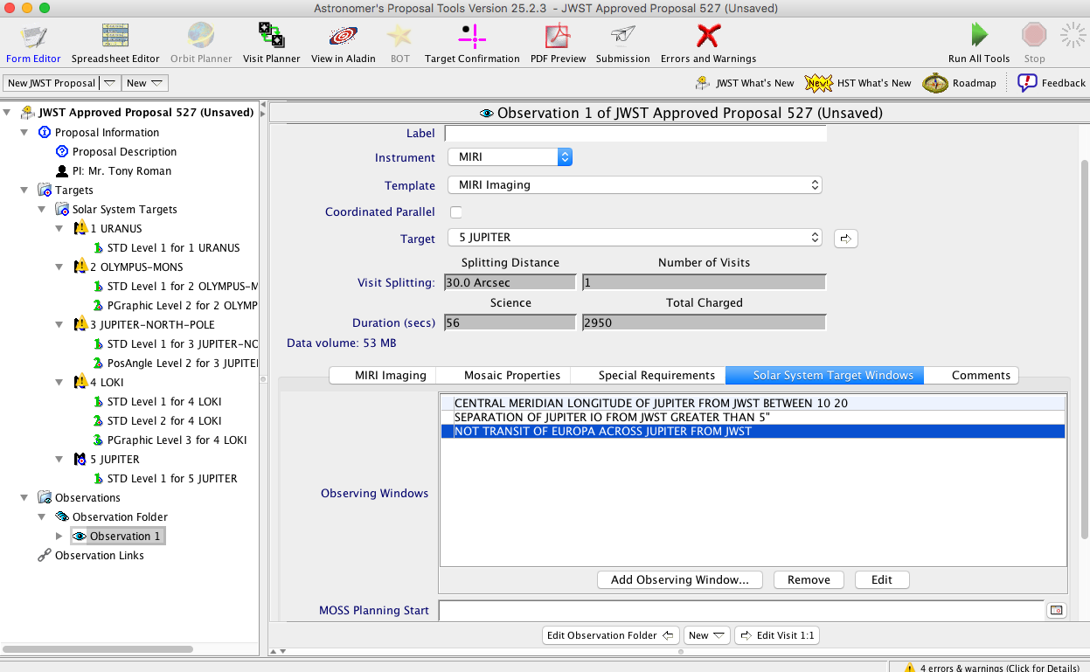

Slide 46
APT Ephemeris Report & Visualization

Slide 47
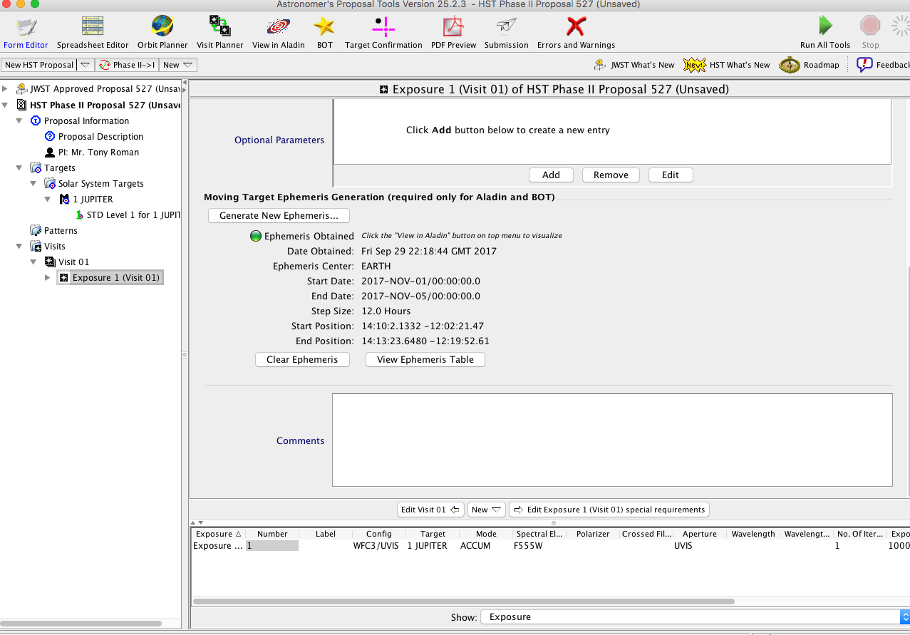

Slide 48
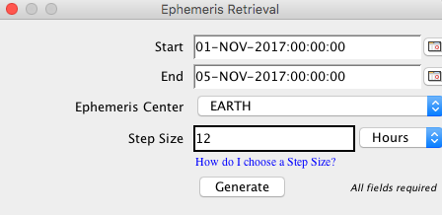

Slide 49
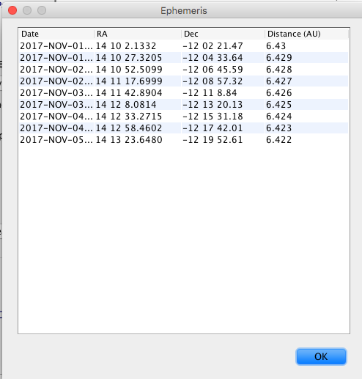

Slide 50
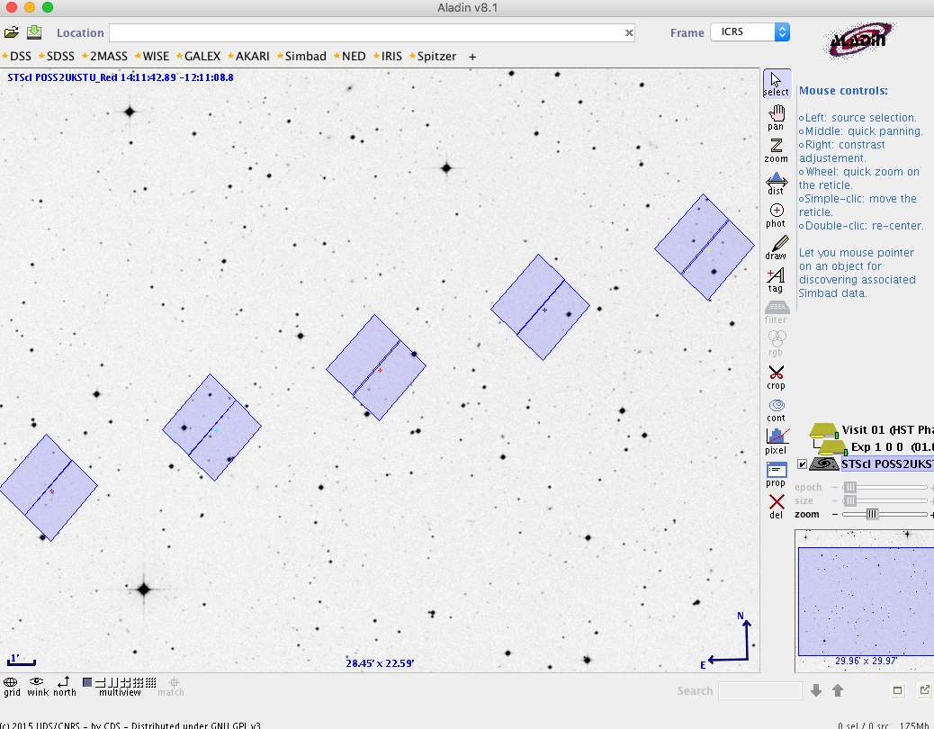

Slide 51
JWST Solar System Workshops
October 15
  Preparing Observations for Solar System Science with JWST
  DPS Meeting, Provo, Utah
November 13-15
  Planning Solar System Observations with JWST
  STScI
December 13-15
  Planning Solar System Observations with JWST
  ESA/ESTEC

Slide 52
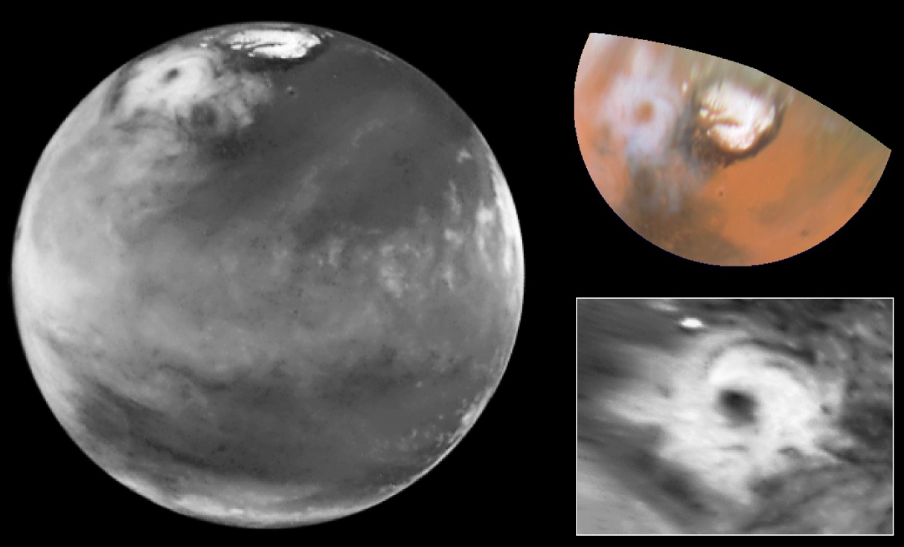
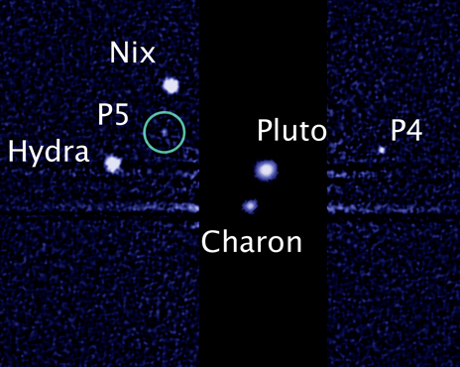
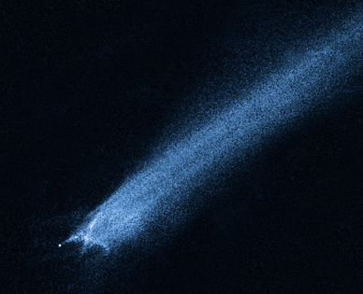
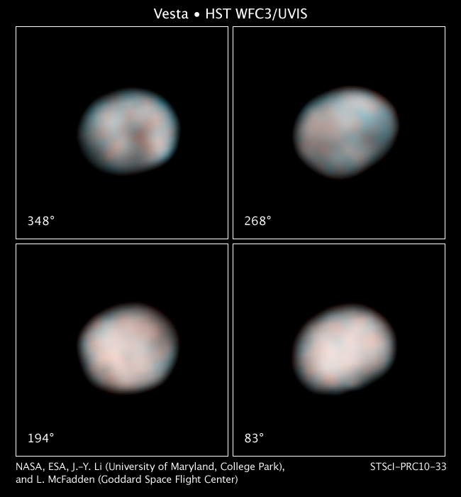
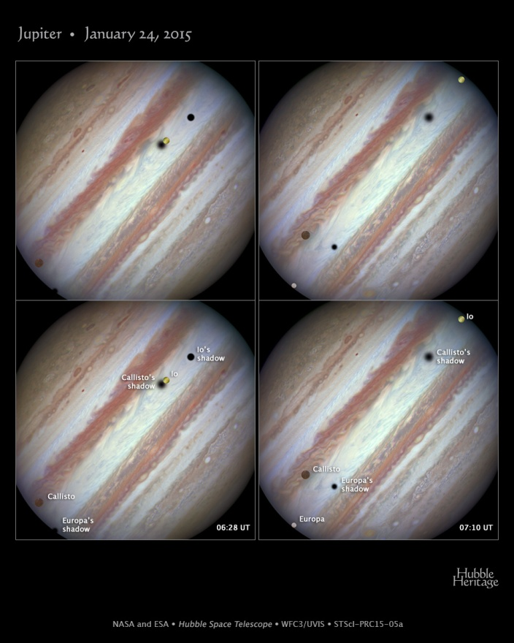
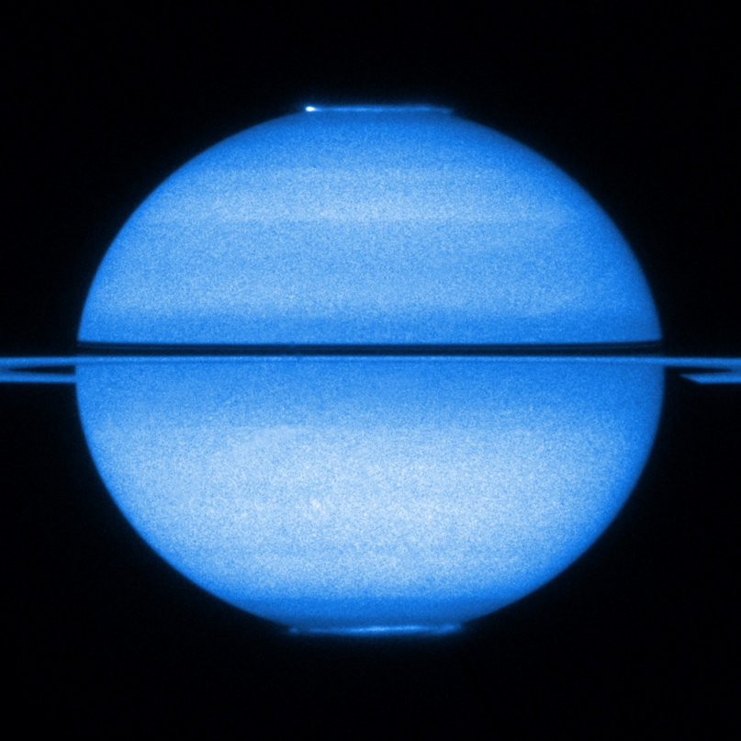
Hubble Space Telscope was launched with:
No moving target tracking
No moving target data pipeline (and it still has none...)

Slide 53
JWST will do even better…
Contact: aroman@stsci.edu

Slide 54
Backup

Slide 55
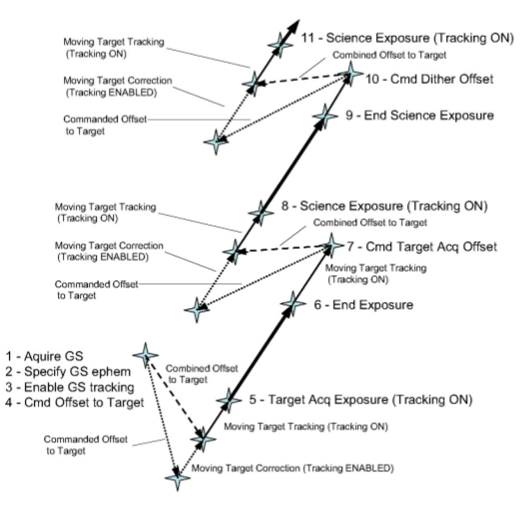
ACS Operations Concept for Moving Targets
On-board Scripts Subsystem (OSS) – Attitude Conctrol System (ACS) Interactions
  Dithers, maps
    Offset sent to ACS at end of exposure
    ACS moves track box to offset + predicted ephemeris motion
    Tracking starts at predicted time target reaches the science aperture
  Target-acq will also work for MT’s
    SI data analyzed by OSS
    Offset sent to ACS
    ACS moves track box to offset + predicted ephemeris motion
MT Target Acq and Dither Schematic
JWST-RPT-009982

Slide 56
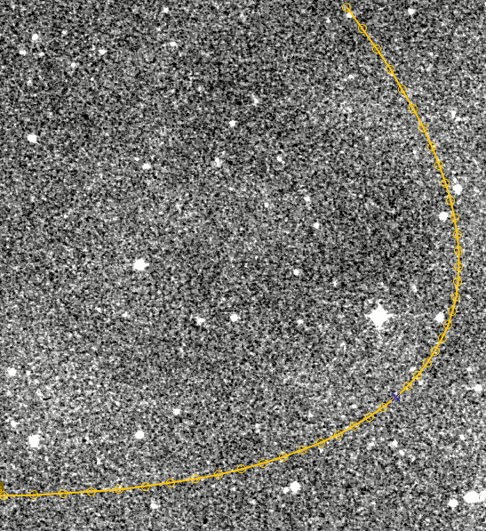
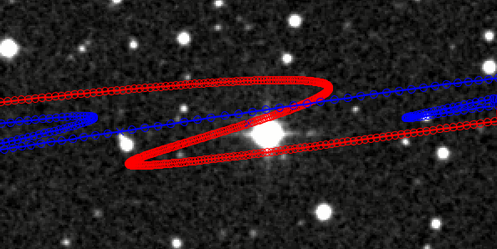
Ephemeris Tracking
Attitude Control System (ACS)
    Autonomously tracks target by moving guide star & track box in FGS
        OSS sends ephemeris to ACS
        ACS corrects ephemeris for applicable SI
    ACS notifies OSS that it is tracking, OK to expose
  Rates ≤ 30 mas/sec over arc of 30” (requirement)
      Rates ≤ 60 mas/sec could probably be supported
  No requirement on acceleration
      5th O polynomial ephemeris supports accelerations as well as event-driven operations
Io + Ganymede
(proper motion)
Eris (KBO)
(reflex motion)

Slide 57
FGS Impingement by Planets
10 year ephemerides
JWST as observatory
Many (but not all) likely SI apertures considered
Planet within JWST FOR
Fixed focal plane orientation (V3 // to the ecliptic)
All known satellites considered
All analysis and graphics done by Bryan Hilbert

Slide 58
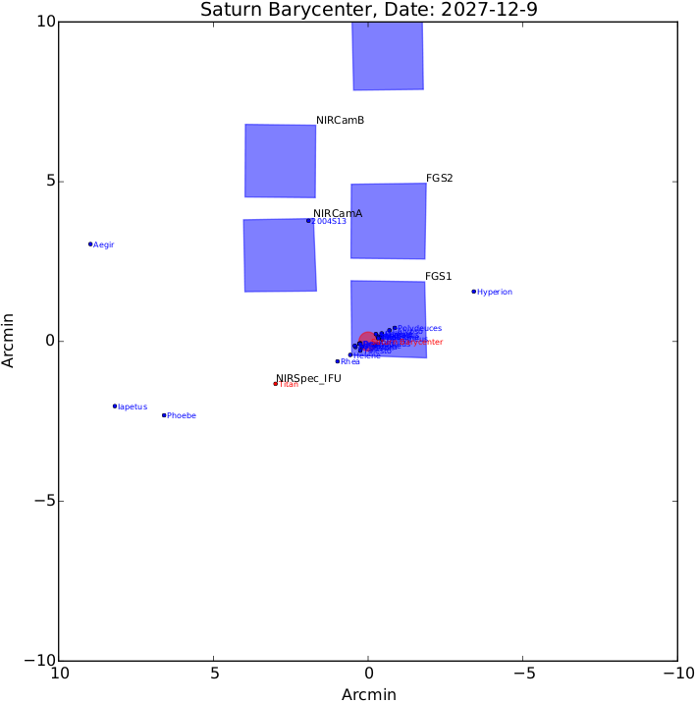
FGS Impingement by Planets
“Impingement” is defined as the limb of the planet encroaching on the FGS FOV to any extent.
Example is for Titan observed using the NIRSpec IFU

Slide 59
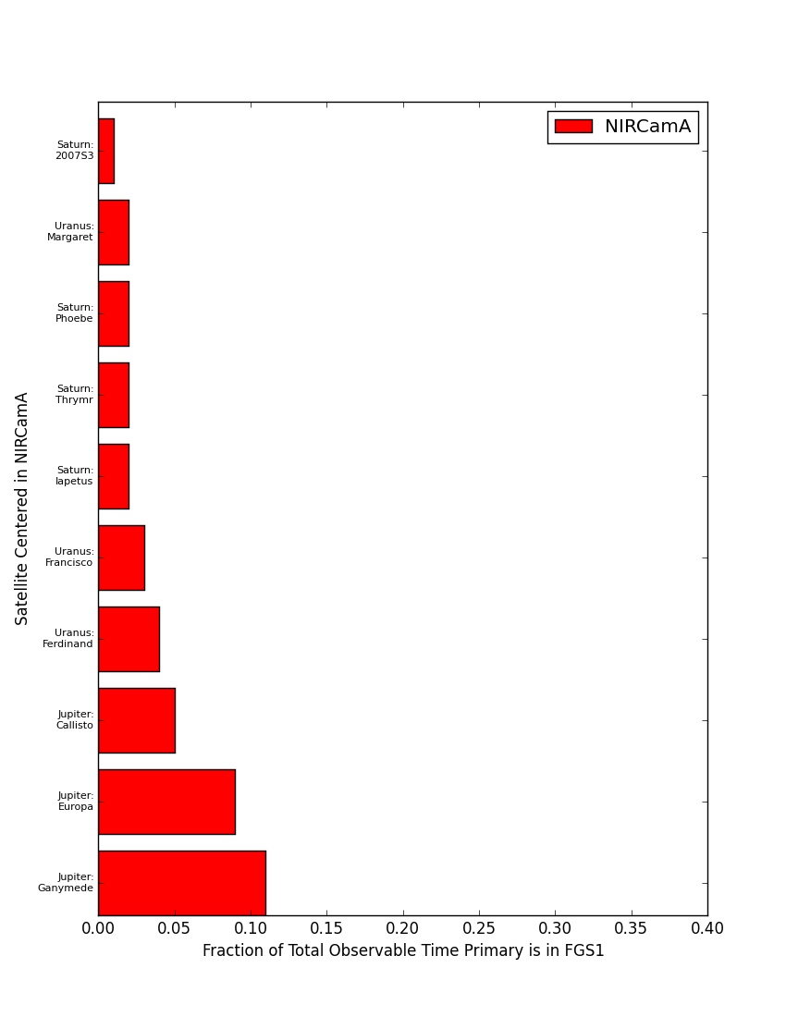
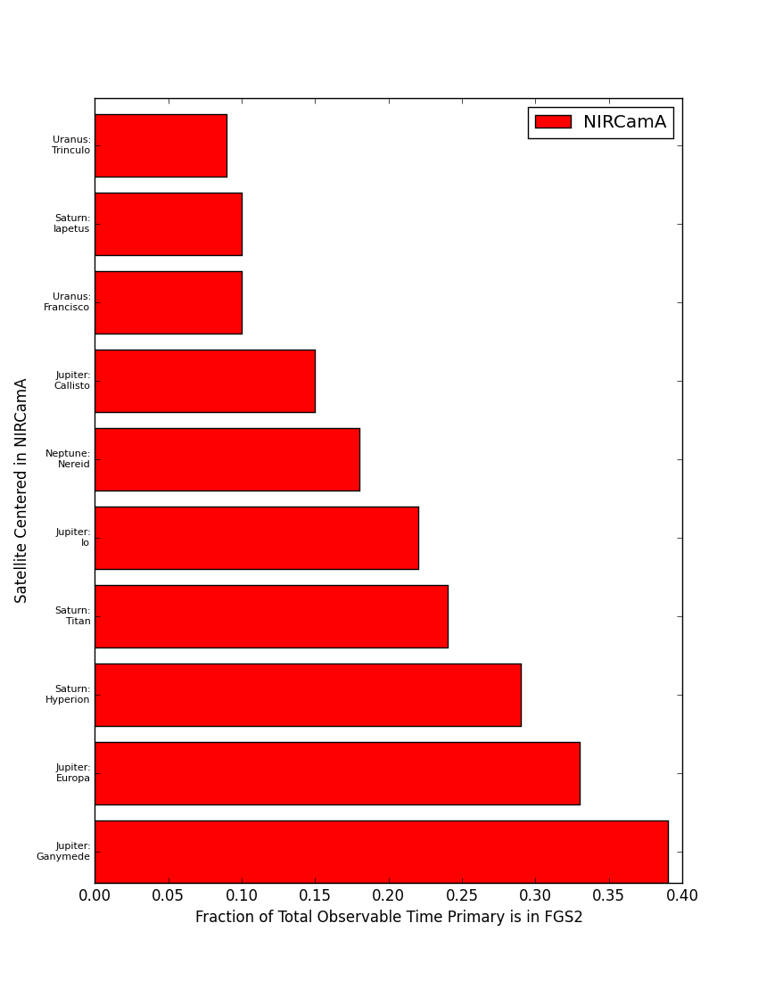
FGS Impingement: NIRCam Imaging – Mod A
FGS1
FGS2

Slide 60

Scattered Light: Jupiter, 2 μm
P. Lightsey, Ball Aerospace

