Slide 1
JWST Help Desk
Stacey Bright
JWST Help Desk Deputy
MIRI Team
ESAC 2017 JWST Workshop

Slide 2
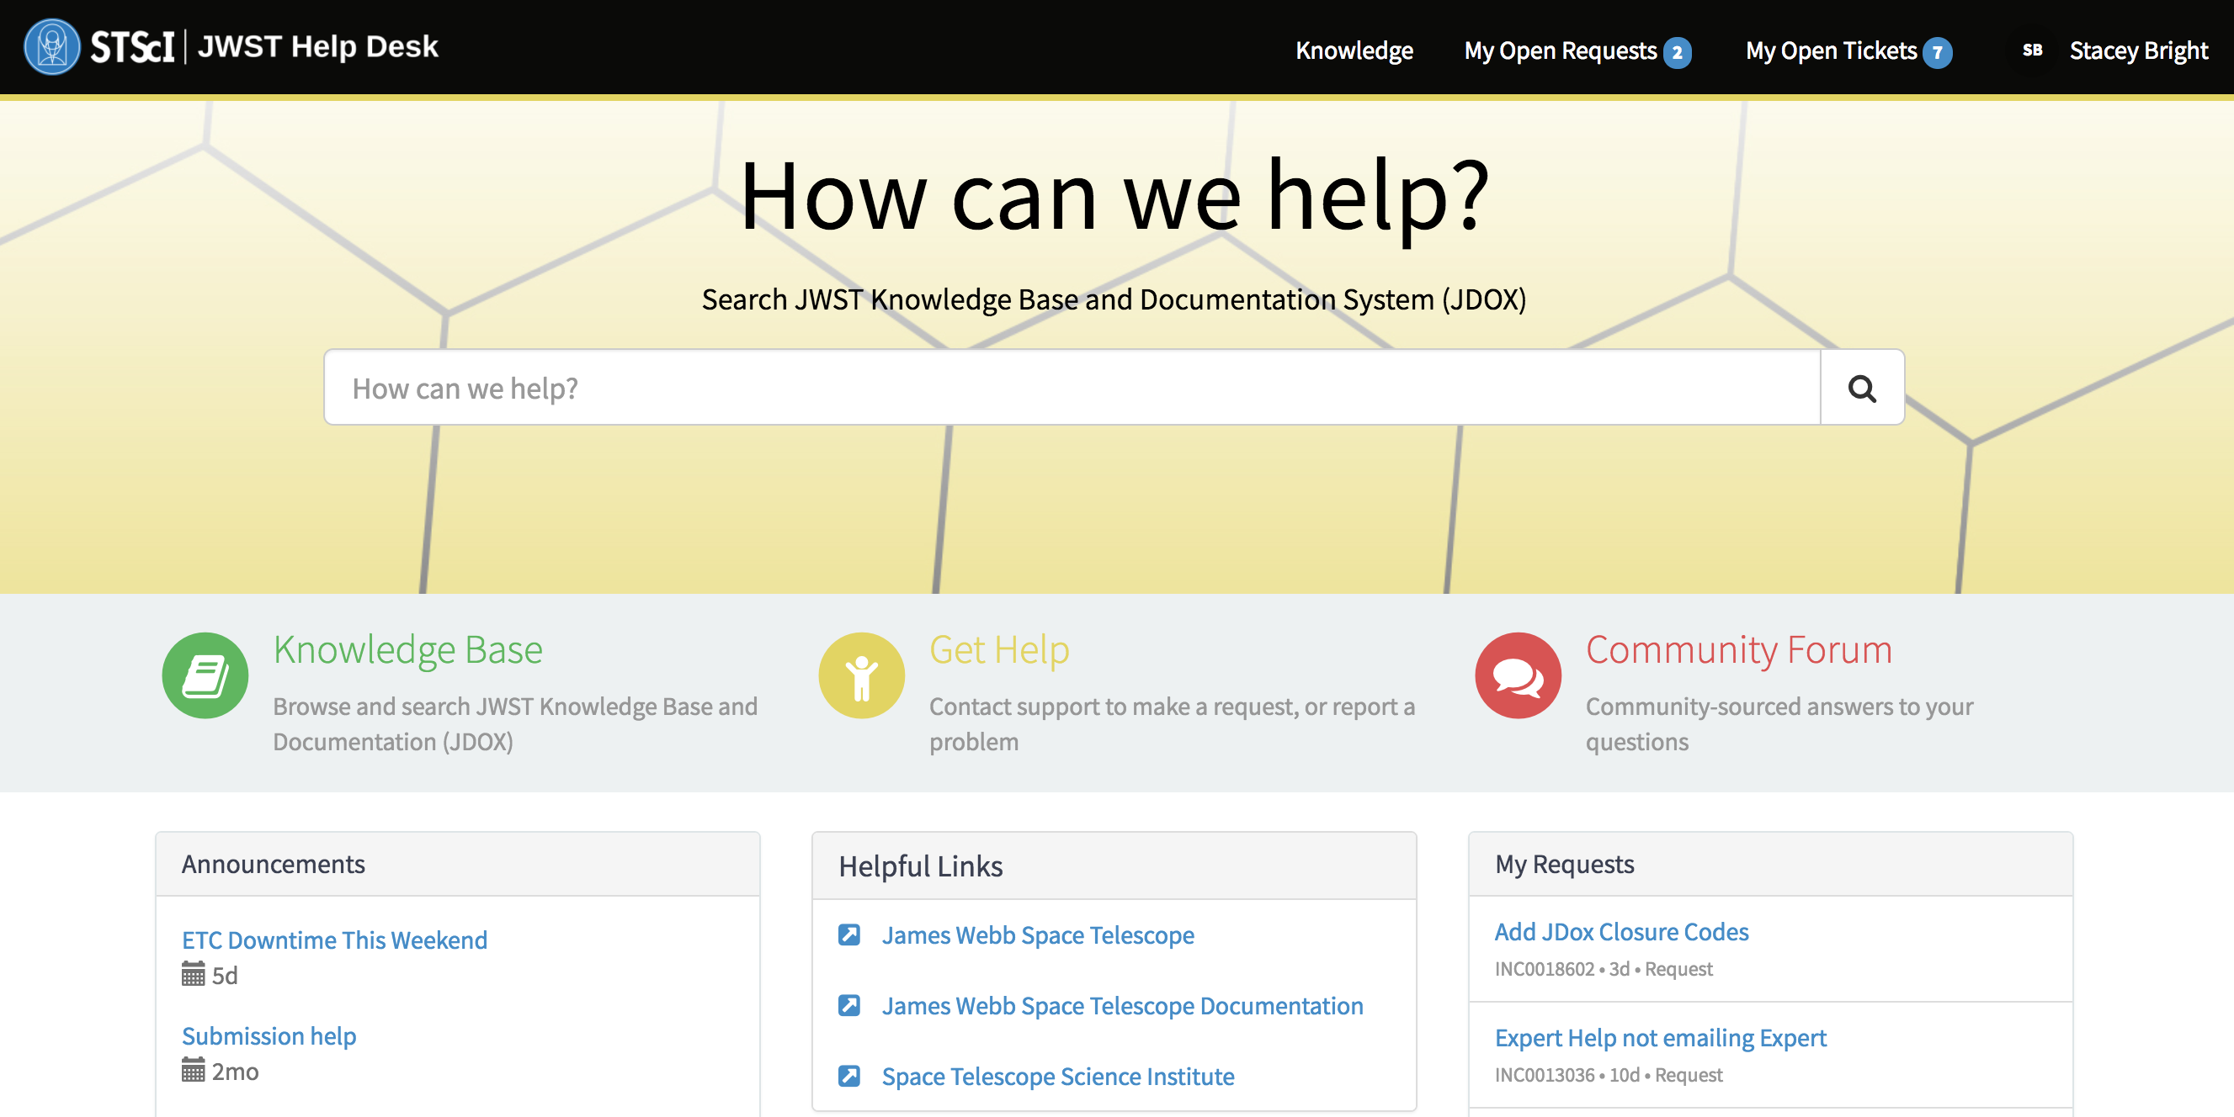
JWST Help Desk– jwsthelp.stsci.edu
jwsthelp.stsci.edu
Not using email or phone number previously used by HST
Faster service by self-selecting topics
JDOX integrated for searching
Knowledge Base articles updated frequently
News and Announcements posted
ESAC JWST Workshop 2017 - Madrid

Slide 3
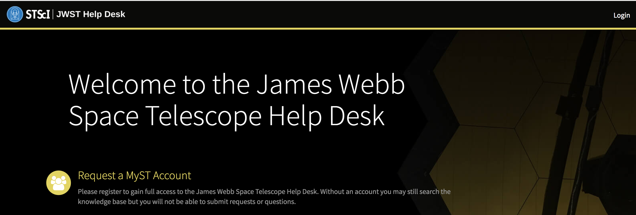
JWST Help Desk– jwsthelp.stsci.edu
jwsthelp.stsci.edu
Use MyST account
ESAC JWST Workshop 2017 - Madrid

Slide 4
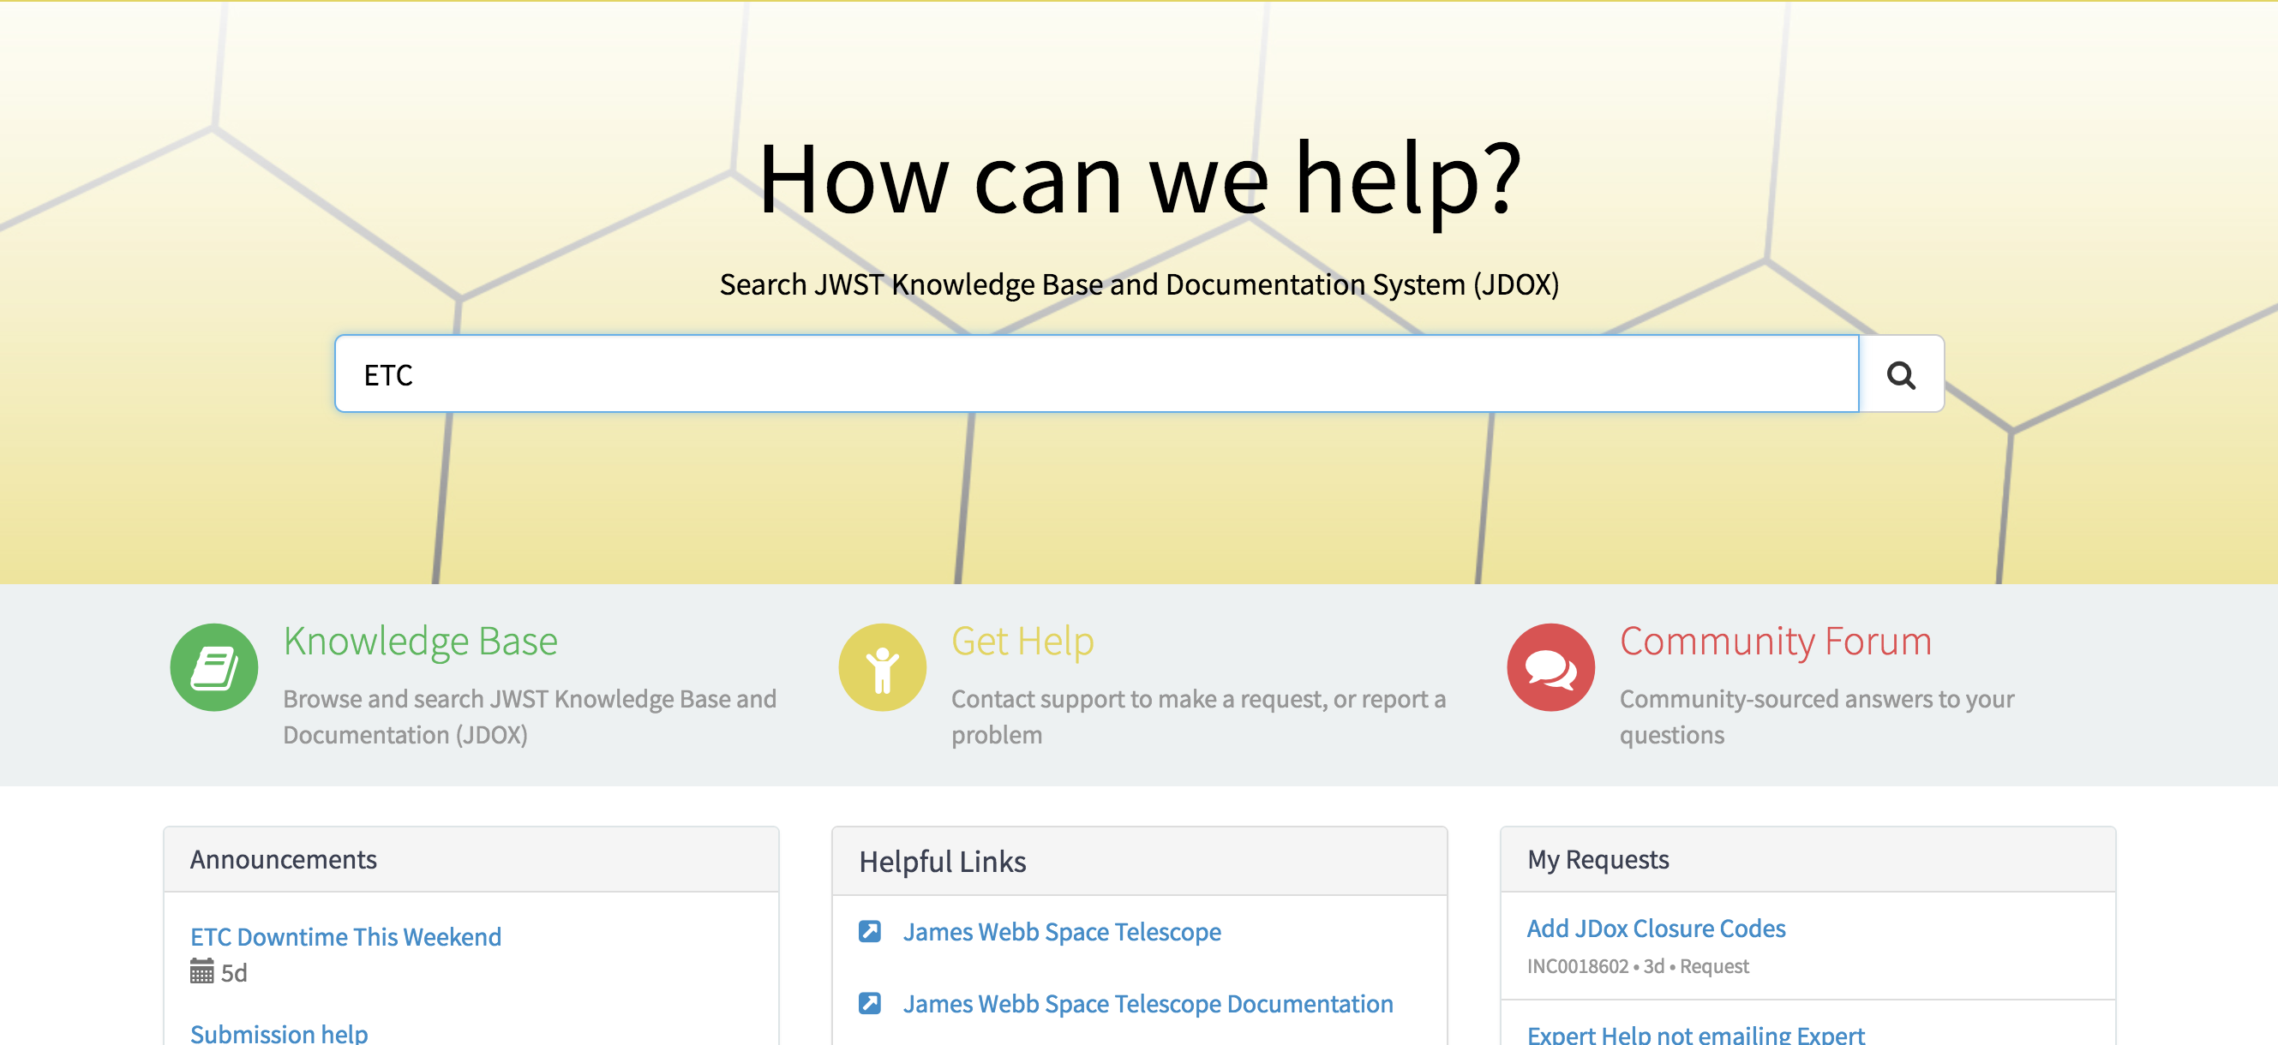
JWST Help Desk– jwsthelp.stsci.edu
1. Search:
Returns both JDOX and Knowledge Base articles
ESAC JWST Workshop 2017 - Madrid

Slide 5
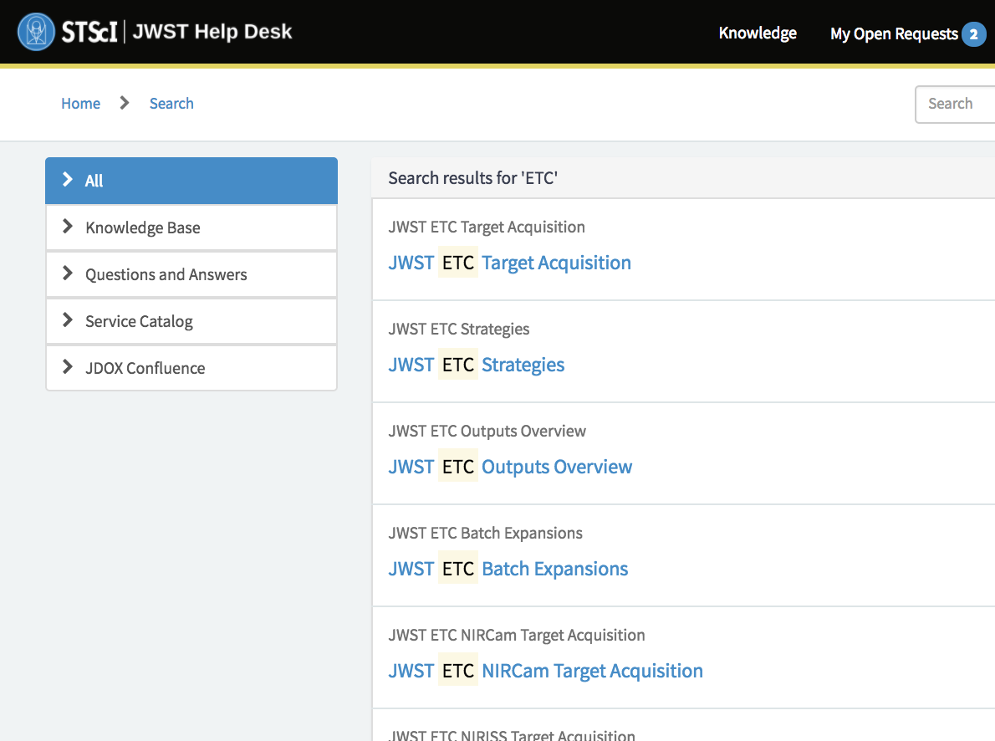
JWST Help Desk– jwsthelp.stsci.edu
1. Search:
Initial results shows all results, with JDOX articles first
ESAC JWST Workshop 2017 - Madrid

Slide 6
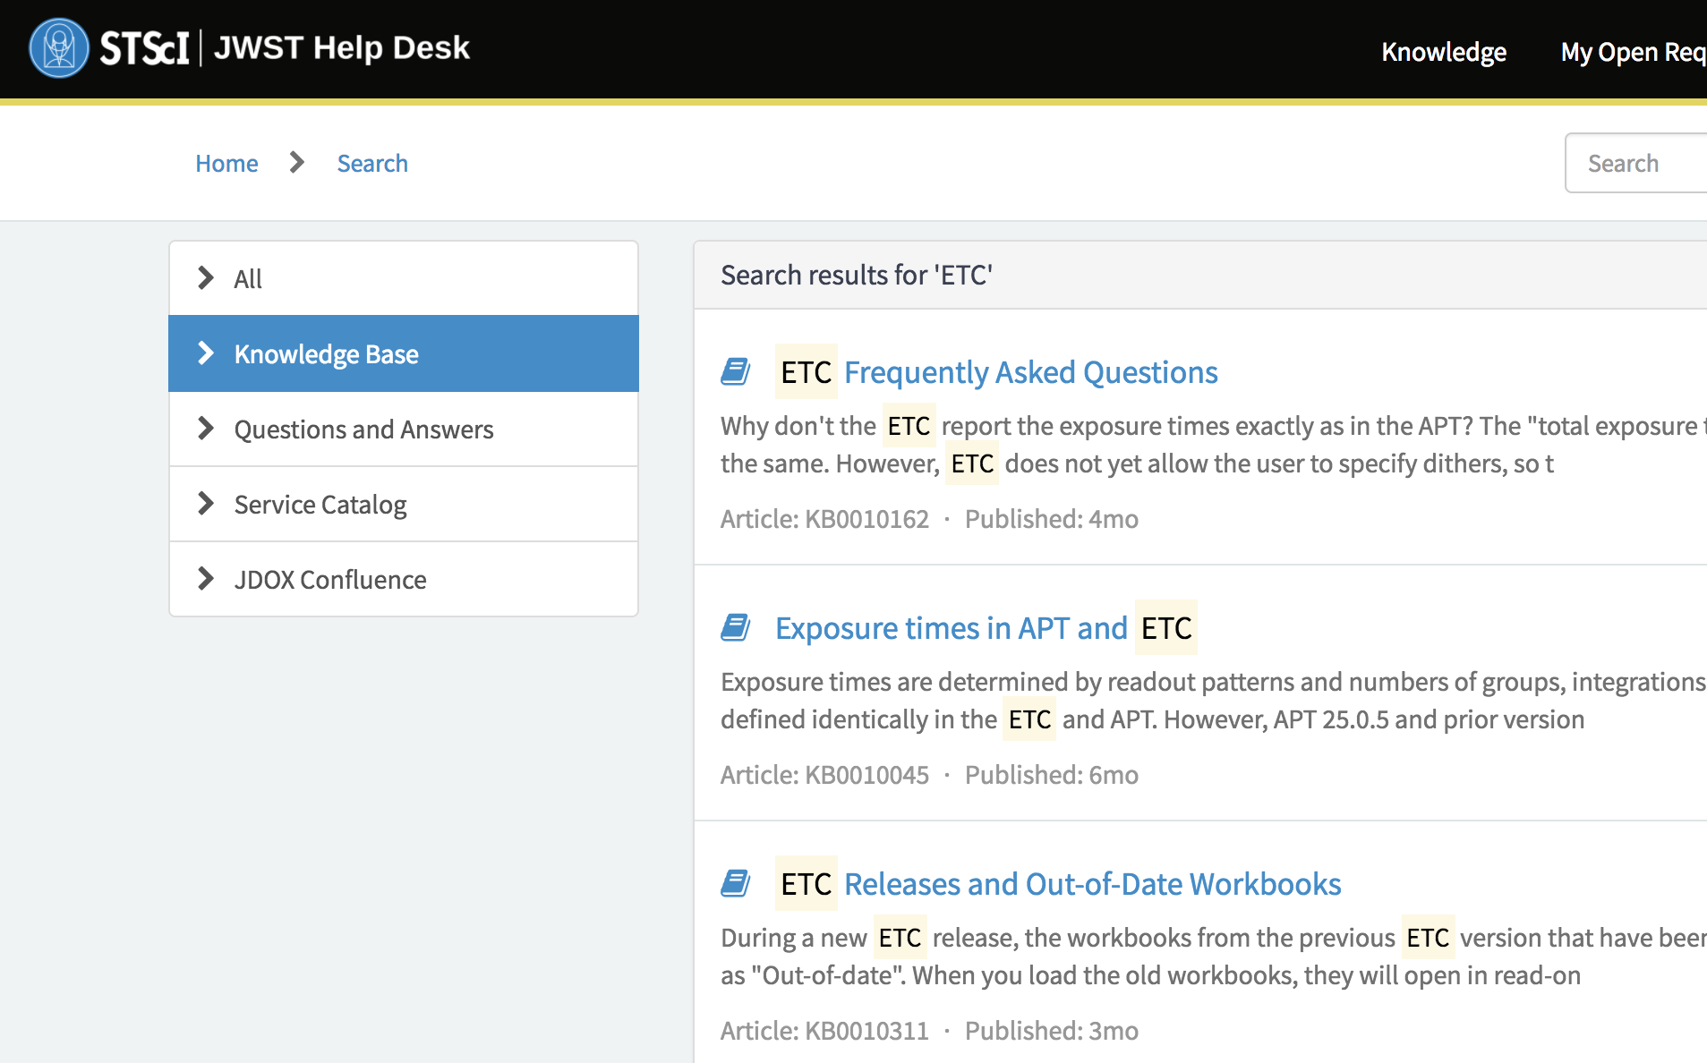
JWST Help Desk– jwsthelp.stsci.edu
1. Search:
Results show JDOX articles first
Use sidebar tree to filter for other articles
ESAC JWST Workshop 2017 - Madrid

Slide 7
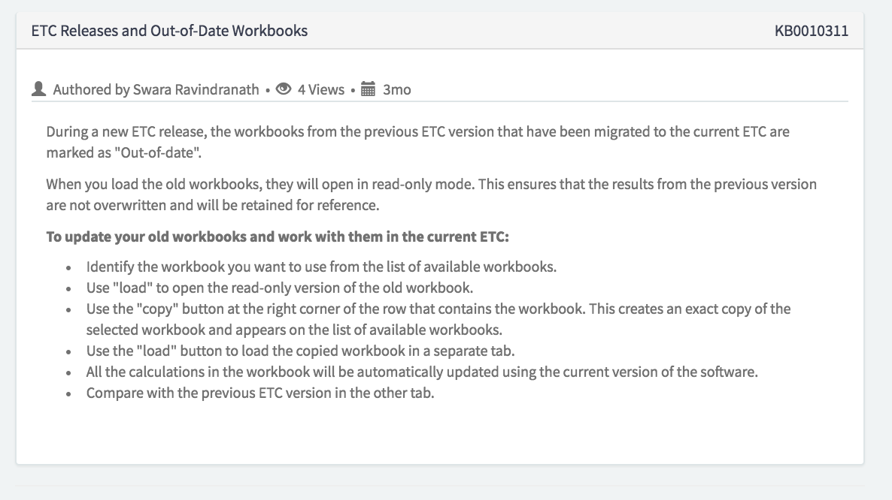
JWST Help Desk– jwsthelp.stsci.edu
1. Search:
Results show JDOX articles first
Use sidebar tree to filter for other articles
Knowledge Base article example:
ESAC JWST Workshop 2017 - Madrid

Slide 8
JWST Help Desk– jwsthelp.stsci.edu
2. Get Help:
Ask a question
ESAC JWST Workshop 2017 - Madrid

Slide 9
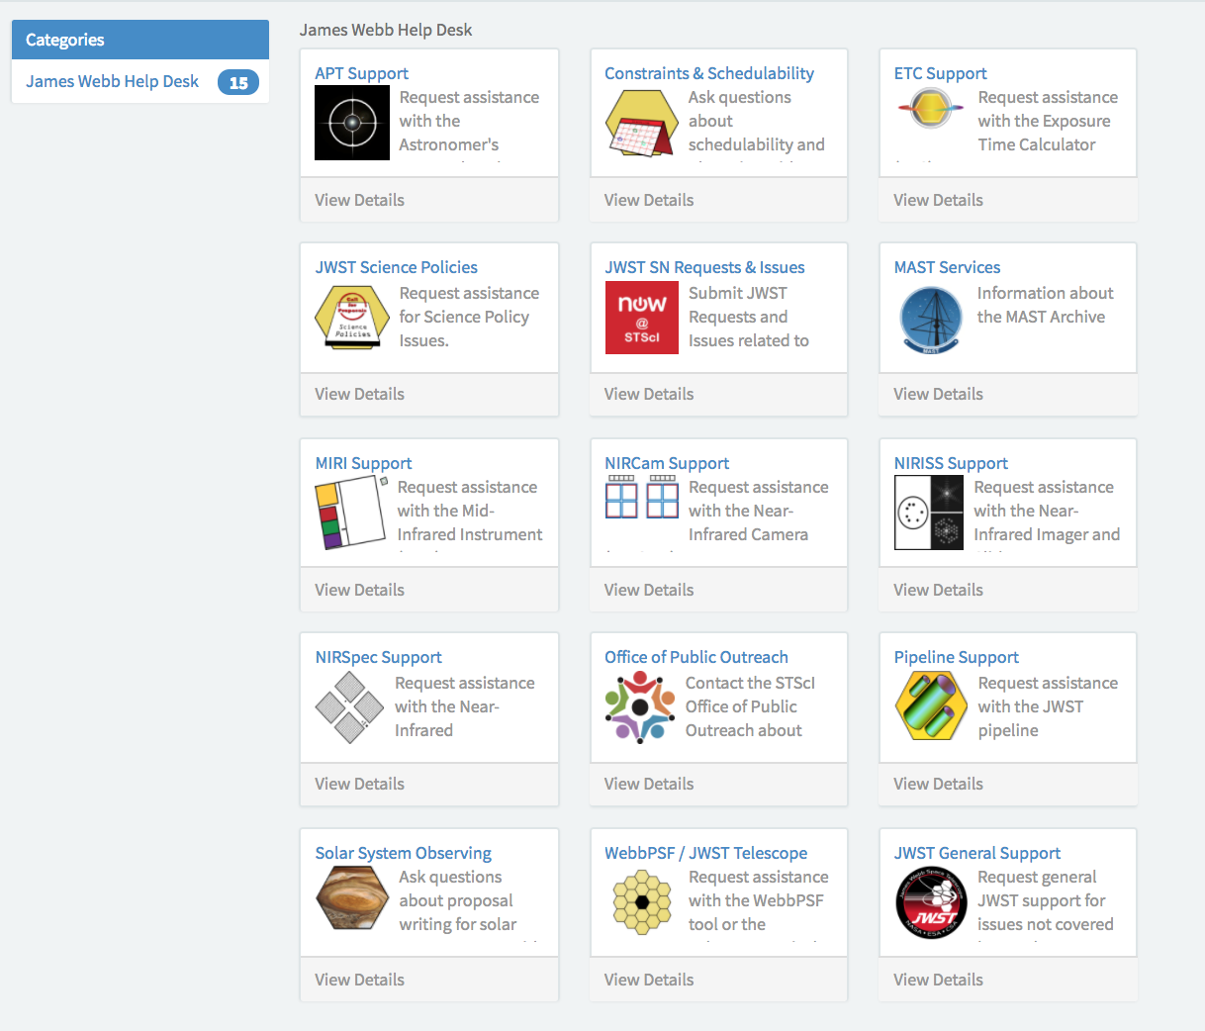
JWST Help Desk– jwsthelp.stsci.edu
2. Get Help:
Ask a question
Many ”Catalogs” to choose from to get an answer quicker
Or choose “General”
ESAC JWST Workshop 2017 - Madrid

Slide 10
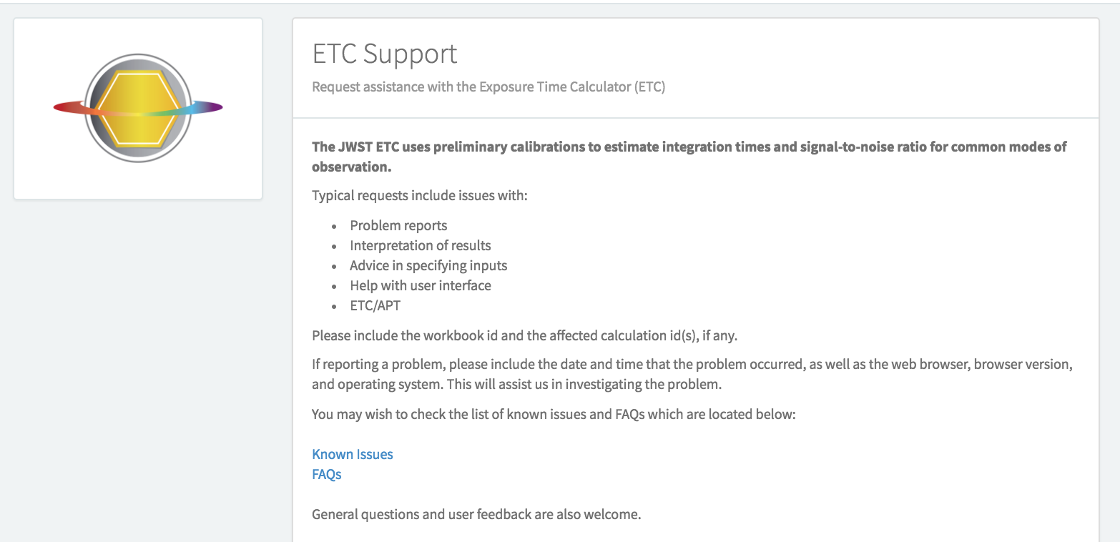
JWST Help Desk– jwsthelp.stsci.edu
2. Get Help:
General Information/Description
Includes link to Known Issues and FAQ
ESAC JWST Workshop 2017 - Madrid

Slide 11
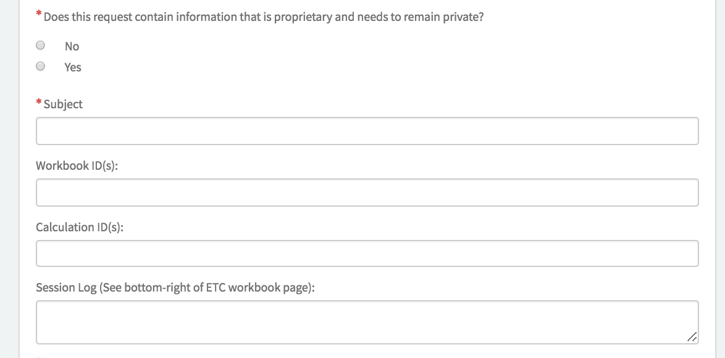
JWST Help Desk– jwsthelp.stsci.edu
2. Get Help:
General Information/Description
Proprietary?
Catalog Specific Information
Workbook ID, etc
ESAC JWST Workshop 2017 - Madrid

Slide 12
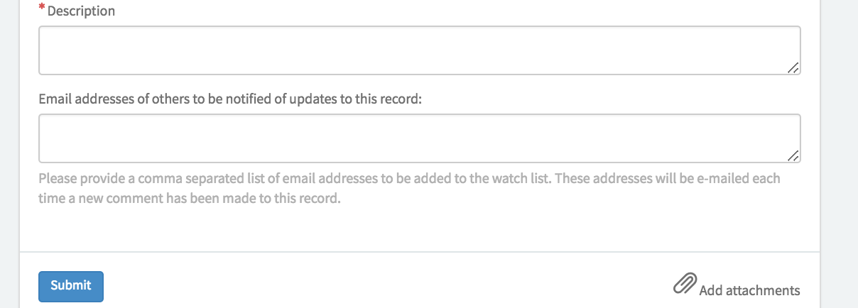
JWST Help Desk– jwsthelp.stsci.edu
2. Get Help:
General Information/Description
Proprietary?
Catalog Specific Information
Workbook ID, etc
Add collaborators
Add attachments
ESAC JWST Workshop 2017 - Madrid

Slide 13
JWST Help Desk– jwsthelp.stsci.edu
3. Answers:
Viewable within HelpDesk via “My Open Tickets” tab or home page
Also sent via email
ESAC JWST Workshop 2017 - Madrid

Slide 14
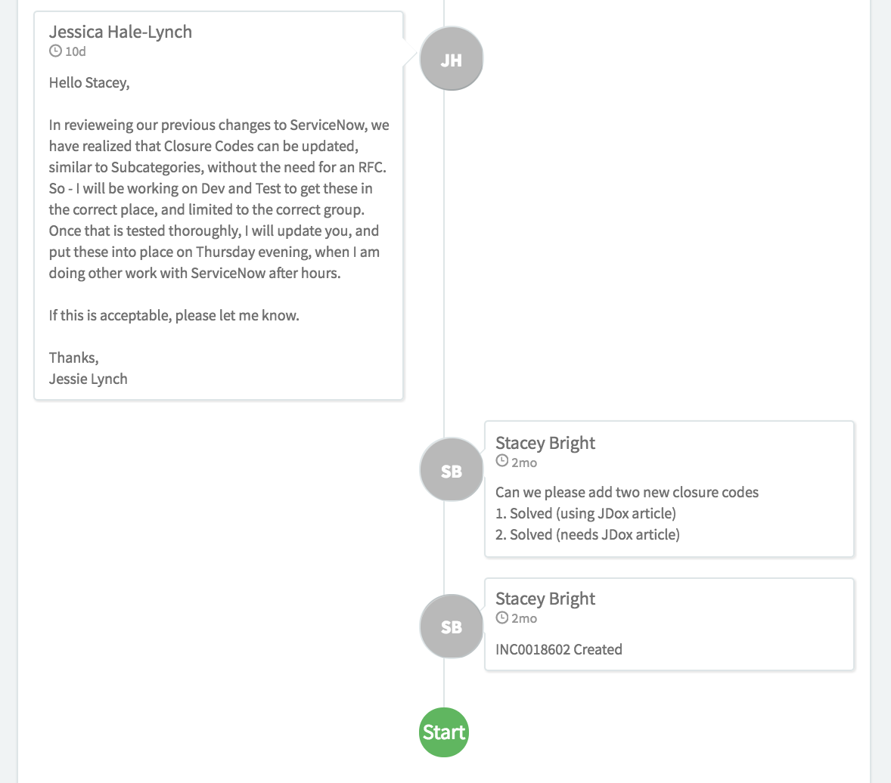
JWST Help Desk – jwsthelp.stsci.edu
3. Answers:
Viewable within HelpDesk via “My Open Tickets” tab or home page
Also sent via email
Answers shown in chat format
ESAC JWST Workshop 2017 - Madrid

Slide 15
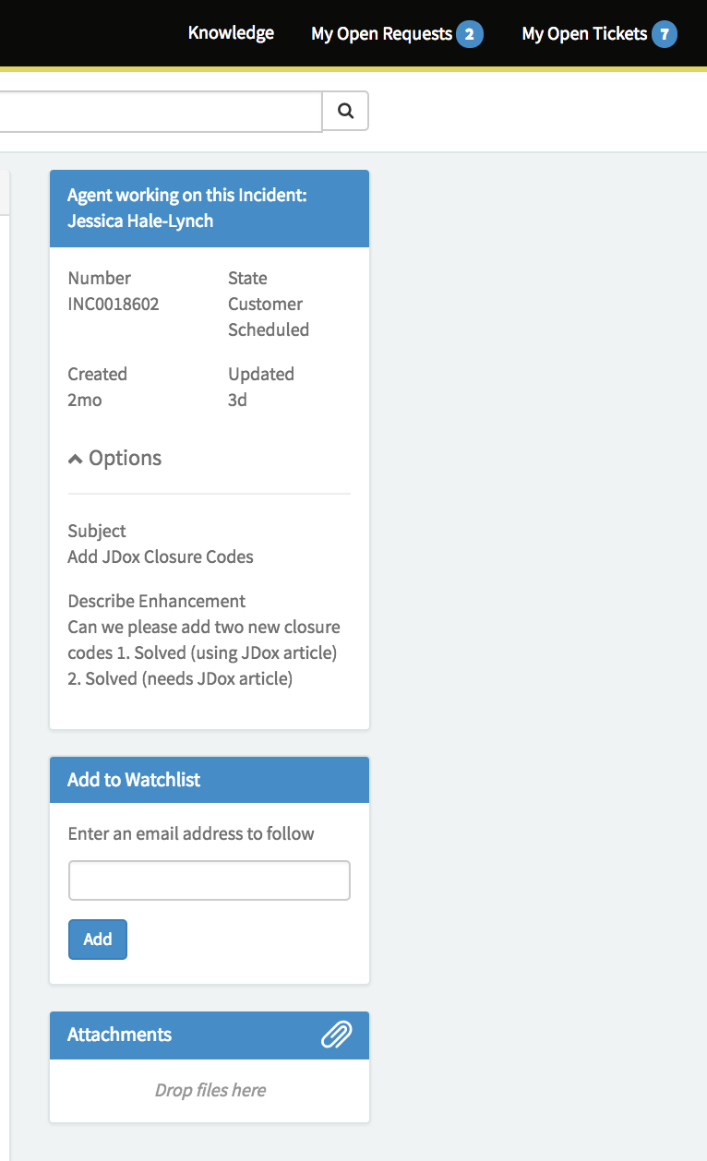
JWST Help Desk
3. Answers:
Viewable within HelpDesk via “My Open Tickets” tab or home page
Also sent via email
Answers shown in chat format
Shows agent when assigned
Add collaborators after submitting
Upload more attachments
ESAC JWST Workshop 2017 - Madrid

Slide 16
JWST Help Desk– jwsthelp.stsci.edu
4. Announcements
Posted news
New releases, downtime, etc.
Helpful during deadline periods
ESAC JWST Workshop 2017 - Madrid

Slide 17
JWST Help Desk– jwsthelp.stsci.edu
4. Community Forum
Community sourced questions and answers
Will be more populated after ERS and hopefully in use for Cycle 1
ESAC JWST Workshop 2017 - Madrid

Slide 18
JWST Help Desk– jwsthelp.stsci.edu
jwsthelp.stsci.edu
ESAC JWST Workshop 2017 - Madrid

