Slide 1
Product Assurance at ESAC
Introducing the SCI-SX PA Team
ESAC - SCI-SX PA Team

Slide 2
Scope of Quality Assurance vs Product Assurance
ECSS Glossary ‐ ECSS‐S‐ST‐00‐01C
Product Assurance (PA) ‐ Discipline devoted to the study, planning and implementation of activities intended to assure that the design, controls, methods and techniques in a project result in a satisfactory degree of quality in a product.
ISO 9000:2015 Quality management systems — Fundamentals and vocabulary
Quality assurance (QA) ‐ part of quality management focused on providing confidence that quality requirements will be fulfilled.
In practice, PA pursues a safe & successful mission, looking at all components of the system (Hardware, Software, Human) and their interfaces.
QA is a discipline of PA

Slide 3
PA Team at SCI-SX
F. Aldea
J.
Gallegos
L. Martín
S. de Castro
J. Marcos
S. Ibarmia
Fran J. Casquero
R. Pérez
SCI-SX PA Manager
SCI-SX PA Team

Slide 4
PA Team at SCI-SX: Interfaces
Head of Operations Department
SCI-SX
SCI-SX Office
H. Vicente de Castro
Head of Divisions
SCI-SD, SCI-SA, SCI-SO
SCI-SX PA Manager
F. Aldea
SCI-SX PA Team
Members

Slide 5
SCI-OS PA General Activities
Product Assurance Manager activities
Direct support at SCI-S projects
  In study-phase: Lisa, ATHENA
  in development (SCI-SD): Euclid, Juice, Plato
  in operations (SCI-SO): BepiColombo, Solar Orbiter, Gaia, ExoMars, INTEGRAL (also Rosetta, Herschel, Lisa Pathfinder… in the recent past)
Direct support to SCI-SA services
  ESDC : General ESDC, Gaia, Euclid, PSA, Helio
  Cross-mission: MAPPS
Support at SCI-S Department level
  ESAC Licensing Board
  Lesson Learned process
  SCI-S reviews
  PA and Engineering Training, etc.
Represent SCI-S Interfacing with External Partners
  Participating in WGs with QQS, EUMESAT,CNES,

Slide 6
SCIO-SX PA Evolution
Automatic quality checks Sonarqube
Quality gates
Common quality model
More languages
Different tools
SW quality
Industry standard CI
Maven, Jenkins, Nexus
CI/CD libs
Common, tested scripts
Continuous Integration
Minimum UT Coverage
Tests as Requirements
Increase Test Automation
Testing in parallel to development
Testing
Collaborative knowledge management
Minimum documentation ready for review
Document templates
traced to PA requirements
Knowledge Management -
Documentation
Agile
Scrum
Multiple, Multidisciplinary Teams
Scaling Scrum
Development Process

Slide 7


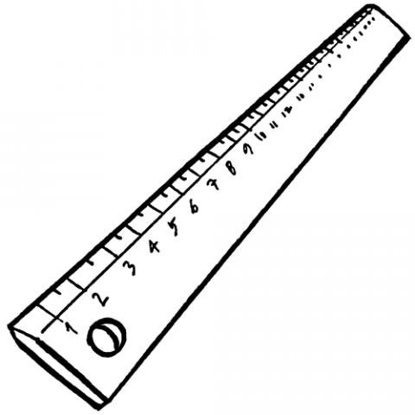





PA Support: ESDC Case
Product Assurance Manager activities
Up to 30 procedures for SCRUM, Development, CI, Release, Start-up, Risk Management
Procedures
68 SW Requirements for SOAR
49 SW Requirements for EAS
39 SW Requirements for Proba-2
Requirements
Estimations performed routinely in planning meetings
Roadmap for upcoming versions produced based on medium/long-term estimations
Estimation
Full traceability:
User Req -> SW Req -> Code -> Tests
Traceability
Quality Profile and Quality Gates defined
Unit Tests: Helio > 60%, Gaia 0 to 20%, Euclid started
Code quality
Proceduralised
Verified and Approved
Increased efficiency (migrated to Maven/Nexus)
Release Process
Improved planning
Efficient retrospectives
Brainstorming/Refinements done every sprint
SCRUM
Customised project status dashboards
Semi-automatic Monthly Progress Reports
Homogeneity of processes among archives
ESDC
Homogeneity

Slide 8



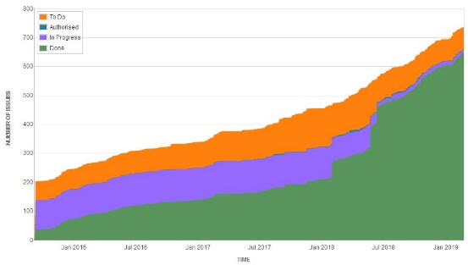





PA Support: Cross-mission case
BEFORE
NOW
WAY-FORWARD
No Quality tools
SonarQube for MAPPS
Static analysis of code: cppcheck
Knowledge of the code status
Quality gates for new code
PROCEDURES
CI with Jenkins
0.20
BEFORE
NOW
QUALITY TOOLS
Testing
No SCRUM / release procedures
Documented SCRUM procedures
On-time sw releases
Increased ratio of resolved vs created issues
BEFORE
NOW
Implement the quality model for PSA (with ESDC Quality Gates)
No tracking of internal validation tests
No formal acceptance tests
Creation of test cases
Definition of Acceptance Test Template
Improve the release process and tools
PSA
PROCESSES
TESTING
Traceability Usr Req – Sw Req – Code - Tests
0.20
BEFORE
NOW
No risk management
Risk mgt and register definition
Compile all operational documentation
DOCUMENTATION
BEFORE
NOW
Create INTEGRAL doc baseline
0.10
Word document
Confluence pages
IFOM - INTEGRAL FACILITY OPERATIONS MANUAL

Slide 9
PA Support: Projects case: (e.g. BepiColombo, Euclid, Exomars)
Backlog
In Progress
Done
Bepi-4
Improving code quality, NOW zero blocking or critical issues , NEXT 0 major
Bepi-1 successfully integrated scrum methodology in a V-lifecycle project
Bepi-2
Full traceability from SIRD to SysReqs, Sub, UC to tests
Bepi-7
Development of the SGS Mercury System
Bepi-6
Compilation of lessons learned by SGS
Bepi-5
Risk management and risk register
Bepi-3
UT from 0 to > 60%
Testing at different levels
Euclid-2
Unit testing>80%
Euclid-6
Integration of SOC SW tools
Euclid-7
ESS from dev to maintenance
Euclid-4
Full traceability from Reqs to Tests
Euclid-5
Automated system testing and production of records
Euclid-1
requirement and test management using Confluence & JIRA
Euclid-3
Agile approach for development
ExoMars-2:
RISK management
ExoMars-1:
Confluence/JIRA
Documentation preparation for Reviews (CORR, NORR)
ExoMars-3:
Tidy up documentation
Euclid-4
Semi-automated production of STP, STS, STR & SRN

Slide 10

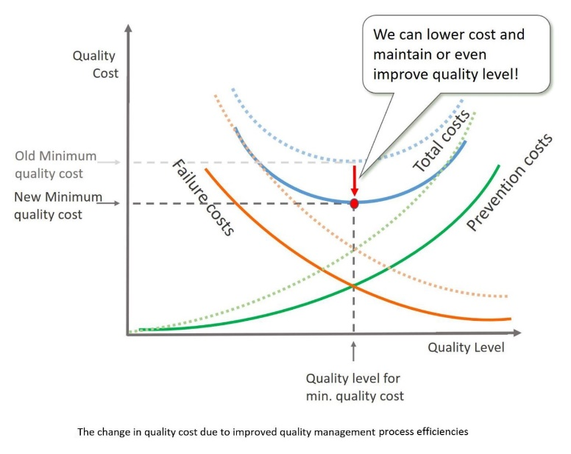
PA - Some myths and facts
The myths
PA belongs to the project team;
PA is all about testing;
Leave PA to the end;
PA does not need management support;
PA is an overhead
The facts
PA is independent from the project team;
PA goes far beyond testing;
PA is embedded in the development process;
Management support is essential to PA;
PA increases efficiency and reduces costs

Slide 11
