Slide 1
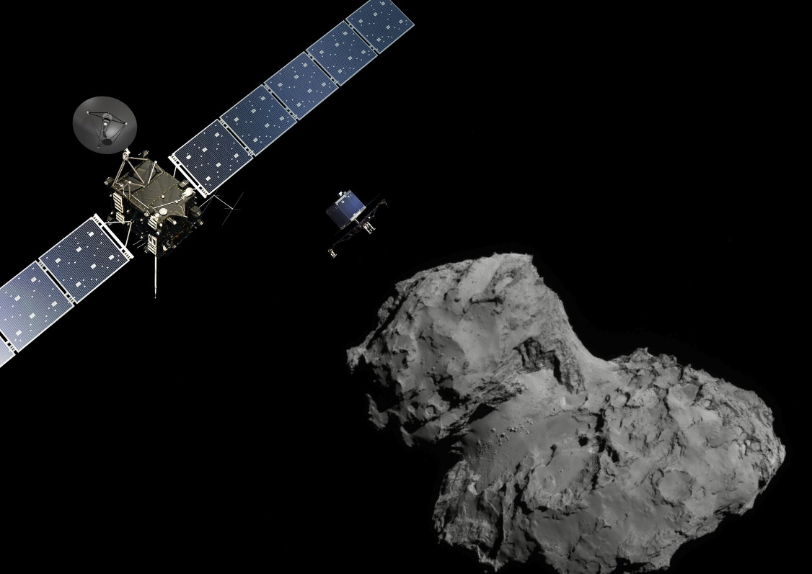
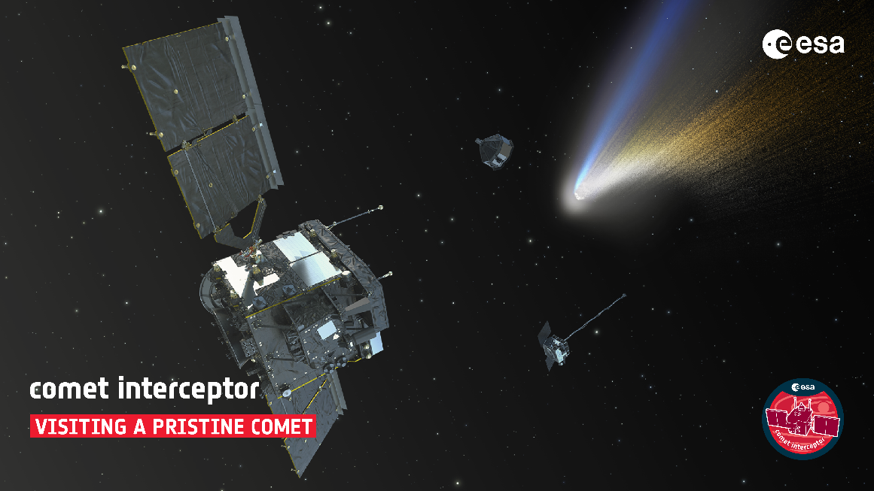
Future Comet Interceptor
Rosetta Anniversary: 10 years after Philae Landing
12 November 2024
ESTEC, Tennis hall

Slide 2
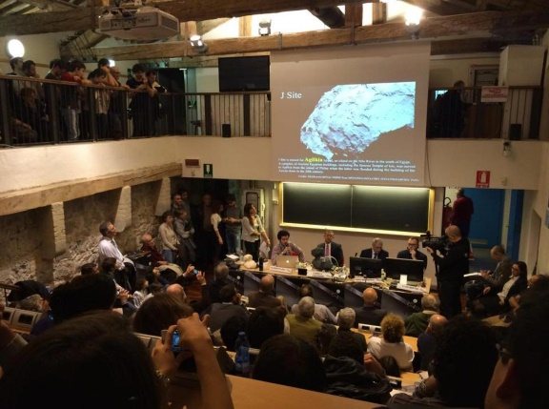
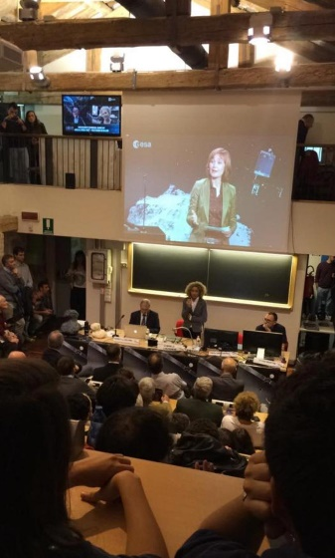
12 November 2014
Department of Physics and Astronomy in Padova

Slide 3
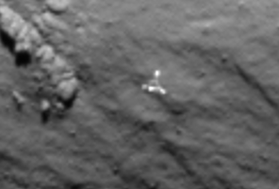
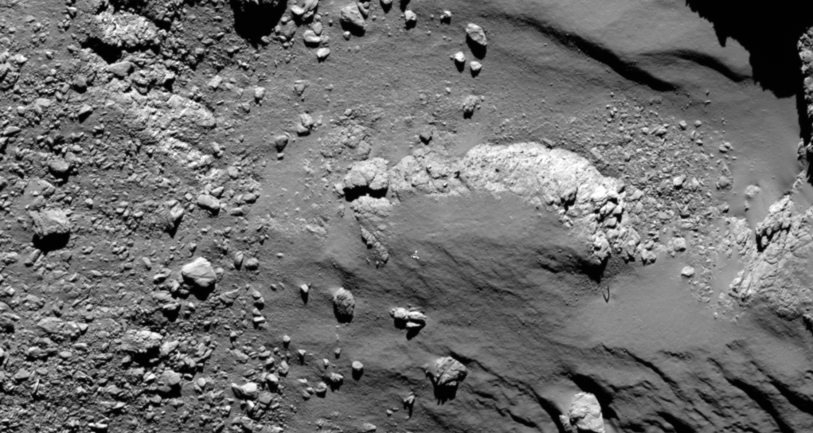
15
Searching for Philae..
Lander
NAC 15:13
Credits: ESA/Rosetta/MPS for OSIRIS Team MPS/UPD/LAM/IAA/SSO/INTA/UPM/DASP/IDA

Slide 4
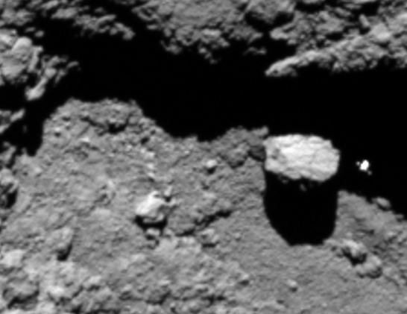
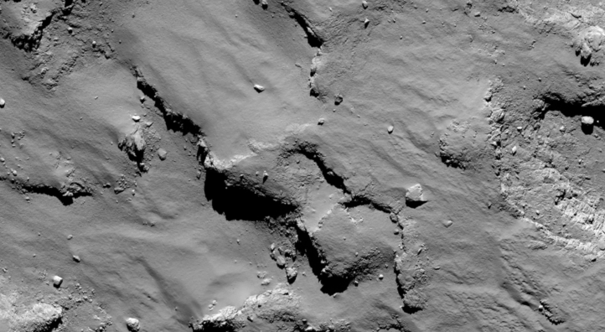
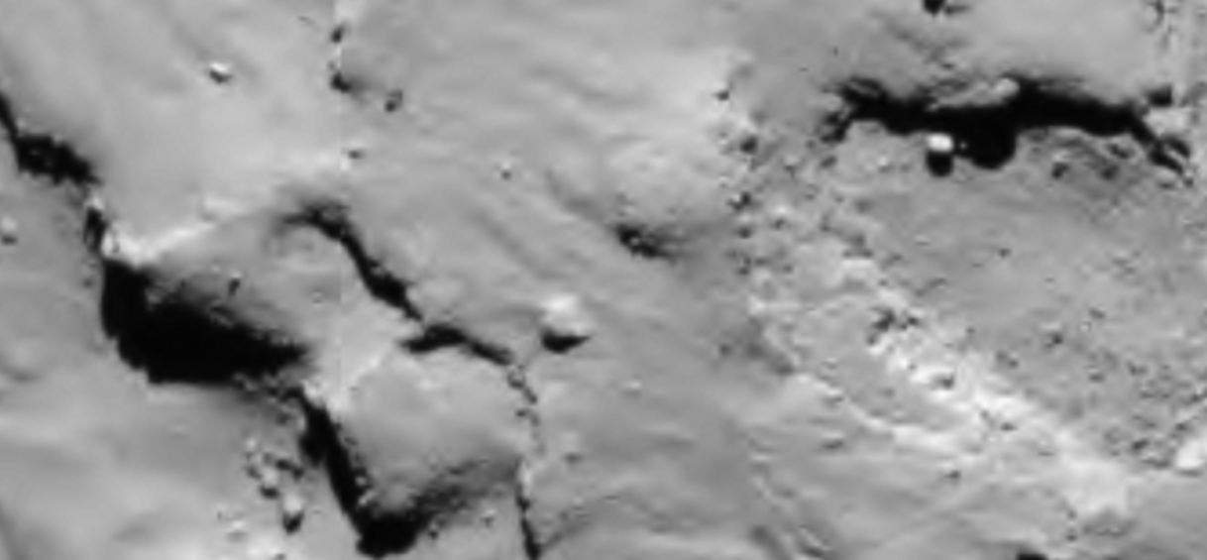
Searching for Philae..
Lander
NAC 15:43
WAC 15:43
Credits: ESA/Rosetta/MPS for OSIRIS Team MPS/UPD/LAM/IAA/SSO/INTA/UPM/DASP/IDA

Slide 5
Philae imaged by OSIRIS
Credits: ESA/Rosetta/MPS for OSIRIS Team MPS/UPD/LAM/IAA/SSO/INTA/UPM/DASP/IDA

Slide 6
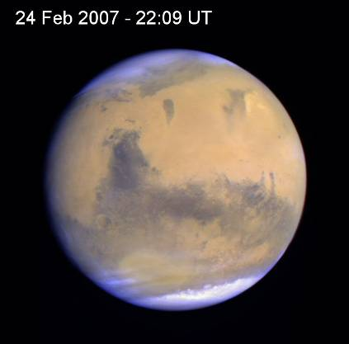
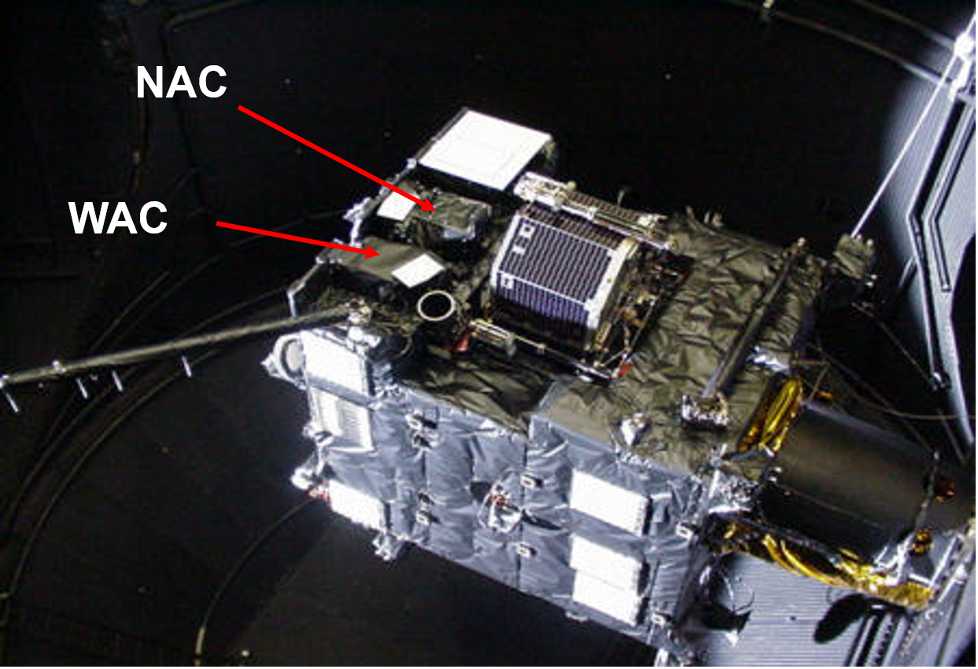
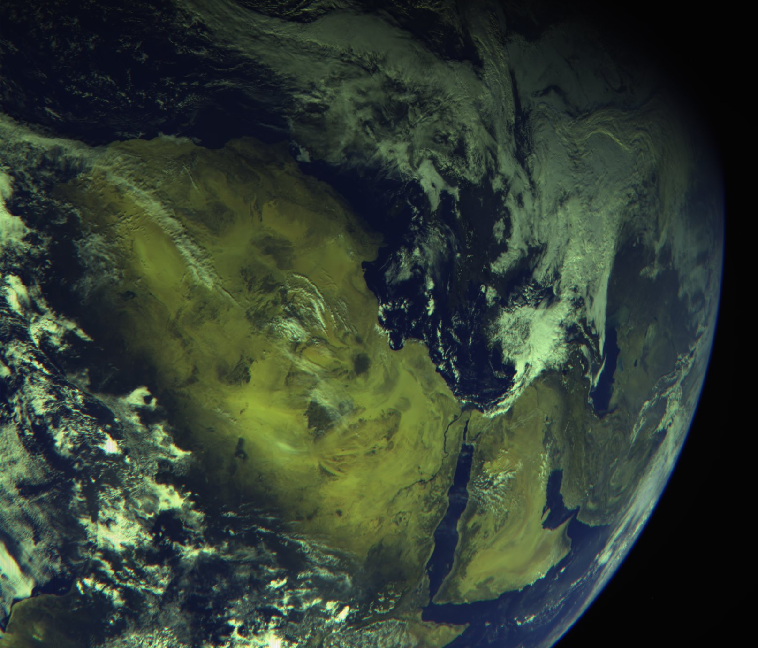
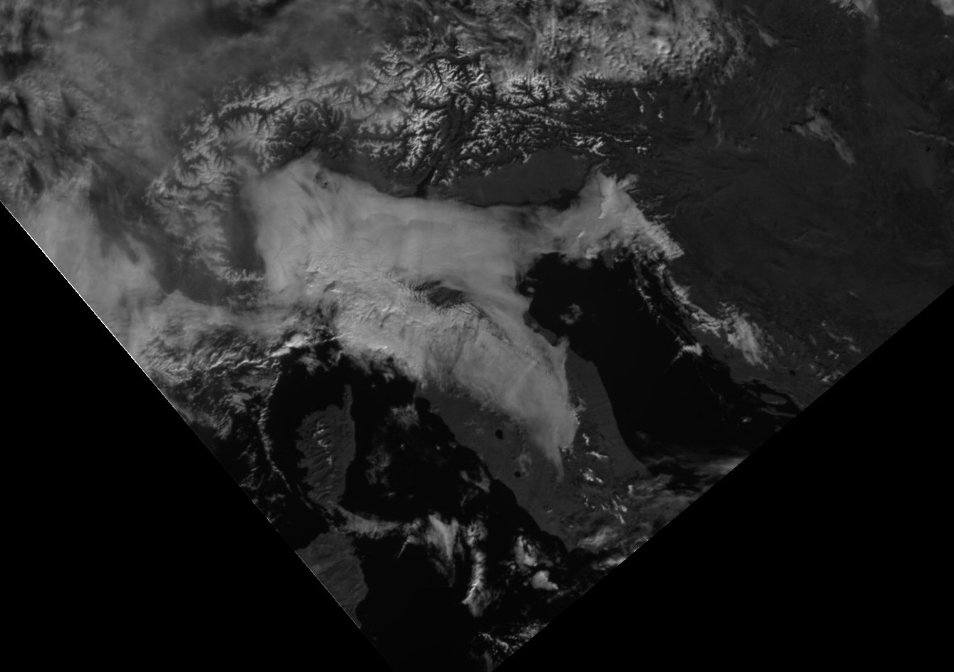
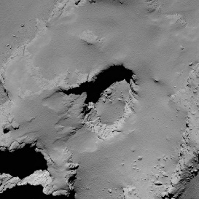
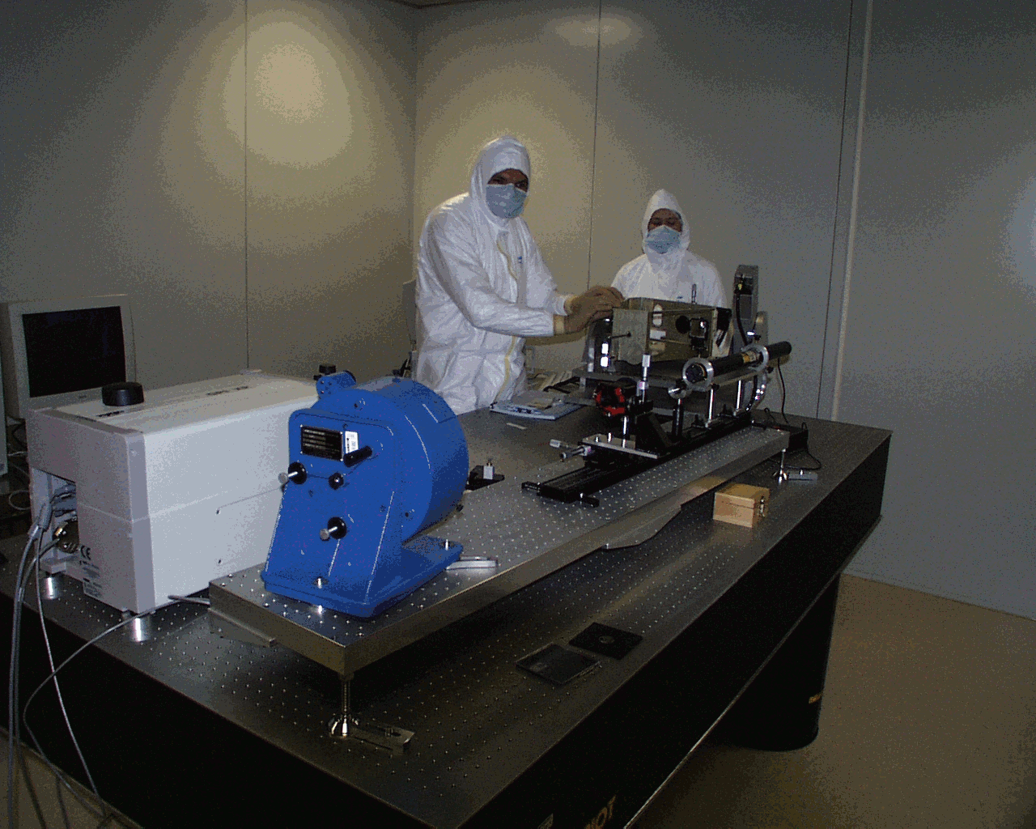
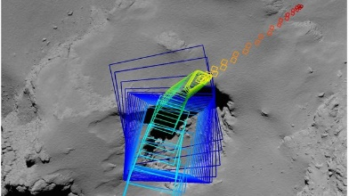
OSIRIS
OSIRIS (Optical, Spectroscopic and Infrared Remote Imaging System)
27 Apr 2004 02:02
13 Nov 2009
Credits: ESA/Rosetta/MPS for OSIRIS Team MPS/UPD/LAM/IAA/SSO/INTA/UPM/DASP/IDA
7-8 Aug 2014
30 Sept 2016

Slide 7
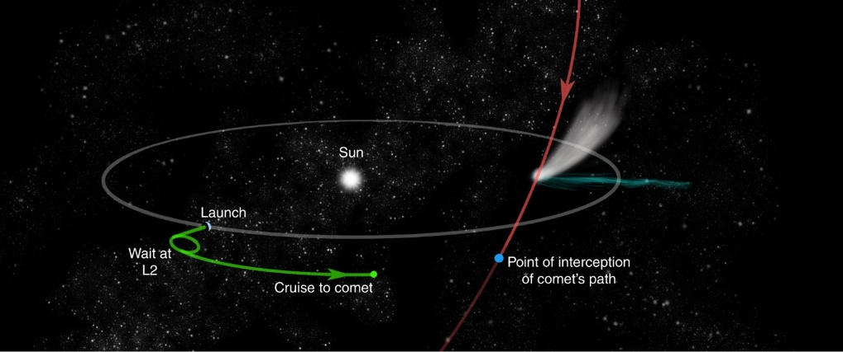
Comet Interceptor
Comet Interceptor is an F-class mission dedicated to study a long-period comet, preferably dynamically-new, i.e. nearing the Sun for the first time and thus made of pristine material.
Most of the previous comet missions have been to objects that have passed the Sun many times. Those comets have changed over time, and are covered in a thick layer of dust
Comet Interceptor has to respond rapidly (6-12 months) after the discovery of a potential target.
Mission parked at SEL2 to wait up to 3-4 years until a potential target is found.
Launch planned for the end of 2029.
Notes:
The mission was proposed to ESA in 2018, selected in June 2019 as the prime candidate for the first fast class mission in its Cosmic Vision Programme, and it was formally adopted by the agency in June 2022
The mission has been conceived to intercept a Long-Period Comet, ideally a Dynamically-New Comet, or even an Interstellar Object originating at another star.
Comet Interceptor’s scientific task is to study the target nucleus, in terms of morphology, composition, shape and structure; and its coma, hence the composition of the gas and dust, its connection to the nucleus and its plasma environment.

Slide 8
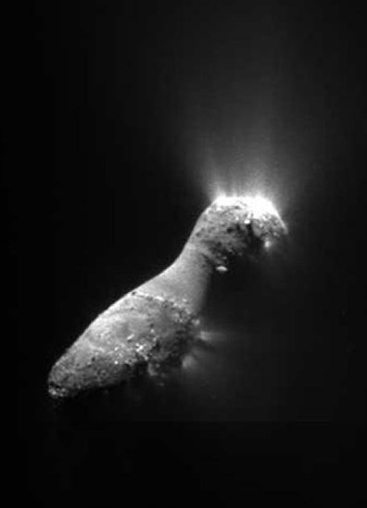
Comet Interceptor: science objectives
The primary goals of Comet Interceptor are:
to provide the first in-situ characterization of a long period comet, which could be dynamically-new (or an interstellar object).
to perform the first simultaneous multi-point exploration of a cometary coma and nucleus.
The science of the mission is split between two themes:
1. Comet Nucleus Science
2. Comet Environment Science
NASA
Carmen Naletto | ICSO 2024 | Antibes Juan-les-Pins, France | October 25th, 2024
Notes:
The goal of the mission is, therefore, to provide new insights on the formation and evolutionary path of the target object, and, more generally, on the condition of the early stages of the Solar System formation.

Slide 9
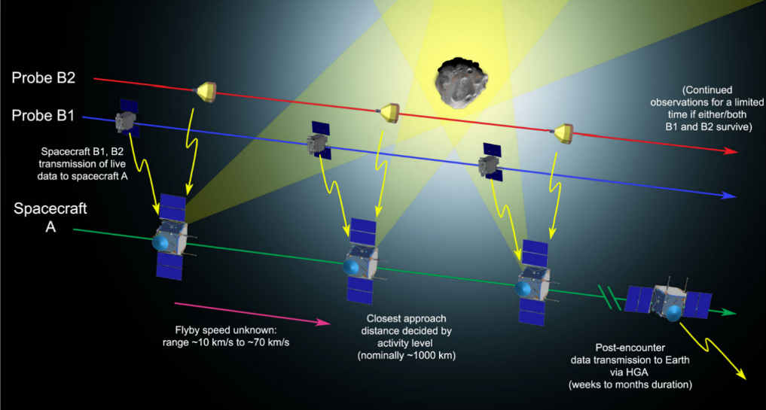
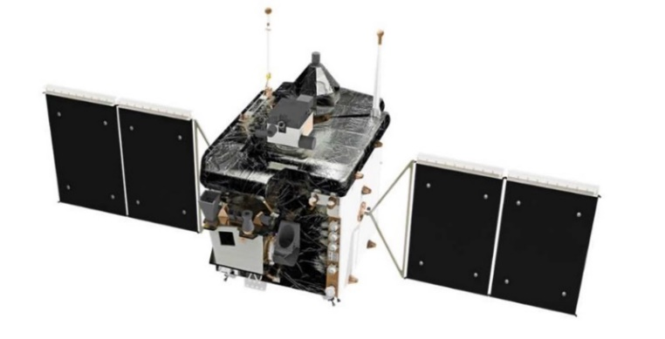
Comet Interceptor: spacecraft concept
Comet Interceptor has been conceived as a multi-spacecraft mission:
S/C A ‘safe’ fly-by distance from the comet (1000 km)
plus two modules getting closer:
Probe B1 inner coma (800 km)
Probe B2 nucleus+coma (400 km).
To separate time and space variation in the coma
To enable simultaneous coma + nucleus + solar wind interaction studies at different distances
To separate safe / distant measurements and high risk / high gain close approaches
The remote sensing instruments aboard all three platforms will allow simultaneous observations from multiple points, thus creating a 3D profile of the chosen object.
Comet Interceptor design concept (credit ESA)
Probe B1
Probe B2
S/C A
Mission analysis configuration sketch (credit ESA)

Slide 10
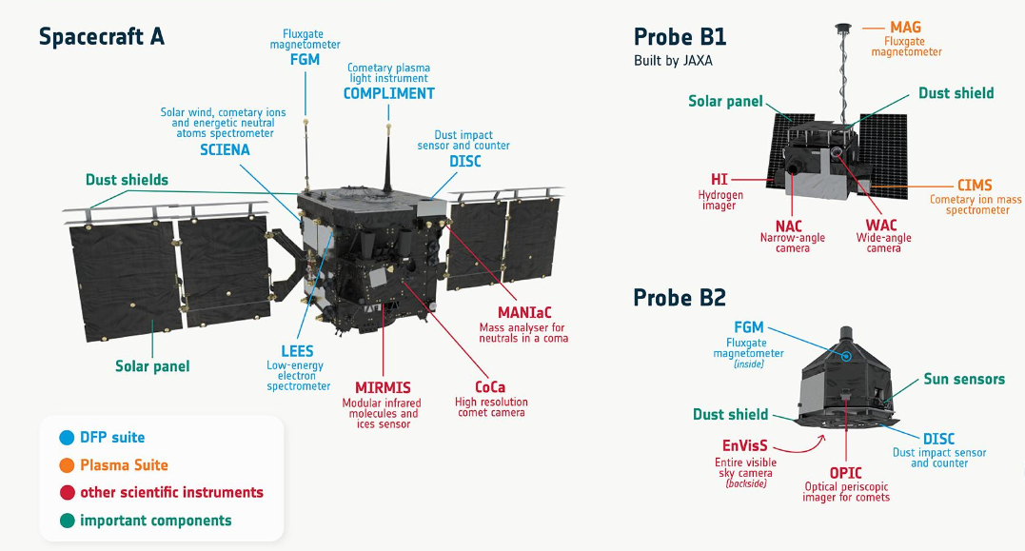
Comet Interceptor: payload
Notes:
JAXA, Japan Aerospace Exploration Agency
OHB-IT, Orbitale Hochtechnologie Bremen (Italia)

Slide 11
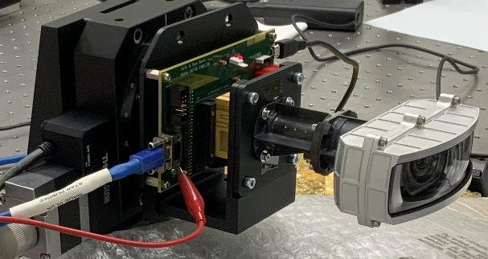
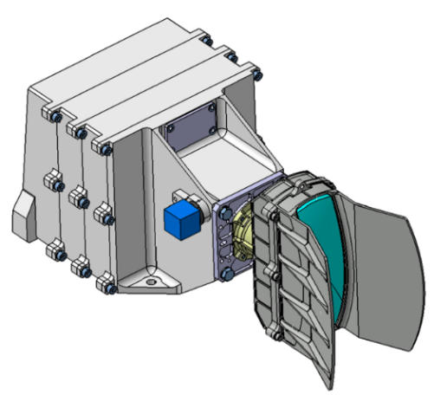
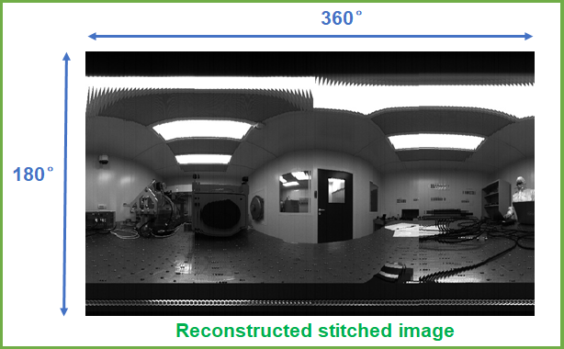
Entire Visible Sky camera (EnVisS)
EnVisS is a wide angle fish-eye camera conceived to study the comet dust environment, including its polarimetric properties, in the visible wavelength range.​
The study will be conducted through the full fly-by encounter from an advantageous point inside the coma itself.
Being the instrument mounted on the B2 spinning probe, a rotational push-broom technique will be adopted. ​
EnVisS prototype
Simulation of the acquisition concept in lab
EnVisS 3D CAD model (credit LDO))
EnVisS placement on B2 and acquisition concept

Slide 12
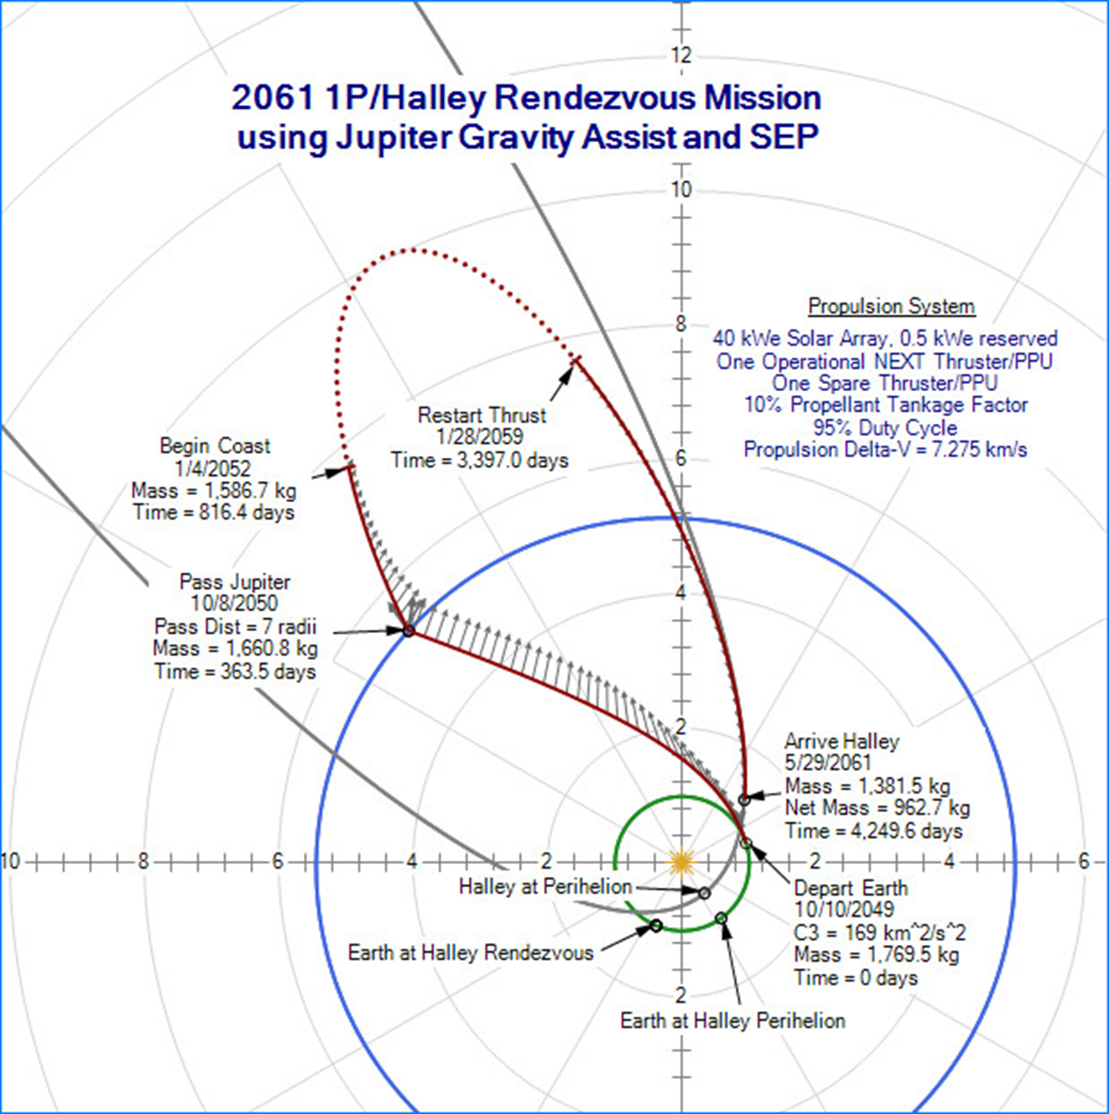
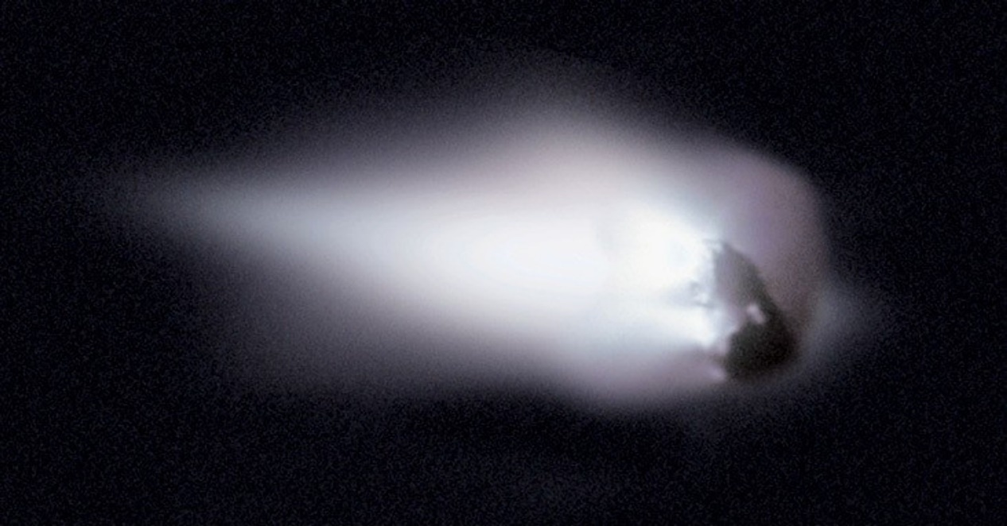
What’s Next?
1P/Halley 2061??
A new rendezvous mission!?
Halley Multicolor Camera Team, Giotto Project, ESA
J. Horsewood, R. McNutt, and A. Delamere, “Halley 2061 Missions – New Technologies” (2022)

