Slide 1
Orbiter Science Highlights
Nicolas Thomas

Slide 2
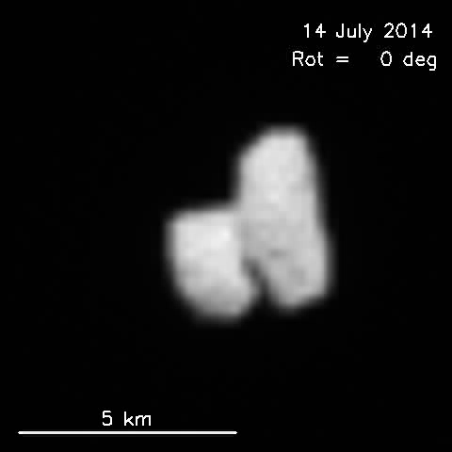
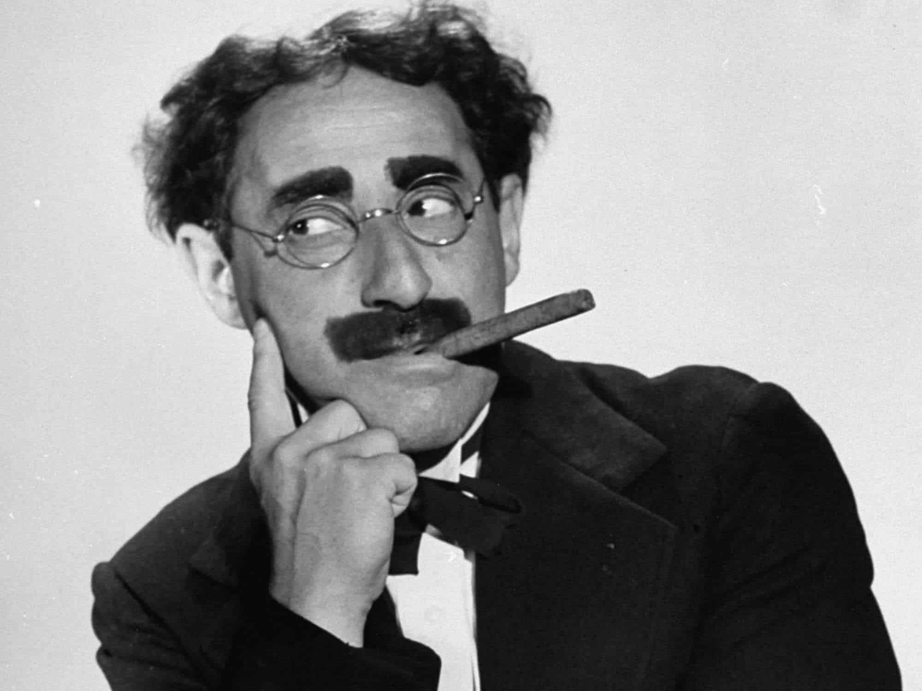
Duck Soup
~1400 refereed papers in 12 minutes???? You are not serious…. So this is MY sub-set of results.

Slide 3
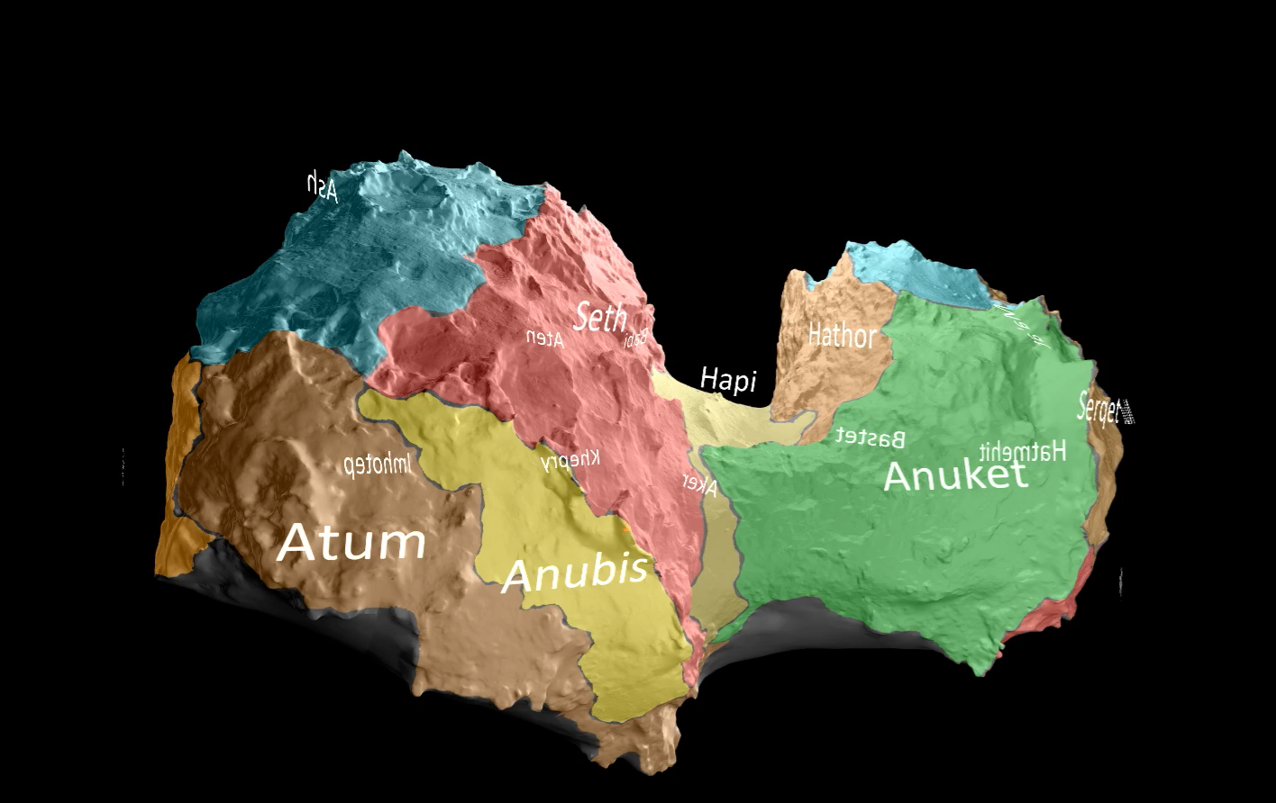
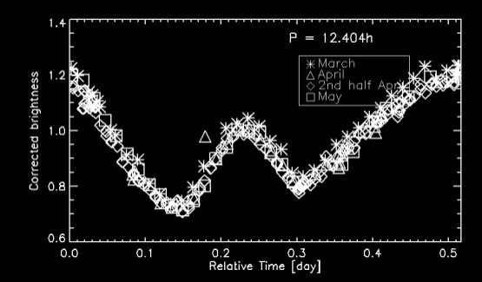
Shape and Illumination
Self-shadowing and self-heating in a rotating system
Rotation Period = 12.404 h.

Slide 4
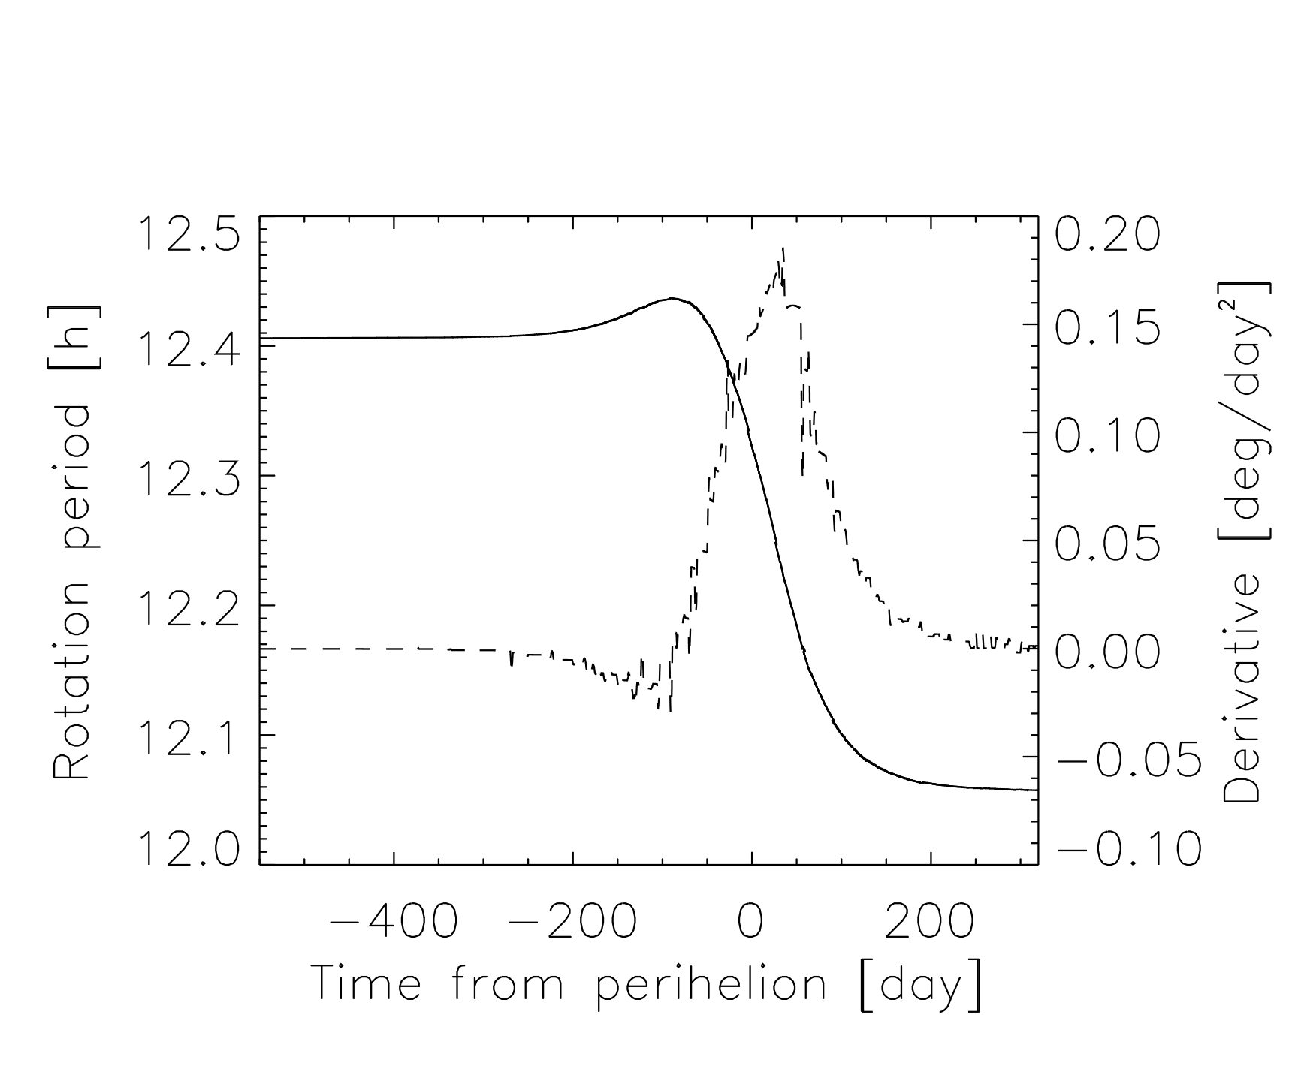
Change in rotation period and the 1st derivative.
20 minute change in the rotation period with a dΩ/dt maximum post-perihelion

Slide 5
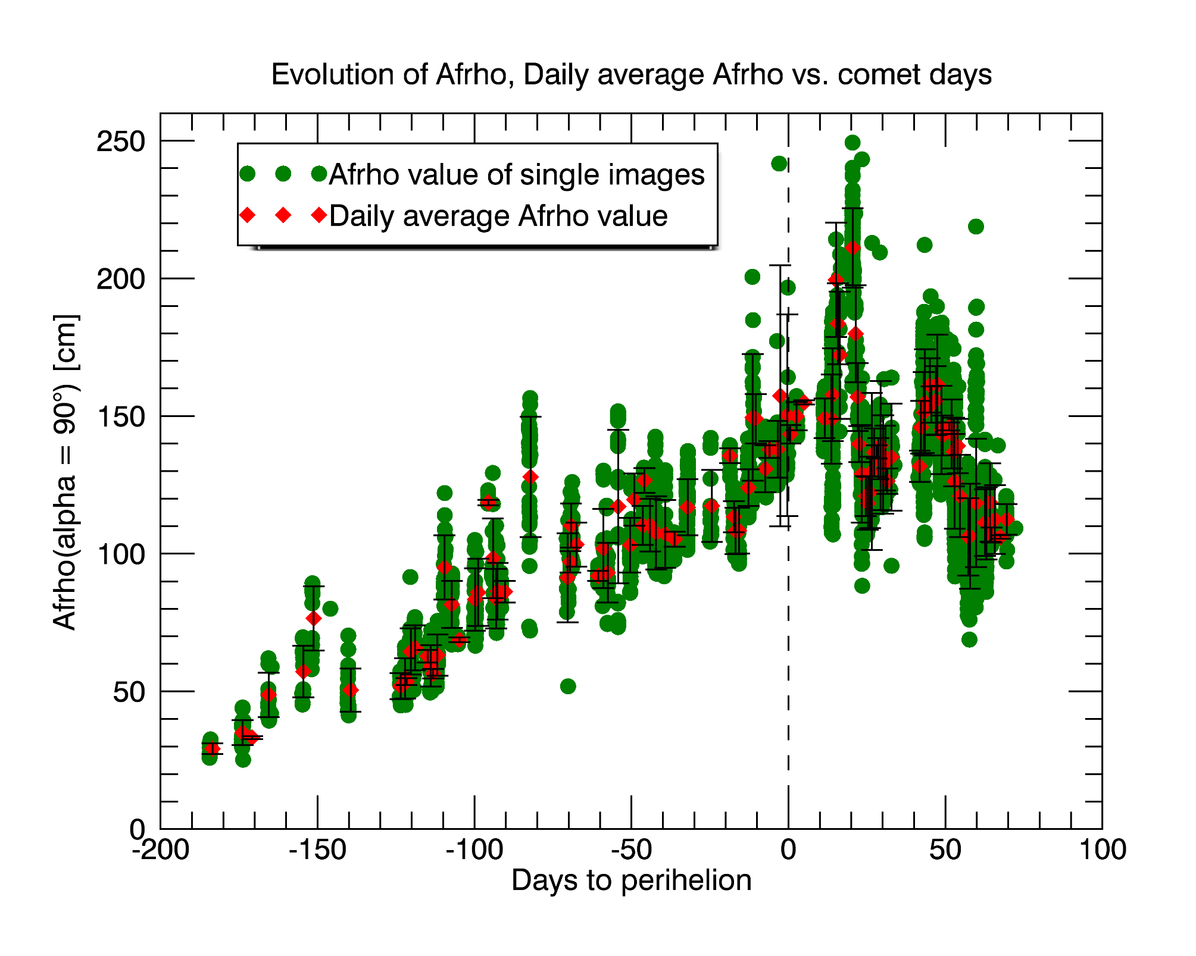
Activity as seen through the dust emission shows a correlation with the change in rotation rate.

Slide 6
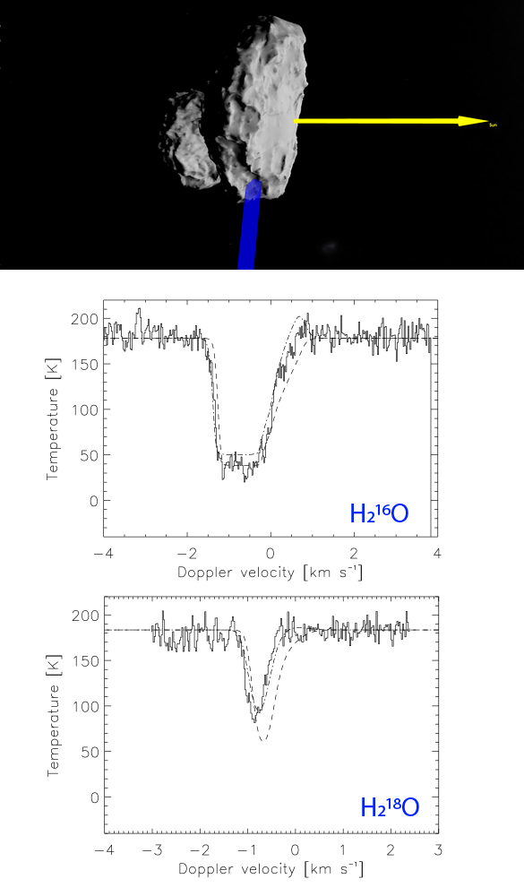
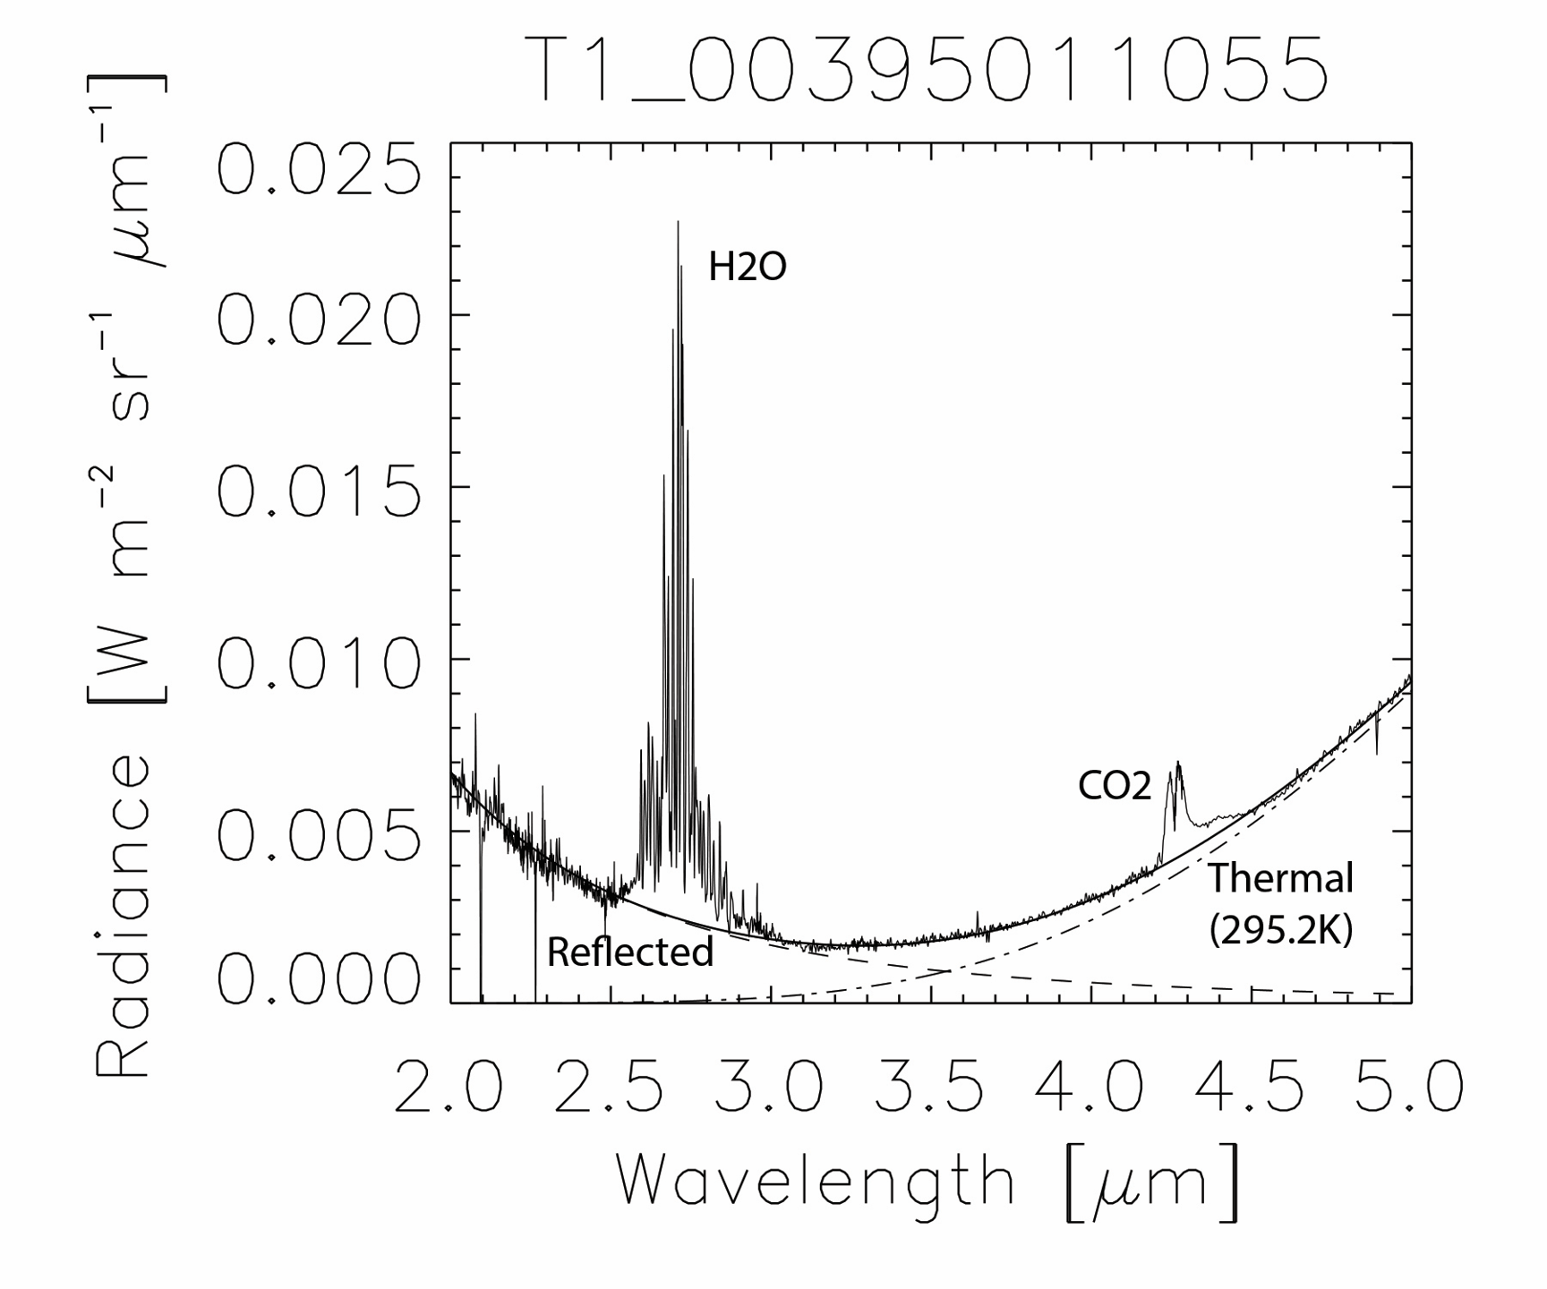
VIRTIS/MIRO measurements of primary species
2015-07-08 T21:10;
phase angle = 90° at 1.31 AU
Rich but challenging data sets

Slide 7
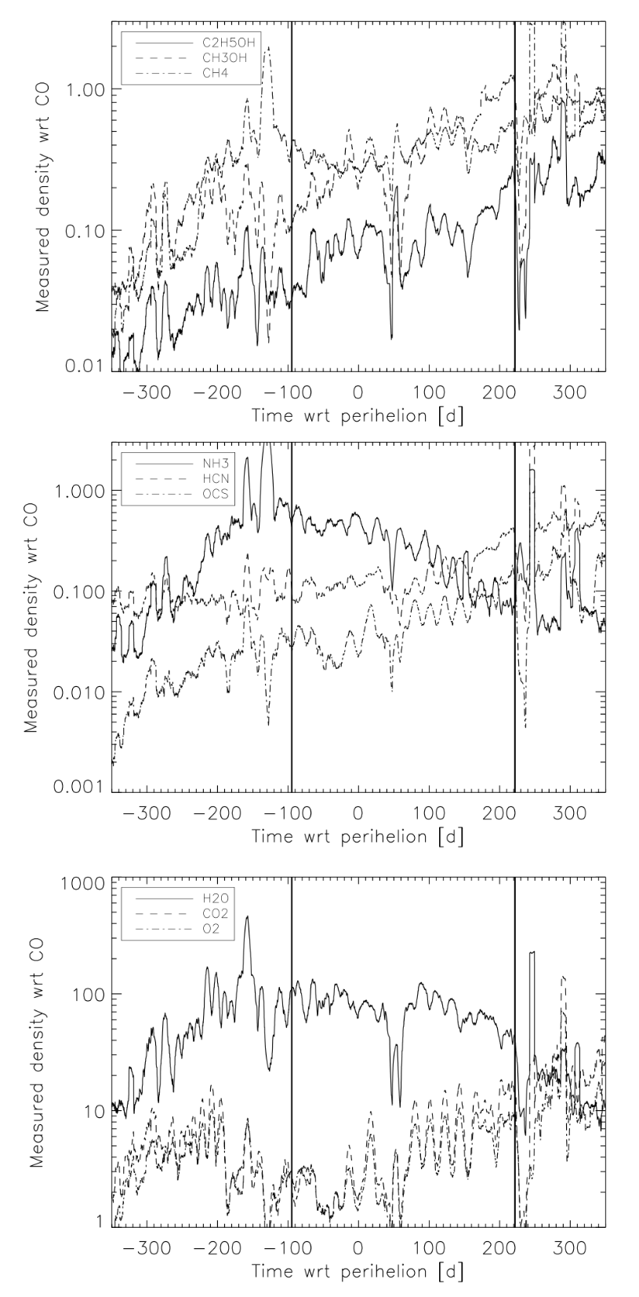
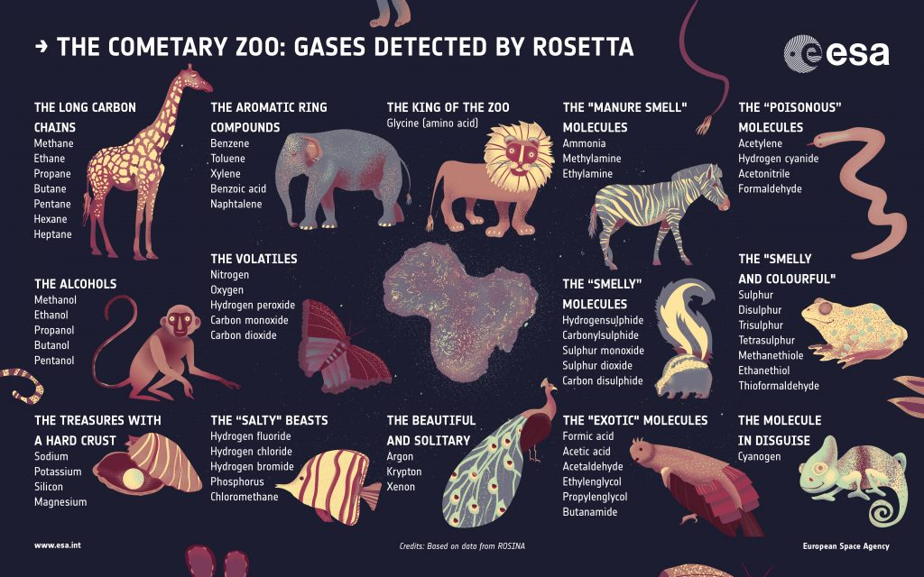
ROSINA: Volatile composition and relationships
Importance of salts – ROSINA/VIRTIS

Slide 8
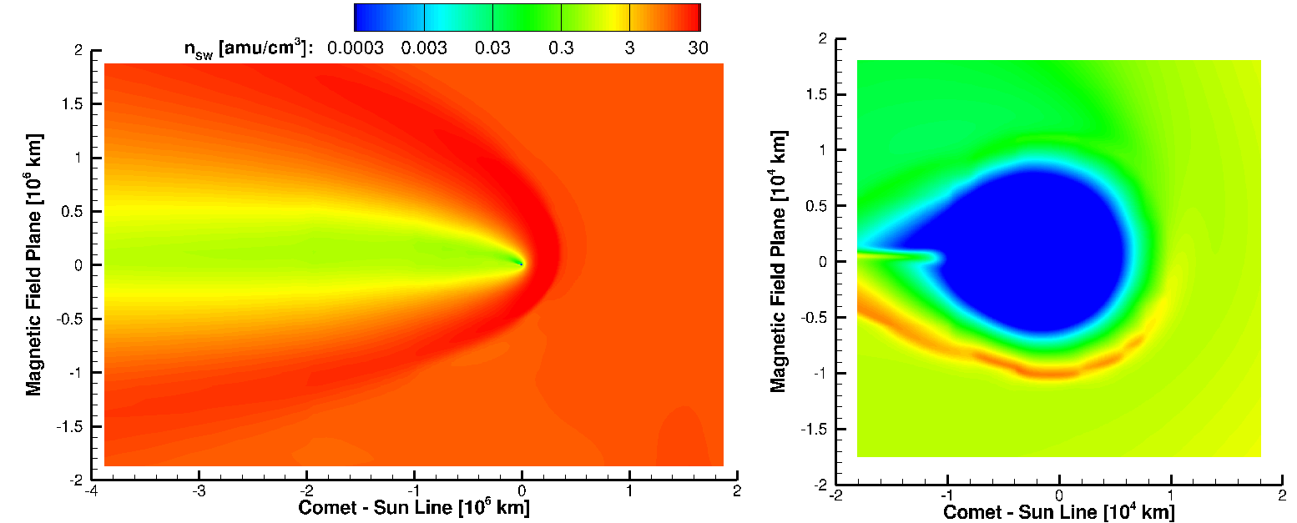
Diamagnetic Cavity
Rubin using the Michigan model.
Goetz et al. 2016

Slide 9
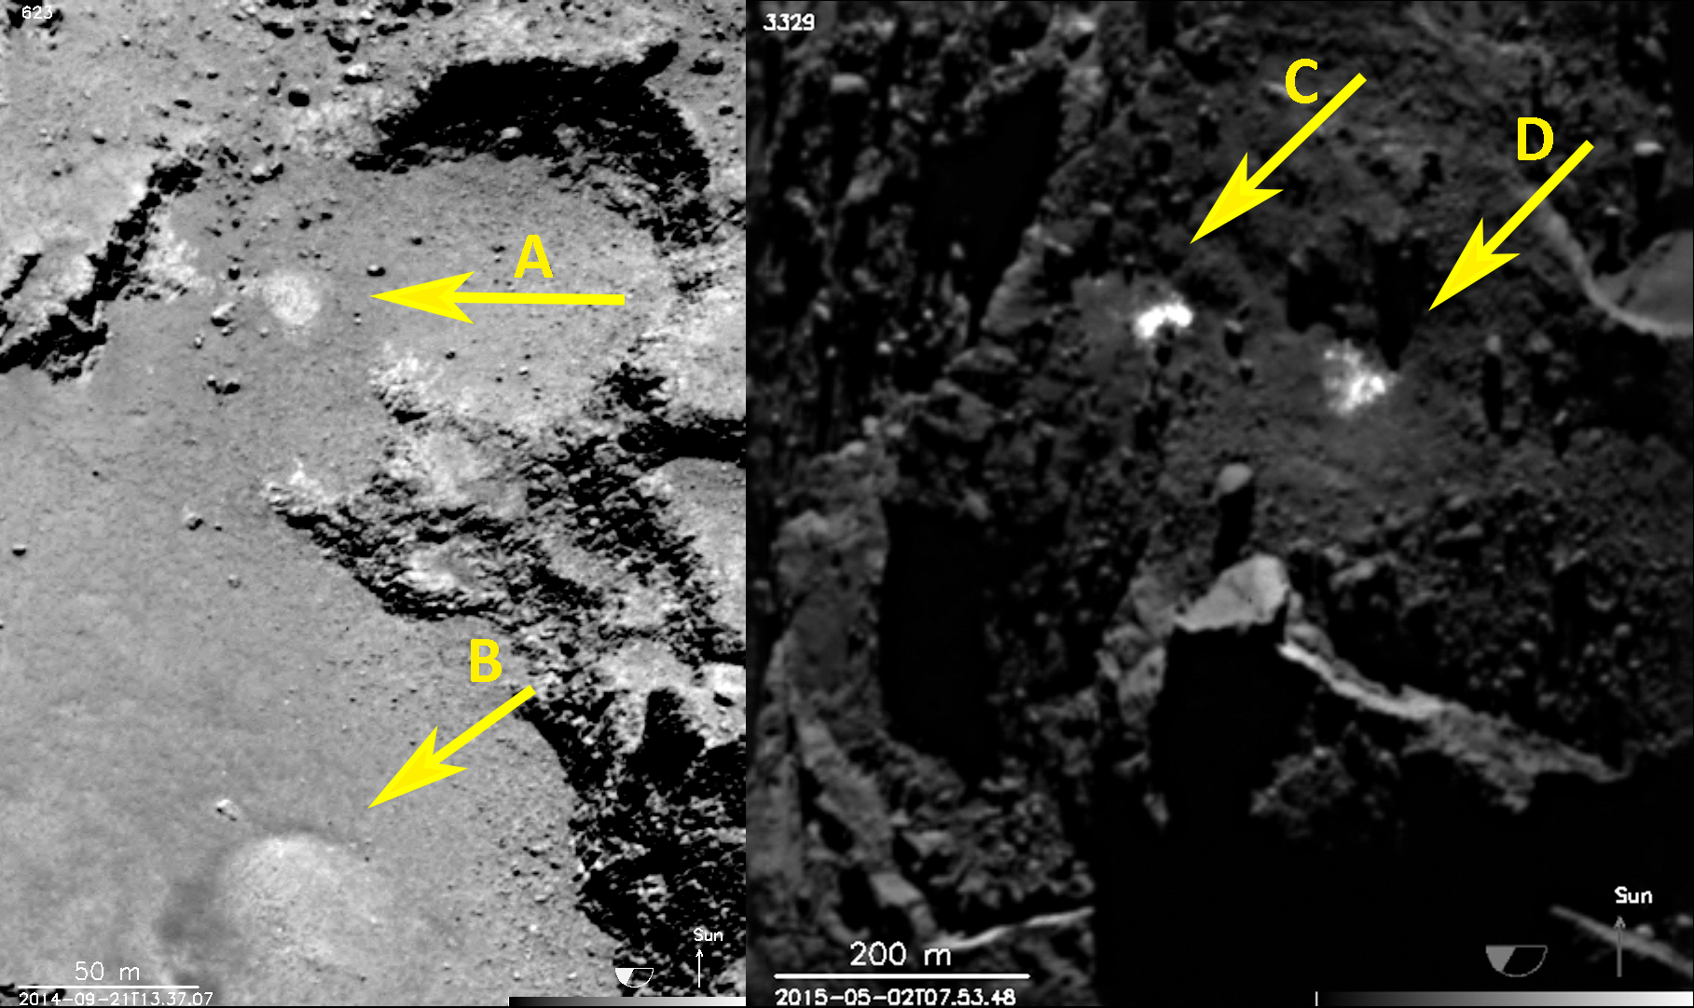
Exposed ices?

Slide 10
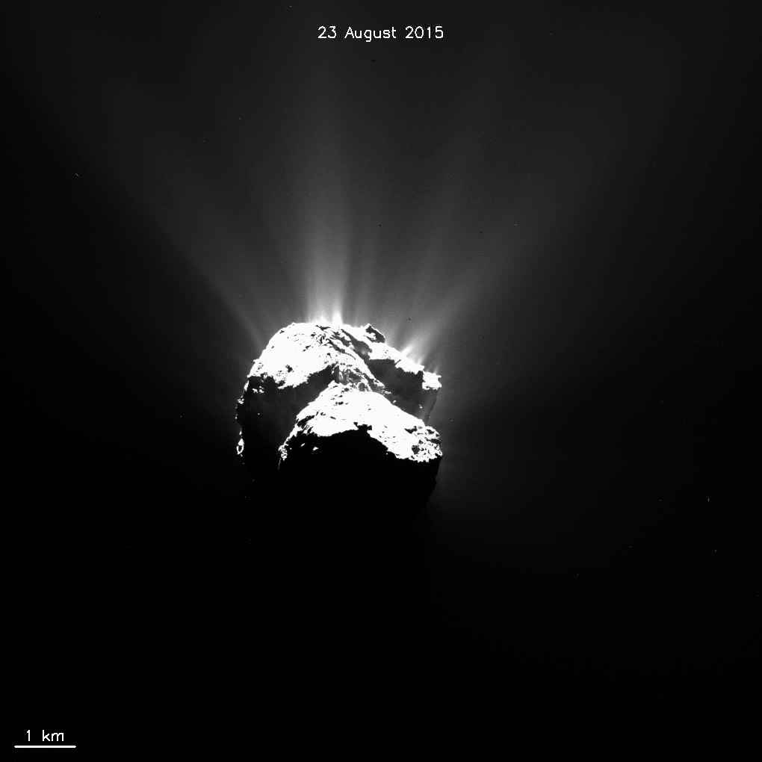
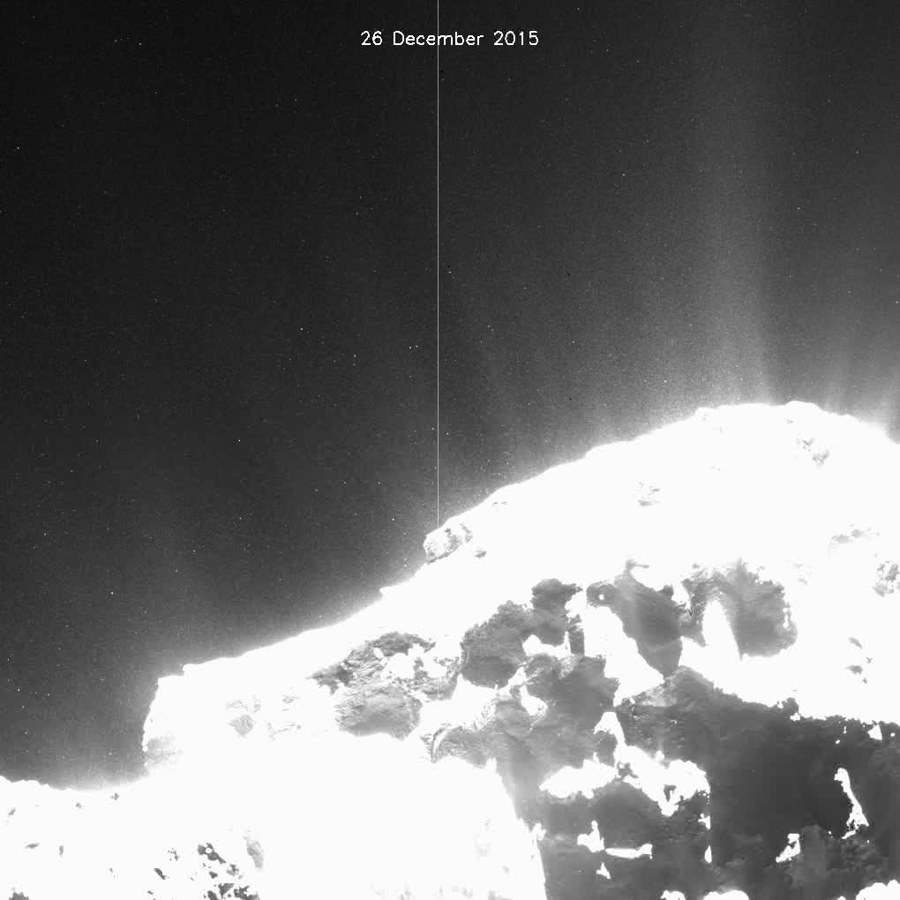

Slide 11
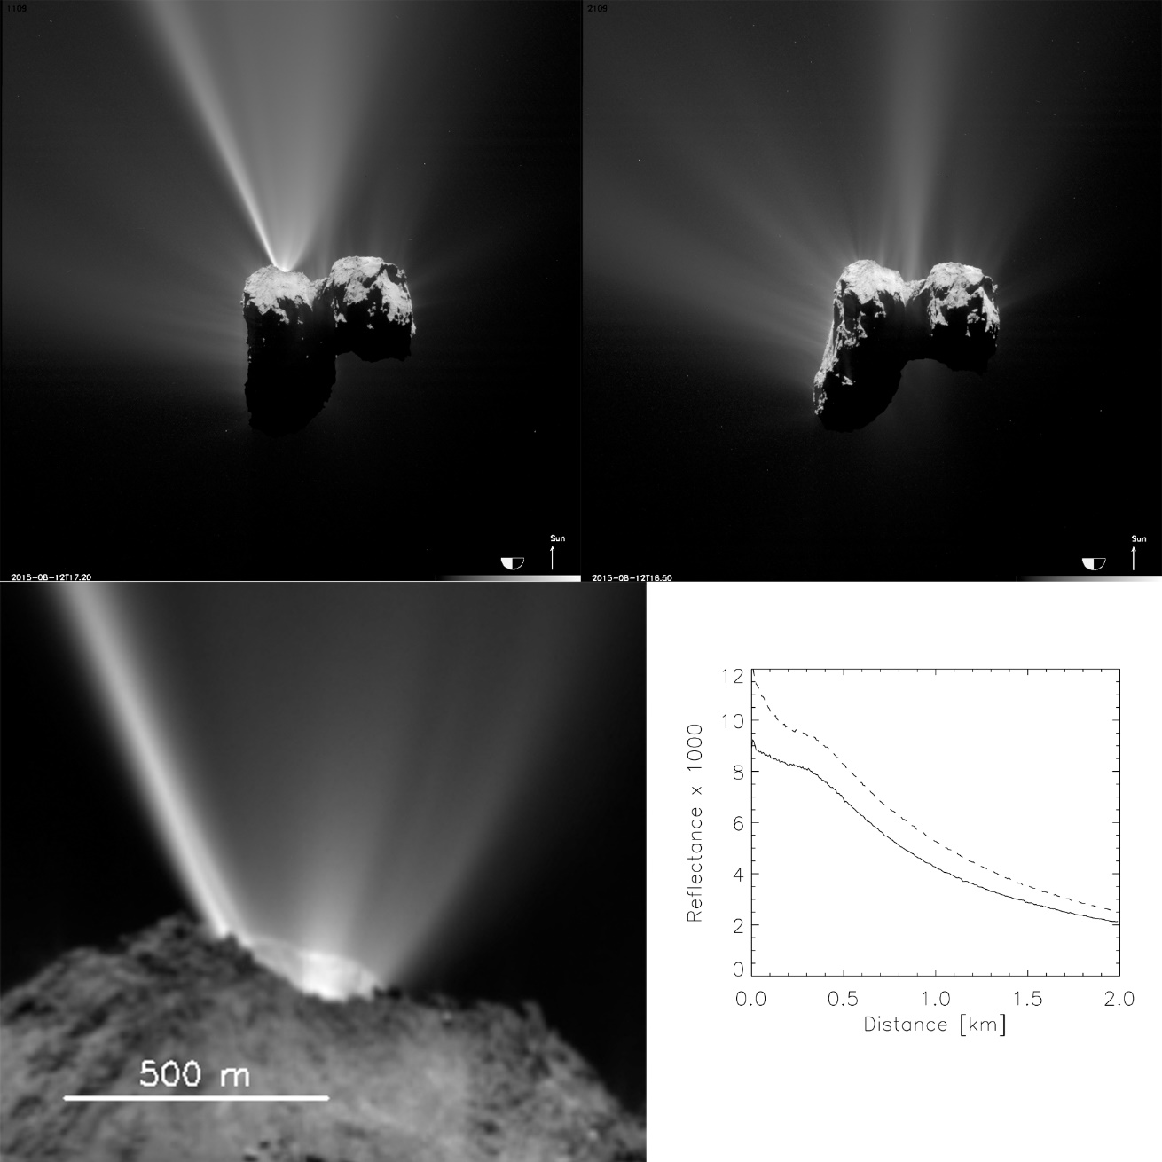
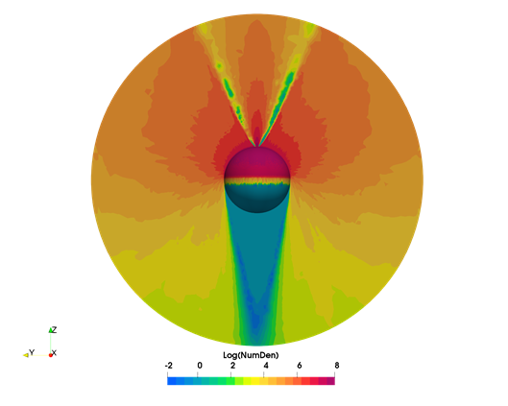
Jet structures and models

Slide 12
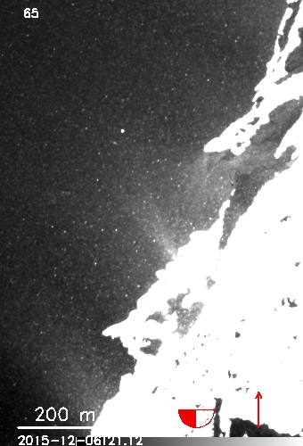
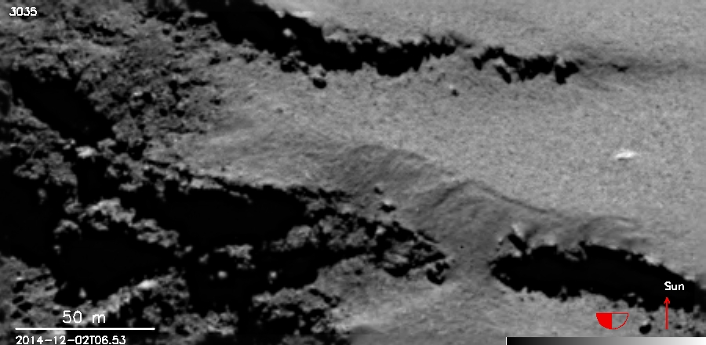
Dust Transport (Non-escaping particles)
Non-uniform emission of large non-escaping dust particles provides a significant evolutionary influence (“dust hail” or “airfall”).
Ash near Aten

Slide 13
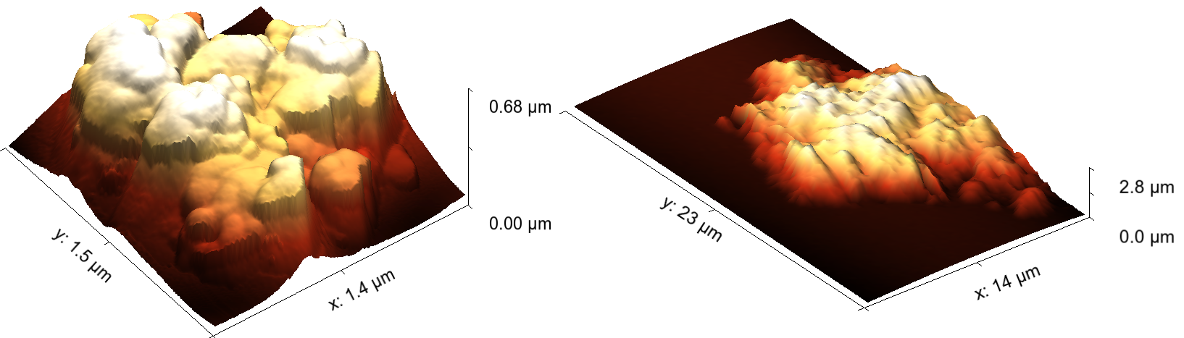
Measurement of the individual particles

Slide 14
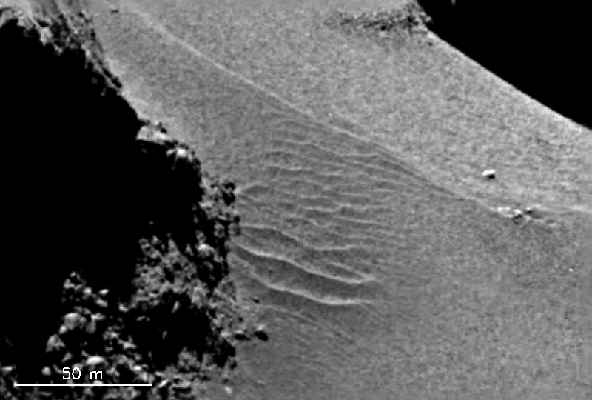
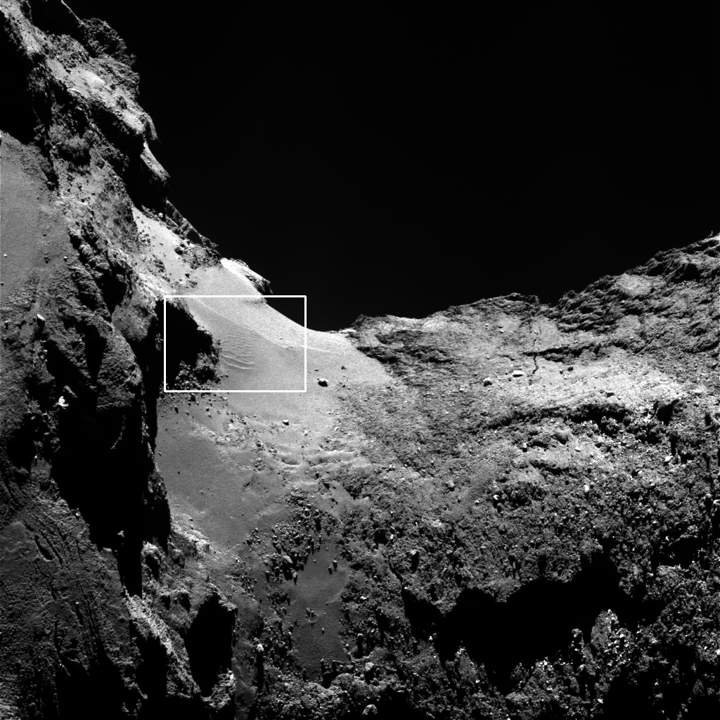
Aeolian Ripples?
Non-escaping large particles strongly influence surfaces
12 m wavelength.
25-50 cm amplitude.
Changing with time.

Slide 15
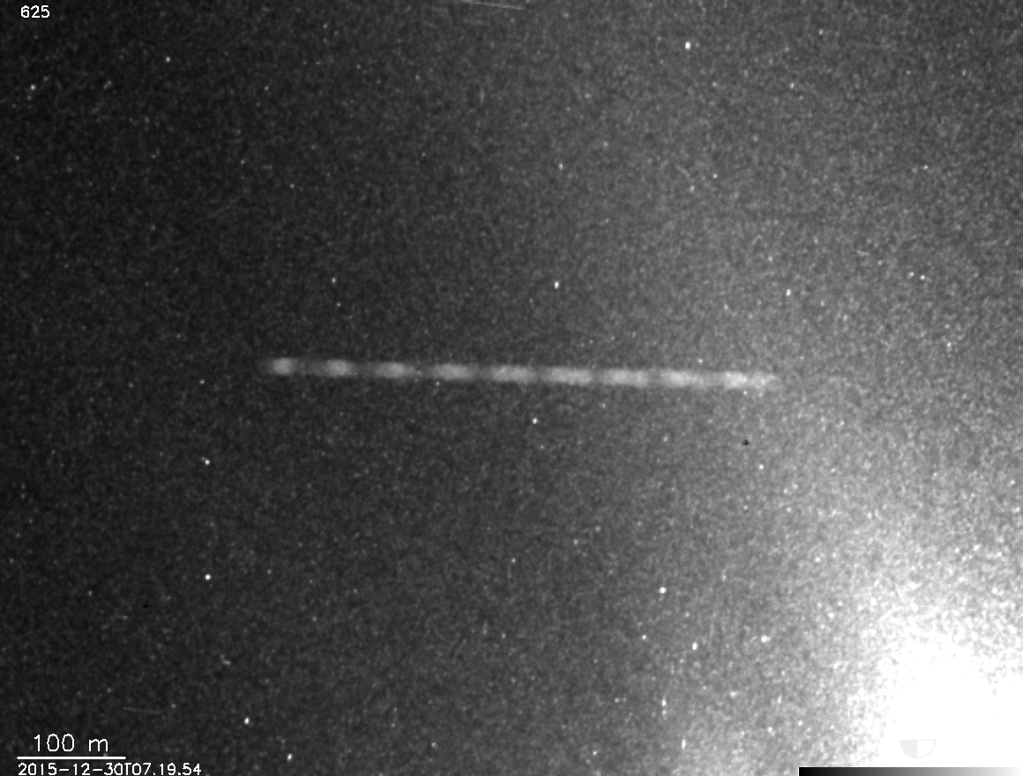
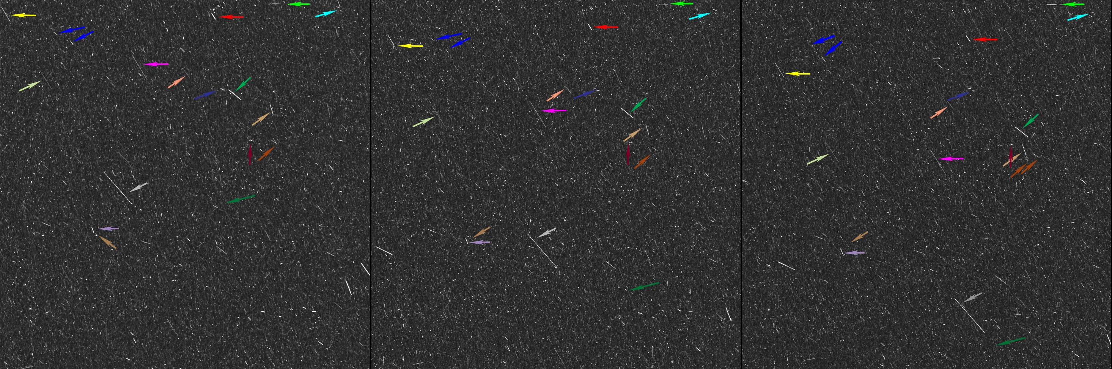
Slow-moving, rotating, particles

Slide 16
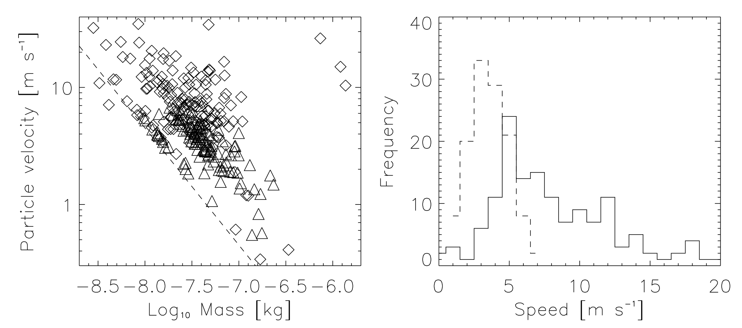
GIADA – Dust mass and speeds

Slide 17
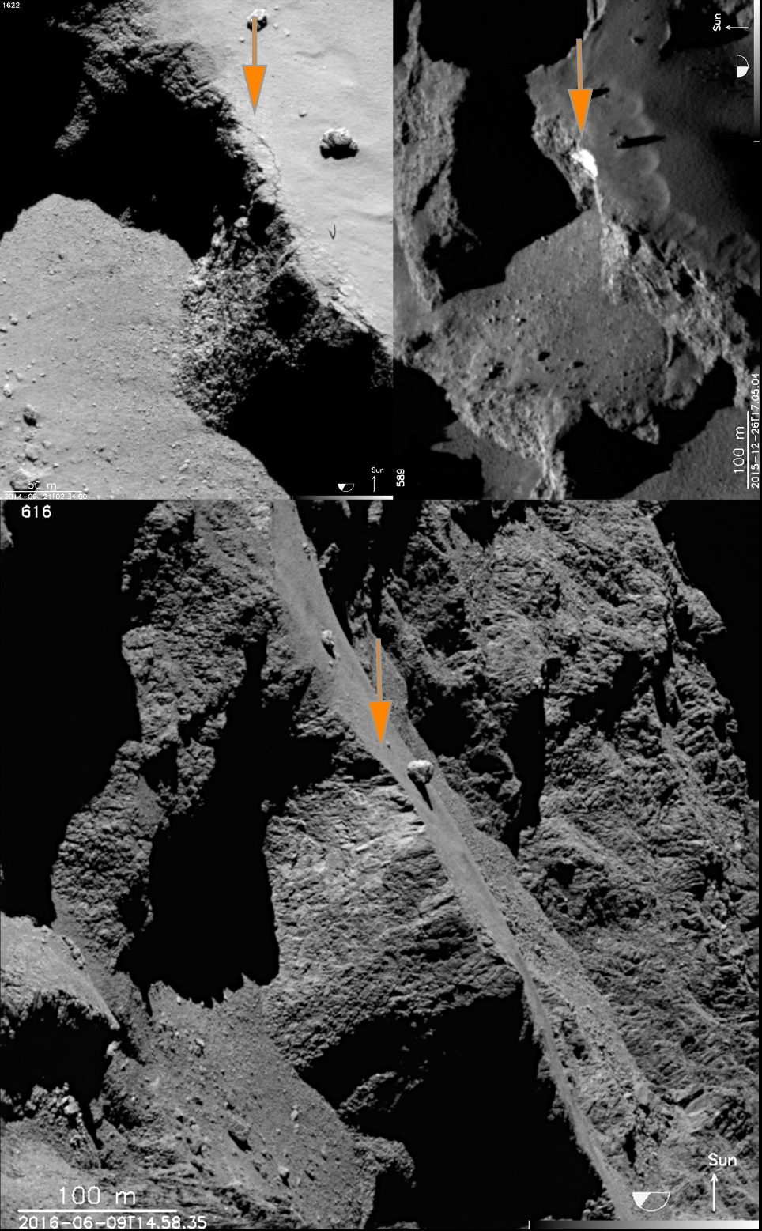
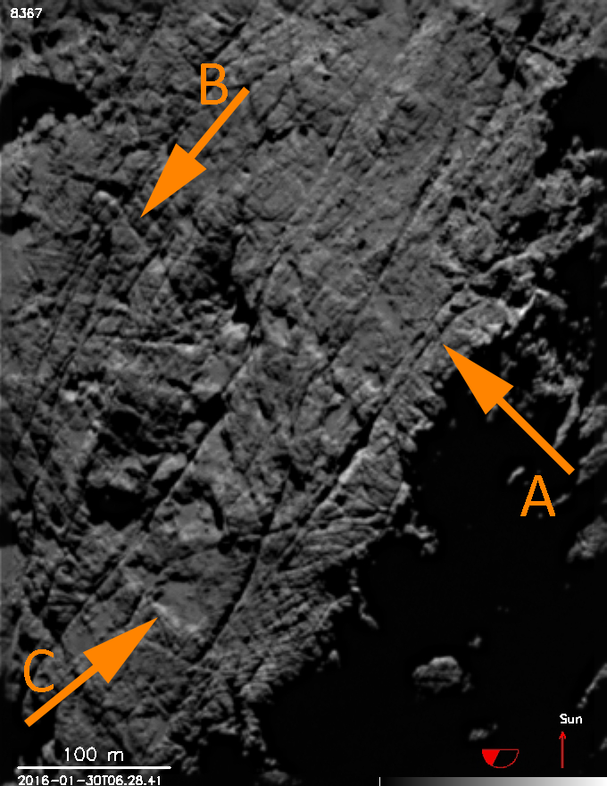
Fractures, cliff collapse, and interior structure

Slide 18
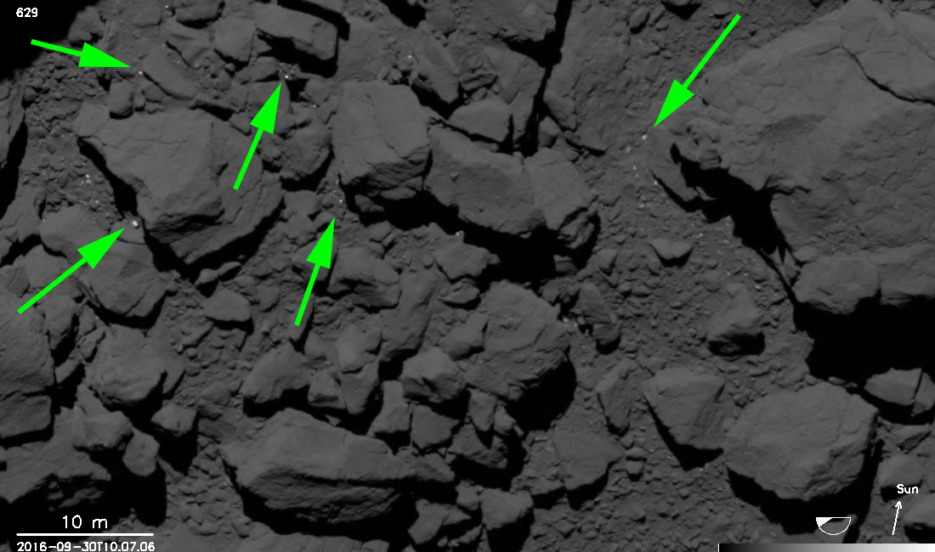
Even the final images brought science…..

Slide 19
But there is one elephant in the room…….
Despite 2 years of observation, 1400 refereed papers, all those PhDs..….how does activity really work?
A task for M8?
With thanks to the Rosetta PIs and in remembrance of Claudia, Hans, Angioletta, and Helmut.

Slide 21
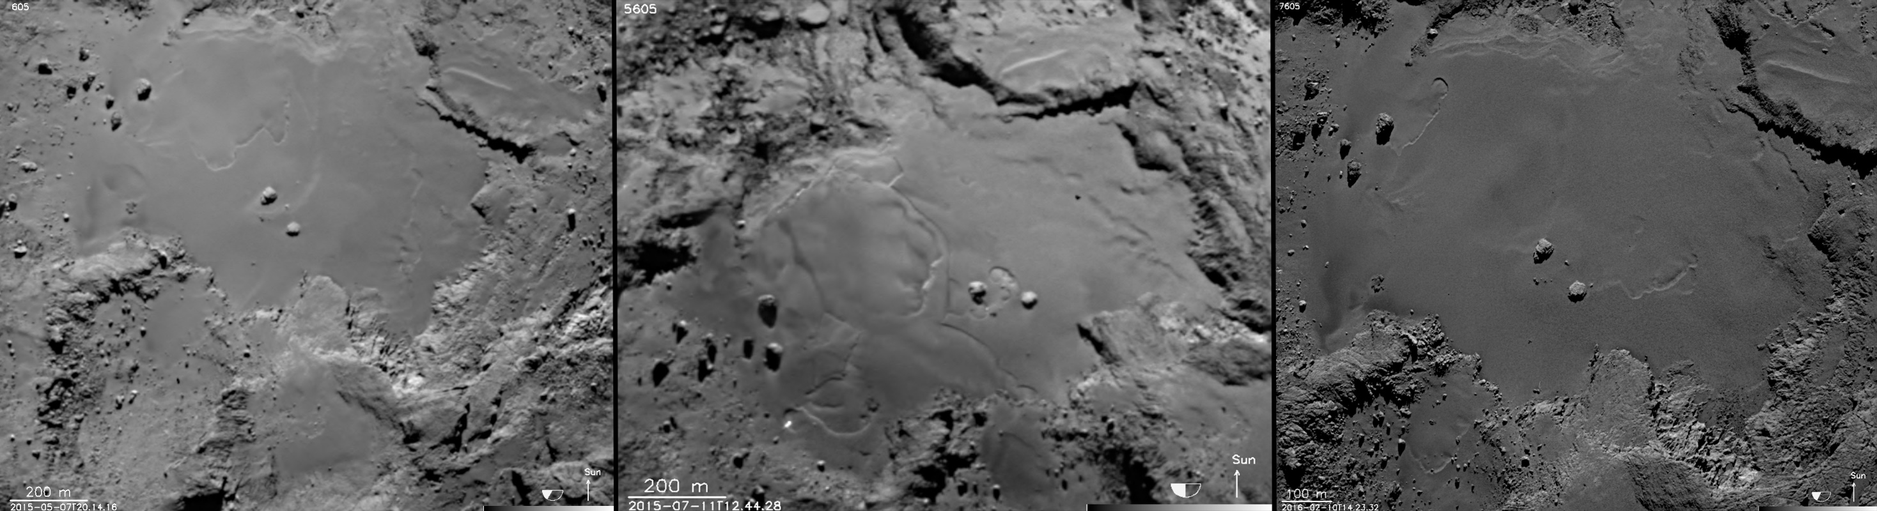
Imhotep - Changes

Slide 22
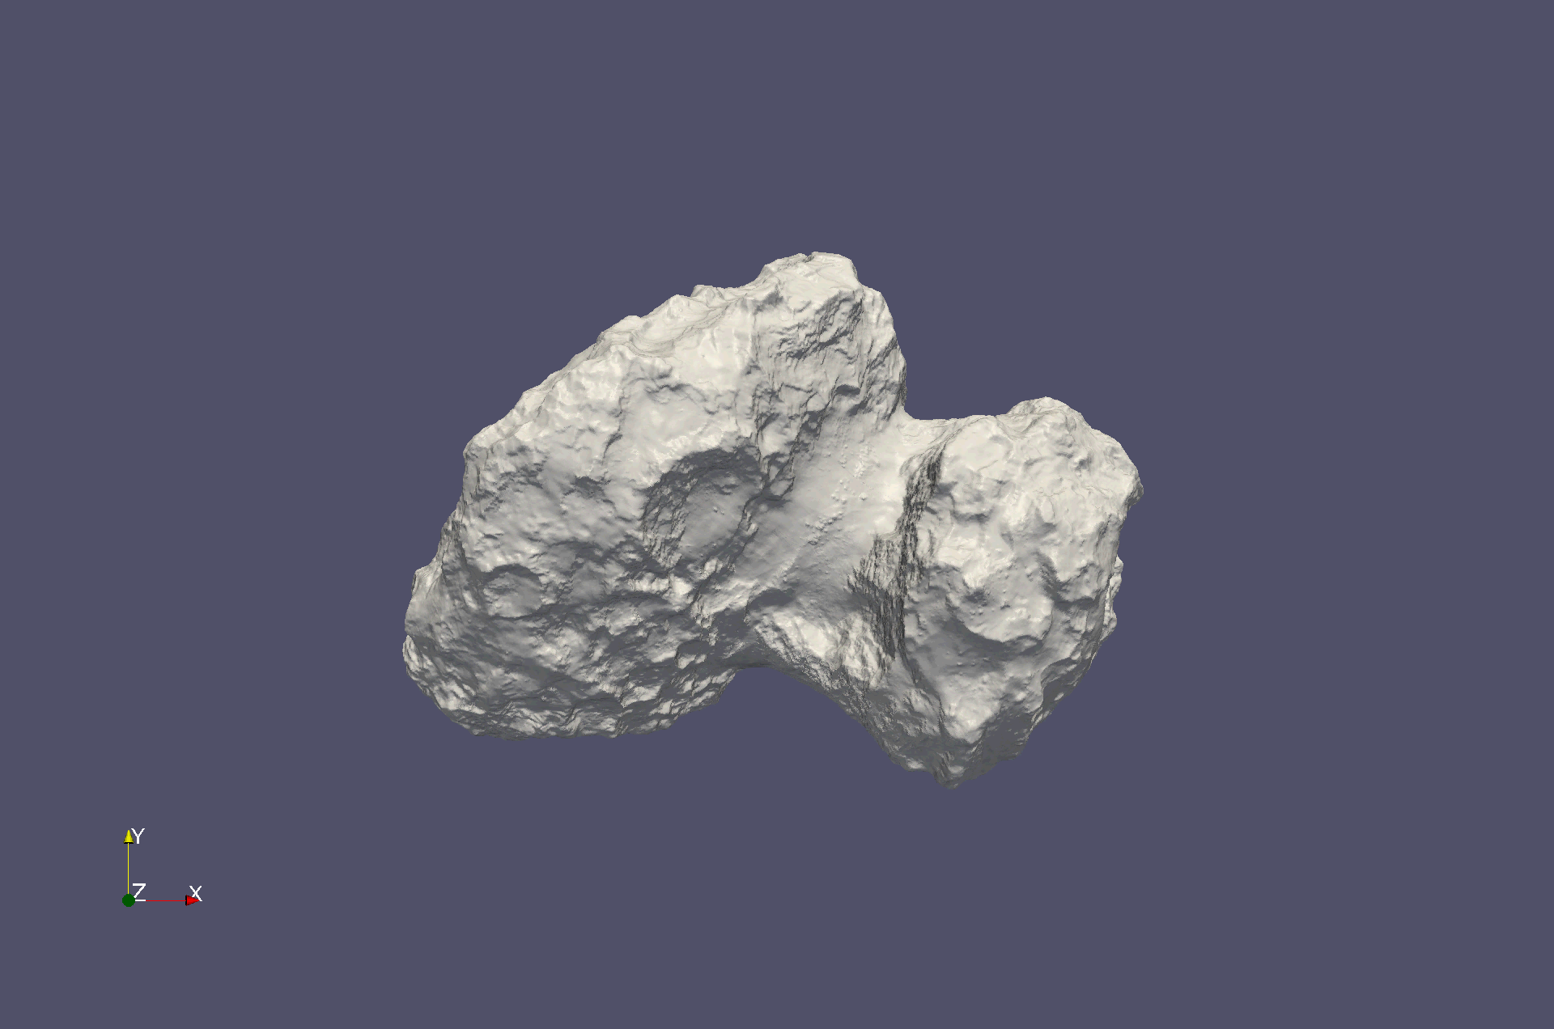
Final model of the nucleus
OSIRIS - LAM/DLR

Slide 23
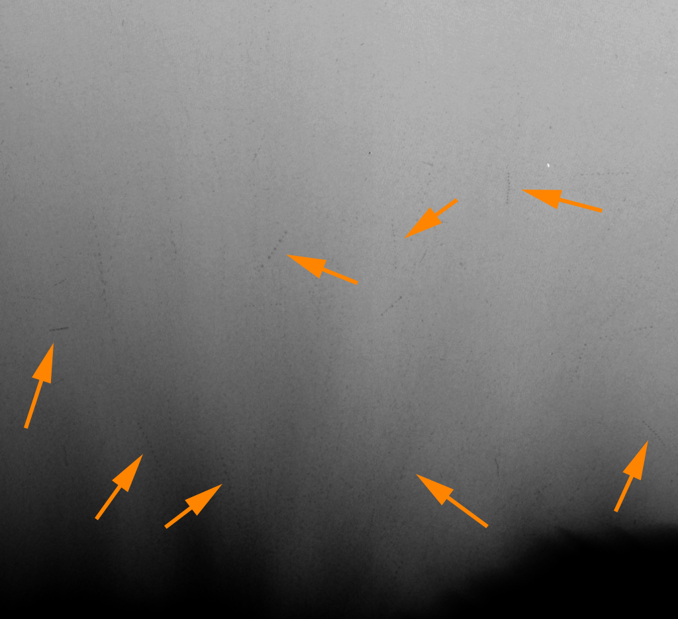
Superposed multiple exposures revealing slow-moving large particles

