Slide 1
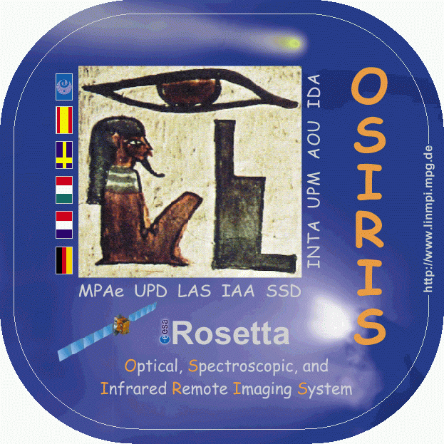
The Nucleus of Comet
67P/Churyumov-Gerasimenko in 3D
P. Lamy¹, D. Romeuf², G. Faury³
¹LATMOS, Guyancourt, France
²Université Claude Bernard-Lyon 1, Lyon, France
³IRAP, Toulouse, France
Philae landing 10th anniversary event, ESTEC
12 November 2024

Slide 2
BUILDING STEREO ANAGLYPHS
OSIRIS-NAC images separated by 5 - 15 minutes
Discard mages with large cast shadows as they lead to temporal stereoscopic incoherence resulting from the rotation of the nucleus (e.g., the temporal variation of the size of the cast shadows).
The two images forming the stereo pair are first rotated so that the relative displacement appeared horizontal and they are limited to the same common region.
The horizontal shift between the two images to create the anaglyph is usually tuned to limit the parallax to 2° for the foreground (to avoid image deformation) and to usually place the scene behind the screen for optimal visual comfort.
Finally, incoherent zones are cropped and cosmetic artifacts removed.
All anaglyphs are visually inspected for validation.

Slide 3
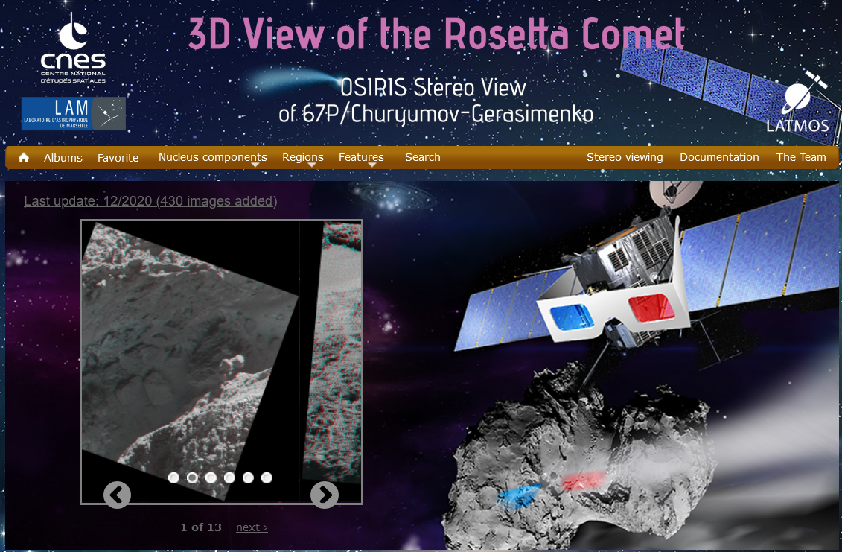
The 67/P 3D WEBSITE: 1953 Anaglyphs
https://rosetta-3dcomet.cnes.fr
To be be updated shortly

Slide 4
EXAMPLES
Whole nucleus
Nucleus + Jets
Close-ups
Neck
Pancake
BEWARE OF THE IMPORTANCE OF THE PARALLAX
≈ 0.5° → Large screens (conferences)
≈ 2° → Computer screens
≈ 3.8° → Smartphones

Slide 5
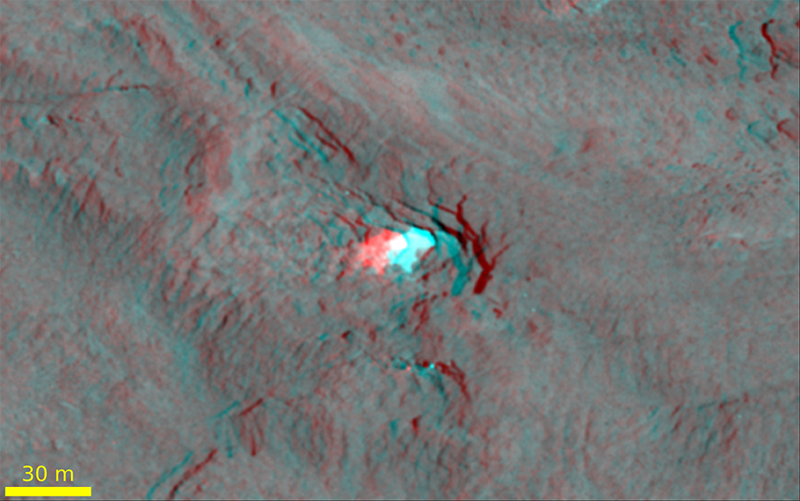

APPLICATION: DEEP ICY CAVITIES DISCOVERED ON ANAGLYPHS
But how to determine the depth? See:
Detection and characterisation of icy cavities on the nucleus of comet 67P
Lamy et al. MNRAS 2024

Slide 6
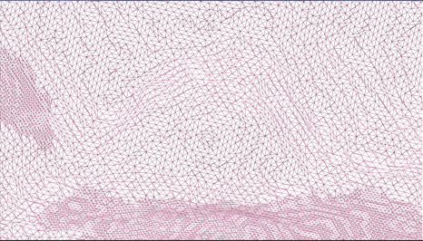
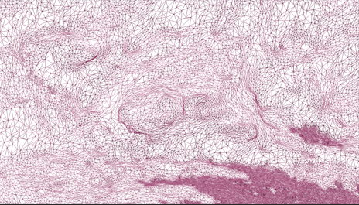
THE NEW HIGH RESOLUTION SHAPE MODEL « 67P-133M »
SHAP7 (Prusker et al 2017) has insufficient resolution (44 10⁶ facets)
We developped the « 67P-133M » model with 133 10⁶ facets
  7682 NAC and 1504 WAC post-perihelion images (Oct 2015 – Feb 2016)
  Photogrammetric processing using « Agisoft Metashape »
Comparison for Cavity A
Preusker
67P-133M

Slide 7
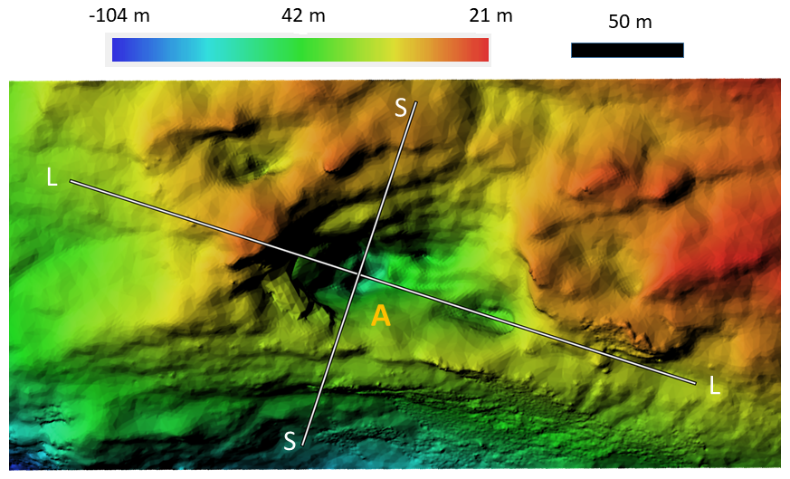
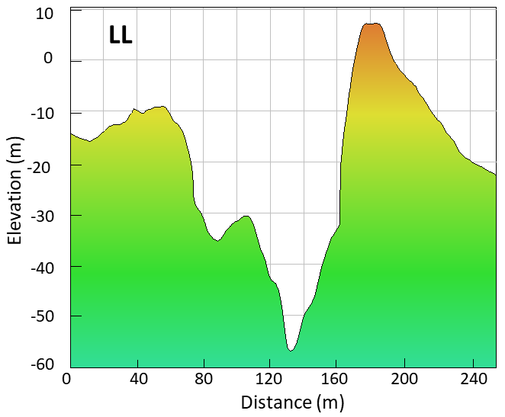
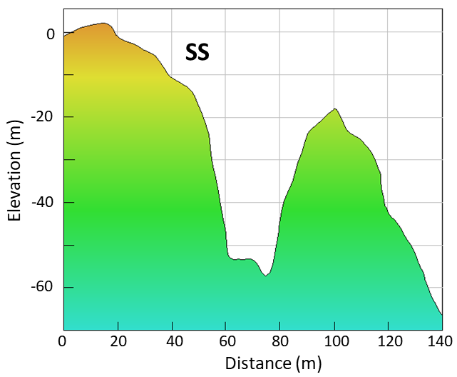
DIGITAL ELEVATION MODEL AND PROFILES

Slide 8
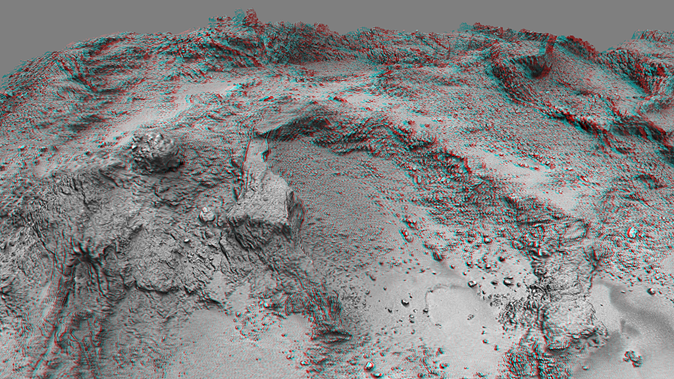
ANAGLYPHS AND STEREO MOVIE CREATED FROM
THE 67P-133M SHAPE MODEL

