Slide 1
The Challenges of the Rosetta Project -
Europe’s Comet Chaser.
John Ellwood.
12th November 2024

Slide 2
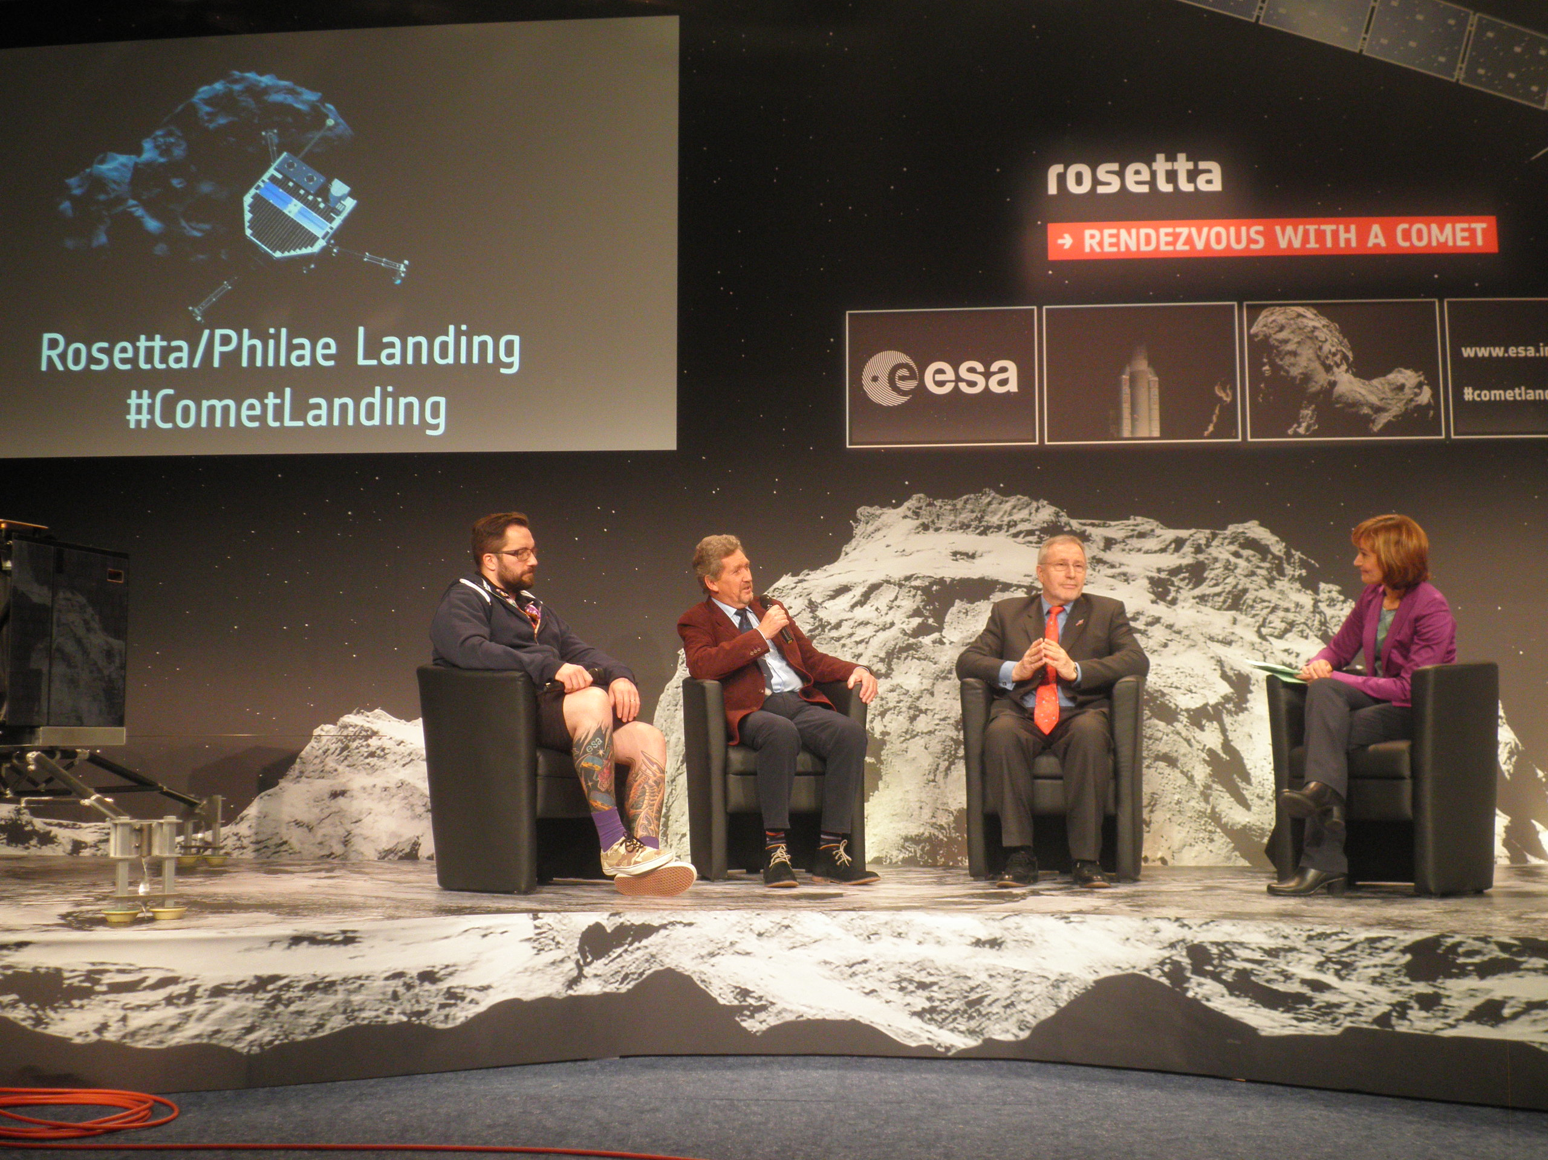

Slide 4
The Journey.
Launch: 2 March 2004
1st Earth gravity assist: 4 March 2005
Mars gravity assist: 25 February 2007
2nd Earth gravity assist: 13 November 2007
Asteroid Steins flyby: 5 September 2008
3rd Earth gravity assist: 13 November 2009
Asteroid Lutetia flyby: 10 July 2010
Enter deep space hibernation: 8 June 2011
Exit deep space hibernation: 20 January 2014
Comet rendezvous manoeuvres: May - August 2014
Arrival at comet: 6 August 2014
Philae lander delivery: 12 November 2014
Closest approach to Sun: 13 August 2015
Mission end: 30 September 2016

Slide 5

The Journey.

Slide 6
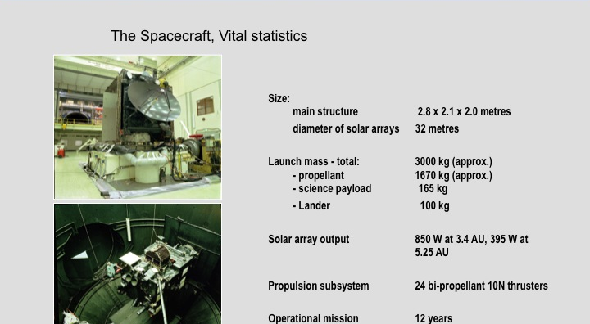
What should the spacecraft look like?

Slide 7
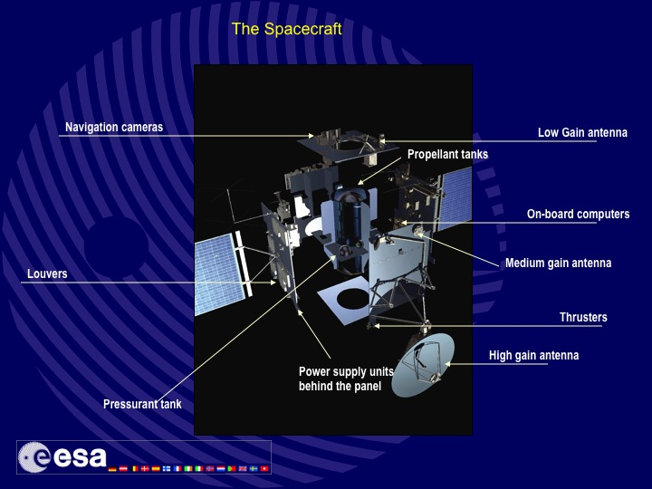

Slide 8
Going out to Jupiter.
Power challenge without radioactive source.
Thermal challenge < 1au – 5au.
Deep space communication challenge.
Autonomous hibernation challenge.
12 year mission reliability.

Slide 9
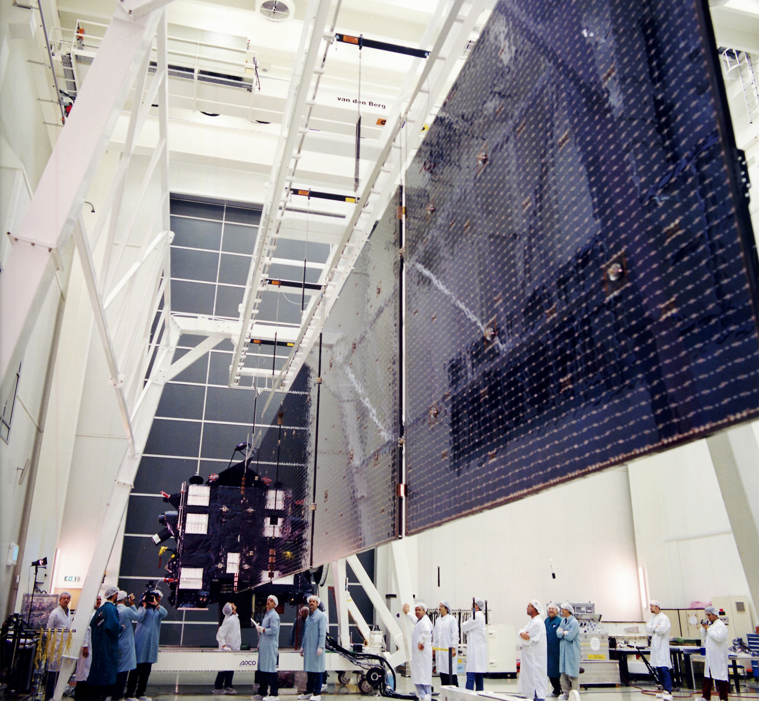
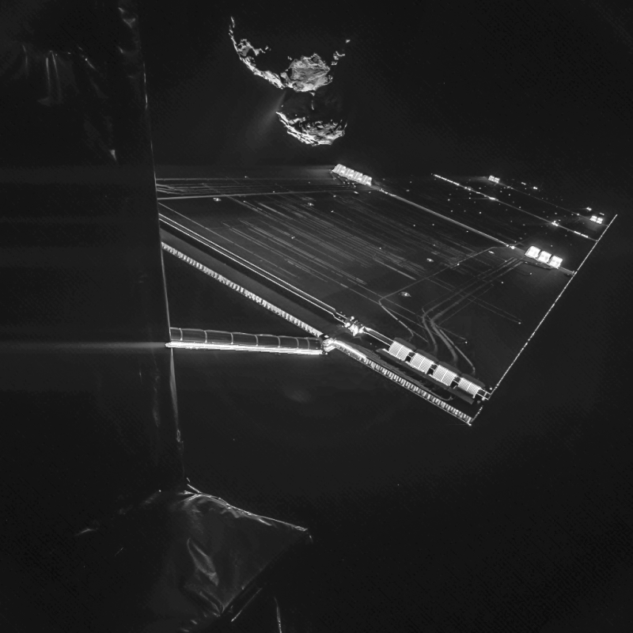
Low intensity/Low temperature (LILT) Solar Array

Slide 10
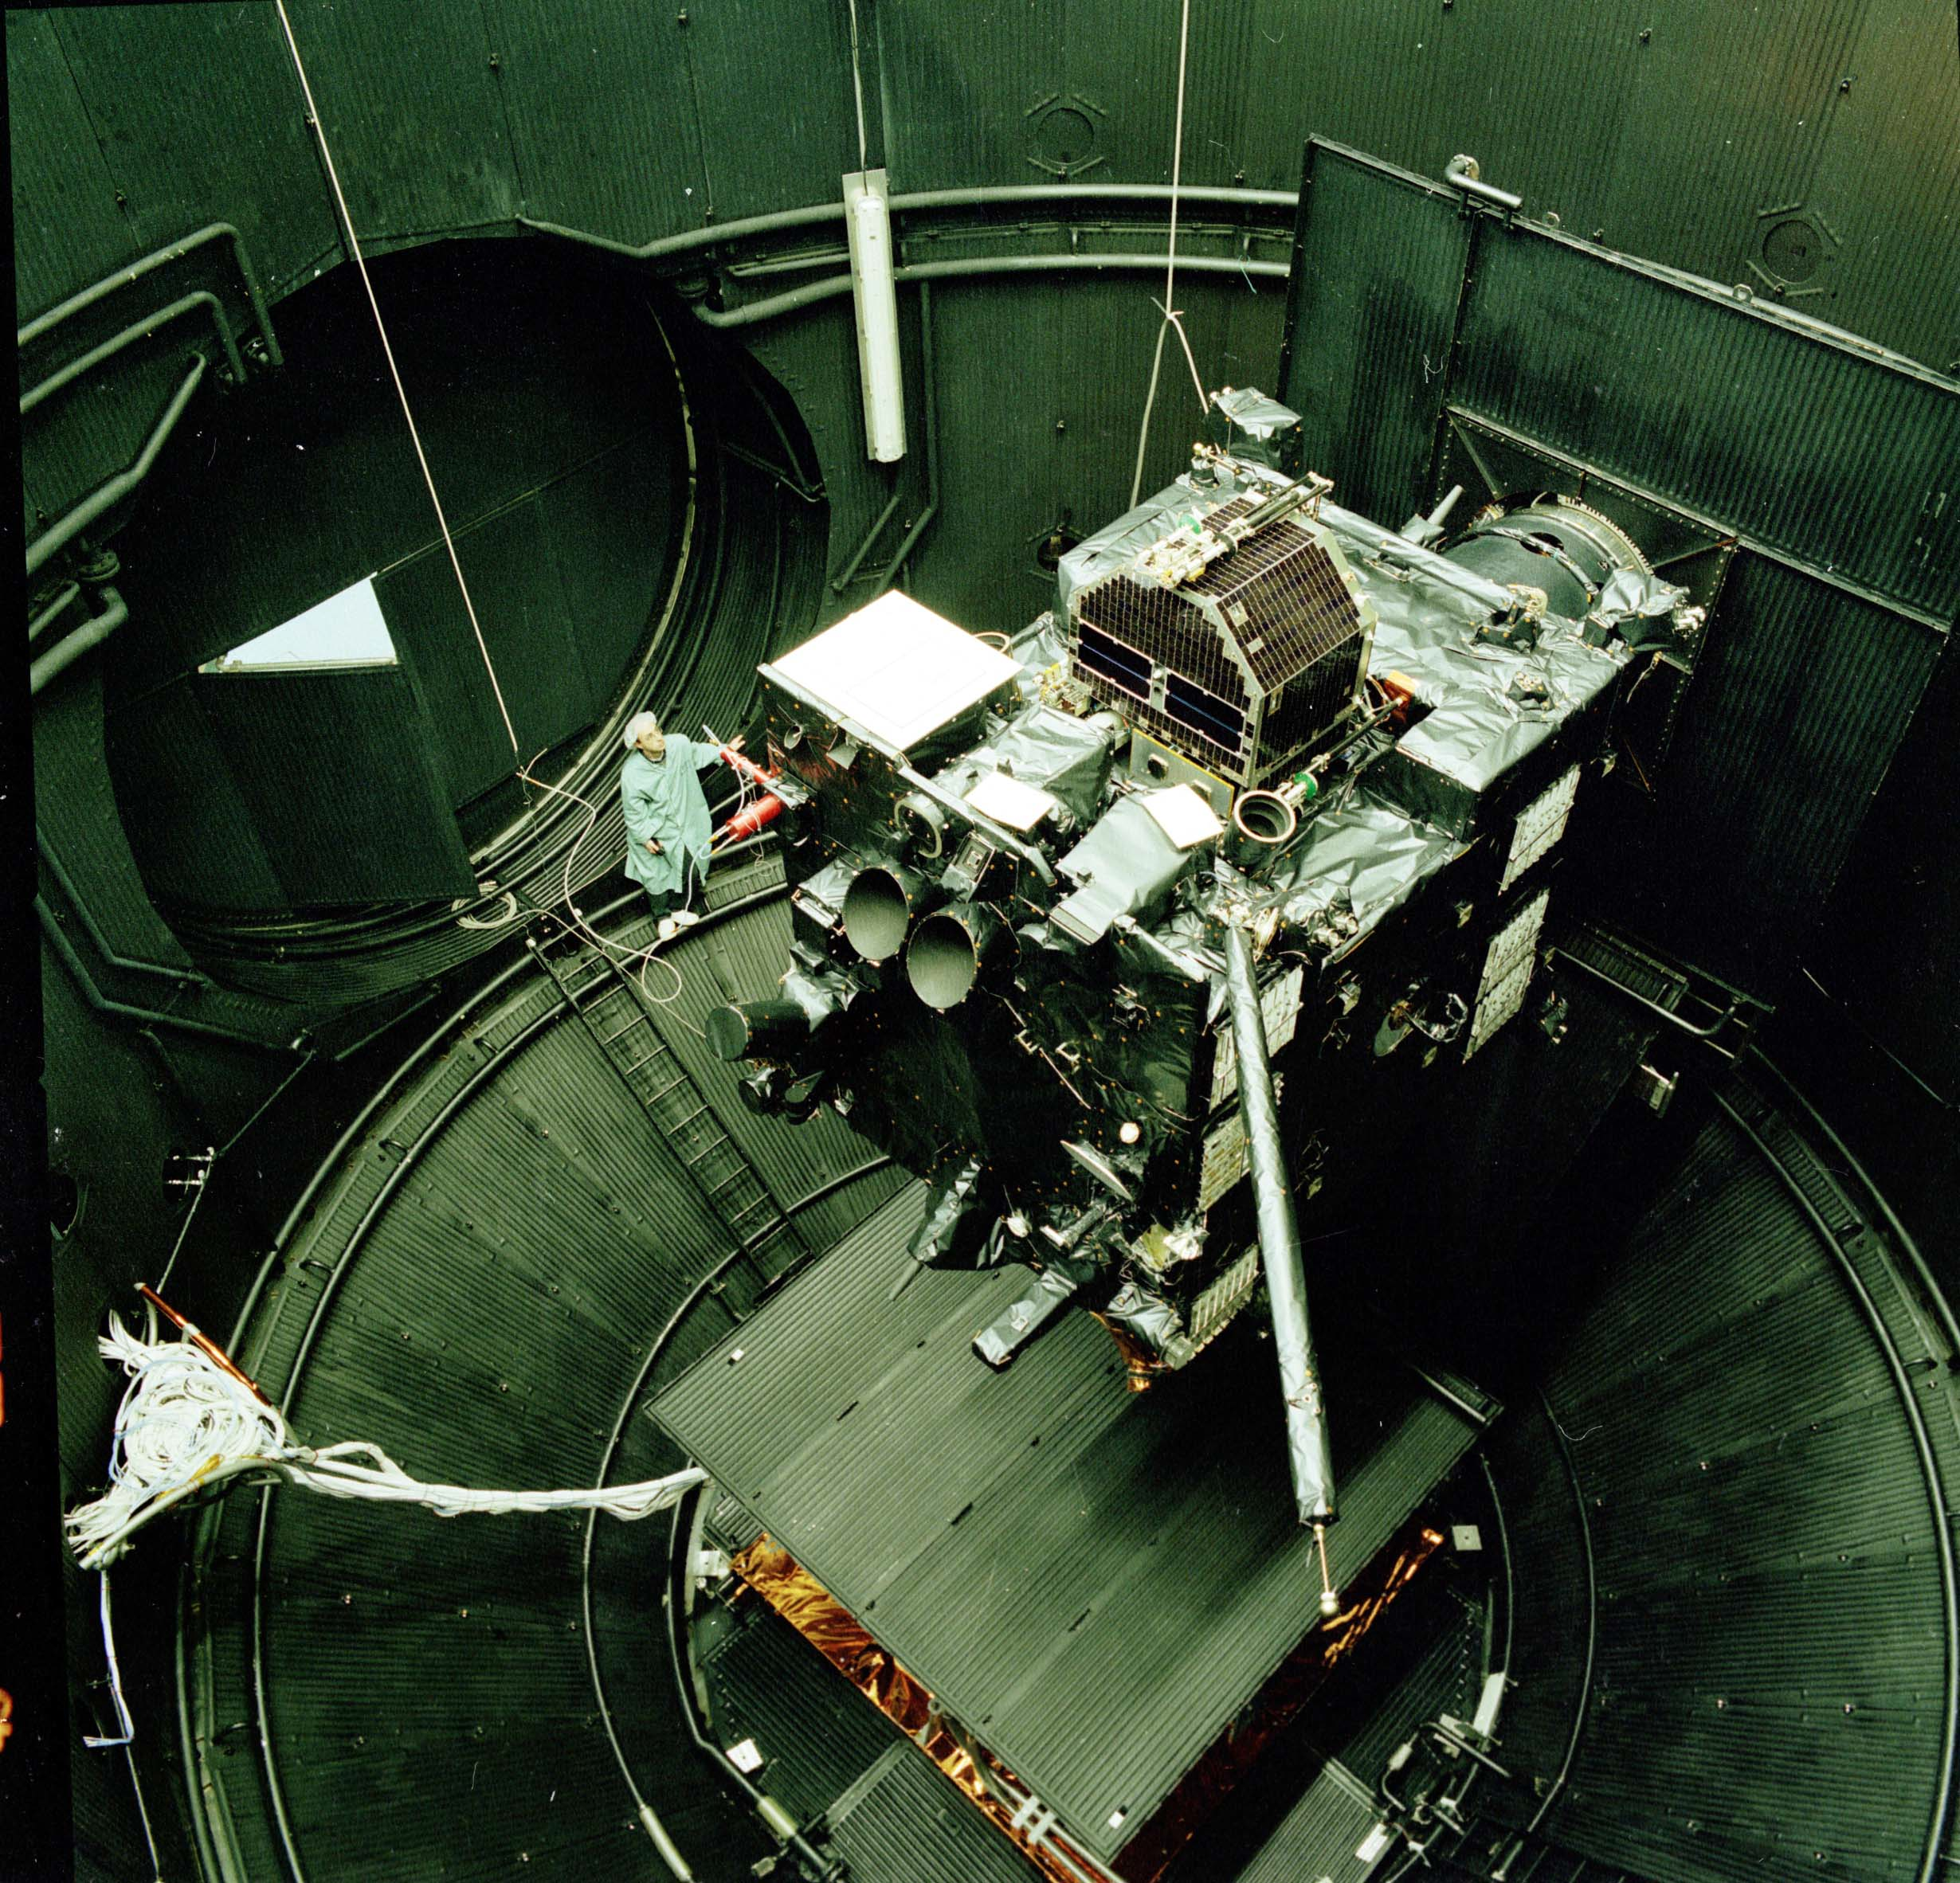
Rosetta in the thermal chamber.

Slide 11
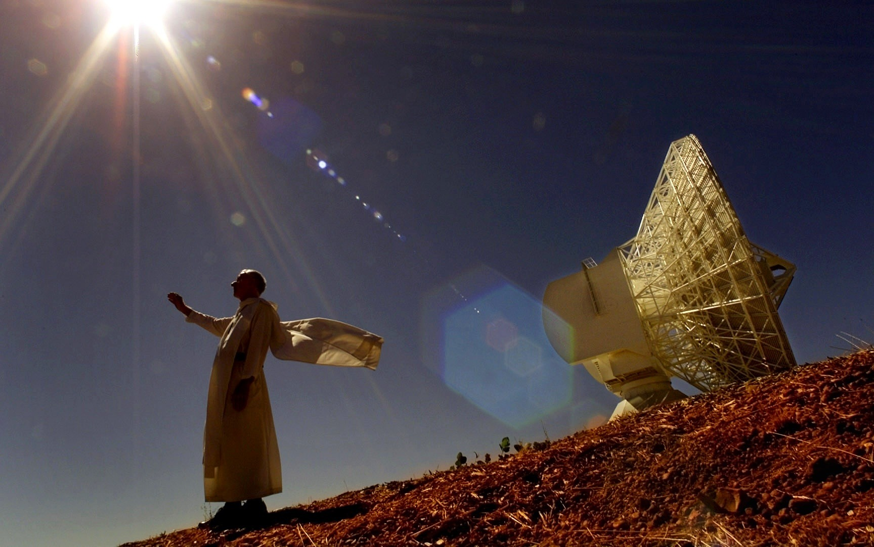
New Norcia (Aus) 35m deep space antenna.

Slide 12
Rendezvousing and landing on an unknown body.
Orbit is known – last orbits well tracked.
How big is it? Observations have given approximation.
What is it’s density (gravity)?
What is the surface like? Flat? Boulders? Craters?
How can we anchor on it? Rock? Ice?

Slide 13
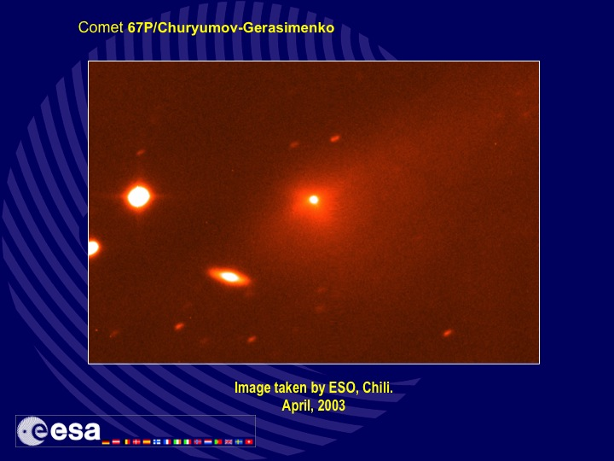

Slide 14
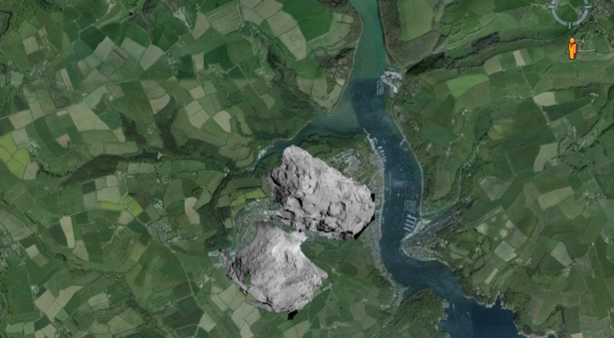
Comet over Dartmouth!

Slide 15
Maintaining a fixed launch date.
Problems with payloads – 1 instrument had to be dropped.
Delays due to different integration teams in Italy and the Netherlands – all integration was moved to ESTEC.
Software development was getting delayed due to lack of interface freeze – special taskforce was formed.
The difficult lander design and testing was getting behind schedule – combined Institute/ESA/industry teams reinforced.

Slide 16
The launch.
Delayed in December 2002 due to Ariane problems.
Spacecraft already fuelled – can they be emptied for transport?
Delay in Ariane launch needs another candidate comet.
If transport possible, Russian launch could be a possibility.

Slide 17
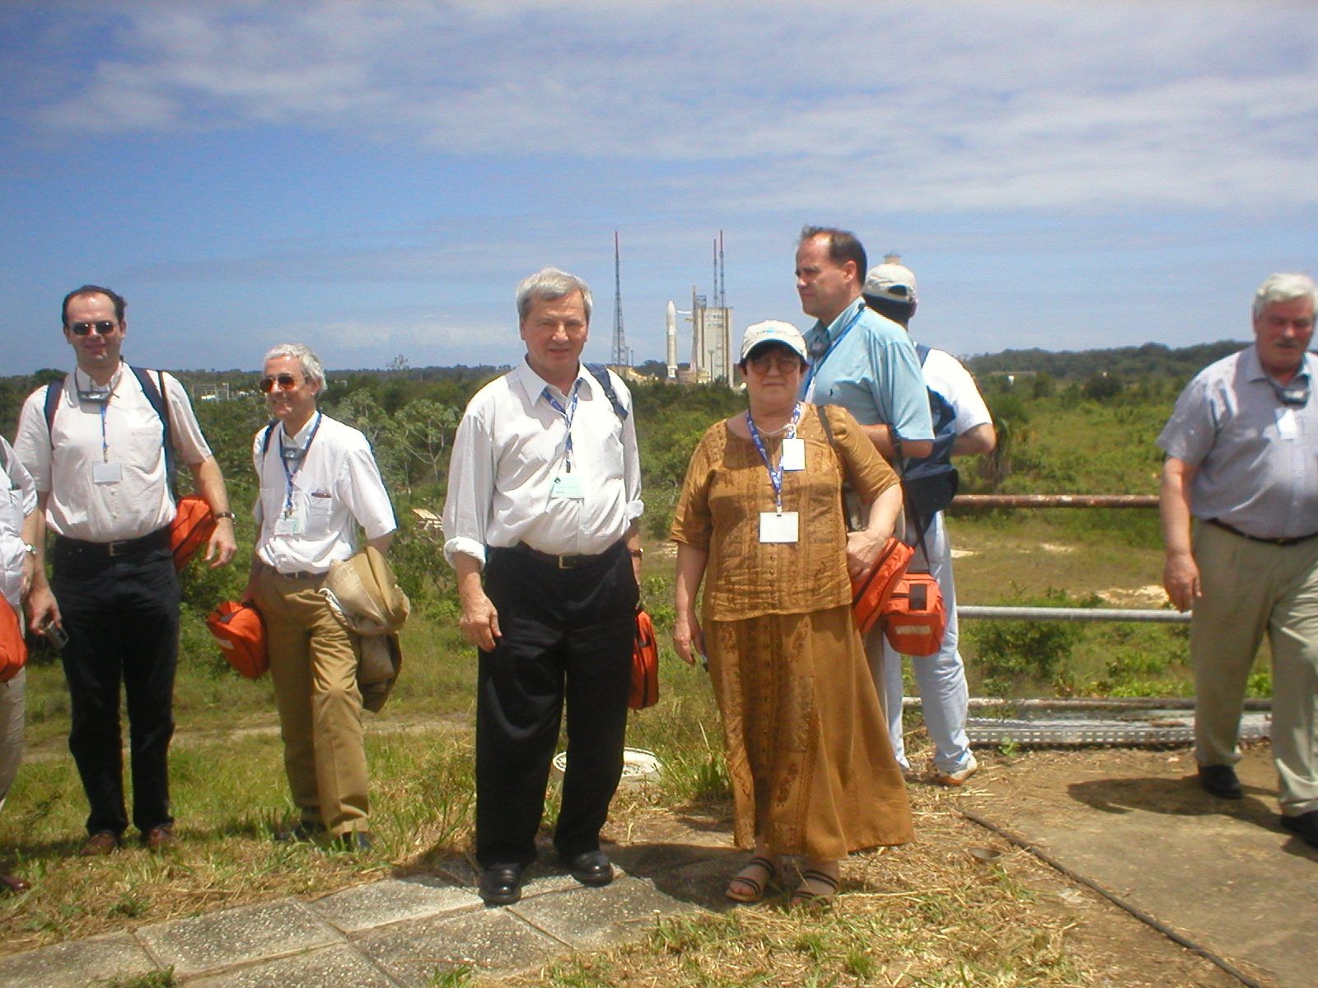
Svetlana Gerasimenko and Klim Churyumov.
Kourou March 2004.

Slide 18
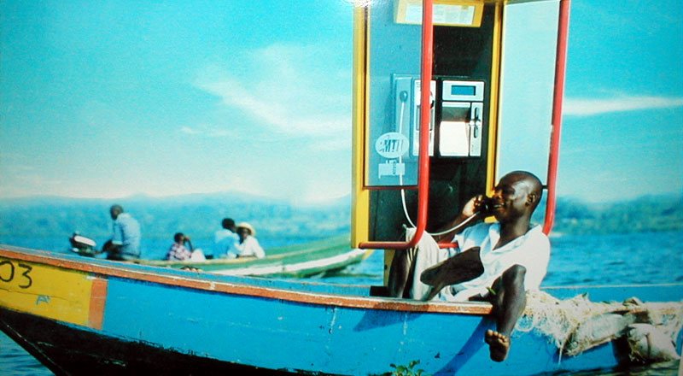
Mobile phone in French Guiana!

Slide 19

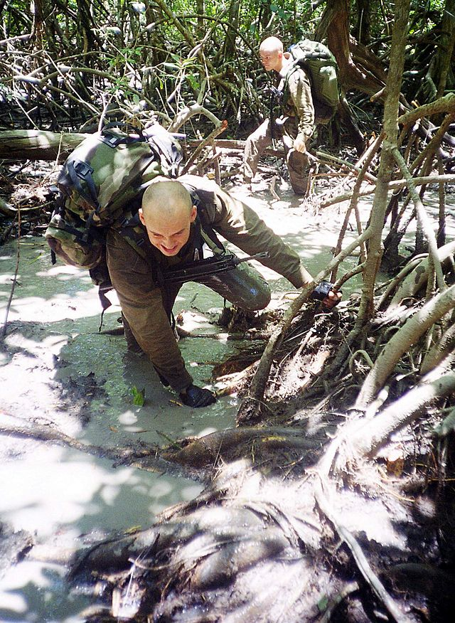
French Foreign Legion
(Les Kepis Blancs) protecting the ESA launch site.

Slide 20
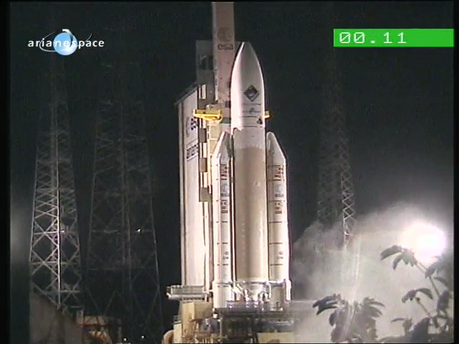

Slide 21
After launch.
Launch totally nominal.
Spacecraft was then commissioned.
Payload turn on and start of commissioning.
Handover to ESOC.
Look for a new job!

Slide 22
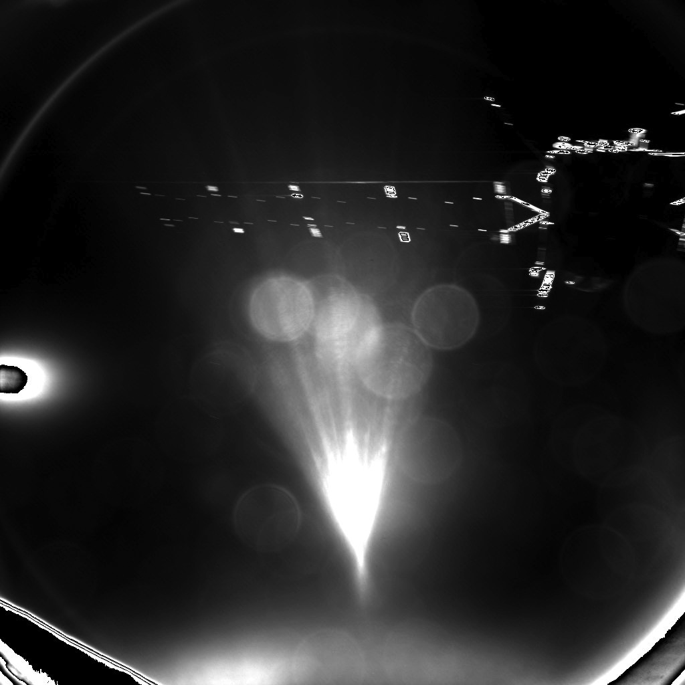
Farewell Rosetta!

Slide 23
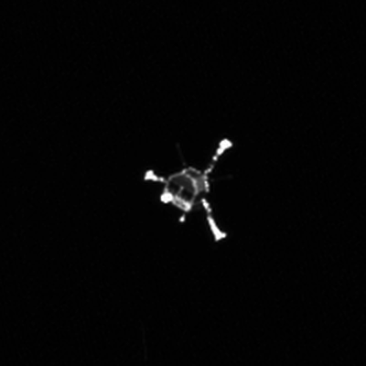
Farewell Philae!

Slide 24
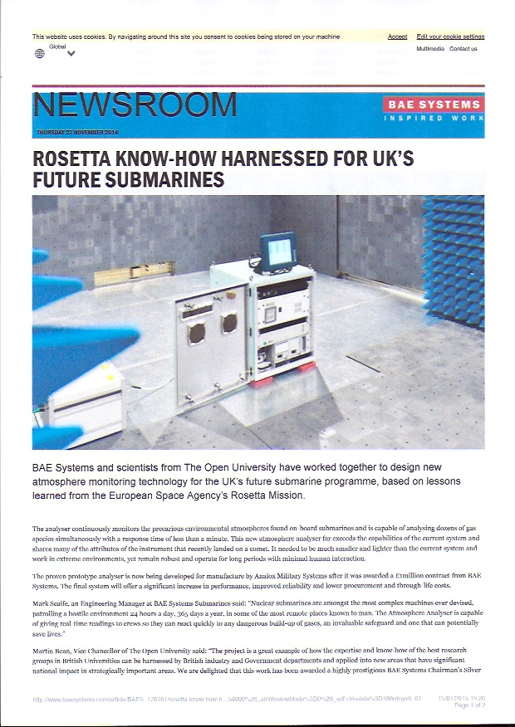
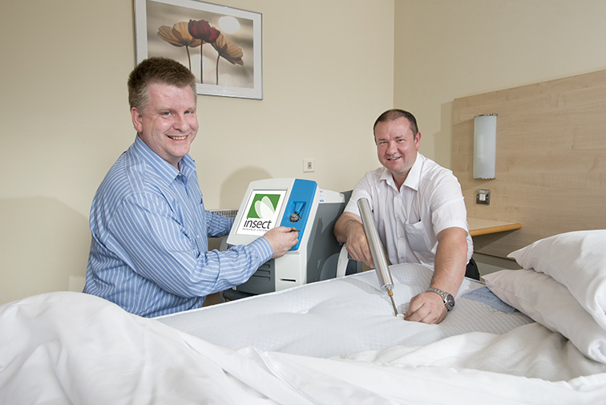
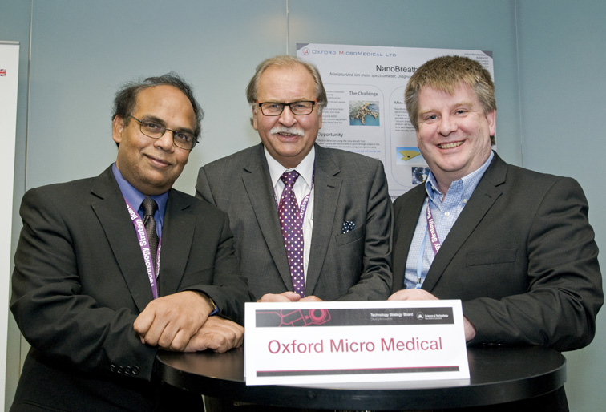
Rosetta Technology Spin offs.
Ptolemy Instrument – Gas analyser – OU.
Project Apollo (OU + Insect Research Systems) is developing technology for monitoring bed bugs in hotels rooms in real time.
Oxford Micro Medical + OU develop Urea Breath Test for the detection of Helicobacter Pylori Bacteria – cause of ulcers.

