Slide 1
Mission Management and the role of science operations
Fred Jansen
@redplanet00 (X/twitter)
@redplanet00.bsky.social
@redplanet00@mastodon.social

Slide 2
Thank you

Slide 3
My start on Rosetta
In May-2013 I was informed that following a letter of concern to D/SCI the directorate’s management team had decided on some changes on Rosetta.
Also given Gerhard’s upcoming retirement I was asked to be Rosetta mission manager as of 1-Jun-2013
Along with this appointment essentially came a management/budget “Carte blanche”
Given the decision for a “late” development of the ESA part of the Rosetta SGS and complications encountered therein, I also took up a very significant role in the RSGS development – 14 months until comet encounter were left
At ESAC a very difficult period with lots of emotions followed – a stress management training was immediately set up for the RSGS for early-July
I will never forget the introductory presentation I was asked to give

Slide 4
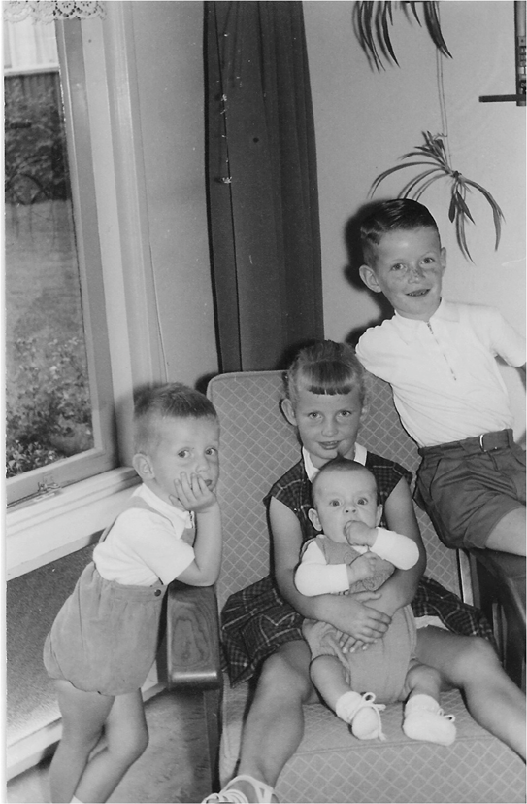
Rosetta Stress Management Training
- Short Introduction
Fred Jansen
7-July-2014, RSGS, ESAC

Slide 5
Initial Analysis
All parties (internal and external to ESA) were diligently ploughing forward with their preparation, with differing degrees of success, but with a quite strong “Every man for himself and god for us all” vibe.
To illustrate: during one of the preparatory reviews (11-Nov-2013) in a moment of despair Andrea Accomazzo remarked “From now on we should not fly payloads anymore”
It was clear that landing site selection would be a massive task with a very demanding timeline, but no complete plan nor the necessary manpower to coordinate this task was available
It quite early became clear there was a vast misalignment of expectations between the ESA and CNES flight dynamics departments
The project had all the elements which could make it ESA’s finest or ESA’s worst hour

Slide 6
SOC Development
A challenging but promising concept for the science planning existed
The RSGS wasn’t internally aligned in its support to this concept
Meetings on significant simplifications and intermediate milestones had taken place
Additional people were added to prototype an old-school (VEX) approach to the short term planning
An existing (MEX/VEX) tool for medium term planning (MTP) was rapidly adapted with D/TEC support
Just running a single MTP would be difficult enough, but the comet mapping phase required running 3 MTP’s in parallel – also a massive headache for the PI teams
Potential tension with the NASA/JPL provided tools/support had to be carefully managed

Slide 7
Landing Site Selection
The individual teams had their campaigns defined
What needed to be created was a timeline for the amalgamation of all the results
A number of workshops at CNES/Toulouse were set up to discuss the results and the options
A pretty good documentary was made by Discovery Channel
(Too) many parameters to optimise

Slide 8
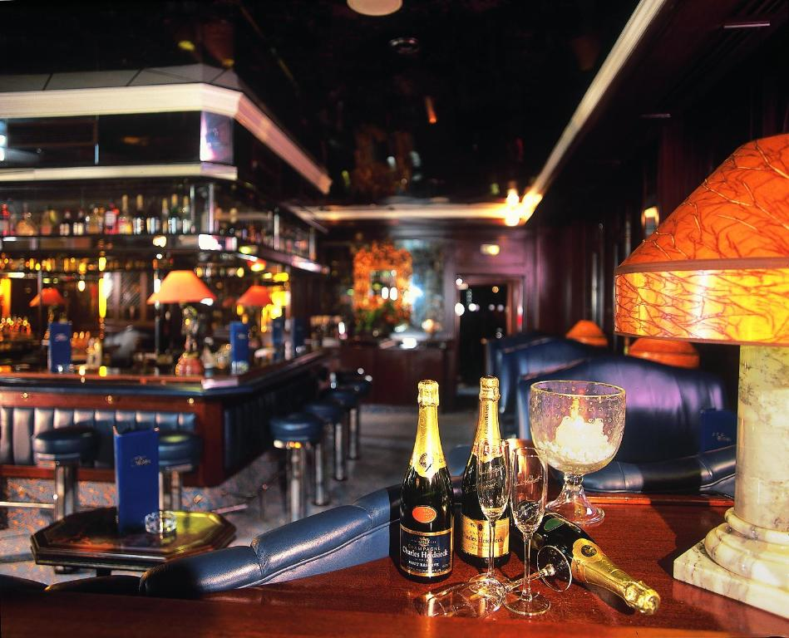
The Night Before ….
Some of us will remember this …

Slide 9
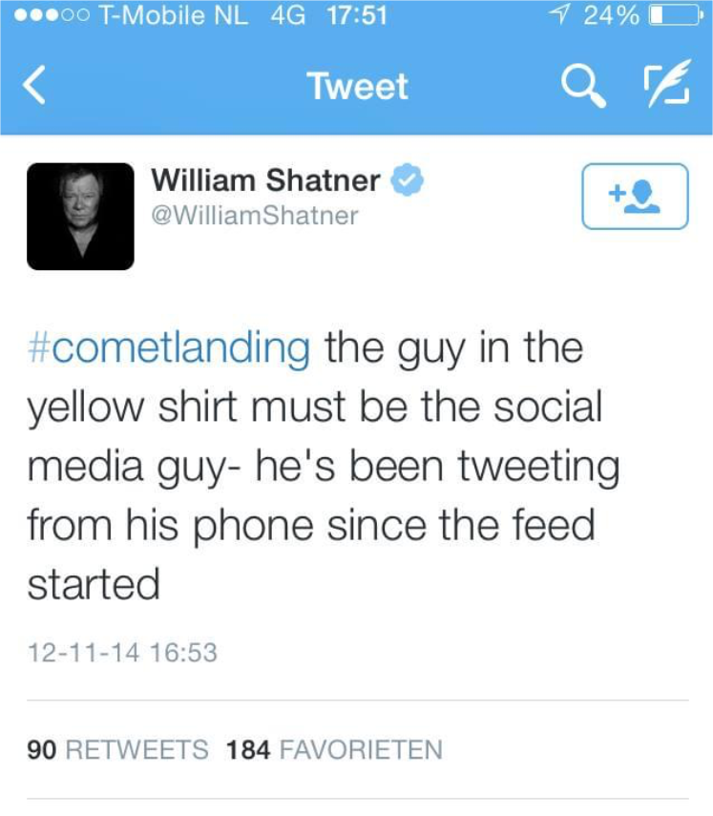
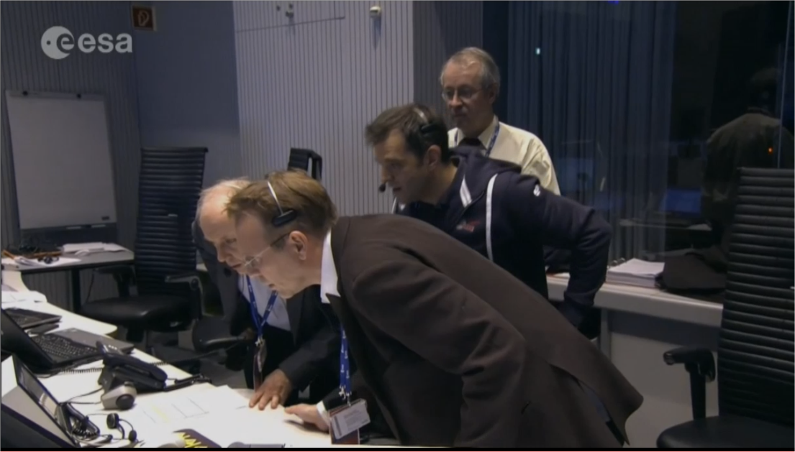
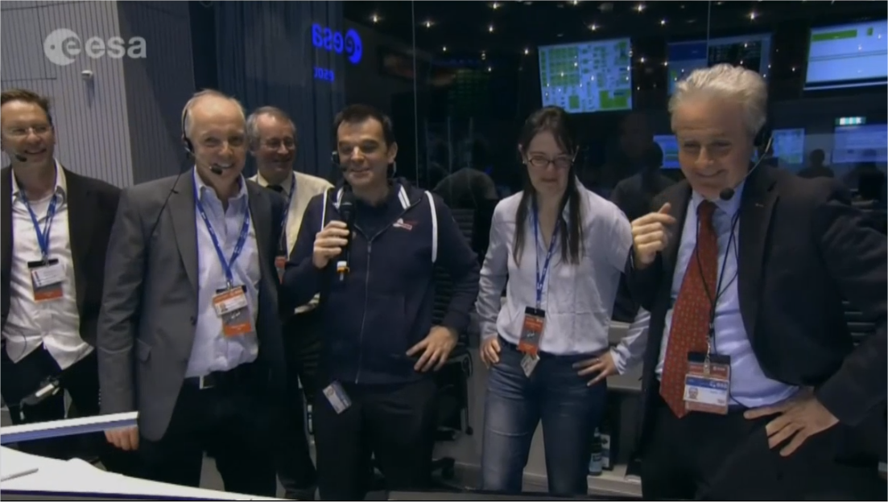
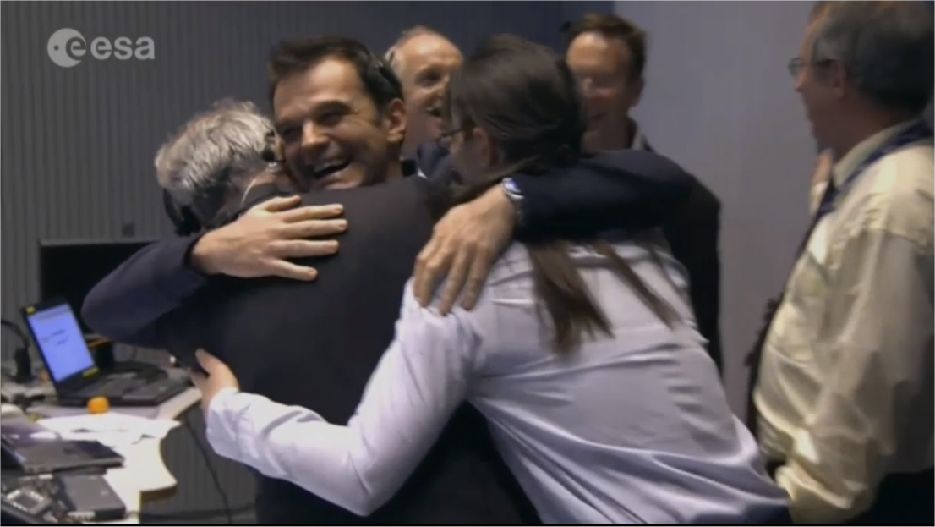
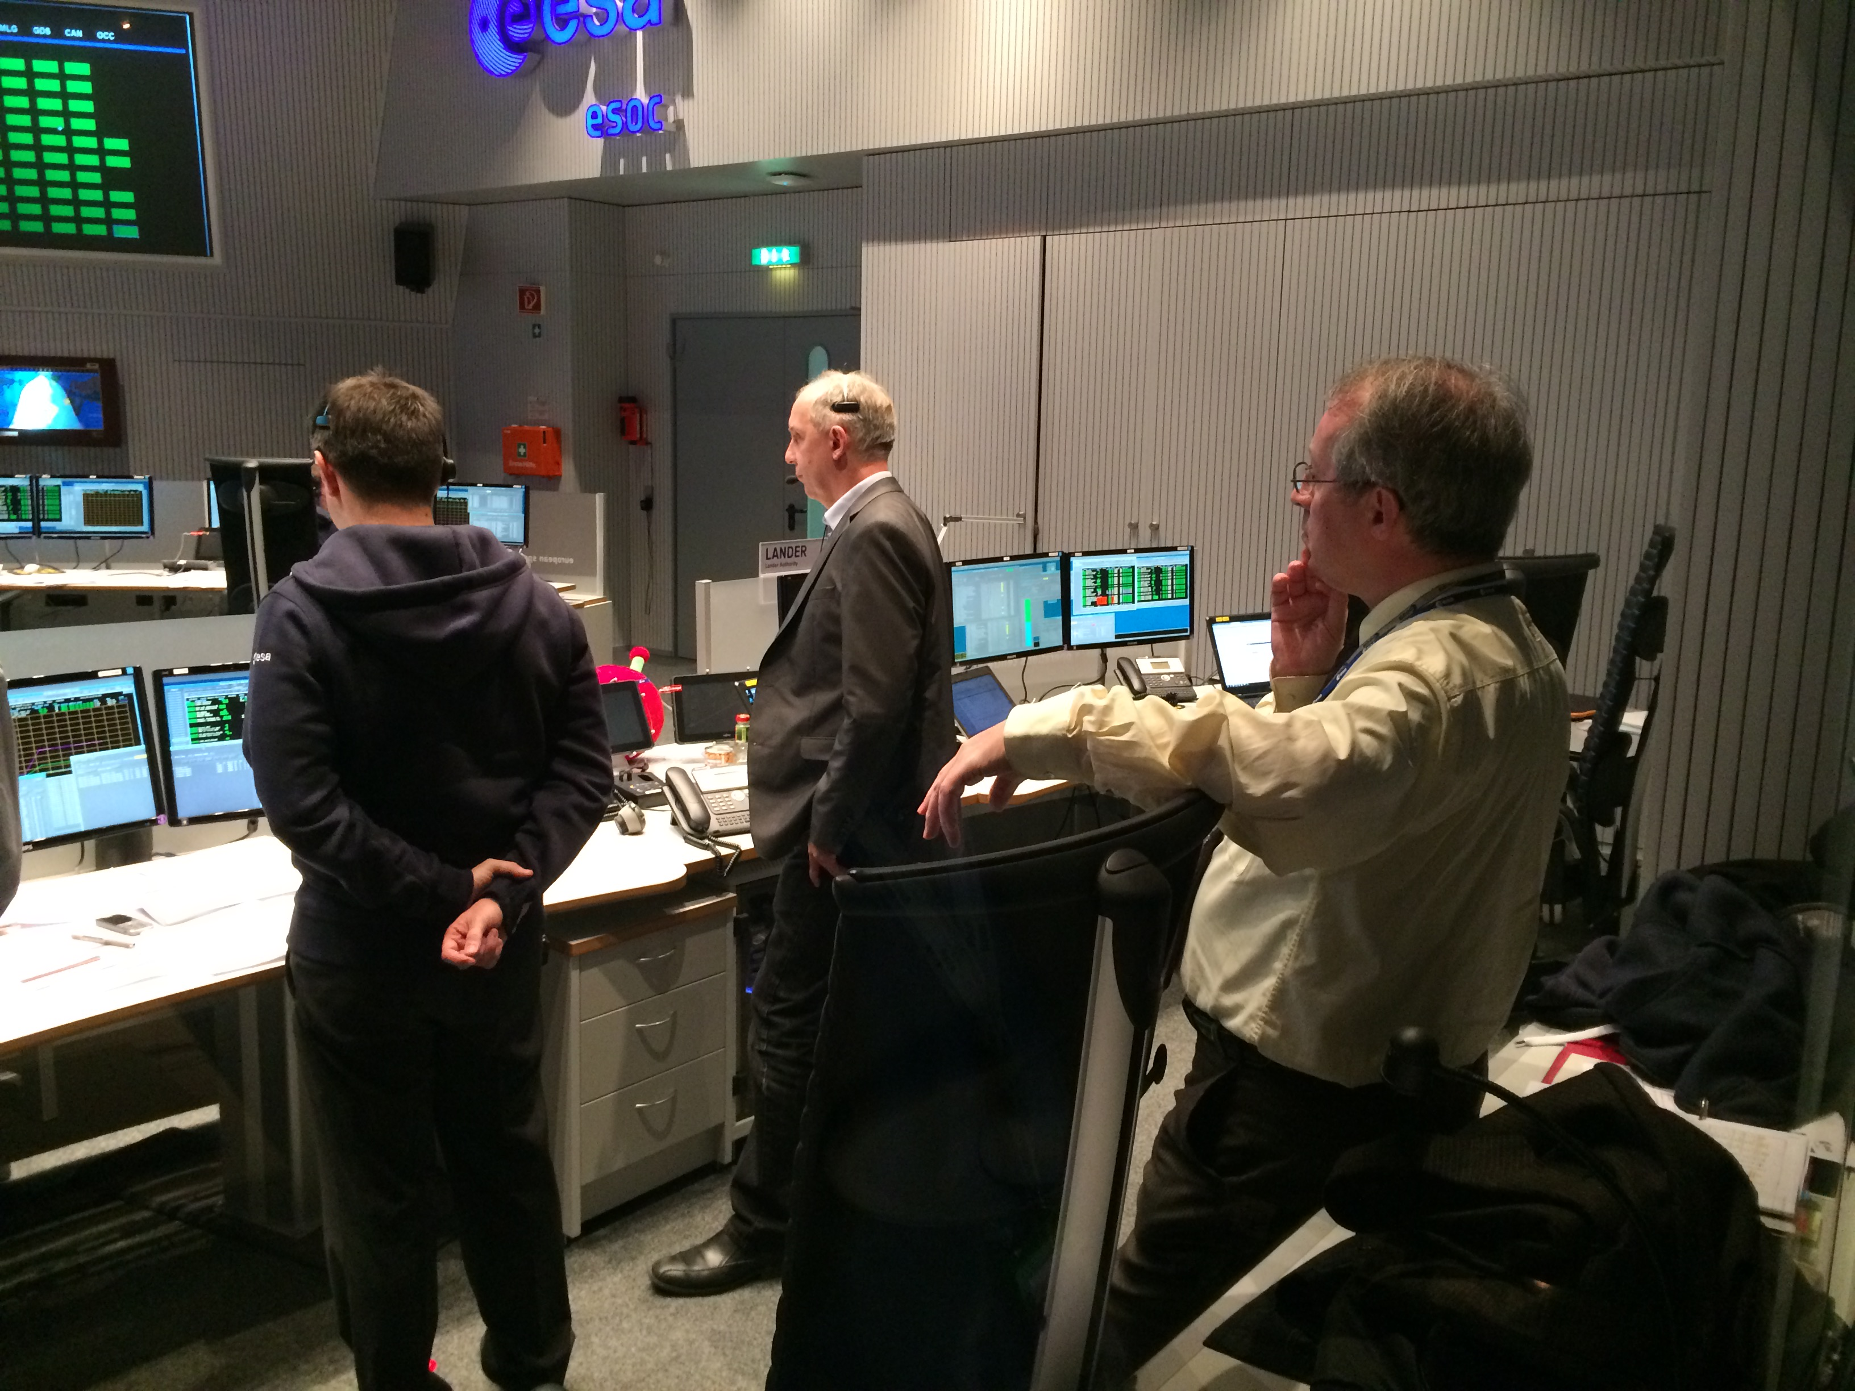
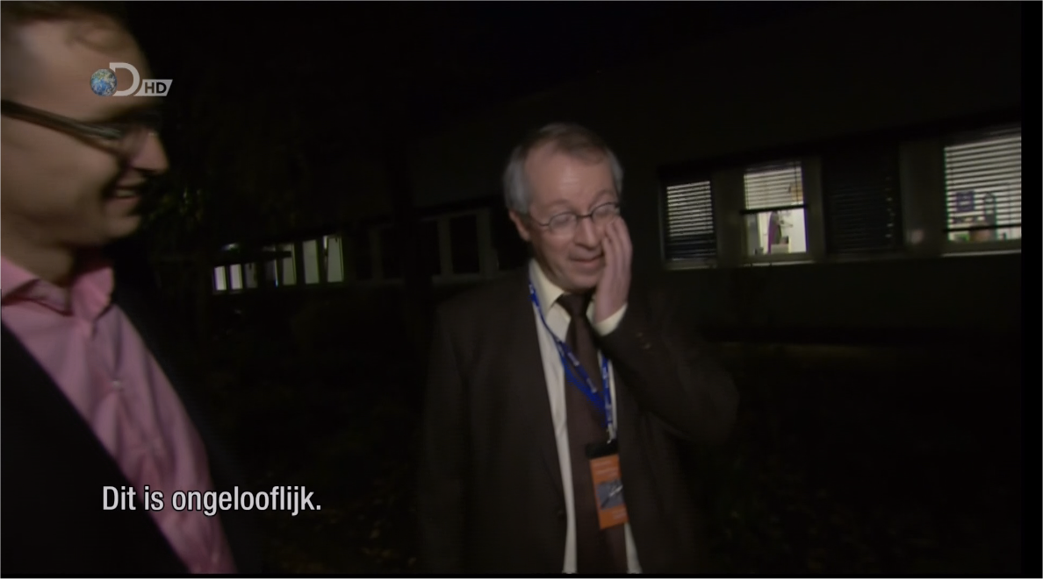
Landing Day
The number of media teams on-site at ESOC was unprecedented
I had a Dutch documentary maker follow me through the day with a camera
The livestreams were extensively followed online
The cheering was intermittent

Slide 10
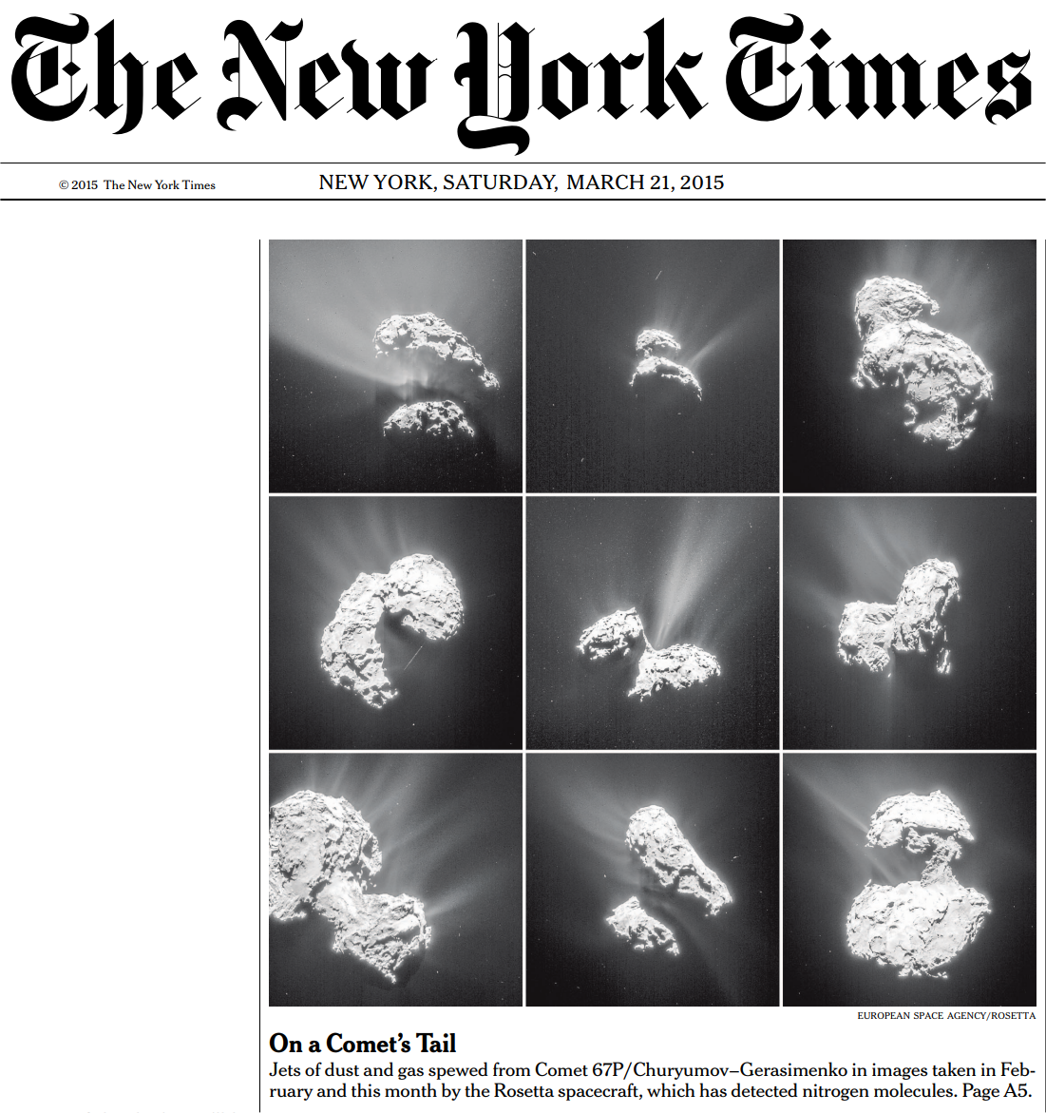
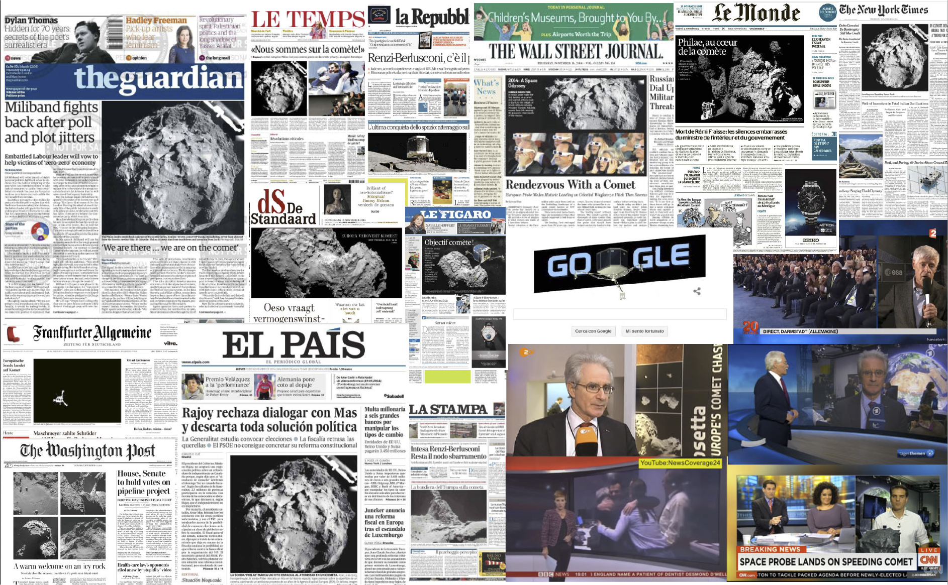
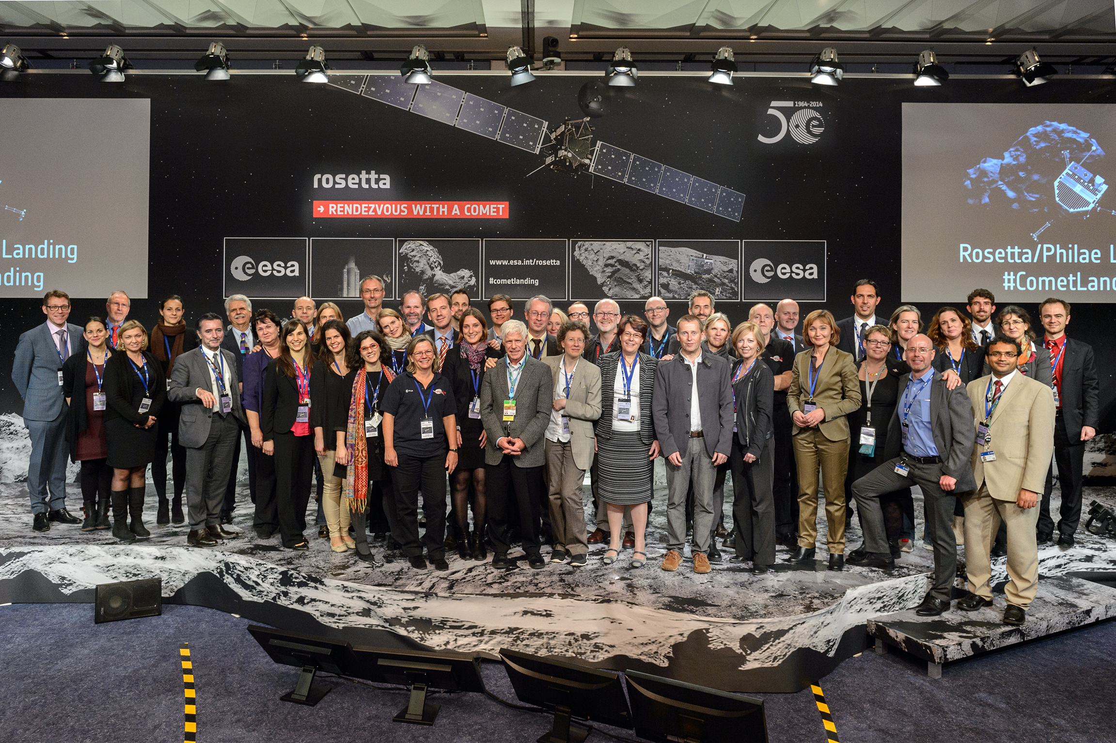
The Media Frenzy

Slide 11
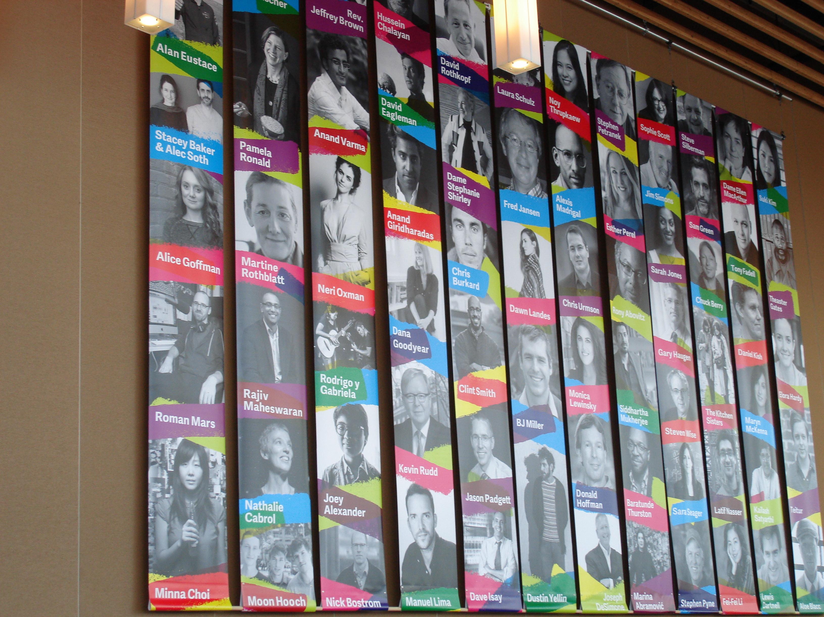
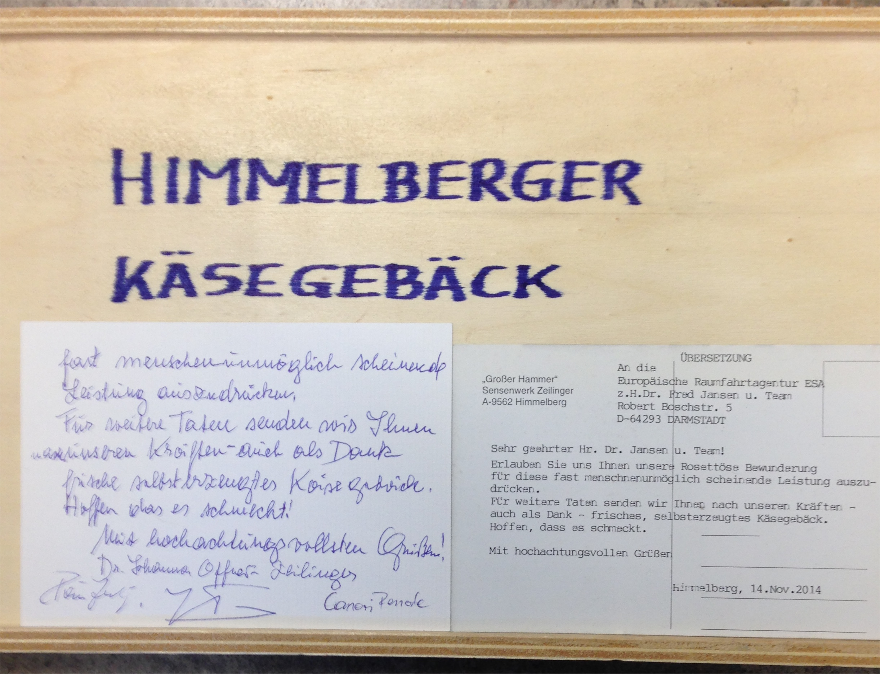
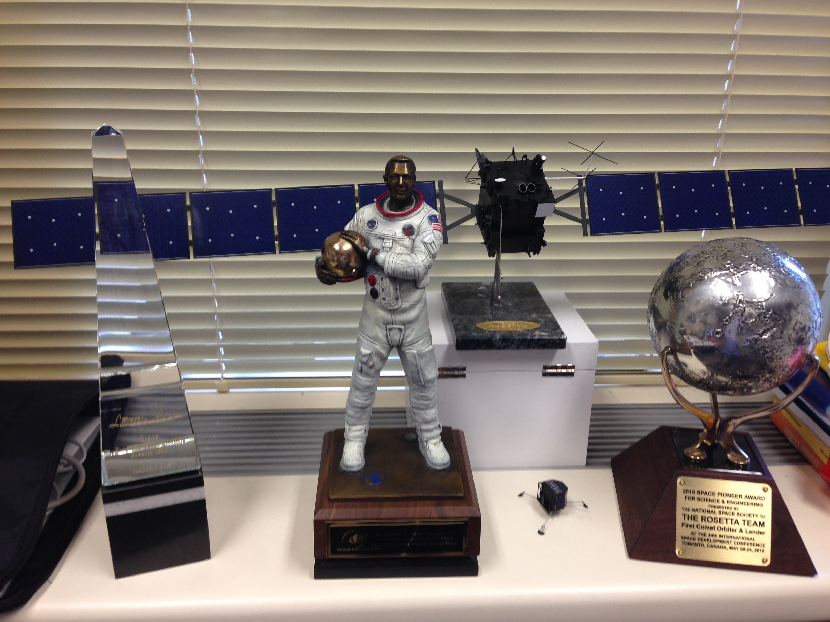
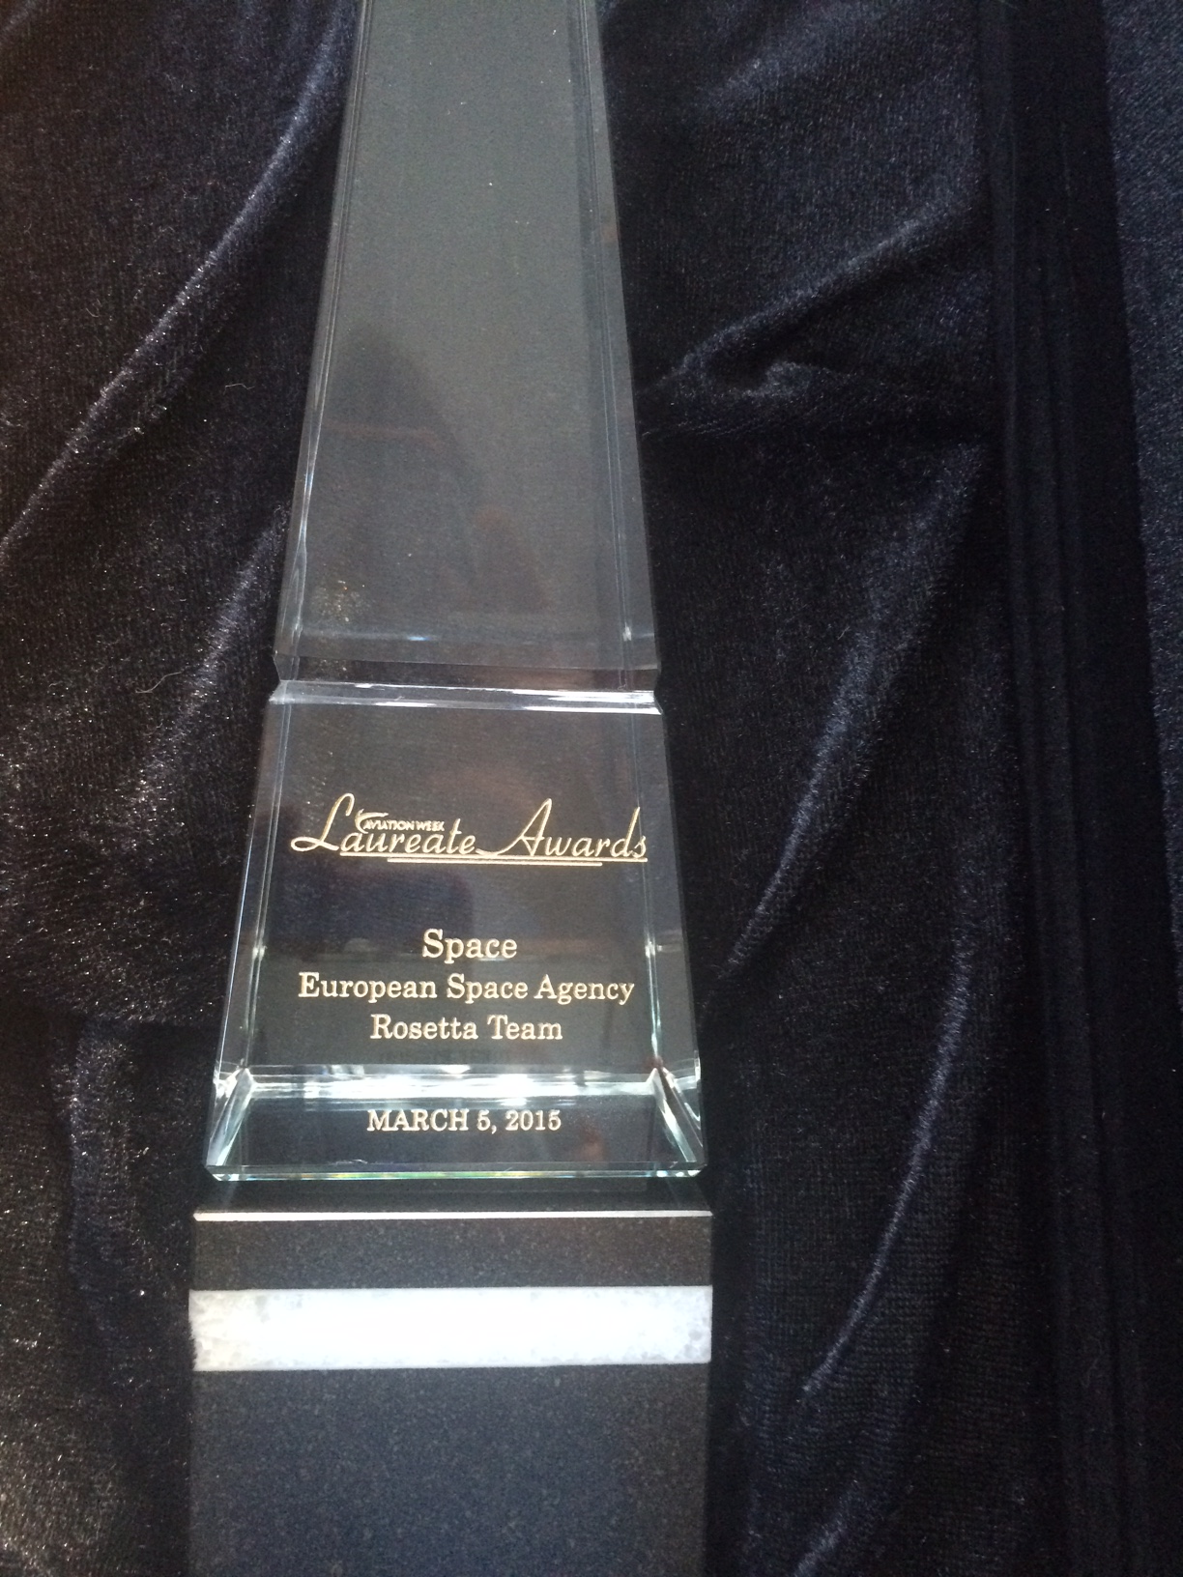
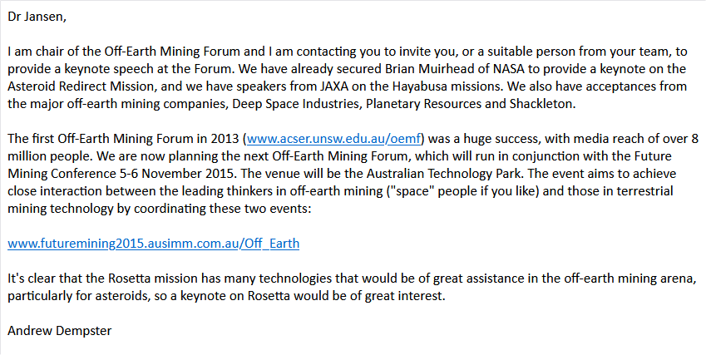
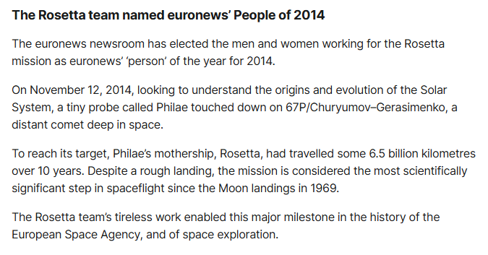
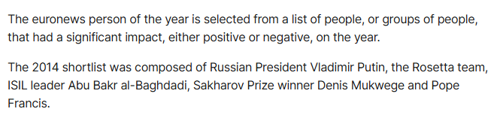
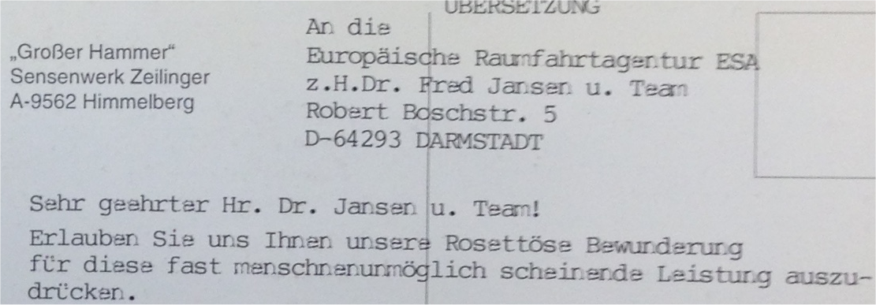
(My) Aftermath
Aviation week and Space Technology award
TED
Space Foundation award
National Space Society award
The stranger stuff
Pity the physical awards were never put together as an achievement of the agency and its external partners

Slide 12
Thank you

