Slide 1
Multi-Messenger Astrophysics with Athena
Matthias Ehle (ESA-ESAC/SCI-O) - Athena SciOps Study Lead Matteo Guainazzi (ESA-ESTEC/SCI-S) – Athena Study Scientist

Slide 2
Outline
Athena scientific goals and mission profile
Athena science relevant to multi-messenger
High-energy counterparts of (Neutron Star)² merger events with Athena
High-energy counterparts of (Super-Massive Black Holes)² mergers with Athena
Synergies with LISA

Slide 3
Scientific goals of Athena
Science theme: The Hot and Energetic Universe
The Hot Universe: How does baryonic matter assemble in large-scale structures? How do they evolve from formation epoch to present day?
The Energetic Universe: How do black holes grow & shape galaxies?
The Observatory & Discovery science:
  Observatory science across all corners of astrophysics
  Fast response (≤4 hours) capability to study transient sources
  ~2/3rd of time during nominal operations open to community

Slide 4
The “Hot Universe” with Athena
z=1 galaxy cluster (Athena vs. XMM/Hitomi)
EAGLE cosmological simulation
T<10^{4.5} K 10^{4.5}≤T≤10^{5.5} K T>10^{5.5} K
Pointecoteau et al., 2013, arXiv:1306.2319
Athena will trace evolution of heavy elements from z~2 to the local Universe
100 Mpc x 100 Mpc
Schaye et al. 2015, MNRAS, 446, 521

Slide 5
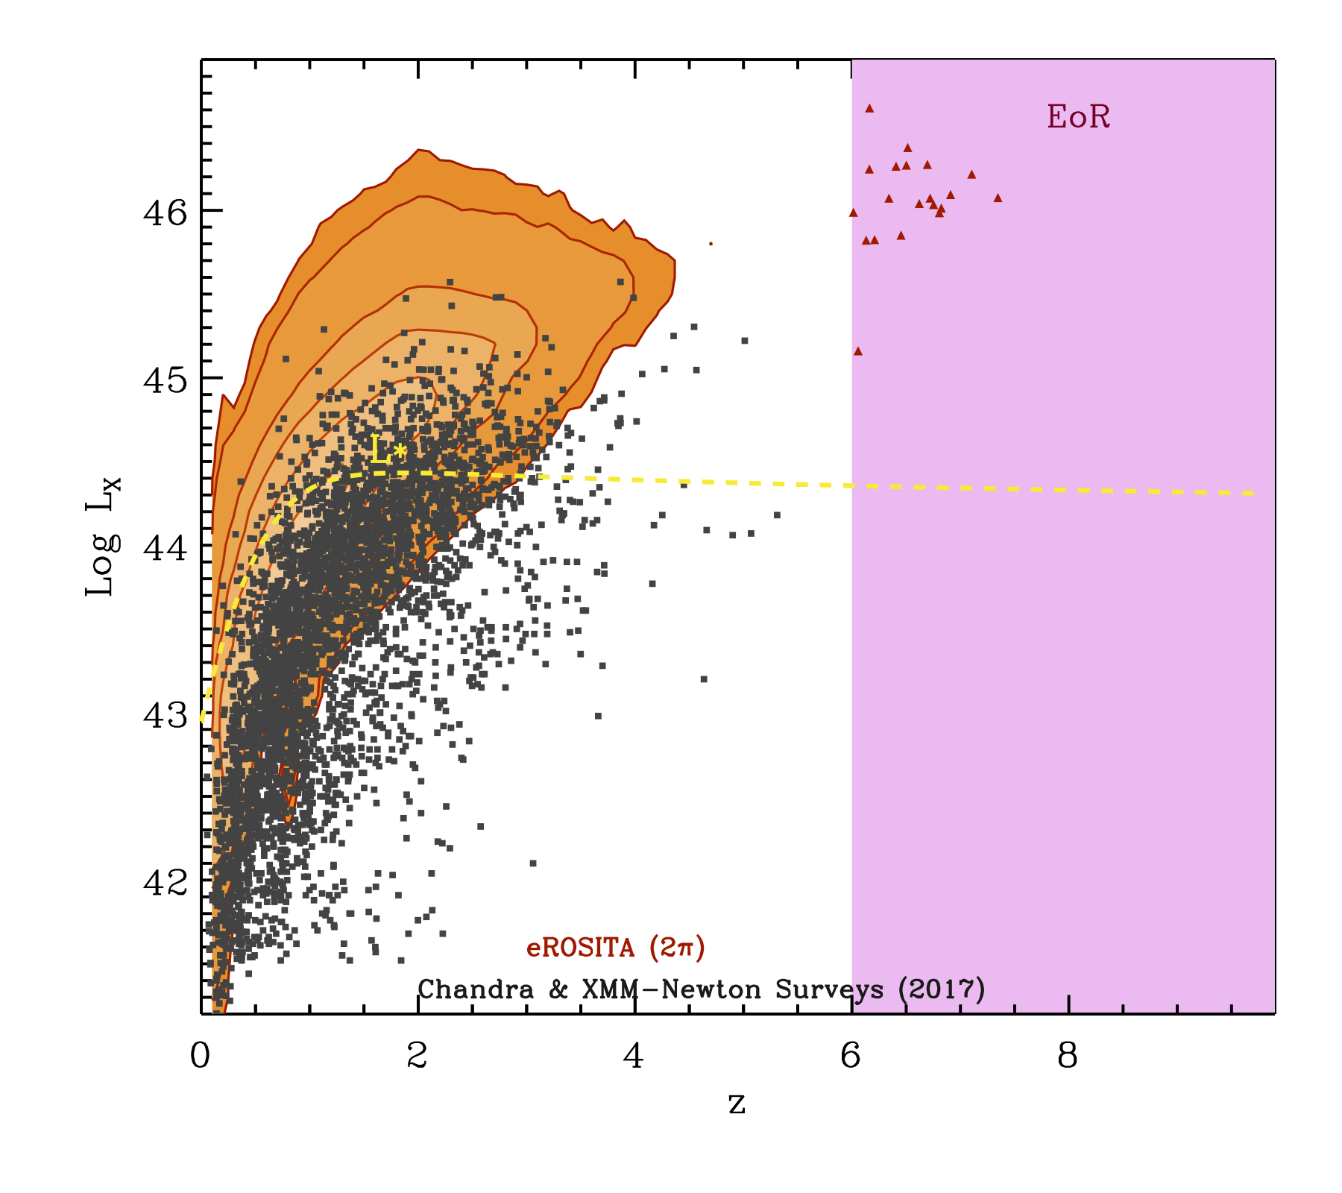
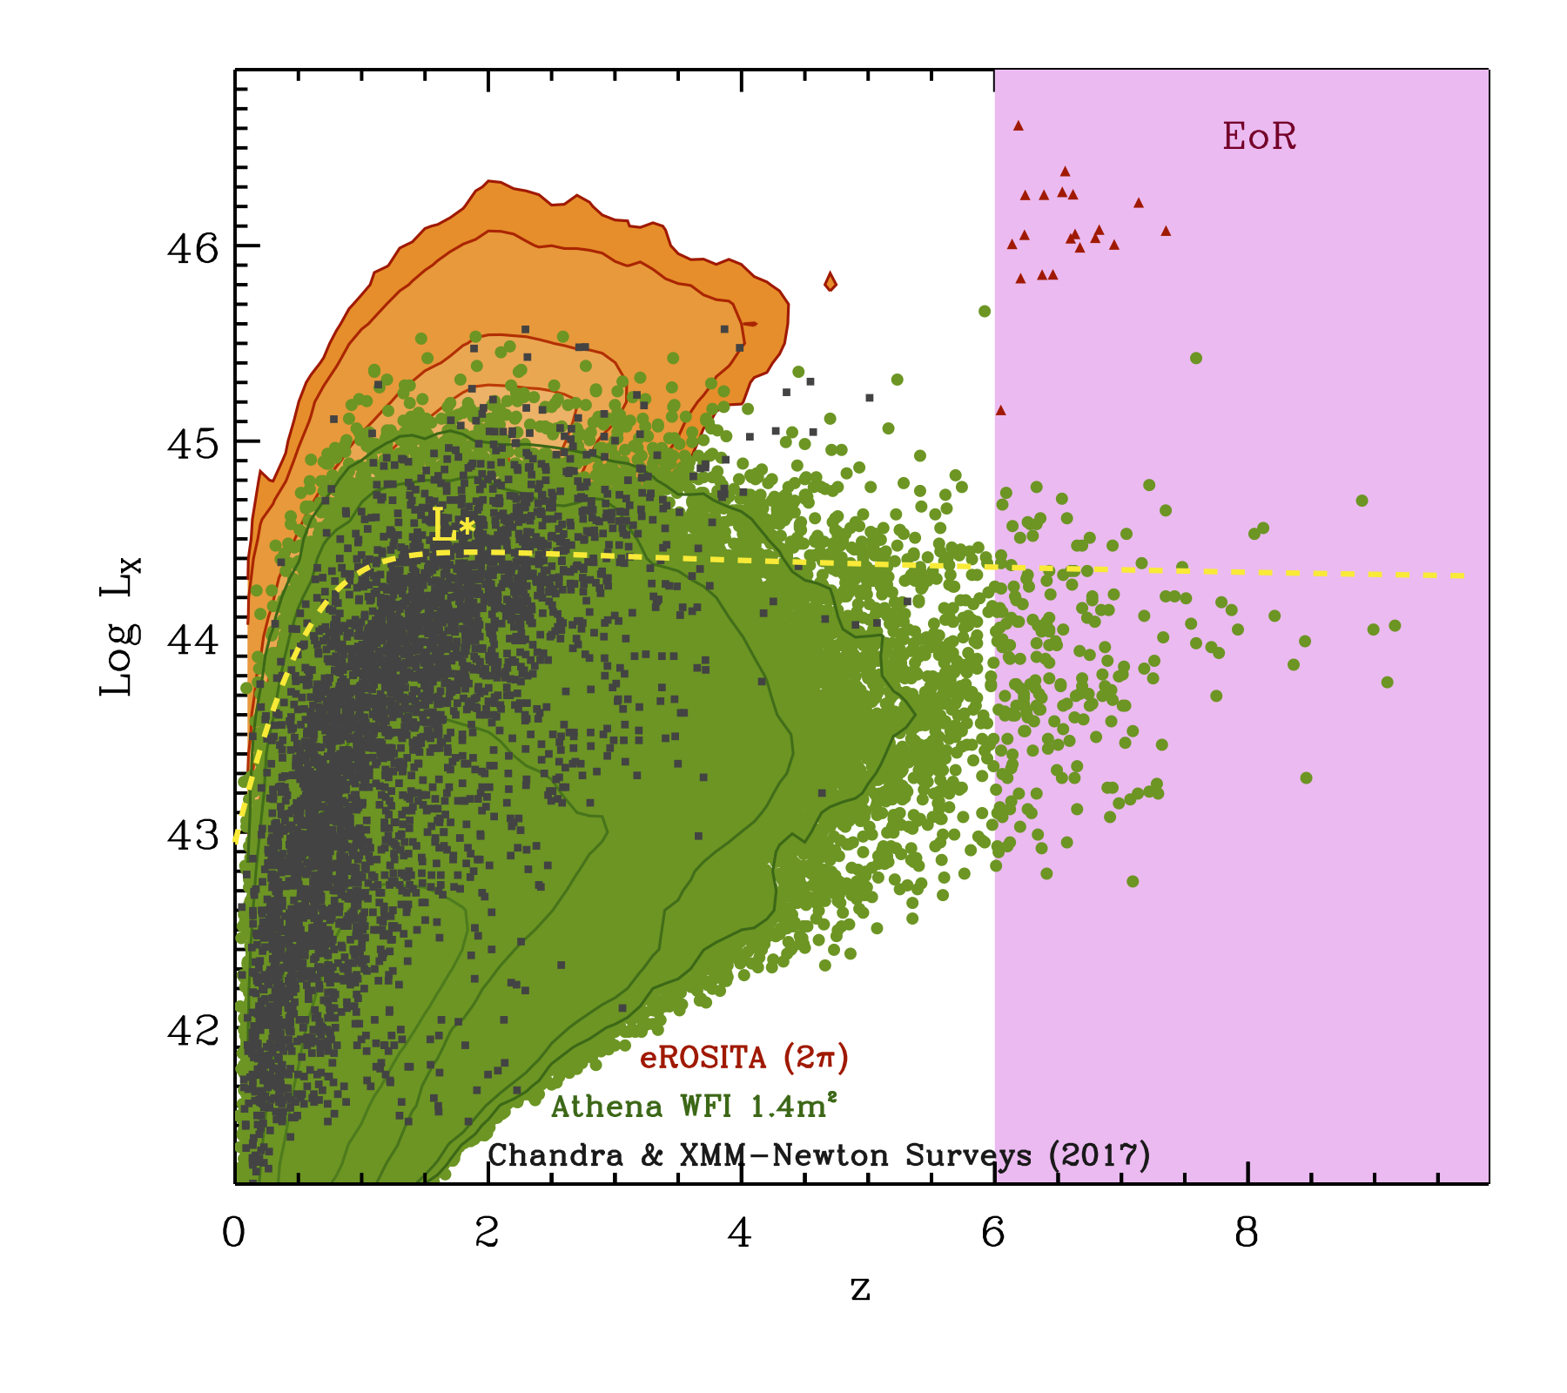
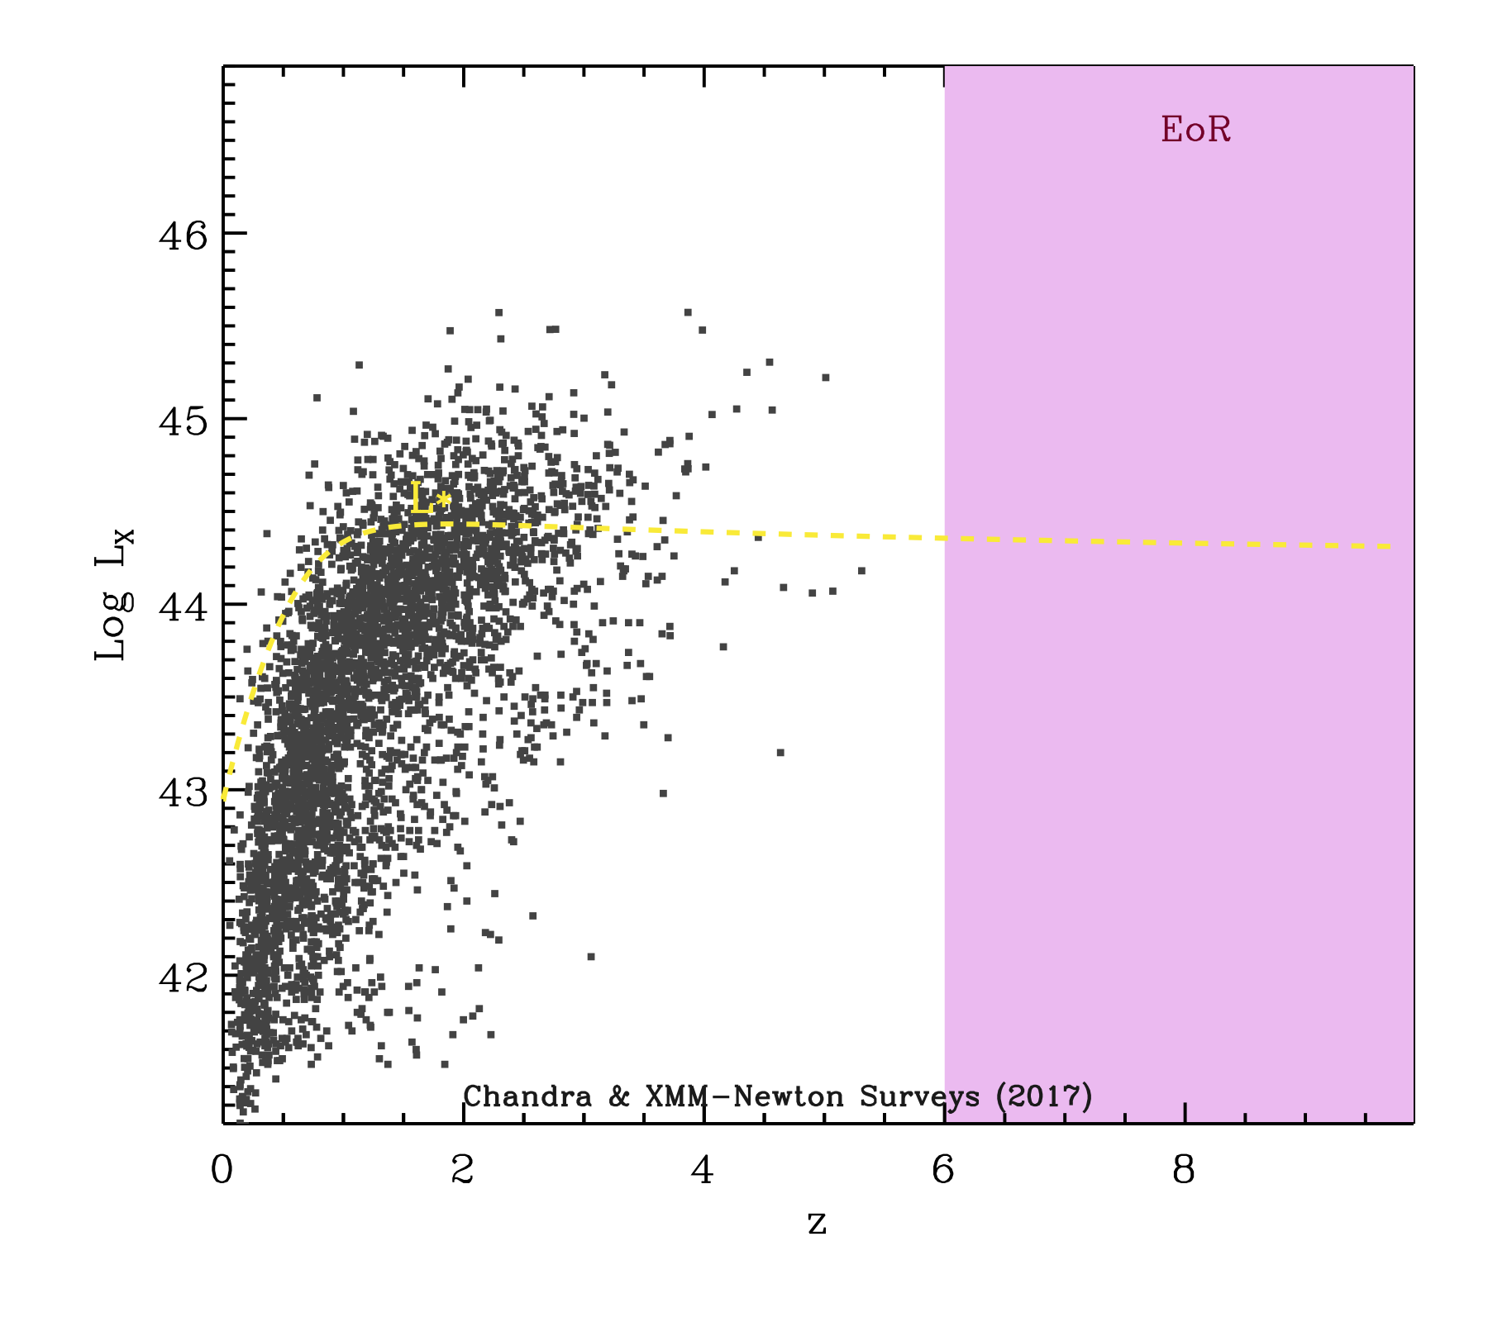
The “Energetic Universe” with Athena
AGN L_{X} versus z plane
X-ray luminosity
star formation
BH accretion (X-rays; Shankar+09)
BH accretion (X-rays; Aird+10)
BH accretion (IR)
The cosmological history of black hole accretion is uncertain at z>3, unknown at z>6
redshift
Madau & Dickinson, ARA&A, 52, 415
Aird et al., 2013, arXiv:1306.2325. Courtesy A.Rau (MPE)

Slide 6
Mission profile
Single telescope, Silicon Pore Optics (SPO) technology, 12 m focal length, ≥1.4 m² area @1 keV, 0.25 m² @6 keV
WFI (Active Pixel Sensor Si detector): wide-field (40’x40’) spectral-imaging, CCD-like energy resolution (120-150 eV @6 keV)
X-IFU (cryogenic imaging spectrometer): 2.5 eV energy resolution (R>2000 @5 keV), 5’ diameter effective field-of-view, ≤5” pixel size
Count rates capabilities: >1 Crab (WFI)/~1 Crab (X-IFU; 50% throughput)
≤4 hours response with ~50% efficiency to observe a Target of Opportunity (ToO) at a random position in the sky (FoR: 50%, 60% goal)
  Under study: Autonomous ToO capability
Launch early 2030s, Ariane 6.4, L2 halo orbit (TBC)

Slide 7
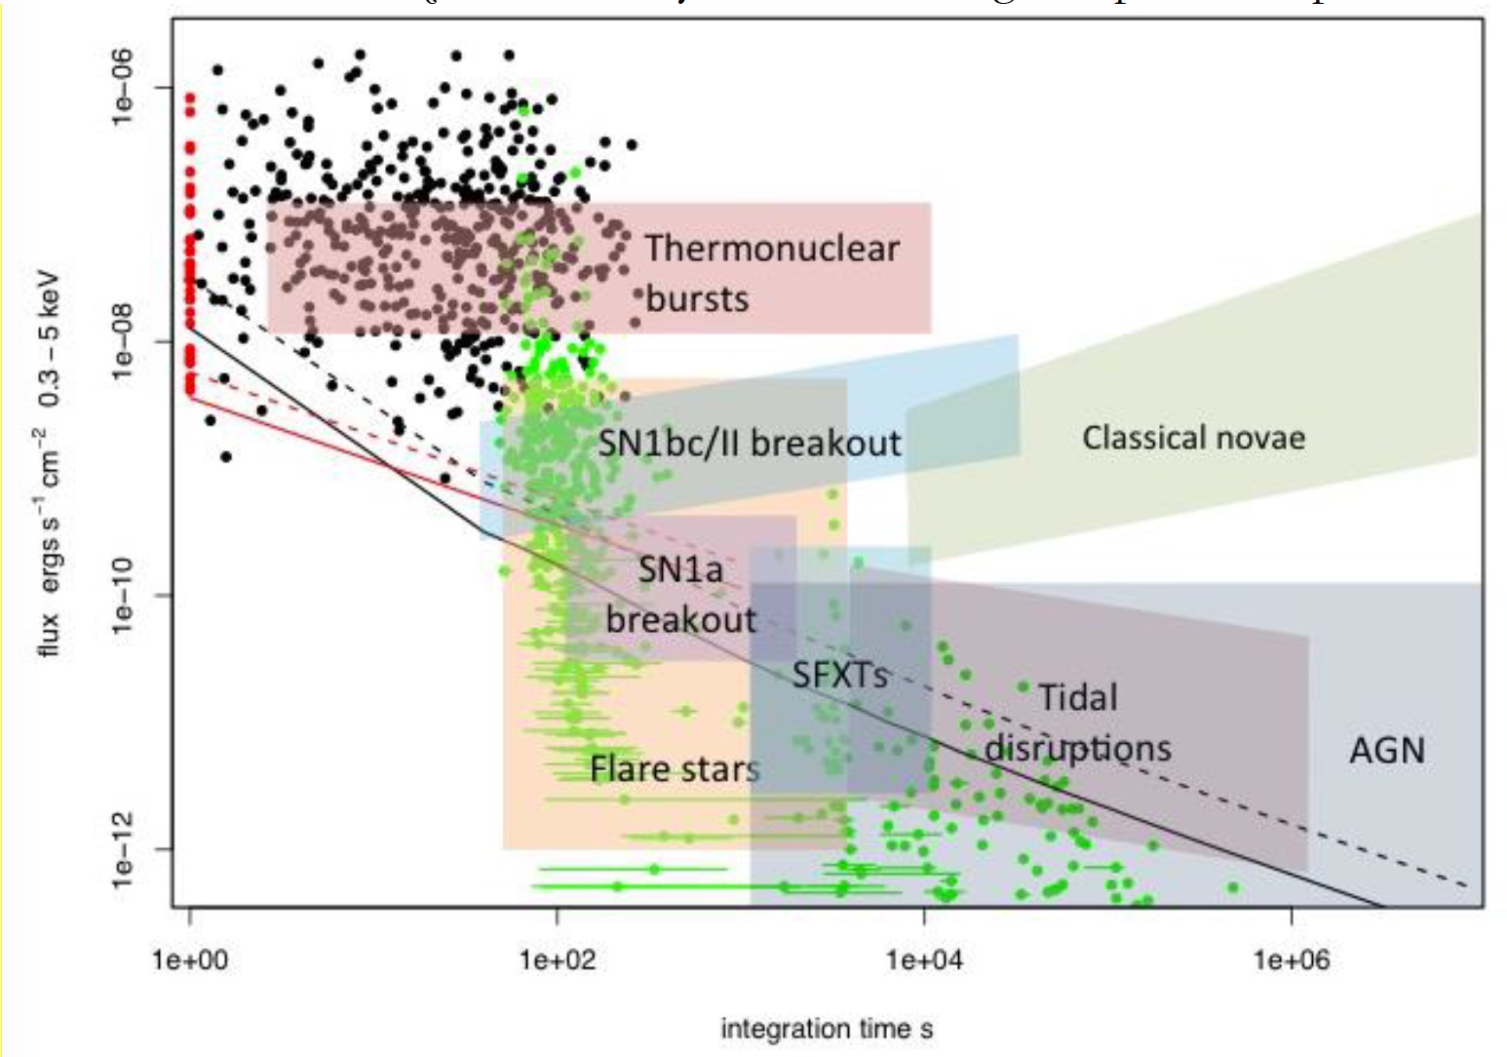
Athena and the transient Universe
Athena White Paper on “Luminous extragalactic transients”
Three main topics:
  Gamma-Ray Bursts
  Tidal Disruption Events
  Supernovae Shock Breakout
Other topics covered by the Athena science requirements
  SgrA* (core science)
  Magnetars
  Novae
  Pulsar Wind Nebulae
  Supernovae
Amati et al., THESEUS M5 Proposal (synergy!)

Slide 8
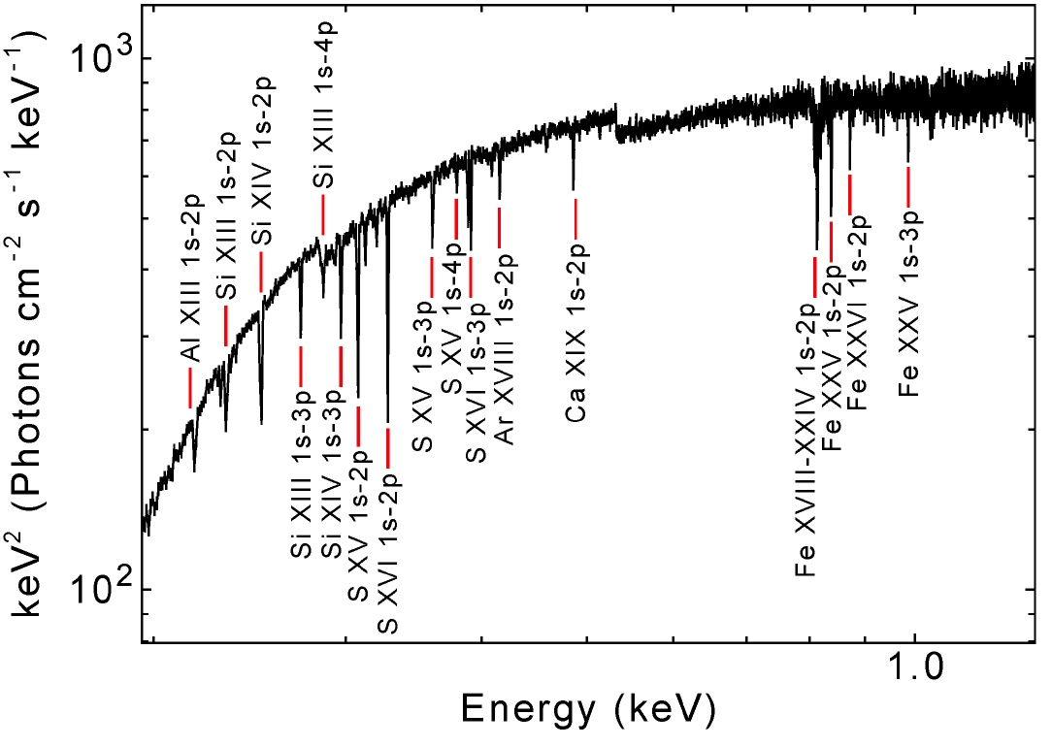
Athena probing the early Universe with GRBs
X-ray absorption spectroscopy of ionized gas from C to Ni
Metal enrichment in the early Universe
Primordial stellar population (PopII vs. PopIII)
Emission line spectroscopy of the GRB environment (jet/ ejecta illumination, QPOs in accreting matter)
Another case involving GRB: WHIM
X-IFU GRB @z=7
Fluence=4x10⁻⁷ erg cm^{-2,} N_{H}=10²² cm⁻²
Jonker et al., 2013, arXiv: 1306.2336

Slide 9
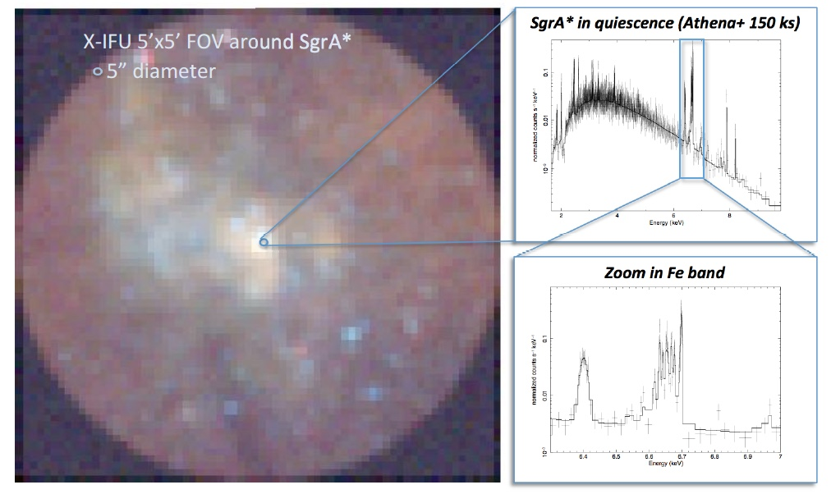
SgrA* (supermassive Milky Way Black Hole)
Mass ~4x10⁶ M⊙
Accrete ~10⁻⁶ Eddington
Daily flares (L_{X}~100-1000x)
Athena science: nature of quiescent emission (thermal) and flare production and emission
Bonus: BH activity history via Fe K_{α} reflection nebulae spectroscopy
Cappi et al., 2013, arXiv:1306.2330

Slide 10
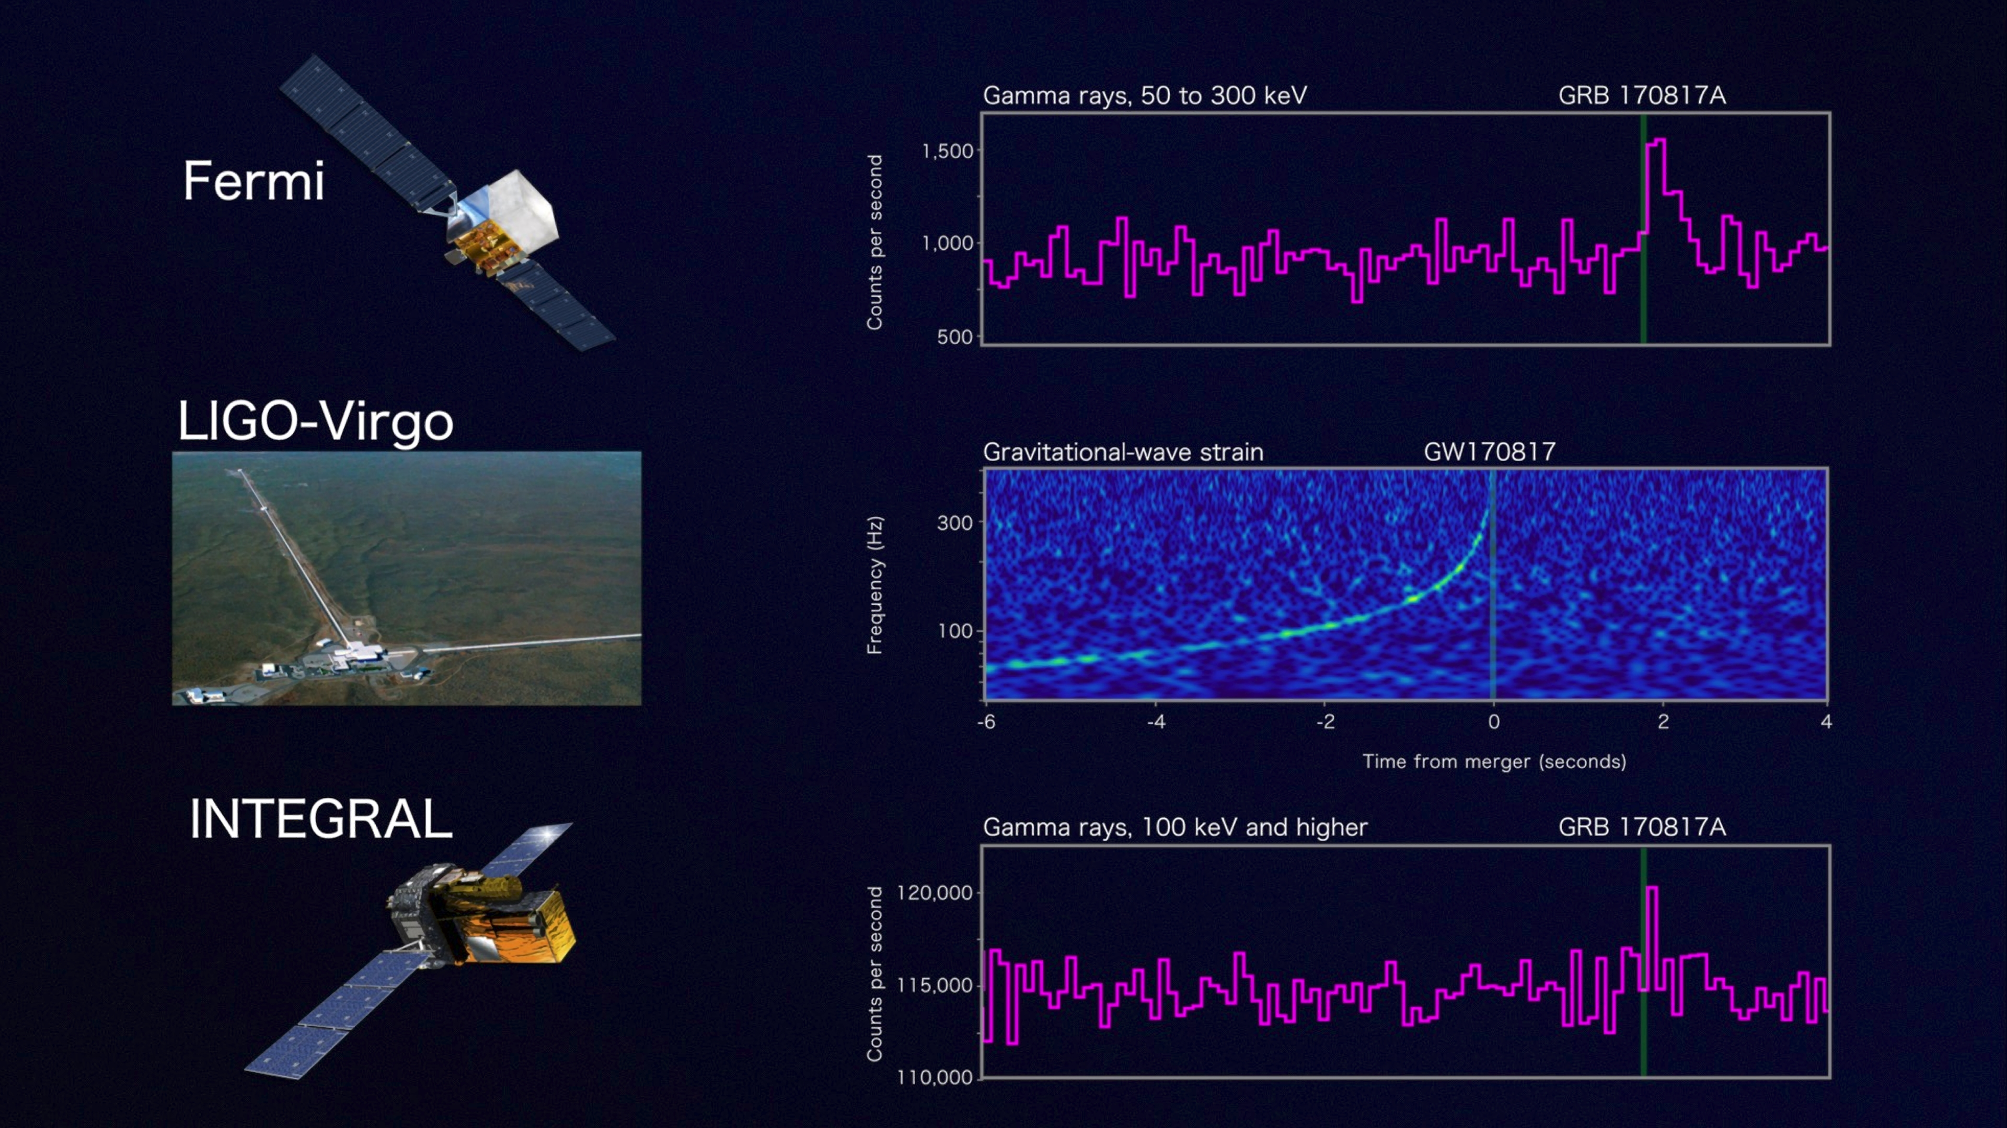
GW170717
Credit: NASA's Goddard Space Flight Center, Caltech/MIT/LIGO Lab and ESA

Slide 11
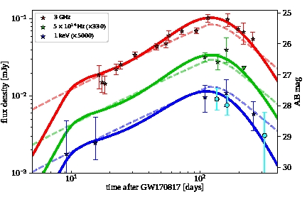
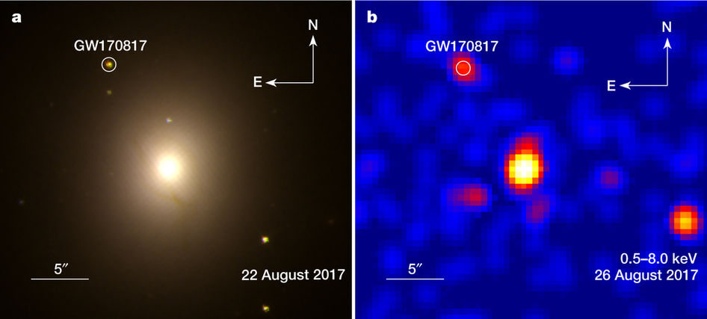
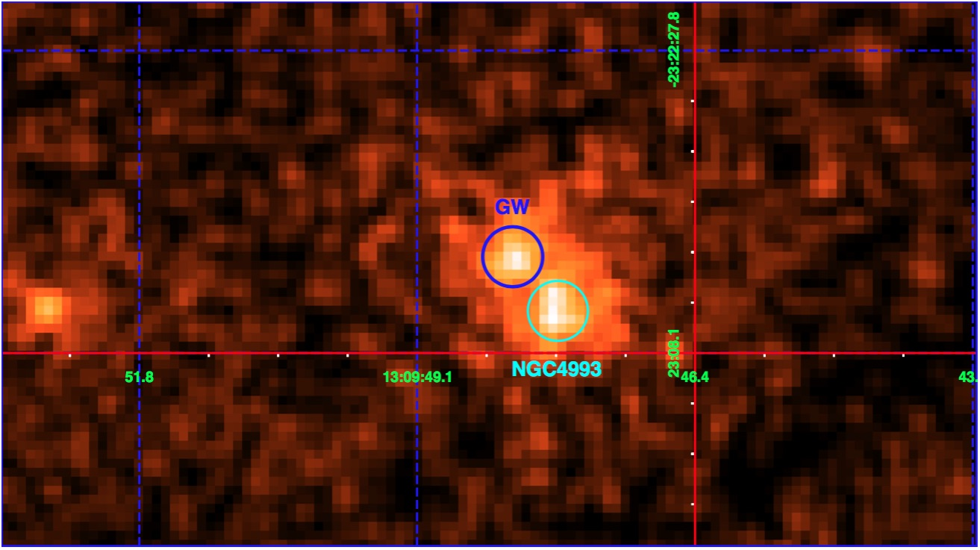
X-ray counterpart of the NS-NS merger
Radio and X-ray light curves
GW170817 EM counterpart
Radio @3 GHz
Optical @5x10¹⁴ Hz
X-rays @1 keV
flux density [mJy]
AB mag
HST
Chandra
XMM-Newton
XMM
Troja, et al., Nature, 2017, 551, 71
D'Avanzo, et al., 2018, A&A 613, L1
Troja et al., 2018, MNRAS, 478, 18
time after GW170817 [days]

Slide 12
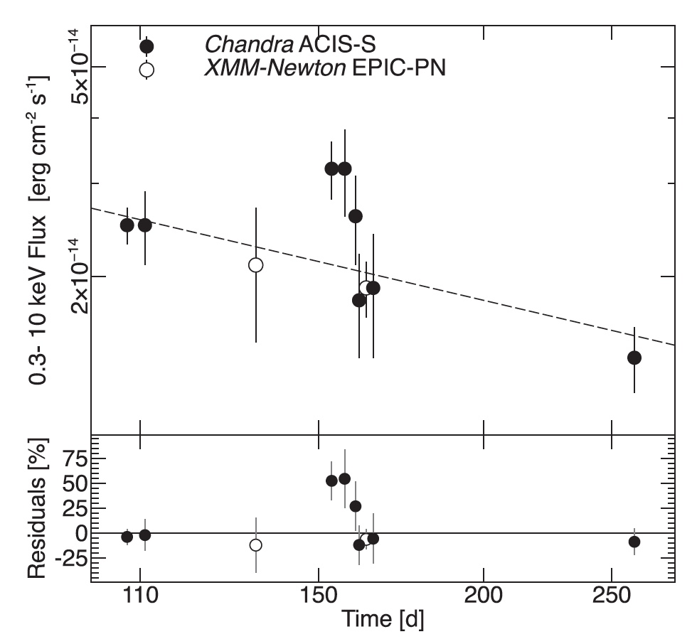
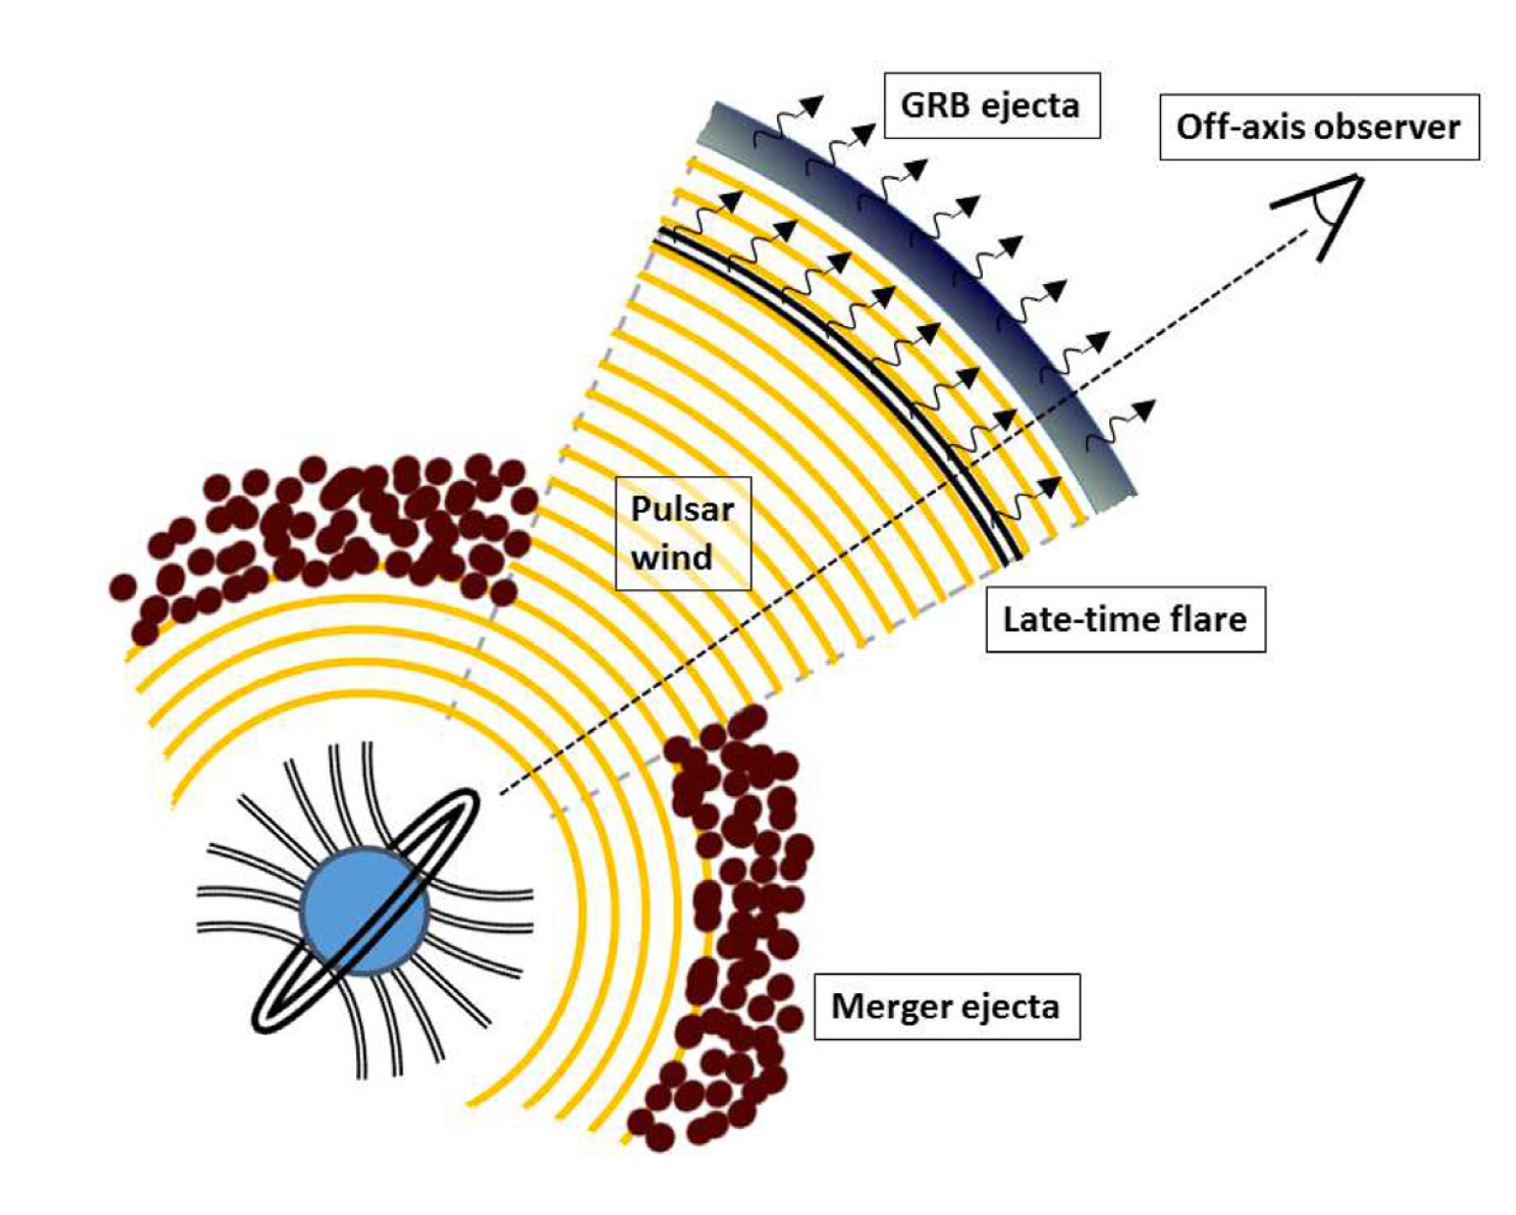
Merger Remnant: Breaking the NS-BH degeneracy
3.3σ X-ray flare
Moreover (on year time-scales):
Long-lasting X-ray plateau
X-ray kilonova remnants
Piro et al., 2019, MNRAS, 483, 1912

Slide 13
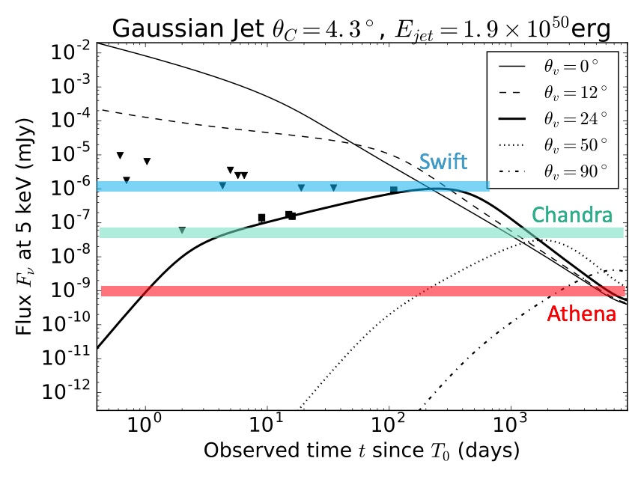
Athena will see them all …
X-rays probe:
Jet: GRB afterglow (from radio to X-rays)
Isotropic features:
  Off-axis (orphan) afterglows
  Cocoon
Beaming angle ~1/Γ
Αthena needed:
for any line-of-sight <50º
to sample most distant counterparts, detected by GW facilities
Credit: L.Piro (IAPS/INAF)

Slide 14
Breaking the NS-BH degeneracy
LISA launch date: 2034?
Moreover (on year time-scales):
Long-lasting X-ray plateau
X-ray kilonova remnants
Piro et al., 2019, MNRAS, 483, 1912
(cf. talk by U. Lammers / P. McNamara)
Notes:
The sensitivity (in terms of characteristic strain) of the proposed LISA 3-detector system with 2.5 × 10⁶ km arms. Numerous sources that are expected to be observed by LISA are displayed. Especially important for the search for a stochastic background will be the galactic background. Thousands of galactic binaries in LISA will produce signals with SNR >7, and will be individually resolvable. Some of these systems are well known and have already been studied; these will be the so-called Verification Binaries, that will produce gravitational wave signals that will help to confirm the sensitivity and calibration of LISA. However, countless other binary systems will contribute to a gravitational wave background that will complicate the LISA search for a cosmologically produced stochastic background. This background is also displayed in this figure. Many other predicted signals for LISA are displayed, including massive black hole binaries (MBHBs, including GW150914), black hole binary systems that can be observed with Advanced LIGO and Advanced Virgo (LIGO-type BHBs), and extreme mass ratio inspirals (EMRIs).. Reproduced from [32] with permission. https://arxiv.org/abs/1702.00786
Examples of GW sources in the frequency range of LISA, compared with its sensitivity for a 3-arm configuration. The data are plotted in terms of dimensionless ‘characteristic strain amplitude’. The tracks of three equal mass black
hole binaries, located at z = 3 with total intrinsic masses 10⁷, 10⁶ and 10⁵M⊙, are shown. The source frequency (and SNR) increases with time, and the remaining time before the plunge is indicated on the tracks. The 5 simultaneously evolving harmonics of an Extreme Mass Ratio Inspiral source at z = 1.2 are also shown, as are the tracks of a number of stellar origin black hole binaries of the type discovered by LIGO. Several thousand galactic binaries will be resolved after a year of observation. Some binary systems are already known, and will serve as verification signals. Millions of other binaries result in a ‘confusion signal’, with a detected amplitude that is modulated by the motion of the constellation over the year; the average level is represented as the grey shaded area.

Slide 15
Why observe SMBH merging with Athena & LISA?
Unique opportunity to probe behaviour of matter in the variable space-time induced by the merging BHs
Study propagation velocity of photons vs. gravitons by phase-correlating the GW with the X-ray time-modulated signal
Extend/calibrate cosmic distance scale to z≤2
  GWs give luminosity distance, X-rays may provide redshift
Unique opportunity to probe AGN physics
  Onset of relativistic jets
  Formation of AGN corona
  Lack of predictive, observational-based theory hampered progress so far
Potentially huge discovery space

Slide 16
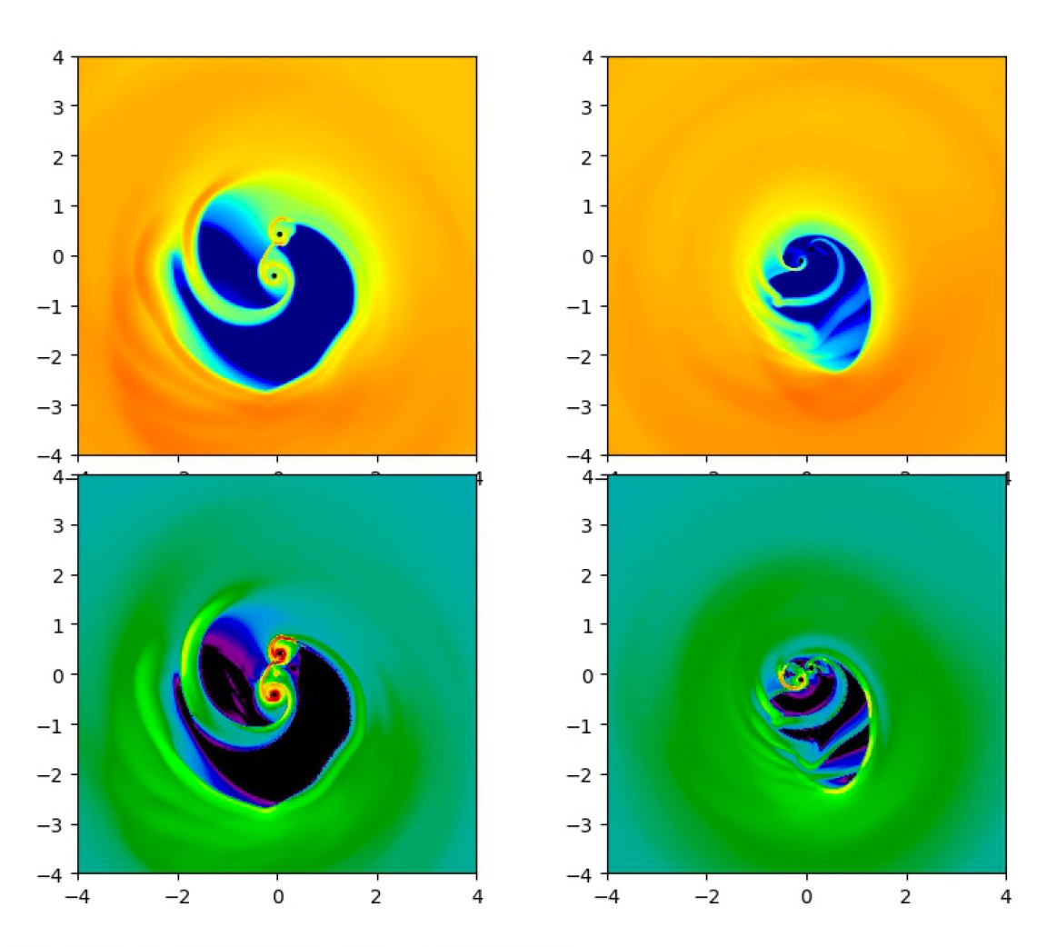
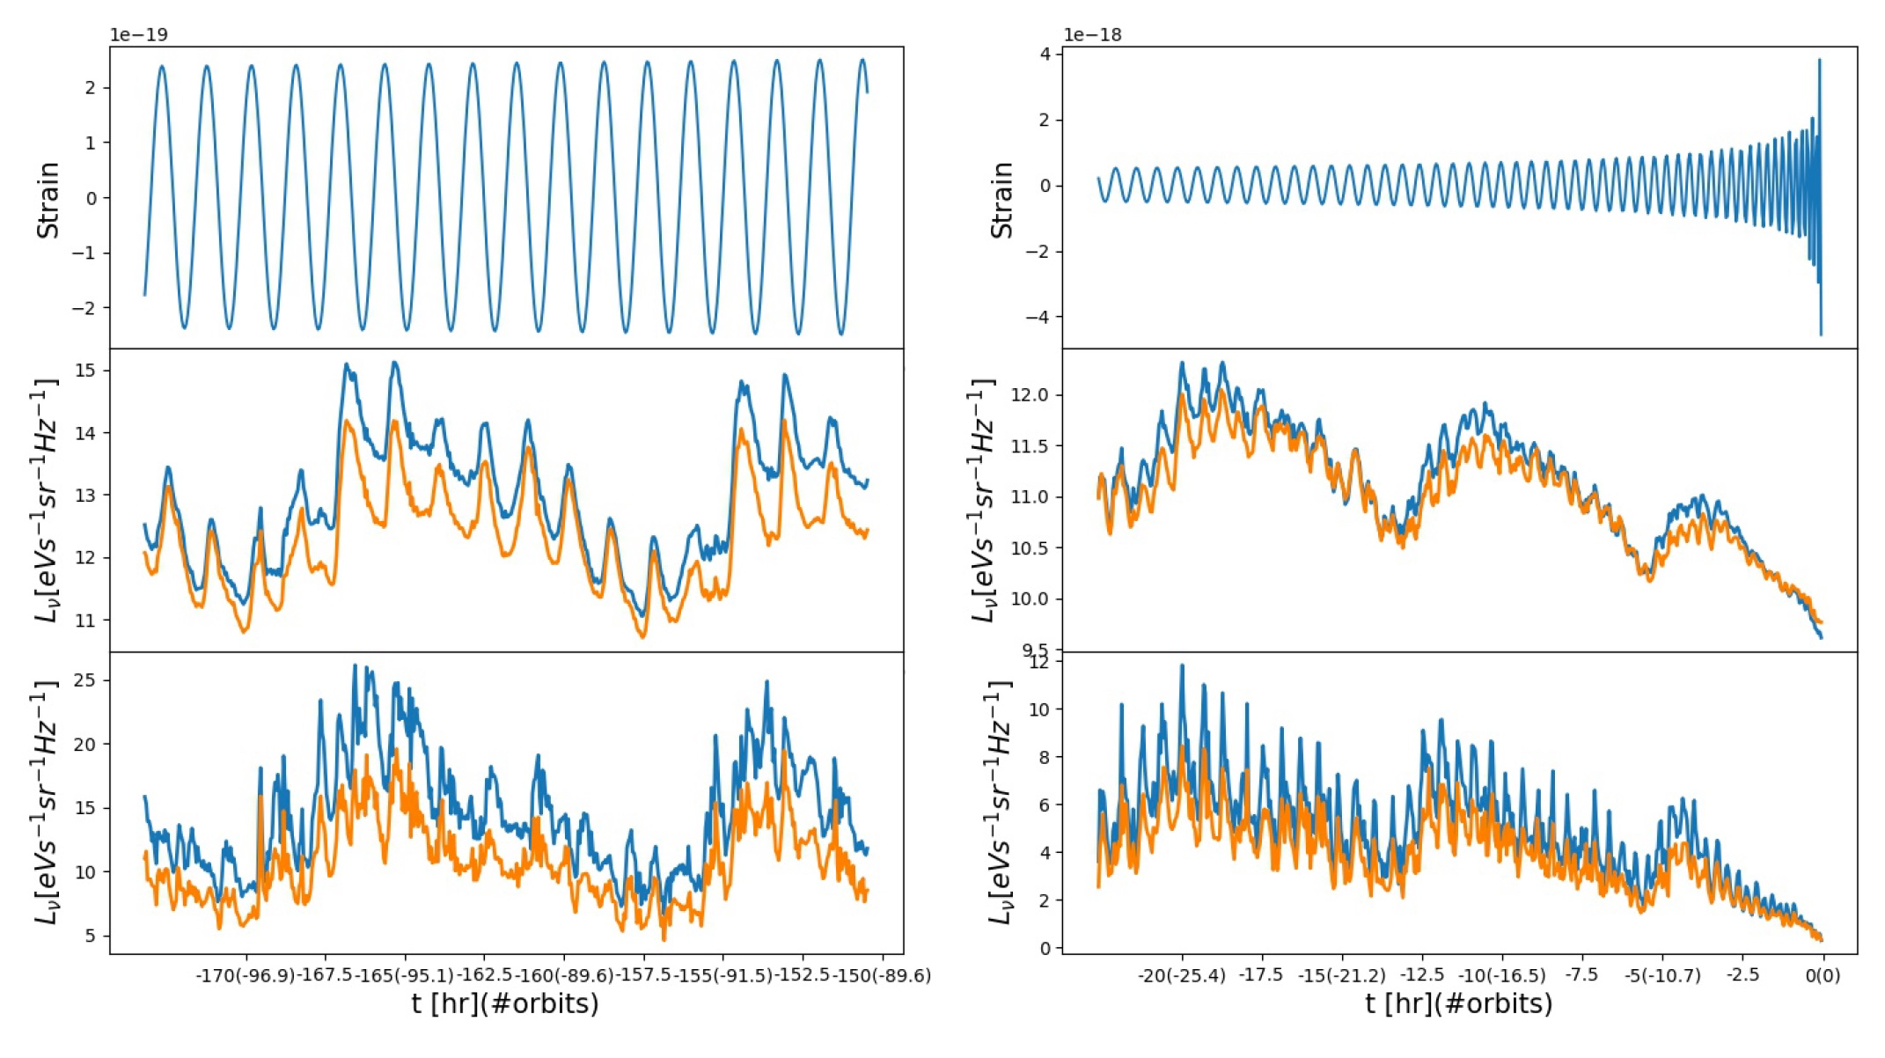
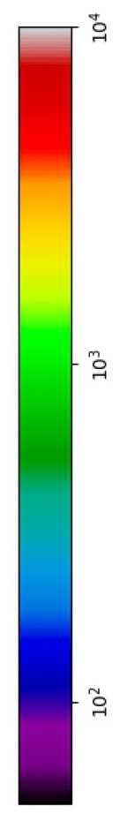
X-ray emission from an in-spiraling SMBH merger
M_{BH}=10⁶ M⊙, d_{start}=60 r_{g}
Outer disk: ≤1 keV
Cavity wall: ~2 keV
Mini-disks: ≥3 keV
Surface density
d=60 r_{g}
~merging
Temperature
2 keV
10 keV
Δt~3.6 days
Δt~1.5 hours
Tang et al., 2018, MNRAS, 476, 2249

Slide 17
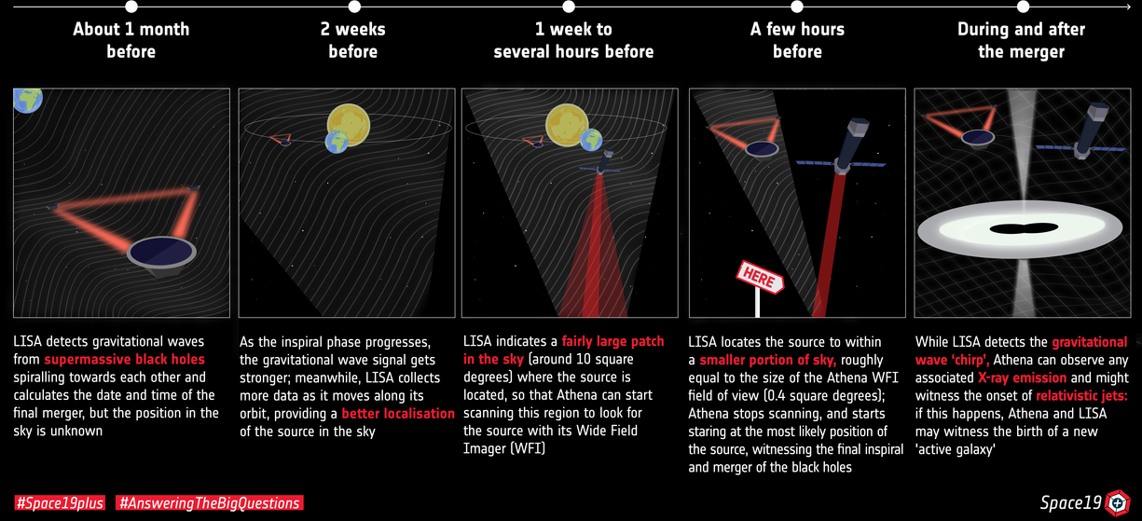
Possible Athena-LISA synergetic strategy

Slide 18
Conclusions
Athena is designed to address topics of The Hot and Energetic Universe
However, it is an observatory capable of impacting all fields of astronomy
Designed to overperform any existing or planned X-ray mission by at least one order of magnitude in several parameter spaces simultaneously
Rapid ToO response and quick agility are well tuned for future multi-messenger astronomy
NS-NS merger events:
  all off-axis jets with inclination <50º
  most distant counterparts of GW facilities
  can discriminate the merger remnant nature via weak X-ray flares, or long-lasting X-ray plateaus
SMBH merger events (synergies with LISA):
  potentiality of studying behaviour of matter in variable space-time of merging BHs
  Witness the post-merger onset of AGN activity (corona, jets)
  Huge discovery space – real challenge for theorist to predict what we could see!

