Slide 1
Joint Programs in the Context of Cross Facilities Collaboration in the Multi-Messenger Era
ESA/ESO SCIOPS Workshop 2019
ESAC, ESA, Villanueva de la Cañada, Madrid, Spain, 19-22 November 2019
Norbert Schartel
XMM-Newton Project Scientist, ESA

Slide 2
XMM-Newton

Slide 3
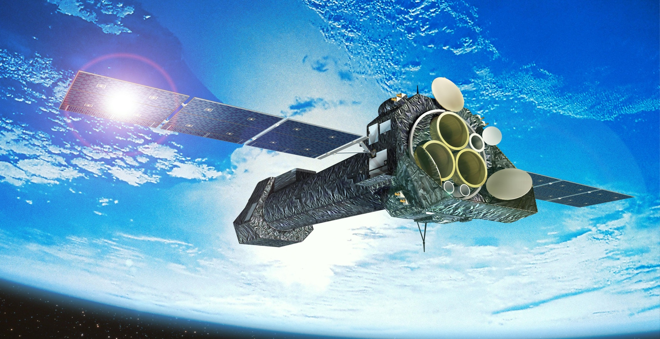

Slide 4
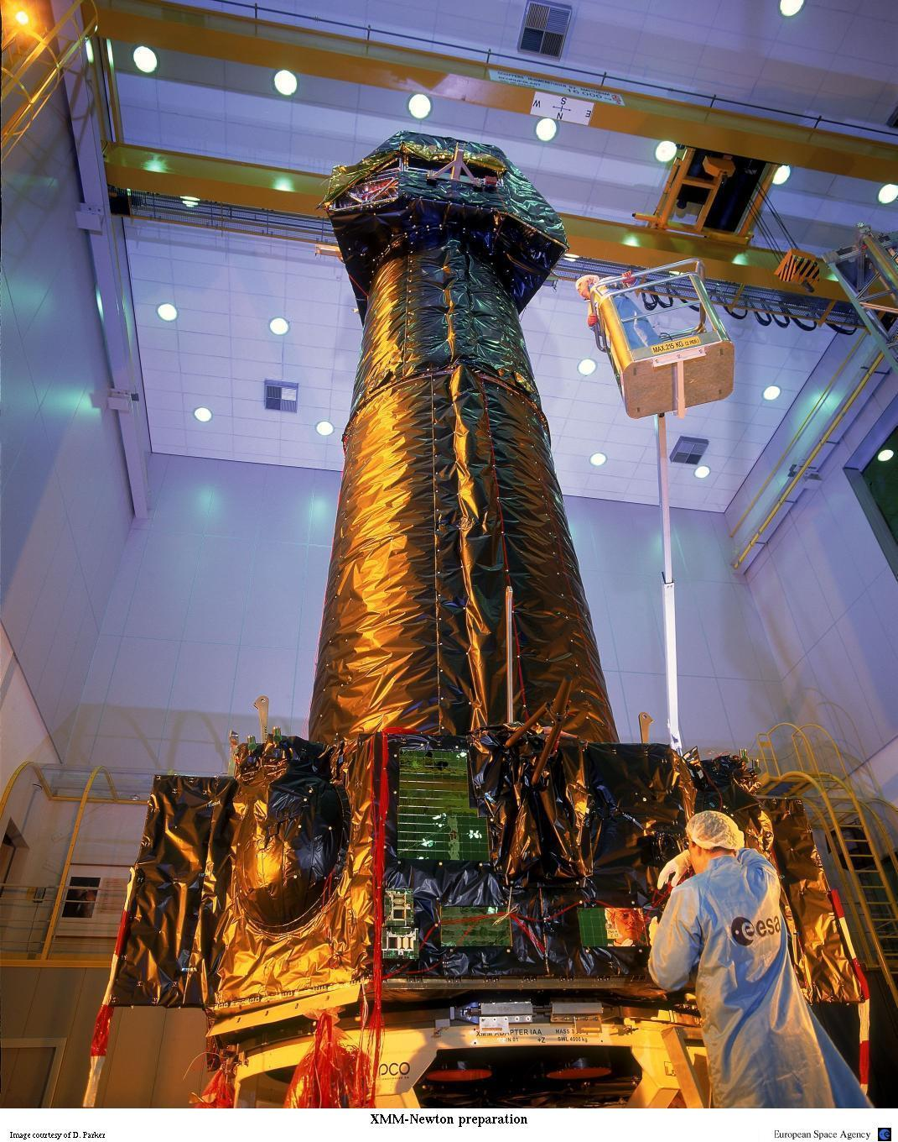

Slide 5
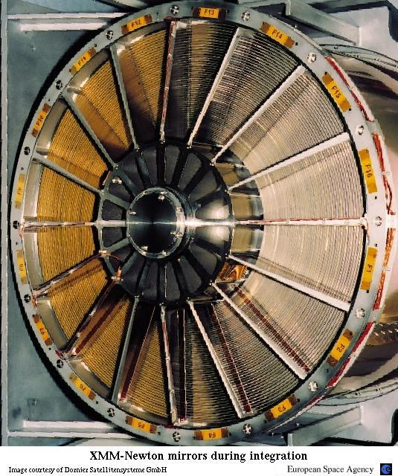
Mirror Module:
grazing-incidence . Wolter 1 telescopes
each mirror shell consists . of a paraboloid and an . associated hyperboloid
- 58 gold-coated nested . mirrors

Slide 6
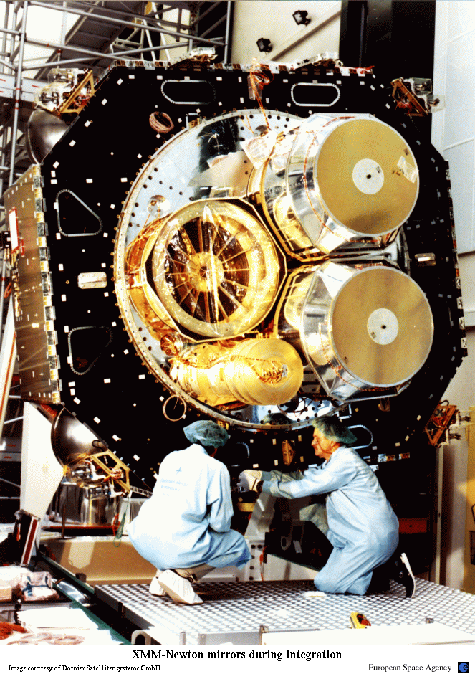
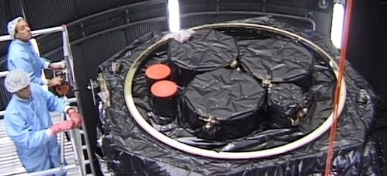
XMM-Newton has three mirror modules

Slide 7
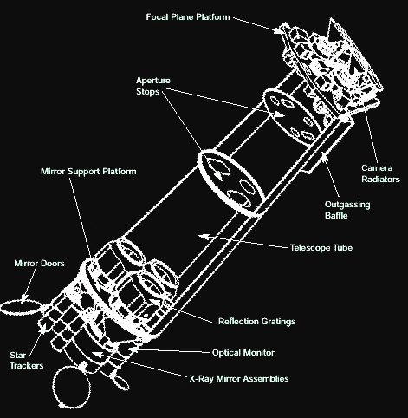
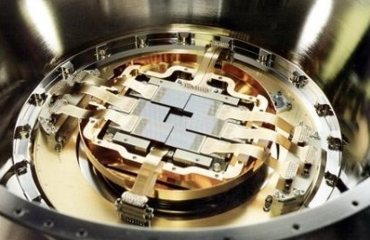
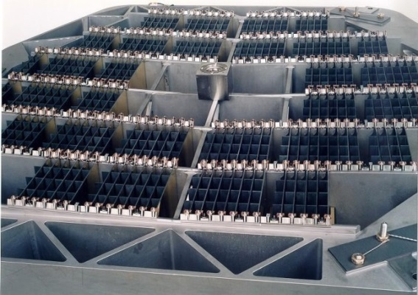
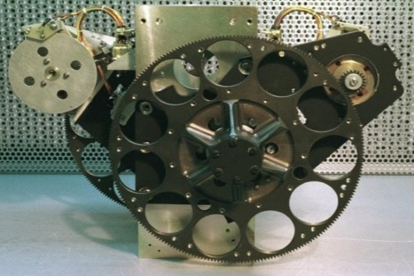
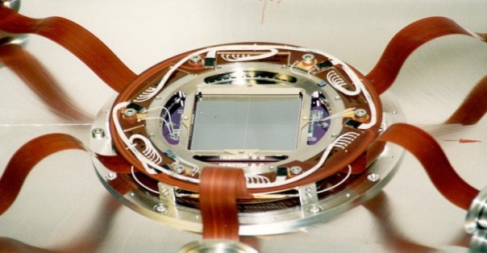
Instruments

Slide 8
XMM-Newton
- 3 Mirror Modules / highest effective collecting area ever
- Six simultaneously observing instruments:
  - 3 CCD cameras (one pn and two MOSs)
  - 2 spectrometers (RGS)
  - 1 Optical Monitor (OM)

Slide 9
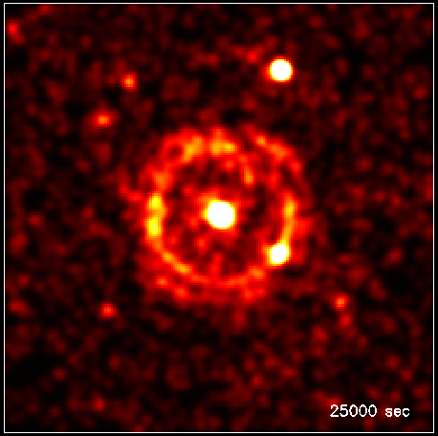
S. Vaughan et al., 2004, ApJ 603, L5
➔ Discovery of an evolving dust-scattered X-ray halo
➔ Will allow highly accurate distance determina-tions to the dust

Slide 10
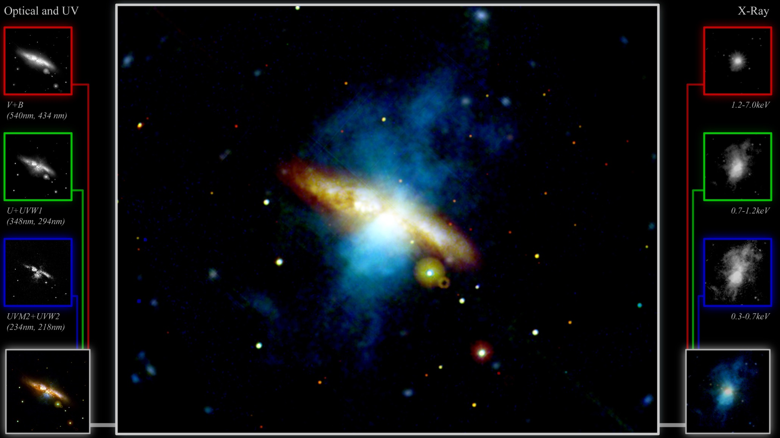
Messier 82 / Image courtesy of Pedro Rodriguez and ESA

Slide 11
Some Scientific Highlights

Slide 12
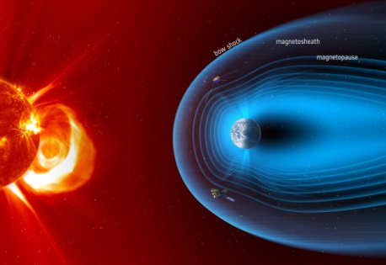
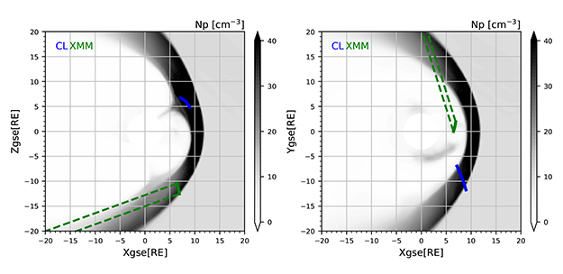
Exospheric Neutral Hydrogen Density 10 RE from XMM-Newton X-Ray Observations
H.K. Connor & J. Carter, 2019 JGRA 124, 1612
XMM-Newton line of sight traversed the dayside of the Earth's magnetosheath and observed strong near-Earth soft X-ray emission
➔ neutral densities
➔ modelled plasma fluxes match well in situ observations of Cluster and Geotail
➔ Solar wind-Magnetosphere-Ionosphere Link Explorer

Slide 13
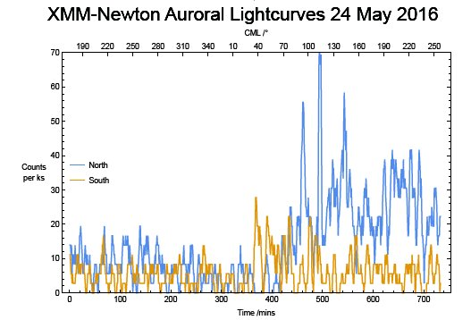
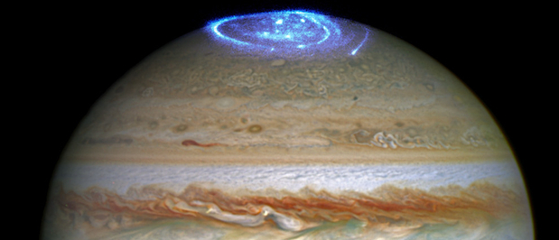
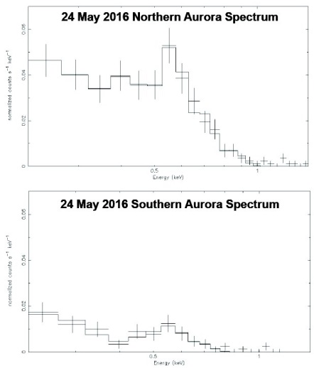
The independent pulsations of Jupiter's northern and southern X-ray auroras
Jupiter's northern X-ray aurora is
concentrated into a hot spot.
The X-ray emission demonstrates
that the hot spot is produced by
oxygen, sulphur and/or carbon ions
that are undergoing charge exchange.
-Observations failed to reveal a similar feature in the south
XMM-Newton, Chandra and JUNO campaigns show that Jupiter's
northern and southern spots each exhibit different
periodic pulsations and uncorrelated changes in brightness
➔ highly energetic, non-conjugate magnetospheric processes
sometimes drive the polar regions of Jupiter's dayside magnetosphere.
in contrast to current models of X-ray generation for Jupiter
Dunn et al., 2017, Nature Astronomy 1, 758

Slide 14
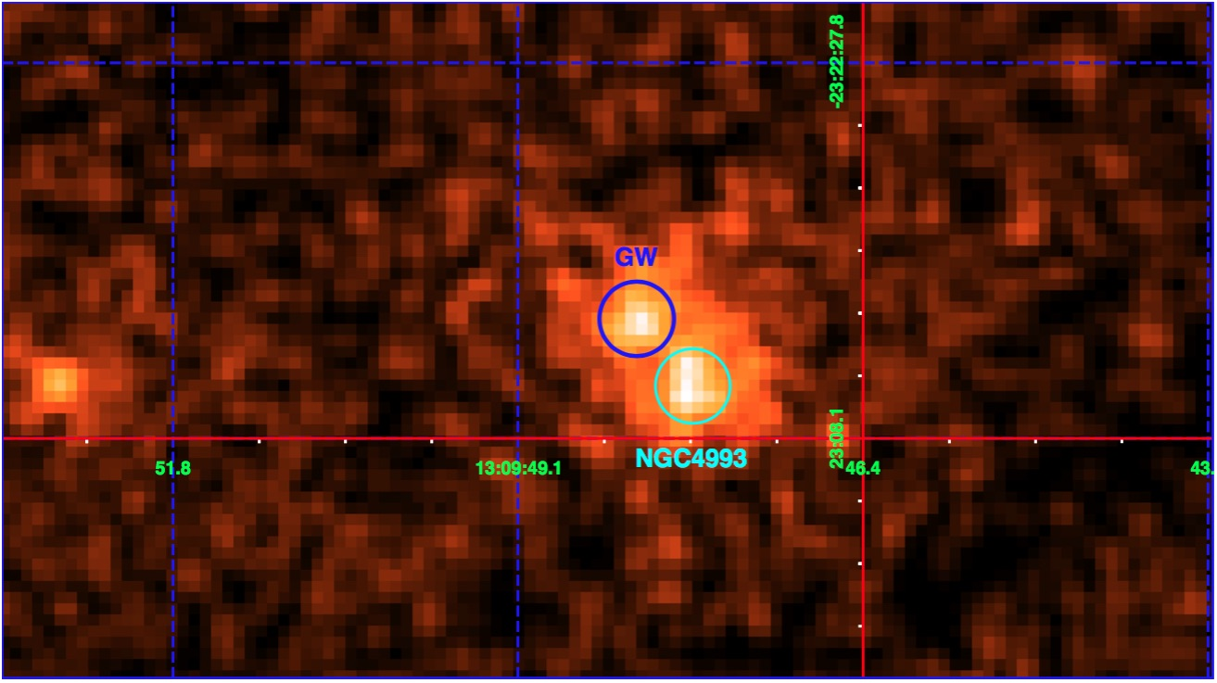
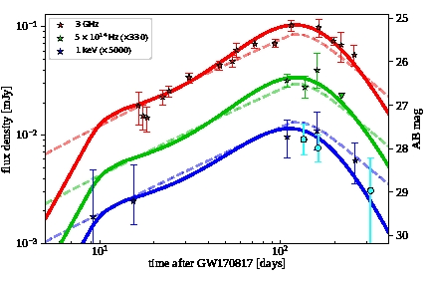
Evidence for a decreasing X-ray afterglow emission of GW170817A and GRB 170817A
- XMM-Newton observation on the 29th December 2017: 135 day after the event
X-ray light curve started to decrease
i) a structured jet
ii) a sotropic fireball
P. D'Avanzo et al., 2018, A&A 613, L1
XMM

Slide 15
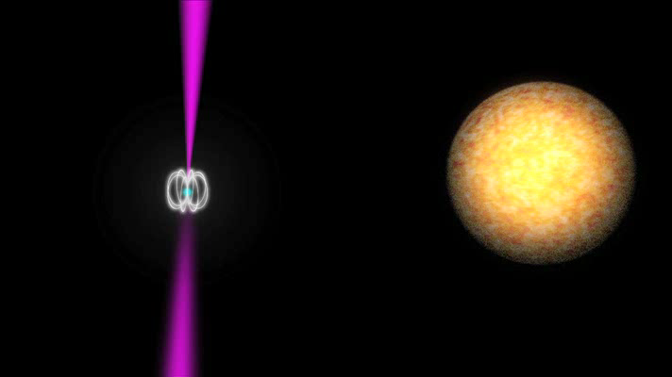
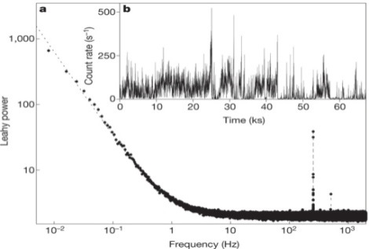
Swings between rotation and accretion power in a binary millisecond pulsar
- first observations of accretion-powered, millisecond X-ray pulsations from a neutron star previously seen as a rotation-powered radio pulsar.
- within a few days after a month-long X-ray outburst, radio pulses were again detected.
➔ evolutionary link between accretion and rotation-powered millisecond pulsar
➔ some systems can swing between the two states on very short timescales
Papitto et al., 2013, Nature 501, 517

Slide 16
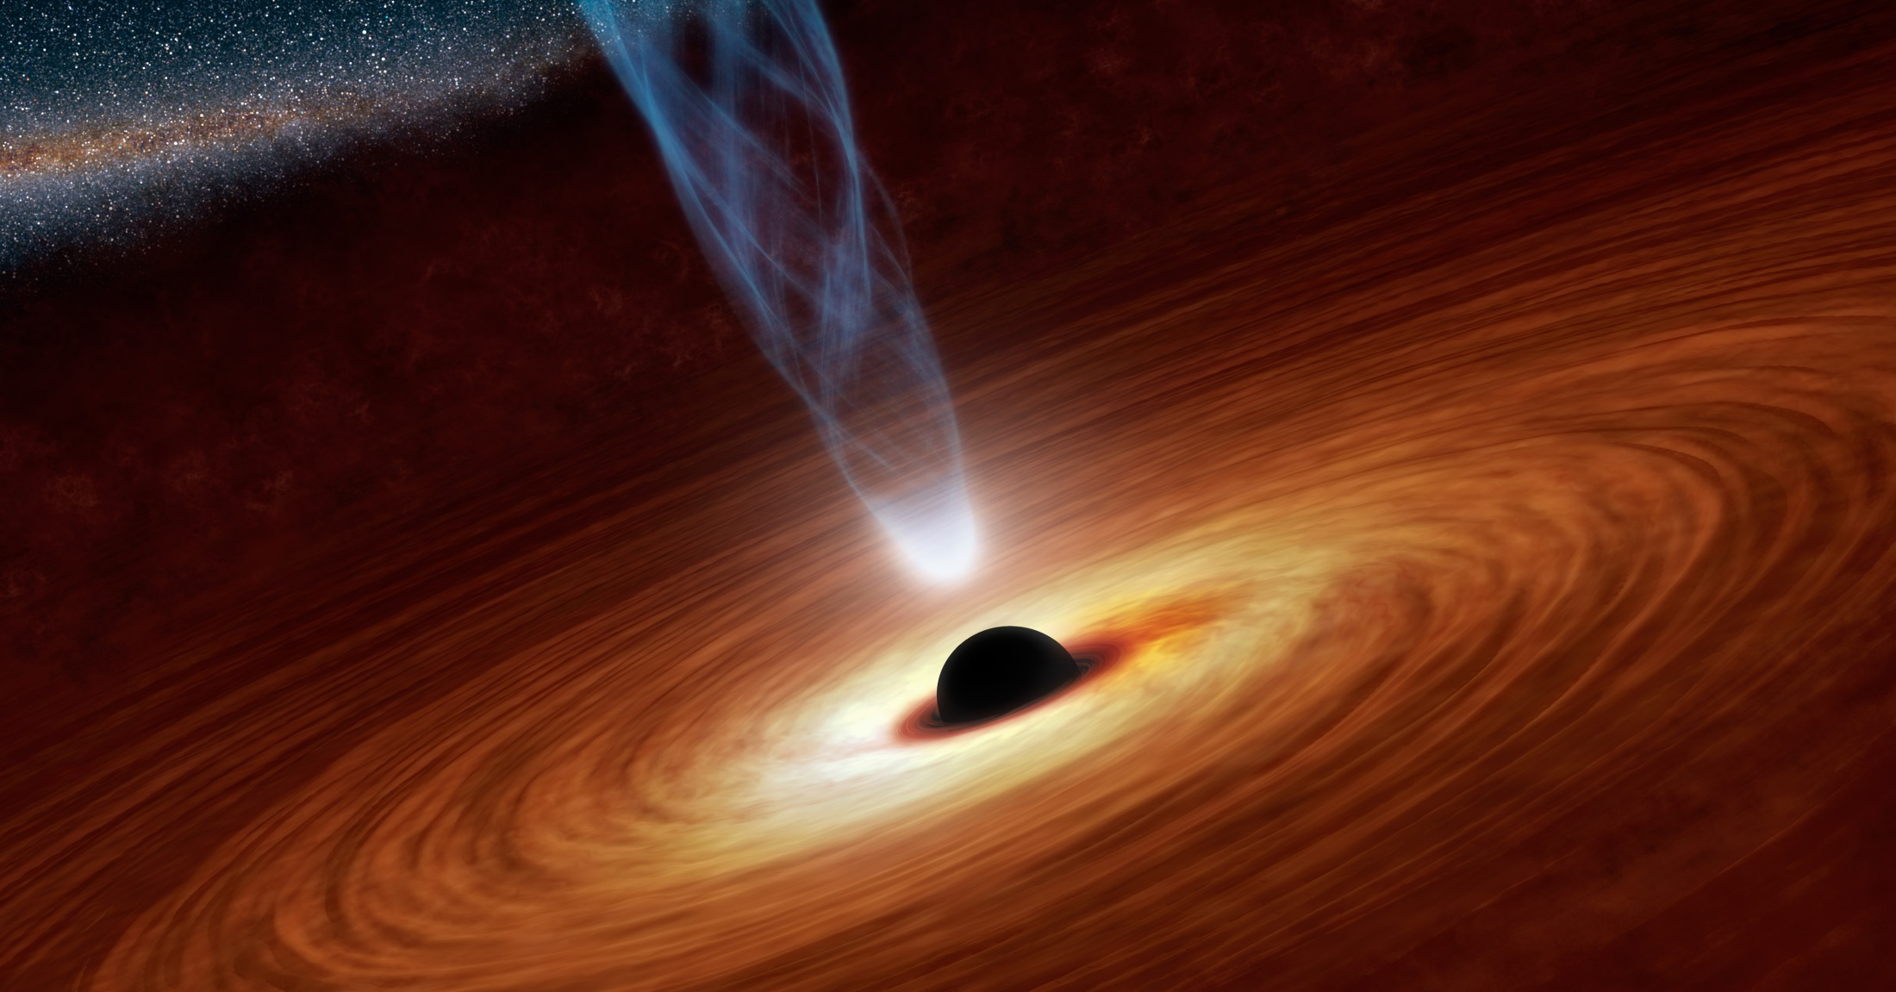
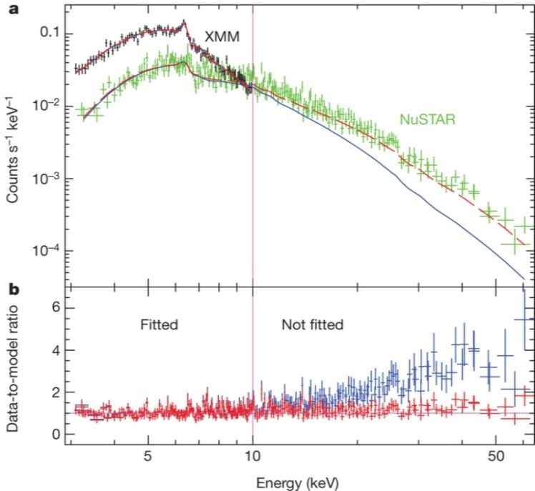
A rapidly spinning supermassive black hole at the center of NGC1365
Simultaneous observation of NGC 1365 by XMM-Newton and NuSTAR:
➔ relativistic disk features through broadened Fe-line emission and an associated Compton scattering excess of 10-30 keV
➔ temporal and spectral analyses allows to disentangle continuum changes due to time-variable absorption from reflection, which arises from a region within 2.5 gravitational radii of the rapidly spinning black hole.
➔ Absorption-dominated models that do not include relativistic disk reflection can be ruled out both statistically and on physical grounds.
a: XMM-Newton and NuSTAR spectral data and models. The two models contain a relativistic reflection component plus variable partial covering (red), and a double partial covering (blue). Both models have been fitted to the data below 10 keV. The models strongly deviate at higher energies. b, Data-to-model ratio for the double partial covering (blue) and relativistic reflection plus variable absorber (red) models.
Risaliti G., et al., 2013, Nature 494

Slide 17
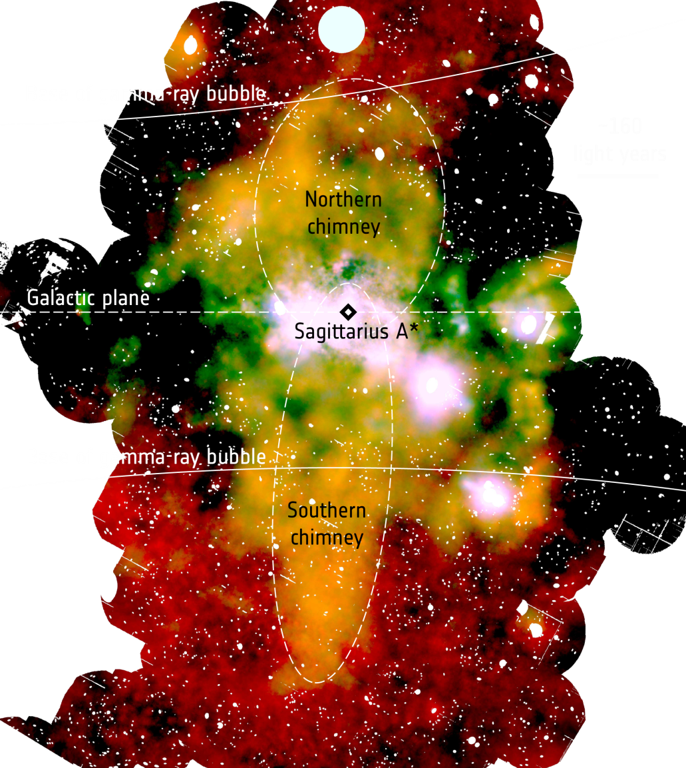
An X-ray chimney extending hundreds of parsecs above and below the Galactic Centre
- γ-ray observations revealed the `Fermi bubble' implying relativistic particles populating huge cavities on both sides of the Galactic plane
- ROSAT X-ray maps show that the edges of these cavities are bright in X-rays
➔ XMM-Newton finds prominent X-ray structures connecting the Galactic Centre to the Fermi bubbles.
➔ channels through which energy and mass, injected by episodic events at the Galactic Centre, are transported from the central few parsecs to the Fermi bubbles
G. Ponti et al., 2019 Nature567, 347

Slide 18
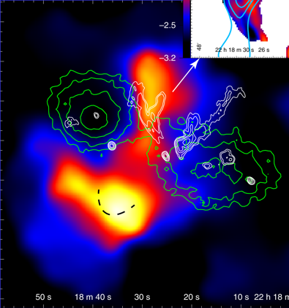
Pre-Merger Shock in Colliding Clusters of Galaxies
1E 2216.0-0401 and 1E 2215.7-0404 are observed at an early phase of major merger.
➔ Contrary to all the known merger shocks, the new shock propagates outward along the equatorial plane of the merger.
L. Gu et al., 2019, Nature Astronomy
XMM-Newton temperature map overlapped with contours from the X-ray (green) and radio 325 MHz (white) images.

Slide 19
Some History

Slide 20
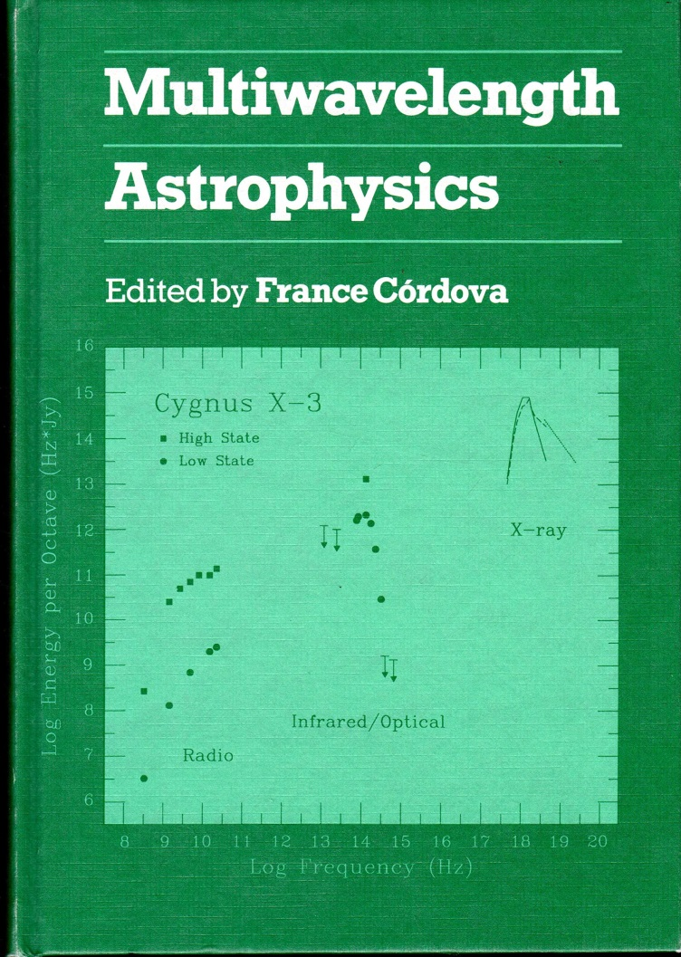
Deep Roots in Multiwavelength
Mid-1980s proposal for a space-based platform to extend AXAF (Chandra) to optical wavelength
1983 proposal to XMM-Newton for OM
1987 First Workshop on Multiwavelength Astrophysics

Slide 21
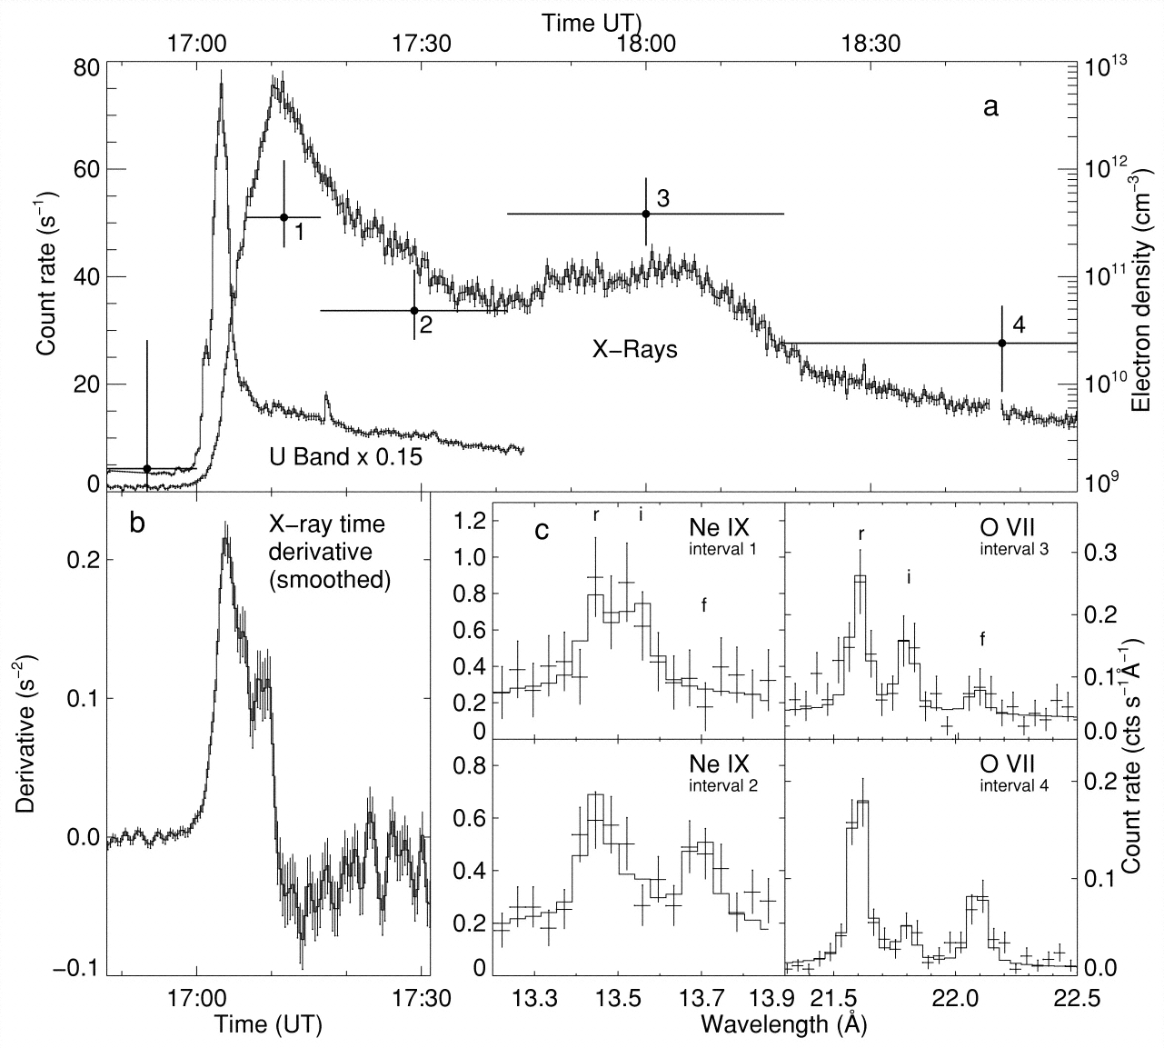
Flare density variations and continual chromospheric evaporation in Proxima Centauri
- Proxima Centauri (dM 5.5e dwarf) is nearest star to the Sun
- XMM-Newton observed the weakest X-ray flares on a magnetically active star ever.
- Correlated X-ray and optical variability strongly supports coronal energy and mass supply by a continuous sequence of rapid explosive energy releases.
- Variable emission-line fluxes in the He-like triplets of O VII and Ne IX allow to determine density variations, implying densities between 2×10¹⁰ and 4×10¹¹ cm⁻³
➔ Estimates of the mass and the volume of the line-emitting plasma.
➔ Importance of chromospheric evaporation in active stellar coronae
M. Güdel, et al., 2002, ApJ 580, L73

Slide 22
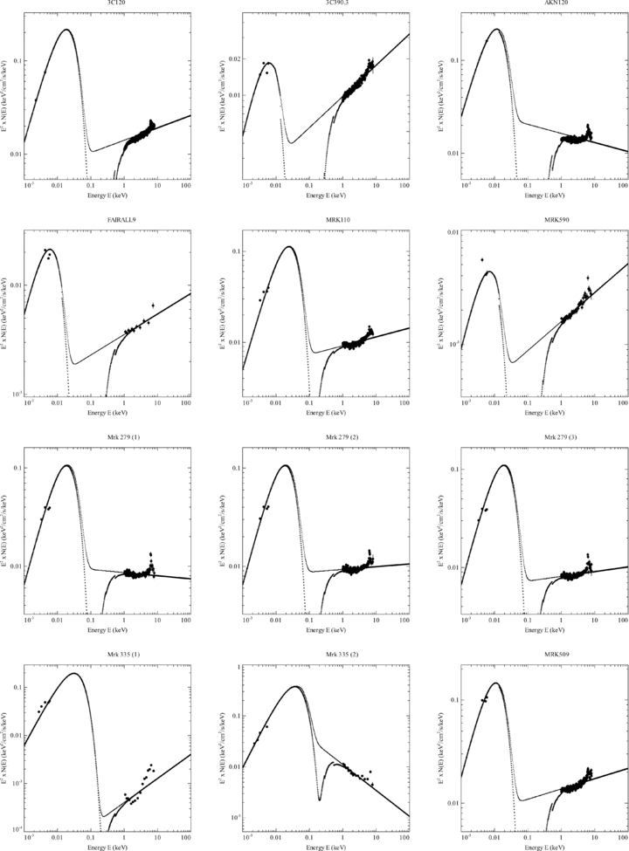
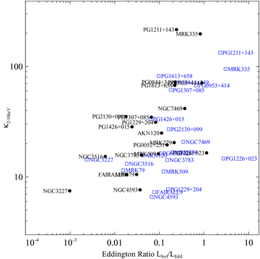
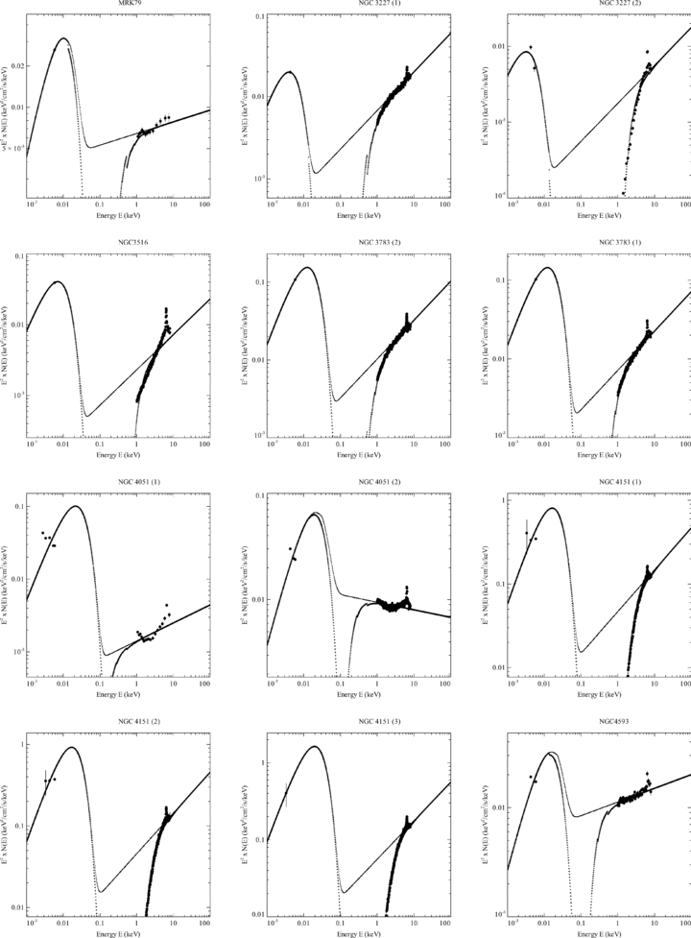
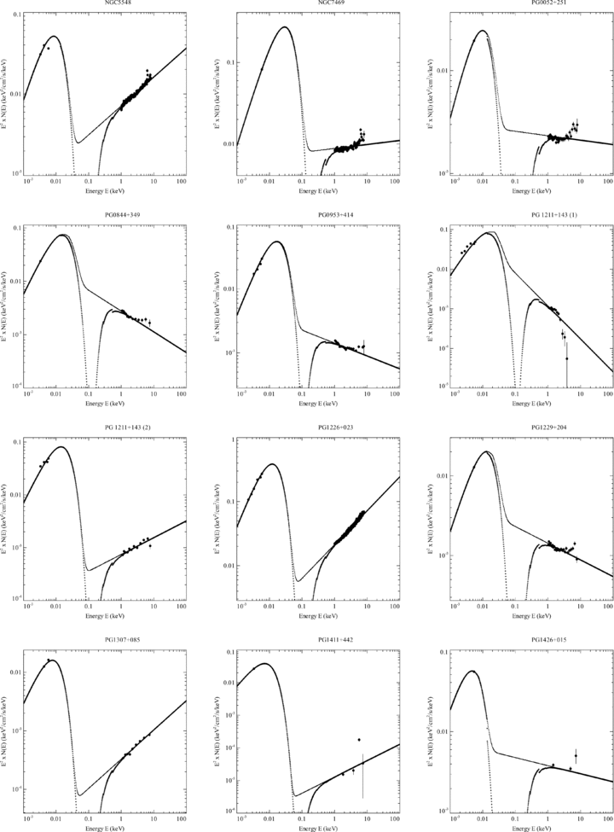
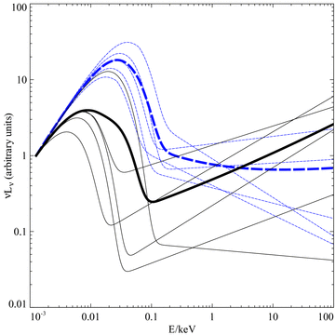
Simultaneous X-ray/optical/UV spectral energy distributions of AGNs
R. V. Vasudevan & A.C. Fabian, 2009, MNRAS 392, 1124
- Contemporaneous optical, ultraviolet (UV) and X-ray observations from the XMM-Newton European Photon Imaging Camera (EPIC-pn) and Optical Monitor (OM)
➔ For the first time, simultaneous spectral energy distributions (SEDs) for the majority of the Peterson et al. reverberation mapped sample of active galactic nuclei (AGN).

Slide 23
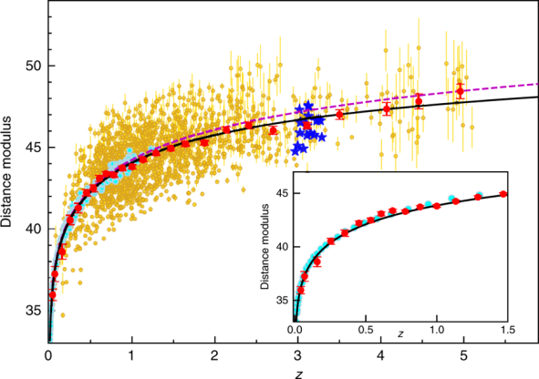
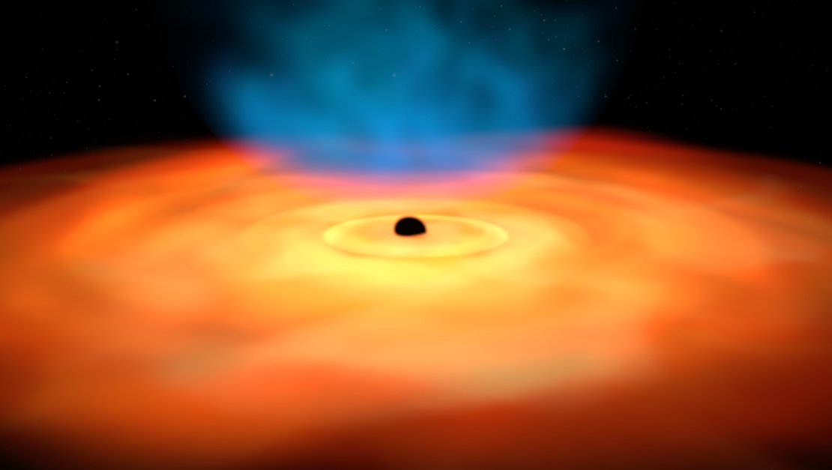
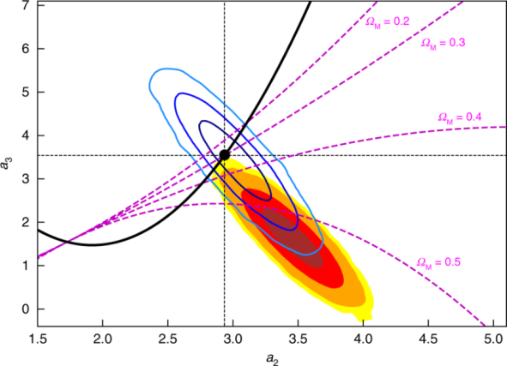
Cosmological Constraints from the Hubble
Diagram of Quasars at High Redshifts
- distances based on the X-ray and ultraviolet emission of the quasars
- z < 1.4 agreement with supernovae and concordance ΛCDM model
➔ z > 1.4 derivations of ~4σ
➔ does dark energy density increasing with time?
G. Risaliti & E. Lusso, 2019, Nature Astronomy 3, 272

Slide 24
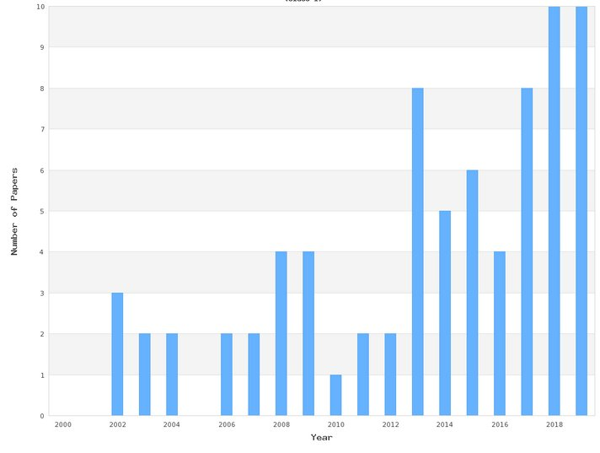
Highest Profile Journals

Slide 25
Multiwavelenght Science: SZ / Planck

Slide 26
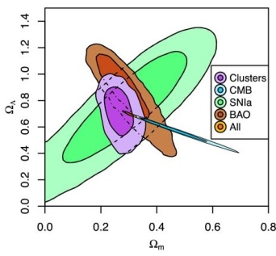
Multiwavelenght Science:
SZ / Planck
Mantz et al., 2015, MNRAS 446, 2005
SZ-X-ray for clusters of galaxies
Most of the XMM-Newton observed clusters of galaxies were compared with the Planck observations
130 observations of Planck detected clusters
Physics: hot gas
X-ray emission ~ (electron density)²
SZ ~ electron density
Most used so far for studying cluster selection for cosmological studies
Cluster physics based on X-ray and SZ starts to build up.
Supported by higher spatial resolution of next generation SZ-telescopes
Clusters are stable and therefore almost no requests for joint programs

Slide 27
Joint Programs

Slide 28

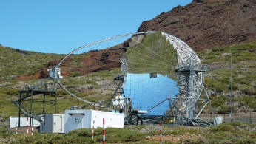

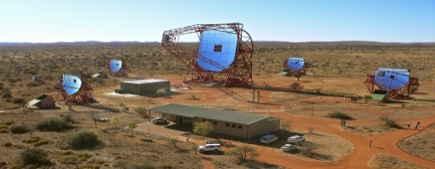
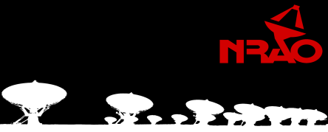
Courtesy P. Kretschmar

Slide 29
Joint Programs of Large Observatories
NASA connects all (its) Large Observatories over joint programs
Large Observatories
  Chandra
  XMM-Newton
  HST / JWST
  Spitzer
  NRAO

Slide 30
Joint Programs of Large Observatories
Connecting all Large Observatories over joint programs:
NASA + European + International
Large Observatories European International
CTA
  Chandra
  XMM-Newton
  HST / JWST ESO VLT(I)
  Spitzer (Herschel)
  ALMA
  NRAO Euro Radio SKA

Slide 31
Joint Programs
Connecting all Large Observatories + (some) medium size missions
Large Observatories European International
CTA HESS & MAGIC
Integral
  Chandra Swift (no exchange)
  XMM-Newton
  HST / JWST ESO VLT(I)
  Spitzer (Herschel)
  ALMA
  NRAO Euro Radio SKA

Slide 32
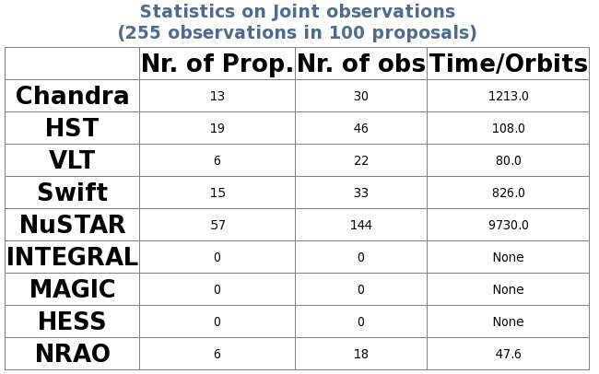
AO 18
(11)
(13)
(69)
(9)
(13)
(6)
(0)

Slide 33
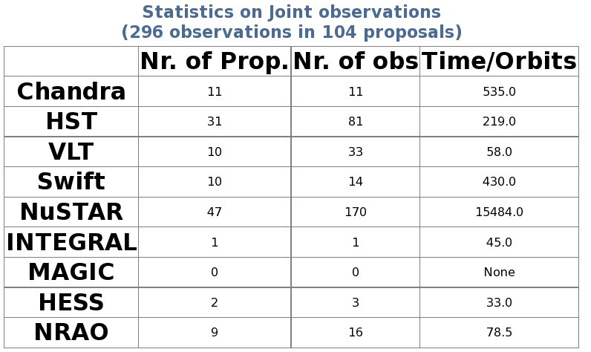
AO 19
(12)
(3)

Slide 34
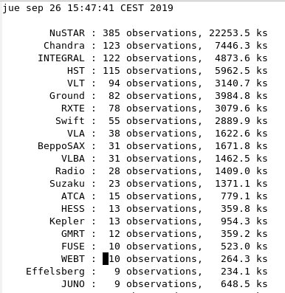
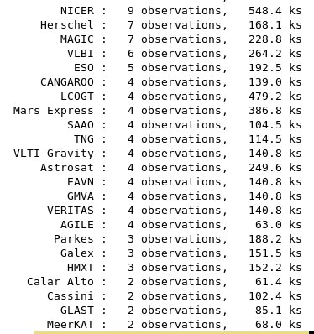
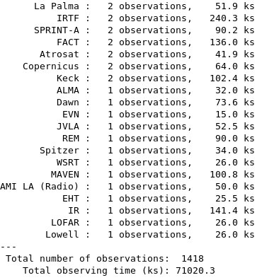
Joint Observations

Slide 35
Joint Observations

Slide 36
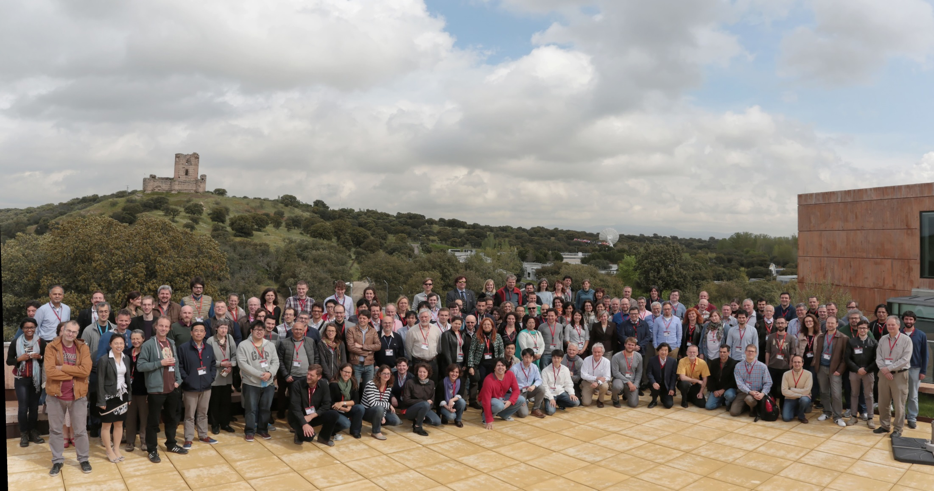
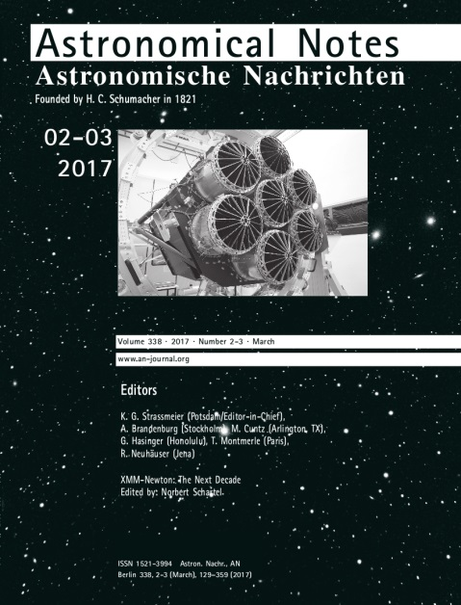

“XMM-Newton the next Decade” Workshop
- May 2016, ESAC with 148 Participants
- Presentations:
http://www.cosmos.esa.int/web/xmm-newton/2016-workshop

Slide 37
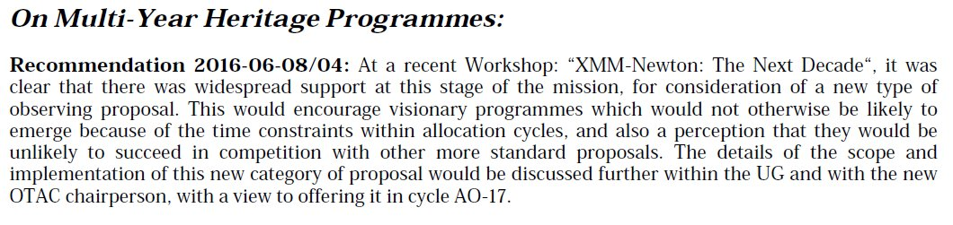
“XMM-Newton the next Decade” Workshop
Many scientific opportunities will be opened up by joint (and follow-up) observations associated with new space missions and ground facilities, e.g., Transiting Exoplanet Survey Satellite (TESS), eROSITA, JWST, Euclid and the Cherenkov Telescope Array (CTA).
Target of Opportunity (TOO) observations are expected to play an increasingly important future role.
MYHP were introduced in AO-17 allowing the allocation for up to 6 Ms observing time.

Slide 38
Scientific Potential

Slide 39
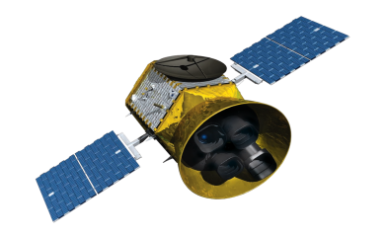
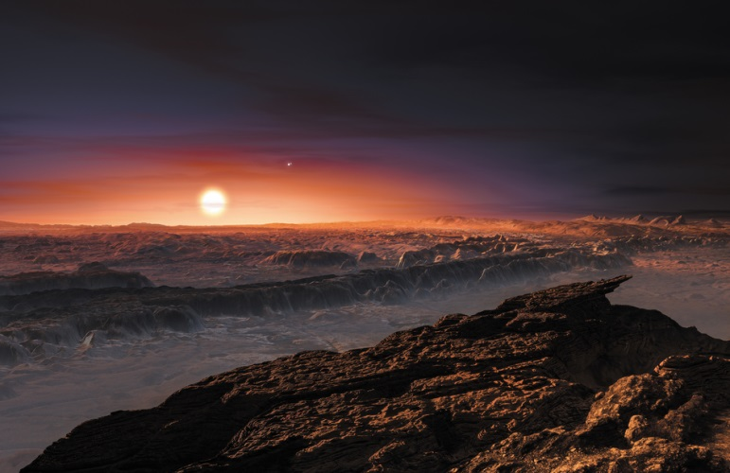

Understanding planetary systems: their formation, and their host stars
NASA’s Transiting Exoplanet Survey Satellite (TESS) mission has started to monitor 200,000 nearby stars to discover new transiting exoplanets.
comprehensive study of magnetic activity in late-type stars
- Our understanding of the star-planet interaction will progress through monitoring programmes of selected systems through planetary orbital phases.
- New hot-Jupiters with evaporating atmospheres (e.g. Salz et al., 2015, A&A, 576, 42) will certainly be key targets for studies of exoplanetary mass loss in the next years.
XMM-Newton is uniquely suited to such studies as it provides simultaneous measurements in the X-ray and optical/UV regimes and has highest effective area.
JWST will perform detailed spectroscopic follow-up of transiting exoplanets to examine their atmospheres. To really understand the chemistry, we will need to
monitor the host star X-ray flares
The X-ray luminosity of the host star is of fundamental importanct to understand planets habitability
TRAPPIST-1 (Wheatley et al., 2017, MNRAS 465, L74) &
Proxima Centrauri b (Ribas et al., 2016, A&A 596, 111)

Slide 40




Iron Line Studies: A Continuing Success
Why is iron so interesting?
- isolated emission line
  e.g. reflection spectrum
XMM-Newton has the required high effective area in combination with the ability to make long uninterrupted observations.
In addition, simultaneous observations with NuSTAR enable an accurate determination of the underlying continuum,- something that cannot be easily achieved by any other combination of satellites, especially for weak sources.
25% of XMM-Newton high priority time (priority A and B) in AO-17 is being observed simultaneously with NuSTAR
NuSTAR (Nuclear Spectroscopic Telescope Array, NASA
ξ=10
pn
ξ=100
+ high ionization parameter
+ high abundance

Slide 41

Exciting New Possibilities: eROSITA
eROSITA is the primary instrument on-board the Russian led "Spectrum-Roentgen-Gamma“ satellite
Four years (8 scans) all-sky survey in the 0.5 to 10 keV energy range
There is a huge potential for XMM-Newton follow-up of new and transient sources while eROSITA continues scanning
Observations with XMM-Newton will be importantl in providing a physical interpretation and understanding of these detections e.g. temperature of hot clusters of galaxies
XMM-Newton’s high effective area, high spatial resolution and its ability to make long uninterrupted observations, make it ideal for follow-up observations.
The main scientific goals are:
50-100 thousand galaxy clusters and groups
All obscured accreting Black Holes in nearby galaxies and up to 3 million new, distant AGN
Extending Galactic X-ray source populations

Slide 42



The Search for Electromagnetic Counterparts of Gravitational Wave Events
The GW interferometers Virgo and LIGO will restart observation in 2019, with 2020 reserved for a major upgrade, followed by operations from 2021 onwards.
increasing sensitivity
decreasing positional error
XMM
GW 170817 impressively
demonstrated the importance
of X-ray observations in order
to understand the burst/jet-emission:
➔ only XMM-Newton and Chandra can attain the required sensitivity
➔ increasing sensitivity of the GW observatories implies that (most) future GW events will be even fainter
➔ Rapid XMM-Newton follow-up observations could permit searches for hyper-massive NS shortly after merger.
XMM

Slide 43





New Sources Emitting at the Highest Energies and New Facilities for finding Transients
New Gamma-ray sources from H.E.S.S., MAGIC, VERITAS and later CTA (from 2022) in the GeV to TeV energy range
A BL-Lac-type AGN was recently discovered as source of high energy cosmic neutrinos.
XMM-Newton is of central importance in the identification and interpretation of new sources detected at γ-ray energies.
As BL-Lacs are rare but strong X-ray emitters, XMM-Newton is clearly the facility of choice for future searches, due to its high sensitivity in combination with a large field of view.

Slide 44
Some Thoughts for Discussion

Slide 45
Quo vadis?
Neil Gehrels, PI of Swift, (passed away)
  Swift was renamed to Neil Gehrels Swift Observatory
  “95% of the knowledge we have about GRB is based on the observation of the three brightest GRBs”

Slide 46
Quo vadis?
Neil Gehrels, PI of Swift (passed away)
  Swift was renamed to Neil Gehrels Swift Observatory
  “95% of the knowledge we have about GRB is based on the observation of the three brightest GRBs.
Very generally astrophysics sources:
  Physics from very very few brightest sources
  Huge amount of weak contributes basically nothing to the physics understanding
  however,
  evolution, universe, H0, m of light
How much of our knowledge about stars comes from the Sun?
Compton Gamma Ray Observatory with BATSE versus BeppoSAX?

Slide 47
Quo vadis?
What do we know about physics of GWE:
  Kilonova / short GRB
    extremely well knowing from theory
    well constraint by short GRB
    however, weak sources

Slide 48
Quo vadis?
What do we know about physics of GWE:
  Kilonova / short GRB
    extremely well knowing from theory
    well constraint by short GRB
    however, weak sources
What do we know about physics of GWE:
  BH – NS
    theory: yes
    observations from SMBH, but also one intermediary BH
    no observation form stellar mass BH
    very likely much weaker than Kilonova / short GRB

Slide 49
Quo vadis?
What do we know about physics of GWE:
  BH - BH
    theory (of EM emission)?
    however, first paper are coming ..
    ignored by observers?
    much, much weaker
    and very short
    New Physics
    Holy grail

Slide 50
Quo vadis?
What do we know about physics of GWE:
  BH - BH
    theory (of EM emission)?
    however, first paper are coming ..
    ignored by observers?
    much, much weaker
    and very short
    New Physics
    Holy grail
What do want to see for BH - BH
  spectrum, with as much large observatories as possible
  we have to be very quick
We need instantaneously extremely good positions
15 arcmin: XMM-Newton goes immediately
7 arcmin: Chandra goes
…. if possible … arcsec
    theory: yes
    observations from SMBH, but also one intermediary BH
    no observation form stellar mass BH
    very likely much weaker than Kilonova / short GRB

Slide 51
Quo vadis?
Three nearby bright GW with a arcsec-position-error per year have the potential to bring much more physics that 1000 weaker GWs per year with a degree-error size position
Improving the position is much more important than going to more sensitivity
If necessary add GW-observatories in Australia, Argentina, Russia, South-Africa .. Chile / ESO ..

