Slide 1
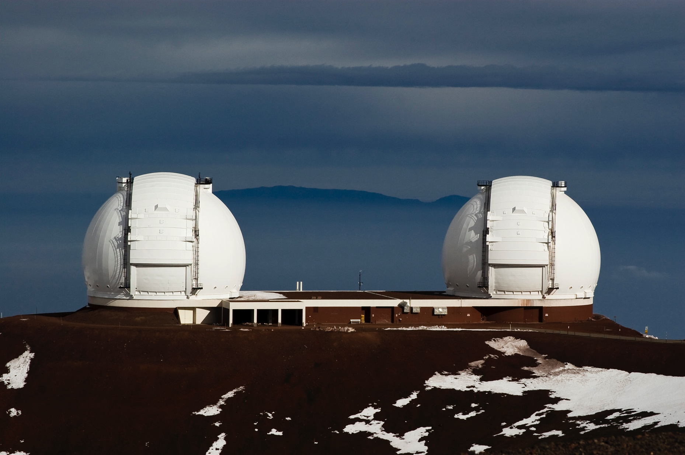
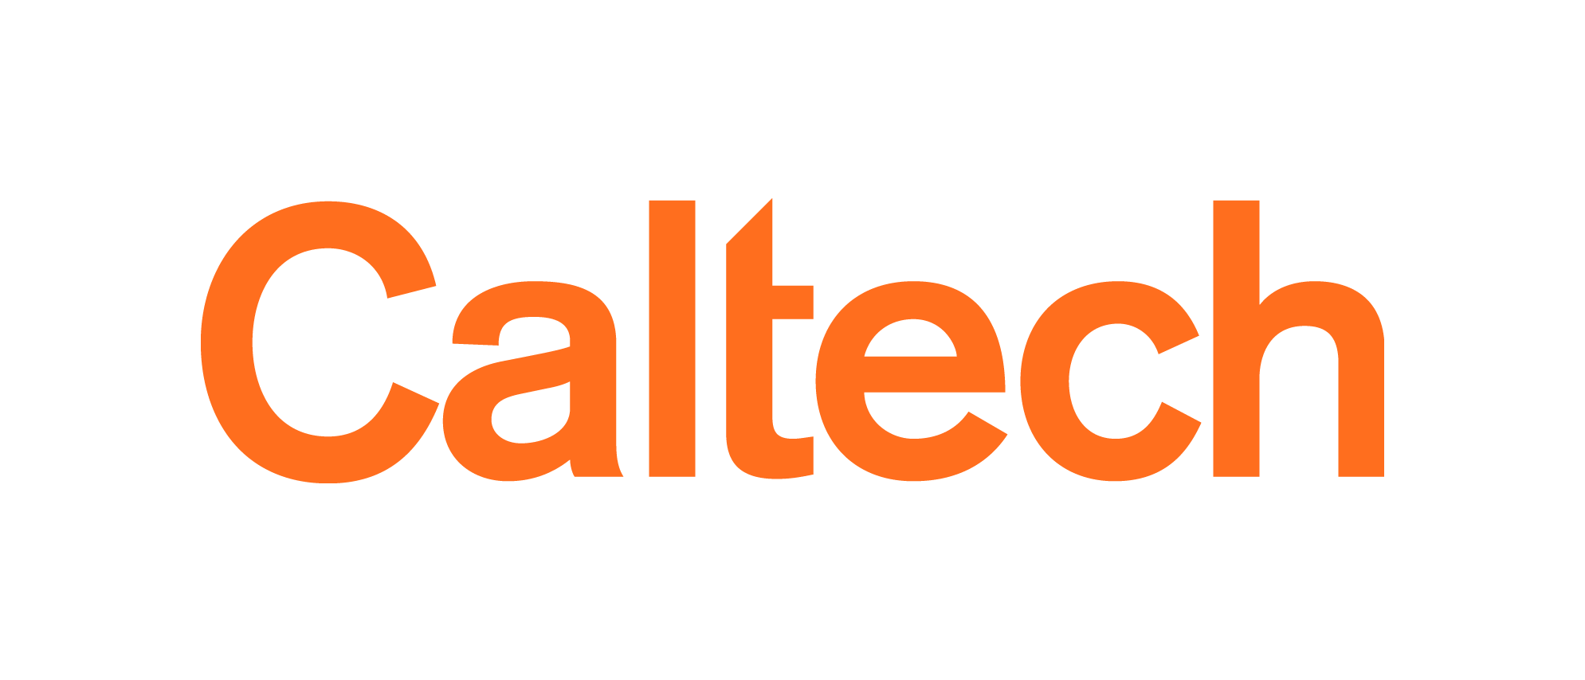
New Infrastructure to Support TDA and MMA at the Keck Observatory and the Keck Observatory Archive .
G. B. Berriman, C. R. Gelino, J. Good, M. Kong, A. C. Laity, M. A. Swain.
(Caltech/IPAC-NExScI)
M. Brown, E. Lucas, J. Mader, J. O’Meara, J. Riley, L. Rizzi.
(W. M. Keck Observatory)
Notes:
Challenges for KOA
-

Slide 2
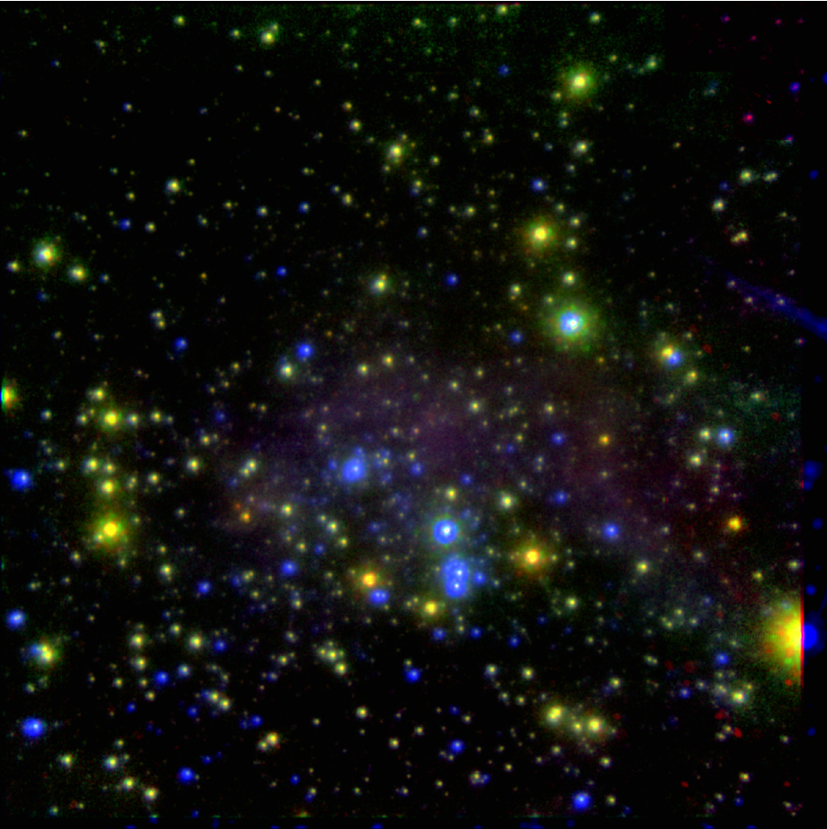
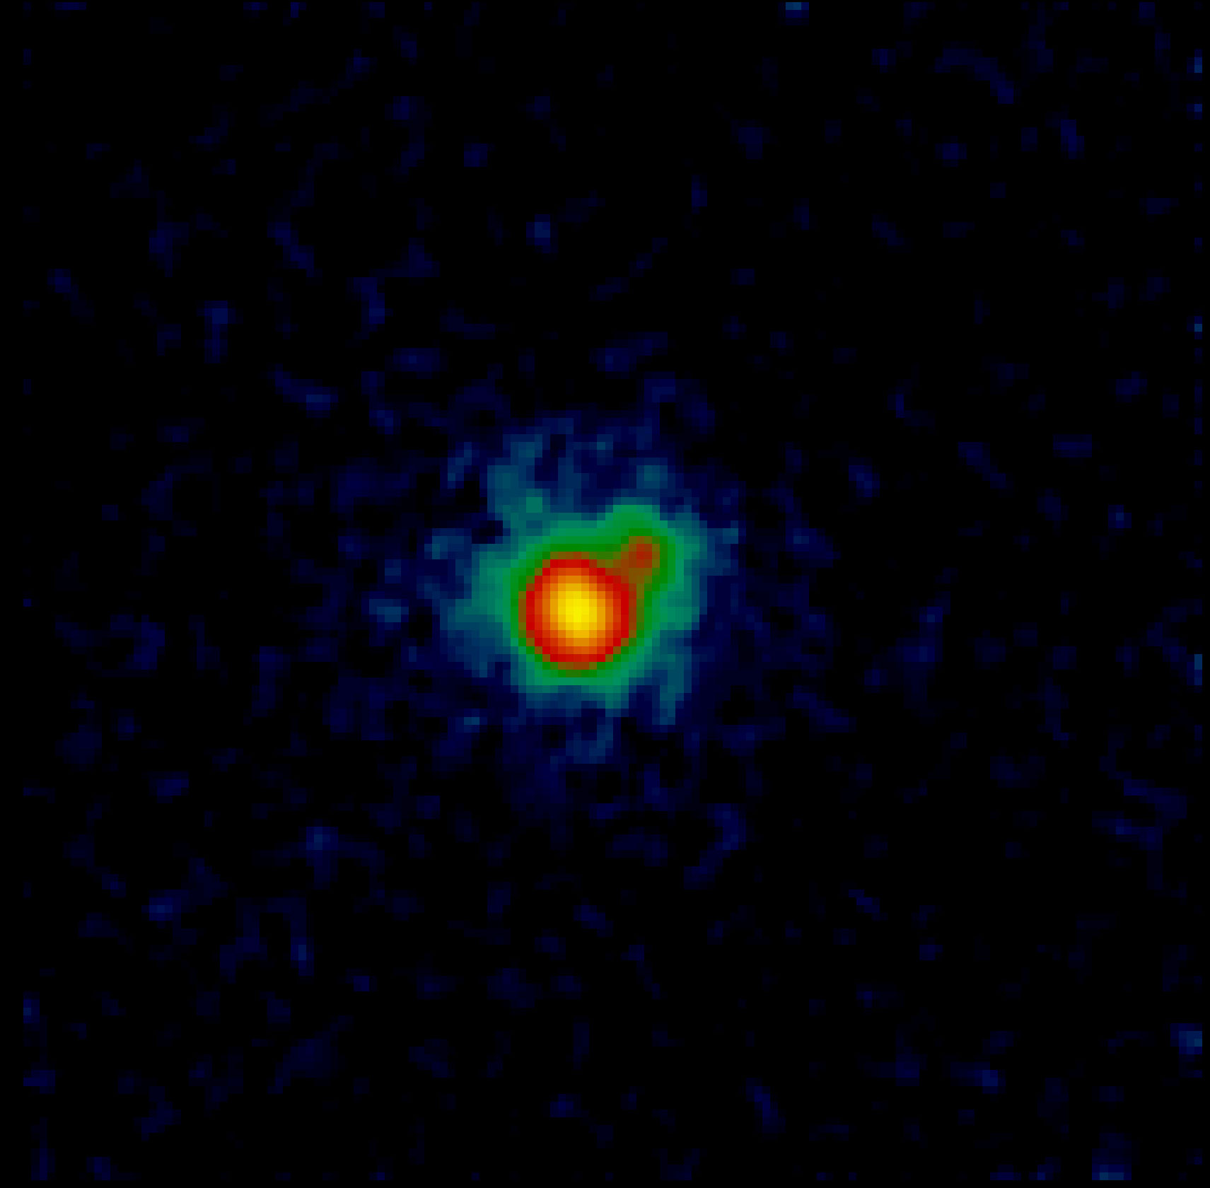
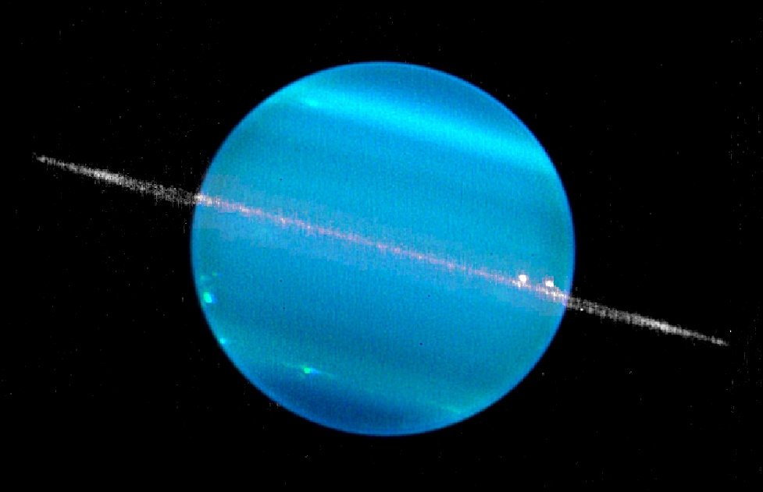
The Observer Owns The Night
The “Keck Advantage” has produced wonderful science but has its consequences:
Difficult for others to analyze and reduce data.
Inefficiencies in observing.

Slide 3
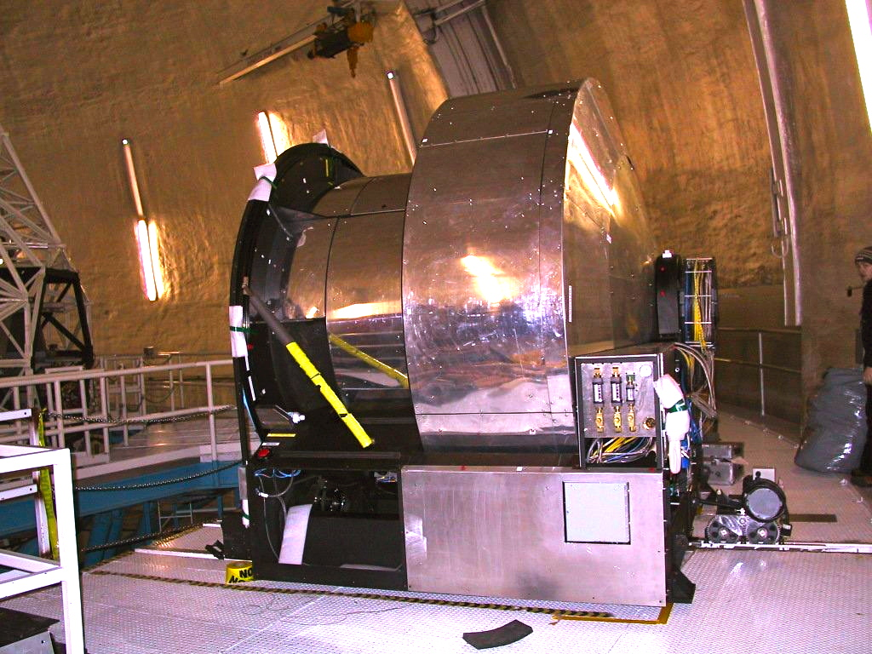
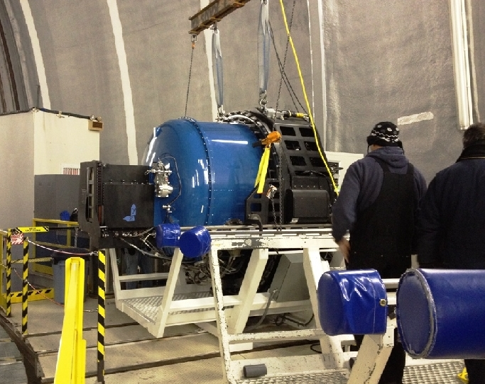
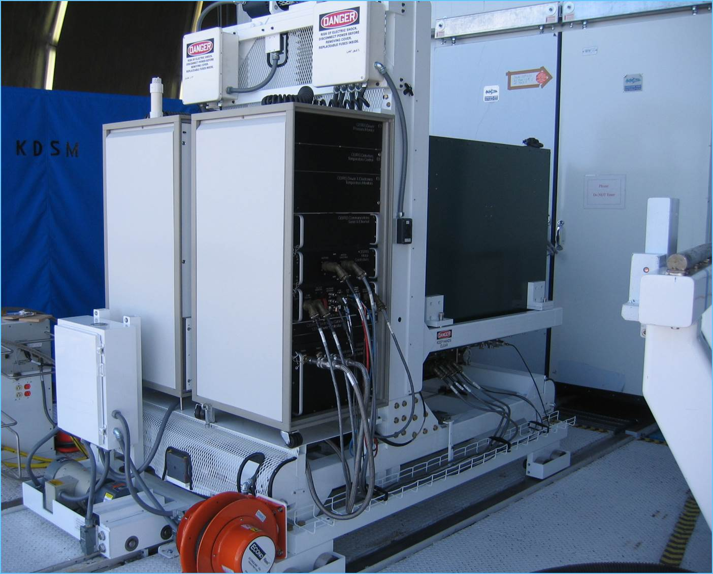
Data Not Intended for Archiving
Keck began operations in 1994, just before the age of modern archives.
Instruments built independently by different teams.

Slide 4
KOA: Community Access to a World Class Telescope
KOA marries WMKO’s expertise with instrumentation and observatory operations with IPAC’s expertise with data management and archiving.
KOA opened for business in 2004.
Focus on creating coherent, consistent data sets for each instrument.
Archives raw data for all 12 WMKO instruments since 1994 (50 TB).
Returns, where possible, optimum set of calibration files and browse quality reduced products.
https://koa.ipac.caltech.edu

Slide 5
New Infrastructure for Science Ready Products
“New Infrastructure to Support TDA and MMA at the Keck Observatory and the Keck Observatory.” O’Meara et al. (2019) Activity, Project and State of Profession White Paper, submitted to Decadal Survey.
See also “ Infrastructure and Strategies for Time Domain and MMA and Follow-Up.” (2019) Miller et al.

Slide 6
Requirements for Support of MMA and TDA
Consistent acquisition of calibrated data at the telescope.
Complete metadata in raw and reduced data.
Data reduction pipelines (preferably facility managed).
Fast archiving of raw and reduced ingestion and availability.
Discoverable and accessible data.

Slide 7
Preliminary Design of WMKO Data Services Initiative

Slide 8
Status of Data Services Initiative
Exposure Time Calculators: available for about half of the instruments
API and Database: design phase.
Planning tool and observing control system: design phase
DRP framework: passed PDR, prototype being tested
Real time ingestion: design phase
Archive: API and Python query tools in development and testing

Slide 9
Old

Slide 10
New

Slide 11
Current NExScI User Services
Web-based search engines and Solar System Search Service.
Table of released observations(web, CSV, IPAC format).
VO Simple Image Access Protocol (SIAP) v2 Program Interface.
All built atop the Science Information System developed for IRSA – C, Java, Javascript.

Slide 12
Future KOA End User Services
New architecture API based - VO Table Access Protocol
Flexibility for archive.
Data discovery through VO.
Synchronous and asynchronous queries.
Proprietary authentication.
VOTable, CSV, column delimited data.
Web form
Python
Custom
TAP Server

Slide 13
Python-based TAP Server
Client
TAP SERVER
Convert ADQL to SQL
Retrieve data dictionary
Query DBMS
Optional Filtering
Format output
DBMS specific
Open source (BSD 3-clause license).
Ready to deploy for NEID archive
In KOA test bed => Deploy early 2020
Notes:
Lightweight Python implementation (install via pip).
DBMS agnostic (we use Oracle and SQLite).
Require no DBMS extensions.
The hard work in making the service simple is not TAP itself, but in supporting ADQL.
Keep the complexity away from the DBMS.
Instead translate the ADQL into SQL in a way an DBMS can handle
Only supports HTM and HPX indexing (any others would have to be added).
We don't have any databases that contain geometric objects so haven't implemented INTERSECTS().
We do have an R-Tree implementation external to the DBMSs that could be folded in.
Since we place no constraints on the DBMS, we could support uploads and joins but do not have plans to do so.

Slide 14
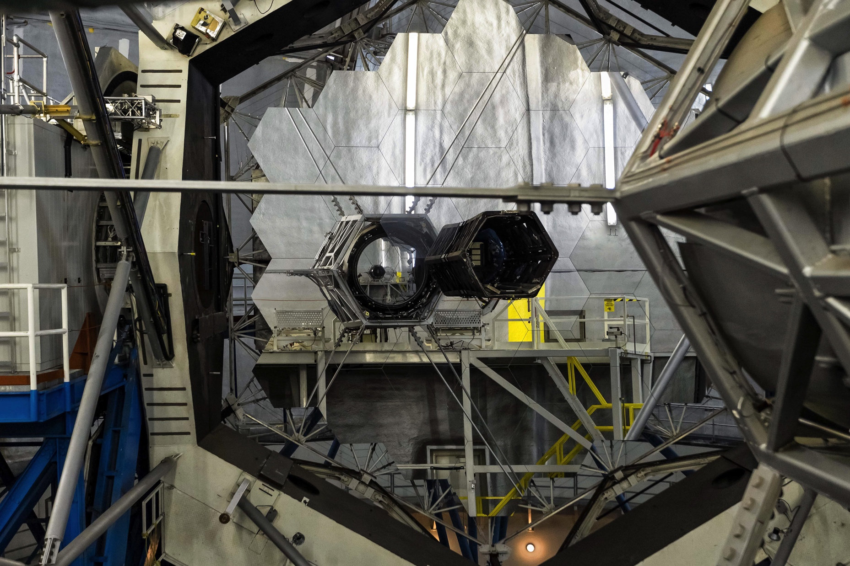
Summary Points
WMKO and KOA are developing a new data services model to benefit MMA/TDA and PIs
Uniformly acquired and calibrated data.
Facility data reduction pipelines.
Fast ingestion into archive.
Modern interfaces.

