Slide 1
Discovery in Astrophysics
G. Fabbiano
Center for Astrophysics

Slide 2

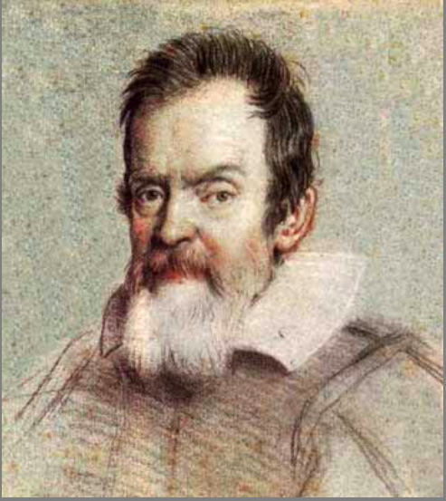

Two approaches
Question / Hypothesis Driven
Exploration
Knowledge ➔?
Instrument ➔
NASA WMAP
(Wilkinson Microwave Anisotropy Probe) “…reveal conditions as they existed in the early universe by measuring the properties of the cosmic microwave background radiation over the full sky.”

Slide 3
The question-driven approach
Formulates the most important open questions
  Theoretical/physics hypotheses
Seeks answers to these questions
Favored by the Funding Agencies and Review Committees

Slide 4
The question-driven approach
Focused
Widely used in our discipline
  New instruments
  Telescopes
  Observing proposals
This is how we teach our students to do research

Slide 5
The question-driven approach
….. addresses only the known unknowns
….. can bias our knowledge
“the key is to make sure that science policy permits discovery for the sake of discovery and not for finding Earth-like planets, which we have prejudiced to be of greatest interest’’
(D. J. Stevenson, CalTech, Physics Today, Nov. 2018)
Similar considerations can be applied to other fields of astrophysics

Slide 6
The question-driven approach
….. does not address the ‘unknown unknowns’
….. they cannot be well-defined ‘important questions’

Slide 7
…but unknown unknowns are important
‘Discovery Space’ – Harwit, 1984
‘Ignorance: How it Drives Science’ - S. Firestein, 2012

Slide 8
Exploration
The only way to address the unknown-unknowns is

Slide 9
Astronomy is first and foremost exploratory
Unforeseen views of the universe have followed
new approaches that opened up the discovery space
new telescopes and instruments
(both hardware and software)
unanticipated data repurposing

Slide 10
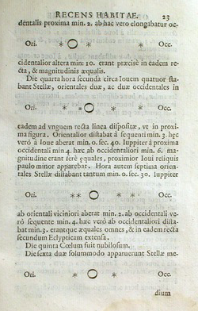
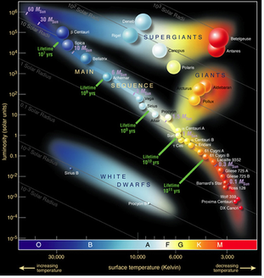
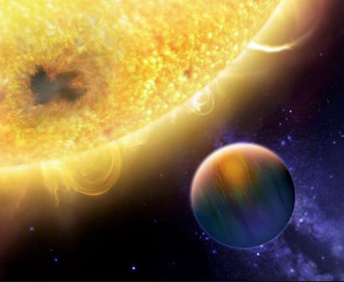
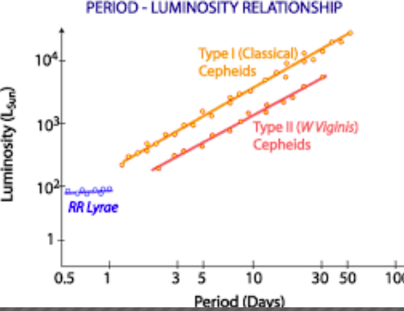
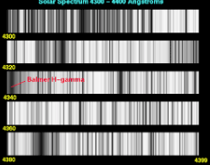
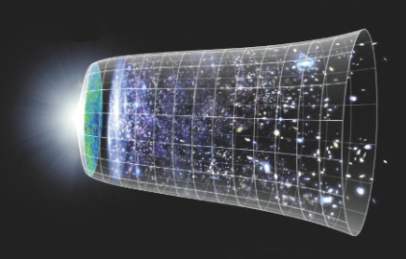
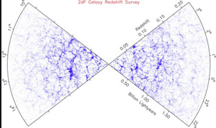
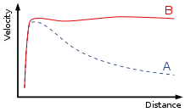
Improvements in optical telescopes and spectrographs
Galilean Moons of Jupiter
– Galilei 1610
Cepheid period-luminosity (LMC)
– Henrietta Leavitt 1908
H-R diagram
– Russel ~1911
Metal composition of the Sun and stars
- Cecilia Payne-Gaposchkin 1925
Expansion of the Universe
– Hubble+Humason 1929, Lemaitre 1927
Dark Matter
– Vera Rubin + 1970
Large scale structure
– e.g., Peebles; Geller+Huchra 1989
Hot Jupiters
– Mayor + Queloz 1995
This year Nobel prizes

Slide 11
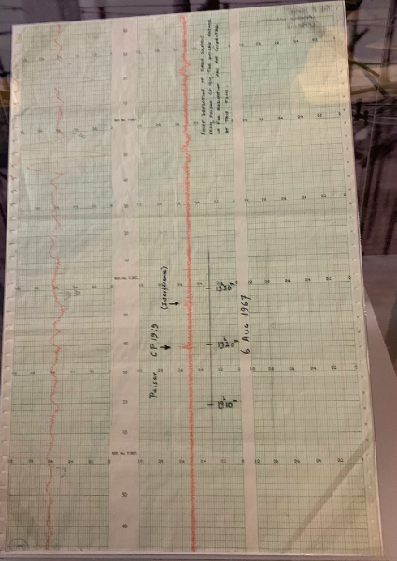
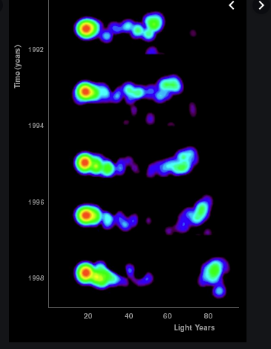
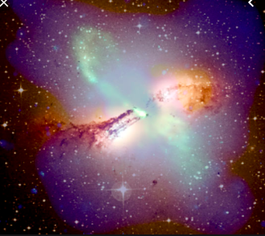
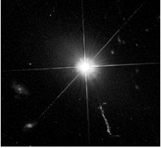
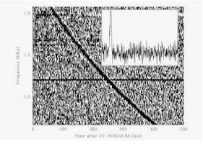
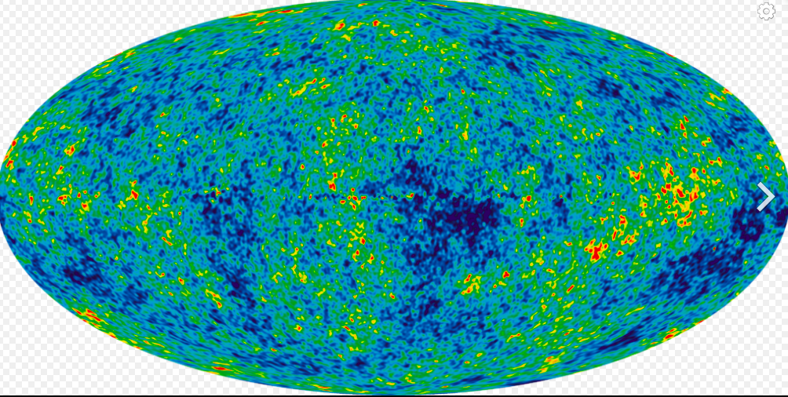

Invention of radio telescopes, VLBI
Radio galaxies
- Cen A: Bolton + 1949
- Fanaroff & Riley 1974 Cambridge Catalog
Quasars
- 1960’s radio surveys
- 3C 273, Maarten Schmidt 1963
Cosmic microwave background
- Penzias + Wilson 1964
Pulsars
- Bell-Burnell + Hewish 1967
Superluminal motion
- VLBI, Gubbay + 1969
Fast (msec) radio bursts
- The first, Lorimer Burst FRB 010724 detected in 2007 in archived data
recorded by the Parkes Observatory on
24 July 2001
Nobel prizes
…then ‘question-driven’ WMAP and Plank

Slide 12
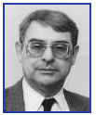
X-ray Astronomy
From rocket science to XMM-Newton and Chandra
X-ray emission is a critical component of our multiwavelength view of the Universe
~10 million degree plasmas
  Strong shocks
  Accretion
  Outflows
  Hot halos
  Galaxy and cluster interaction and merging
Nobel prize

Slide 13
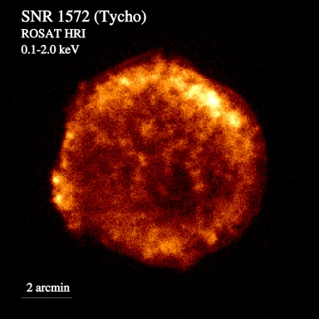
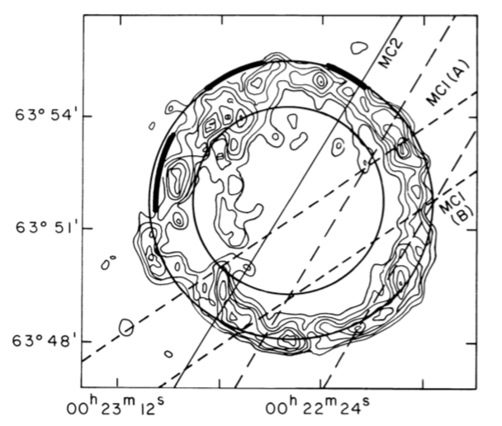
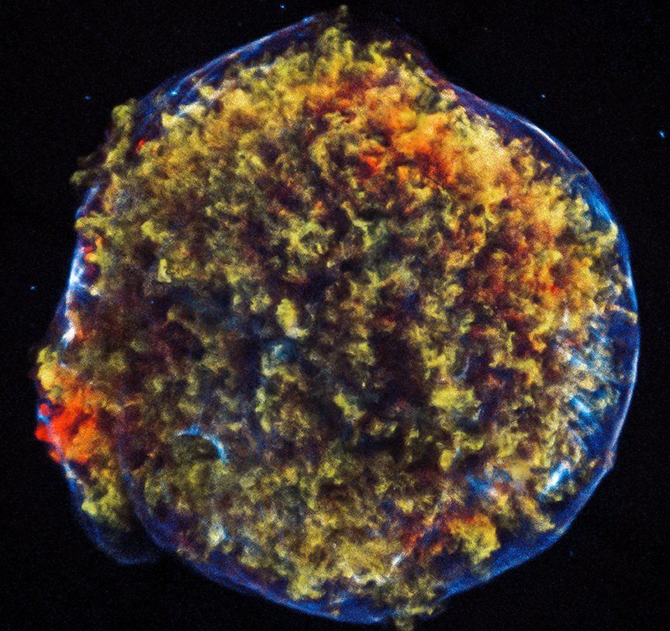
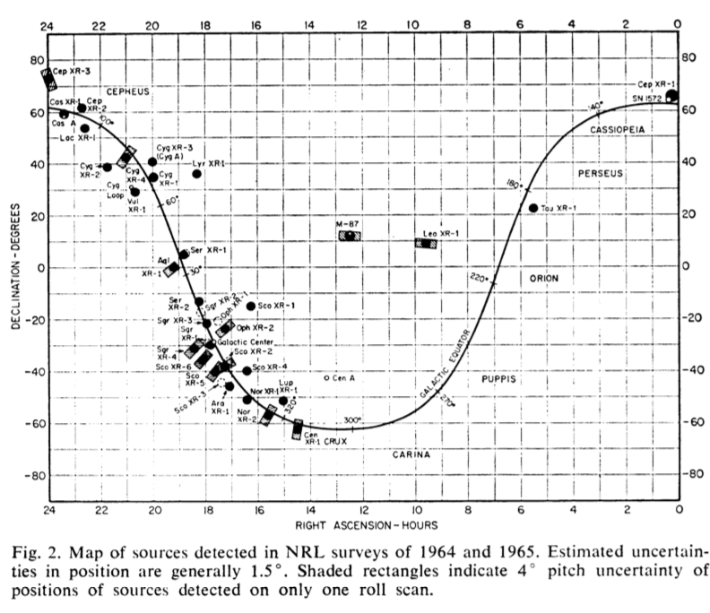
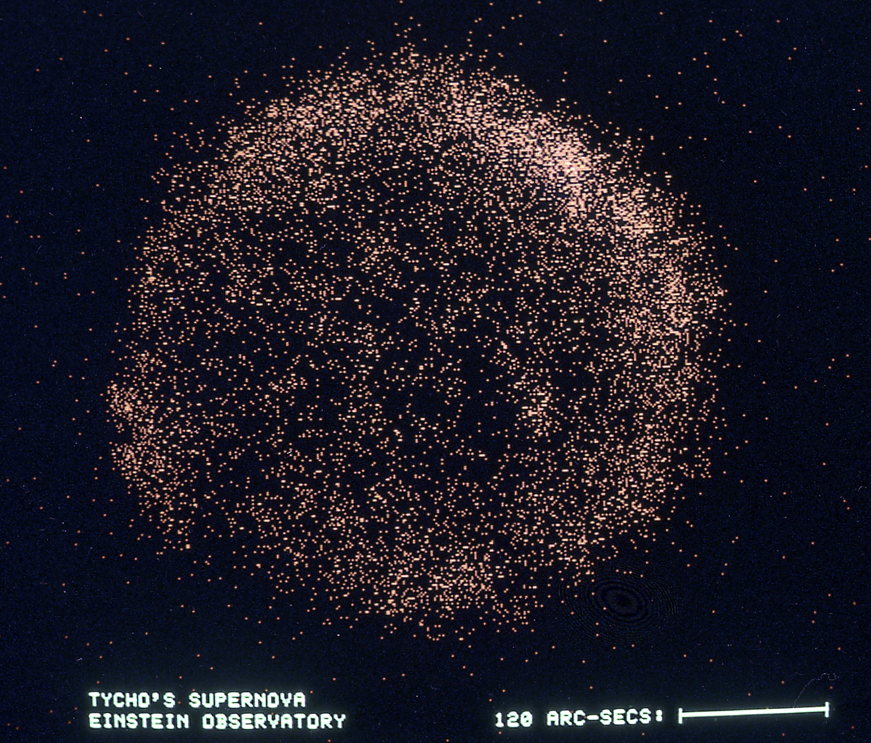
40 years of X-ray Astronomy image improvement
Lu et al,
2011
Chandra
Seward, Gorenstein & Tucker
1983, Einstein HRI
Fabbiano et al., 1980
HEAO-A3 - SMC
Hughes 2000
Friedman, Byram & Chubb
1967 Science
Tycho

Slide 14
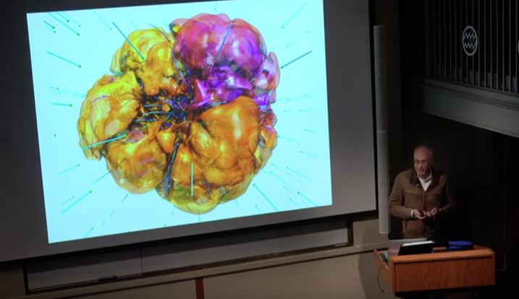
..and now data are driving theory
Dave Burrows, CfA Colloquium, 3D supernova simulations from the Princeton group https://www.youtube.com/watch?v=yRmNfjLgUYI

Slide 15
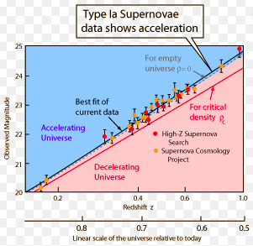
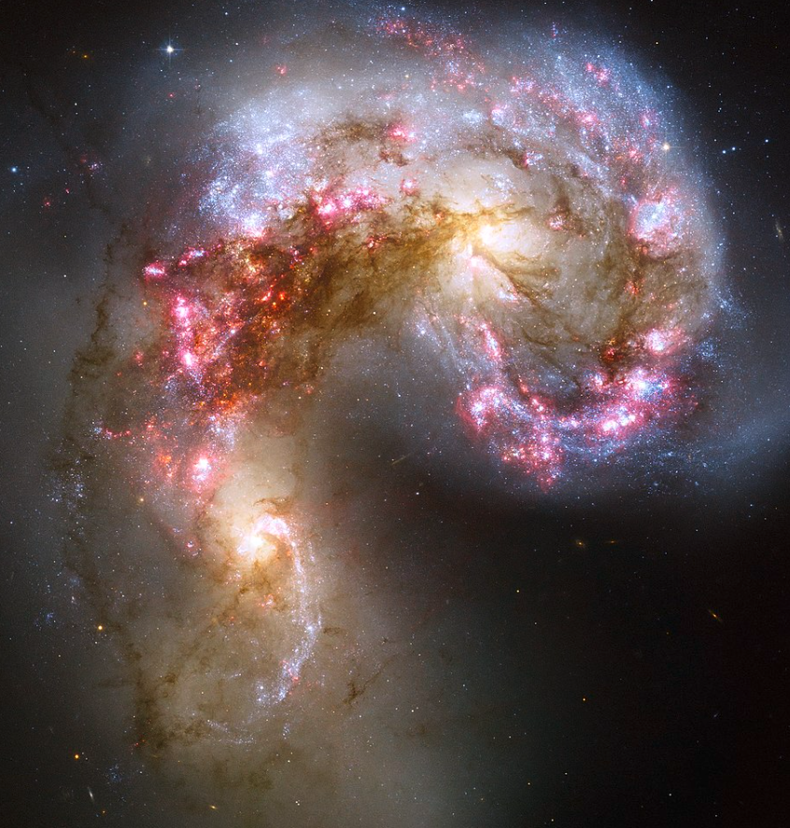
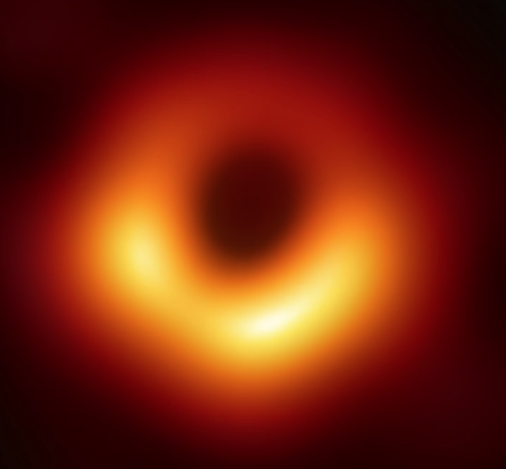
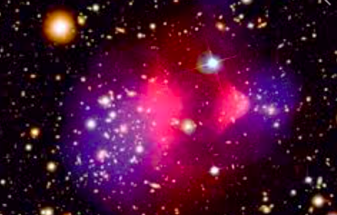
Multi-wavelength space observations e.g., Hubble, Chandra, Spitzer, XMM-Newton
Black holes and their mass range
  X-ray accretion sources
  End-product of massive star evolution
  Ubiquitous in galaxy nuclei
  Now imaged with EHT (question-driven)
Dark Energy
  Riess + 1998, Perlmutter+ 1999
Non-baryonic Dark Matter
  Markevitch + 2004
High-z super-starburst galaxies
  NASA press release 2008
Nobel prizes

Slide 16
These are foundational discoveries for the understanding of the Universe
Not in any way anticipated
….from Exploration
i.e. expansion of the Discovery Space

Slide 17
Increasing the Discovery Space

Slide 18
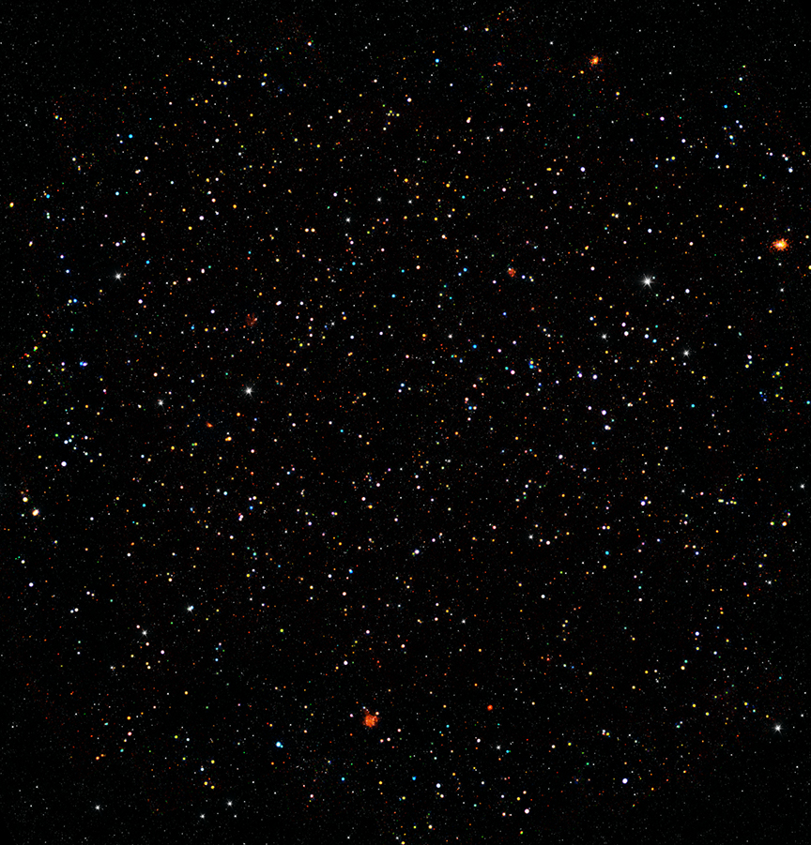
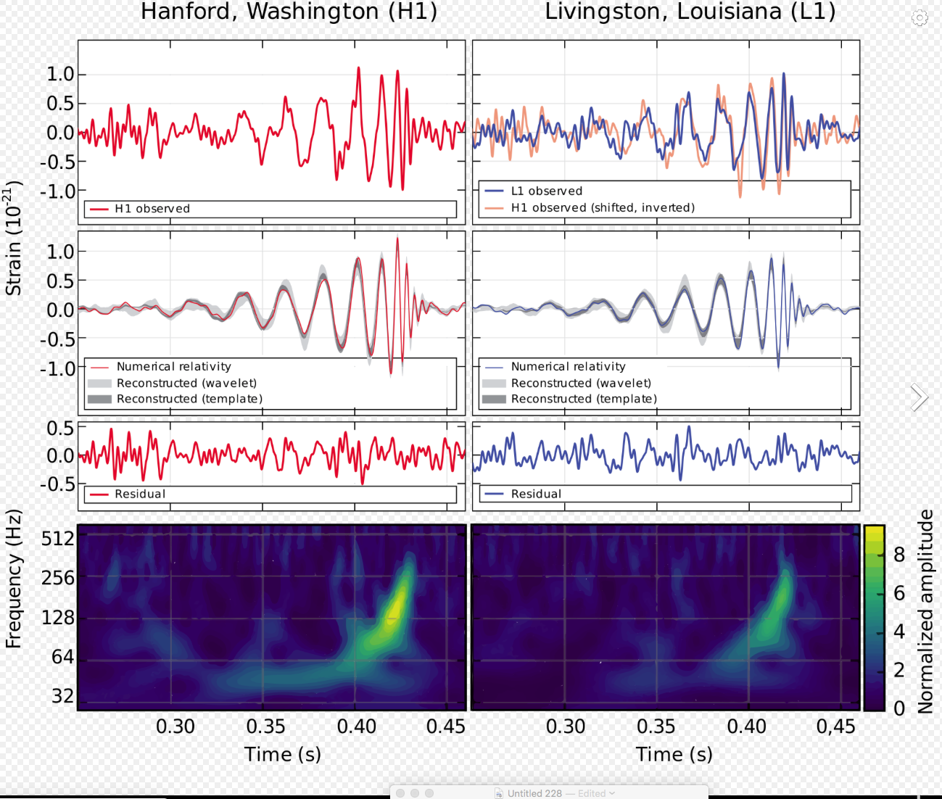
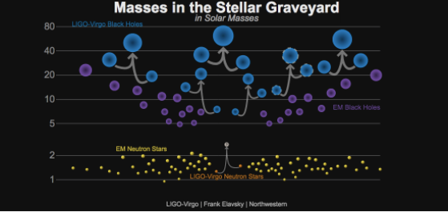
Foster next-generation tools
COSMOS Legacy Survey (2.2 deg², 80-160 ks)
Bullet Cluster – baryonic mass displaced from dark mass
  Optical image / z (Hubble)
  Mass distribution from gravitational lensing
  Baryonic mass (Chandra)
Radio – X-rays COSMOS survey
  Galaxy and quasar evolution
Identification of gravitational wave sources
Gamma ray bursts, Fast radio bursts?
Increasingly larger and complex multi-wavelength and multi-messenger data sets and catalogs
Data will need to be properly reduced and curated to fully enable their discovery potential.
Archives must provide both easy access to these data and (with the community) the means to exploit them.
Energy range
Sensitivity
Exposure time
Angular resolution
Higher dimensional data
Rapid response
Observing facilities that expand boundaries
Multi-wavelength & Multi-messenger capabilities
Curated Data Archives & Powerful Analysis tools
Civano et al. (2016)

Slide 19
In conclusion….
Keep multi-wavelength and multi-messenger exploration center stage in the deliberations of new facilities
  including consideration for flexible and well-calibrated modes of operation that could foster adaptation for use with new discovery space
Recognize the importance of data and their stewardship, and computational services, as major elements of any new scientific development for the next decade

Slide 20
Innovative observing facilities,
and the state-of-the-art astronomy archives needed to support these facilities,
will open up the universe to new discovery

Slide 21
If you want to know more….
2019arXiv190306634F 2019/03
Increasing the Discovery Space in Astrophysics - A Collation of Six Submitted White Papers
Fabbiano, G.; Elvis, M.; Accomazzi, A. and 46 more

Slide 23
Operational (old and new) facility/missions should explicitly include in their scope the proper processing software
To produce well documented and calibrated data products,
Have the capability for data recalibration and reprocessing

Slide 24
Data products in well-maintained archives, following the International Virtual Observatory Alliance (IVOA) standards
To allow a basic level of access and interoperability, as well as repurposing.
Much of this is already in place in the major data centers world-wide
Collaborations are in place to extend and evolve these capabilities to meet the demands of new data types and research methods through the 2020s.
Data products should be replicable and reproducible, ranging from basic observation data to high-level aggregated data and catalogs.

Slide 25
Ensure that new facilities are adequately supported
Future facilities will demand a transformation in the way data are analyzed.
The early phases of this transformation are already underway (e.g., the use of Python as an environment, cloud computing).
Resources must be made available for full development
See, e. g.
  LSST Science Platform Design document https://ldm-542.lsst.io
  NASA Big Data Task Force (https://science.nasa.gov/science-committee/subcommittees/big-data-task-force)

Slide 26
Foster next-generation tools
Interoperable, user-friendly advanced visual interfaces
Data mining tools
The ability to construct and implement analysis workflows easily, both via visualization and scripting
Remote Science Platforms and Server-side analytics
Implementation of complex fault-tolerant workflows
Support interdisciplinary research in astrostatistics and astroinformatics and the transfer of methods from the statistics, computer science, and machine learning communities

Slide 27
Support interdisciplinary research in astrostatistics and astroinformatics and the transfer of methods from the statistics, computer science, and machine learning communities
For development and application of innovative data analysis methods and algorithms.

Slide 28
Ensure that facilities and archives participate in curation efforts and initiatives to link together datasets, related ancillary data (e.g., atomic and molecular databases), objects, and the literature

