Slide 1
The Asterics Policy Forum Policies for multi-wavelength / multi-messenger astrophysics
Saskia Matheussen, Dutch Research Council
Denis Mourard, Observatoire de la Côte d'Azur
Esa/eso sciops workshop 2019, 22 november 2019, ESAC Madrid

Slide 2
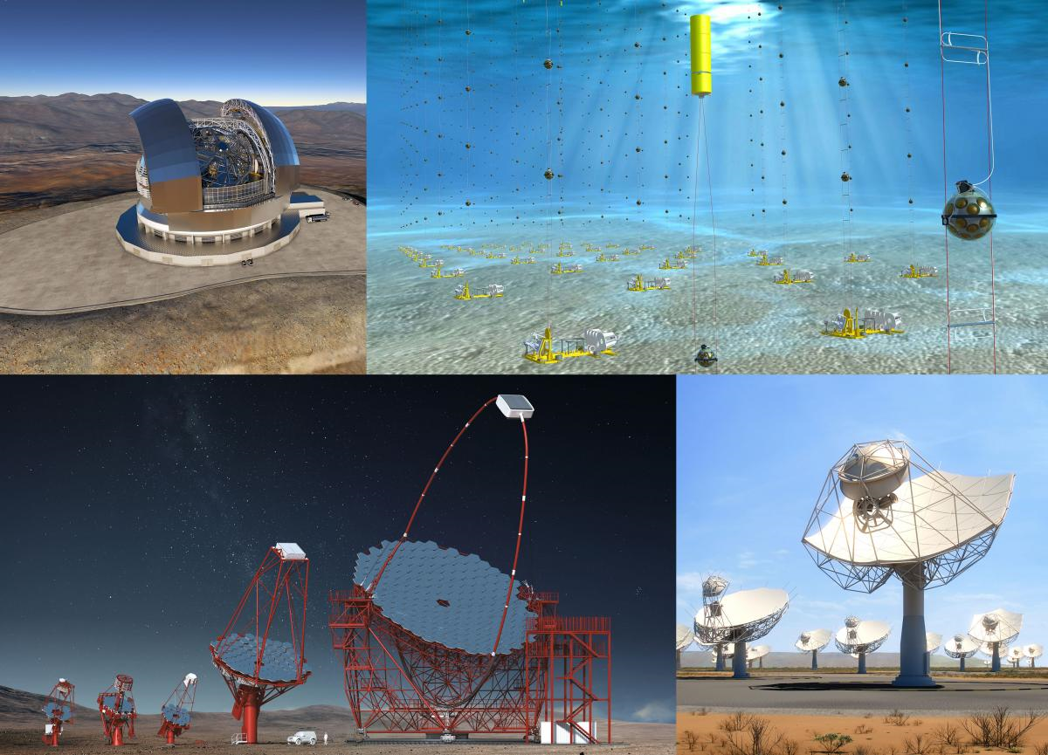
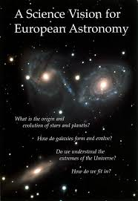
A joint effort of Asterics and ASTRONET
ASTERICS: working together on multi-messenger challenges
ESFRI: ELT, KM3-NET, CTA, SKA
ASTRONET: A comprehensive planning for the development of European Astronomy
European Funding Agencies

Slide 3
Why a policy forum?
Astronomy advances with breakthroughs in fundamental knowledge and also facilities. It has driven scientific enquiry across the widening electromagnetic spectrum (originating in the optical) to today’s truly multi-wavelength discipline.
New windows to unravelling the physics of the Universe have opened recently, with the recent detection of gravitational waves and of astrophysical neutrinos. We are moving into the era of multi-messenger astronomy (MM).
However, there are challenges. Critically, today’s facilities are intrinsically complex and have a range of different, distributed, and usually worldwide organisations that operate them. This raises a range of issues for astronomers wishing to exploit a suite of these MW/MM facilities for a science topic.
Notes:
Focus on MW/MM. But time domain astronomy, HPC & numeric, VO and archives?

Slide 4
Aim of the Asterics Policy forum
Review the current MW/MM landscape
Derive some recommendations on how to harmonize joint and efficient scheduling, operations and interoperability of the various telescopes
Produce accountable outcomes in key policy areas
The review covered four main strategic topics:
1/ Joint time allocation,
2/ observing strategies for MM/MW campaigns,
3/ data access and sharing, and
4/ general policies of common interest.

Slide 5
Approach
Asterics Policy Forum Guidelines
Reports from the Science Groups CTA, ELT, KM3-NET, SKA
Policy Forum Meeting with scientists and infrastructure managers Nice, January 2018
Working meeting to review the policy document The Hague, November 2018
Draft for feedback to research infrastructures
Outcome presented at The New Era of Multi-Messenger Astrophysics Workshop Groningen, March 2019

Slide 6
Science as a starting point
The individual science cases as defined in the ESFRI roadmap provide the starting point for the policy discussions and recommendations.
Science Vision and the Infrastructure Roadmap, ASTRONET Important aspect: identification of actions that transverses the infrastructures like Virtual Observatory (VO), Laboratory Astrophysics, High Performance Computing, sharing of codes, and training and outreach.
Ten exemplar science cases which are either benefitting now, or will do so in the future, from a MW/MM approach. These cases are presented by four science groups from the science community of CTA, ELT, KM3-NET, and SKA.
Notes:
Agreement from CTA – ELT –KM3NeT – SKA to distribute this with this mention!

Slide 7
Science teams (1/2)
Transient phenomena as outstanding example of a productive MW/MM science. Gamma-ray bursts, fast radio bursts, neutrino events, gravitational wave detection, are clearly part of the key science programs.
Different observing strategies are being considered: many will adopt the Virtual Observatory-Event approach and the Target of Opportunity frameworks for time allocation. Is this a sustainable approach?
Moreover, common tools will need to be extended to support the source identification and characterization coupled with facilitated access to archival MW/MM data.

Slide 8
Science teams (2/2)
Infrastructures require major strong science cases (first light, epoch of reionization, cosmology, exoplanets, search for life …) These are derived almost independently for each infrastructure.
Example: correlated surveys on cosmology, dark matter, and dark energy. SKA, ELT, KM3NeT and CTA together with new infrastructures or missions like LSST, EUCLID, FERMI, ATHENA must all deliver vital contributions.
Critical importance of the MW/MM information requires observing coordination and data-sharing policies now. Not immediately obvious considering the political and managerial constraints of each facility.
Notes:
Question of data-sharing policy: are we ready to open this debate? Is it really a debate? Could we (who is we?) orient things?

Slide 9
A critical review of the current situation
During the activities of the Policy Forum, we have progressively been confronted with a certain number of facts that indicate that MW/MM astrophysics is probably not working in an optimal way.
Barriers have been expressed by scientists and/or representatives of research infrastructures and are, of course, important if one wants to propose ways of progress.
We find that the nature of these barriers is varied. Whilst our list is not exhaustive, we believe these reveal key weaknesses that assist in defining the future.

Slide 10
A critical review of the current situation
Lack of coordination across Facilities from the outset
Convincing science case essential: unique science and important progress.
The case for unpredictable discovery is not advocated
Need for complementary views brought by other facilities considered a weakness
Space missions wrt important ground follow-up
Ground facilities wrt the potential opened by MM/MW astrophysics.
Important: scientists, managers of infrastructures, evaluation panels and funding agencies must recognise that it is not a weakness to dedicate some time to challenging and sizeable coordinated programs.
Notes:
Is it workable, useful, important?

Slide 11
A critical review of the current situation
Perception that MM/MW is well-organised through KSP’s:
Key Science Programs are highly publicized.
They greatly benefit from coordinated programs among infrastructures.
One may consider that MM/MW astrophysics is well organized through the coordination of key science programs. While very little, or no, additional effort is usually made to support coordinated programs within the telescope’s open time.
This may generate a fracture in the community depending on whether or not you (as an individual) are involved in a particular key science program.
Notes:
Key Science Programs versus open time.

Slide 12
A critical review of the current situation
Variable adoption of Targets of Opportunity policies across facilities:
MW/MM astrophysics is strongly supported by the Targets of Opportunity (ToO) policies.
It is not clear at all today if each infrastructure has a clear policy of ToO, if there exists a standard model for ToO, and if these ToO observations are finally not organized through a general agreement between facilities for periods of time.
Notes:
Interest to progress on this aspect?

Slide 13
A critical review of the current situation
Need for coordination of Regional Centres & expertise:
The extreme complexity of modern instruments, in their operation and/or in their data analysis has demanded the development of expert centres which extends the knowledge of the consortium.
With the increasing data flow, this will become increasingly common in the coming decades.
The coordination/communication among these centres will be vital if one wants to fully exploit MM/MW astrophysics, given it is clearly impossible to have the expertise on all the facilities involved in any one science question.
Notes:
Point of view from 4RI?

Slide 14
Formulating the recommendations
The Policy Document does not intend to elaborate solutions. Instead its aim is to raise awareness of the stakeholders involved, and to embed itself as a living document in the community to progress on this issue.
The recommendations are directed towards scientists, research infrastructures, and funding agencies.
They are based on discussion of important science cases developed today by CTA, ELT, KM3NET, and SKA.
Contributions: ASTERICS Management: C. Jackson, G. Cimo, R. van der Meer, and ESFRI Research Infrastructures: J. Knodlseder (CTA), M. Cirasuolo & P. Padovani (ELT), E. de Wolf (KM3NeT), S. Berry (SKA).
Notes:
How do we distribute this? RI & FA mainly? IS there a need for a diffusion to the astronomical community?
Important to give some guidelines for the future… probably in the final version, after IAU, ASTRONET, Event…

Slide 15
Recommendations
I Raising awareness
Crucial for scientists, research infrastructures and funding agencies.
Barriers identified – Recognition of these difficulties (not only technical but often political) is important.
Science is the driver for MW/MM and it is important that scientists keep pushing for solutions. It is key to take responsibility and to continue to raise awareness of the issues we have to deal with.

Slide 16
Recommendations
II Towards enhanced coordination for the benefit of MW/MM astrophysics
Recognition of the important differences in the nature of the facilities - Physics experiment and telescopes - Space missions and ground facilities - Intergovernmental organisations versus consortium-facilities
Enhance the detailed communication on the Key Science Programs - Analyze possibilities for coordination in the early phases of development - Requires better description of the parameter’s space.

Slide 17
Recommendations
II Towards an enhanced coordination for the benefit of MW/MM astrophysics
Lessons to be learned from positive and negative experiences - Recent plans for EUCLID and PLATO and ground-based follow-up observations. - Electromagnetic counterpart of gravitational waves
More energy for an easier access to science-ready data.
Open forum of Research Infrastructure in Astrophysics - A place for open discussion, exchanges, identification of joint actions.

Slide 18
Recommendations
III Possible actions towards an enhanced MW/MM framework
Reinforce the ToO approach and analyse the sustainability of this model in the growing demand for multi-facility programs.
Develop joint programs between facilities. TACs to consider conditional approval of proposals submitted to multiple facilities. No Super-TAC.
Strong recognition of the importance of VO compliance.
Continue and even further develop the implementation of expertise centres, with a wider communication on the services offered
Network to be built, for example to share the business models and the key features towards science-ready data and an easy access to the data.

Slide 19
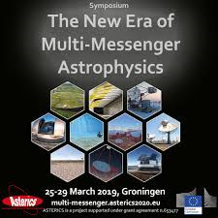
Policy paper discussed and distributed
CTA, ELT, KM3-NET, SKA
APPEC
JIVE, LOFAR, IRAM, ALMA
XMM, INTEGRAL, Fermi
HESS, MAGIC
GTC, TNG
LIGO, VIRGO
IceCube, ANTARES, Global Neutrino Network

Slide 20
Main feedbacks
CTA: Science & transients
Clarification of the definition of expert centres.
Push to go to « open and easily accessible, science-ready data ». But can we go so far?
HESS
Internal collaboration but 40% of time for ToO. First XMM-HESS joint call
Lack of manpower and funding for full release of the high level products.
XMM
30% of high priority observations together with other (large) facilities.
Joint programs US dominated, European community still is reluctant to this approach.
Recommendation that each facility establishes a joint program with XMM, later Athena. Experience: joint programs are only successful if they go through one TAC only.

Slide 21
Main feedbacks
LIGO
For GWs, very clear that coordination of pointed instruments has great value.
Balance of coordination and competition is critical.
Middle ground between a Super-TAC and chaos.
ENGRAVE probably merits some reference here
« I wish US astronomers were also working more in the direction of coordination. »

Slide 22
What’s next ?
Important to continue the communication on the actions and recommendations from the policy forum!
Asterics project finished - Who can continue and coordinate?
ASTRONET (Next Science Vision & Infrastructure Roadmap)
Opportunities EC projects like ESCAPE, AHEAD2020 ?

