Slide 1
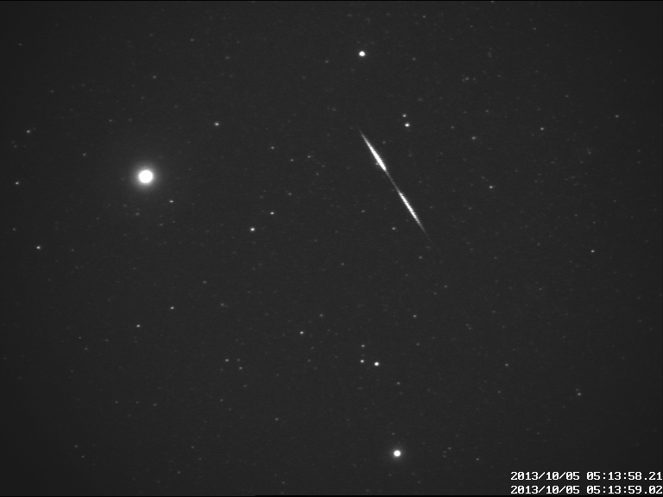
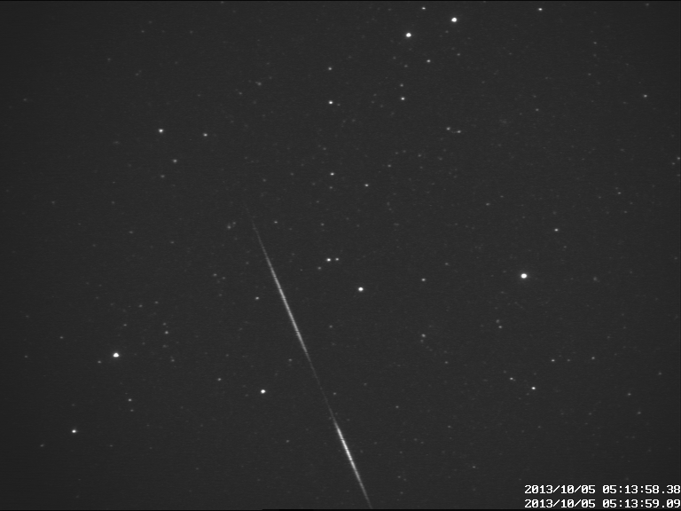
Meteor Research Group overview D. Koschny
European Space Agency, Keplerlaan 1, Postbus 299 2200 AG Noordwijk, The Netherlands
Detlef.Koschny@esa.int
1

Slide 2
Jorge Diaz del Rio (contractor) - s/w support
Esther Drolshagen (master student) – flux densities, Rosetta dust analysis
Gerhard Drolshagen – flux densities, meteoroid modelling
Detlef Koschny – CILBO data cleaning, flux densities, orbits)
Sam Leakey (Young Graduate Trainee) – data analysis software
Cornelius van der Luijt - h/w support when needed
Regina Rudawska (post-doc) – CILBO data cleaning, orbits, spectra
Hans Smit – CILBO s/w support
Theresa Ott (master student) – flux densities, Rosetta dust analysis
Andrea Toni – h/w + s/w test and installation
Joe Zender – spectra
Total current (wo)manpower in 2016: 5 FTE
Close collaboration with Thomas Albin, Univ. Stuttgart
Joining 01 Oct 2016: Chrysa Avdellidou (post-doc) – lunar impacts

Slide 3
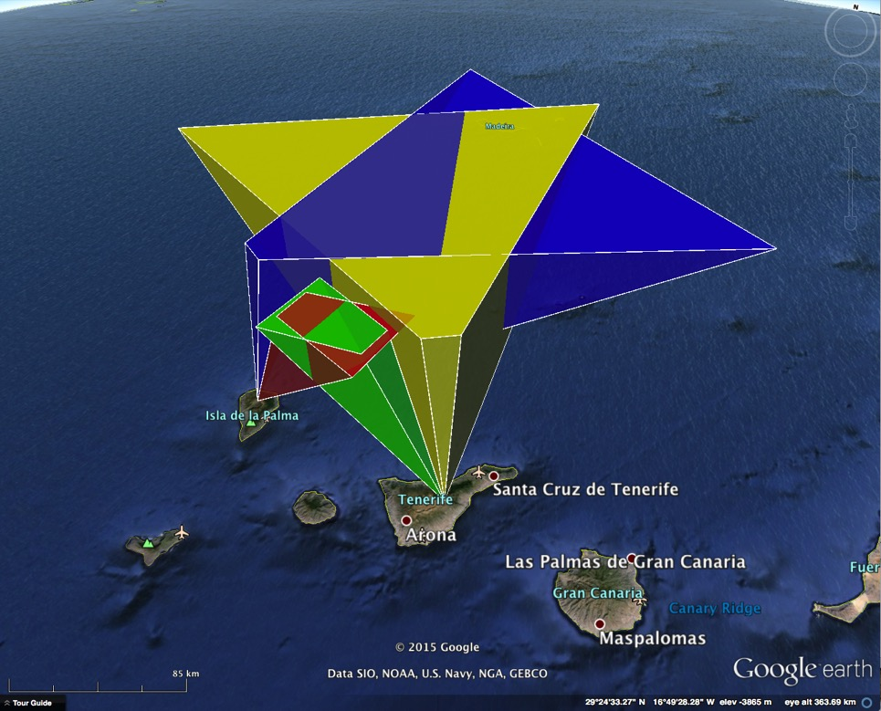
CILBO

Slide 4
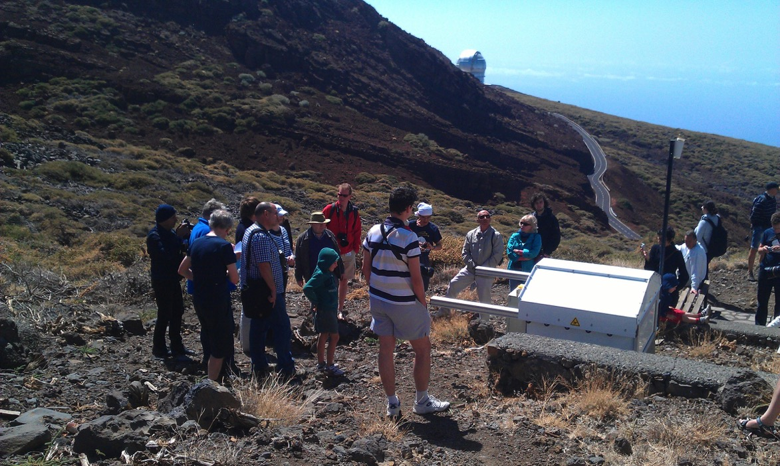
4

Slide 5
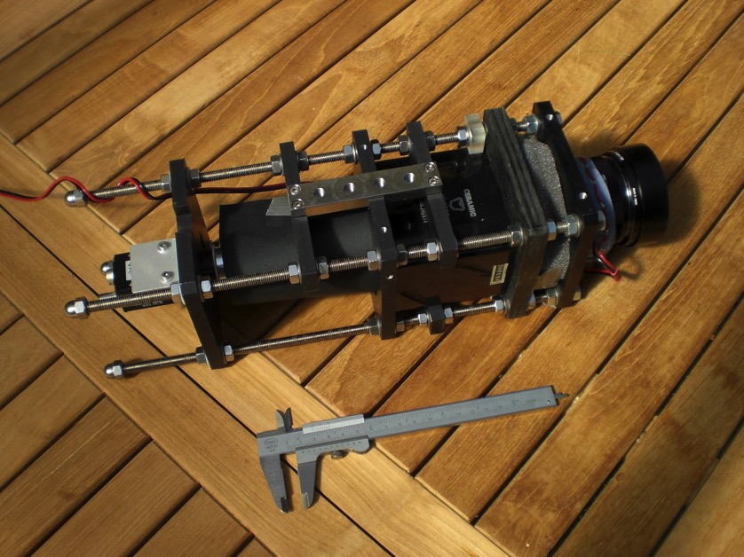
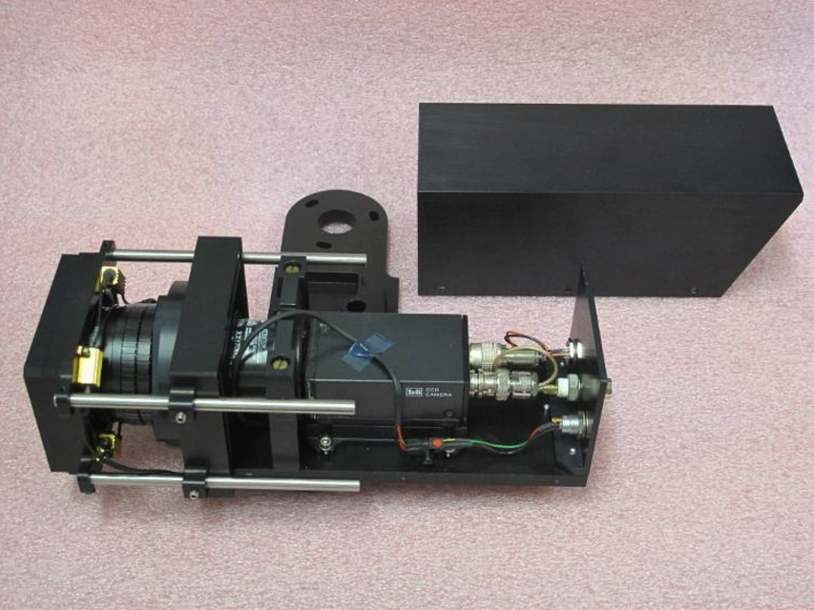
Cameras
LIC = Large field-of-view Intensified Camera (60 deg)
Meteor detection done with MetRec
ICC = Image-intensified CCD camera, 22 x 28 deg²

Slide 6
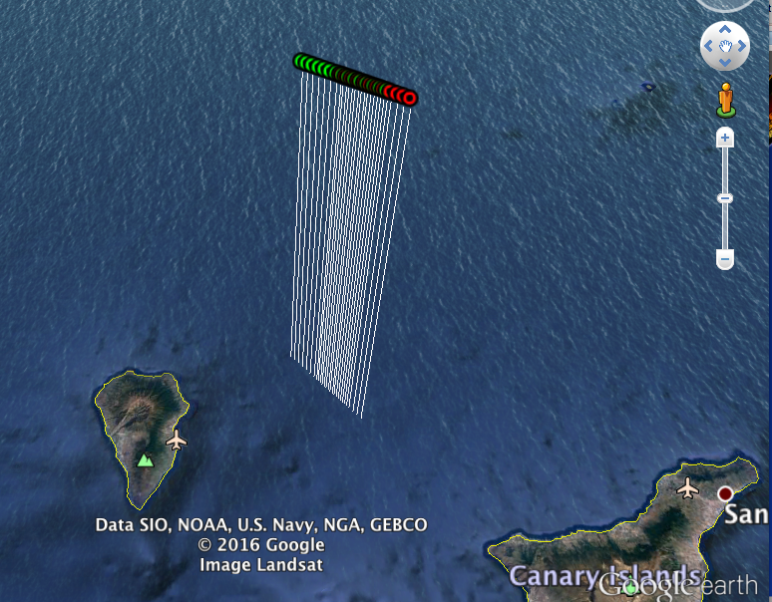
Compute trajectories
Take data from two parallel cameras, computes trajectories, generates ‘detailed altitude file (daf)’
Check quality of daf’s – e.g. meteoroid height between 30 km and 150 km; moves good files to separate directory
These (and a number of other routines) read the MetRec ASCII files
MOTS = Meteor Orbit and Trajectory Software

Slide 7
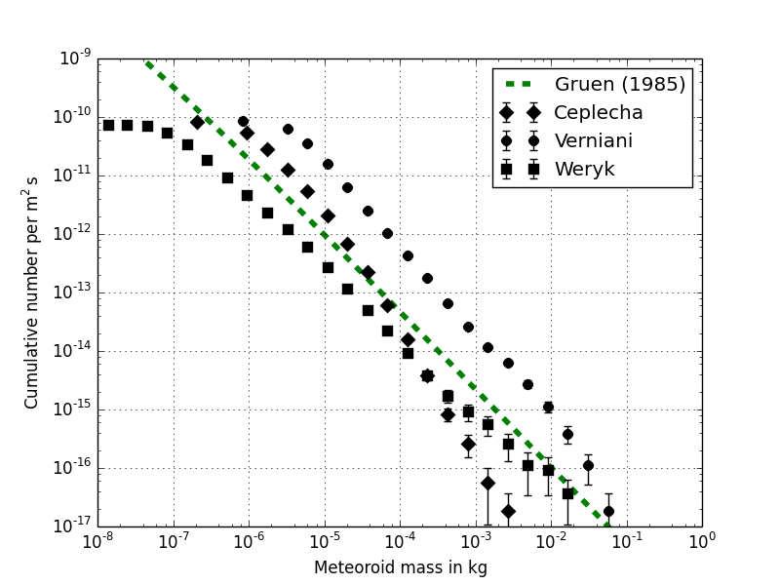
Flux density computation
Was done by four Bachelor students (Drolshagen E., Ott T., Drolshagen S., Kretschmer J.) – written up in paper for PSS, submitted 01 Sep 2016

Slide 8
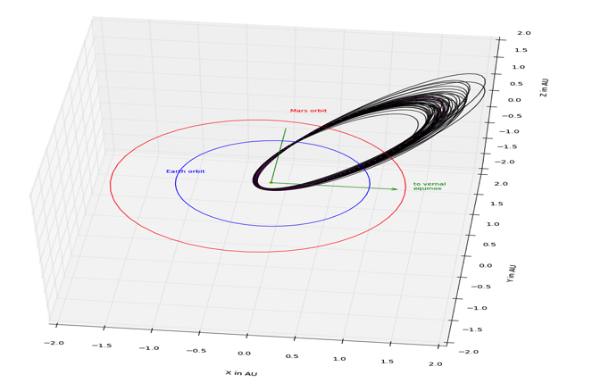
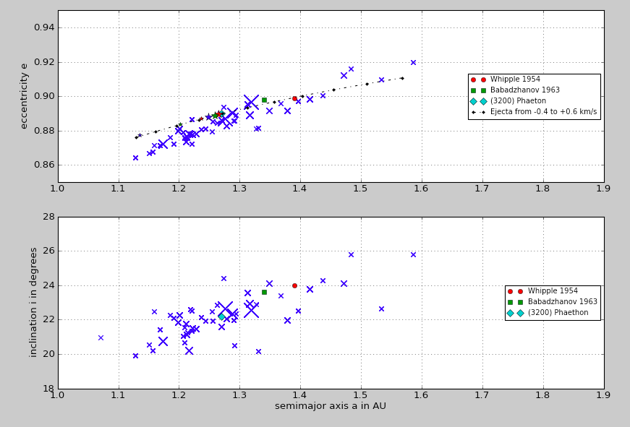
Orbit computation
First version: MOTS 1, 2002 (Jorge)
MOTS 2, 2006 – integrated in VMO, web-based (Geert Barentsen)
MOTS 3 – 2015/16 (Detlef, Thomas Albin)
Current idea: no online version, only stand-alone

Slide 9
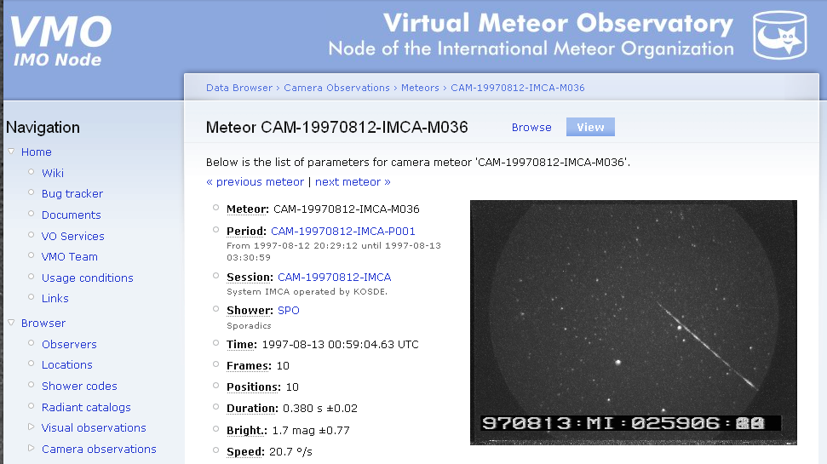
VMO
Old version online and functioning – long-term archive for IMO video meteor data
Other functionality not maintained
Future: Update VMO to be compatible with current ESA/SSO security and the ‘cosmos’ web environment
Get the science software to use the database!

Slide 10
Spectra work

Slide 11
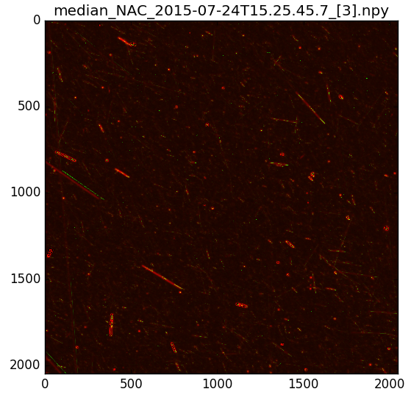
Rosetta dust
Studying size distribution of dust at comet 67P (Drolshagen + Ott)

Slide 12
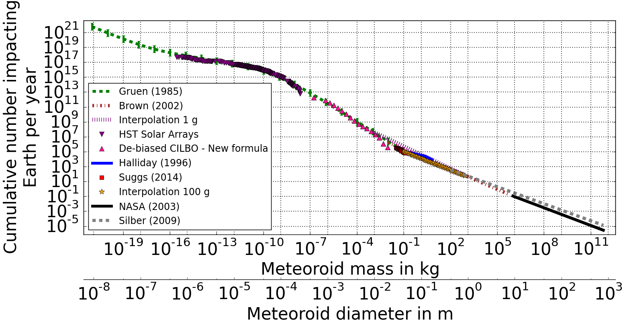
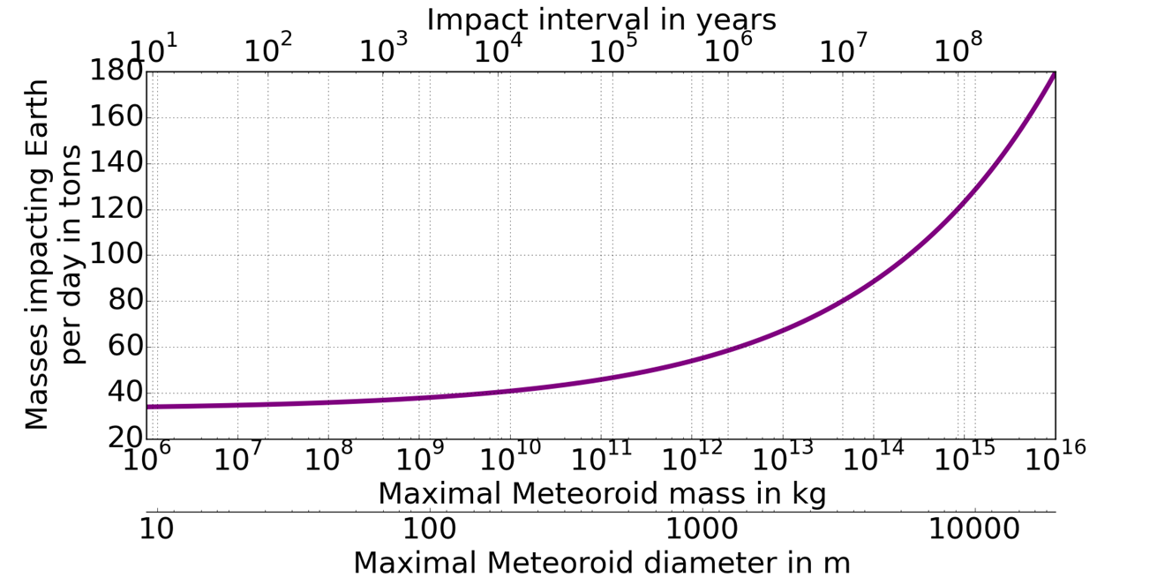
Mass accumulation
Drolshagen et al., submitted to PSS 2016

Slide 13
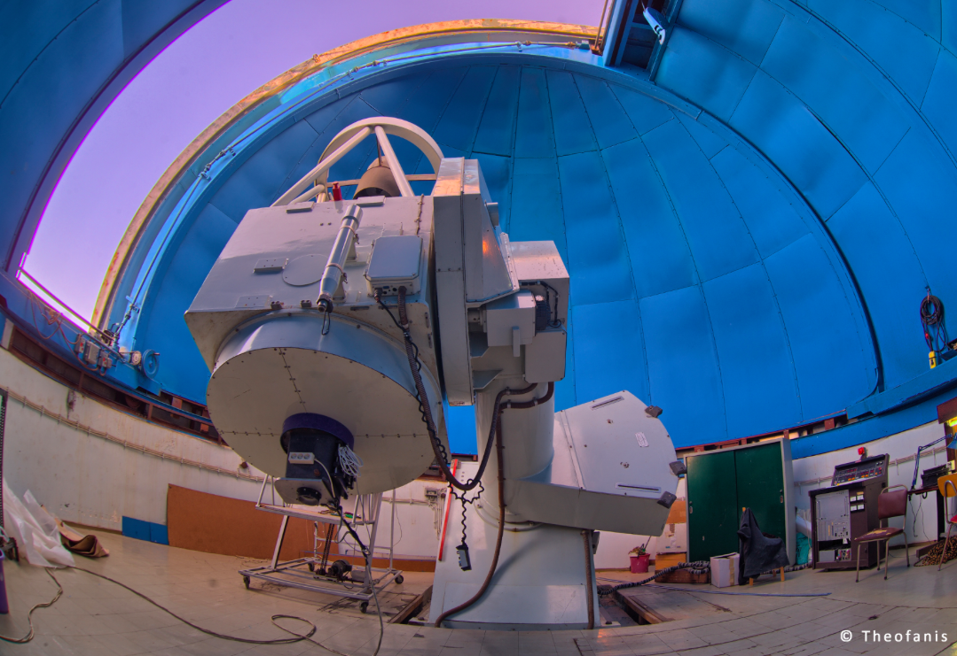
Lunar impacts
Contract with Athens observatory – they are refurbishing their 1.2 m telescope at Kryoneri with two 25 fps cameras to record lunar impacts; observing period 24 months part of contract

