Slide 1
Radar and Optical Observing Biases
M. Campbell-Brown
University of Western Ontario

Slide 2
All meteor observations
Limiting mass is a function of speed
Limiting mass is a function of meteor position
Mass distribution index needed to correct rates
Detection algorithms

Slide 3
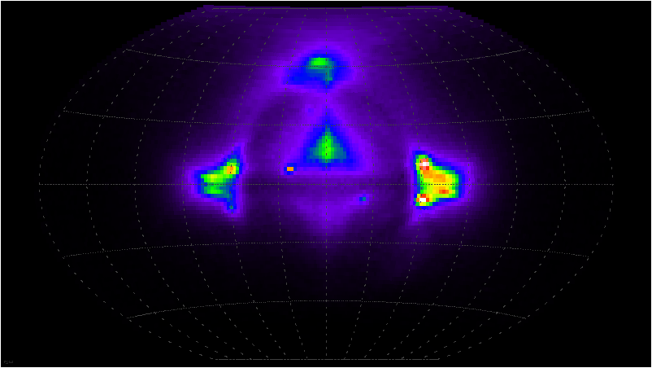
Radar

Slide 4
All radars
Ionization efficiency vs. speed
Generally observe a small portion of the trail (1st Fresnel zone/main beam): extrapolate to get total mass
Radar

Slide 5
Transverse scatter radars (backscatter)
Initial trail radius
Finite velocity effect
PRF effect
Faraday rotation (linearly polarized beams)
Transverse Radar

Slide 6
Initial radius
Meteors ablating high in the atmosphere suffer destructive interference.
The form of initial radius with height is not well known, and may be complicated by fragmentation.
meteor
Ionization column
Radar beam
Transverse Radar

Slide 7
Finite velocity effect
A meteor trail expands as it crosses the first Fresnel zone (where most of the scattering occurs).
If the meteor is slow, it may be attenuated before it reaches maximum amplitude.
This effect is expected to be much smaller than the initial radius effect, but it affects mainly slow meteors.
Transverse Radar

Slide 8
PRF effect
Meteor echoes, particularly from weak or high meteors, decay quickly.
If the pulse repetition frequency of the radar is not high enough, short echoes may be missed.
This is also usually much smaller than initial radius.
Transverse Radar

Slide 9
Faraday rotation
When a radar beam travels through a region with free electrons (the ionosphere), along the magnetic field, the polarization of the beam rotates.
If the returning beam’s polarization is not parallel to the antenna, the echo is attenuated.
This effect occurs only in the afternoon, for certain directions, and is not an issue for circularly polarized beams.
Transverse Radar

Slide 10
Radial scatter radars
Radar cross-section to mass relation
Cross-section as a function of altitude
Sidelobes
a
meteoroid
head echo plasma
Electron Density
Radial Distance from Meteoroid
Radial scatter Radar

Slide 11
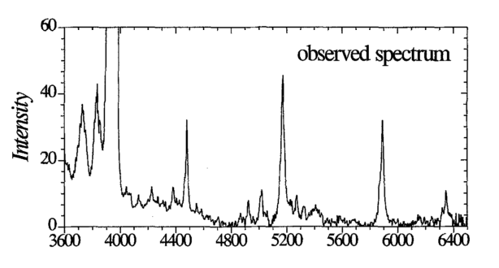
Optical systems
Mass scale (luminous efficiency)
  Depends on wavelengths observed
  Function of speed (?)
Borovicka & Betlem 1997, Perseid
Optical

Slide 12
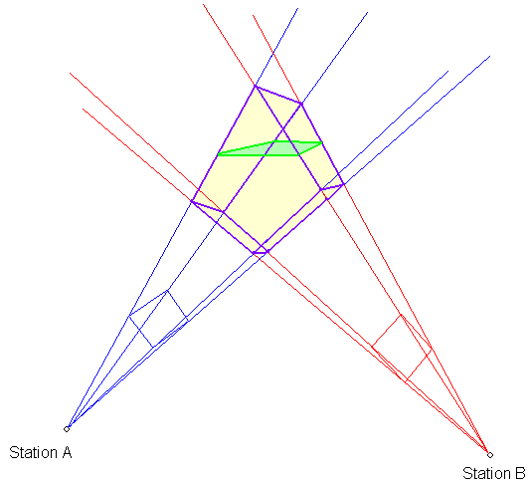
Optical Collecting area
Need to account for
  Range to camera(s)
  Angular speed/spread of light
  Sensitivity of camera
  Height bias
  Any obscured part of the
  field of view (wide field)
Optical

Slide 13
Limiting meteor magnitude
Usually no single limit; different in different parts of the field
Depends on:
  Sky conditions (limiting stellar magnitude)
  Angular spread of light
Optical

