Slide 1
Concerning the Reconnection-Induction Balance at the Magnetopause of Mercury
Daniel Heyner, Christian Nabert, Evelyn Liebert, Karl-Heinz Glassmeier
BepiColombo-MESSENGER Workshop 2015

Slide 2
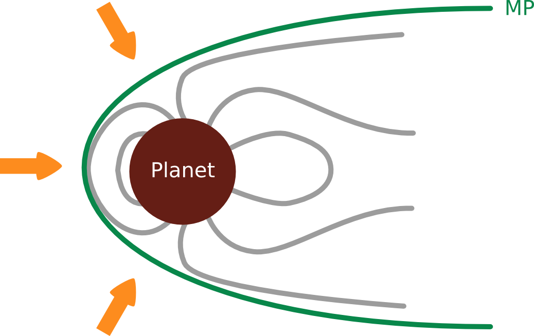
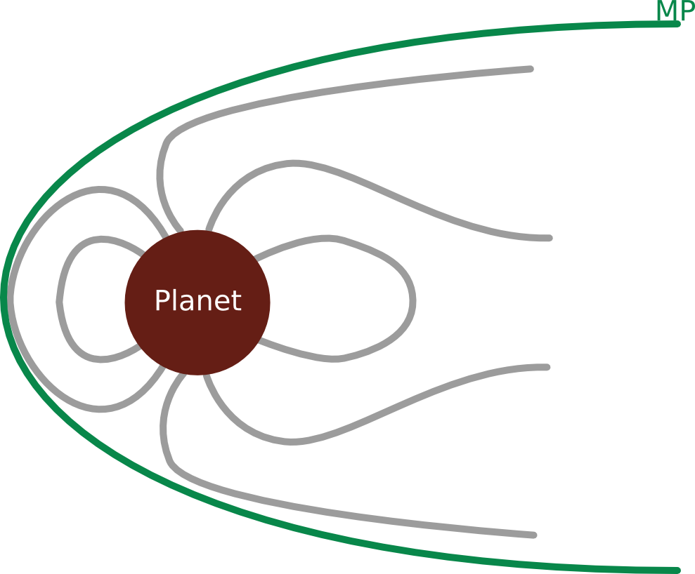
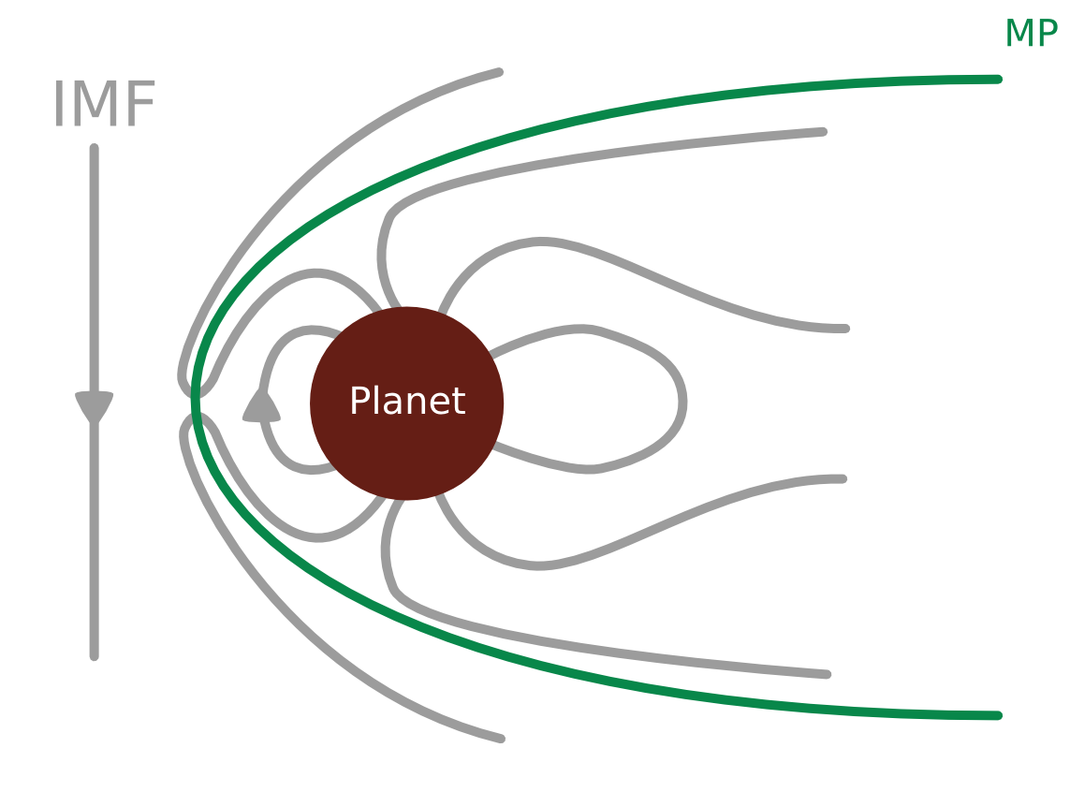
Compression & Erosion
compressed
eroded
“Onion Peel Model”
normal
Notes:
1:38
IMF Abk.
Return Flux!

Slide 3
Dayside MP-Erosion Processes at Mercury
Onion-Peel model: imbalance in flux transport
Field-aligned R1 Currents: fringe fields
Open magnetosphere: IMF penetration
Neutral sheet current: fringe fields
Proximity of the planet: Role of induced fields?
First step: Quantify external field change.
Notes:
1:22

Slide 4
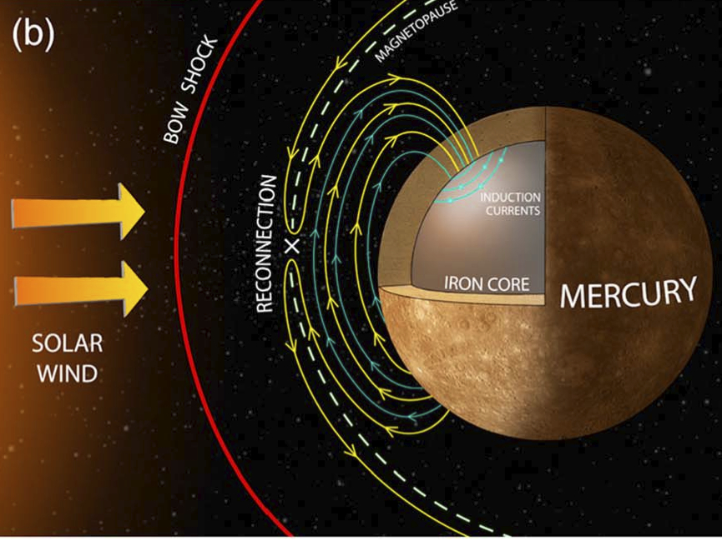
Induction as Consequence of Erosion
  Reconnection transports
magnetic flux to the
nightside
Magnetopause (currents!)
moves closer to planet
External field amplification
Slavin et al., (2014)
→ Induced currents
Secondary fields enhance
subsolar magnetospheric
field
(counteracting their source)
Notes:
2:15

Slide 5
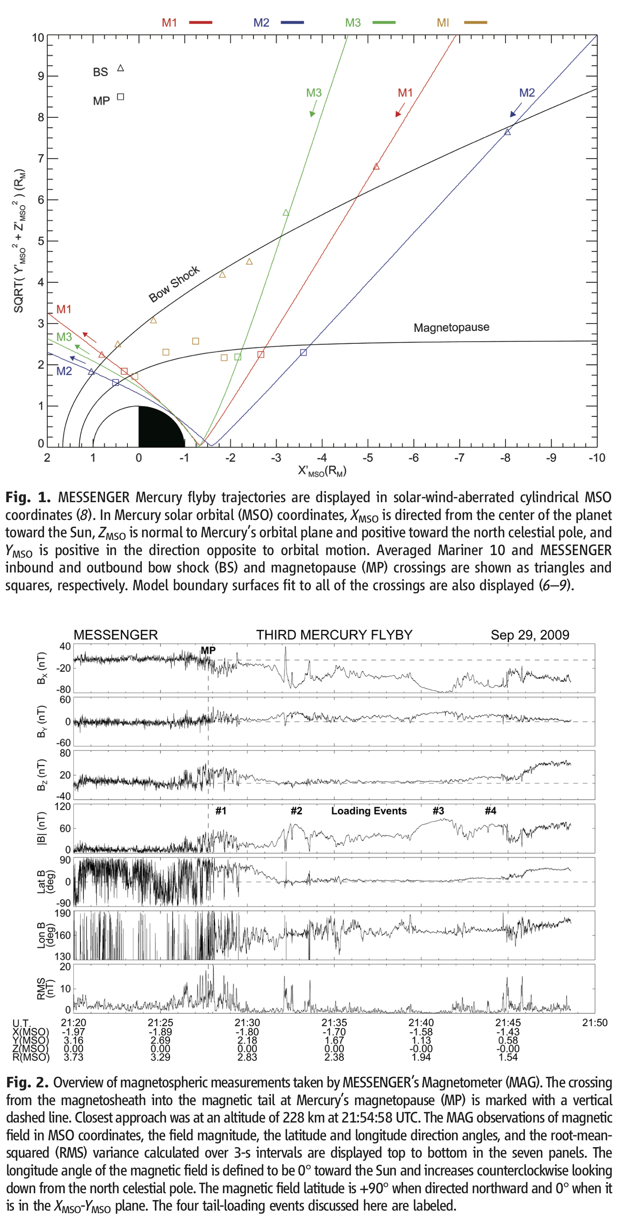
Tail Loading Events
Slavin et al. (2010) :
Tail flux 2 … 3.5-fold enhancement
2-3 min
Slavin et al., (2010)
Notes:
2:16

Slide 6
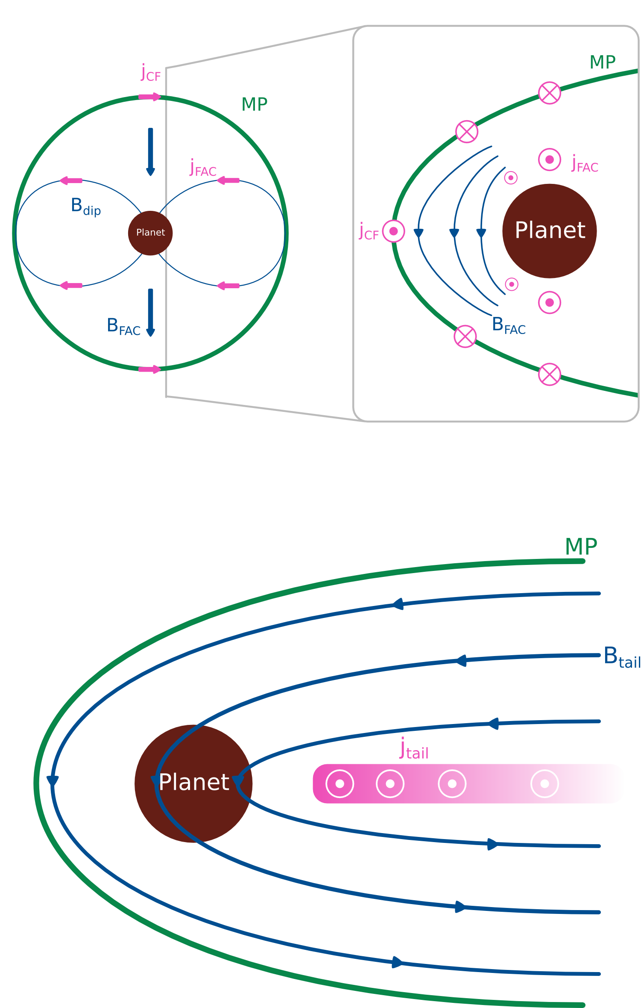
External Field from Neutral Sheet Currents
dipole
field
Enhanced tail flux
(Slavin et al., (2010)
& Johnson et al., (2012)):
Notes:
1:27

Slide 7
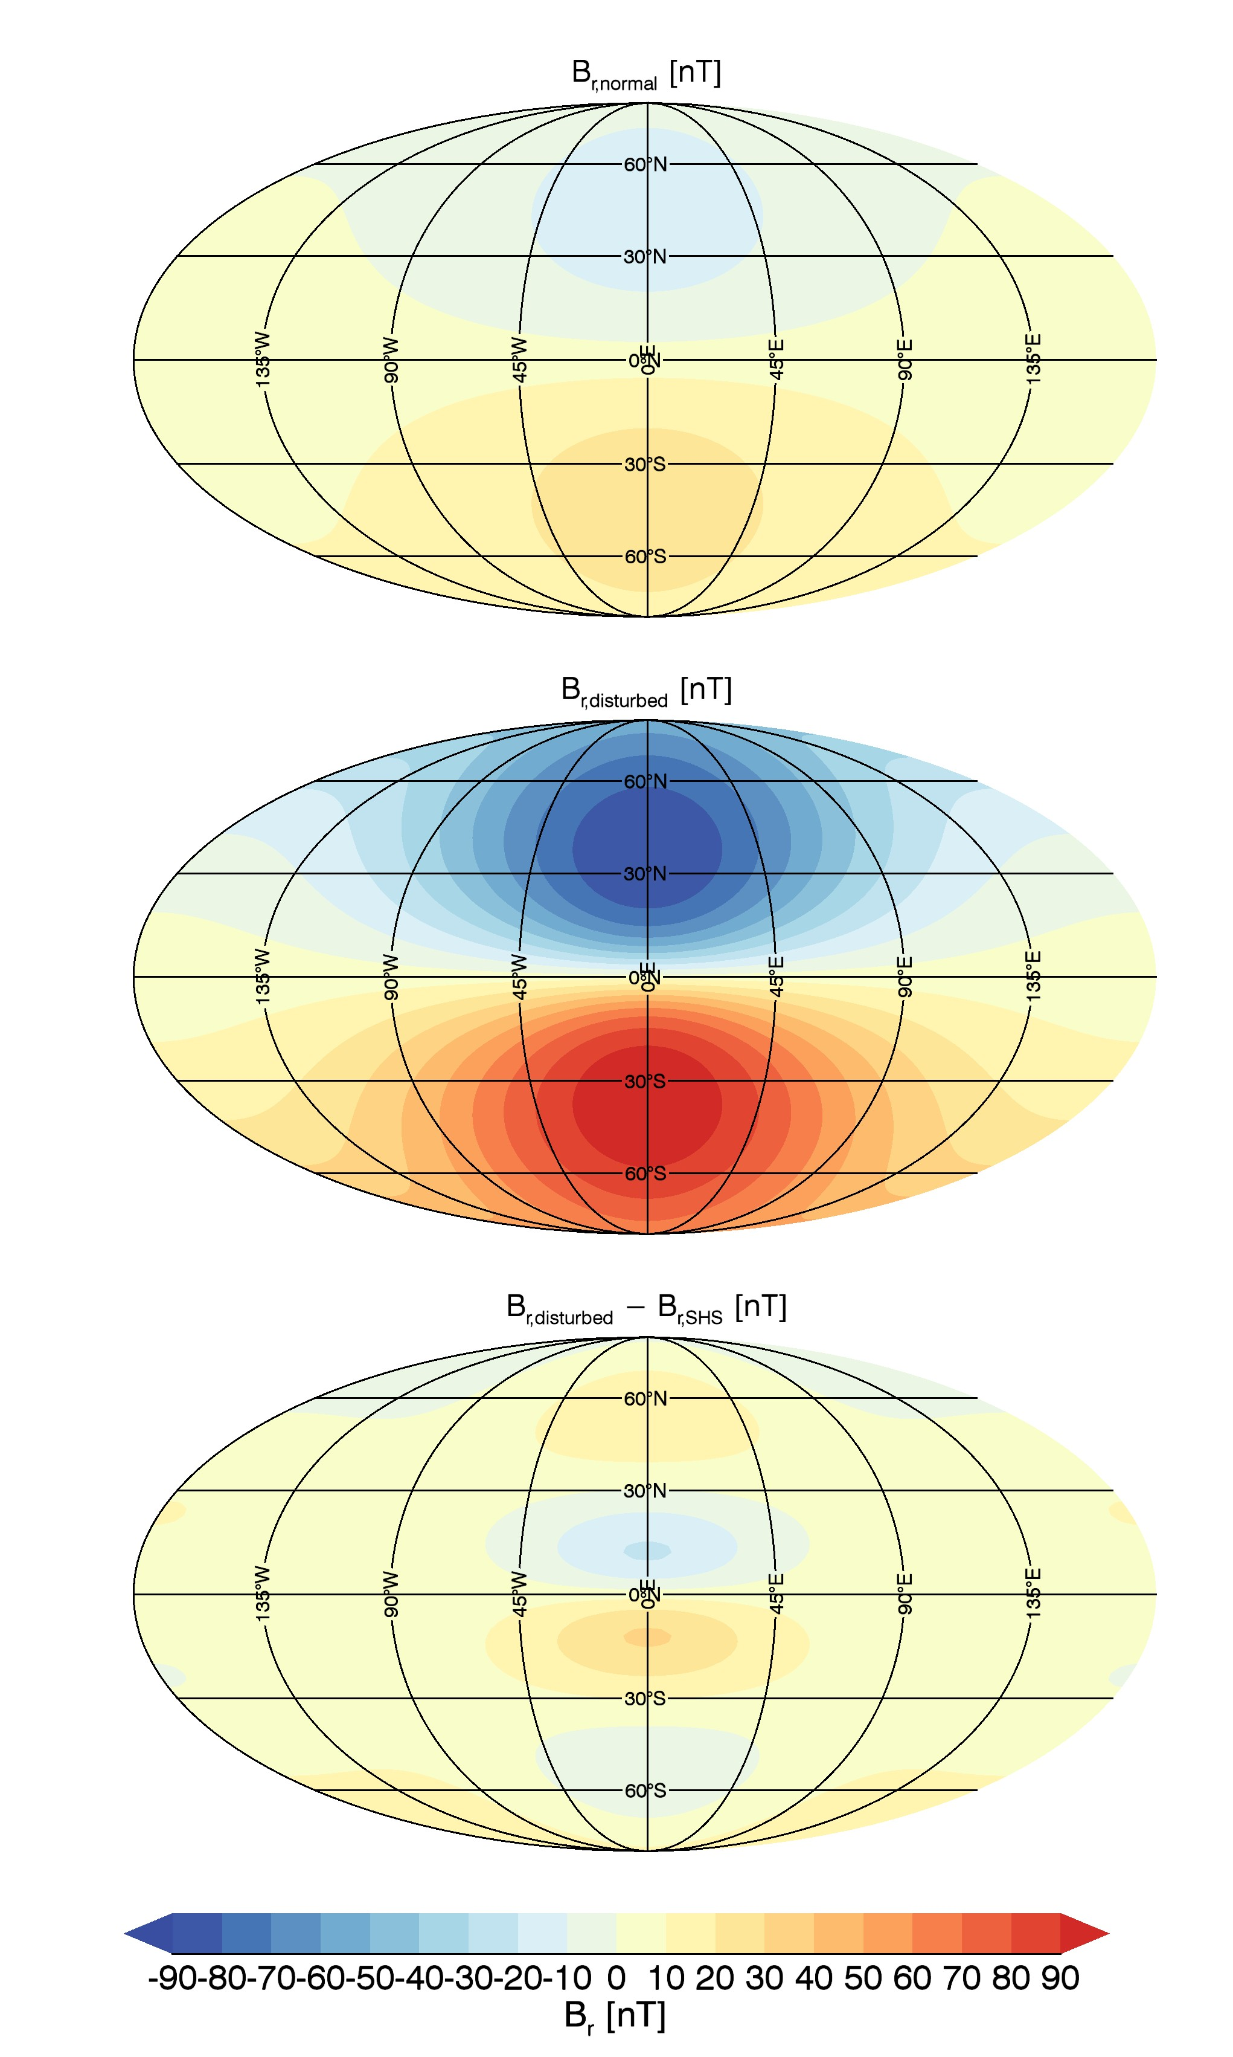


Spherical Harmonic Analysis
Notes:
2:28
SHA results
Subsolar point!

Slide 8
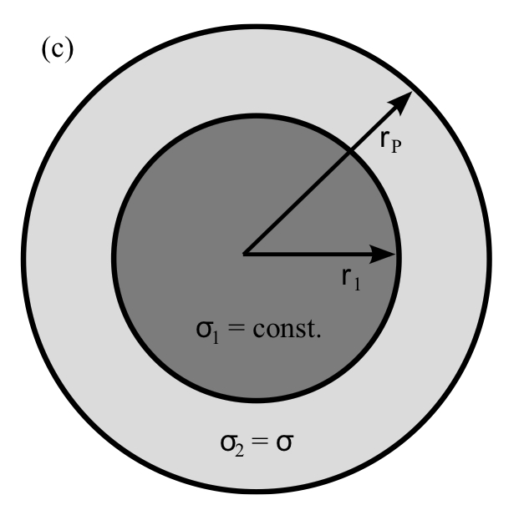
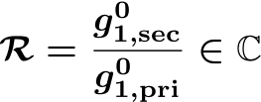

Induction Modeling
Solve induction equation
Rikkitake-factor
Liebert, (2013)
Notes:
2:00
Induction modeling with nested shells
Rikitake factor: real part, imaginary part

Slide 9
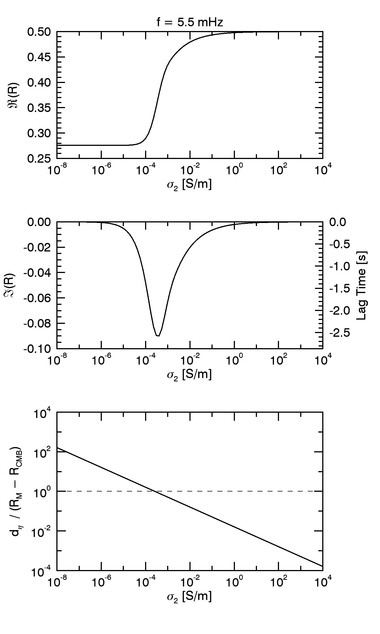

2 Shell Model:
Results
T=3min
Amplitude
ratio
(surface)
Skin Depth
Geometric decrease
to r = 1.45 R_{M}:
0.33
Maximum effect:
Notes:
Induction results
Low silicate shell conductivity: external field only reacts to the core
High silicate shell conductivity: external field reacts to the crust

Slide 10
Summary
During phases of subsolar
reconnection: tail field enhancement
Major effect in decreasing subsolar magnetopause distance
Induction in the planetary interior may compensate for app.
20…40% (at average magnetopause distances)
Notes:
Outlook to Bepi Colombo:
Two probes
Time lag

Slide 11
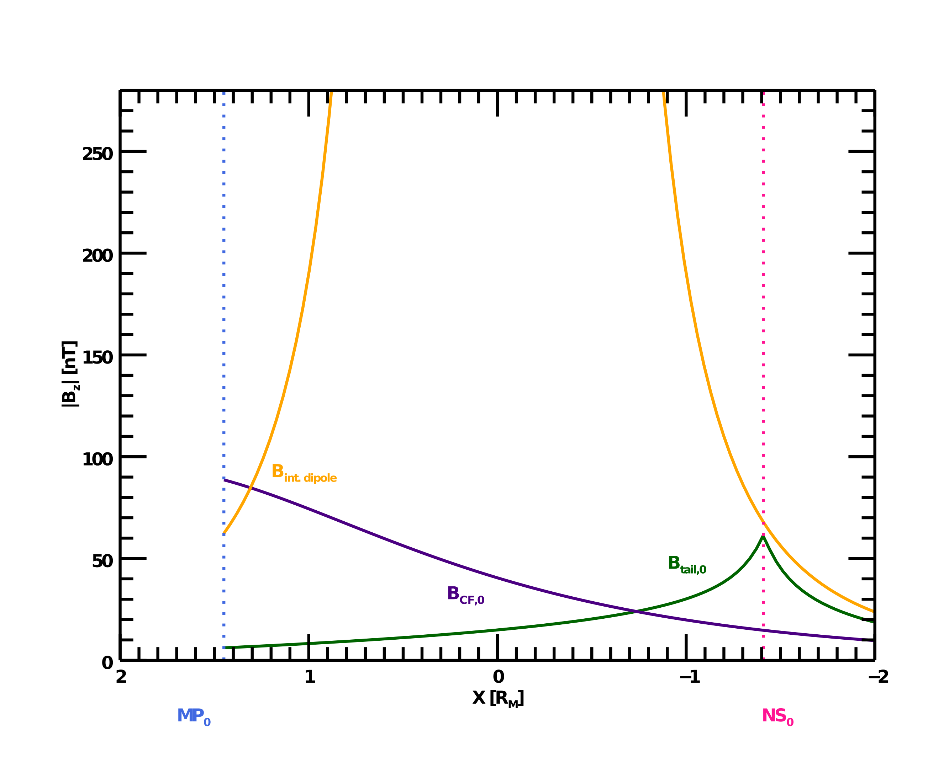
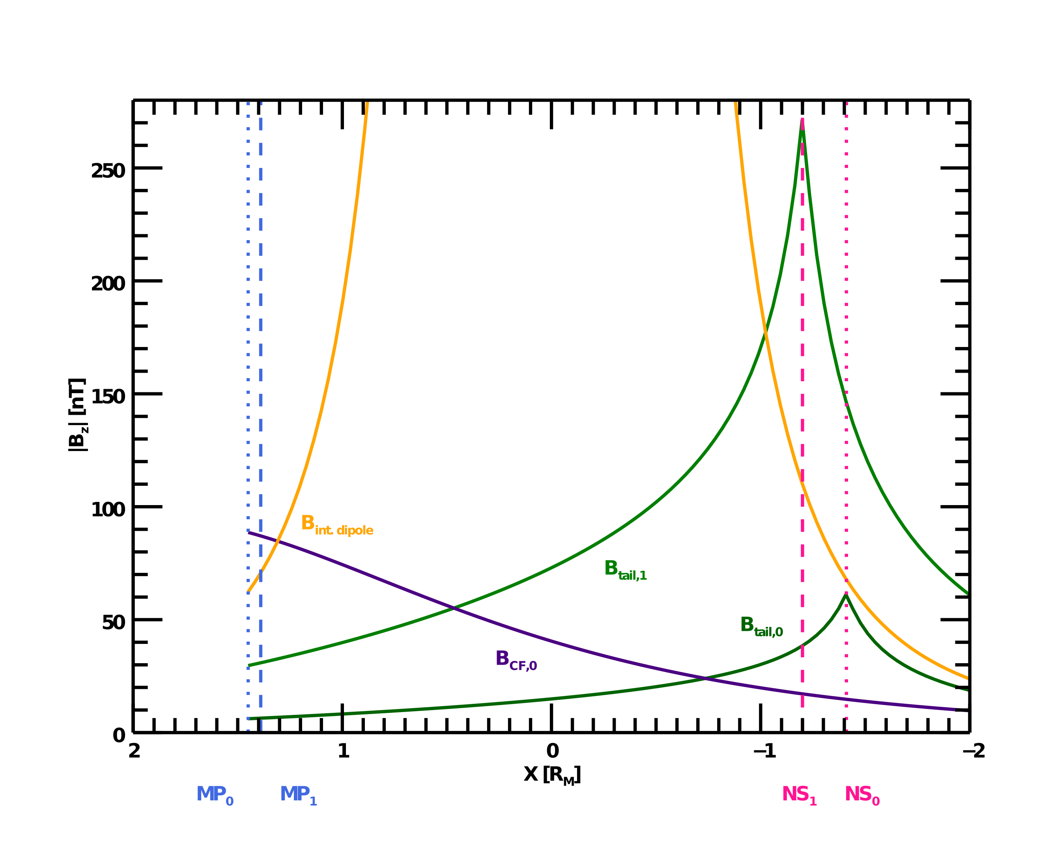

B_{z} from Various Sources (Y=Z=0)
Enhanced tail field
Normal tail field
Notes:
2:11
Externe Feldanteile

Slide 12
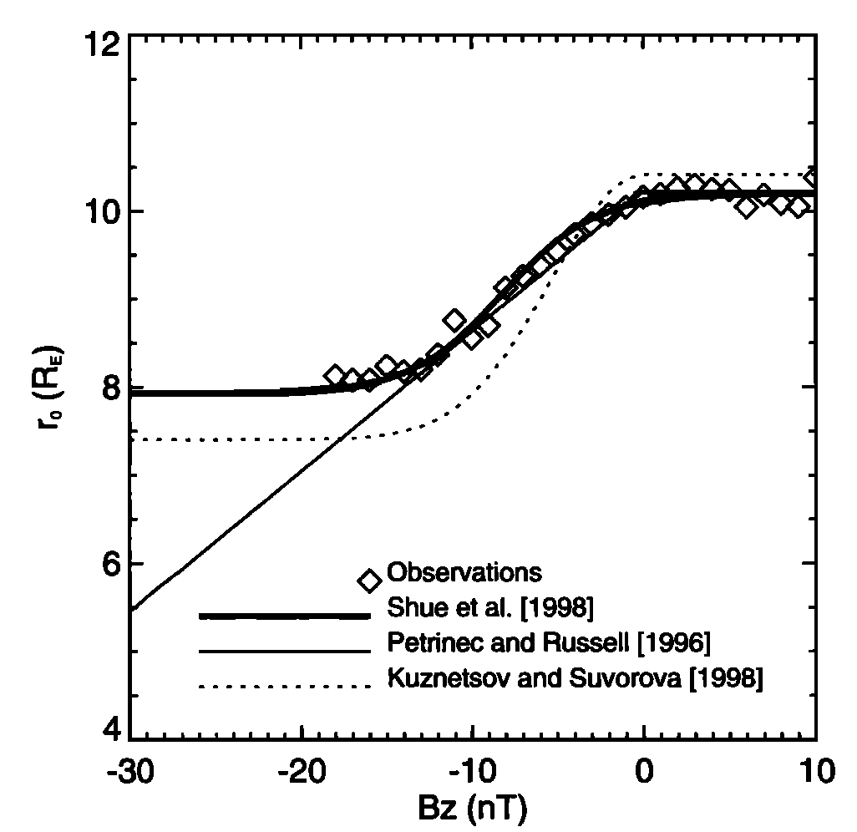
Terrestrial Dayside MP-Erosion (empirical)
Stationary erosion:
Delayed convective
flux return from
the nightside
Saturation for strong
negative B_{IMF,z}
Shue et al. (1998)
Notes:
1:12

Slide 13
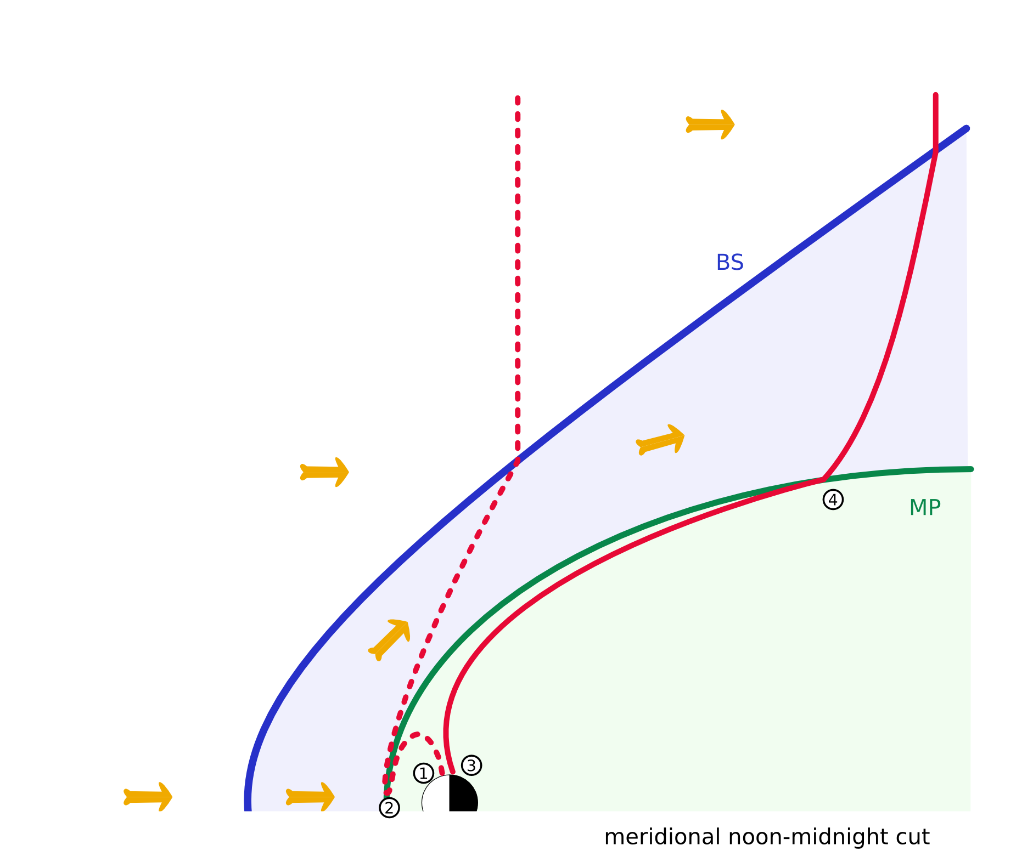
Fieldline Stretching
Fieldline stretching
→Magnetic field is amplified
(dynamo effect)
Reconnected dayside flux
Enhanced tail flux
(Slavin et al., (2010)
& Johnson et al., (2012)):
Notes:
0:48
Verstärkung durch Verlängerung
-> also keine komplette Erosion der tagseitigen Magnetosphäre wie von Slavin angenommen

Slide 14

Compression & Erosion II
Pressure balance at magnetopause yields:
Taking into account the effect of
erosion due to reconnection:
Notes:
Erosion – compression law
Leicht anderer Exponent für Merkur

Slide 15
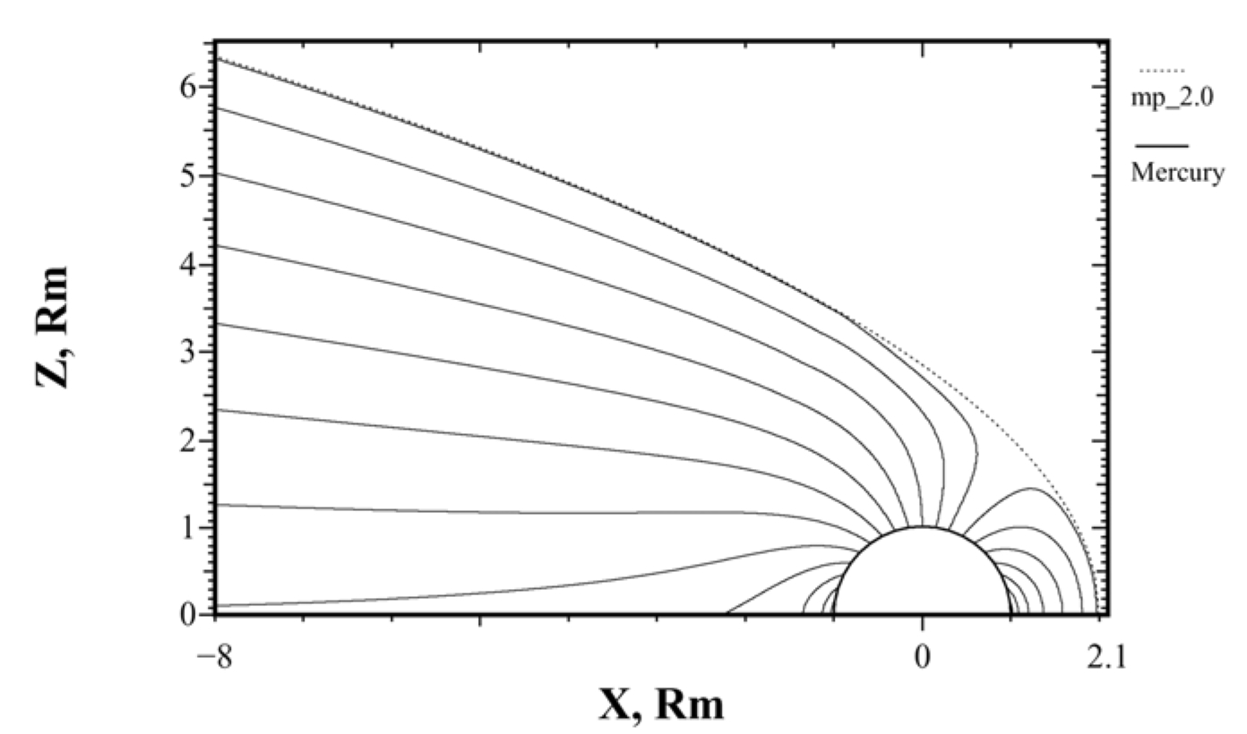
Parabolic Magnetosphere Model
Alexeev et al. (2008)
Average model control parameters from Johnson et al. (2012),
who analysed orbital Messenger data.
Notes:
0:25
Johnson used Messenger orbital data to obtain average model

Slide 16
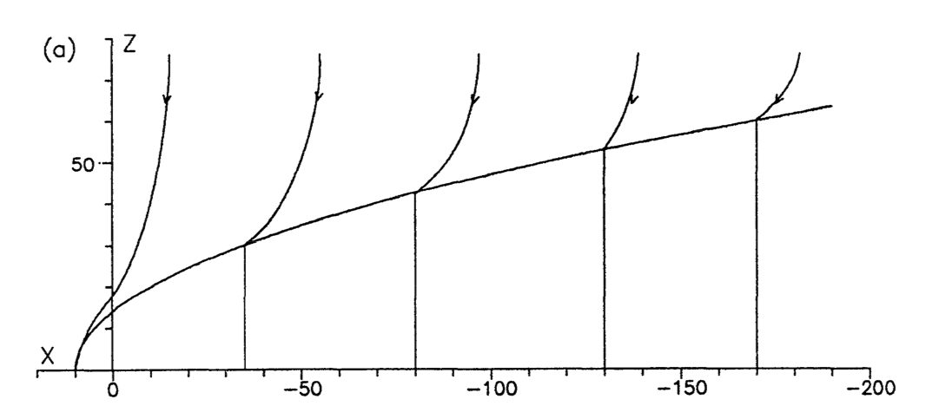
IMF Penetration

Slide 17
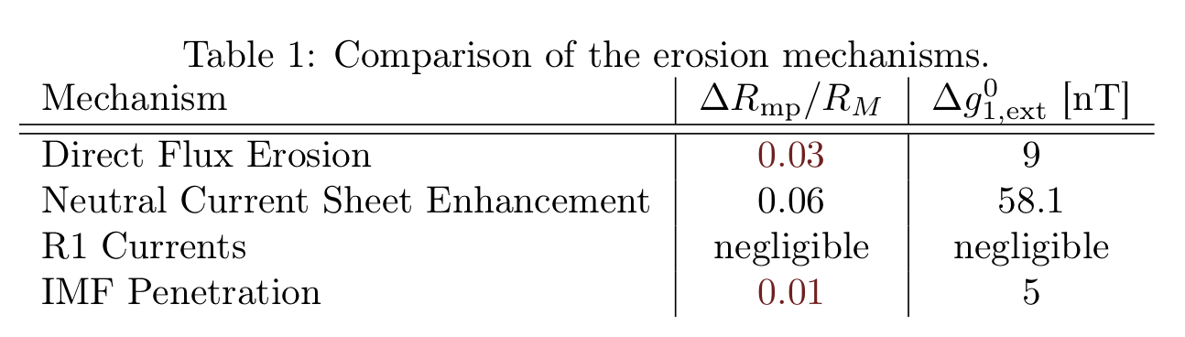
Comparison of Erosion Effects

Slide 18
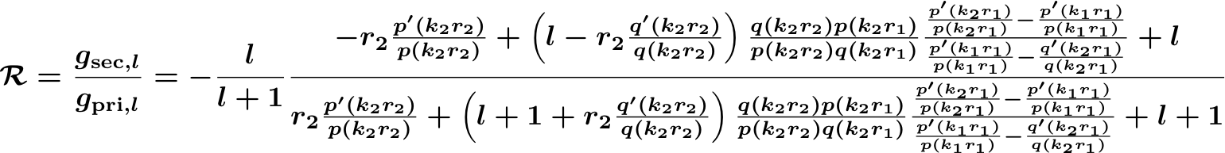

Rikitake-Factor for a 2-shell model
Induction parameter

Slide 19
Induction Modelling

Slide 20
R1 Currents
Notes:
R1 Ströme, Bild von Anderson

Slide 21
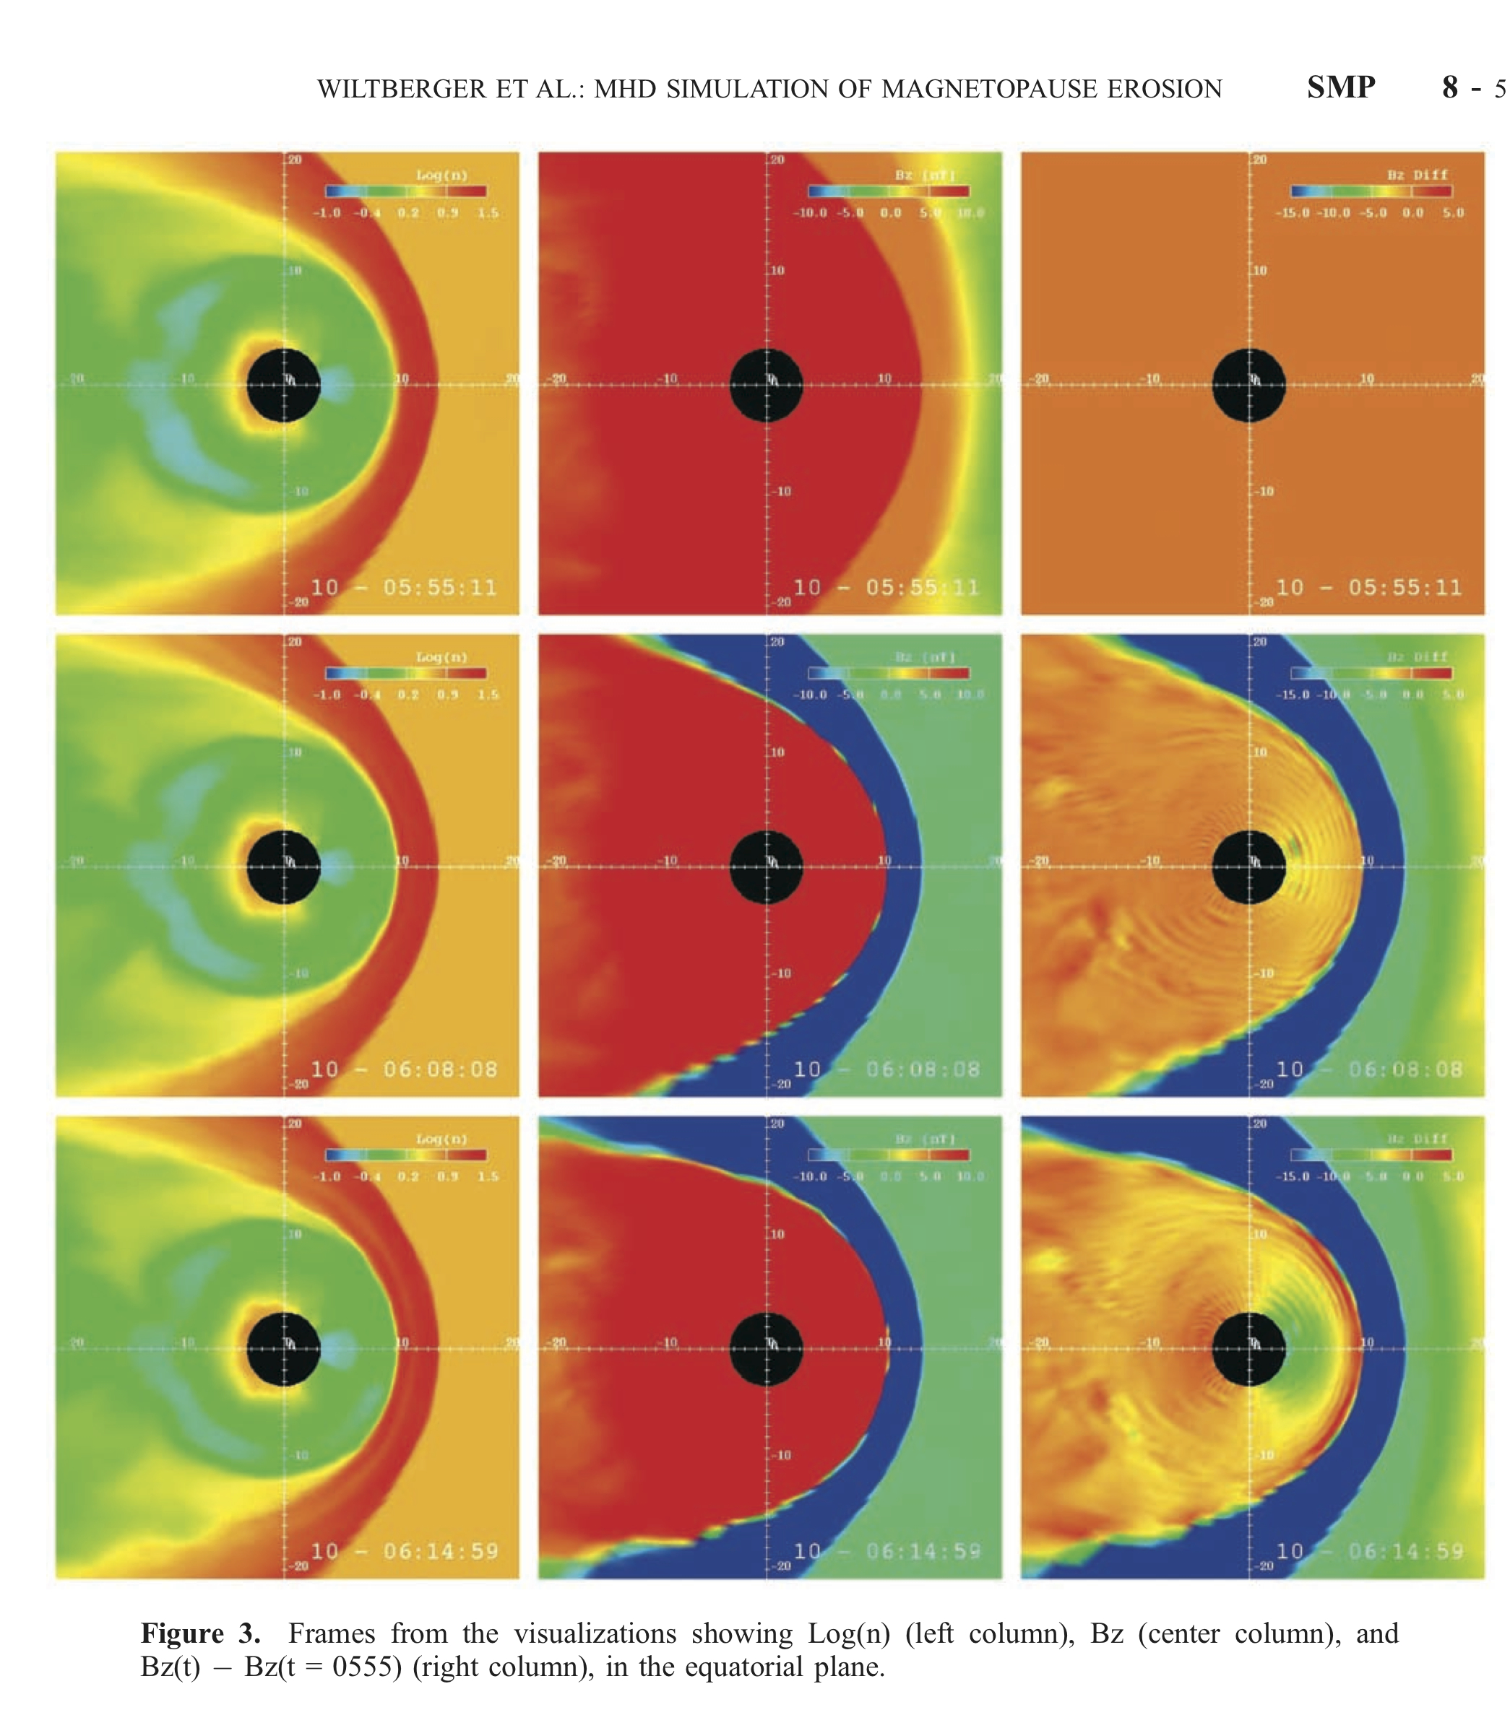
n
B_{z}
dB_{z}
t

Slide 22
