Slide 1
Dynamo model explanation for Mercury’s unusual magnetic field
Futoshi Takahashi
Kyushu University, Japan

Slide 2
Mercury’s Magnetic Field
Discovered by Mariner 10 in 1974-1975
Confirmed by MESSENGER
  Small dipole moment 190 nT R_{M}³ (R_{M}= 2440 km)
  Offset 0.2 R_{M} to the north
  Nearly axisymmetric
  Low secular variation
  (Anderson et al. 2012; Johnson et al., 2012;
  Philpott et al. 2014)
  Cao et al. (2014)

Slide 3
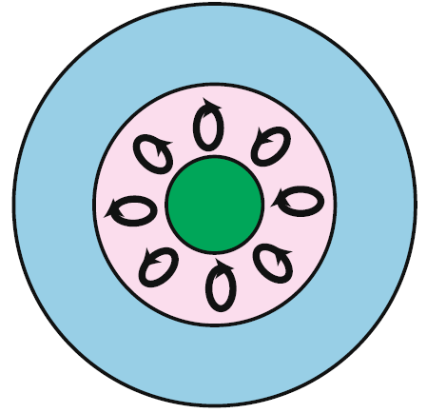
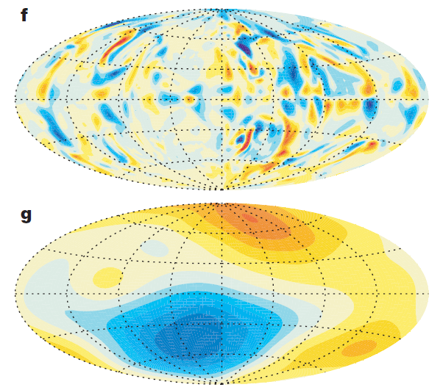
Dynamo with stably stratified layer
Br@bottom of stable layer
Interval: 25,000 nT
Thermally
Stable layer
Ω
Inner
core
From Stanley & Glatzmaier (2010)
Non-dipolar dynamo in the core.
Multi-polar and high frequency components are attenuated through the conducting stable layer due to the skin effect.
Only low frequency dipolar field survives.
Br@R_{M}
Interval: 30 nT
Christensen (2006)

Slide 4
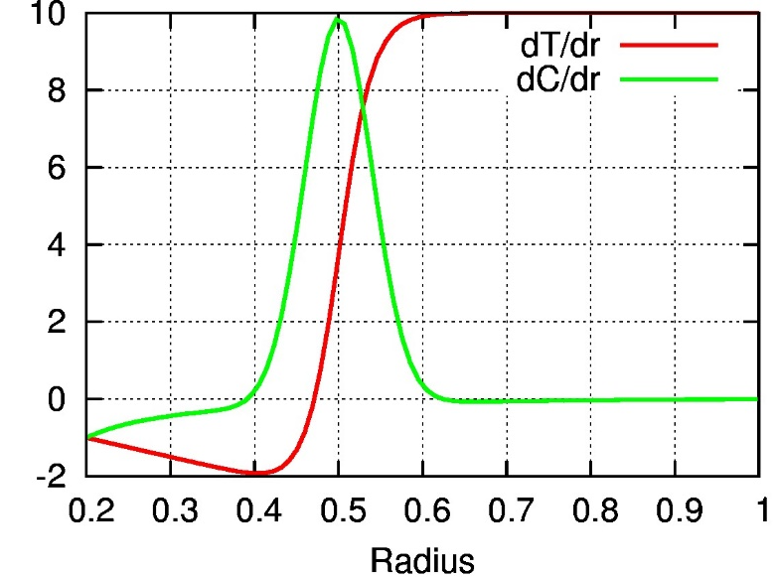
Model 1:Snow layer dynamo
Compositionally
Stably stratified layer
Heat & compositional
flux
Thermally
stably stratified
Dumberry & Rivoldini (2014)
Compositionally stable
CMB
IC
Fe-rich Snow
Thermally stable
Flux
stable
Floating S-rich fluid
unstable
ICB
CMB

Slide 5
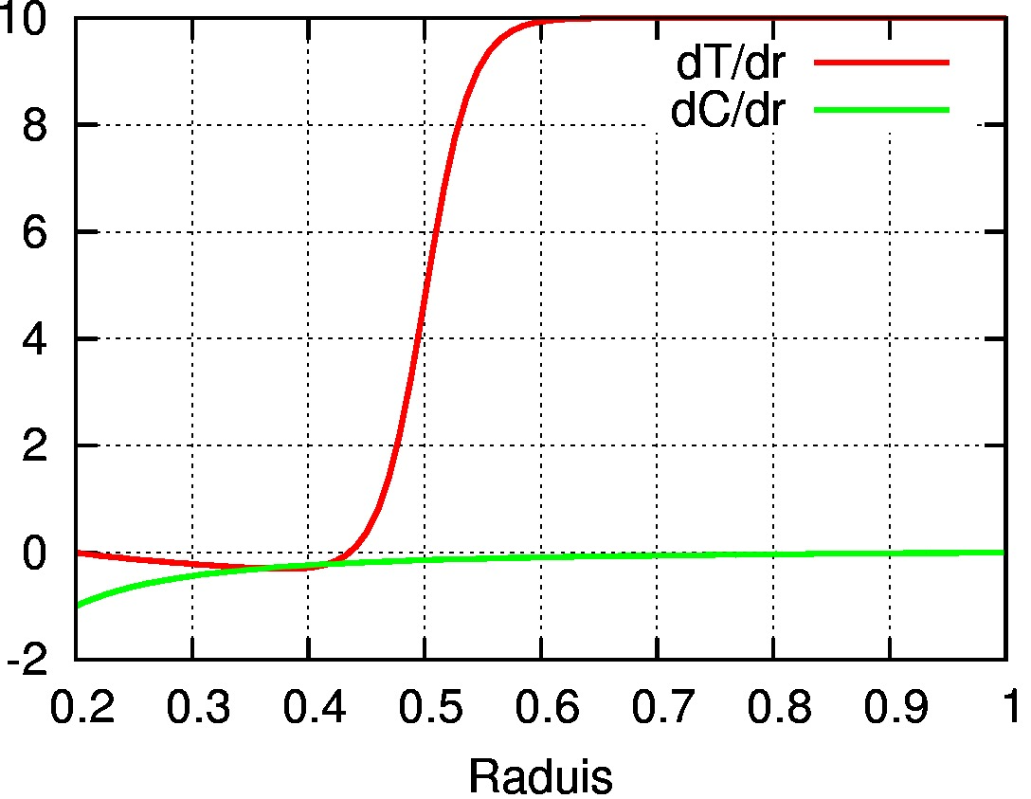
Model 2:Deep snow dynamo
Fe-rich Snow
CMB
Thermally
stably stratified
Dumberry & Rivoldini (2014)
Thermally stable
IC
stable
Flux
Inner core growth
by snow accumulation
unstable
ICB
CMB

Slide 6
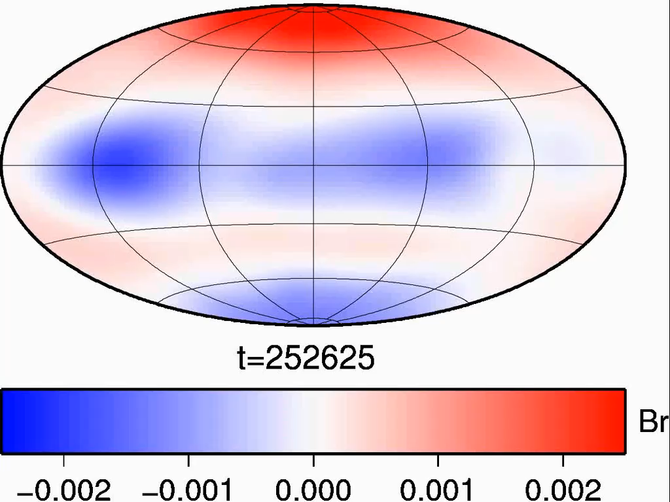
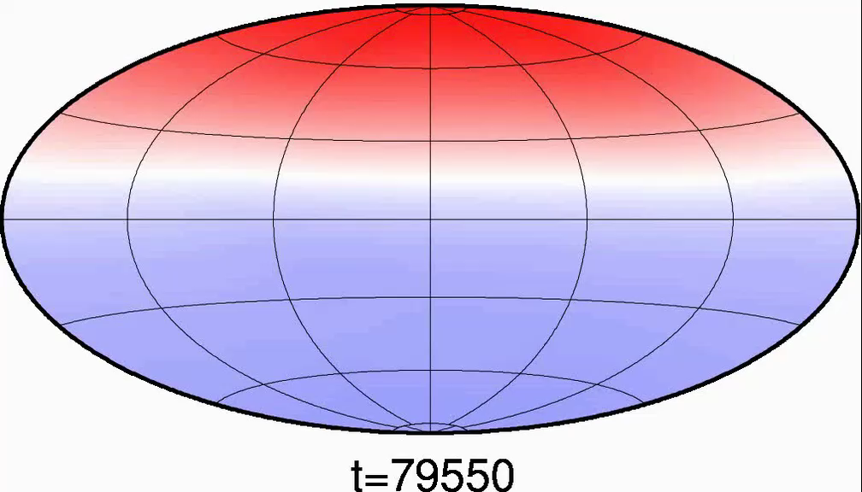
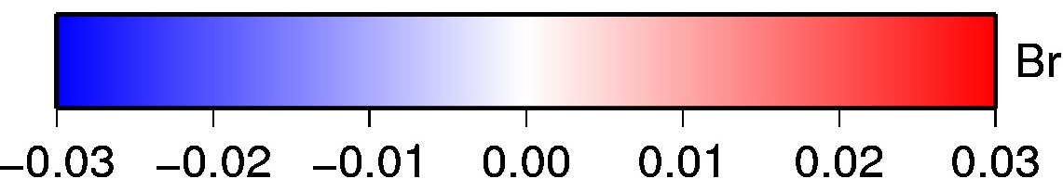
Magnetic field morphology@ CMB
Snow Layer
Deep Snow
Dipole offset: 0.23R_{M}
Dipole offset: 0.14R_{M}

Slide 7
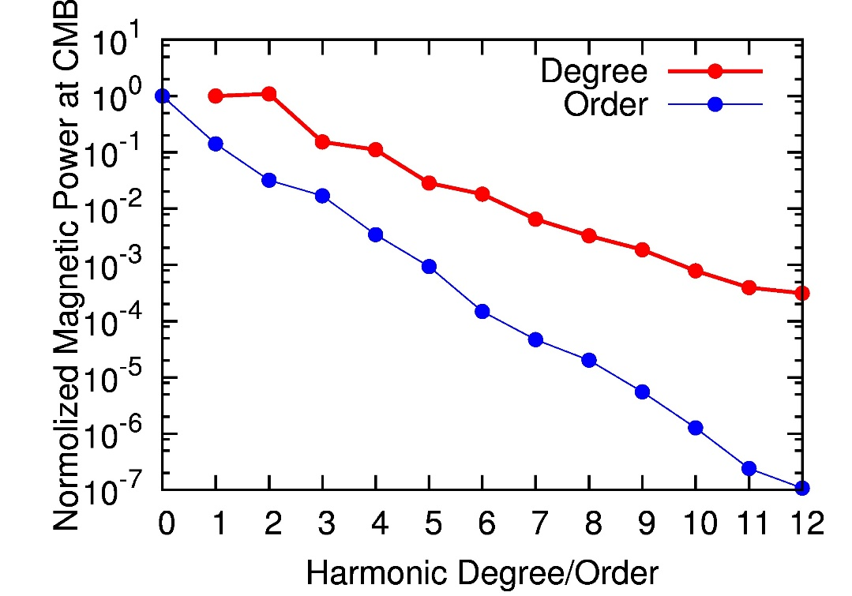
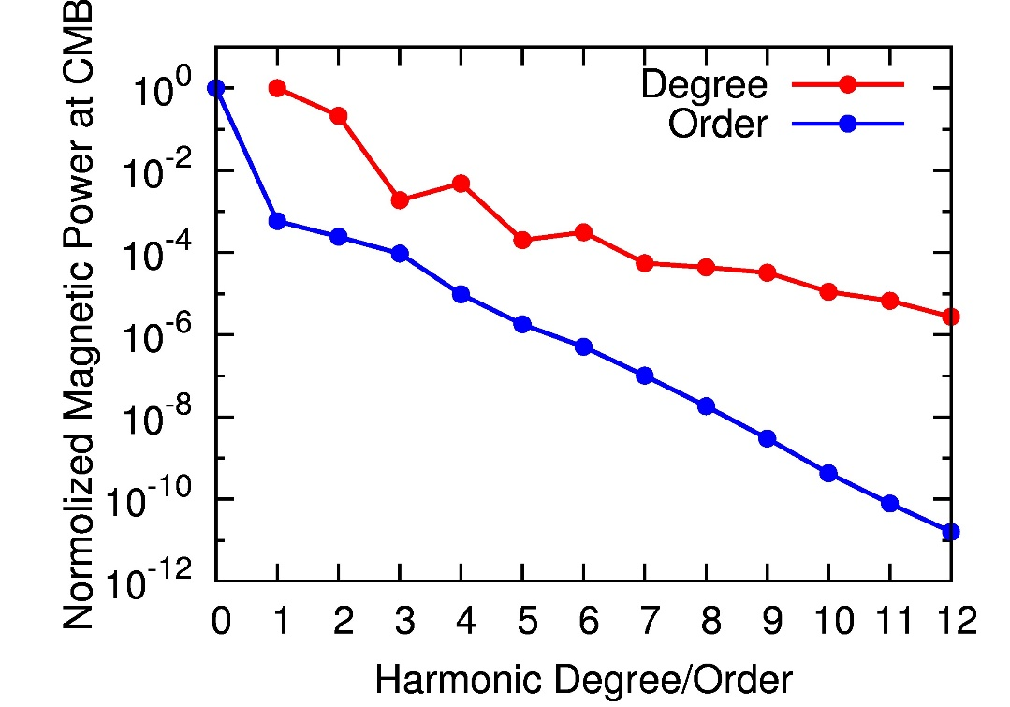
Magnetic power spectrum
Snow Layer
Deep Snow
Dipole and quadrupole, zonal
Dipole, zonal

Slide 8
Summary
Both snow layer & deep snow models yield Mercury-like weak, offset dipolar magnetic fields.
Weaker secular variation and stronger axisymmetry may prefer deep snow dynamo
Observations by BepiColombo is needed to further understand and constrain Mercury’s dynamo and the current state of core

