Slide 1
MESSENGER observations of Mercury’s northern cusp
Jim M. Raines
University of Michigan
Patrick J. Tracy, Daniel J. Gershman, Gang Kai Poh, James A. Slavin, Thomas H. Zurbuchen, Haje Korth, Brian J. Anderson, and Sean C. Solomon
MESSENGER-BepiColombo Joint Meeting
16 June 2015
Notes:
Add co-authors

Slide 2
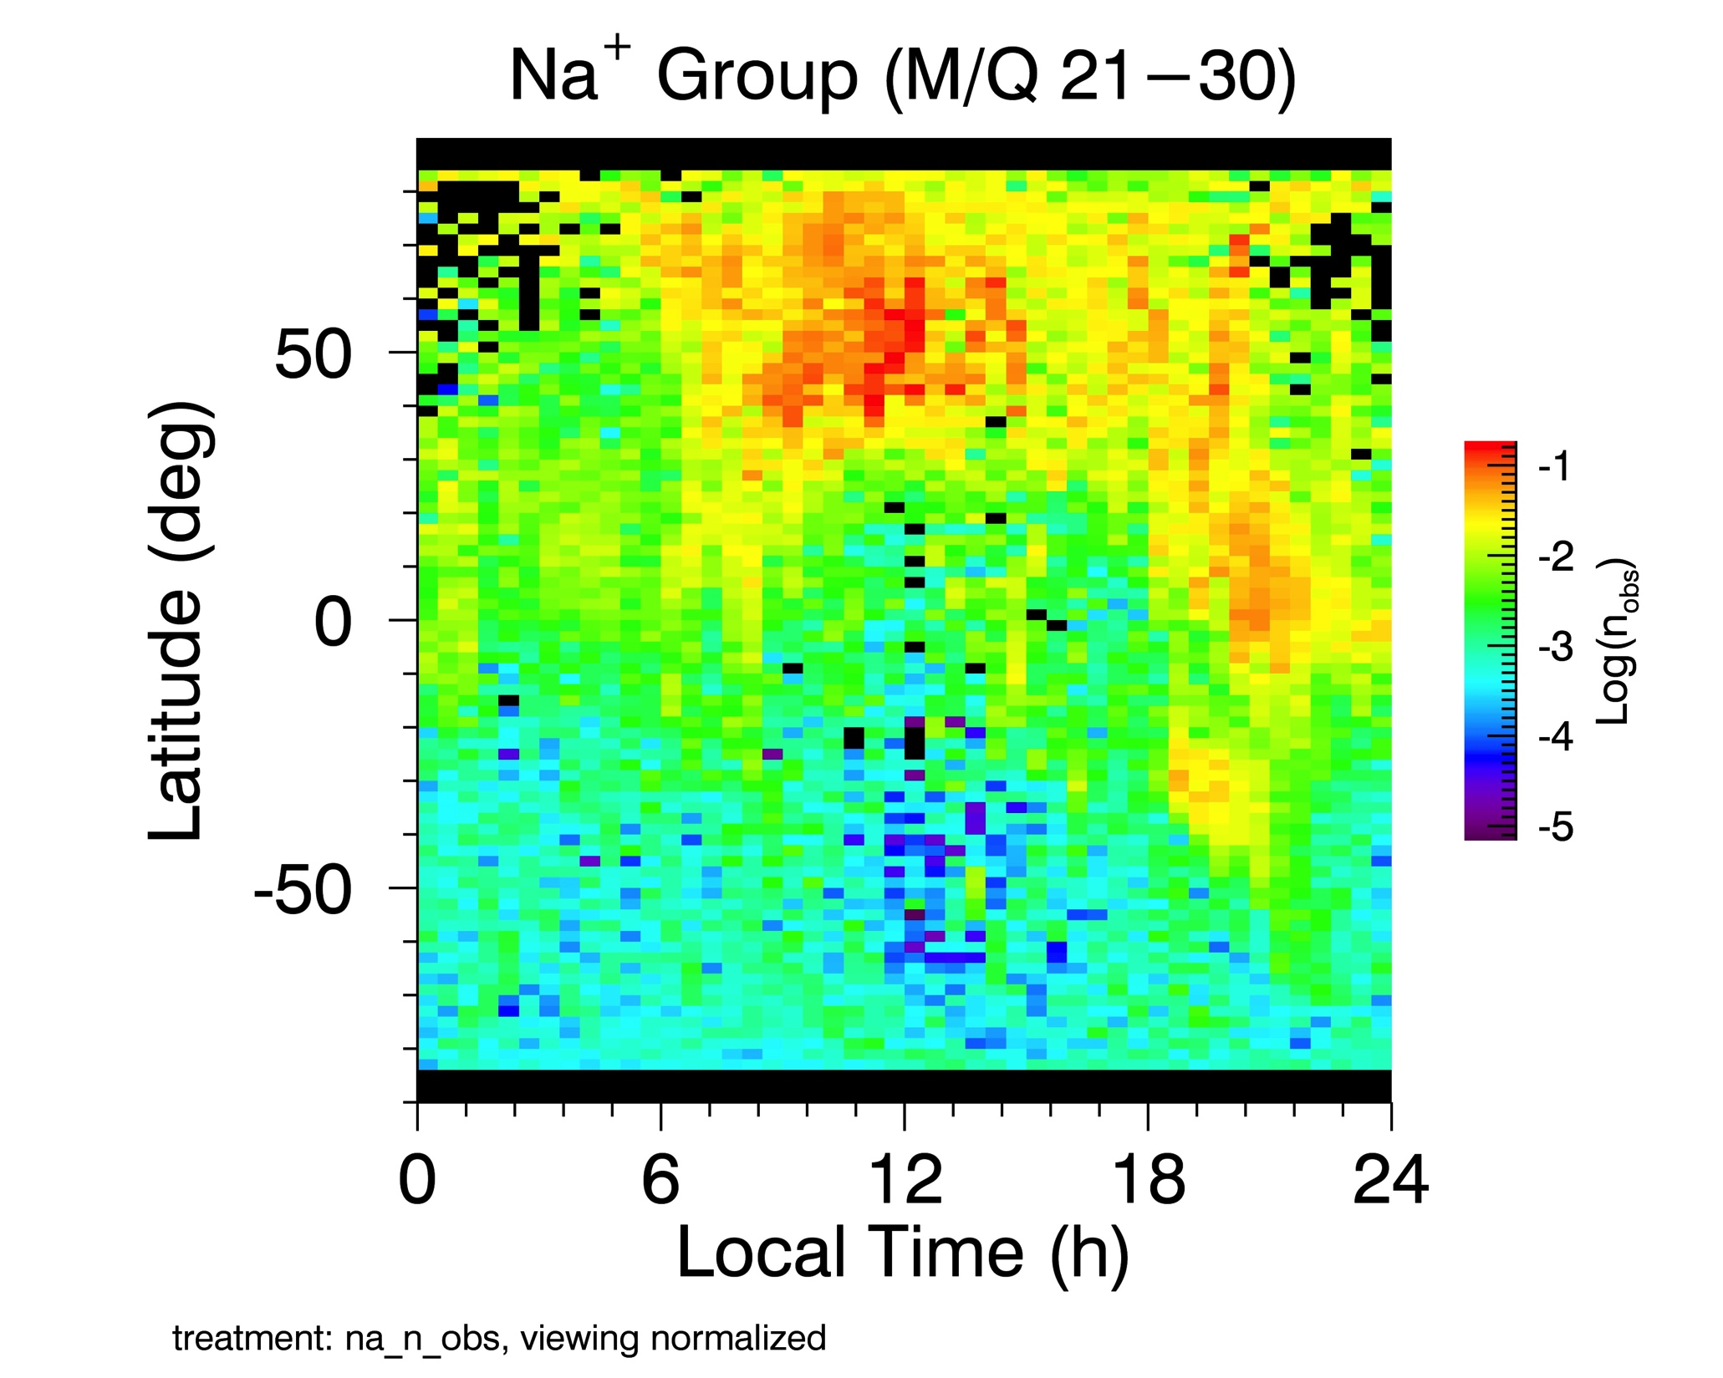
Magnetospheric Cusps
First orbital observations
Updated version from Zurbuchen et al., 2011
Enhanced plasma flux observed on >90% orbits
LAT: 30-80; LT 6-14 h. Consistent with analysis of magnetic depressions [Winslow et al., 2012]
Na⁺-group ions dominate planetary species, but He⁺ and O⁺ group ions observed.
2

Slide 3
Three sources for cusp plasma identified
Raines et al., 2014
1. Solar wind H⁺ enter on newly reconnected field lines, loss cone shows some will precipitate onto surface.
2. Upwelling Na⁺ ions observed down to 70 km altitude may be from surface sputtering.
Energy: 100-300 eV.
3. Na⁺ are ionized near the magnetopause and driven into the cusp by reconnection.
Energy: 2.7 keV (ave)

Slide 4
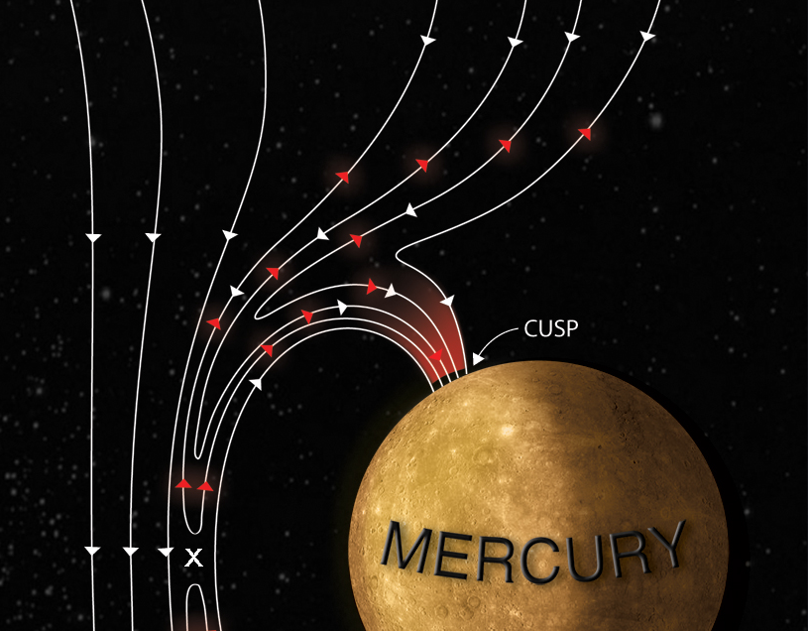
Typical case 3: Active
Energy dispersion curve
Cusp
Dayside Na⁺-group ions

Slide 5
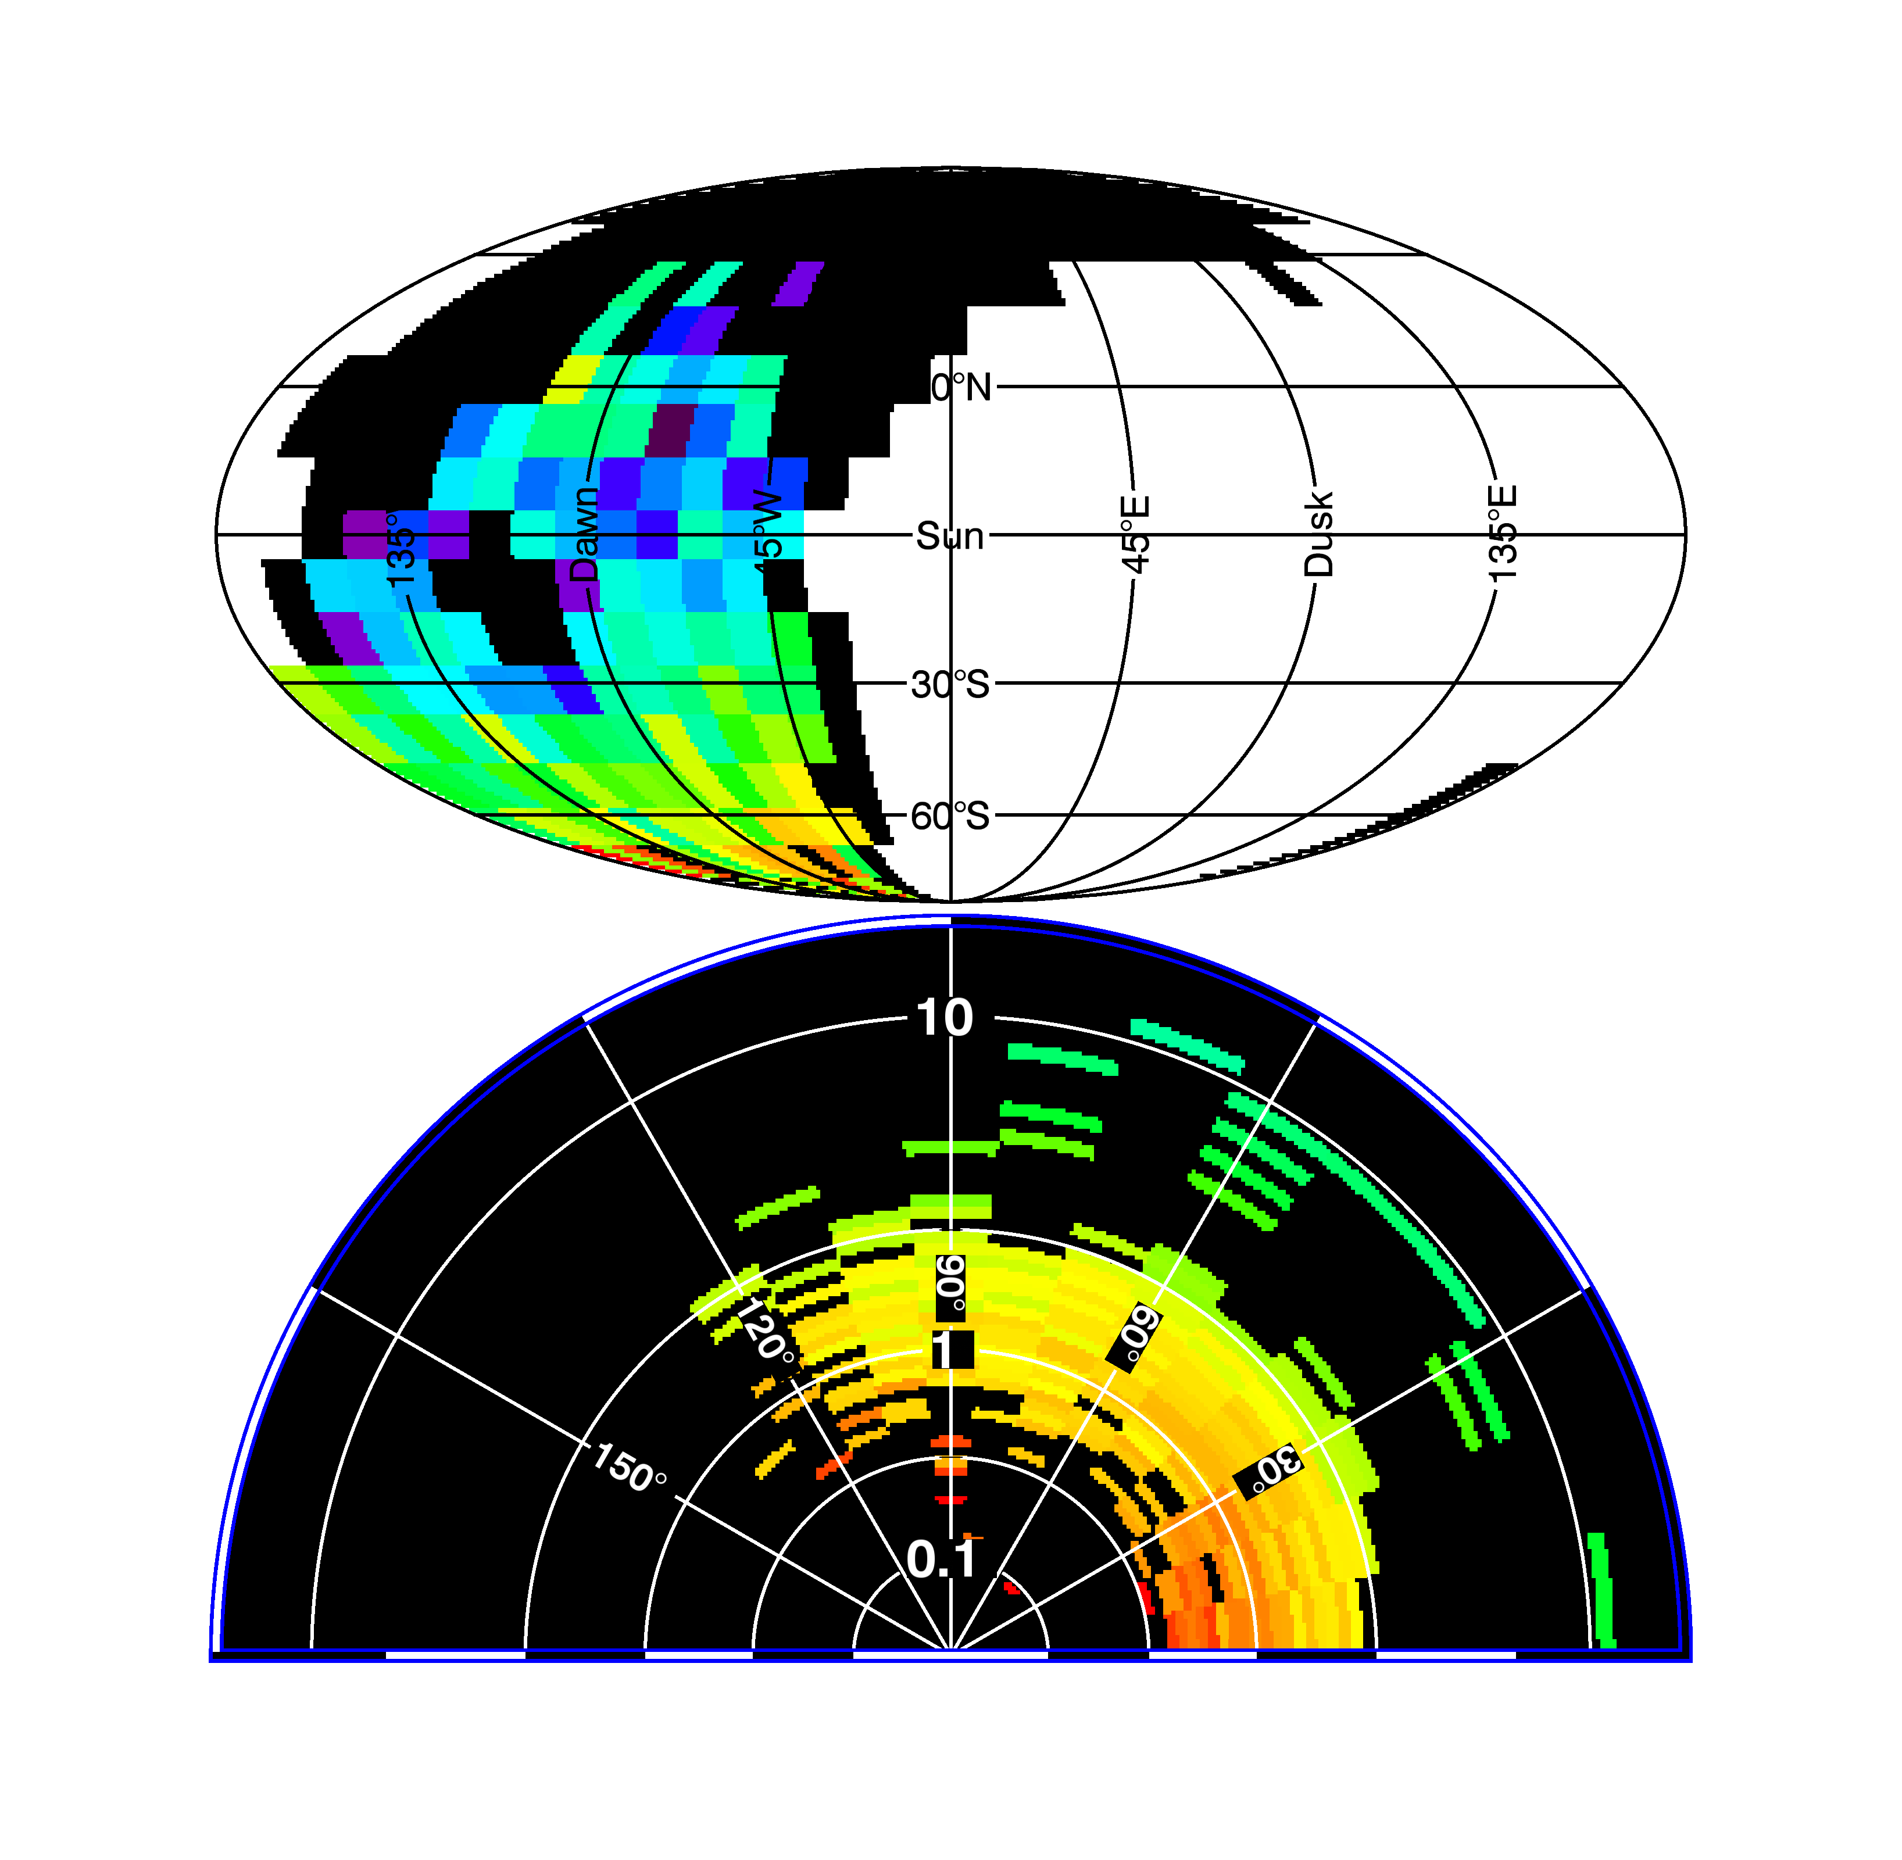
Precipitating protons
H⁺ in cusp
α=180
α=0
surface →
50-60° Loss cone
Flow into cusp down to surface
Reflectometry: 56-62°
Winslow et al., 2014
5
Notes:
Clean, 140° cut-off angle evidence of 50° loss cone evident. Consistent with 59° average loss cone [Winslow et al., 2014]
Very narrow (~15°) beam directed toward surface is <10 s in duration
6.2 x 10⁷ (cm² s)⁻¹ PPT flux

Slide 6
Upwellng Na+
Pitch angles for Na⁺ in cusp
α=180
α=0
Surface
Very little flux directed at surface
Upwelling component

Slide 7
North-flowing beam on dayside consistent with freshly-reconnected field lines sweeping over the cusp
Cusp
Cusp
Dayside
Dayside

Slide 8
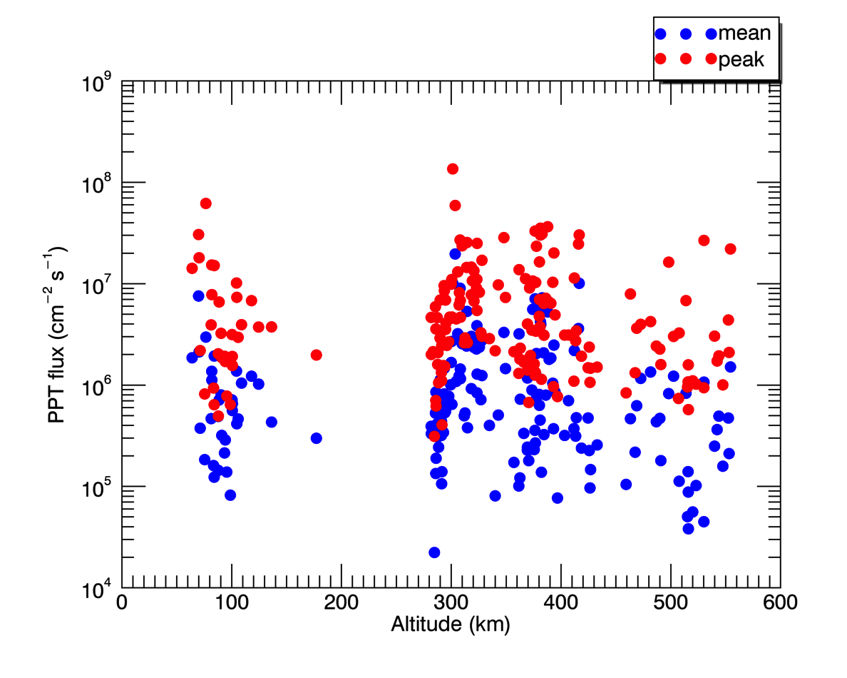
Statistical results (1)
Proton precipitation (PPT) flux varies over 4 orders of magnitude, likely due to changing solar wind conditions.

Slide 9
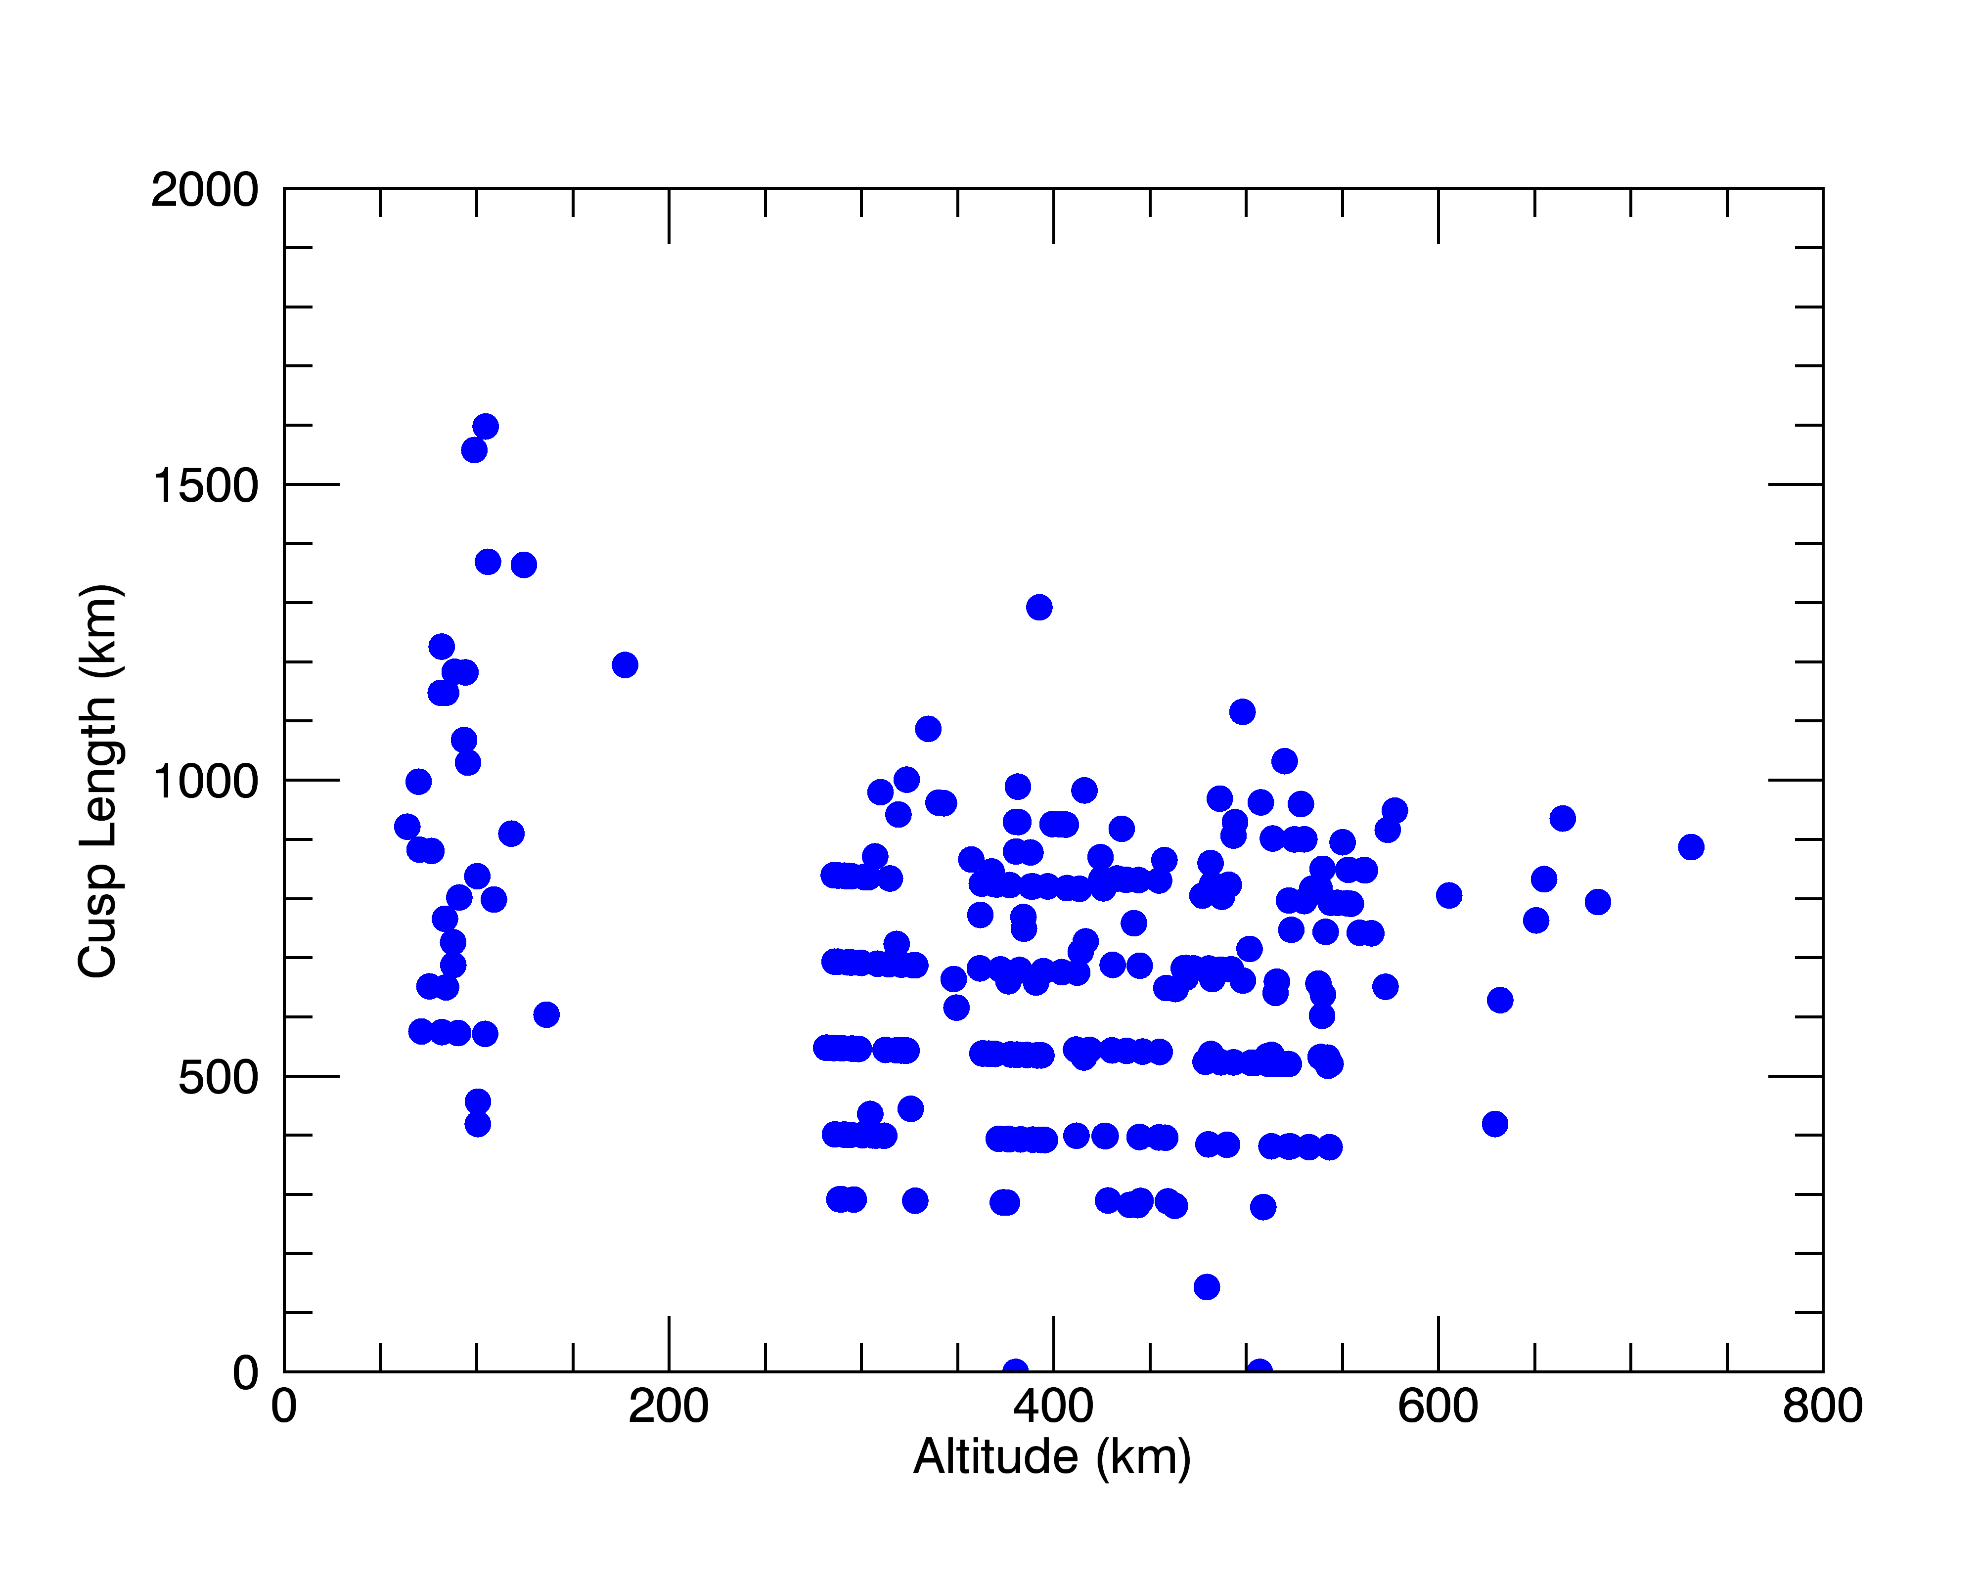
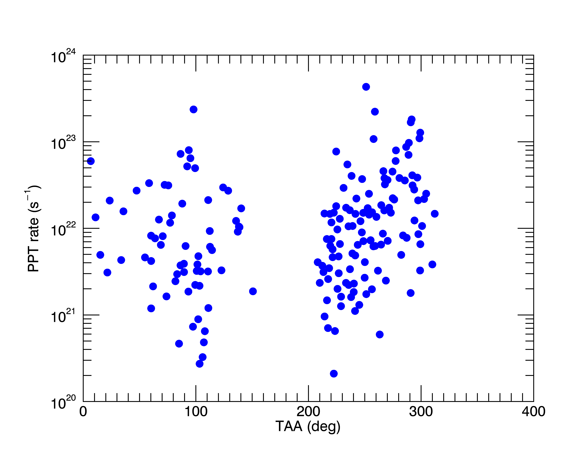
Statistical results (2)
Variation due to solar wind conditions dominates variations due to altitude.
(PPT rate calculated assuming circular cusp of measured length.)

Slide 10
Summary and Beyond
Studies in progress now
Detailed examination very low altitude data (< 100 km)
Identification of reconnection site through energy dispersion analysis
Very high time resolution (150 ms) analysis of cusp dynamics
Search for new species m/q > 30 via laboratory measurements
Summary
Proton precipitation observed at all altitudes substantial. Fluxes range 10⁴ – 10⁸ cm⁻² s⁻¹.
>50° loss cone observed as <130° cutoff angle
High-energy (> 1 keV) Na+ is swept in by reconnection and is evident at all altitudes
Low-energy (100-300 keV), upwelling is Na+ evident at all altitudes, though not directly coupled to observed proton precipitation flux.
Variation due to solar wind conditions dominates those due to altitude.
Notes:
Change!

