Slide 1
Modeling Mercury’s magnetospheric magnetic field: Past, present, and future
Haje Korth, Nikolai A. Tsyganenko, Catherine L. Johnson, Lydia C. Philpott, Brian J. Anderson, Sean C. Solomon, Ralph L. McNutt Jr.
16 June 2015
MESSENGER BepiColombo Joint Science Meeting Berlin, Germany

Slide 2
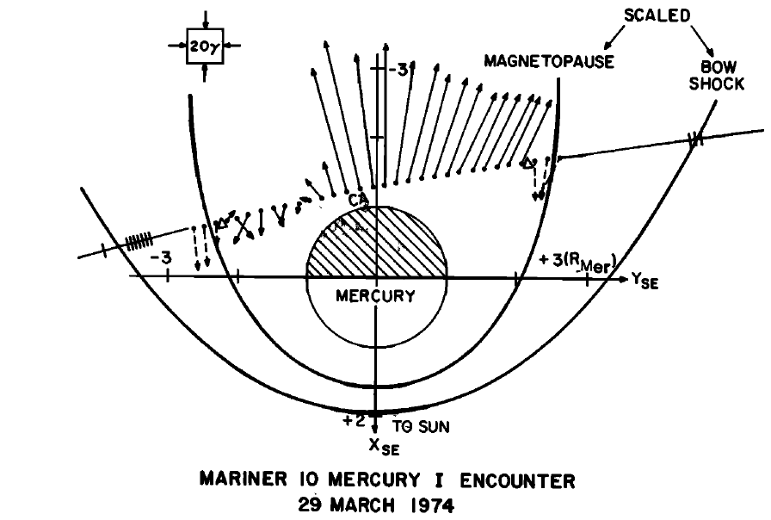
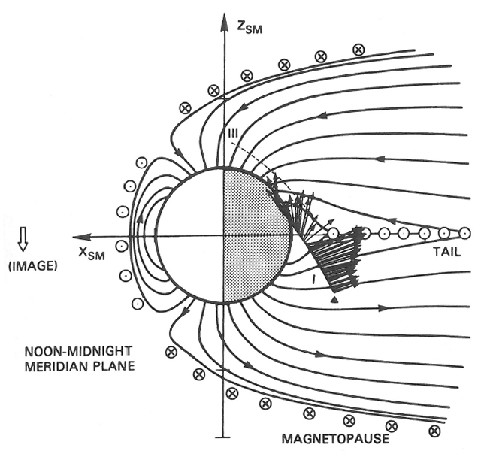
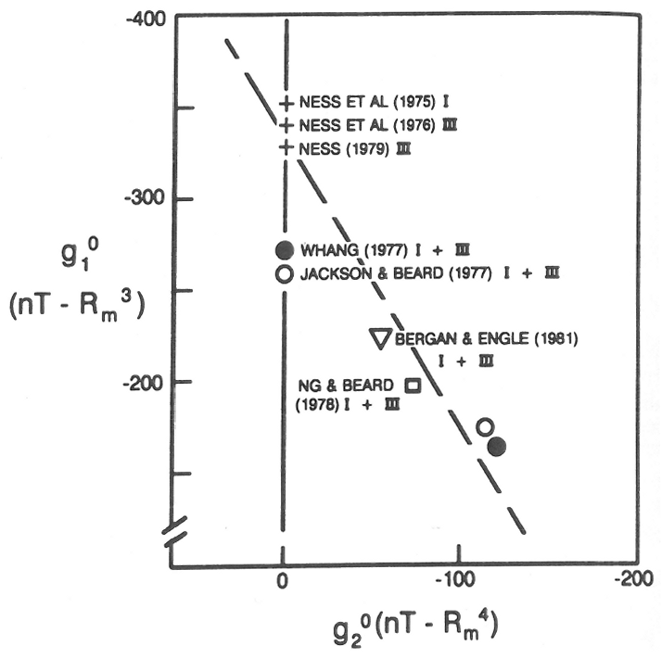
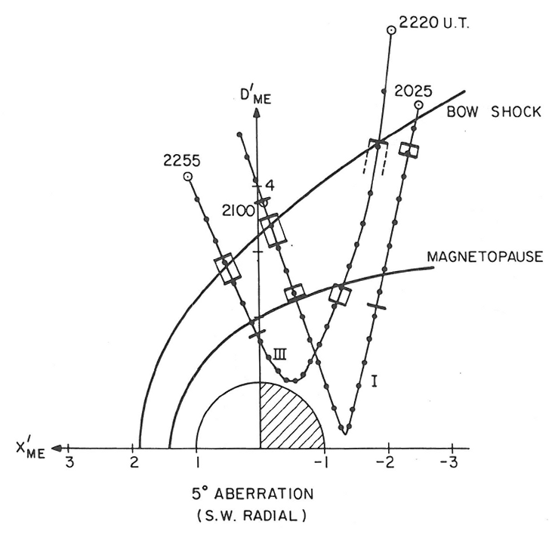
Past: Mariner 10
Two flybys of Mariner 10 through Mercury’s magnetosphere in 1974 and 1975.
Limited observations: one equatorial and one polar planetary flyby.
Dipole moment estimates varied greatly, correlated with higher-order terms.
Conceptual model of the magnetosphere, e.g., based on image dipole.
External fields and dipole offset poorly constrained.
Ness, 1975
Whang, 1975
Lepping, 1979
Connerney, 1975
Notes:
Early models of Mercury’s magnetospheric magnetic field were either Earth-like models scaled in size to account for Mercury’s smaller planetary magnetic moment [Luhmann et al., 1998; Korth et al., 2004] or developed specifically for the innermost planet with simplified assumptions for the geometry of the magnetospheric cavity [Grosser et al., 2004].

Slide 3
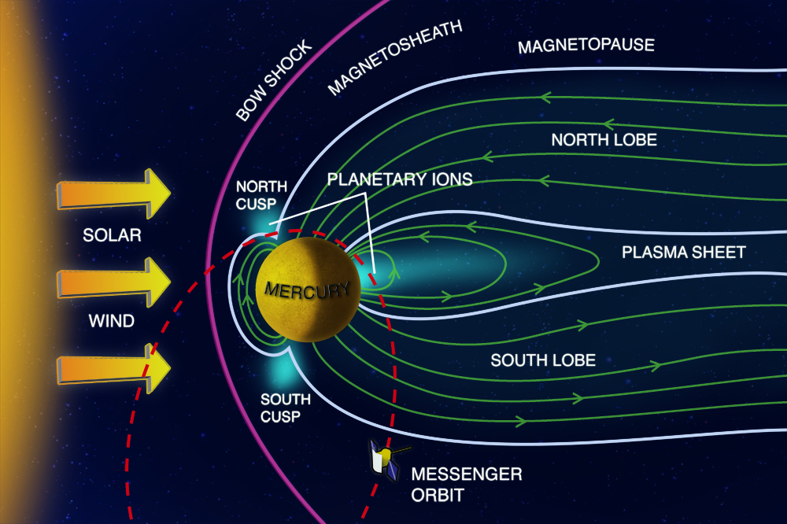
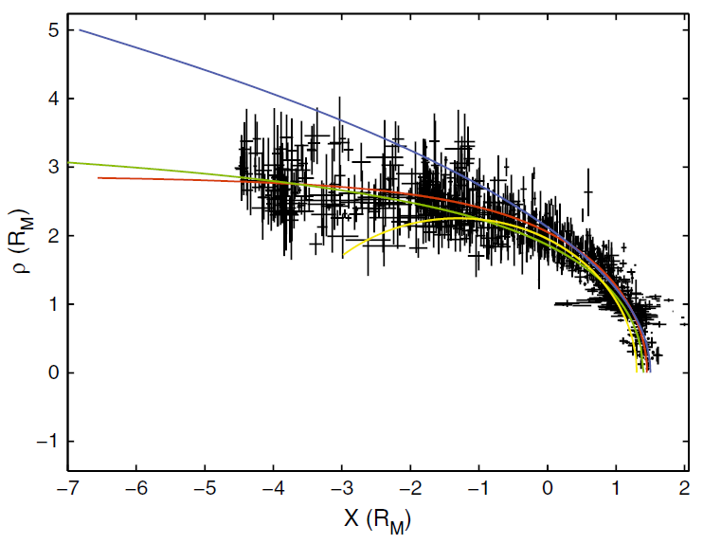
Present: MESSENGER
Orbit: elliptical, near-polar, 5−15000 km altitude, 12/8-h period, 0.2 h/day LT precession.
Fluxgate magnetometer, 20/s sampling in magnetosphere.
Data included in magnetic field model: 600 days (7 Mercury years), 1-min averaged data within observed magnetopause, 95,000 samples.
Data coverage: ≤5 R_{M} radial distance, low-altitude observations limited to northern hemisphere.
Winslow, 2013
Notes:
Presented here KT14; parameters for KT15 using twice as much data (1000 days, 185,000 samples) not substantially different.

Slide 4
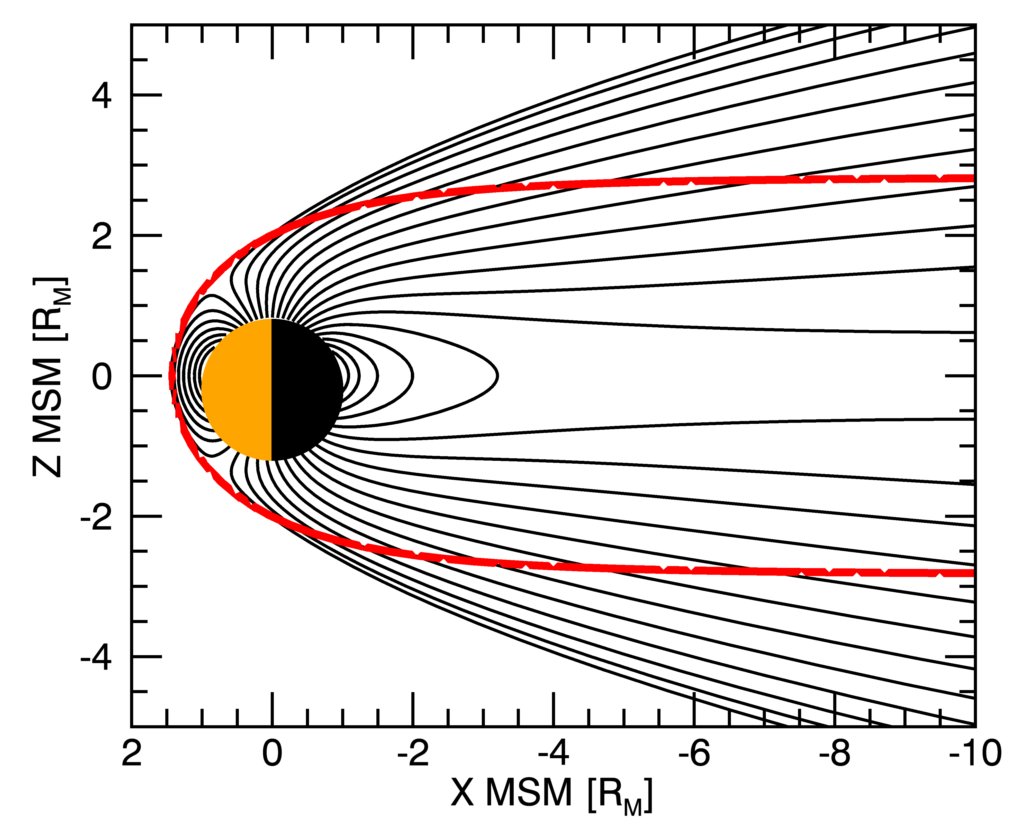
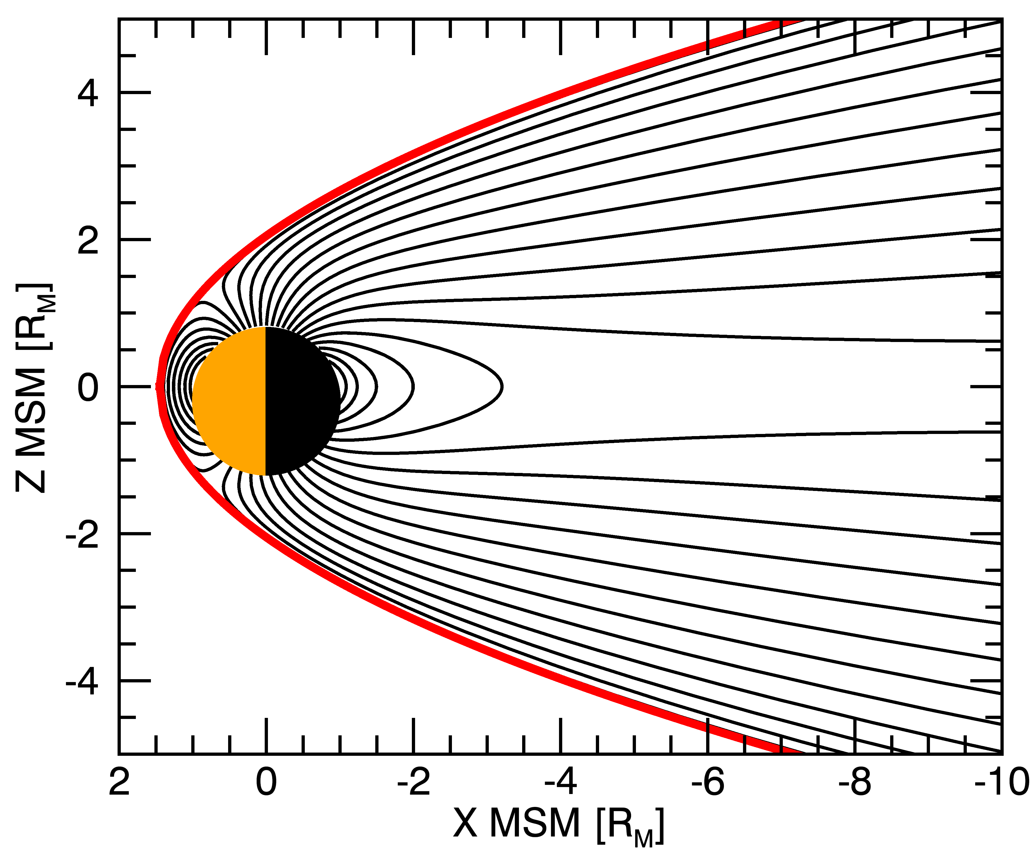
Paraboloid Model
Substantial magnetic fields from external current systems.
Accurate modeling of magnetospheric magnetic field is key to analyzing planetary field (dynamo, crustal, induced).
Paraboloid model: internal offset dipole field + cross-tail & magnetopause currents confined within a magnetopause prescribed by a paraboloid of revolution.
Model parameters directly observed: magnetopause shape, tail current sheet geometry, tail flux, dipole origin and tilt.
Limitations:
Model magnetopause shape deviates substantially from observations;
Discontinuity at inner edge of tail current yields O-lines;
Difficult to modify (rigidly tied to analytical formalism);
Slow (Bessel function integrals).

Slide 5
Tsyganenko Model Approach
Magnetopause separates planetary and interplanetary magnetic field lines: B_{n} = 0 holds at the magnetopause (ignores reconnection).
Analytical paraboloid model fulfills this condition exactly, but numerical approach to minimize B_{n} works just as well.
Advantages:
Allows for arbitrary magnetopause shape;
Definition of current systems independent of shielding function.
Modular external sources:
Current disk with smooth inner edge to avoid discontinuities;
Sheet current to provide continuity into far tail;
Additional current systems may be added.
Magnetopause shielding field adapted to best-fit Shue model.
Shue MP fit

Slide 6
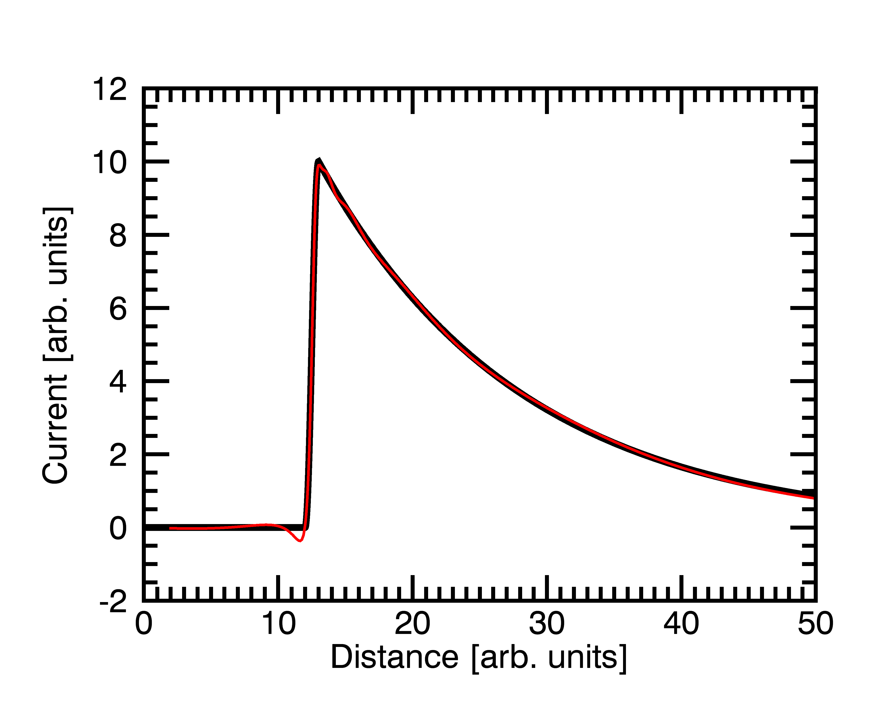
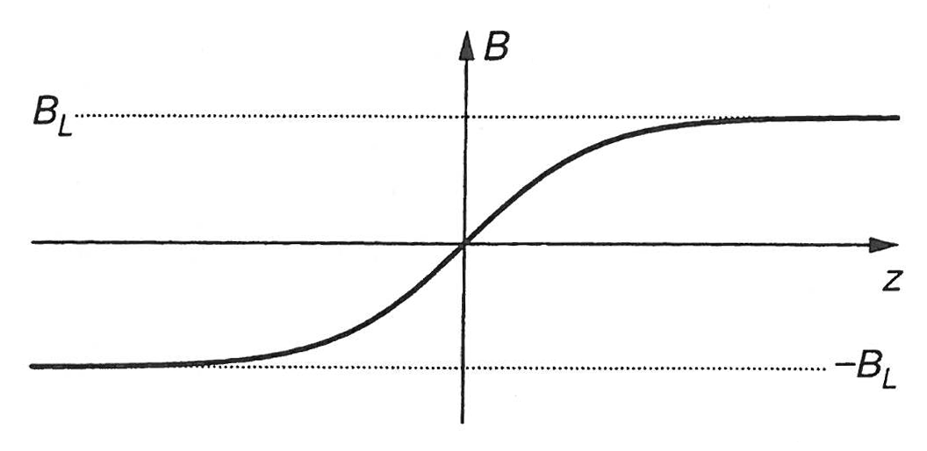
Continuous Cross-tail Current Sheet
Cross-tail current in inner magnetosphere represented by disk current; radial current profile is piece-wise continuous function.
Constant magnetotail at tailward distances >5 R_{M} modeled by sheet current.
Both currents are centered on magnetic equator and widen infinitely toward the dayside magnetosphere.
Magnetic field determined from numerically-fit (disk current) or analytic (sheet current) vector potential A as .
Tail-current amplitudes t_{1,2} fit to observations.
Disk Current
$$I\left(ρ\right)=0$$
Harris Sheet Current

Slide 7
Magnetopause Shielding Field
Magnetic field of magnetospheric sources is curl-free at the magnetopause (MP):
Box potentials provide simple and numerically efficient shielding field: with N² linear coefficients a_{ik} and N non-linear coefficients p_{i}.
Fit U by minimizing residual rms value of the normal magnetic field component:
Linear and non-linear coefficients, a_{ik} and p_{i}, obtained through singular value decomposition and downhill simplex method, respectively.
Each internal source has its own MP shielding current system.

Slide 8
Model Fitting
Initial dipole moment & offset taken from Johnson et al. (2012); later varied separately to confirm their best-fit value.
Retained nominal current sheet half-thickness from observations.
Amplitude of tail disk and sheet currents determined from minimization of rms residual magnetic field:
Fitting uses 1 min. averages within observed the magnetosphere in aberrated MSO coordinates over 7 Mercury years (DOY range 11083−12327).
Expansion of tail current sheet thickness:
X direction: set empirically to yield plausible current configuration with ∇ ⋅ B = 0 in the magnetosphere;
Y direction: match observed boundary between open and closed field lines;
Exact values for these parameters have small effect on rms residuals.
Notes:
Plausible configuration: X-direction=Magnitude of dayside equatorial current as small as possible. Y-direction=Open-closed field-line boundary of model matches that identified from particle precipitation.

Slide 9
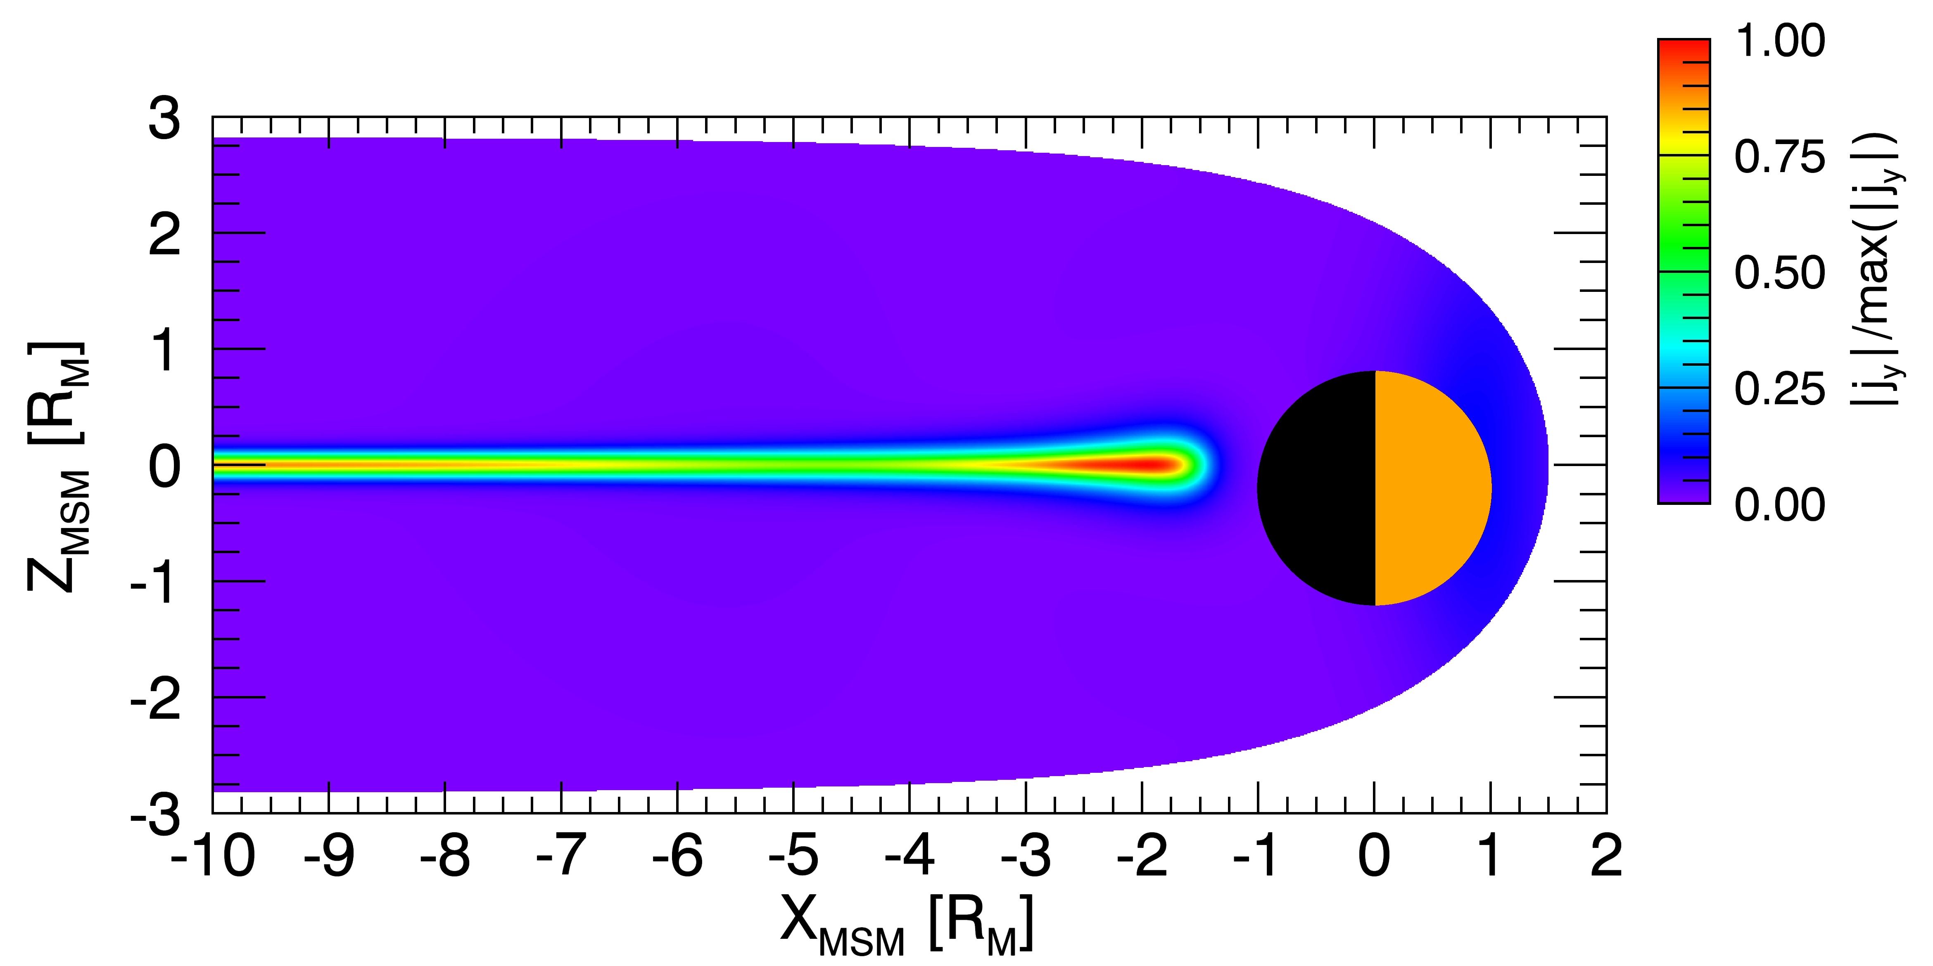
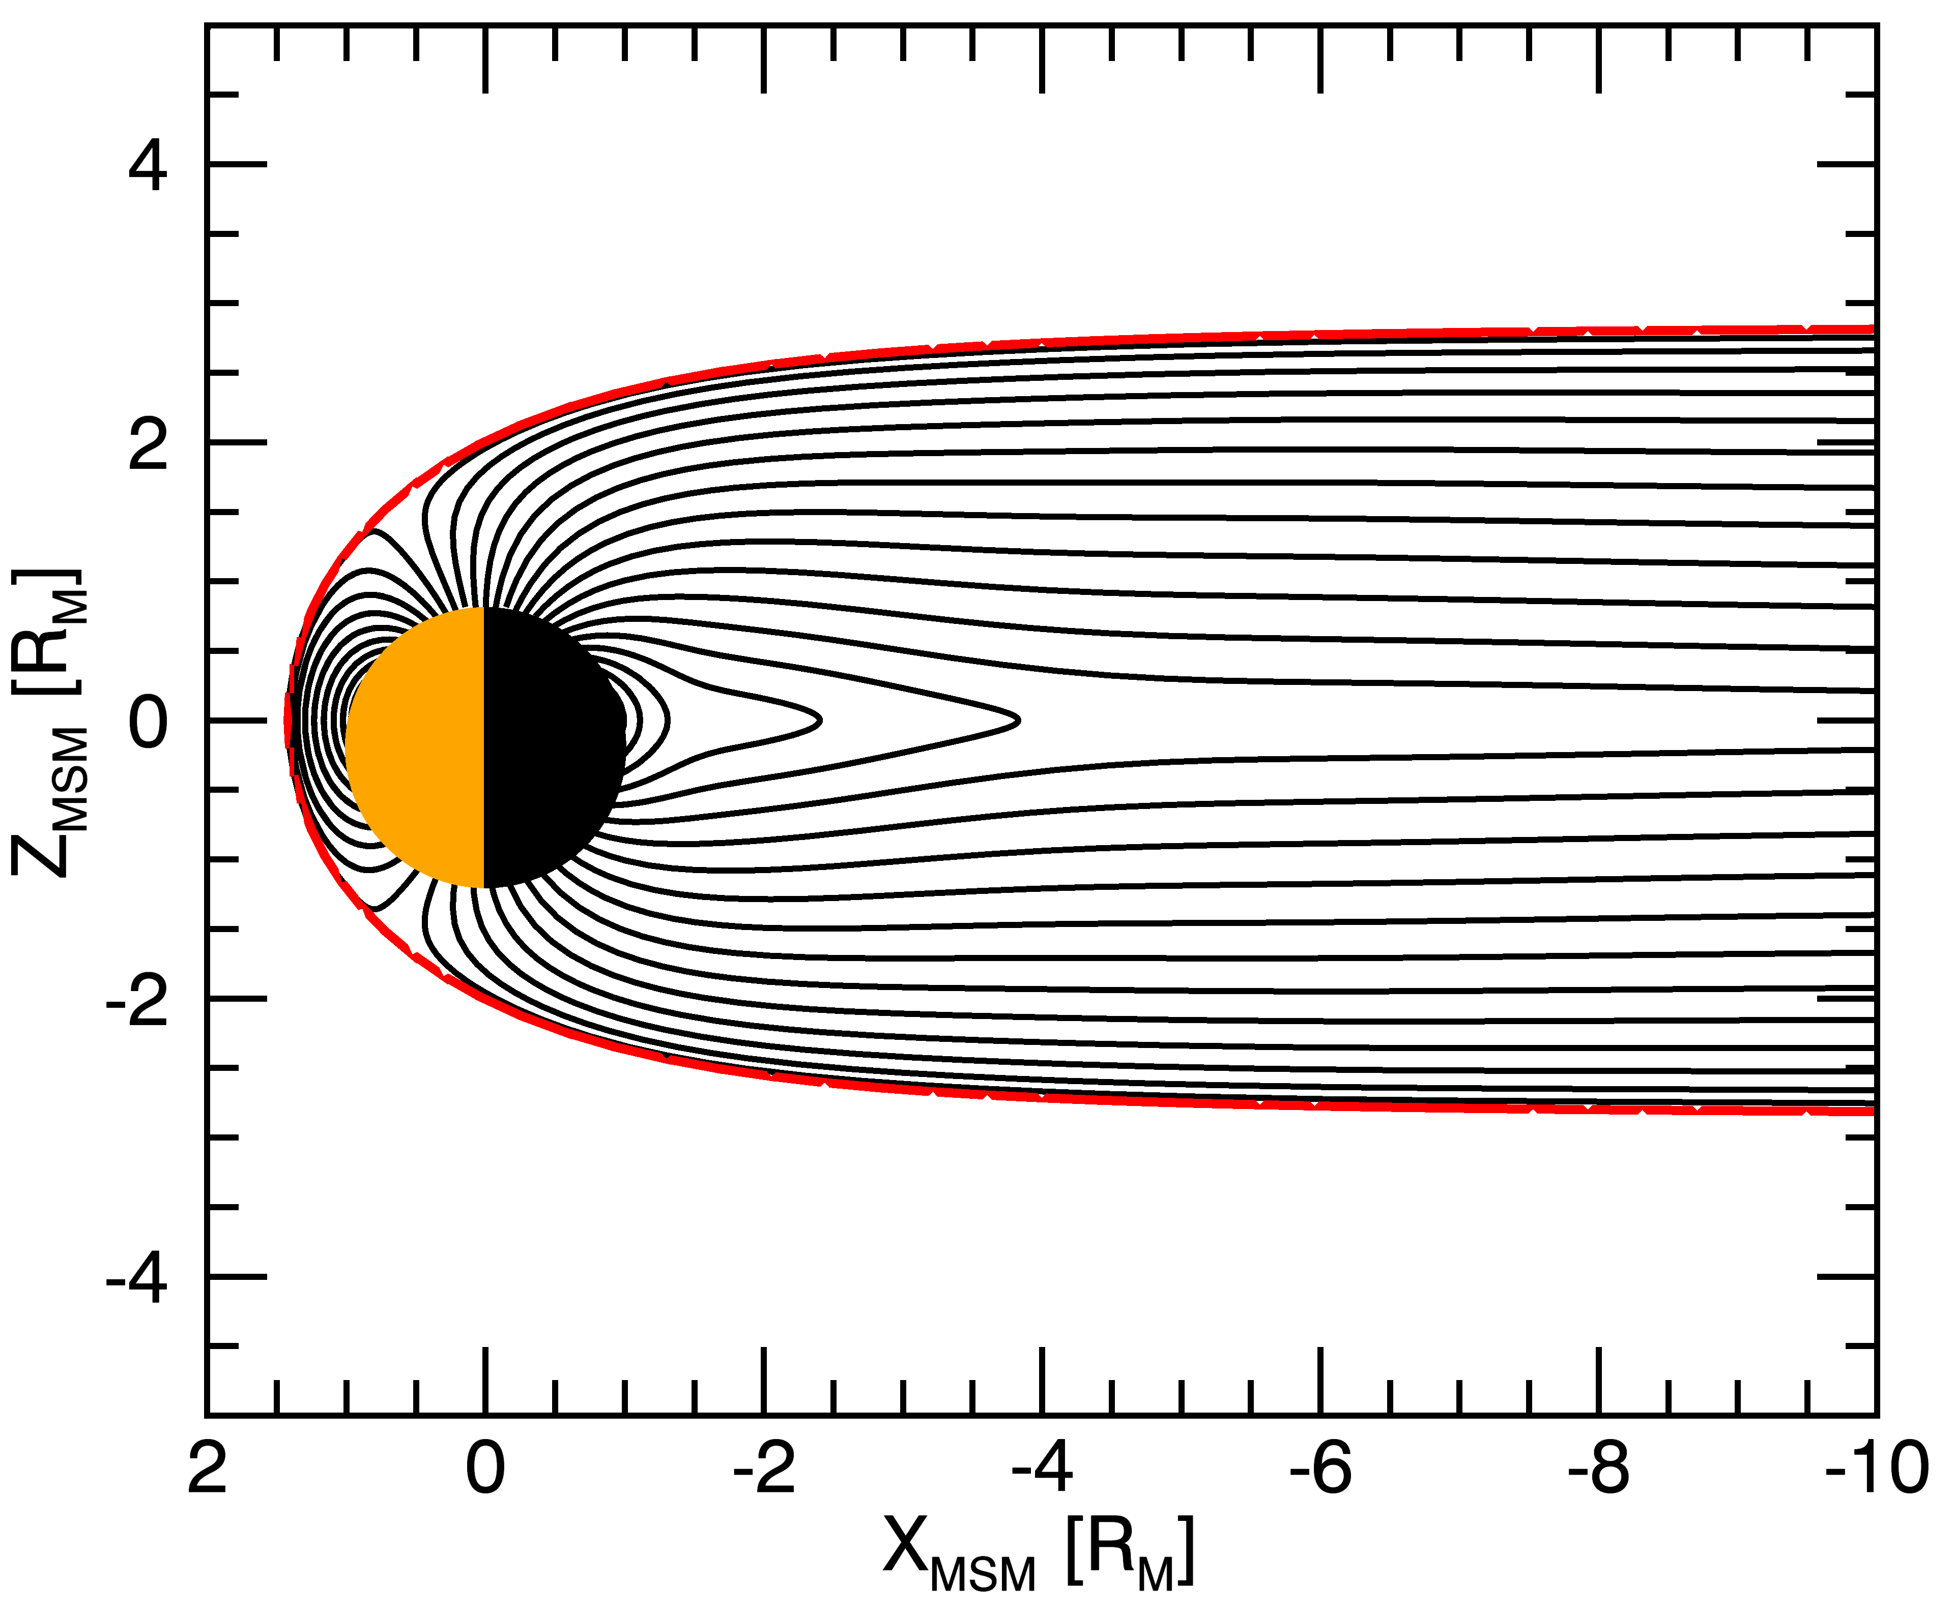
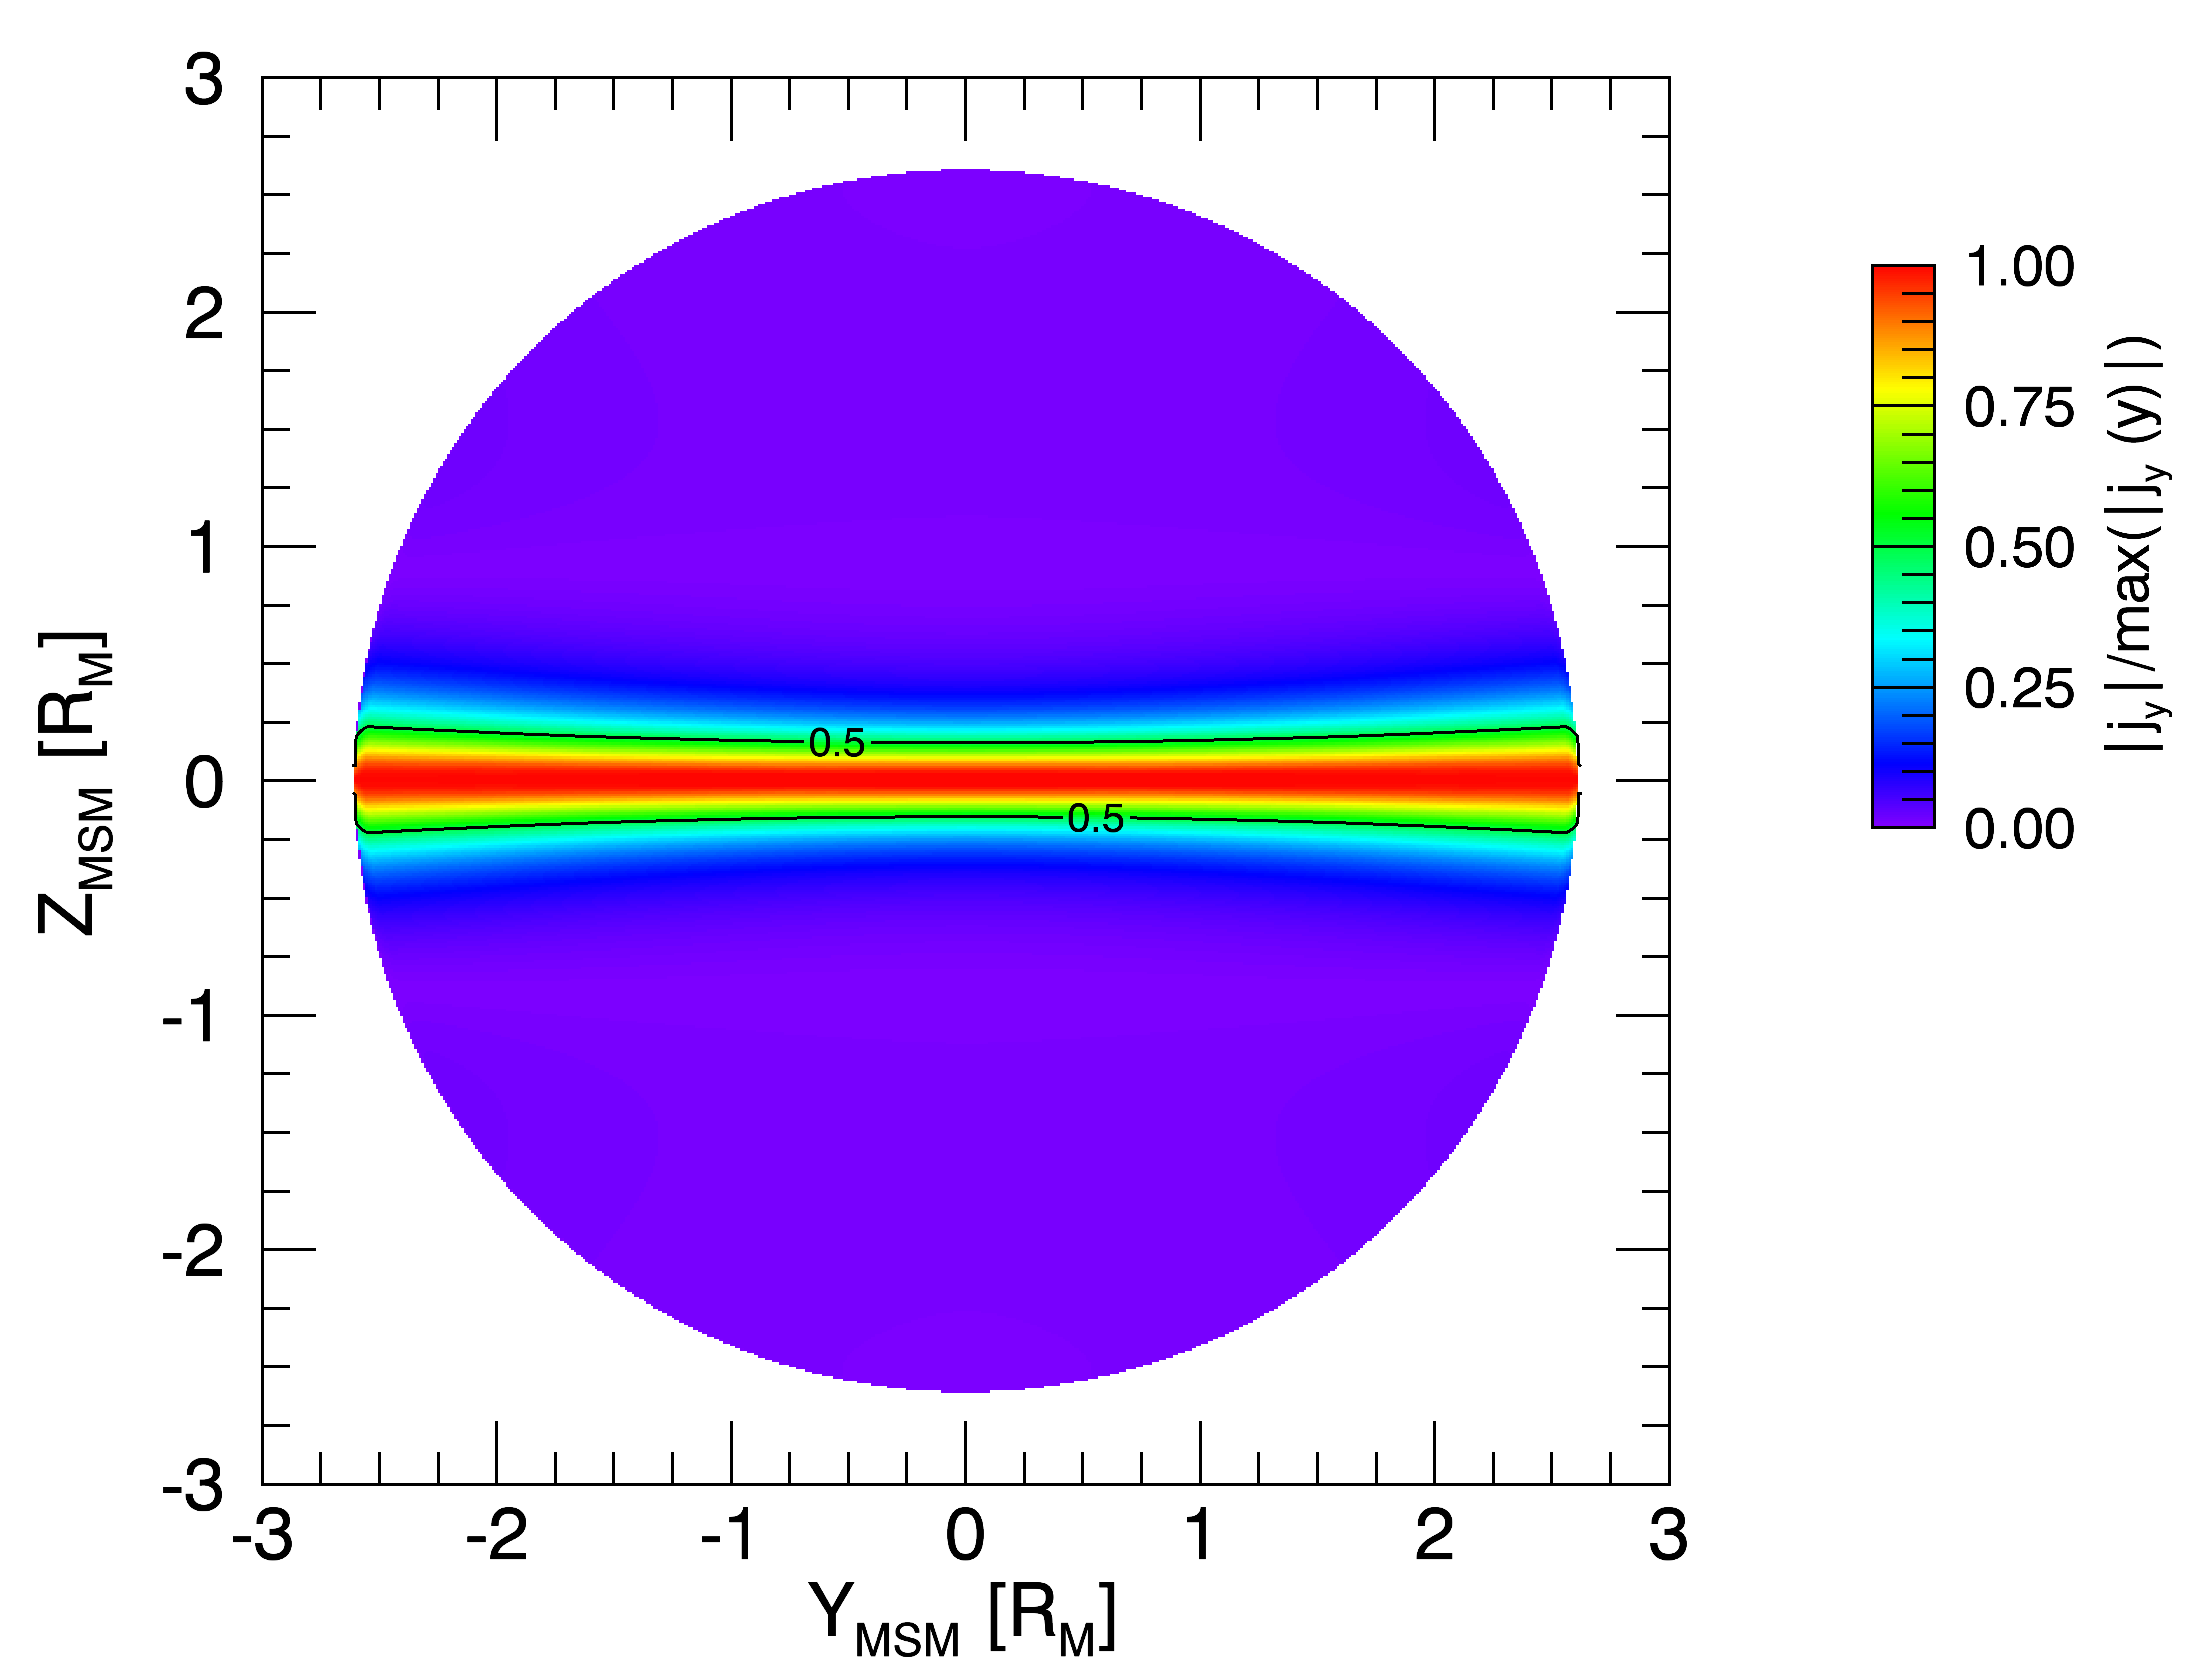
KT14 Model Configuration
Current Distribution
Magnetic Field Lines
Y_{MSM} = 0 R_{M}
X_{MSM} = -2 R_{M}

Slide 10
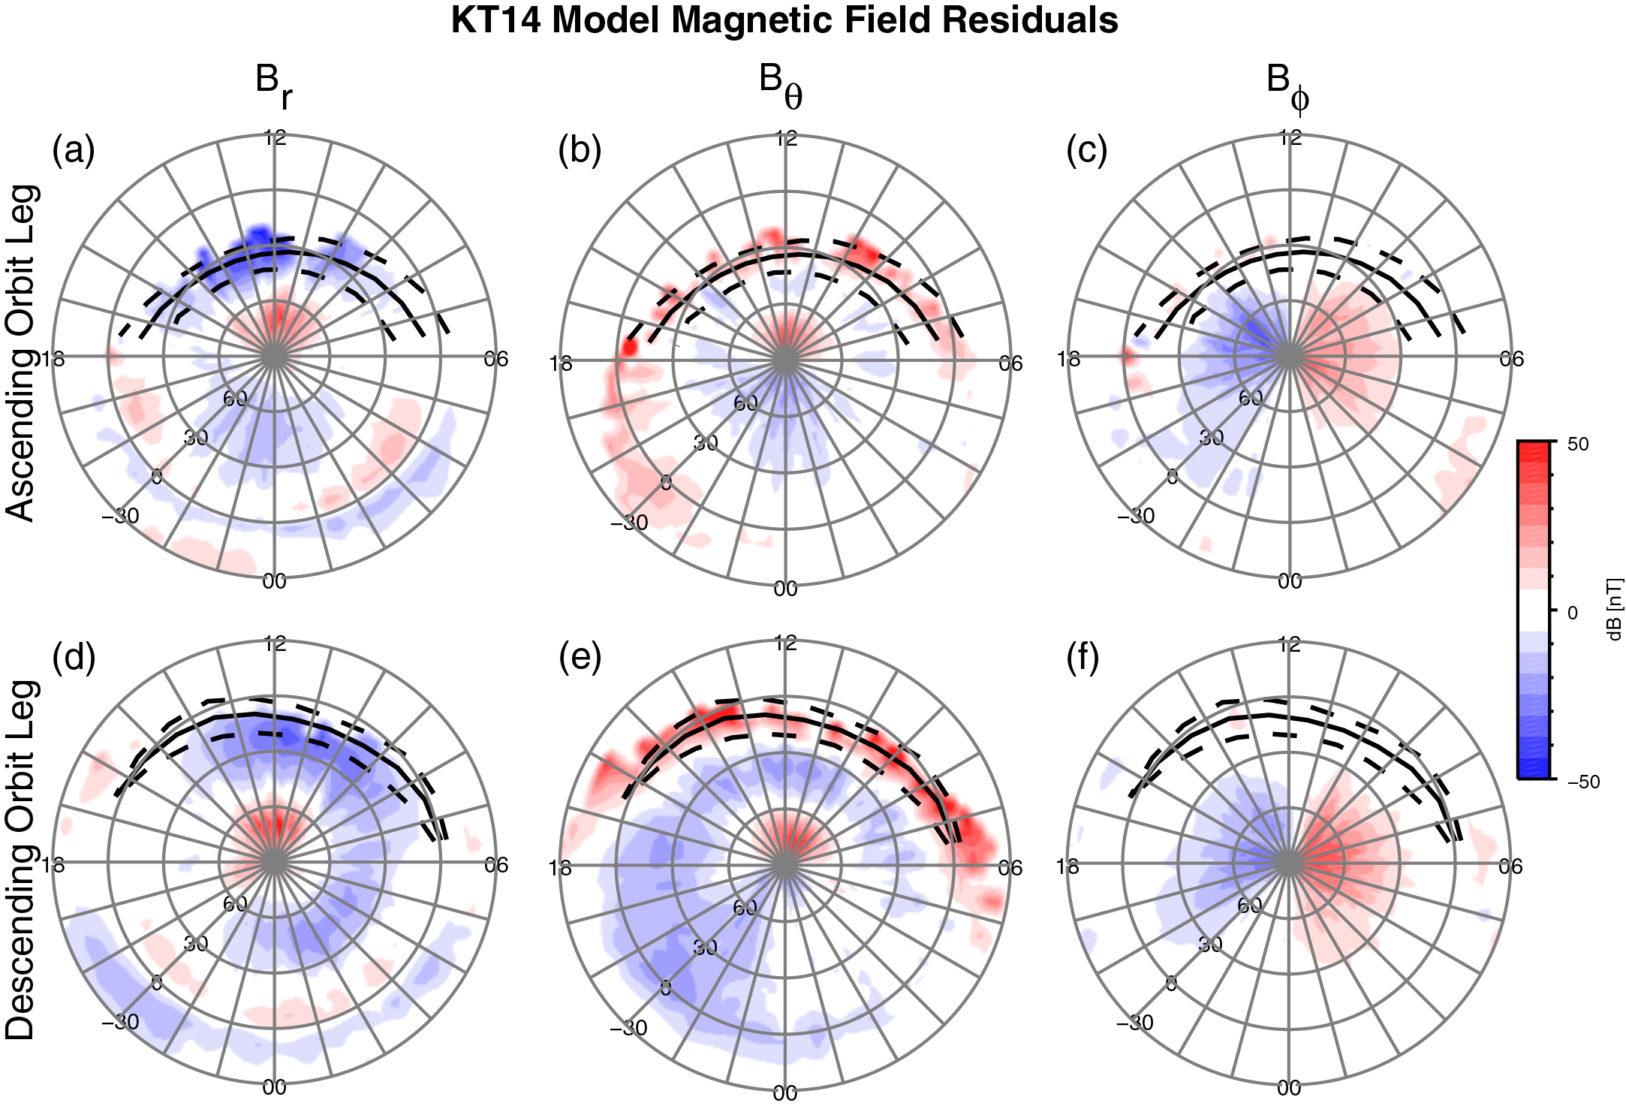
KT14 Model Magnetic Field Residuals
Grid averages for period 11083−12327

Slide 11
KT14 Model Magnetic Field Residuals
Grid averages for period 11083−12327
Largest residuals at dayside MP; could be boundary layer.

Slide 12
KT14 Model Magnetic Field Residuals
Grid averages for period 11083−12327
Residuals due to plasma population not considered in vacuum model.

Slide 13
KT14 Model Magnetic Field Residuals
Grid averages for period 11083−12327
Substantial systematic residuals indicative of additional sources…

Slide 14
KT14 Model Magnetic Field Residuals
Grid averages for period 11083−12327
…, e.g., Birkeland currents.

Slide 15
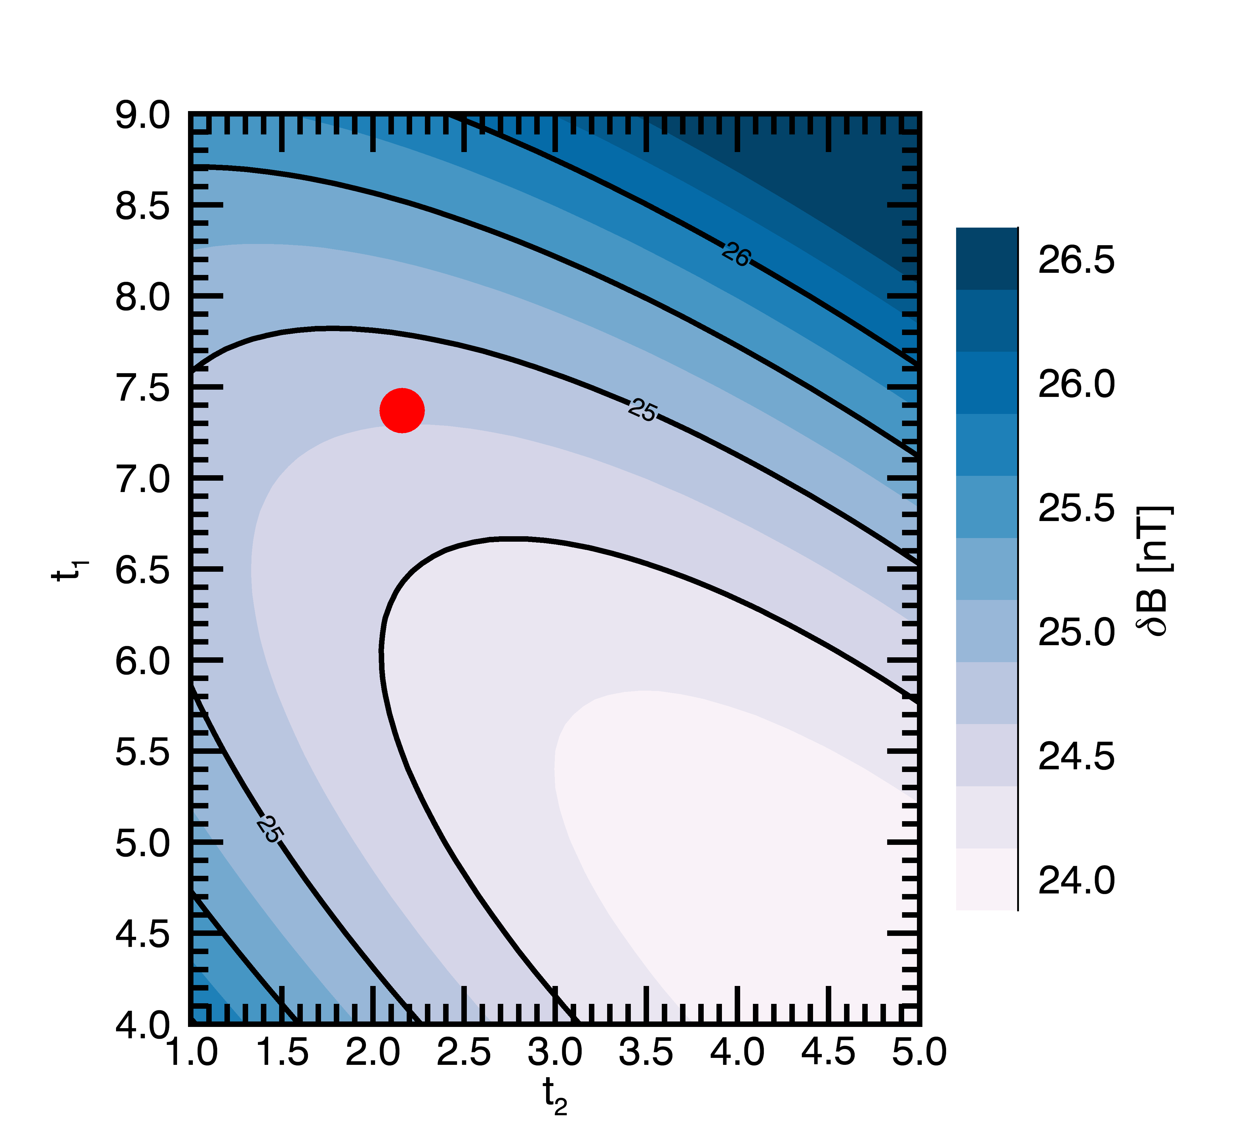
Future: BepiColombo
Model development will benefit from refinements and additions enabled by the BepiColombo mission.
Better estimate of planetary field by including low-altitude (<800 km) observations in the southern hemisphere.
Improvements of a-priori parameters; e.g., tail current inner edge, current sheet thickness and expansion.
Tighter constraints on tail field through additional spatial sampling; allows simultaneous fitting of disk and sheet current amplitudes.
Dual spacecraft observations may allow for parameterization by solar wind drivers (e.g., IMF magnitude and direction) despite short Dungey cycle period.
KT14 RMS Residual

Slide 16
Summary
We have developed a new magnetic field model for Mercury featuring a continuous magnetic field confined within the average observed magnetopause.
Shielding fields provided by magnetic potentials, which minimize the magnetic field normal component at the magnetopause.
Substantial magnetic field residuals remain; indicative of additional magnetic field sources not considered in the existing models.
Sources and drivers can be added in the future.
Model development will benefit from refinements (planetary field, tail current sheet) and additions (solar wind drivers) enabled by the BepiColombo mission.

Slide 17
Backup

Slide 18
Model Parameters At A Glance
Dipole moment | -190 nT R_{M}³
Subsolar magnetopause stand-off distance | 1.42 R_{M}
Magnetopause flaring factor | 0.5
Taildisk current amplitude | 7.37
Harris sheet current amplitude | 2.16
Half-thickness of current sheet | 0.09 R_{M}
Expansion magnitudes of tail current sheet in x direction | 1.0
Expansion magnitudes of tail current sheet in y direction | 0.1
Scale factor for disk current expansion in x direction | 1.0
Scale factor for disk current expansion in y direction | 2.9
Scale factor for quasi-Harris sheet expansion in x direction | 1.5
Scale factor for quasi-Harris sheet expansion in y direction | 9.0
Location of image sheets for Harris sheet | 3.5

Slide 19
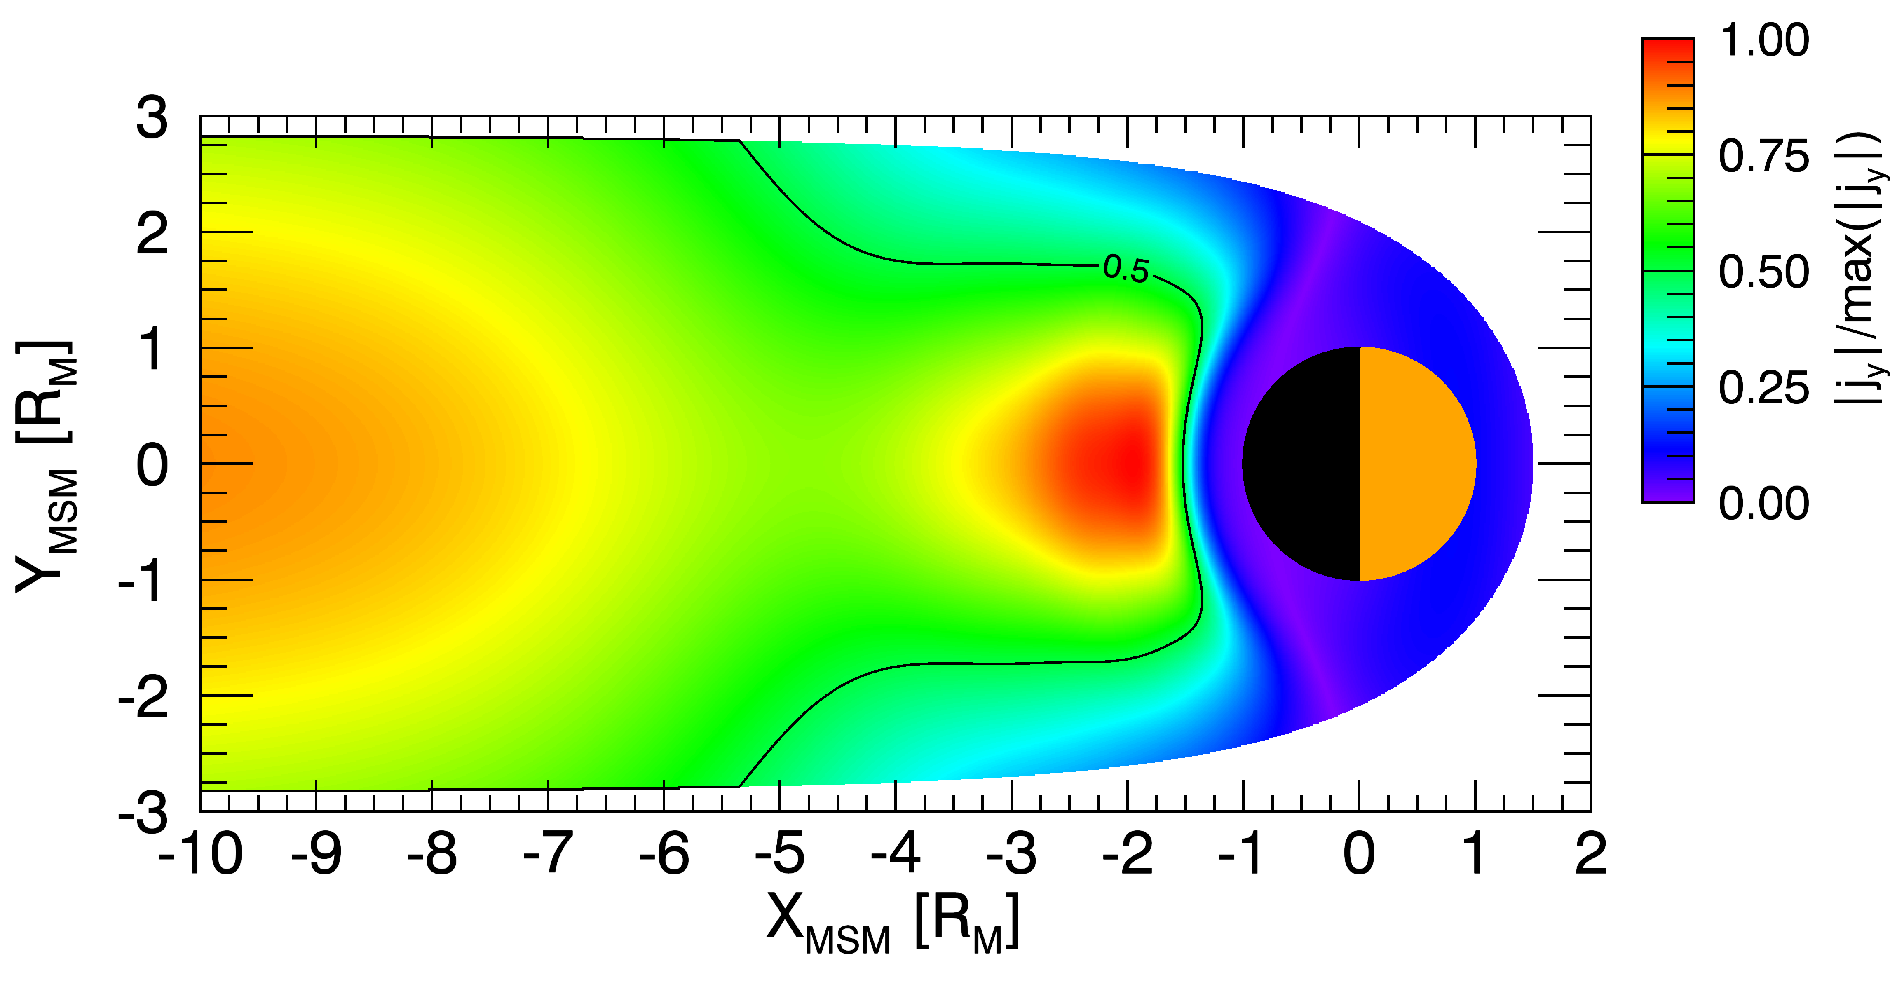
Current Distribution
X_{MSM} = -2 R_{M}
Y_{MSM} = 0 R_{M}
Z_{MSM} [R_{M}]
Z_{MSM} = 0 R_{M}

Slide 20
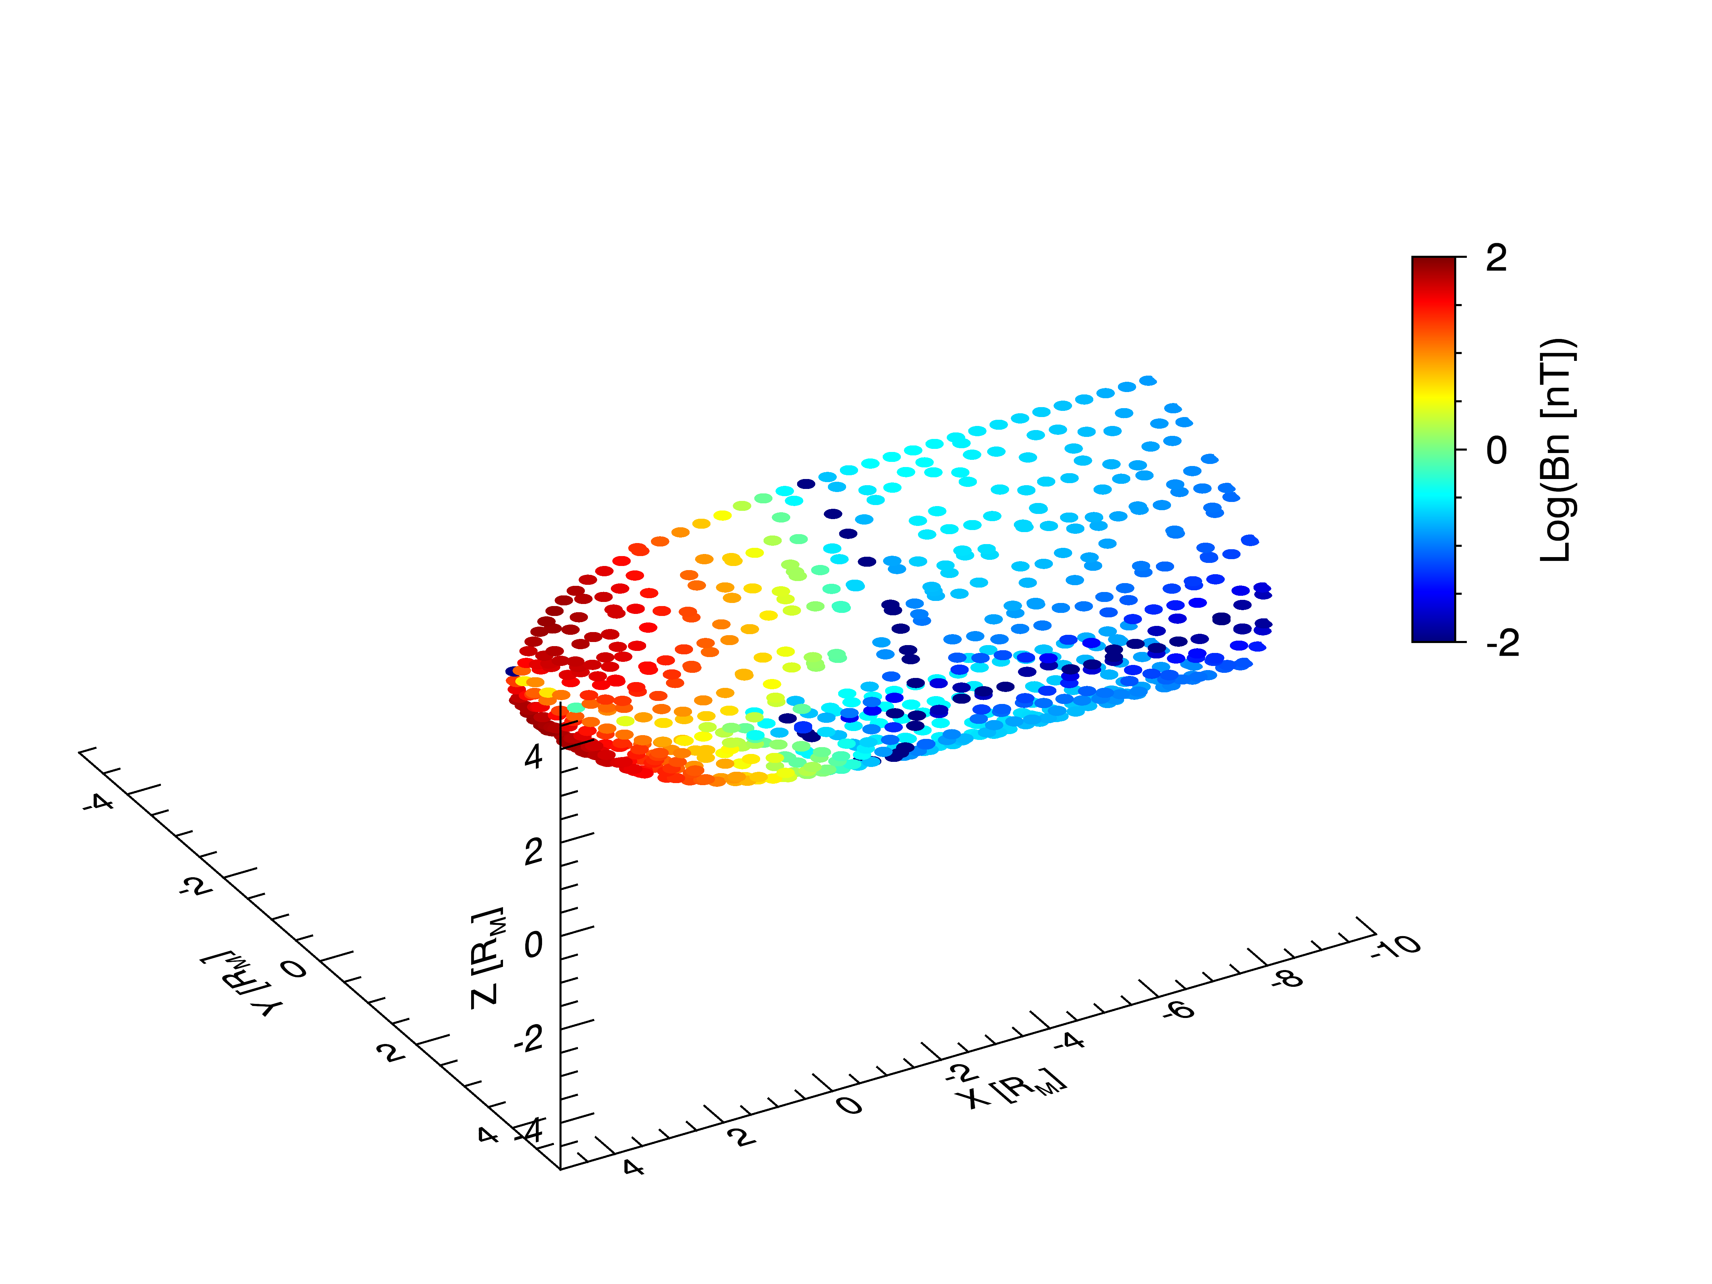
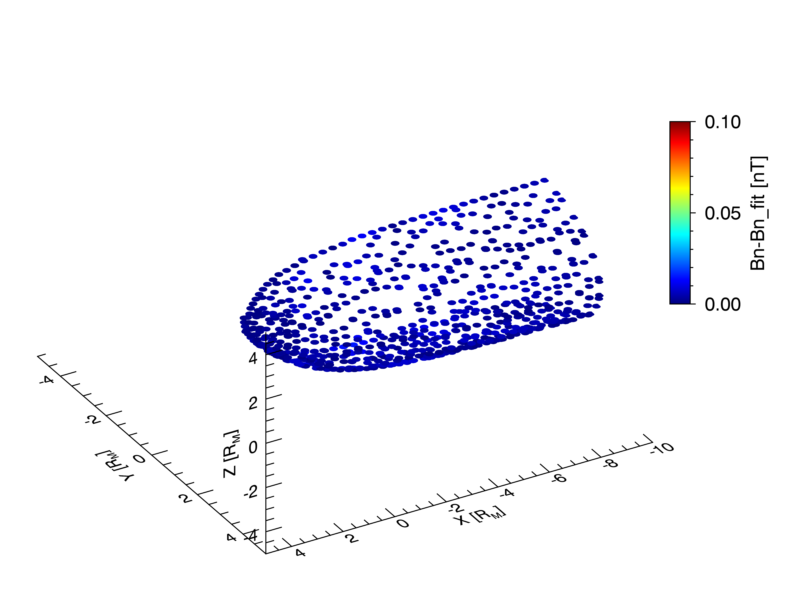
Model Components
Modules of initial model:
Internal offset dipole field,
Current disk with smooth inner edge to avoid discontinuities,
Sheet current to provide continuity into the far tail.
Dipole shielding
Fit 4th order potential function with 16 linear and 4 non-linear parameters,
Residual B_{n} are few pT, much smaller than observed B_{n} of ~10 nT.
Dipole Log(Bn)
Dipole residual Bn

Slide 21
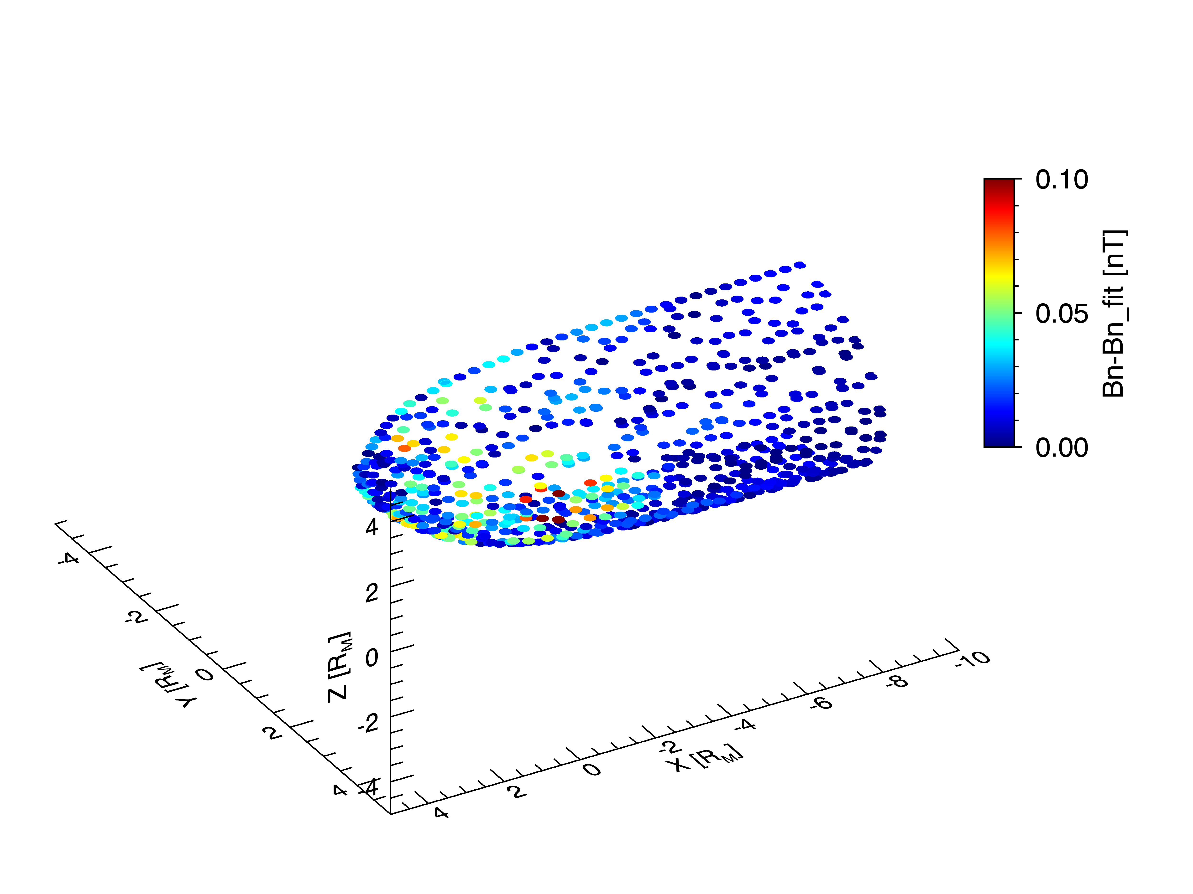
Tail Disk Module
Fit current profile produced by magnetic vector potential A.
Current in equatorial plane, so elsewhere $∇×∇×A=0.$
Differential eq. for axial symmetry: $\frac{∂A}{∂z^{2}}+\frac{∂}{∂ρ}\left[\frac{1}{ρ}\frac{∂(ρA)}{∂ρ}\right]=0$
Solution: $A=\sum_{i=1}^{N}{f_{i}\int_{0}^{∞}{J_{1}}(λρ})exp\left[−λ(β_{i}+|z|)\right]∙\sin\left(β_{i}λ\right)dλ$
Current: $I\left(ρ\right)=\frac{2}{μ_{0}}{\left.\frac{∂A}{∂z}\right|}_{z=0}$
Radial Current Profile
$$I\left(ρ\right)=I_{m}exp\left(\frac{ρ_{2}−ρ}{L}\right)$$
$$I\left(ρ\right)=I_{m}\sin^{2}\left(\frac{π}{2}\frac{ρ−ρ_{1}}{ρ_{2}−ρ_{1}}\right)$$
$$I\left(ρ\right)=0$$
Taildisk residual Bn

Slide 22
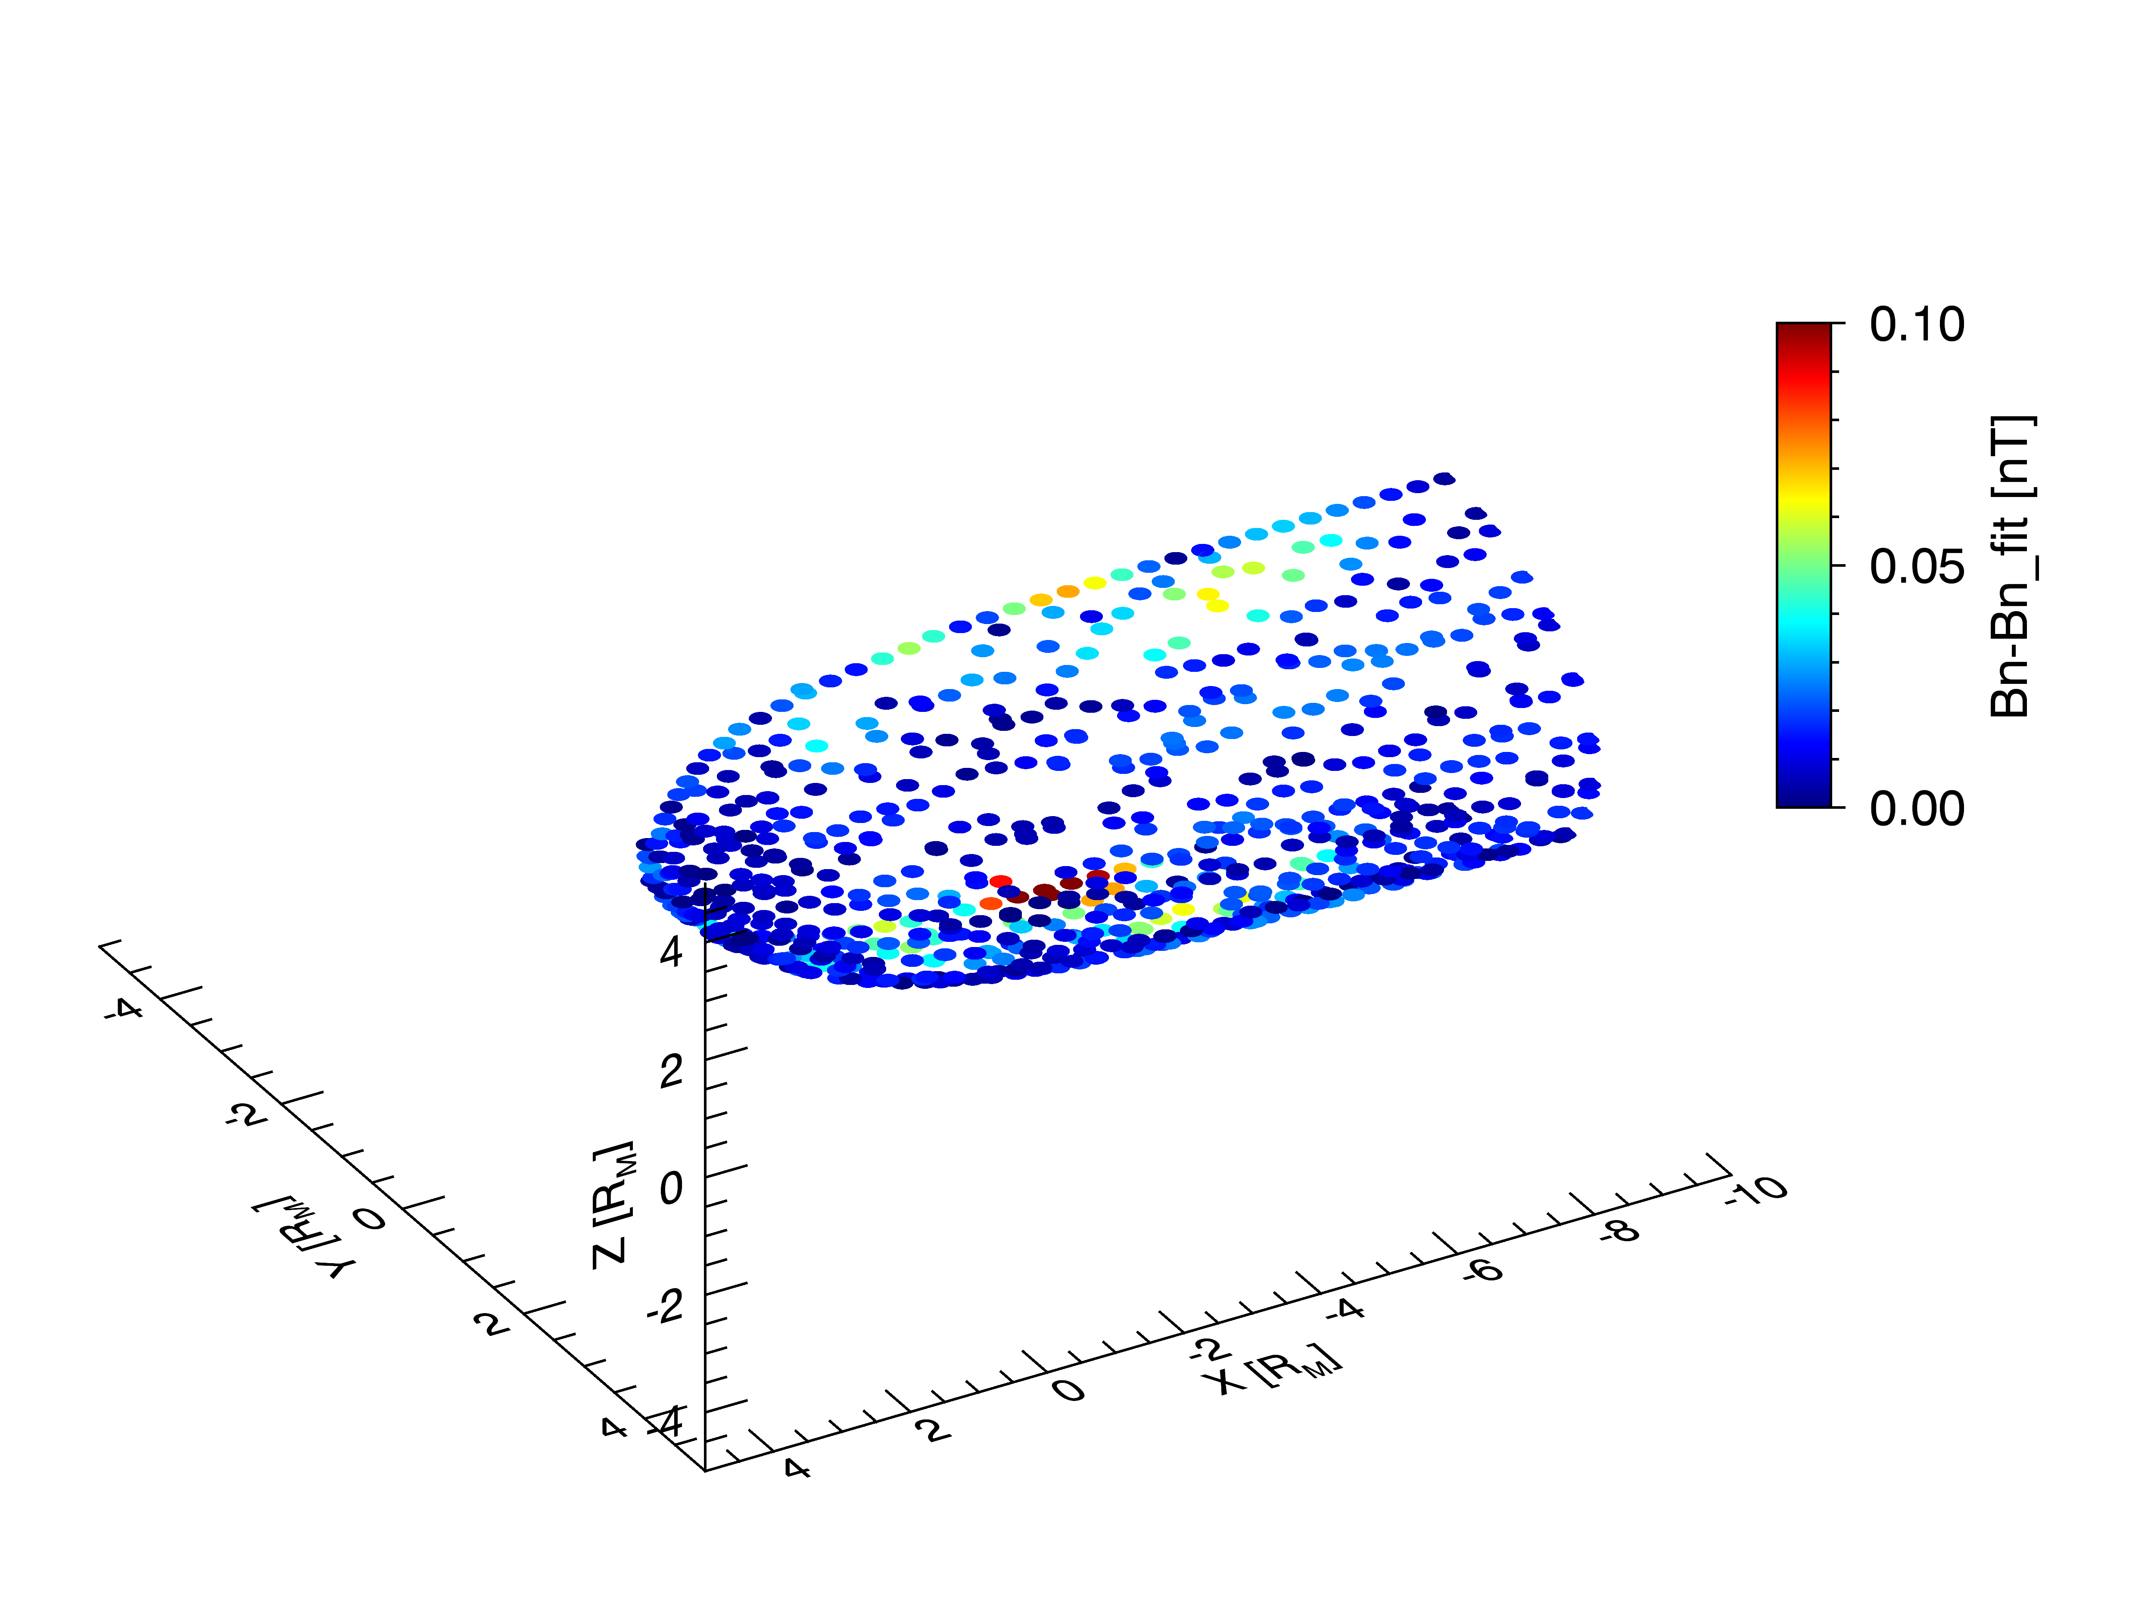
Tail Sheet Module
Continuous tail current provided by quasi-Harris sheet.
Vector potential: $A_{y}=−2\ln{\cosh\left(\frac{z}{d}\right)}$
Harris sheet B-field from $\underline{B}=∇×\underline{A}$: $B_{x}=\frac{2}{d}tanh\left(\frac{z}{d}\right)$ $B_{z}=\frac{2z}{d^{2}}tanh⁡\left(\frac{z}{d}\right)\frac{dd}{dx}$
Term ${dd}/{dx}$ infinitely widens the current sheet toward the dayside.
Use image current sheets outside MP to facilitate fit of shielding field.
Harris Sheet
d
Harris sheet residual Bn

Slide 23
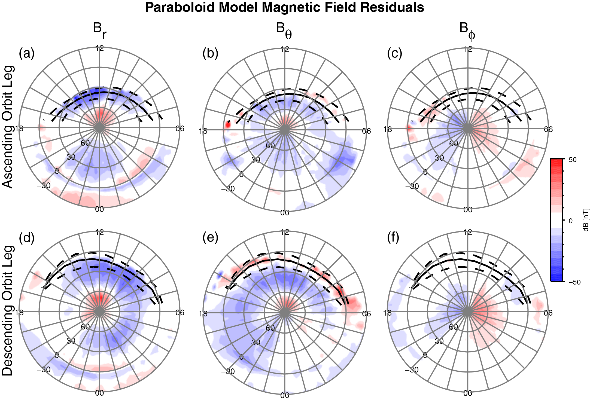
Paraboloid Model Magnetic Field Residuals
Grid averages for period 11083−12327
+50
dB [nT]
−50

Slide 24
KT14-Paraboloid Model Comparison
Grid averages for period 11083−12327
KT14 Model
+50
B_{r}
B_{θ}
B_{φ}
dB [nT]
−50
Paraboloid Model

Slide 25
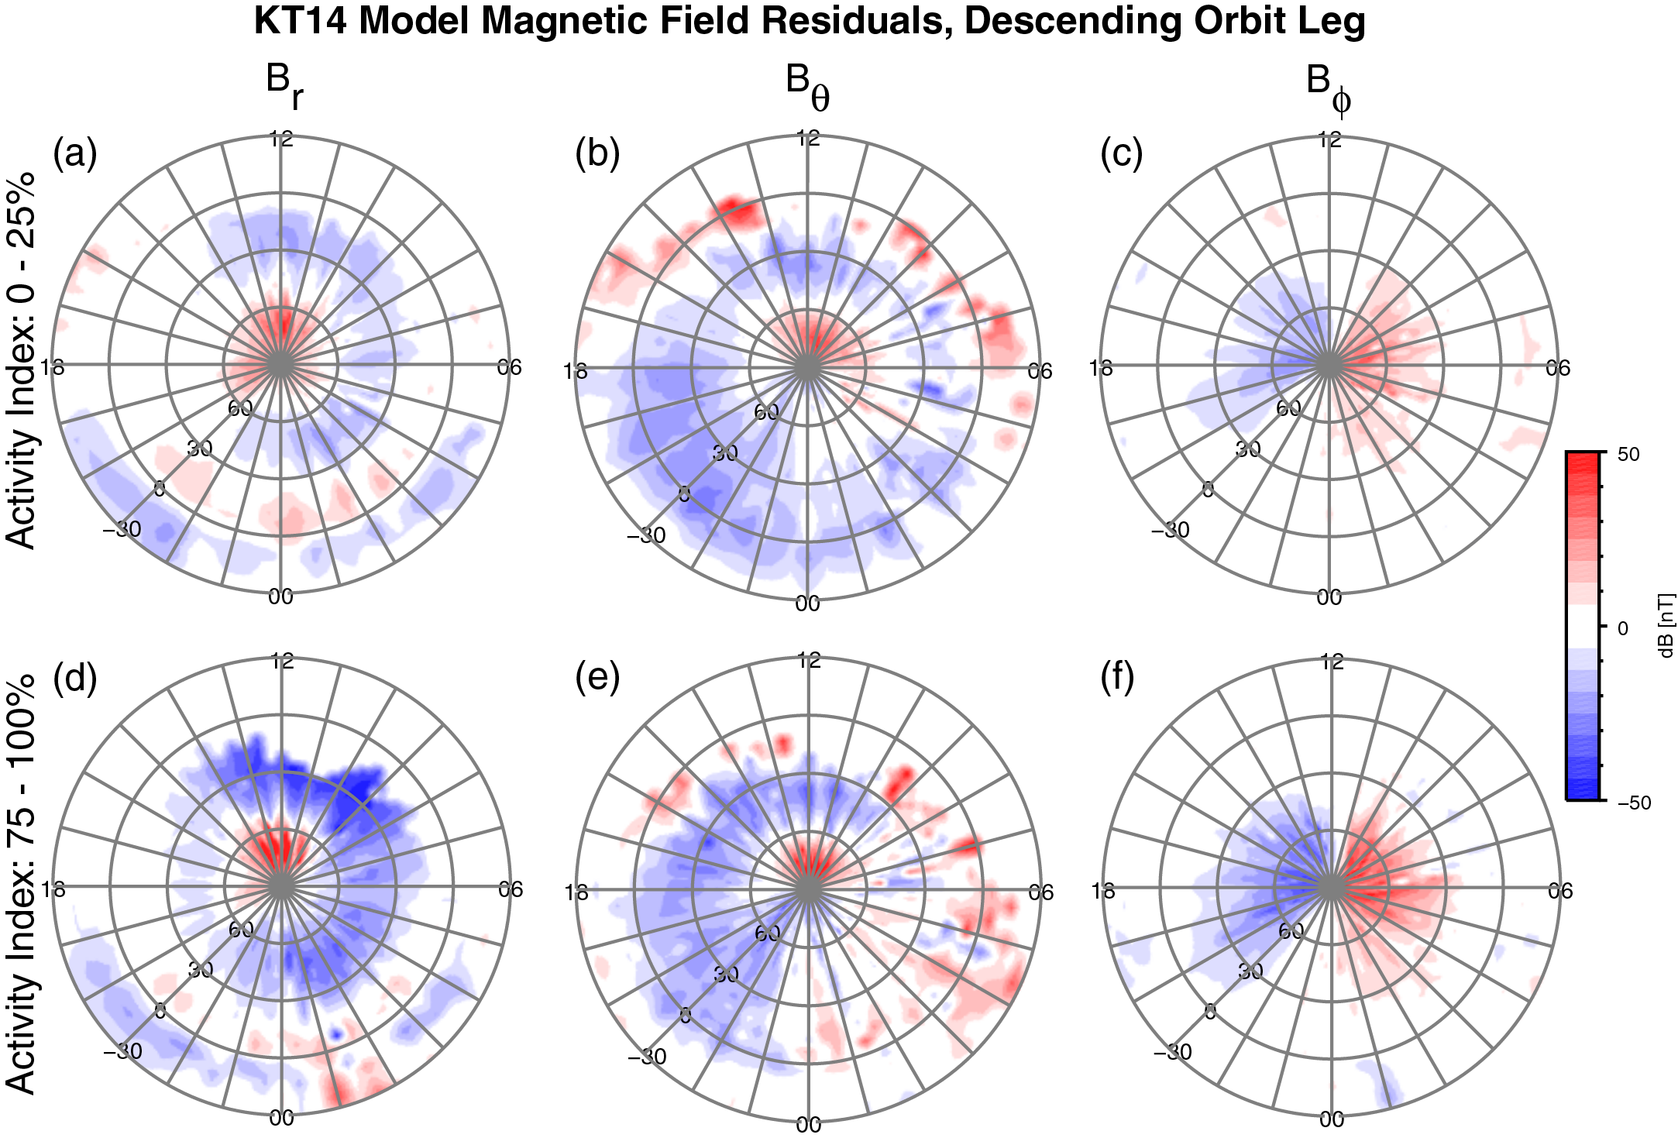
Dependence on Magnetic Activity
Grid averages for period 11083−12327
+50
dB [nT]
−50

Slide 26
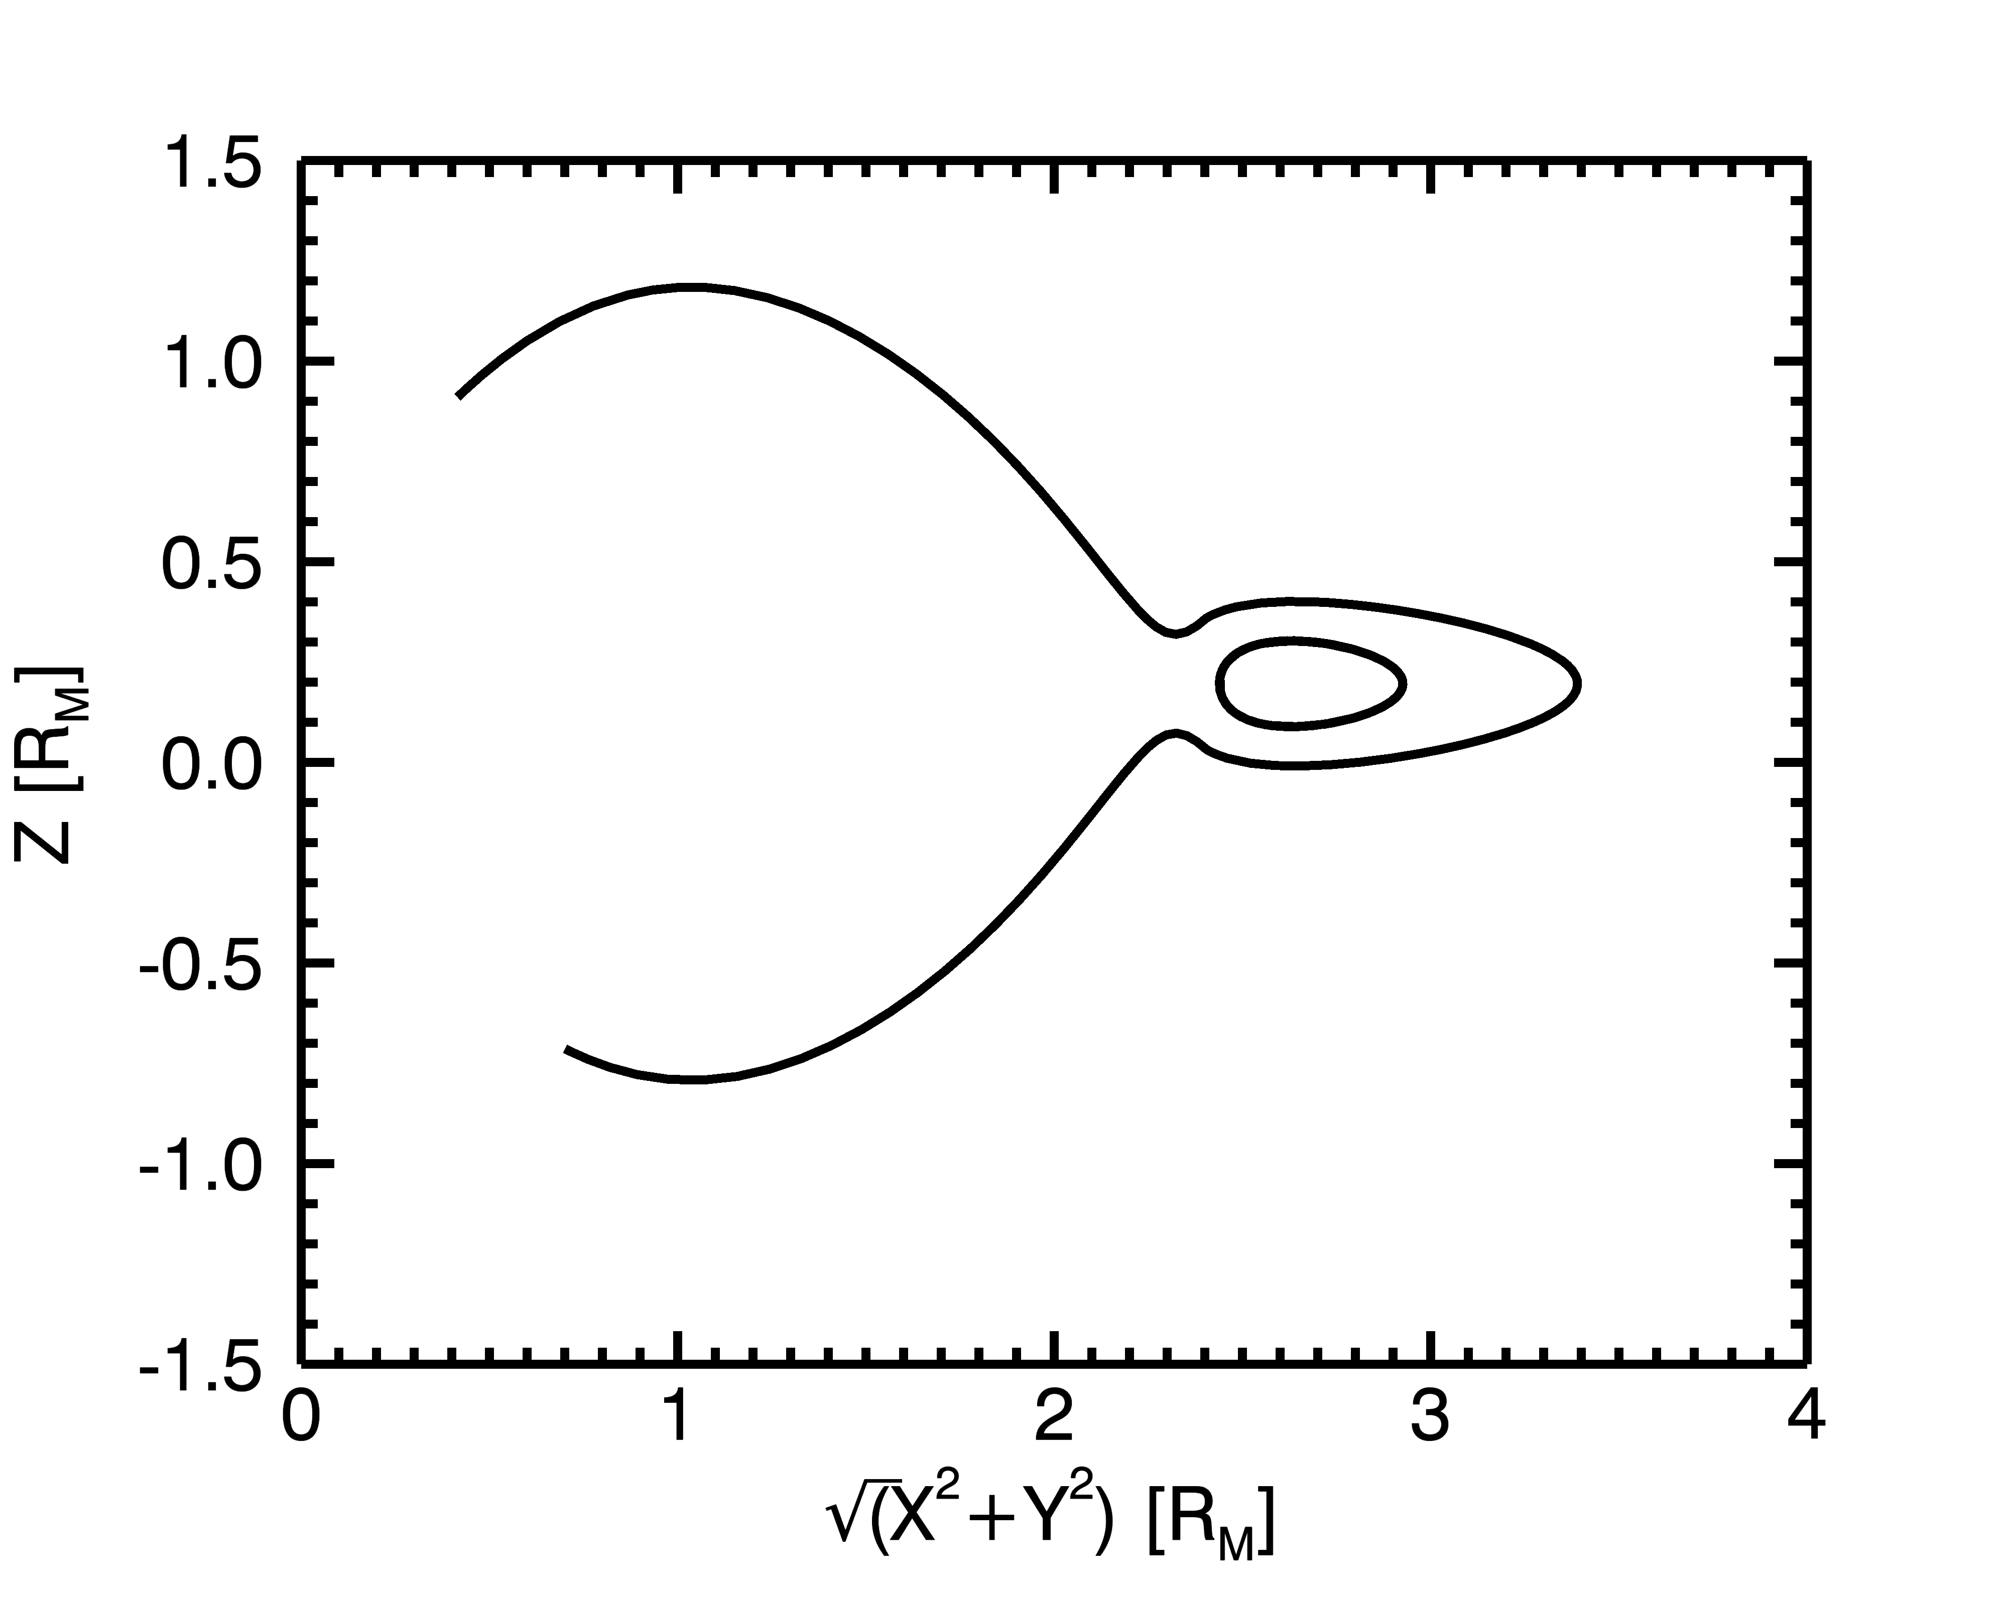
Need for New Model
Paraboloid model, used in initial analysis, has several limitations:
Model magnetopause shape deviates substantially from observations,
Discontinuity at inner edge of tail current yields O-lines,
Difficult to modify (rigidly tied to analytical formalism).
Future investigations require higher fidelity correction of external field.
Need a general/flexible formalism that allows for realistic magnetopause shape and expansion to include new current systems.
Magnetopause Shape
Paraboloid fit
Winslow et al., 2013
Magnetic O-lines
Notes:
Old model sufficient to determine the lower-order structure of the internal field, magnetic pressure deficits, Birkeland currents, and induction studies. New model is required for the higher-order planetary field studies, near magnetopause studies, and higher altitude studies to identify plasma signatures (boundary layers, plasma sheet etc.).

