Slide 1
Imaging Investigations of Water Ice on Mercury and Future Exploration of the South Polar Region
Nancy L. Chabot¹, John K. Harmon², Carolyn M. Ernst¹, Brett W. Denevi¹, David T. Blewett¹, Scott L. Murchie¹, and James W. Head³
¹The Johns Hopkins University Applied Physics Laboratory
²National Astronomy and Ionosphere Center, Arecibo Observatory
³Brown University

Slide 2
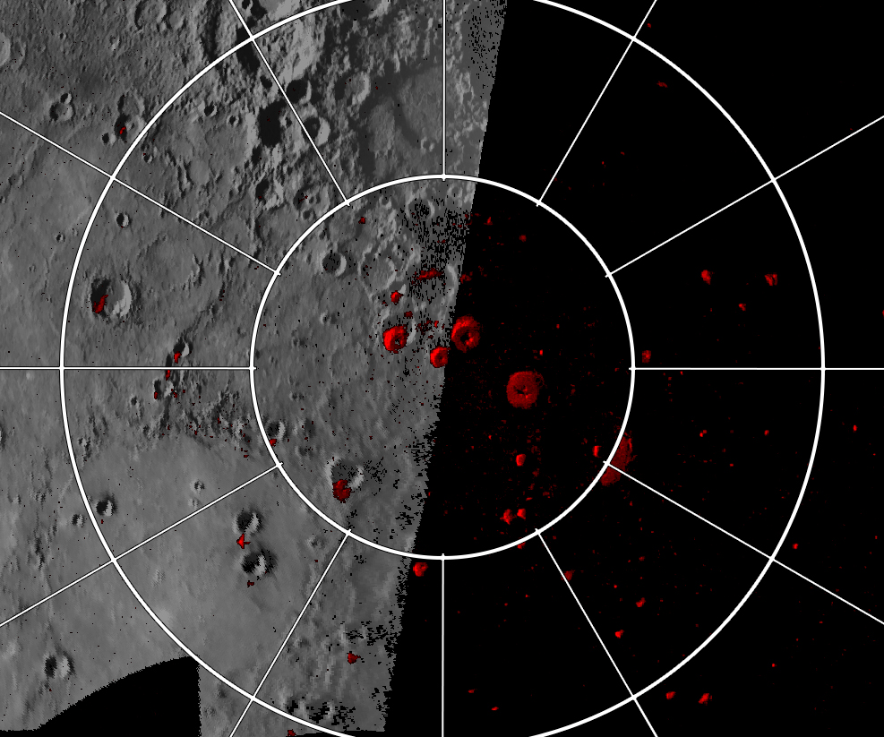
Mercury’s North Polar Region
The view pre-MESSENGER
“What are the unusual materials at Mercury’s poles?”
80°N
270° E
90° E
First Earth-based radar observations:
Slade et al., 1992 Harmon et al., 1992 Butler et al., 1993
0°
Radar-bright regions with high reflectivities and high circular polarization ratios in red, Harmon et al., 2011

Slide 3
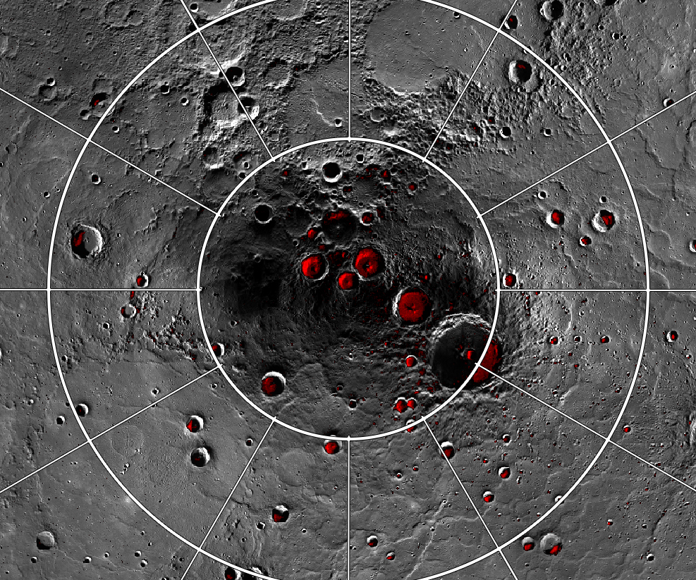
Mercury’s North Polar Region
The MESSENGER View
Neutron Spectrometer
Mercury Laser Altimeter
Mercury Dual Imaging System
80°N
270° E
90° E
0°
Radar-bright regions with high reflectivities and high circular polarization ratios in red, Harmon et al., 2011

Slide 4
Mercury’s North Polar Region
The MESSENGER View
80°N
Prokofiev (112 km)
270° E
90° E
0°
Radar-bright regions with high reflectivities and high circular polarization ratios in red, Harmon et al., 2011

Slide 5
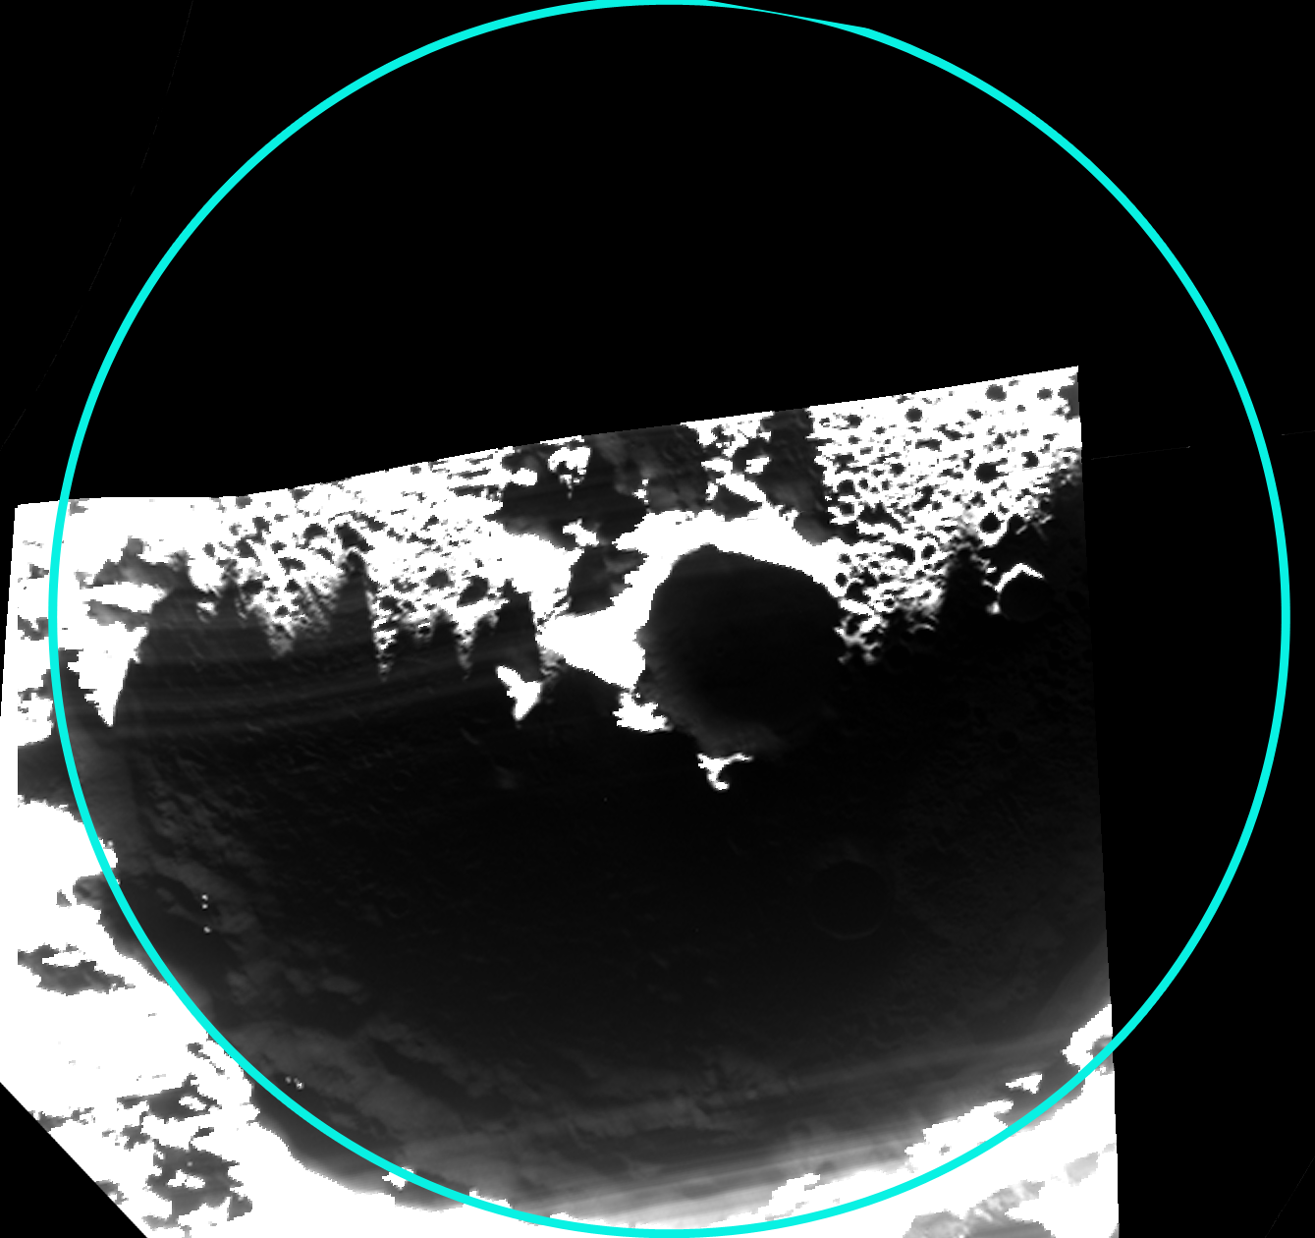
Prokofiev (112 km)
Broadband Filter Image
(700 nm, 600 nm bandpass)
Crater Position
shadowed surface
during image
(Chabot et al., 2014)

Slide 6
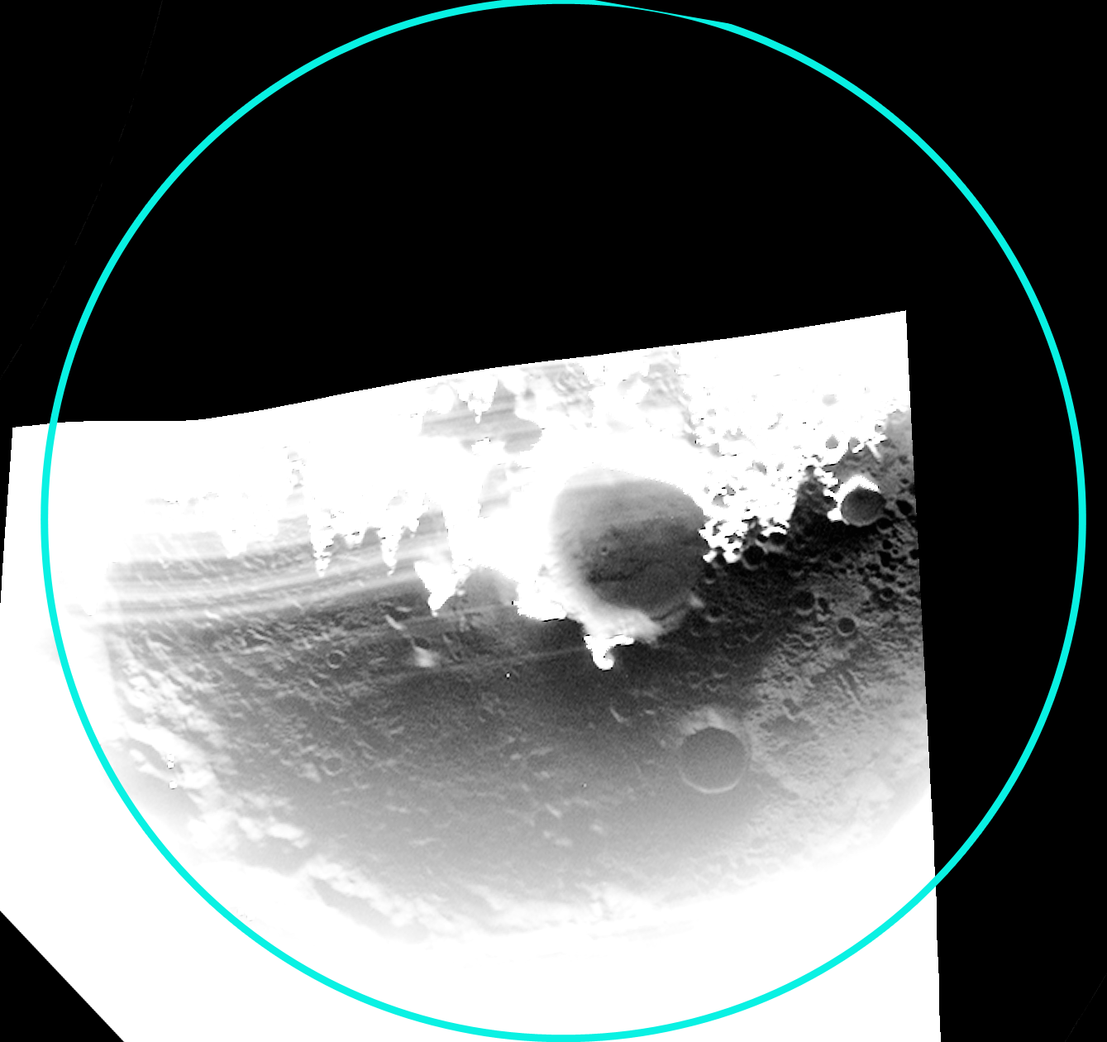
Prokofiev (112 km)
Broadband Filter Image
(700 nm, 600 nm bandpass)
Crater Position
(Chabot et al., 2014)

Slide 7
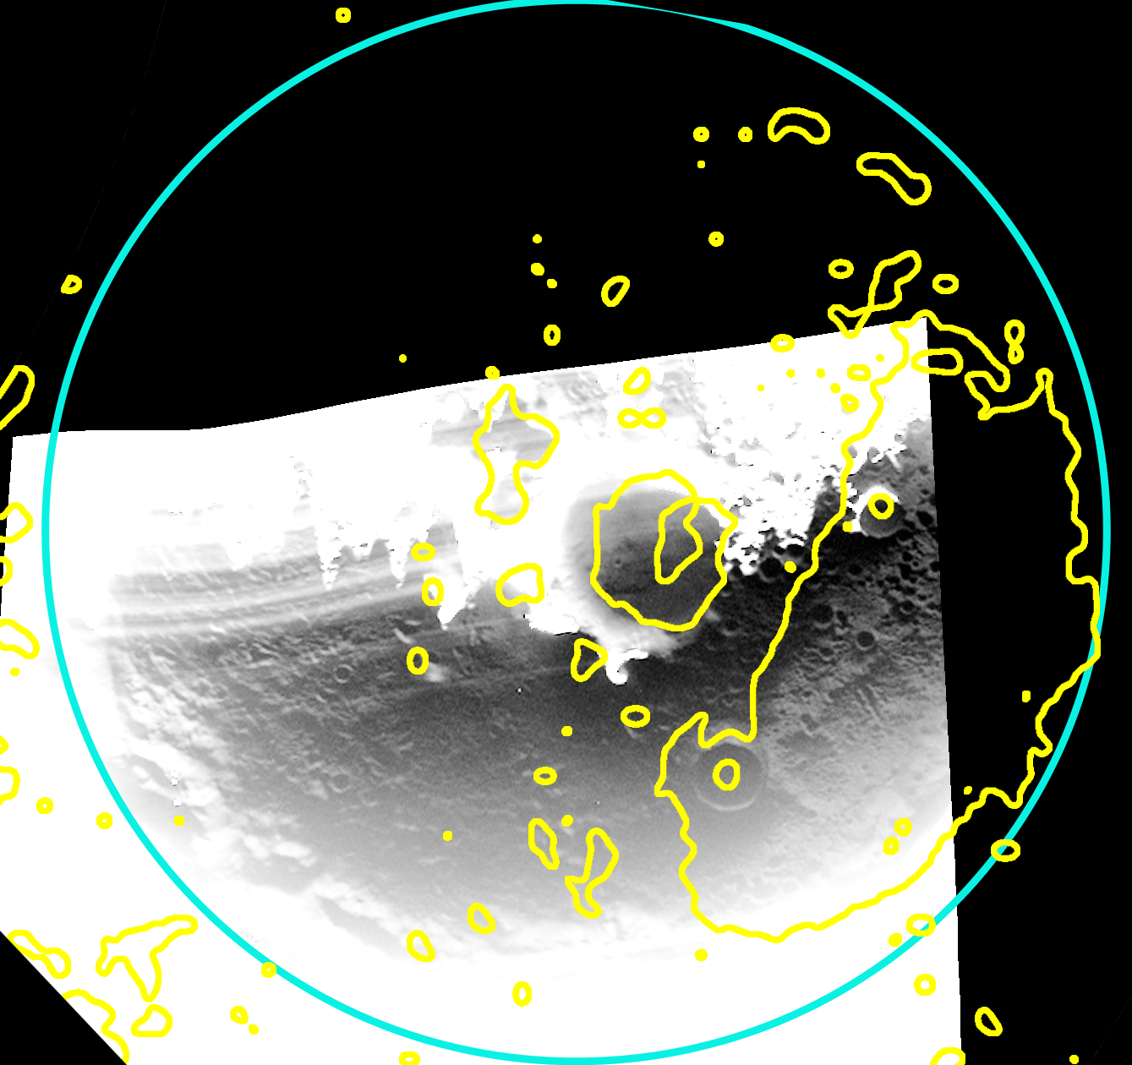
Prokofiev (112 km)
Broadband Filter Image
(700 nm, 600 nm bandpass)
Crater Position
Radar
(Chabot et al., 2014)

Slide 8
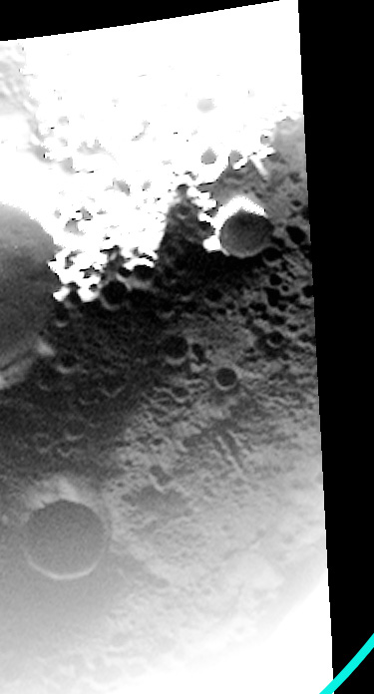
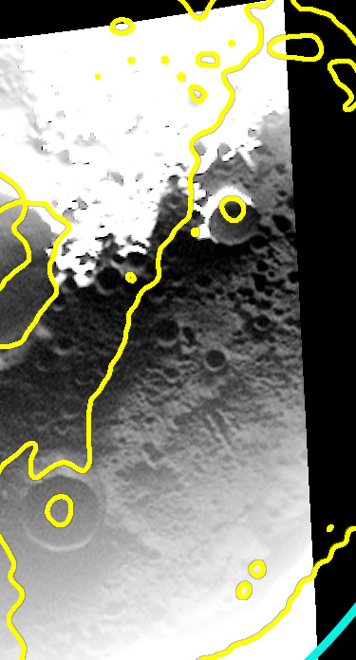
Prokofiev (112 km)
The higher reflectance region in Prokofiev is consistent with an expansive area of surface water ice
4 km
Radar-bright region

Slide 9
Mercury’s North Polar Region
The MESSENGER View
80°N
Prokofiev (112 km)
270° E
90° E
Fuller
27 km
0°
Radar-bright regions with high reflectivities and high circular polarization ratios in red, Harmon et al., 2011

Slide 10
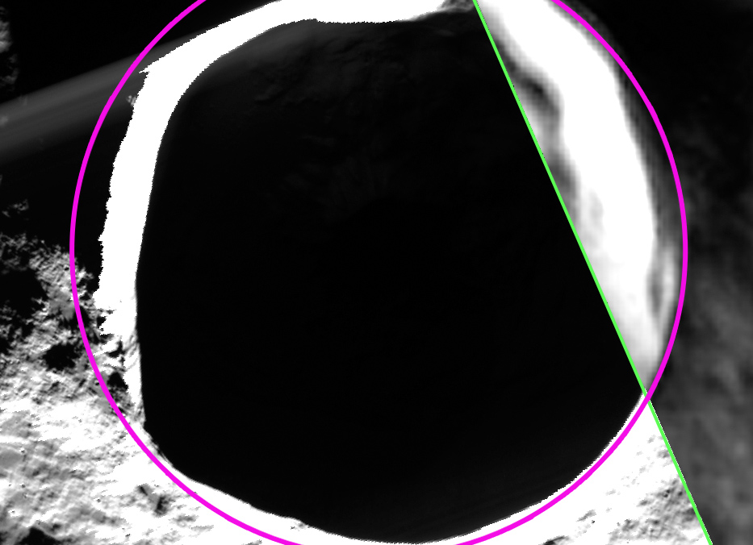
Fuller
(Diameter: 27 km)
2 km
shadowed surface
during image
MDIS
broadband image

Slide 11
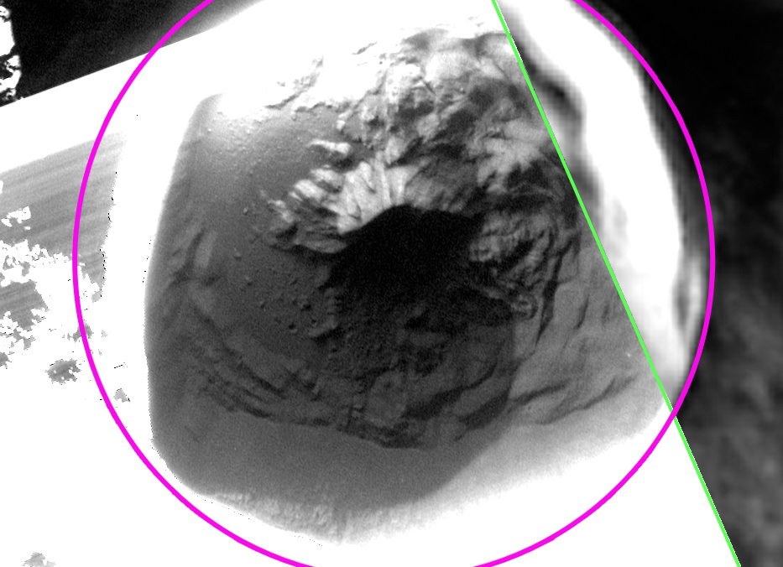
Fuller
(Diameter: 27 km)
2 km
low reflectance deposit
with a sharp boundary
MDIS
broadband image

Slide 12
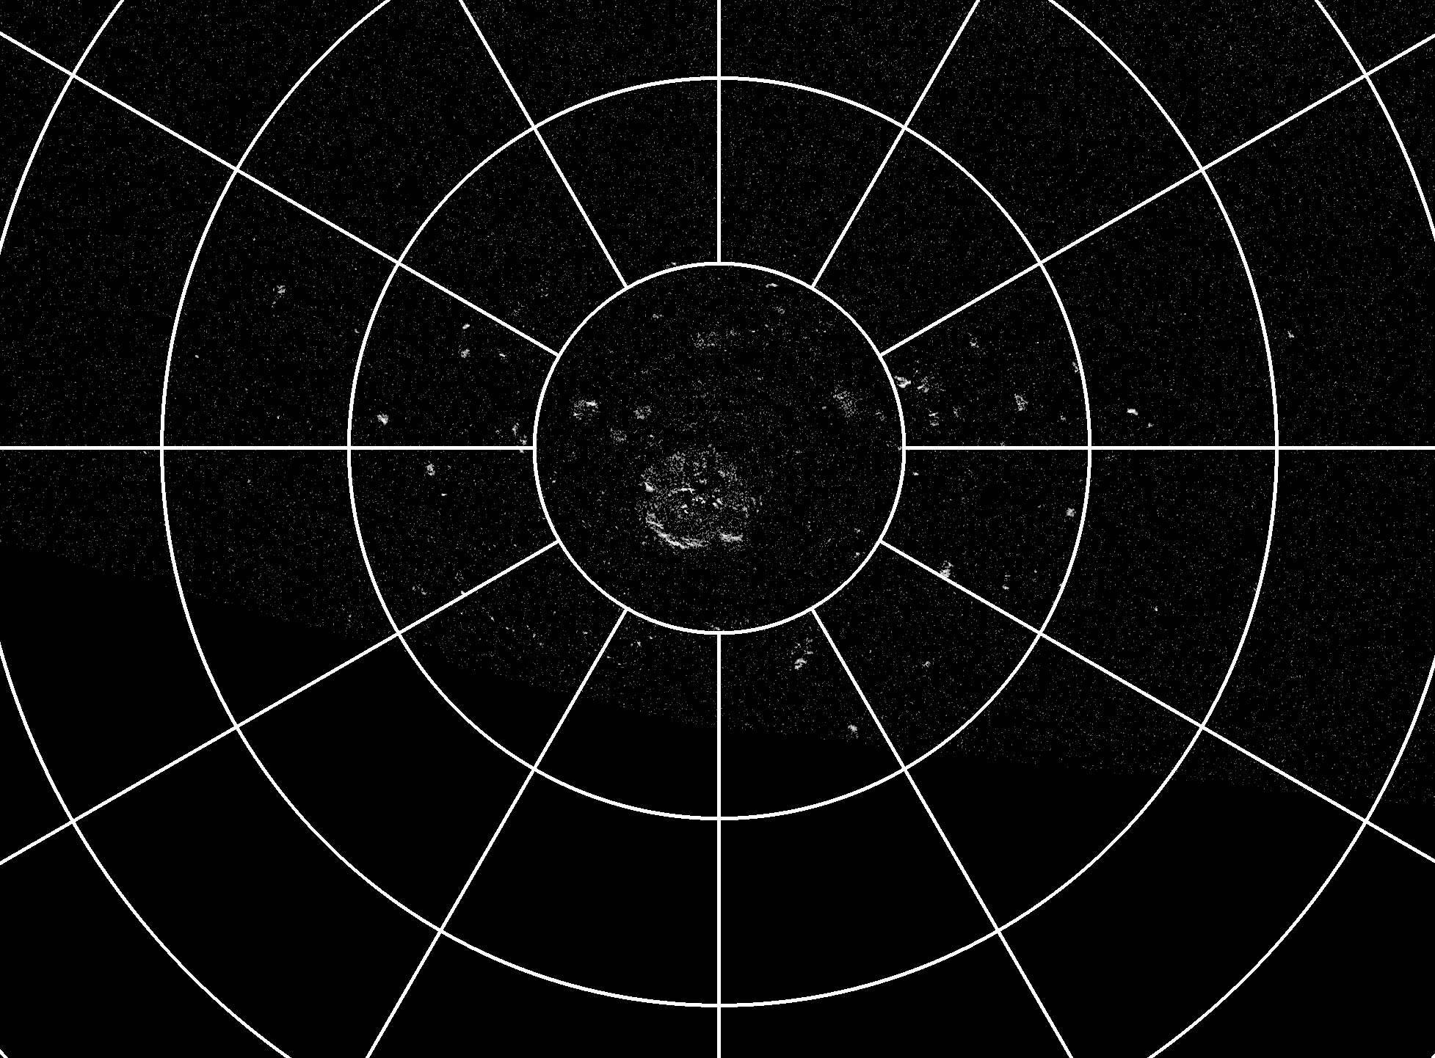
Mercury’s South Polar Region
80° S
Best published Earth-based radar data sets:
Arecibo:
(S-band, 12.6 cm)
Harmon et al., 2011
Goldstone:
(X-band, 3.5 cm)
Harcke, 2005
70° S
Harmon et al., 2011
180°

Slide 13
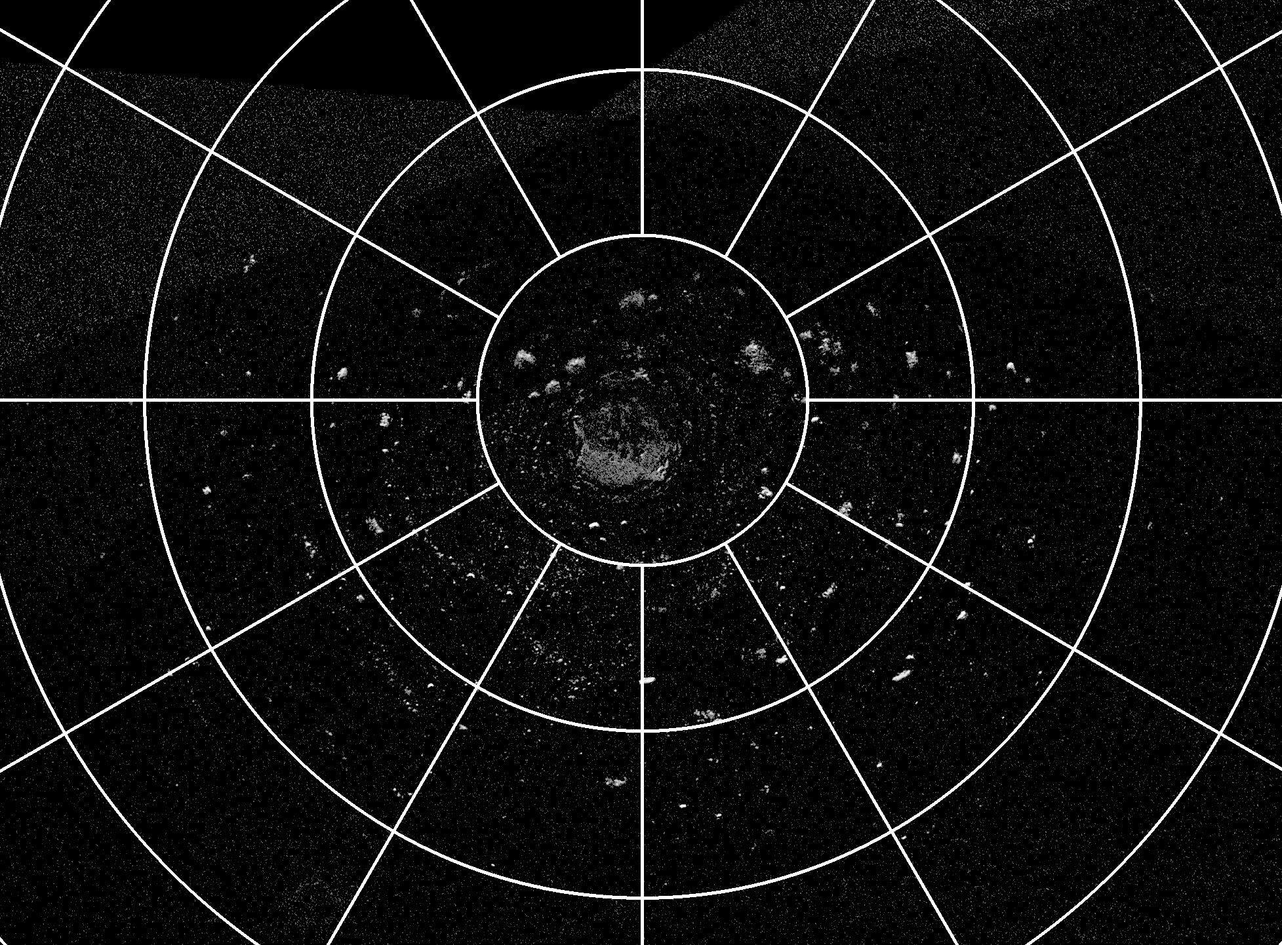
Mercury’s South Polar Region
New Arecibo Radar Observations from 2012:
(courtesy of John Harmon)
80° S
70° S
180°

Slide 14
MESSENGER observations of Mercury’s south polar region
were more limited

Slide 15
Mercury’s South Polar Region
Repeated MDIS imaging, every 2 Earth days, covering one Mercury solar day (176 Earth days)

Slide 16
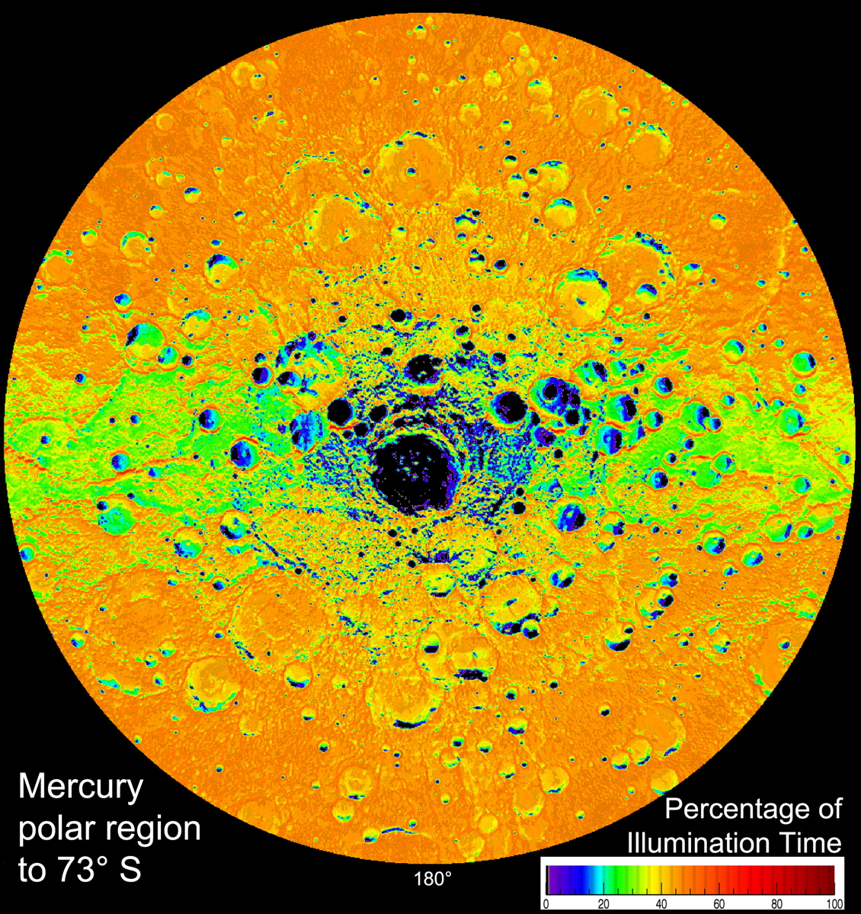
Mercury’s South Polar Region
MESSENGER’s illumination map identifies permanently shadowed regions
(Chabot et al., 2012)

Slide 17
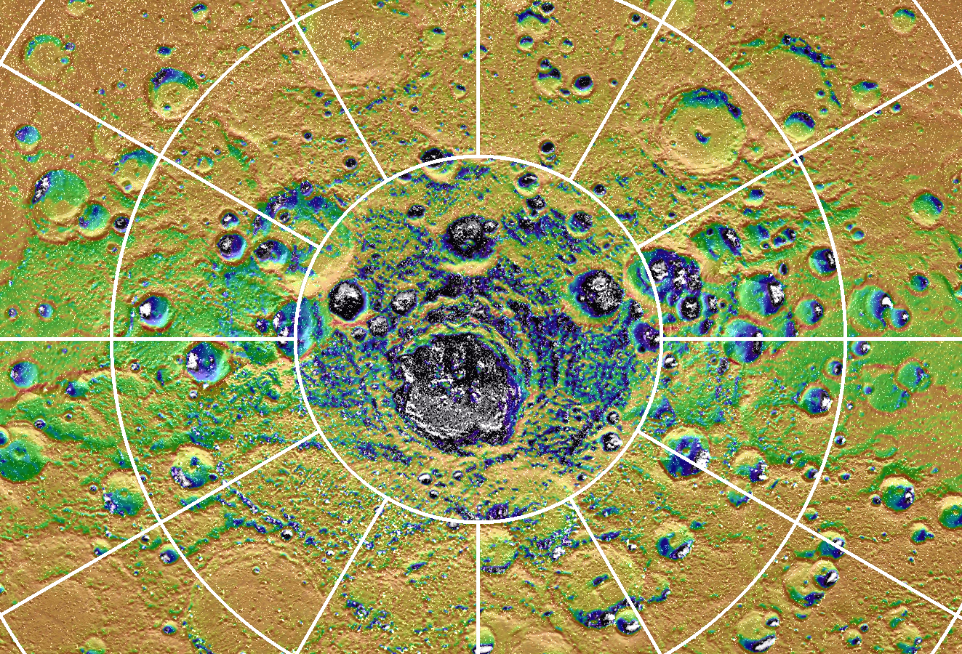
Mercury’s South Polar Region
white = Arecibo radar image
0°
80° S
Percentage of Illumination Time

Slide 18
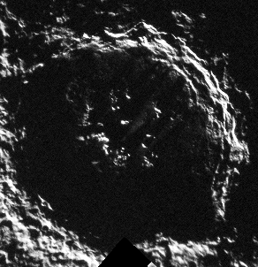
Mercury’s South Polar Region
white = Arecibo radar image
0°
Chao Meng-Fu
diameter ~160 km
Largest crater to host extensive radar-bright deposits on Mercury!
80° S
Percentage of Illumination Time

Slide 19
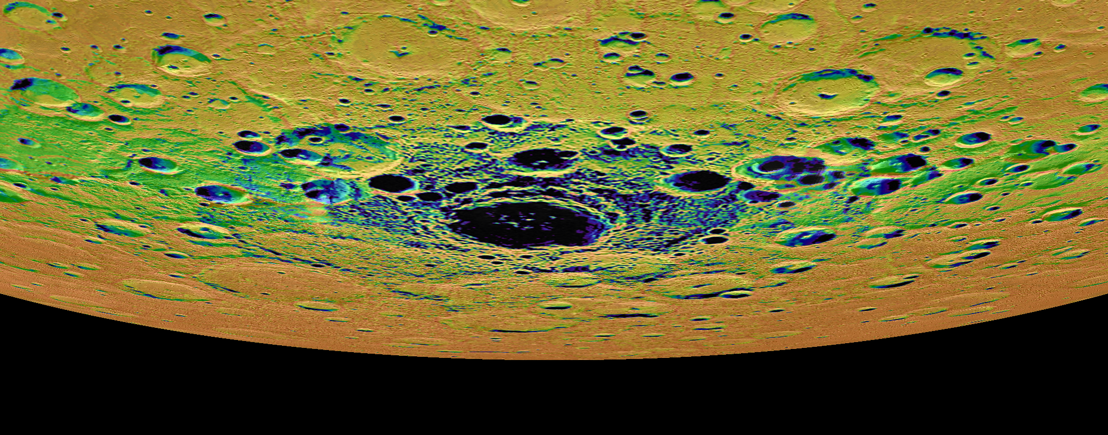
BepiColombo is positioned to provide the first in-depth exploration of Mercury’s south polar deposits
MESSENGER’s measurements of the north polar region can inform exploration of the south polar region
Neutron spectrometry to measure Hydrogen
Topography measurements to inform thermal models
Surface reflectance measurements to characterize the deposits
Imaging to reveal the deposits’ morphology
Earth-based radar images and MESSENGER’s illumination map are valuable resources to plan BepiColombo’s exploration of Mercury’s south polar region

