Slide 1


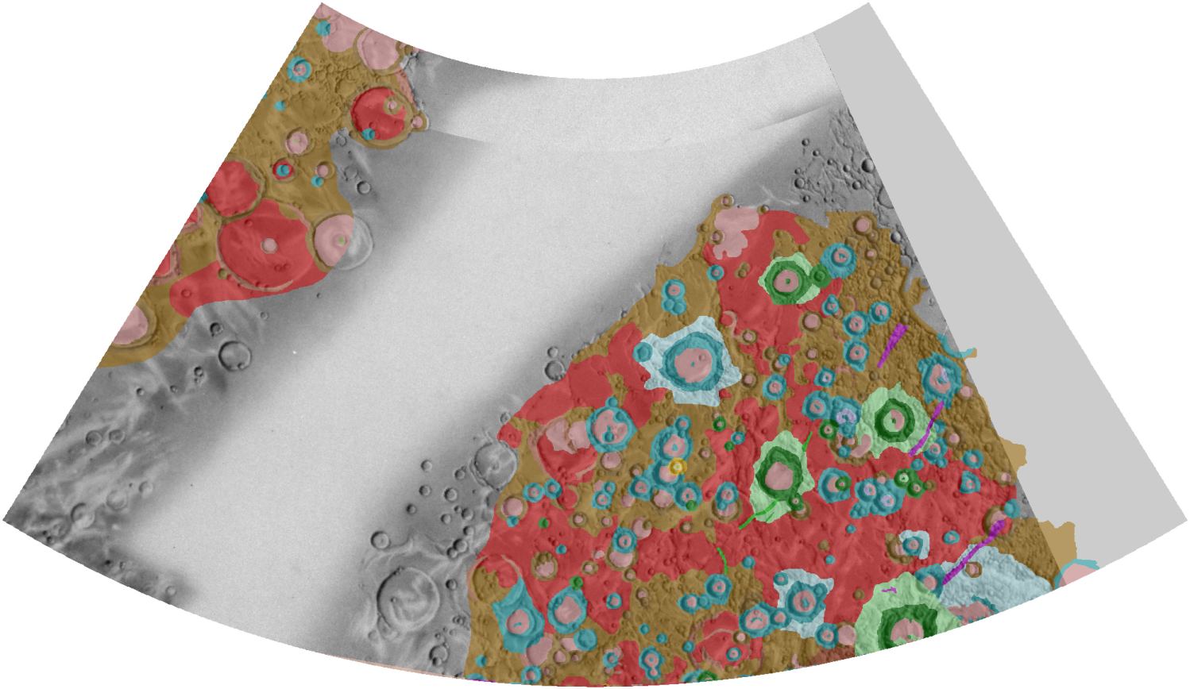
Geological mapping of Mercury
in preparation for BepiColombo
David Rothery & Matteo Massironi
ESA Mercury Surface & Composition Working Group
Published scale
1:5M
McGill & King 1983

Slide 2
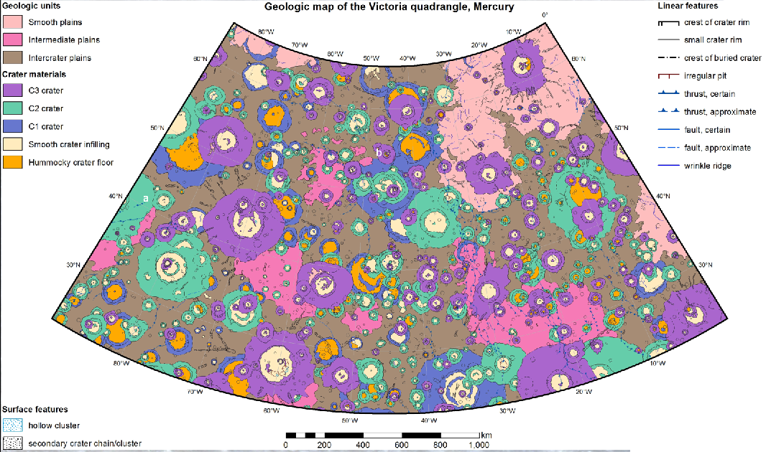
Valentina Galluzi
1:3M

Slide 3
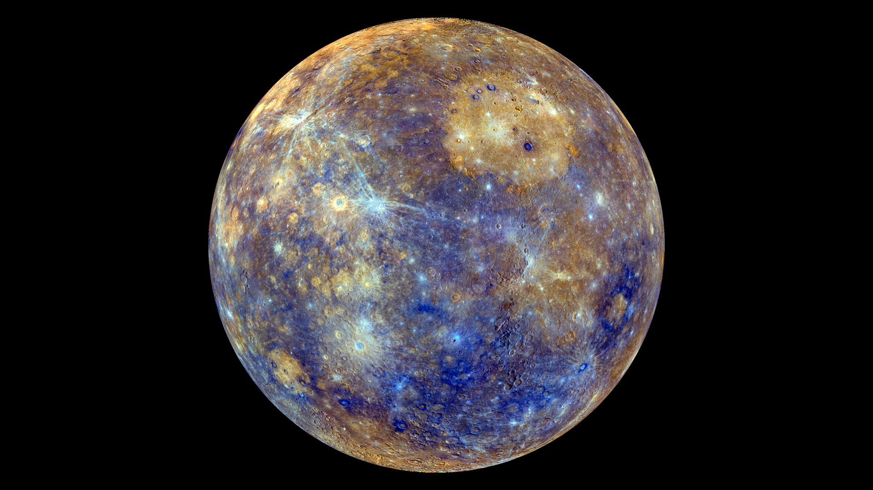
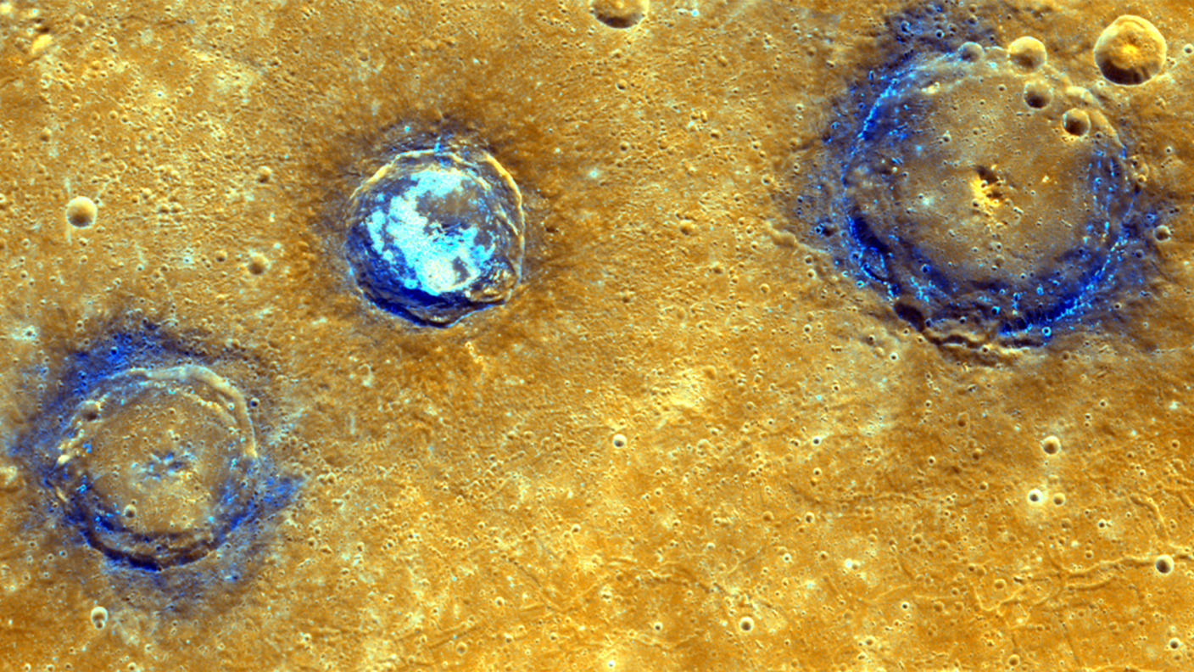
Why?
To provide context for future study
How?
MDIS images, supplemented by MESSENGER topographic and compositional data
What to map?
How many crater age classes? Should we subdivide smooth plains (HRP, LRBP …)
Should we map LRM, hollows, ‘pyroclastic’ deposits? Classes of tectonic features?
(Use of GIS layers?)

Slide 4
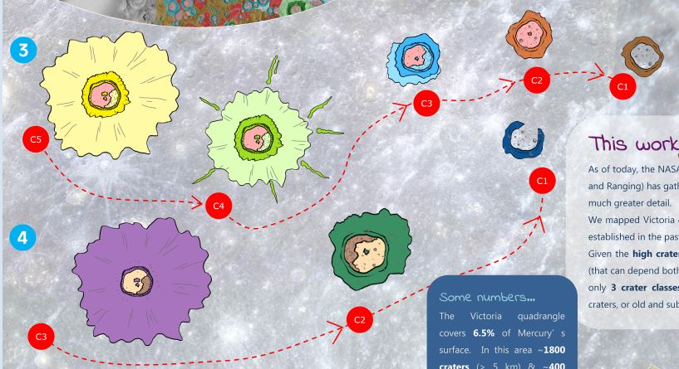
How many degradation/age classes of craters?

Slide 5
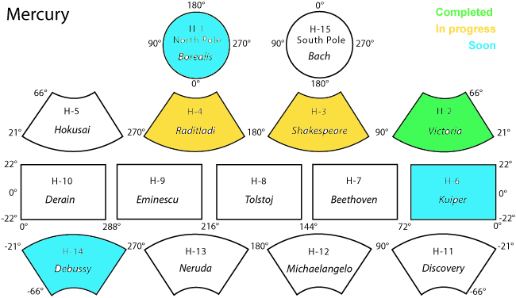
Valerio
Vivaldi?
Known mapping plans
Paolo
Mancinelli
Laura
Guzzetta
Valentina
Galluzzi
? Sabrina
Ferrari
Quad tbd
Jack Wright
Lorenza
Giacomini
Global ‘morphostratigraphic’ map
1:15M, Prockter et al.
Maps of special interest areas? (e.g. individual basins?)

Slide 6
How to progress future discussion?
Avoid duplication
Foster collaboration
Encourage consistency

