Slide 1
Photometric properties of Mercury’s surface at visible to near-infrared wavelengths
Deborah L. Domingue, Mario D’Amore, Sabrina Ferrari, Jörn Helbert, Noam R. Izenberg

Slide 2
overview
The Data
The Models
Preliminary Results
Preliminary Interpretations
Remaining Tasks

Slide 3
The data
MESSENGER’s Mercury Atmospheric and Surface Composition Spectrometer (MASCS) acquired photometric observations of Mercury at 14 distinct sites across the planet’s surface for the purpose of characterizing photometric behavior from visible to near-infrared wavelengths.
The objective of these observations was to provide a dataset for photometric standardization.
The 14 MASCS photometric regions were divided into five distinct geologic units. Each geologic unit was modeled separately.

Slide 4
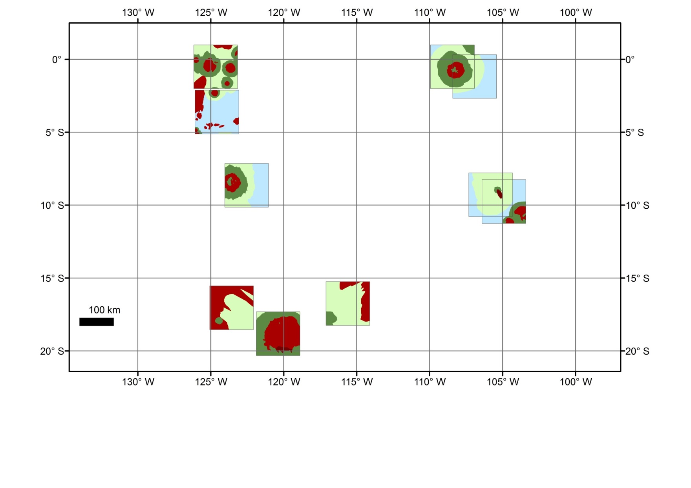
The photometric regions I
1542
1548
1546
1540
1545
1544
1552
1547
1544
1549

Slide 5
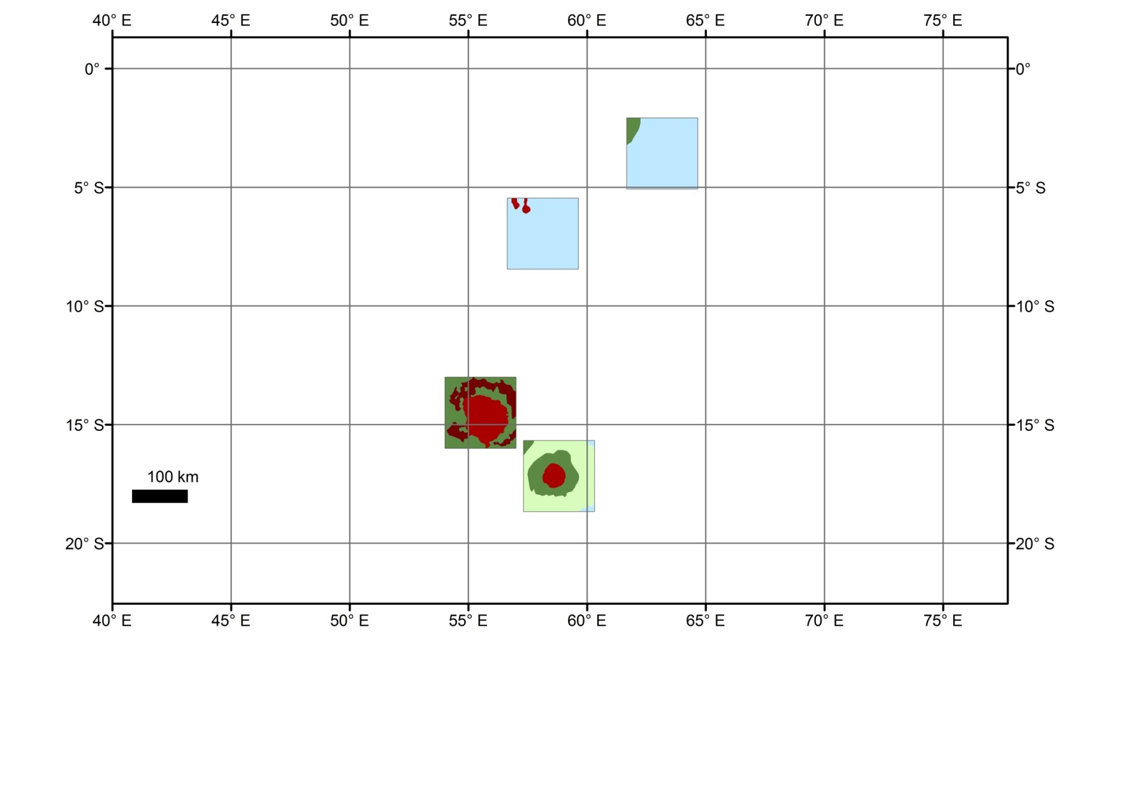
The photometric regions II
1550
1541
1553
1551

Slide 6
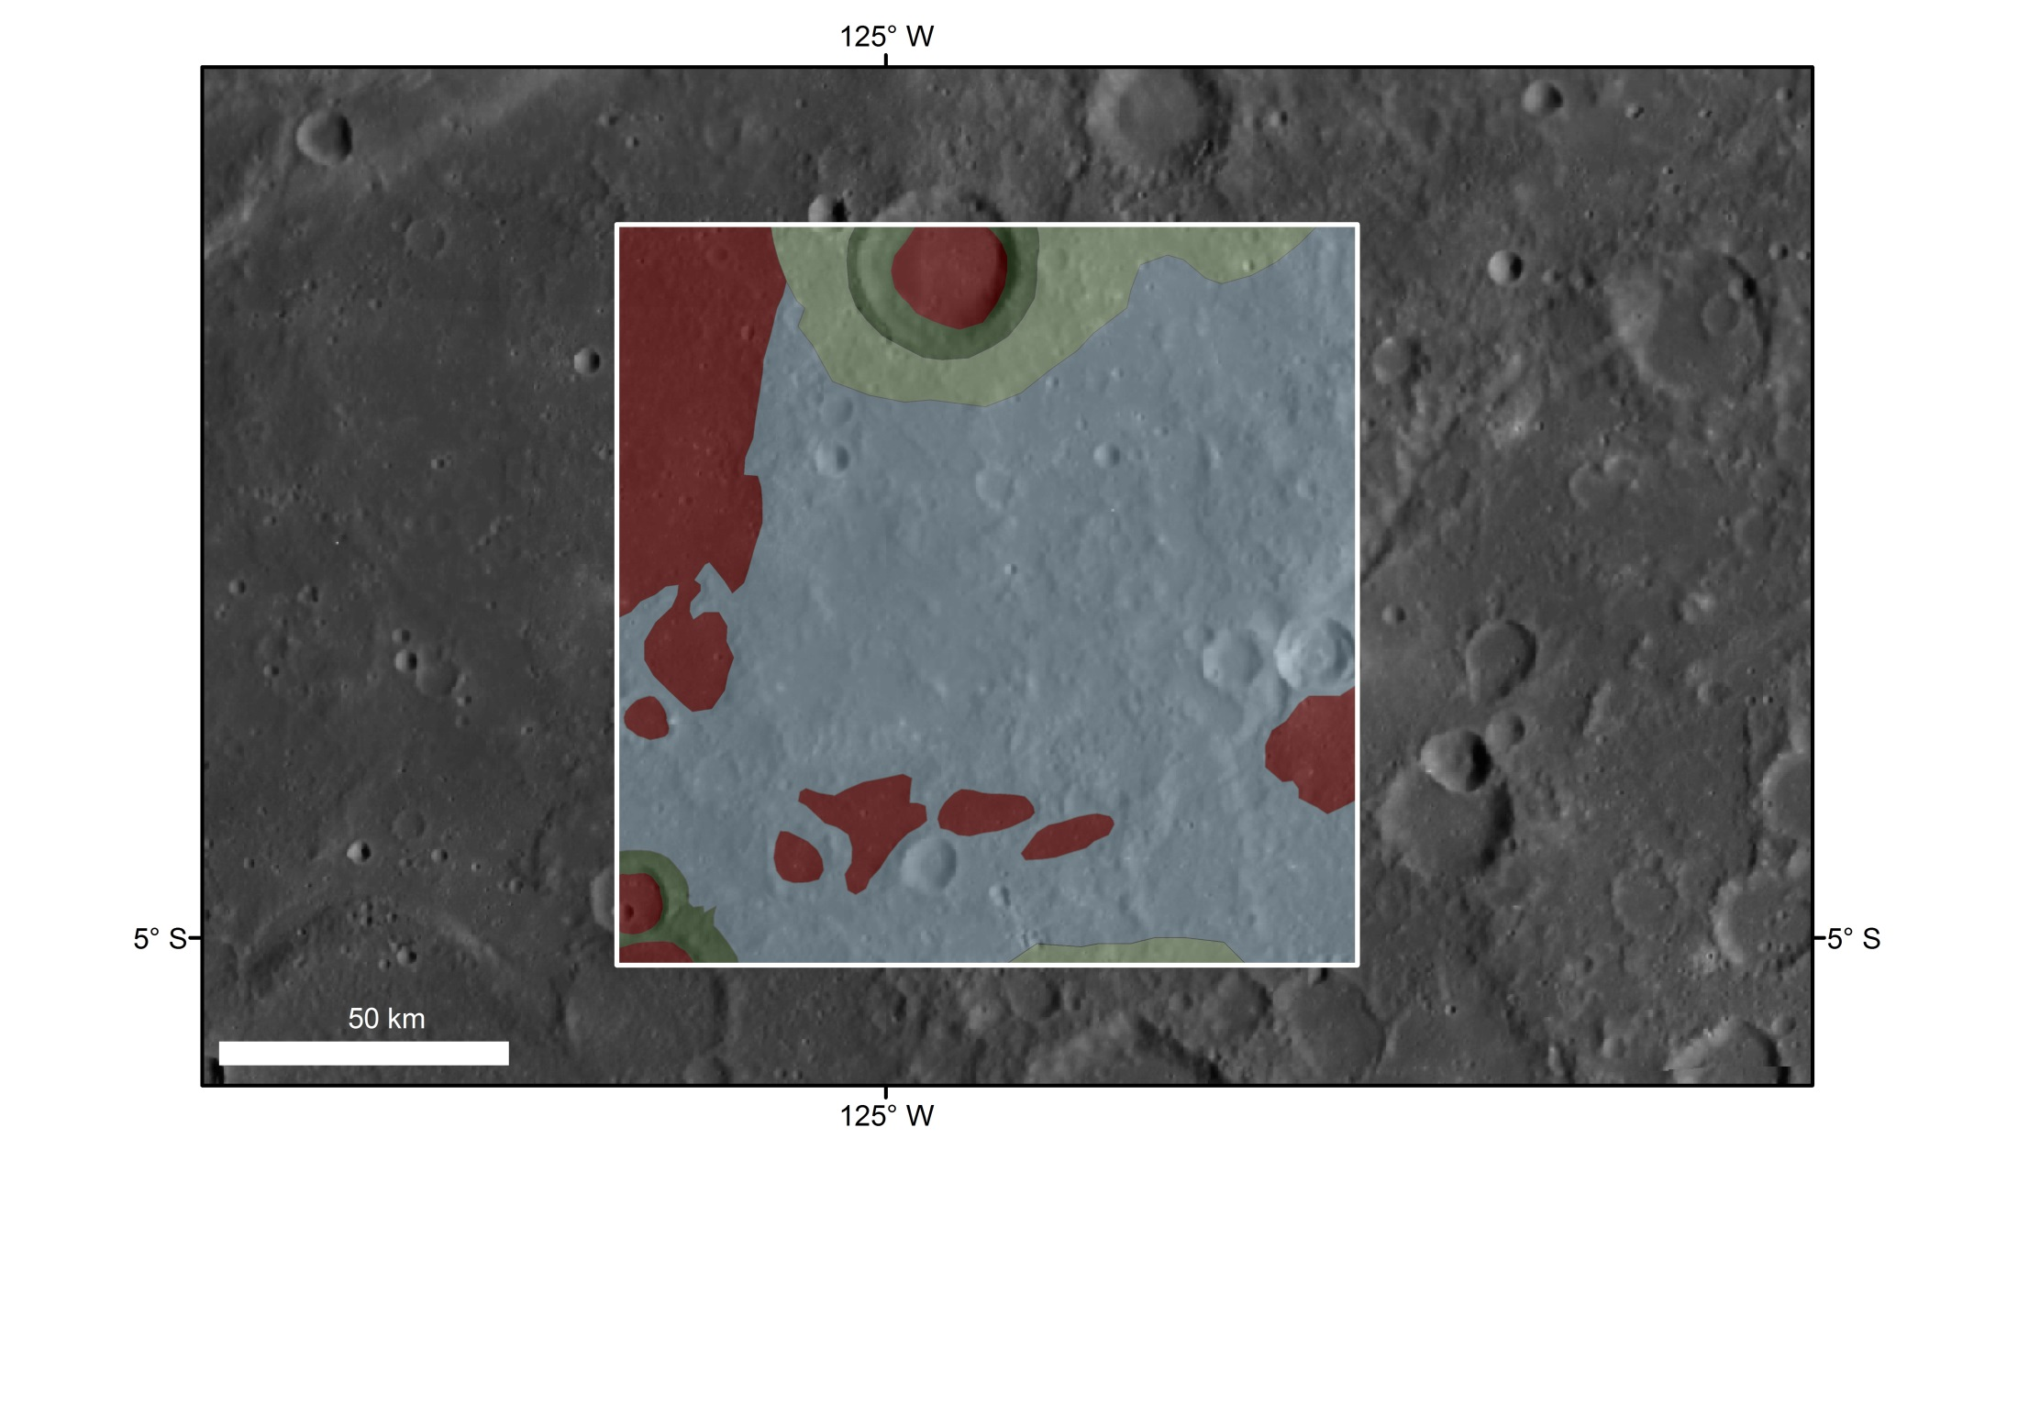
Example region
Bright radially lineated ejecta of Mena crater - ref. area 1542 - crosscut the area, which is dominated by impacts of different size and degradation; several patches of smooth materials are observable, though sharp distinctions are difficult.
1540

Slide 7
Data organization
Within each photometric region only those MASCS observations where the footprint contained only one geologic unit were selected.
The data from each photometric region were binned by geologic unit.
The data from each photometric region for a single geologic unit were binned together. This is the primary data set examined and presented today.
Today’s results will compare the photometric properties between the five geologic units present in the photometric regions.
The MASCS data were binned into 45-nm spectral resolution increments.

Slide 8
The models
Each data set is being modeled with two distinct methods that follow similar modeling efforts applied to images from MESSENGER’s Mercury Dual Imaging System [1].
The first method invokes the Hapke model [2-8], which is based on geometric optics and the equations of radiative transfer.
The second method uses the equations described by Kaasalainen et al. [9] and Shkuratov et al. [10], which have been successfully applied to observations of Vesta [11], the Moon [10], and Mercury’s global color mosaic [1].
References
[1] Domingue, D. L., et al. 2015, Lunar Planet. Sci. 46, abstract 1832. [2] Hapke, B., 1981. J. Geophys. Res. 68, 4571–4586. [3] Hapke, B., 1984. Icarus 59, 41–59. [4] Hapke, B., 1986. Icarus 67, 264–280. [5] Hapke, B., 1993. Theory of Reflectance and Emittance Spectroscopy. Cambridge University Press, N.Y., 455 pp. [6] Hapke, B., 2002. Icarus 157, 523–534. [7] Hapke, B., 2008. Icarus 195, 918–926. [8] Hapke, B., 2012. Theory of Reflectance and Emittance Spectroscopy. Cambridge University Press, N.Y., 2nd Ed., 513 pp. [9] Kaasalainen, M., et al., 2001. Icarus 153, 37–51. [10] Shkuratov Y., et al., 2011. Planet. Space Sci. 59, 1326-1371. [11] Schröder, S.E., et al., 2013. Planet. Space Sci. 85, 198-213.

Slide 9
Hapke model i
The “basic” form of the model was applied to the MASCS data set. This form does not include coherent backscatter opposition parameters, excludes the explicit porosity term, and assumes the shadow-hiding opposition terms are uniform across all wavelengths (the value of these terms are taken from disk-integrated studies of MDIS data).
This form was chosen since there are no MASCS observations within the opposition surge and this is the form of the Hapke model that best described the MDIS photometry data.
The “advantage” of this model is the theoretical correlation of parameter values to surface properties (though this has been brought into question in some laboratory tests by Shepard and Helfenstein (2011)).

Slide 10
Hapke model II
Parameter | Value Range | Relation to Regolith
w single-scattering albedo | 0 – 1 | A volume averaged single scattering albedo, the ratio of the amount of light scattered to the amount of light both scattered and absorbed.
b single-particle scattering function amplitude | -1 – 1 | A Heney-Greenstein function parameter that governs the relative amplitudes of the forward and backward scattering components.
c single-particle scattering function partition coefficient | -1 – 1 | A Heney-Greenstein function parameter that governs the partition of scattered light into forward or backward directions.
B_{S0} SHOE amplitude | 0 – 1 | The amplitude of the opposition effect due to the shadow-hiding mechanism. This is a single scattering mechanism.
h_{s} SHOE width | † | A measure of the width of the opposition effect due to the shadow-hiding mechanism, related to grain size distribution and filling factor within the scattering volume.
θ surface roughness | 0 – 40 (degrees) | The mean slope angle averaged over an upper size limit defined by the angular resolution of the detector and a lower limit defined by the radiative transfer equations, typically of the order of 100 -1000 μm (Hapke 2012).

Slide 11

Kaasalainen – Shkuratov (KS model)
Used the variation of this model that was shown to best describe the MDIS photometry measurements
This form includes only three parameters: A_{N} (Normal Albedo), phase parameter (μ), and disk function parameter (C_{l}).
The correlation of parameter values to surface properties is predominately empirical, though the phase parameter can be related to surface roughness.

Slide 12
Application methodology
Each model was fit to the observations using a least squares grid search method that varied all parameters simultaneously.
The best combination of parameters was found by minimizing the root mean square (RMS) between the measurement and the model predict.
In the following graphs the geologic units are noted as:
sm = smooth surface
smd = darker smooth surface
rew = intercrater material
rim = rim/proximal ejecta
ej = radial/discontinued ejecta

Slide 13
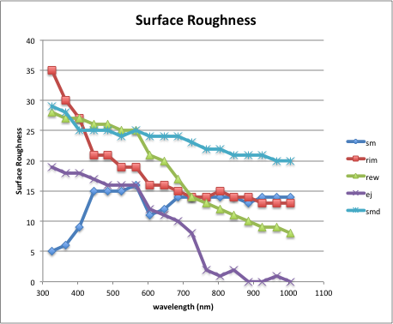
Preliminary results – hapke model I

Slide 14
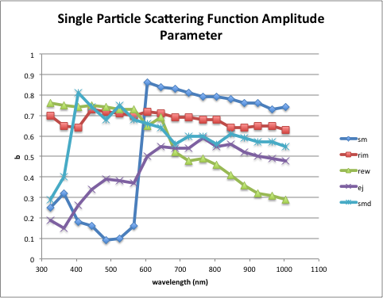
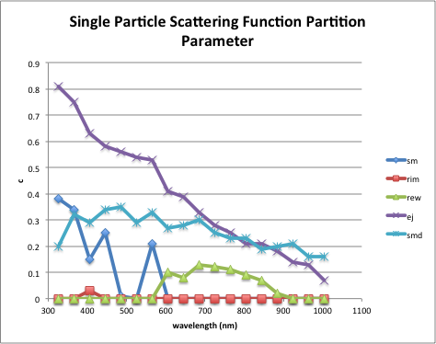
Preliminary results – hapke model II

Slide 15
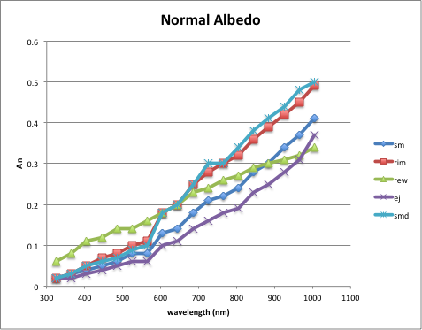
Preliminary results – ks model I

Slide 16
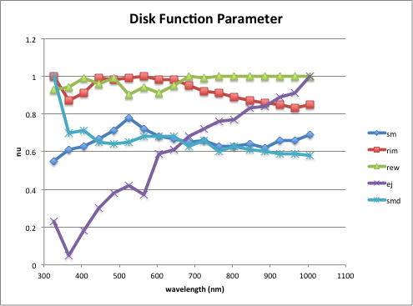
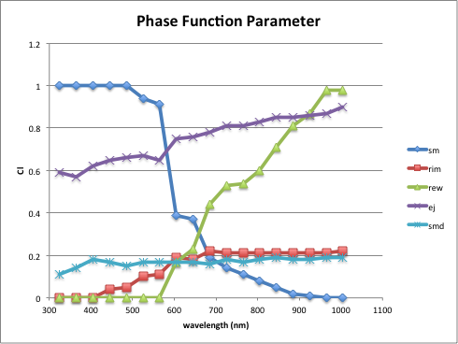
Preliminary results – ks model II

Slide 17
Synopsis of results
Both models show model parameter variability with wavelength
Both models show variations in parameter values with geologic unit, however….
  The KS model normal albedo parameter shows similar trends with wavelength between the geologic units while the Hapke model single scattering albedo does not.
  The Hapke model’s surface roughness parameter and the KS model’s disk function parameter (which is related to surface roughness) both show that the ejecta (ej) unit displays roughness values as a function of wavelength that are different from all the other geologic units.
  Surface roughness (especially as a function of wavelength) between the geologic units varies greatly in the Hapke model, but much less so in the KS model.
  The Hapke model scattering function parameters and the KS model phase function parameter show variations between the different geologic units.
QULAITY OF FIT?!

Slide 18
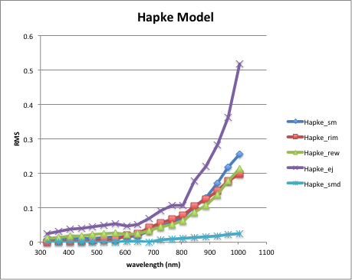
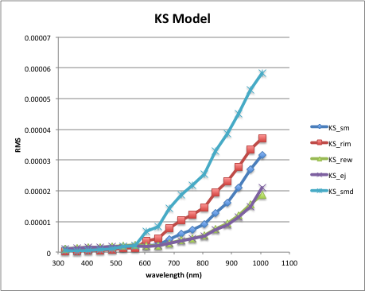
Quality of fit: RMS

Slide 19
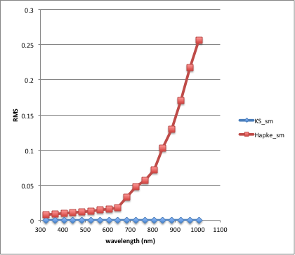
RMS: example comparison
While both models show that the quality of fit decreases (higher RMS values) with increasing wavelength, the KS model has significantly lower RMS values than the Hapke model.

Slide 20
Preliminary interpretations
To first order, the KS model better describes the MASCS photometry as compared with the Hapke model. Additional tests to quantify the quality of fit are coming….
Both models indicate variations in “roughness” between the geologic units
Is there one set of model parameters that can be applied to the MASCS data set to provide a robust photometric correction?
      Answer: Perhaps…..

Slide 21
Remaining tasks
The KS model parameters show the least variability between geologic units. The largest variability between geologic units for this model is seen in the Phase Function Parameter.
  Next Step: Combine all geologic units into a single data set and apply the KS model. This is the first step to determine if there is a single set of model parameters that can provide a photometric standardization across the MASCS data set.
Is there photometric variability within the geologic units between the different photometric regions?
  Next Step: Model each geologic unit, within each photometric region, separately. This has been completed with the Hapke model, but application of the KS model remains to be performed.
The quality of the model solutions needs further examination.
  Next Step: Perform a ratio analysis (measured versus modeled) for the current set of model solutions for the geologic units. Perform this same test on the combined data set described above, and below.
Spectral Properties testing
  Next Step: Select pairs of spectra from the same geologic unit, from the same photometric region, taken under different incidence, emission, and phase angle conditions. Correct one spectrum of the pair to the geometry of the second spectrum of the pair. Examine how well the correction predicts the actual spectrum.

