Slide 1
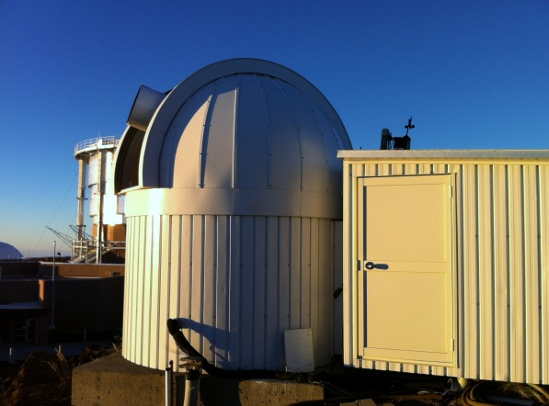
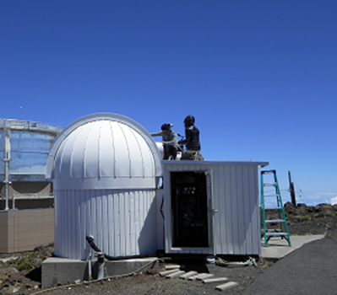
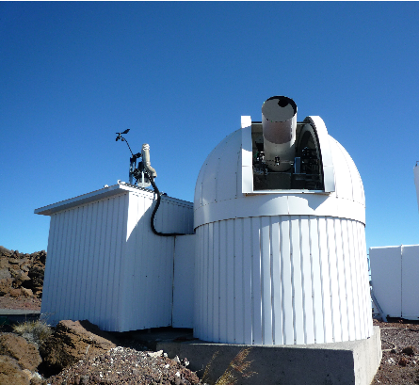
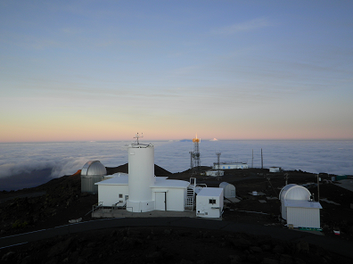
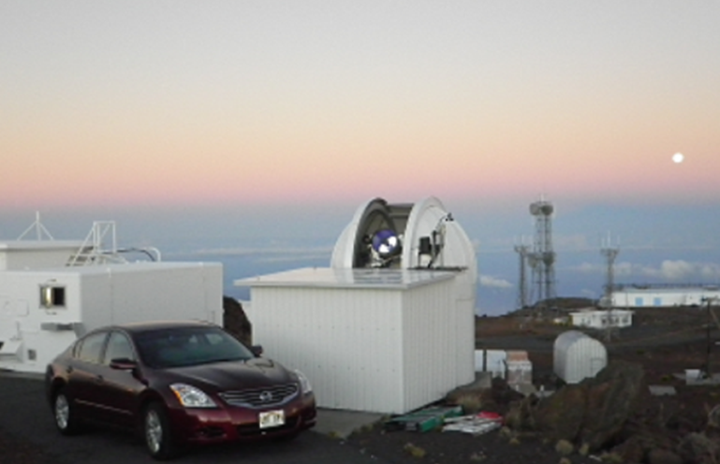
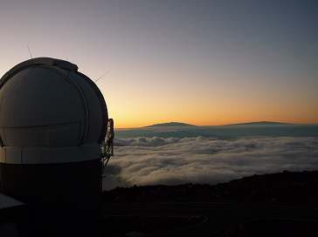
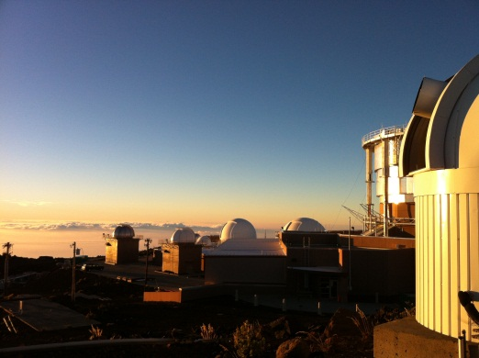
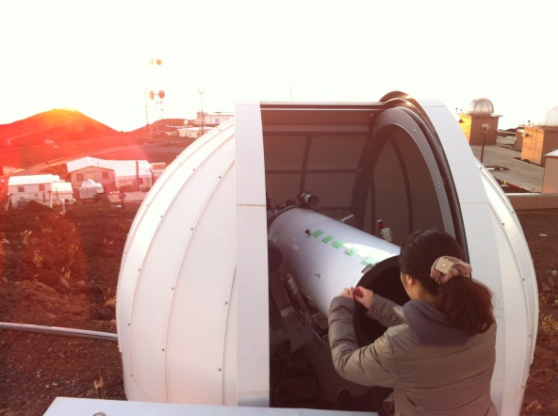
Seasonal variability of Mercury’s sodium and interplanetary dust distribution
(from 2011 to 2015)
S. Kameda¹, A. Fusegawa¹, T. Yasuda¹, M. Kagitani², M. Yoneda², and S. Okano²
¹ Rikkyo University, ² Tohoku University

Slide 2


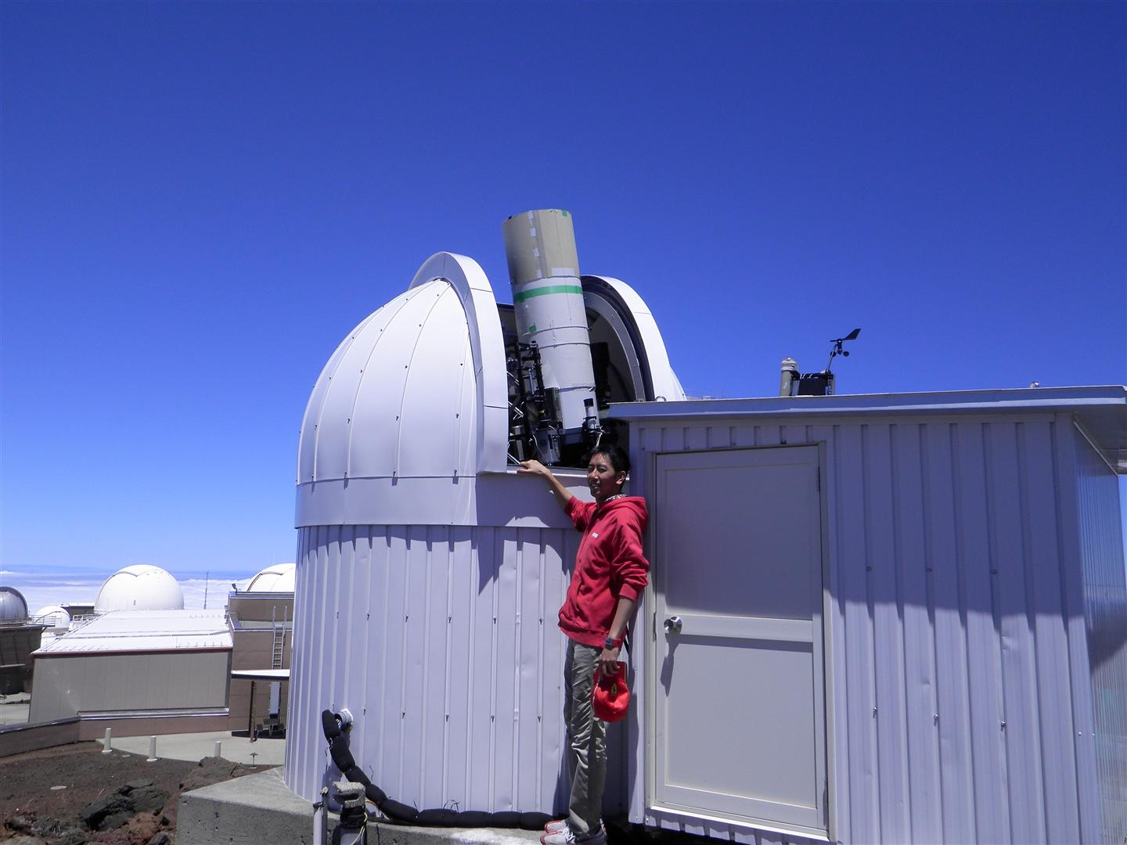
MESSENGER and small ground-based telescope (40 cm) in Hakealaka
1, March 2011 –March 2013
Short term variability of sodium density
and solar wind flux
(Daytime: 47 days with handmade hood)
2, March 2013 – January 2015
Seasonal variability of sodium density
(After sunset or before sunrise: ~150 days)
3, April 30, 2015

Slide 3
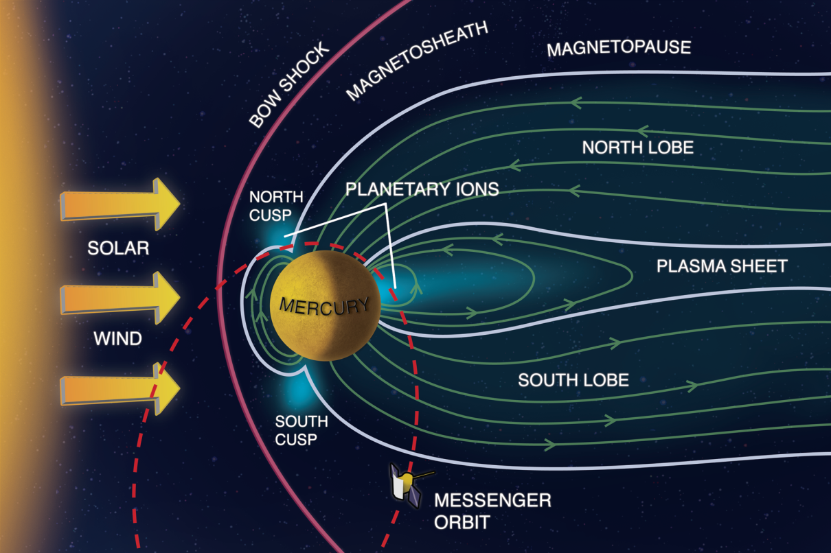
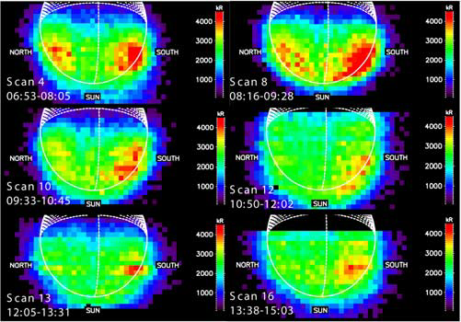
Sodium exosphere
Concentration at high latitudes
North-South asymmetry
Temporal variability
[Zurbuchen et al.,2011]
■ Source processes
Photon-stimulated desorption
Solar wind impact (sputtering or diffusion)
Micro meteorite vaporization
[Leblanc et al., 2009]

Slide 4
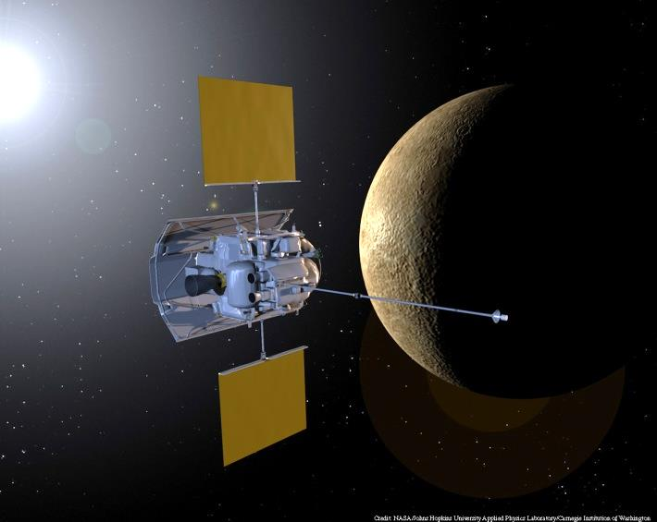
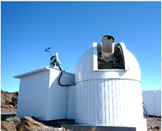
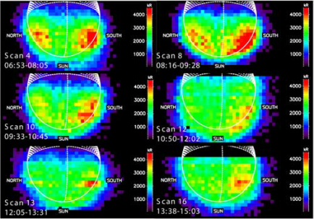
Purpose of this study
From March 2011 to March 2013,
Solar wind flux ← MESSENGER
Sodium exosphere ← Ground-based obs.
If the solar wind impact is the dominant
source process of sodium,
The sodium density should increase
when the solar wind flux increases.
MESSENGER NASA
Haleakala observatory
[Zurbuchen et al.,2011]
[Leblanc et al., 2009]
Notes:
In such a situation, from March 2011, MESSENGER has started the world‘s first observation in Mercury orbit.
Because MESSENGER observes solar wind, it is possible to confirm the variation of the sodium exosphere when the solar wind flux increase.
In this study, we observe sodium exosphere during observation of MESSENGER, and to confirm relation between solar wind flux and sodium exosphere.

Slide 5
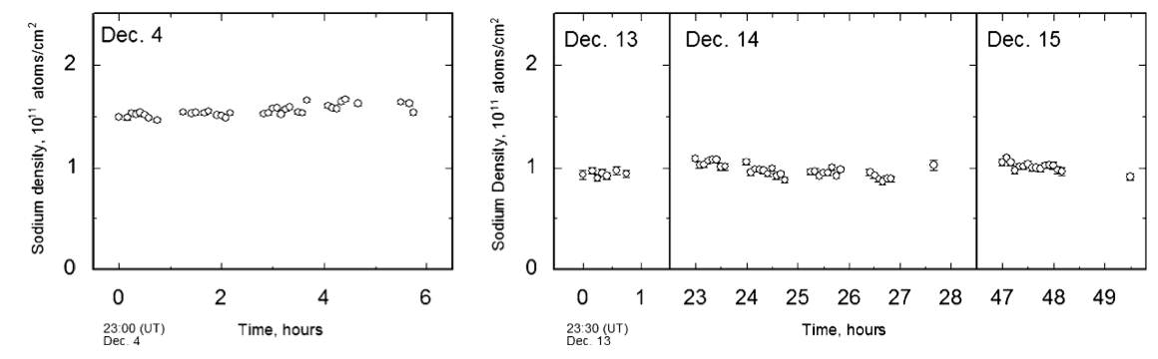
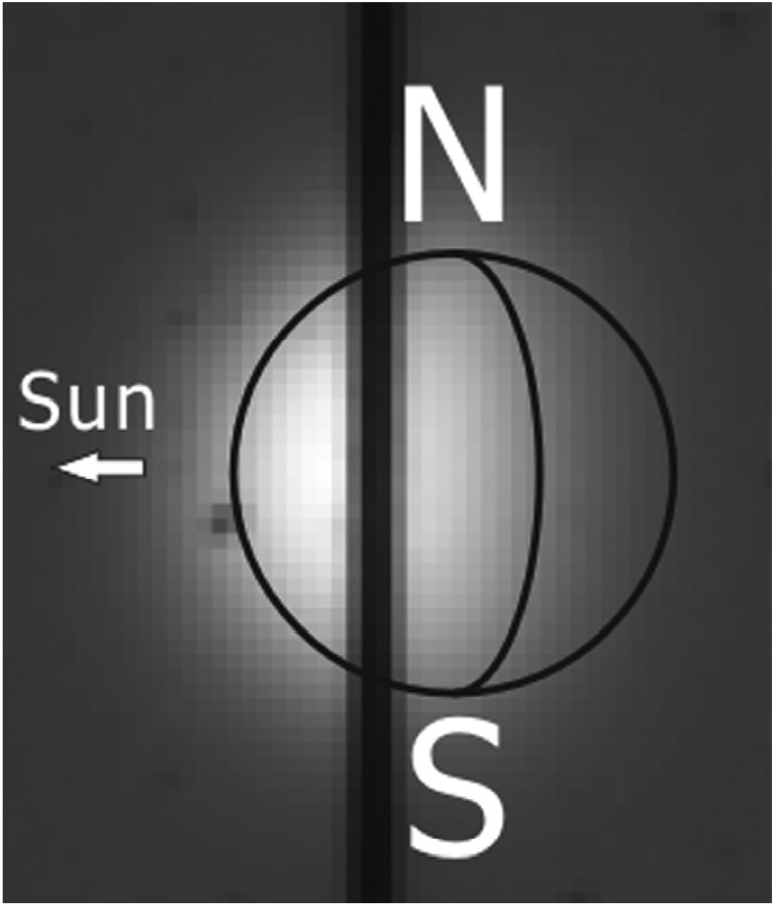
Dec 2005
Kameda et al., PSS2007
Stable in short term
Seasonal variation

Slide 6
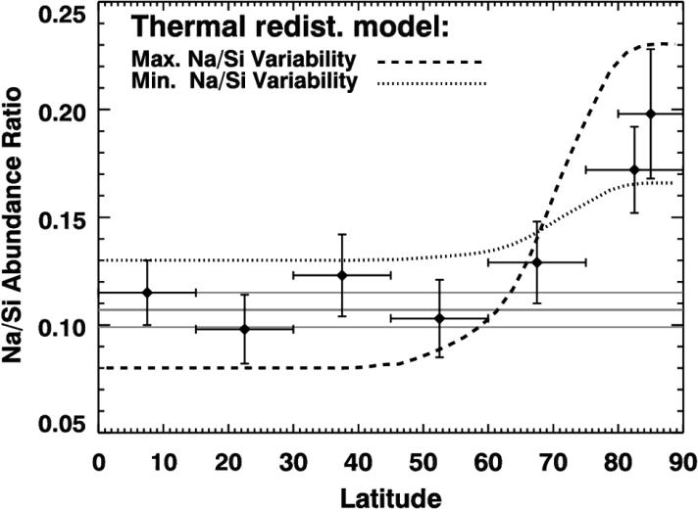
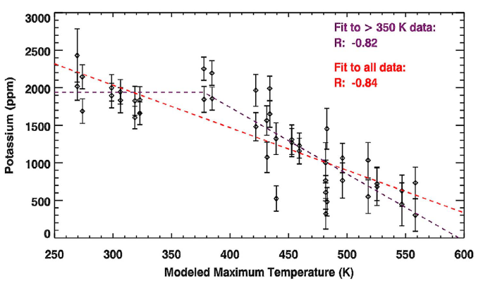
Why is sodium dense at high at high latitudes ?
Sodium is abundant in high latitudes at the surface.
(MESSENGER/GRNS)
[Leblanc et al., 2009]
■ Na distribution over the
northern hemisphere
Na/Si at polar region is higher than at equatorial
region. [Peplowski et al., 2014; Evans et al., 2012]
[Peplowski et al., 2014]
■ Relation to surface temperature
There is a high anti-correlated to the
surface temperature and the
abundance of potassium.
[Peplowski et al., 2012]
K abundance
Surface temperature (K)
[Peplowski et al., 2012]

Slide 7
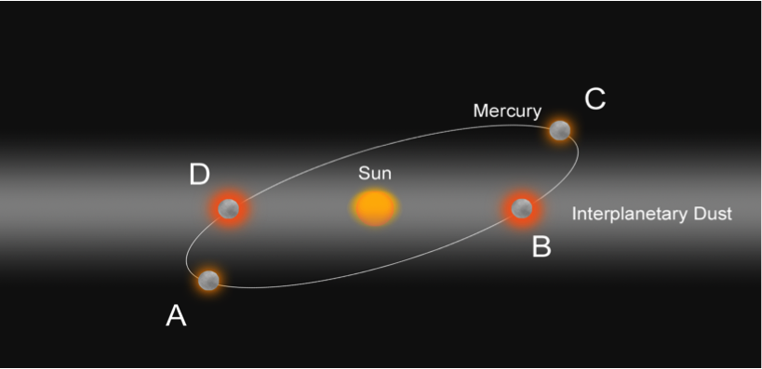
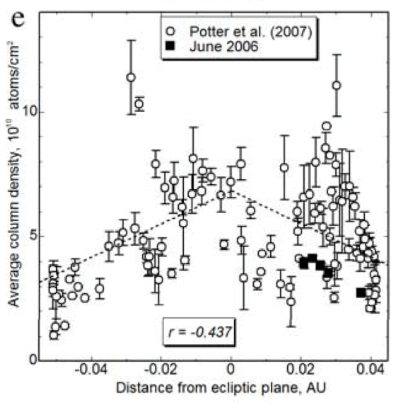
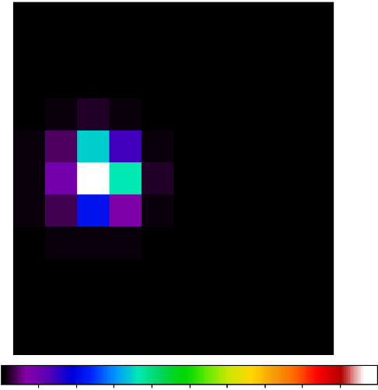
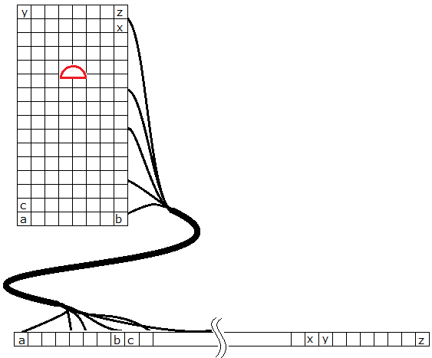
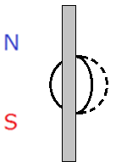
March 2013 – January 2015
Seasonal variability – dust distribution
Higher sodium density near interplanetary dust plane.
Kameda+2009
Sun
March 2013
Long slit→
Image slicer
To estimate the total amount of sodium atoms
We changed from slit to fiber optics for 2-D spectroscopy.

Slide 8
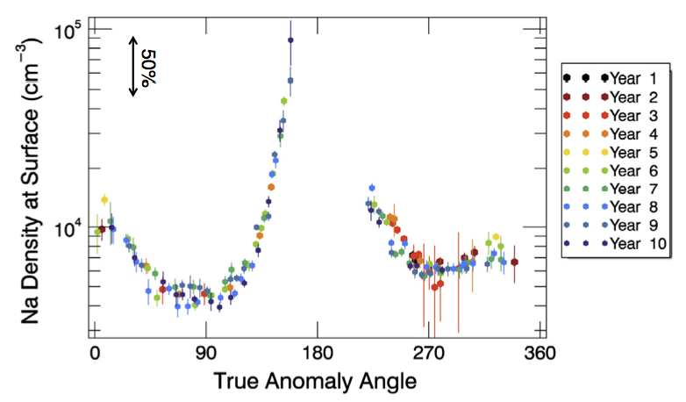
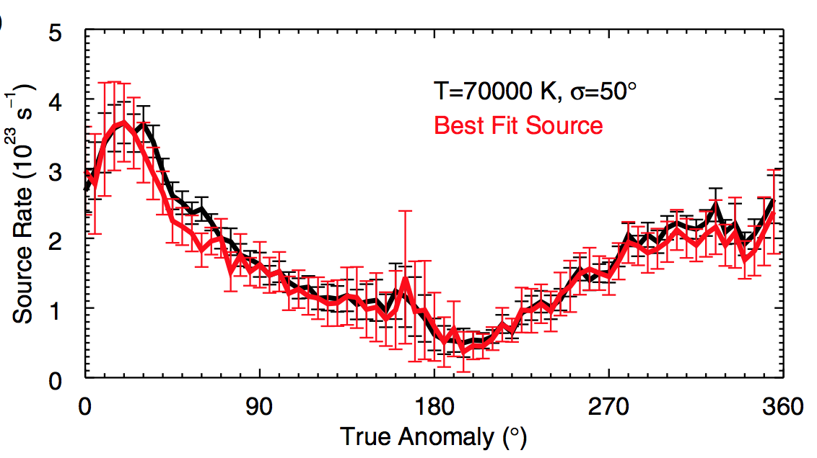
March 2013 - January 2015
MESSENGER & HALEAKALA
Dawn
Dusk
Ca
Comet Enke
Dust trail
Killen and Hahn 2015
Cassidy et al., 2014
Burger et al., 2014

Slide 9
March 2013 - January 2015
Interplanetary dust plane
140°
320°
Inclination i=2.03±0.017
Ascending node Ω=77.7±0.6
DIRBE Model [Kelsall et al., 1998]
(at ~1AU)
140°
320°
Near Mercury orbit,
dust cloud is very thin?
Denser, farther from the sun?

Slide 10
Sodium and Calsium
140°
320°
Na
Dust size distribution
Na: Gardening effect
Ca: Impact vaporization
Ca
140°
320°

Slide 11
Apr 30, 2015

Slide 12
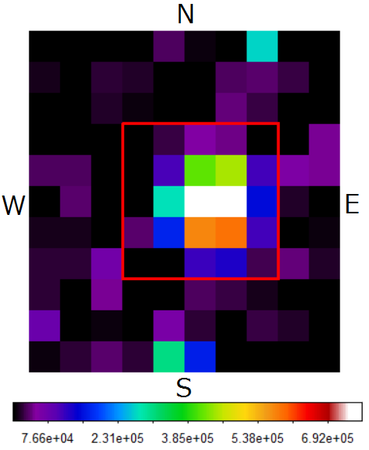
Apr 30, 2015
Impact to the far side from Earth
19:26 UT Light time ~8 min
Stable (within the error）

Slide 13
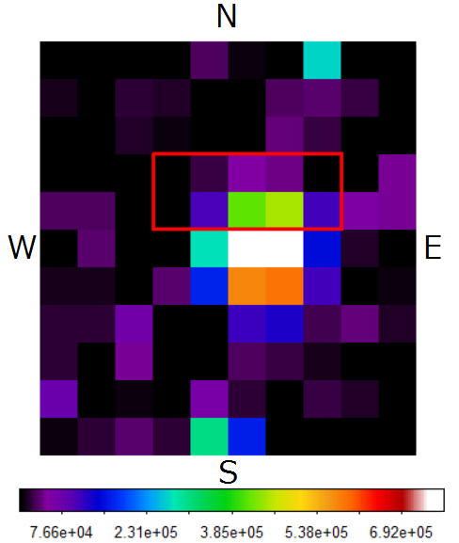
Apr 30, 2015
Impact to the far side from Earth
19:26 UT Light time ~8 min
Stable (within the error）

Slide 14
MESSENGER and small ground-based telescope (40 cm) in Hakealaka
1, March 2011 –March 2013
Short term variability of sodium density
and solar wind flux
(Daytime: 47 days with handmade hood)
→Mercury’s sodium exosphere is stable
in short time.
2, March 2013 – January 2015
Seasonal variability of sodium density
(After sunset or before sunrise: ~150 days)
→Not simple
3, April 30, 2015
→No surprise.
Mercury’s sodium exosphere is stable
Plan:
Looong term observation
from 2013 to 2026-
Na/K observation from 2016

Slide 15
END

