Slide 1


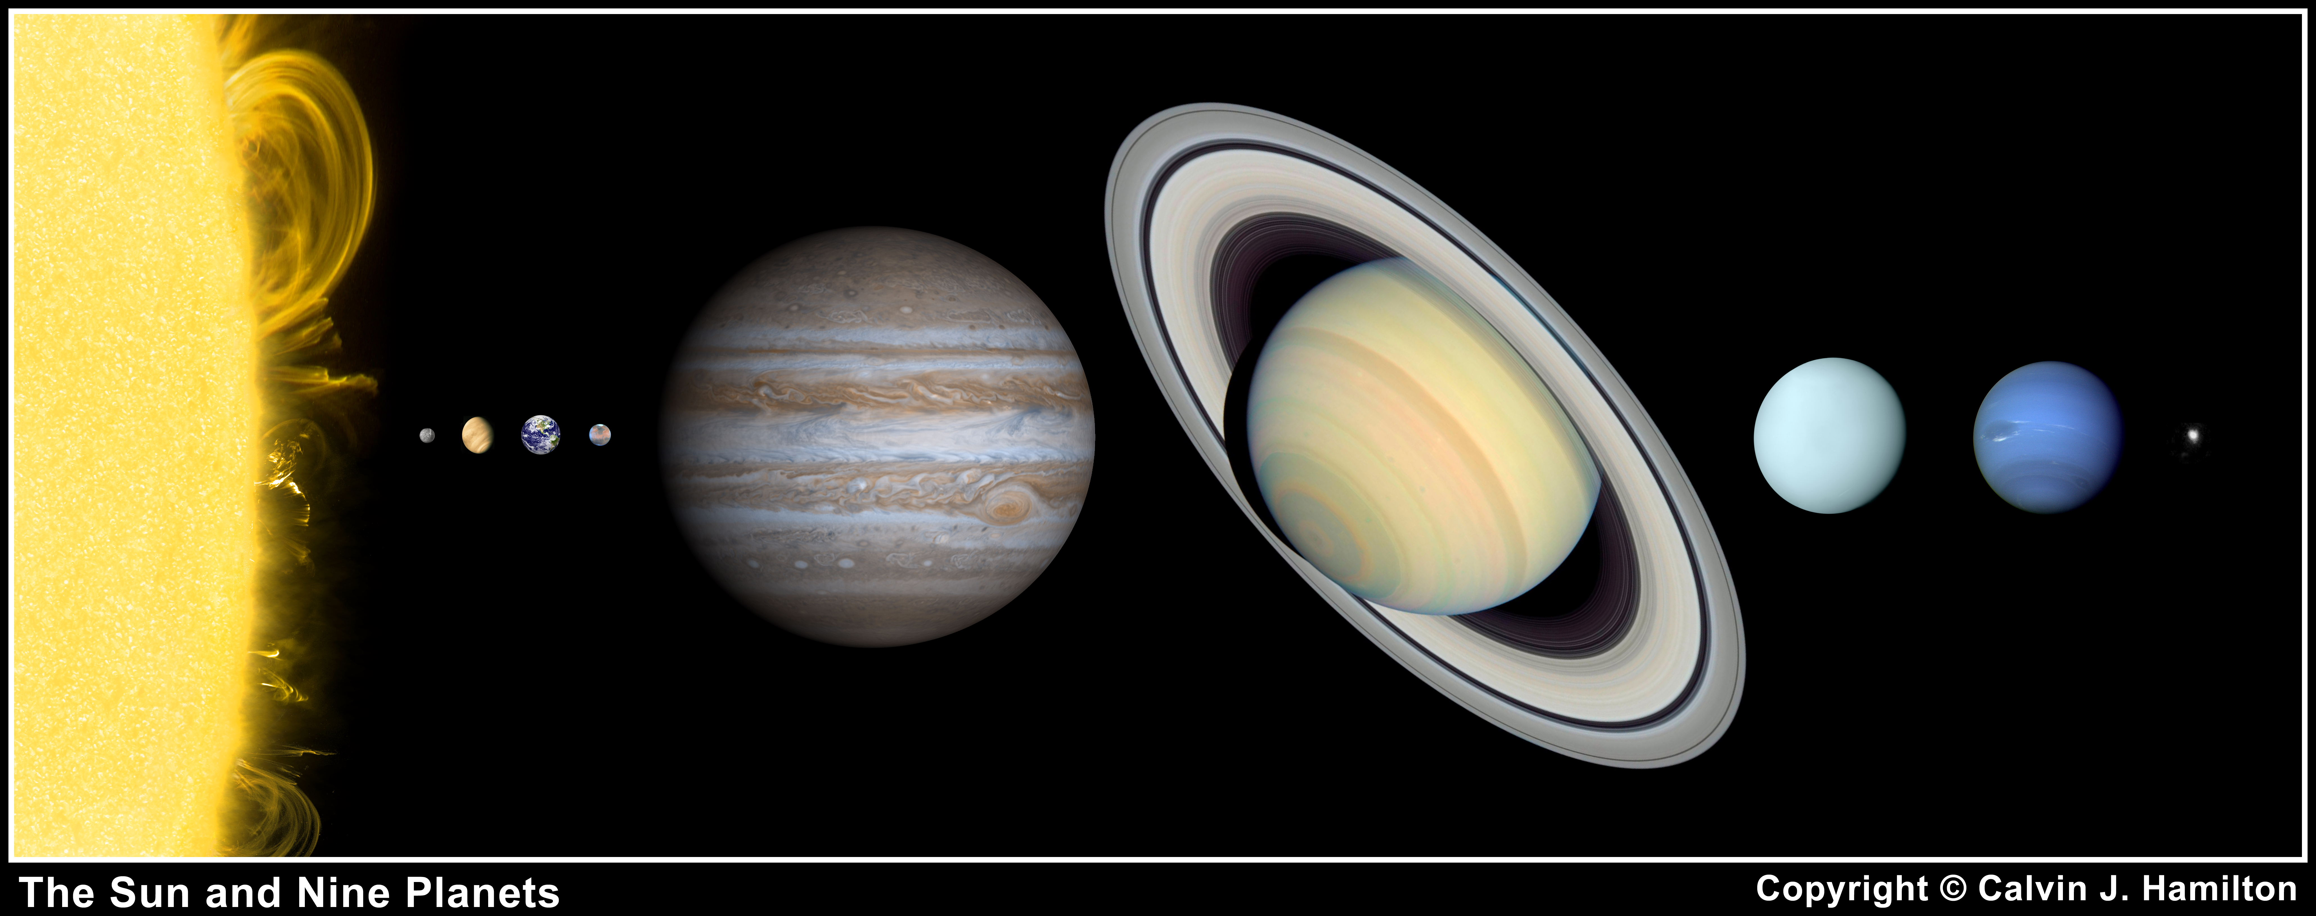
The Big Picture:
Contributions Expected from Bepi Colombo
Tilman Spohn

Slide 2
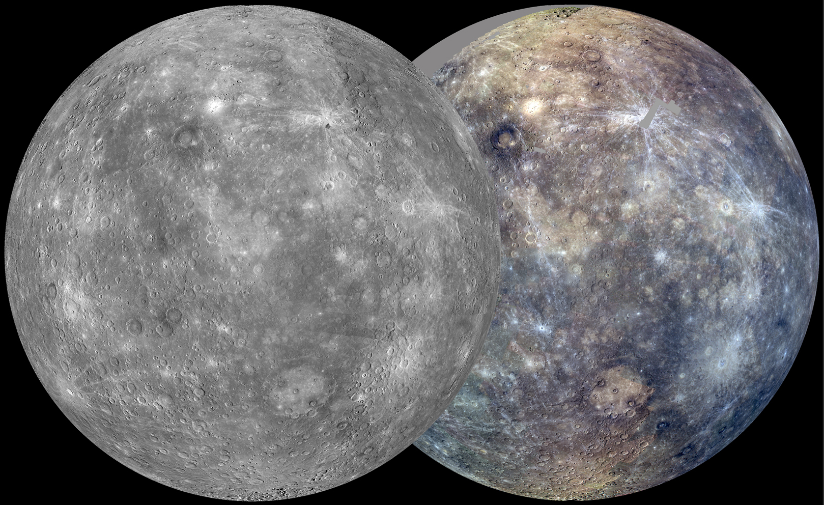
The BIG Picture
...calls for some comparative planetology
Mercury in Comparison
Formation of Mercury
Interior Structure
Evolution
BepiColombo

Slide 3
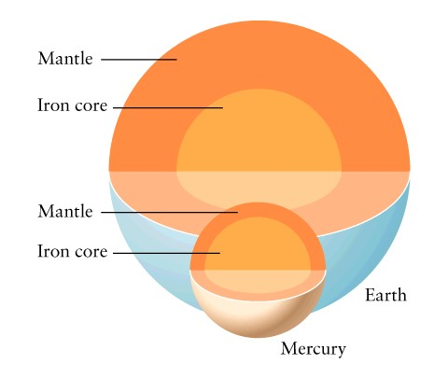
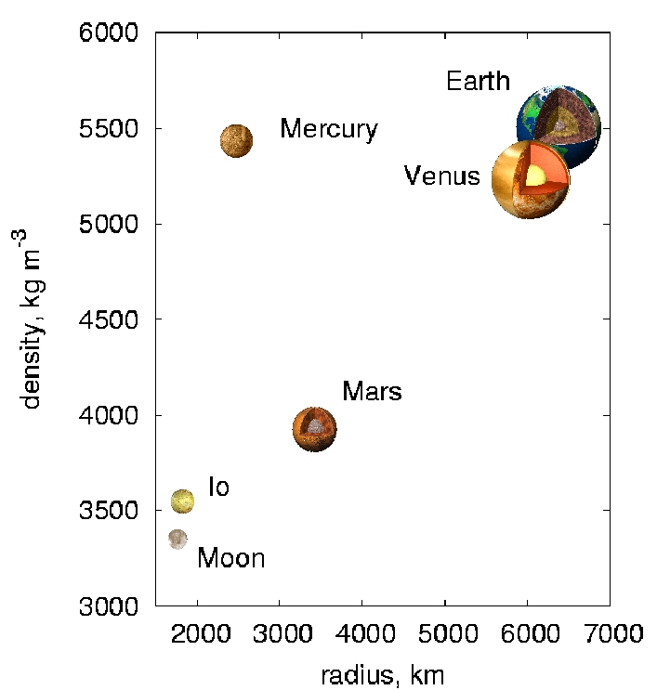
Mercury in the Solar System
Innermost planet, close to parent star, hottest surface, harsh radiation environment
Smallest planet with 0.38 R_{E} and 0.06 M_{E,} smaller than e.g., Ganymede
Largest uncompressed density of solar system planets and satellites implies largest relative core size
Mostly cratered (i.e. old) surface with tectonic and volcanic features (e.g., scarps, rupes..)
Self sustained magnetic field
Thin exosphere

Slide 4
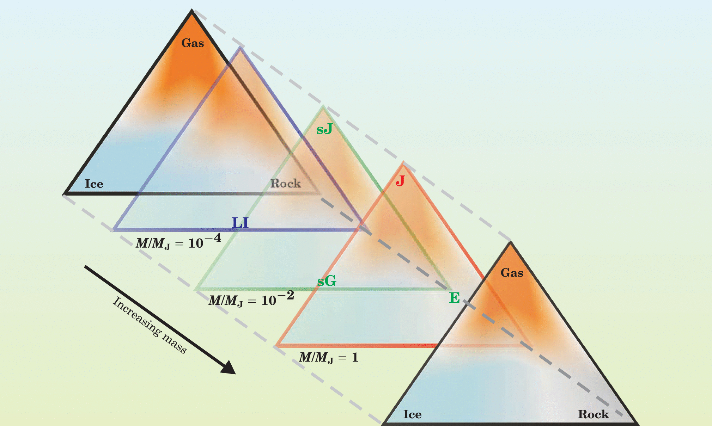

Planetary Diversity
Stevenson, 2004

Slide 5
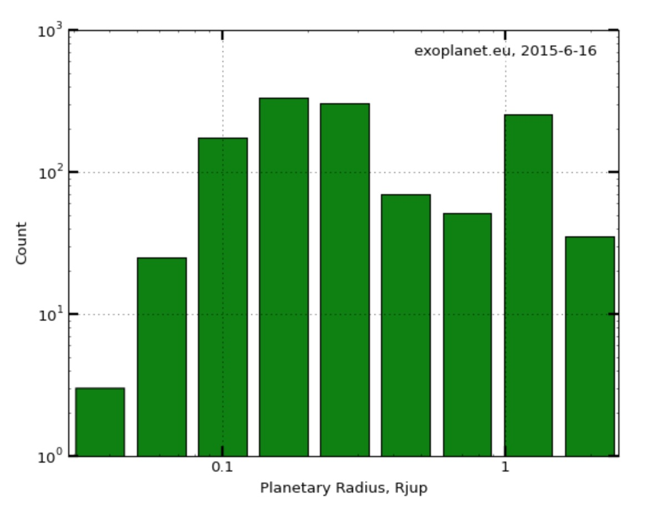
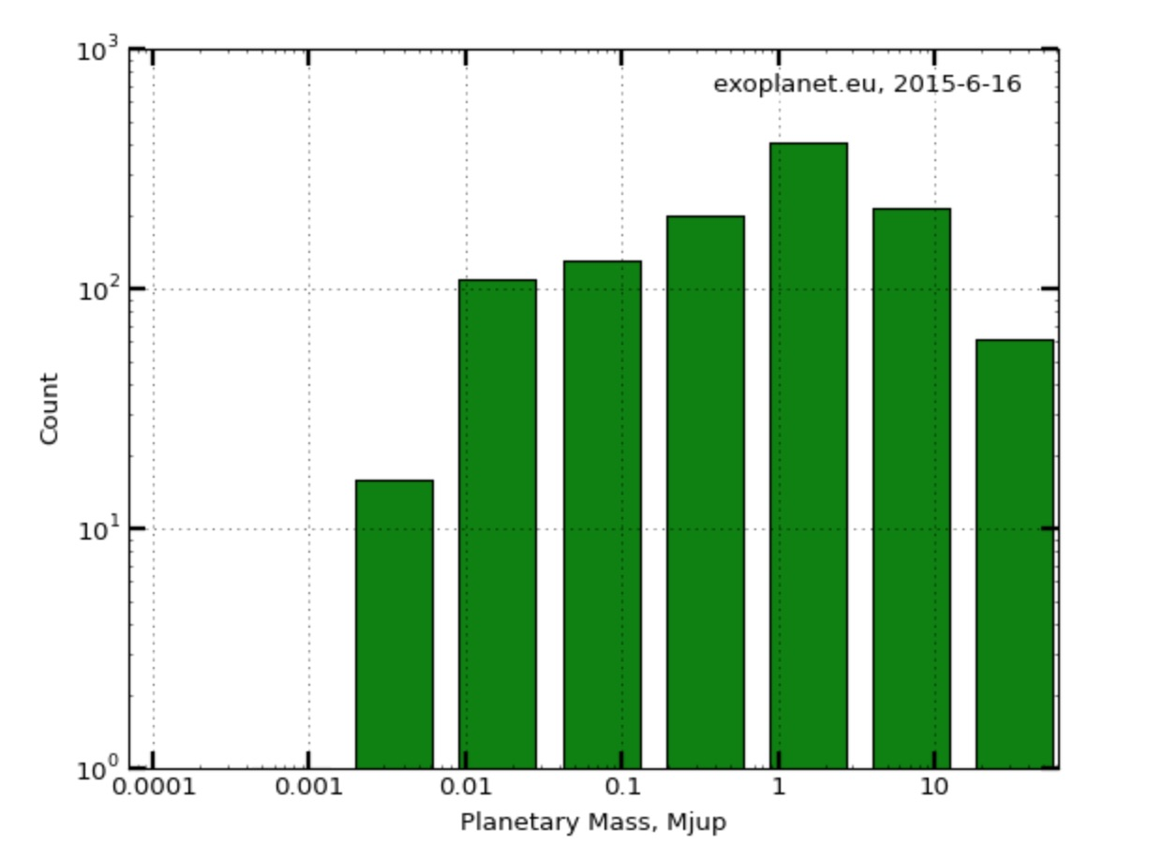
Exoplanets, confirmed and candidates

Slide 6
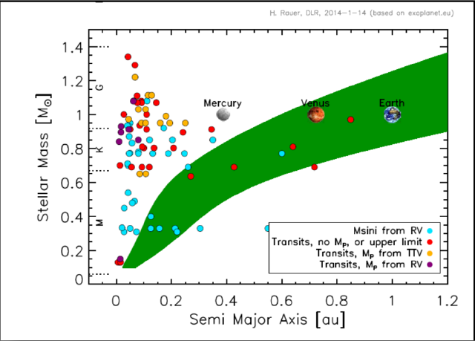
Exoplanets, detected super Earths

Slide 7
Formation
Chambers and Halliday, 2015

Slide 8
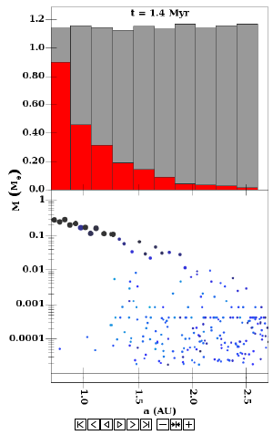
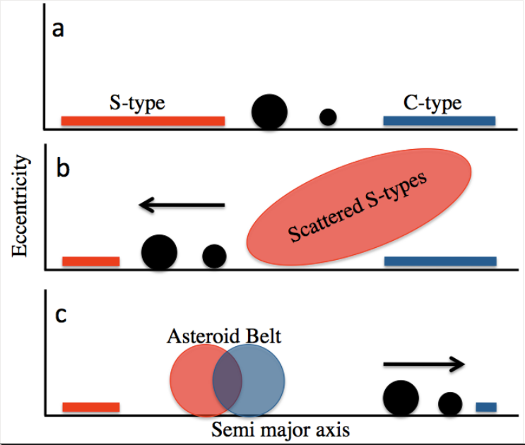
Grand Tack and Pebble Scenarios
Much effort has gone in recent years into models of solar system formation that would explain
  Core formation in Jupiter and Saturn
  Mars small mass
  LHB
Comparatively little attention has been placed on Mercury, although its bulk chemistry is puzzling
Levison: Pebble stage resulting in ca 20 planetasimals followed by a “Bam Bam” stage. For a recent model see Asphaug et al., 2014
Walsh et al., 2011

Slide 9
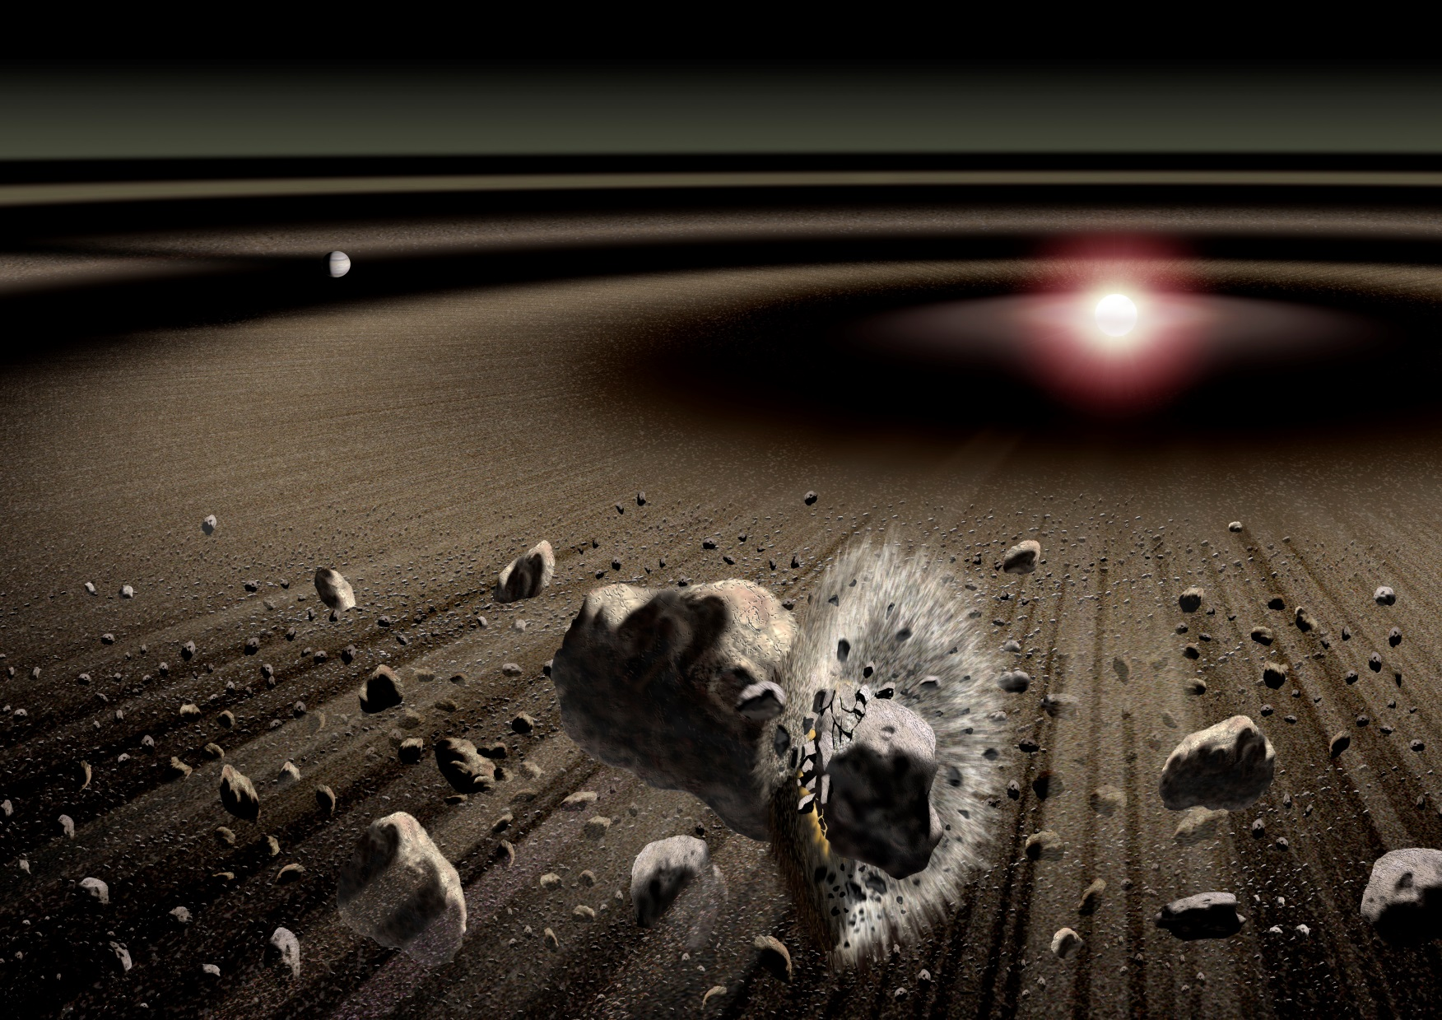
Hal Levison and colleagues

Slide 10
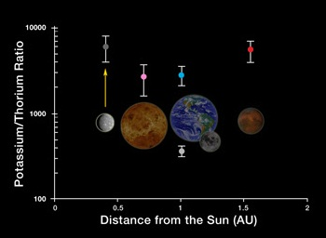
Grand Tack and Pebble Scenarios
Messenger showed that Mercury is volatile richer than previously thought and then perhaps not consistent with some formation scenarios e.g., giant impact or series of giant impacts. Way out, late veneer?

Slide 11
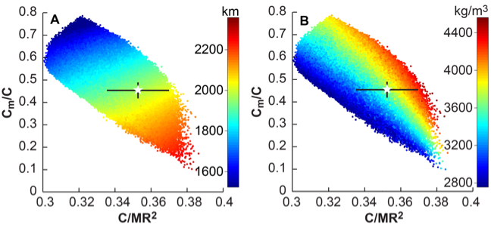
Interior Structure
Core radius
Messenger observations of the gravity field components C₂₀, and C₂₂ together with earthbound observations of the libration and obliquity have been used determine the interior structure using Peale‘s method.
Core radius of 2000 – 2050 km, mantle thickness of ca 400 km (Hauck et al, 2013)
The late Stan Peale saw some problems with his assumption of a fully decoupled core, though
Gravity data have also been used to derive the crust thickness
Crust
Mantle
Liquid
Outer Core
Solid
Inner Core
Hauck et al. (2013)

Slide 12
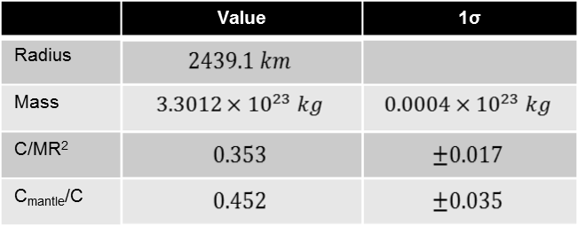
MESSENGER Constraints
Improved geodetic parameters provided by NASA spacecraft MESSENGER
Crust
Mantle
Liquid
Outer Core
Smith, D. et al.: Gravity Field and Internal Structure of Mercury from MESSENGER, Science, vol. 336, pp. 214-217, 2012.
Solid
Inner Core
Notes:
Welche physikalischen/ geodätischen Beobachtungsgrößen besitzt man?
Radius (MESSENGER mission sehr genau bestimmt) + Masse = Durchschnittleiche Dichte Merkur
Merkur – Trägheitsfaktoren aus geodätischen Messungen besonders gut bestimmt
Fehler:
Normierte polare Gesamtträgheitsmoment
Auf das gesamte Trägheitsmoment normierte Trägheitsmoment des Mantels
(ergeben sich aus einer Kombination Schwerefeldfaktoren (niedrigen Grades) und Librationsparameter
Beobachtbaren weisen darauf hin, dass der innere Kern entkoppelt von Mantel und Kruste -> flüssig
12

Slide 13
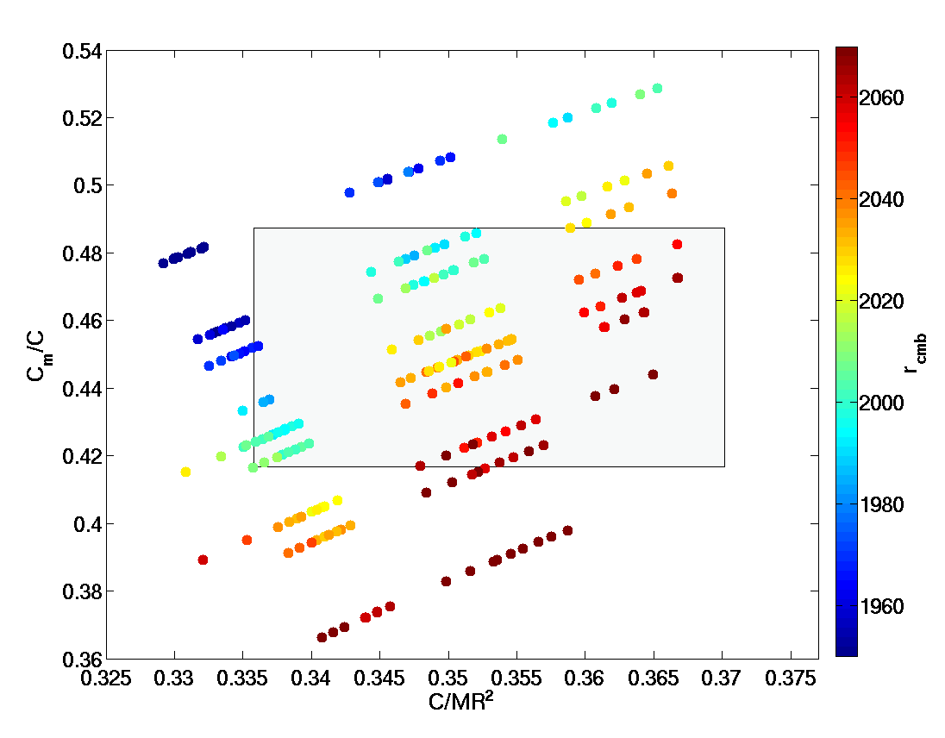
Distribution of Models - Core - Mantle - Boundary
Mercury‘s core radius ranges from 1980 km to 2080 km.
Notes:
Variation:
innerer Kern zwischen 0 und 1000 km
Krustendicke 25, 50, 75
Gute Abdekung des Bereiches mit unseren Modellen
Auf Schwachstelle hindeuten!
Schwefelgehalt:
13

Slide 14
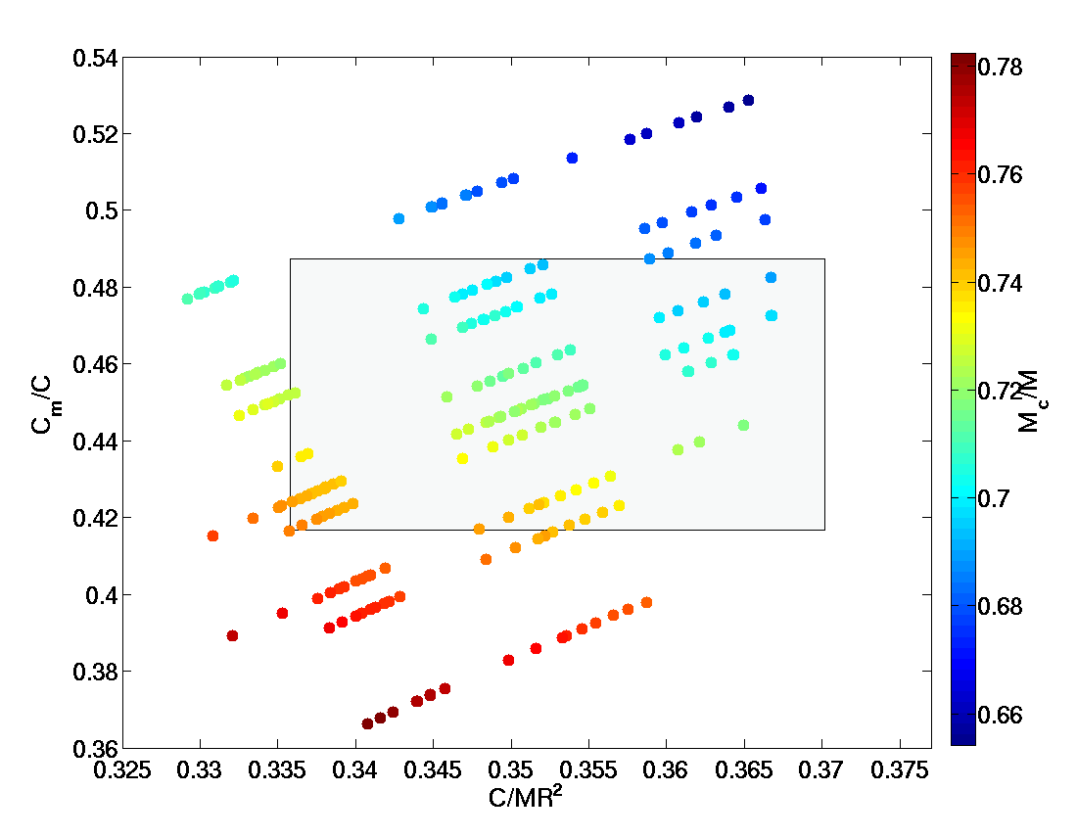
Distribution of Models - Relative Core Mass
mantle density:
4.3 g/cm³
mantle density:
3.7 g/cm³
mantle density:
3.2 g/cm³
T. Steinke, 2013
Notes:
Variation:
innerer Kern zwischen 0 und 1000 km
Krustendicke 25, 50, 75
Gute Abdekung des Bereiches mit unseren Modellen
Auf Schwachstelle hindeuten!
Schwefelgehalt:
14

Slide 15
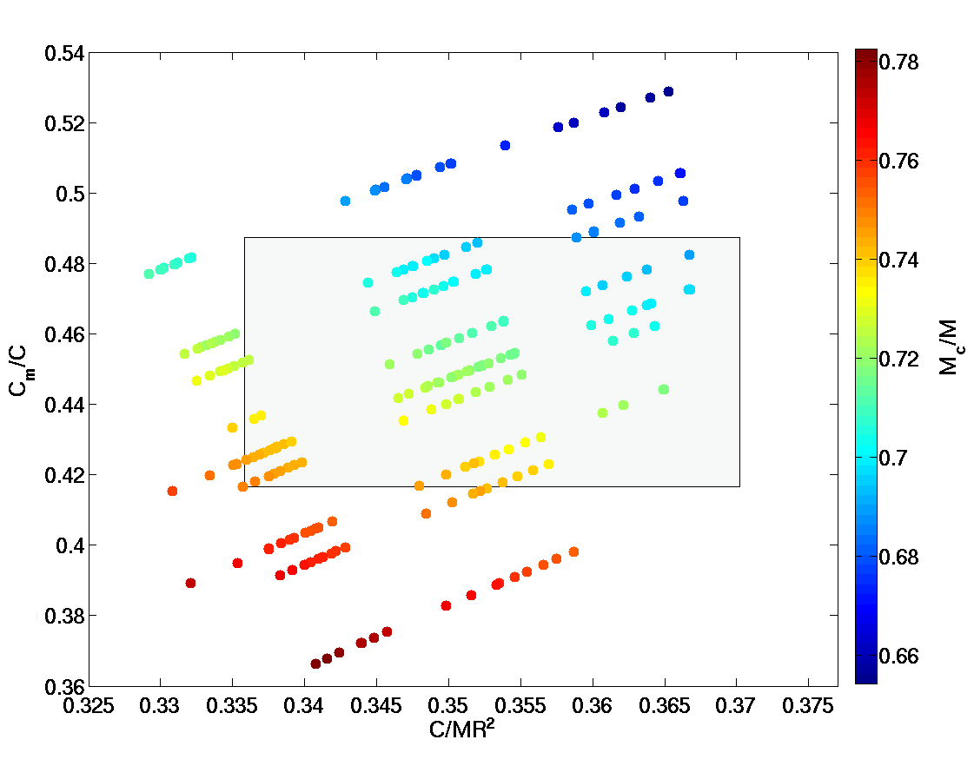
Distribution of Models
Larger Inner Core
100% Fayalite
50% Forsterite
50% Fayalite
100% Forsterite
Outer Core Radius
Outer Core Radius
Mantle Density
Outer Core Radius
Mantle MoI
Thicker Crust
MoI
Notes:
Variation:
innerer Kern zwischen 0 und 1000 km
Krustendicke 25, 50, 75, oder 100 km
15

Slide 16
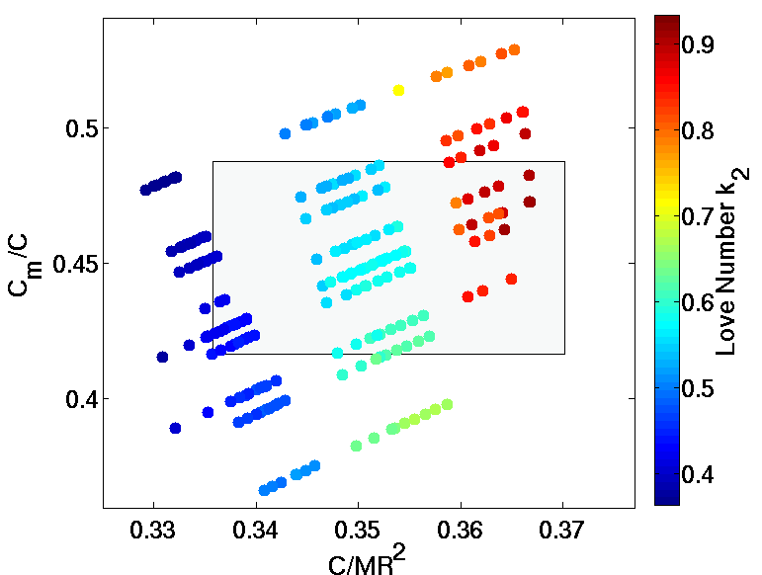
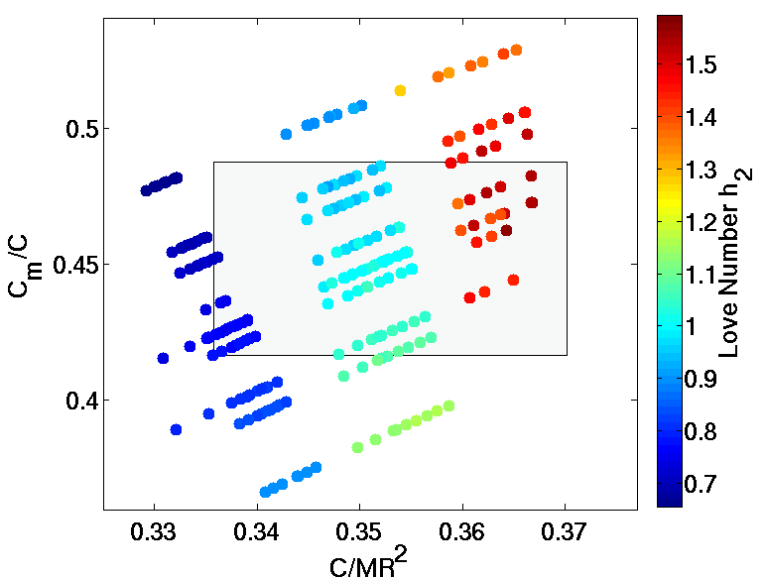
Tidal Love Numbers h₂ und k₂
Body tide Love numbers are useful to set further constraints on Mercury‘s interior structure. See poster by Steinbrügge et al
Notes:
Unterschiedliche Mantelzusammensetzung seismisch bemerkbar:
Drei Modelle (ersten gezeigten) mit den drei Zusammensetzungen
Vergleich der Dichte ( rot) und der seismischen Geschwingigkeiten (blau)
Raumwellen: P und S
Unterschied in ihrer „Ausbreitungsweise“
16

Slide 17
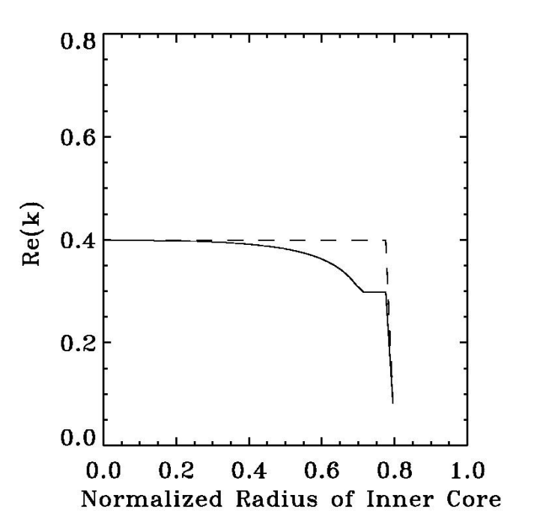
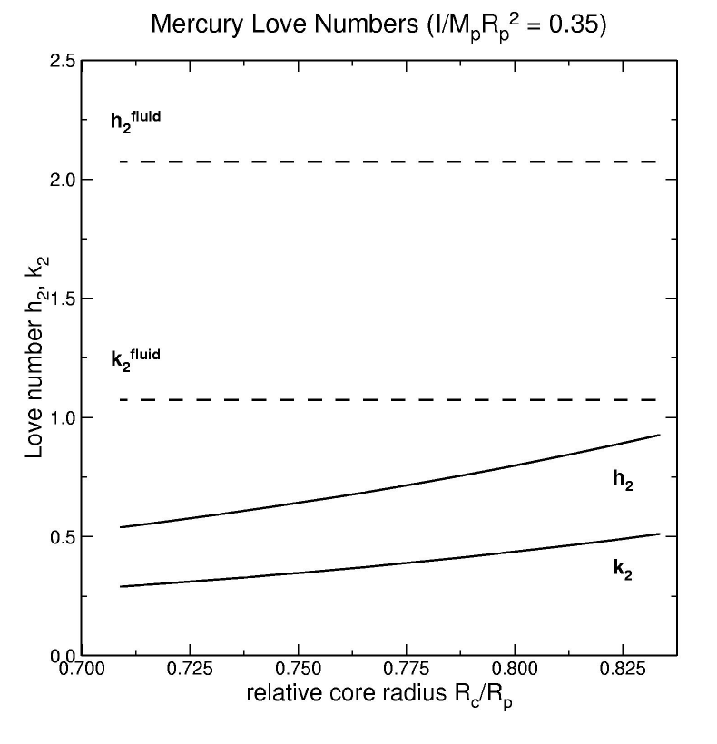
Tidal Response Constraint
Tidal measurements would provide additional constraints on Mercury's inner core size for Ric/Rp
Spohn et al., 2001
Notes:
Mean (uncompressed) density is related to the bulk chemical composition of a planetary body.
17

Slide 18
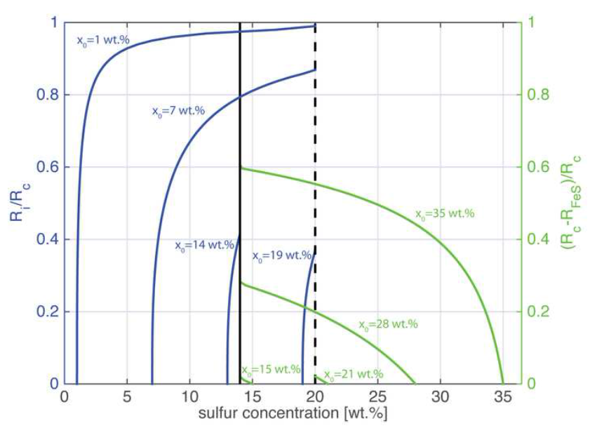

Slide 19
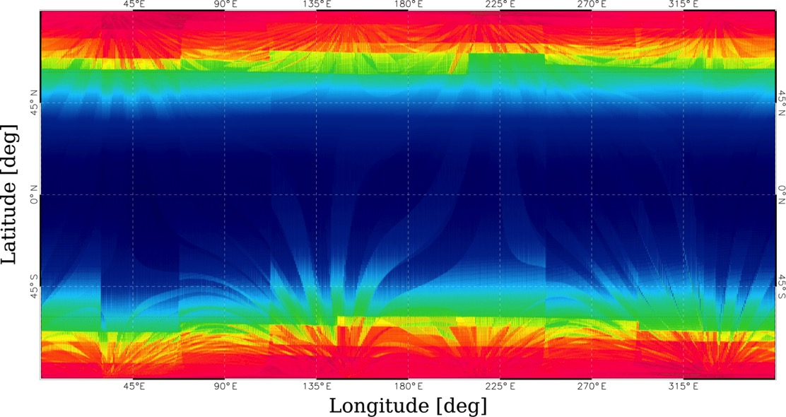
Expected BELA coverage for 1 year (nominal mission)
BELA can obtain full global coverage due to the MPO orbit and its natural shift of pericenter
Blue regions correspond to the best signal-to-noise ratio (lowest altitude ~400 km, red regions to ~1050 km altitude)

Slide 20
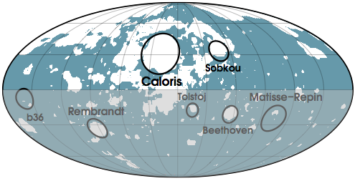
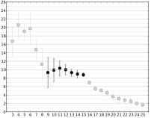
Geoid-to-Topography Ratio (GTR)
GTR analysis of the northern hemisphere excluding large impact basins and smooth plains
Padovan et al., GRL (2015)
GTR is nearly constant between degree 9 and 15
Assuming Airy isostasy: dcrust = 35 ± 18 km
For larger degrees, decrease in quality and resolution of the data
At lower degrees, GTR is scattered: other possible sources?

Slide 21
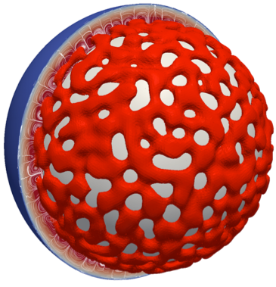
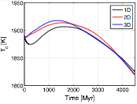

Fully dynamic (2D and 3D) models
Fully dynamic 2D cylindrical and 3D spherical models confirm the predictions of 1D models (thermal history, contraction and crustal production)
Convection pattern characterised by stable and regular cells with nearly unitary aspect ratio and no preferred orientation
Tosi et al., JGR (2013)

Slide 22
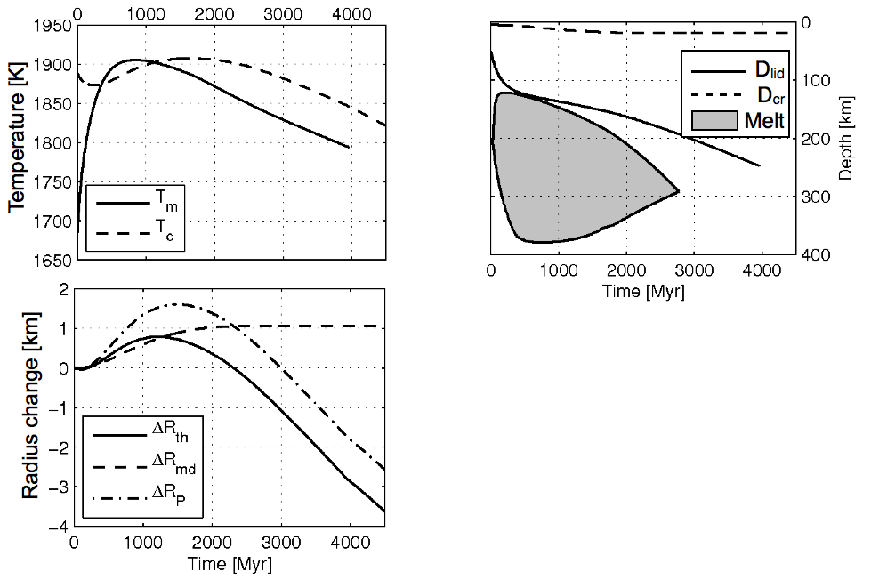
Typical Evolution Scenario
Initial heating and expansion phase, followed by core-mantle cooling and contraction
Dry rheologies are preferred
Crustal thickness of 20-40 km produced for up to 2-3 Ga
Most models predict convection to stop after 3-4 Ga

Slide 23
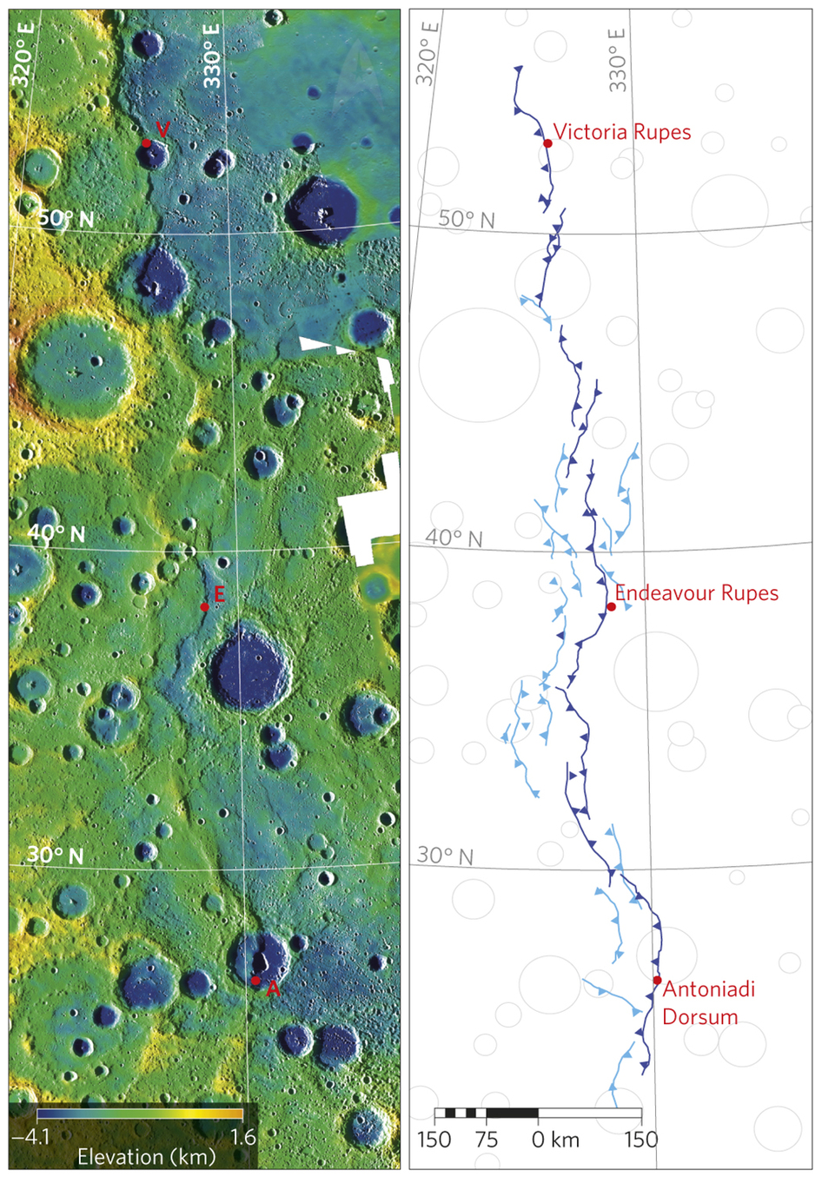
Constraints
Contraction of the planet
Early volcanic acitvity
Early and sustained magnetic field
Crustal heat production rates from γ-ray spectroscopy
Byrne et al. 2014

Slide 24
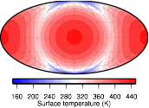
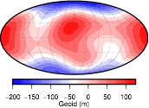
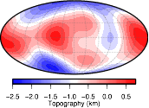
Surface temperature, geoid and topography
3:2 spin-orbit resonance, high eccentricity and small obliquity result in significant latitudinal and longitudinal variations of the surface temperature
Pattern of mean surface temperature can be expressed in terms of degree 2 and 4 spherical harmonics (Vasavada et al., Icarus,1999)
Geoid and topography correlate with the surface temperature
How to exploit such correlation?
Nicola Tosi‘s talk yesterday

Slide 25
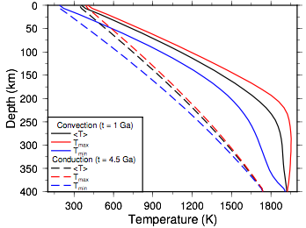
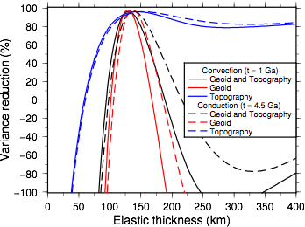
Convection vs Conduction
  3-D thermal evolution model with imposed surface temperature variations
  Variance reduction vs
  elastic thickness for
  geoid and topography
For elastic thicknesses between 130 and 140 km, the model predicts more than 95% of the data for both convective and conductive solutions
Nicola Tosi‘s talk yesterday

Slide 26
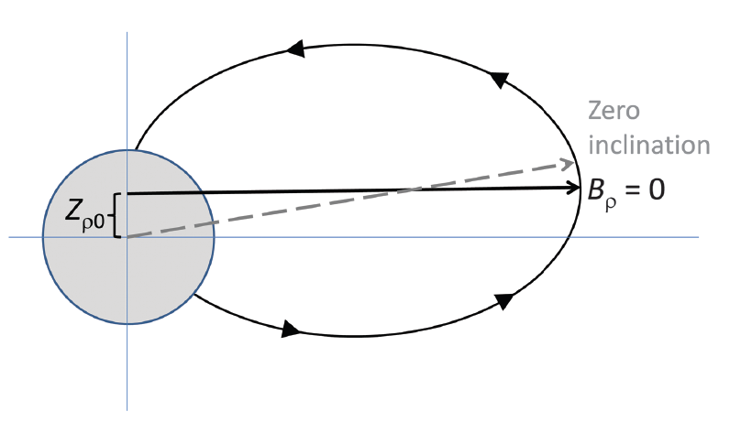
Anderson et al., 2011

Slide 27
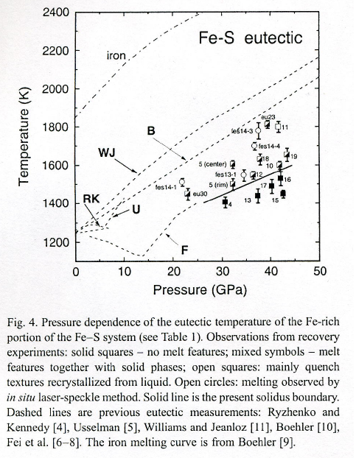
Mars
Mercury
Galilean Satellites

Slide 28
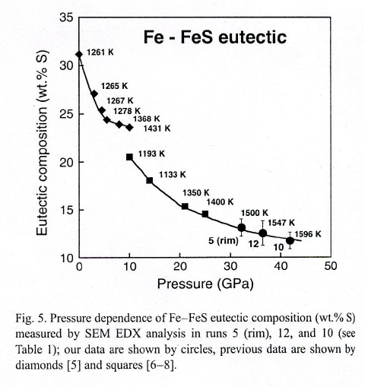
Mars
Mercury
Galilean Satellites

Slide 29
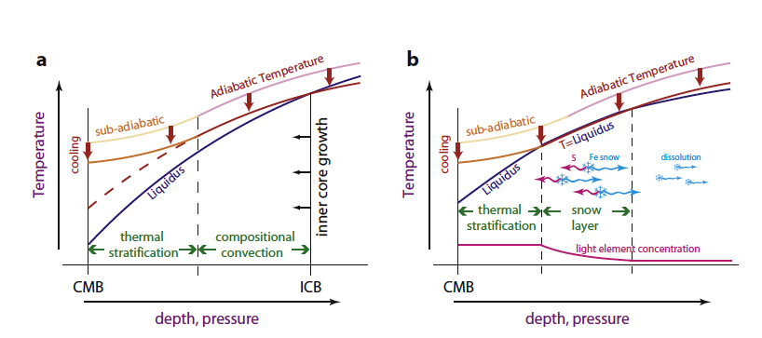
Dumberry and Rivoldini, 2015

Slide 30
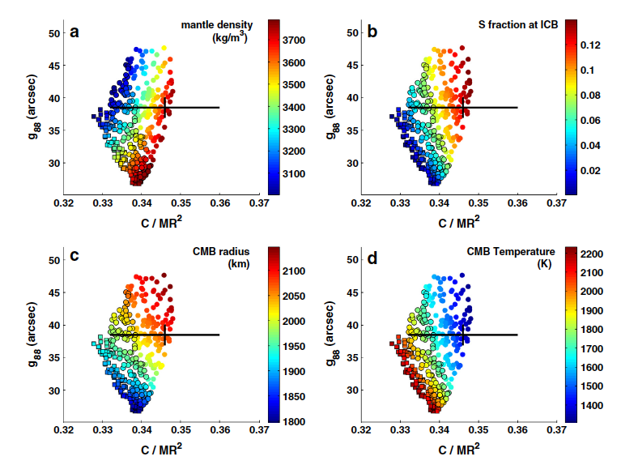
Dumberry and Rivoldini, 2015

Slide 31
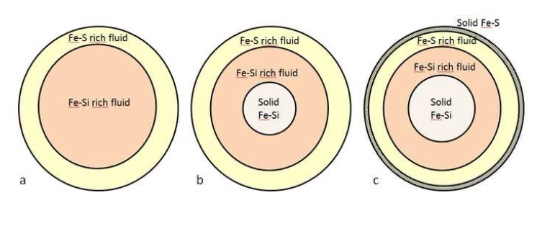
Bepi may give us clues to constrain the depth to the dynamo
Breuer et al., 2015 sub

Slide 32
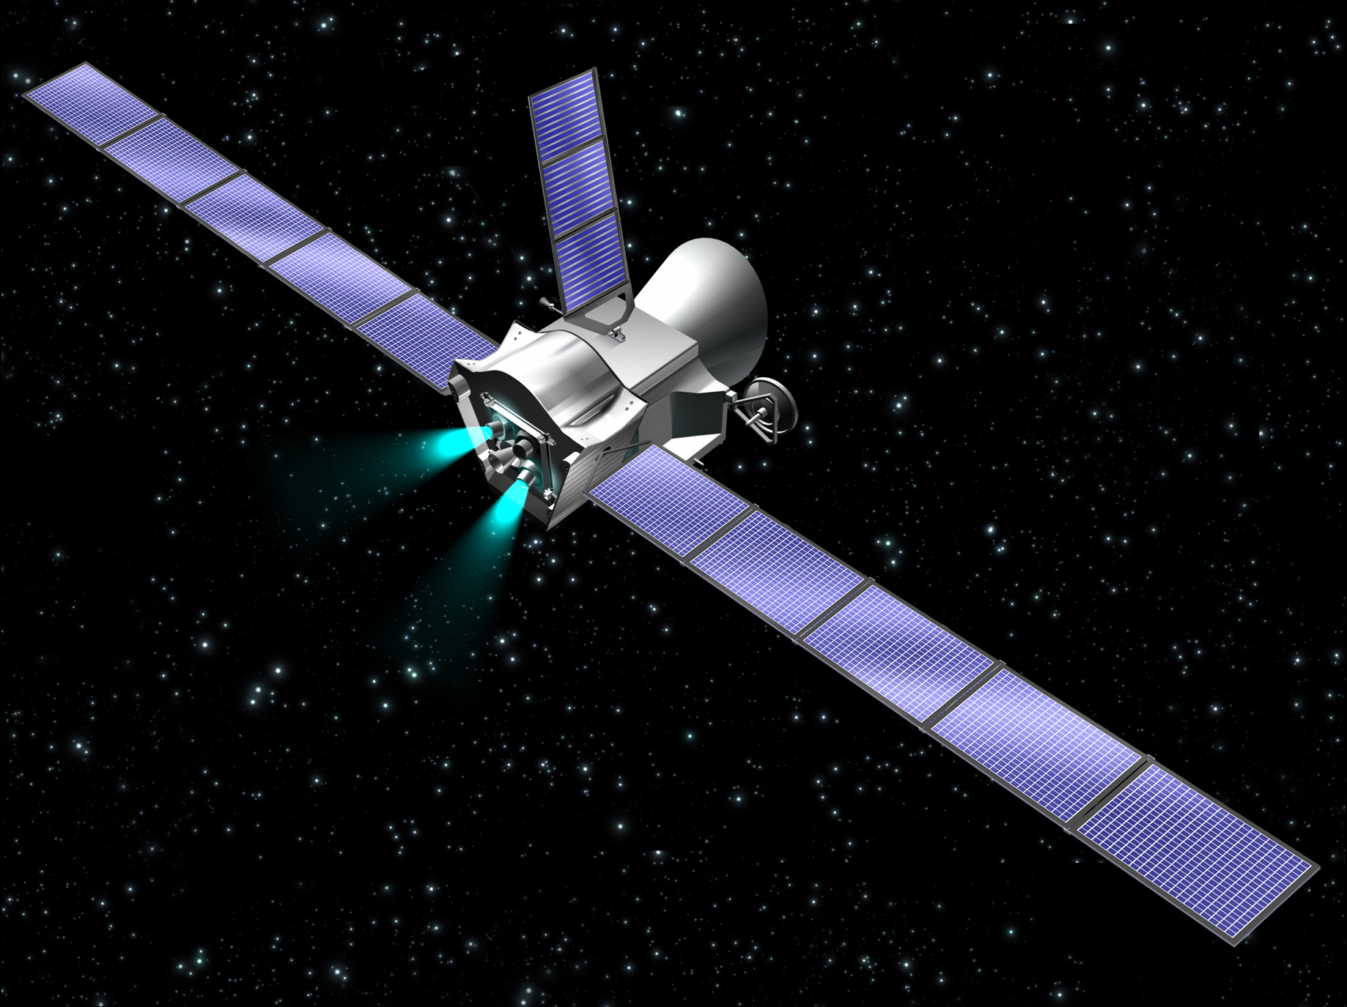
BepiColombo
Comprehensive Exploration
of Planet Mercury
Credit: ESA

Slide 33
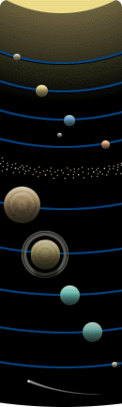
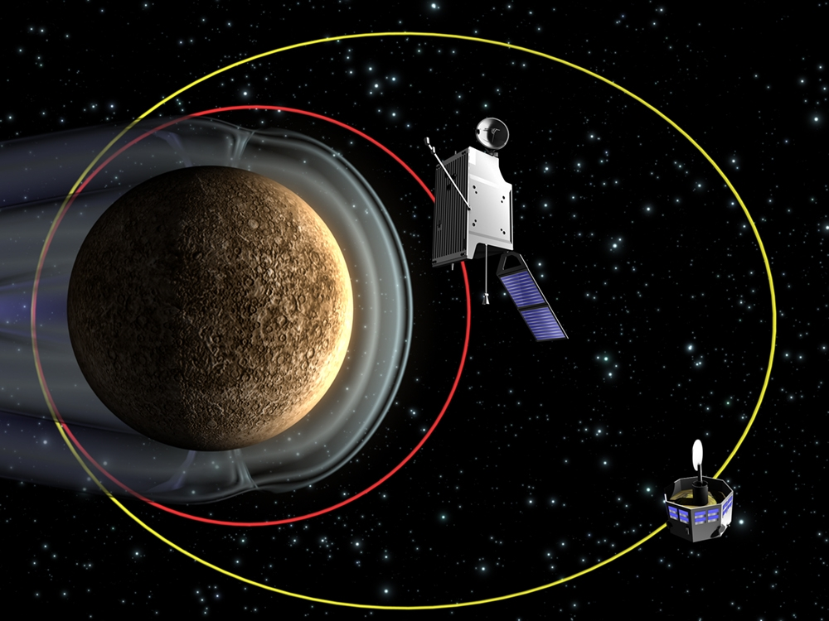
BepiColombo at Mercury
Planetary Orbiter (MPO)
polar orbit 400x1500 km, 2.3 hr period
Magnetospheric Orbiter (MMO)
polar orbit 400x12000 km, 9.2 hr period

Slide 34
Launch Opportunities
  Launch January 2017 (baseline - with repeating opportunities in March, and July 2017)
  Arrival January 2024
  (1 Earth, 2 Venus and 5 Mercury fly-bys)

Slide 35
Scientific Objectives 1/3
Mercury as a planet:
  surface morphology and topography (< 10m accuracy)
  surface age (observation of craters > 500m diameter)
  mineralogical and Elemental Composition (thermal IR spectral range 7-14µm,
  spectral resolution 200nm; near IR 0.4 - 2µm)
  determination of abundance of key elements (X-ray telescope better than 200km
  spatial resolution; MGNS)
  search and identify signatures of unexpected species
  study mass, figure and moment of inertia (moment of inertia factor C/MR2 with
  accuracy better 0.003; second degree tidal Love number k with Signal/Noise ~ 50)
  chemistry of the surface
  surface heat flow

Slide 36
Science Objectives 2/3
Origin of Mercury’s magnetic field:
  map magnetic field
  separation of internal/external sources
Exosphere:
  composition and vertical structure
  search for noble gases, isotopes, molecules, atoms from crustal origin, composition and dynamics (UV range 50-300nm)
  surface release processes
  search for Ionosphere, Exosphere/Magnetosphere exchange and
  transport processes

Slide 37
Science Objectives 3/3
Magnetosphere:
  structure, dynamics, interaction with planet
Relativity and Gravitational Physics:
  test general relativity and alternative theories of gravity

Slide 38
Scientific Payload MPO
Science Topics
SIMBIO-SYS Spectrometers and Imagers ☻ ☻
PI: Enrico Flamini (Italy)
MERTIS Mercury Radiometer and Thermal
Imaging Spectrometer ☻
PI: Harald Hiesinger ( Germany)
MIXS Mercury Imaging X-ray Spectrometer ☻
PI: Emma Bunce (United Kingdom)
SIXS Solar Intensity X-ray and particle spectrom.
PI: Juhani Huovelin (Finland)
MGNS Mercury Gamma-Ray and Neutron ☻
Spectrometer
PI: Igor Mitrofanov (Russia)
PHEBUS Probing of Hermean Exosphere by ☻
Ultraviolet Spectroscopy
PI: Eric Quemerais ( France)
SERENA Search for Exospheric Refilling and☻ ☻ ☻
Emitted Natural Abundances
PI: Stefano Orsini ( Italy)
BELA BepiColombo Laser Altimeter ☻ ☻
PIs: Tilman Spohn (Germany)
Nicolas Thomas (Switzerland)
MORE Mercury Orbiter Radio Science Experiment ☻
PI: Luciano Iess (Italy)
ISA Italian Spring Accelerometer ☻
PI: Valerio Iafolla (Italy)
MERMAG Magnetic Field Investigation ☻ ☻
PI: Karl-Heinz Glassmeier (Germany)
Surface - topography;
morphology; composition
SIMBIO-SYS, MERTIS,
MIXS, MGNS, SERENA, BELA
Interior – state of the core;
composition; magnetic field
SIMBIO-SYS, BELA,
ISA, MORE
Exosphere – composition;
dynamics; surface release
PEBUS, SERENA
Magnetosphere structure,
dynamics, composition
MERMAG, SERENA

Slide 39
Scientific Payload MMO
Science Topics
MGF Magnetic Field Investigation studies magnetic field from
(2 sub-units) the planet, magnetosphere, and interplanetary solar
wind.
PI: W. Baumjohann, Austrian Academy of Science, Austria.
MPPE Mercury Plasma Particle Experiment studies plasma
(7 sub-units) & neutral particles from the planet, magnetosphere, and
interplanetary solar wind.
PI: Y. Saito, ISAS, JAXA, Japan.
PWI Plasma Wave Investigation studies electric field,
(7 sub-units) electromagnetic waves, and radio waves from
magnetosphere and solar wind.
PI: Y. Kasaba, Tohoku University, Sendai, Japan
MSASI Mercury Sodium Atmosphere Spectral Imager studies
the thin sodium atmosphere.
PI: I. Yoshikawa, Univ. Tokyo, Japan.
MDM Mercury Dust Monitor studies dust from the planet and
interplanetary & interstellar space.
PI: H. Shibata, Kyoto Univ., Japan.

Slide 40
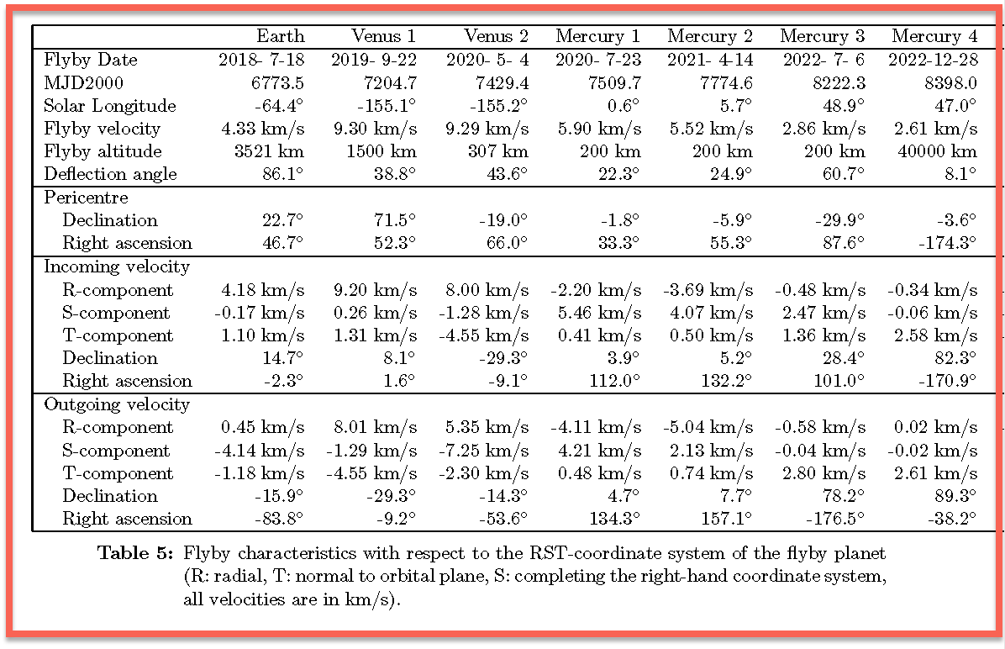
BepiColombo - Flybys

Slide 41
BepiColombo after Messenger
We have heard over the past days how Messenger and BepiColombo are complementary
Aside from repeating some measurments almost a decade later (the chance of getting time as a variable into the picture) there are a number things that will be new or improved observations
  Observing the southerly hemisphere from a significantly lower distance
  Observing the magnetic field with two spacecraft on significantly different orbits
  Pld elements that Bepi has but that Messenger did not have such as the thermal infrared spectrometer, the magnetospheric pld...
So, the exploration will continue, we will all be 10 years older, some may have turned elsewhere, but new folks will have joined the group.
Stay tuned

Slide 42
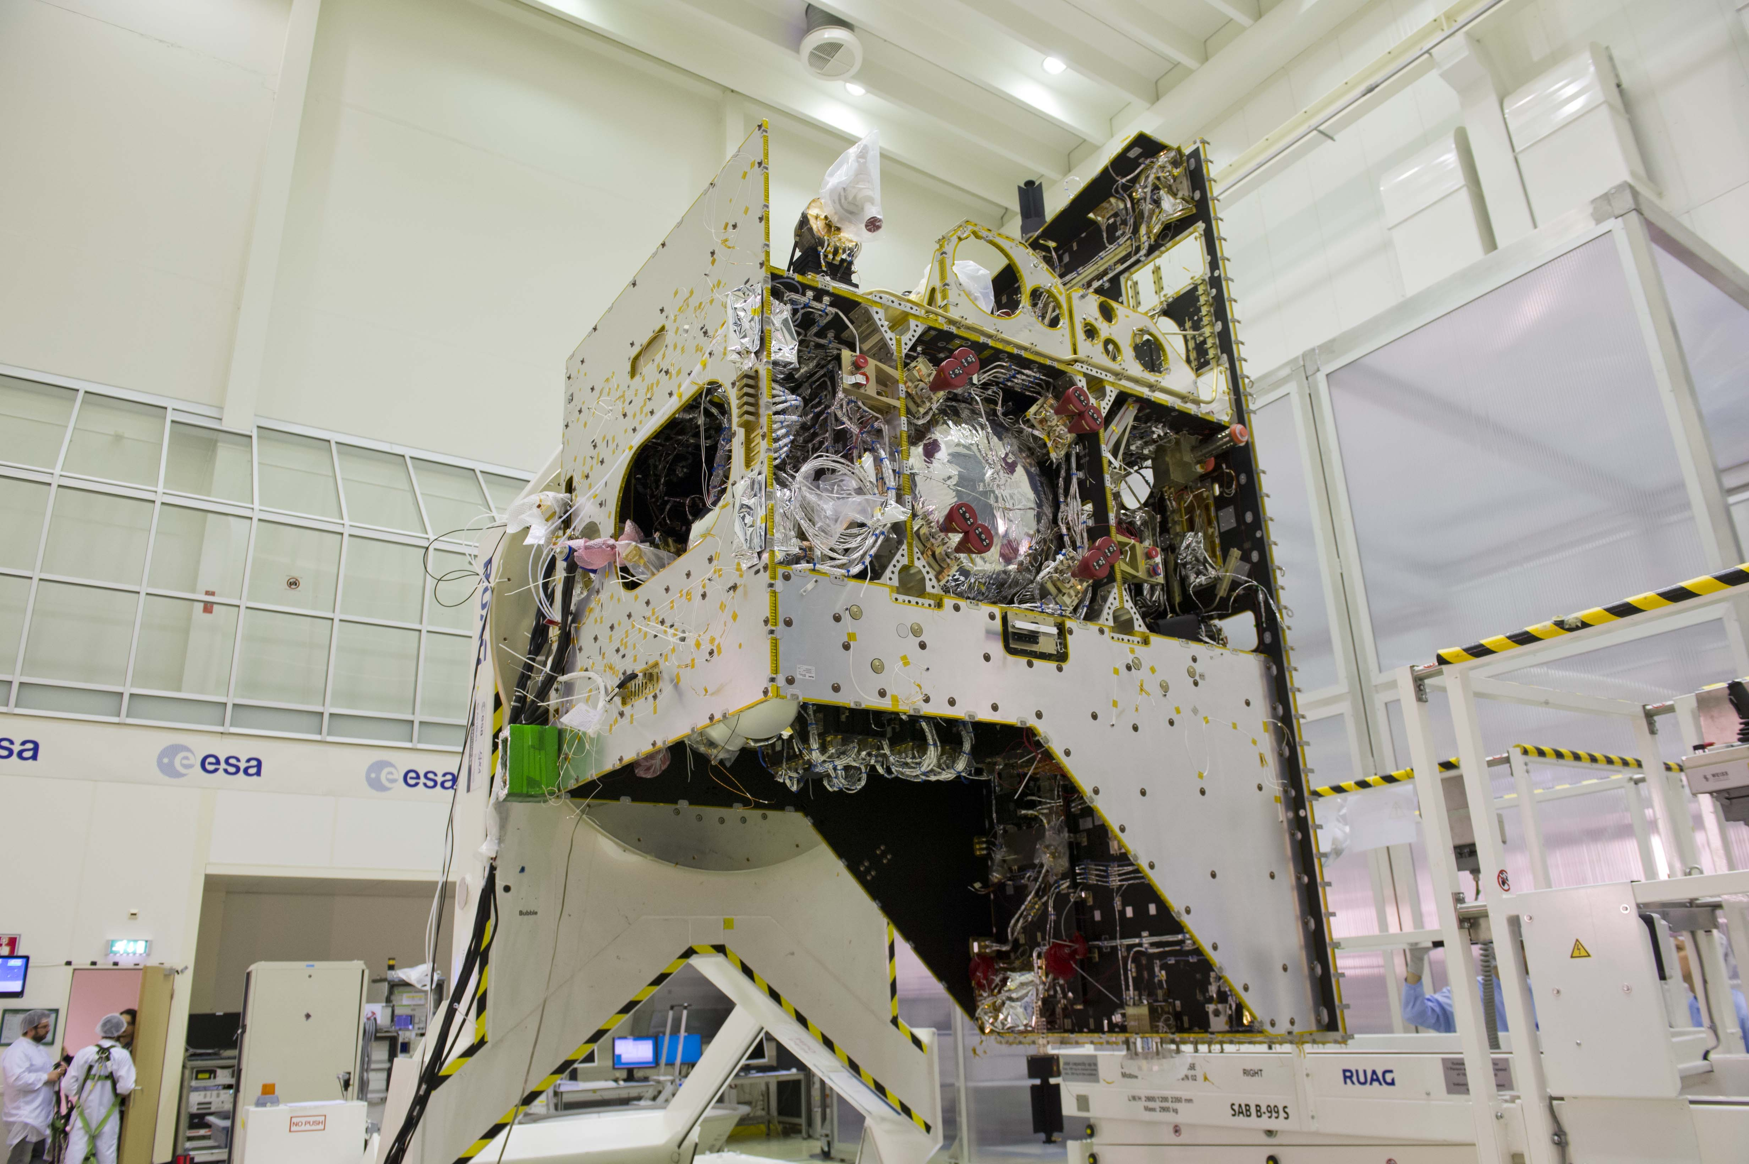
Acknowledgements
I profited from discussions with and contributions from
J. Benkhoff, J. Helbert, N. Tosi, and D. Breuer

