Slide 1
E X O M A R S
ADDITIONAL SLIDES TO REPORT OF THE CURRENT STATUS OF THE ROCK CHARACTERISATION FOR THE EXOMARS 2018 LANDING SITES
L. Joudrier, ESA ExoMars project

Slide 2
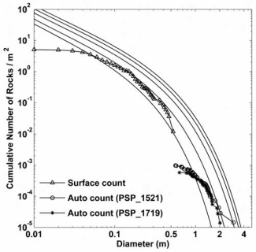
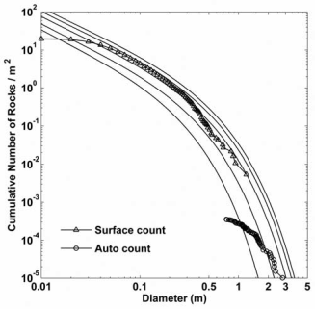
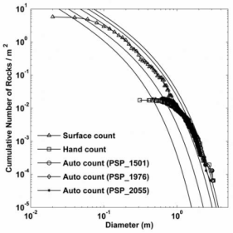
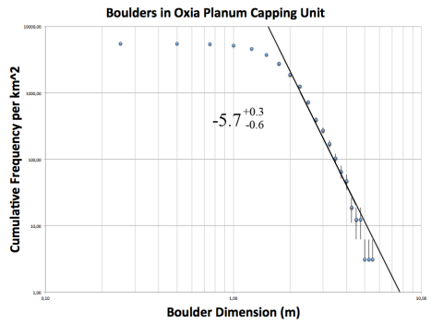
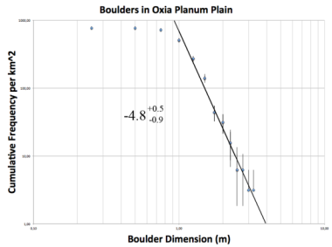
VL1
MPF
VL2
on HiRISE counts: on surface counts:
VL1 : at 1m, 600 rocks/km² at 10 cm, 2 rocks/m²
VL2 : at 1m, 10000 rocks/km² at 10 cm, 3 rocks/m²
MPF: at 1m, 300 rocks/km² at 10 cm, 5 rocks/m²
Oxia Capping Unit: at 1m, 4000 rocks/km²
Oxia Plain Unit: at 1m, 500 rocks/km²

Slide 3
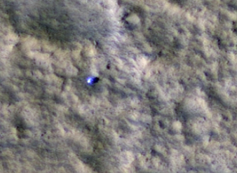
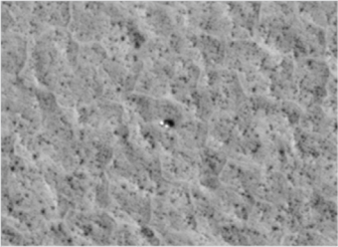
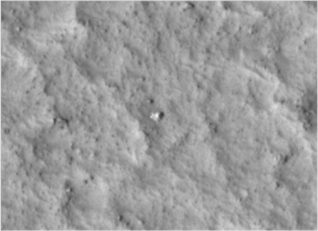
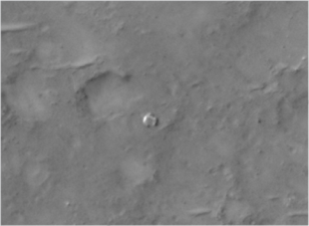
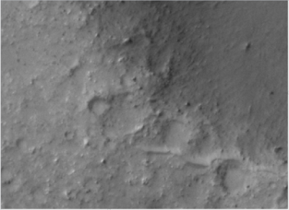
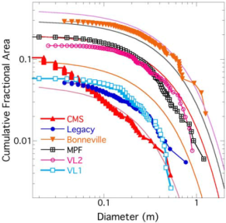
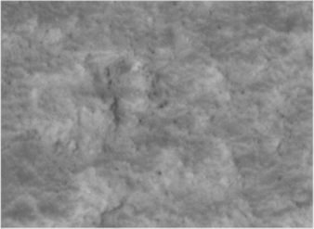
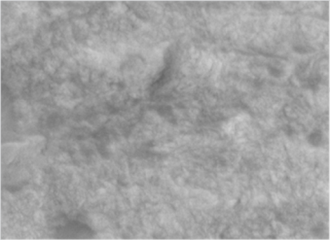
VL1 -solar incidence 48°
VL2 -solar incidence 51°
MPF -solar incidence 52°
CMS -solar incidence 60°
Bonneville -solar incidence 60°
Oxia Capping Unit
- solar incidence 49°
Oxia Plain Unit
-solar incidence 49°

Slide 4
Objectives
Rock map are compulsory to certify landing sites against Engineering constraints linked to landing success, egress success and surface roving capabilities.
Automatic Rock counting is compulsory to achieve the task on full ellipse(s).
Rock hazards are >35cm height (70cm diameter) for lander and >20cm height (40cm diameter) for Rover Mobility.
Rock size modelling is so far the only way to resolve the knowledge gap between image resolution minimum size rock counting and the size of the hazards in an unknown environment.

Slide 5
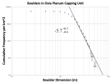
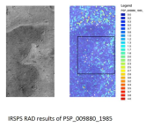
Manual Rock Counting
Automatic Rock Counting
Rock size distribution
Models
Thermal Inertia
Rough !
Oxia Planum
Man1
Auto1
Model1
capping
Auto2
Model2
Man2
Plain
Tuning of model
Man1 >> Man 2
Auto2 >> Auto 1
Model1(Man1)
> VL2
Model2(Man2)
~ VL1
In line with visual
Clues from Hirise
Discrepancy
VL2
VL1
Visual
Discrepancy
on HiRISE counts: on surface counts:
VL1 : at 1m, 600 rocks/km² at 10 cm, 2 rocks/m²
VL2 : at 1m, 10000 rocks/km² at 10 cm, 3 rocks/m²
MPF: at 1m, 300 rocks/km² at 10 cm, 5 rocks/m²
Oxia Capping Unit: at 1m, 4000 rocks/km²
Oxia Plain Unit: at 1m, 500 rocks/km²
Questions:
1/ Reliability of Manual counting?
2/ Reliability of Rock size model for the geology we are facing?

Slide 6
Rock maps is what we need ultimately
Proposed way forward is:
1/ from geologic maps and other pieces of info available, derive a “rough rock map” defining areas of similar rock abundance.
2/ define one area that is most representative and ask for multiple HIRise images to perform hyper-resolution
3/ confirm the rock counts and confirm/define the rock size distribution model to use further on.
4/ run automatic counting tuned based on the confirmed rock counts for the whole ellipse (when data are available).
5/ Derive from 3 & 4 the rock map to be used to confirm landing & egress success.

Slide 7
Probability of encountering rock as high as 35 cm is what we need.
Note: Map showing the rocks size and position in the landing site would be ideal but it is understood that this can not be made available for a landing ellipse in Mars. Correct?
Proposed LSSWG steps:
1/ assess the validity and limitation of the super-resolution images for usage of rock counting.
2/ Clarify the discrepancy between manual and automatic counting
3/ Converge on the the rock size distribution model/s to use further on. How?
If super-resolution is considered reliable: use few super-resolution images to validate automatic/manual counting and associated models
Review comparisons results and review the applied model at LSSWG level

