Slide 1
ExoMars 2020 Mission
Sharing TGO passes
between Rover and Surface Platform
18 April 2018, issue 0.0

Slide 2
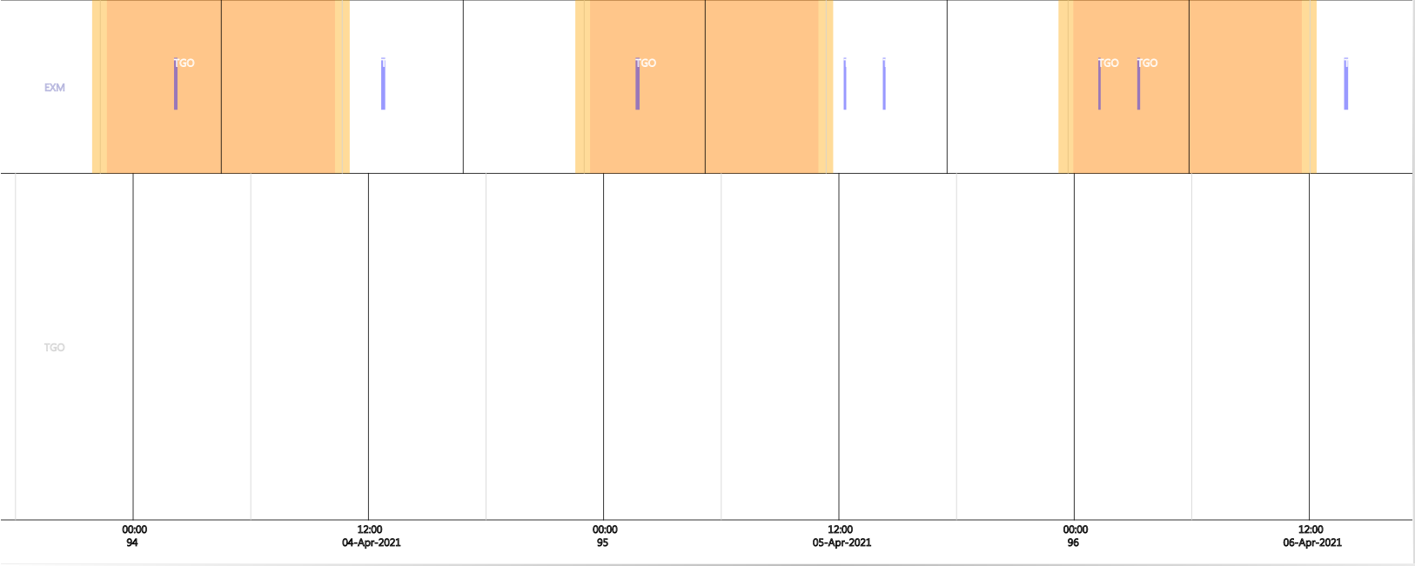
Overflights
Notes:
Before going into the topic of sharing TGO passes between Rover and Surface Platform, I want to start by explaining the communications regime which exists for the Rover and Surface Platform.
Neither asset has a Direct to Earth communications link, so all communication has to be via a Mars orbiting satellite. In this presentation I will be mainly concentrating on the TGO, but use of NASA orbiters and Mars Express is also planned.
Here we see in purple the TGO passes over the Rover/Surface Platform landing site for a three Sol period shortly after egress.
The Martian day is shown in orange, the Martian night is in white, the dawn and dusk (when the sun is between 0 and 10 degrees elevation) is shown in yellow.
Each overflight is between 5 and 15 minutes long (roughly speaking)
The ground track is such that there is an East and a West overflight approximately every 12 hours. So nominally we see two overflights, separated by 2 hours, every 12 hours. Some of the overflights may be at too low an elevation angle to be usable, which is why sometimes only one is shown in the diagram.
Note that although the Rover and Surface Platform can only perform science operations during the day, they do support communication sessions with the Mars orbiters during the night.
This diagram only shows TGO overflights. Additional NASA MRO and potentially other orbiter overflights will also be available.

Slide 3
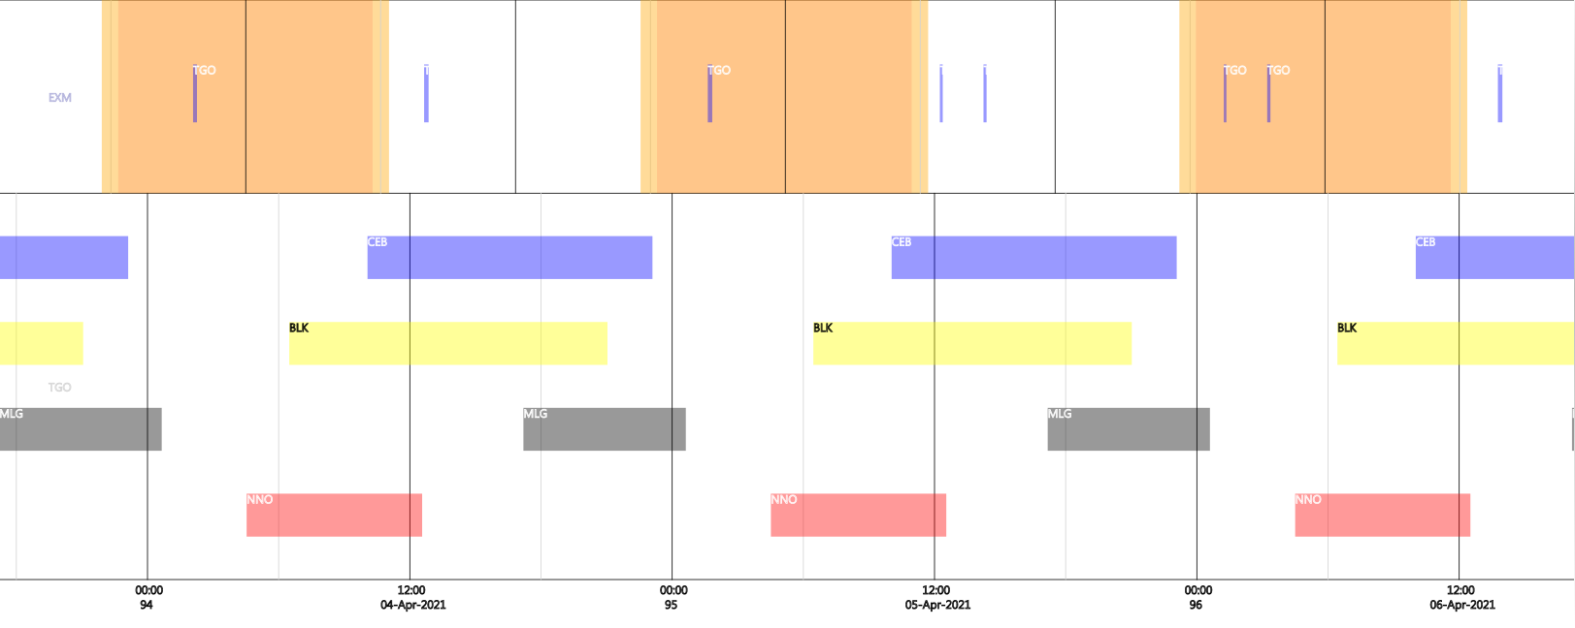
Overflights with ground station visibility
Notes:
To make use of any of these overflights, we need ground station passes for the orbiter. Rover and Surface Platform telecommands need to be uplinked to the orbiter before the overflight, and telemetry, collected during the overflight, needs to be downlinked to Earth some time after the overflight.
Here you can see the PHYSICAL visibility of the from Cebreros (in blue), Malargue (in grey), New Norcia (in red) and the Russian Kaliazin ground station (in yellow) (BLK means Bears Lakes or Kaliazin, Bear Lakes being the backup for Kaliazin – they both have very similar visibilities).
Remember, this diagram does NOT take into account the station bookings, just when the TGO COULD be seen from each antenna.
Note that there are periods when the TGO is not visible from any ground station.
Note also that we have an agreement with NASA to supplement the above ground station network with NASA DSN station time.

Slide 4
Overflights with idealized ground station bookings
Notes:
Here I show with the bright blue bars a potential set of ground station bookings which could be useful for relay operations.
Each overflight has some TGO ground station bookings before the overflight (to get the Rover/SP commands on board the TGO), and some ground station time after the overflight (to get the Rover/SP TM back to earth).
It does not take into account other missions which need to use the station. It simply shows which parts of the physical visibility from the station to the TGO could be useful. However, it also does not take into account NASA DSN station time, which could be used to replace these stations if they were not available. Nor does this slide show the effect of overflights provided by other orbiters, which would of course improve the situation.
In the case shown there are some delays between when the ground station is available, and when the overflight takes place. So even in the best cases there will be some time between when the ROCC or SPOCC have their commands ready to be sent to Mars, and when they actually reach the Rover /SP – this is known as the forward link latency.
Similarly, there is a delay between when the Rover/SP TM is available to be sent to Earth, and when the TGO is able to return it - the return link latency.

Slide 5



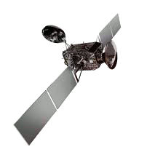
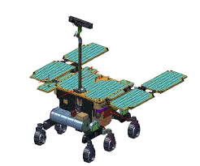

Forward Link Latency : mean of 4.1 hours (+/- 1 hour)
50 – 75 min
1 – 10
min
2 hours
1 sec
30 sec – 1 hour
Transmit
GFTS
OPS-LAN
MPLS
Failure Report
Transmit
ROCC
ERCO
TGO MOC
Re-Transmit
TGO
Rover
Ground
Station
(Tx duration x2
+ OWLT x 3)
Return Link Latency : mean of 1.6 hours (+/- 1.2 hours)
5 min
20 min –
1 hr 53 min
1 – 10
min
1 sec
1 min
Transmit
Transmit
MPLS
OPS-LAN
GFTS
Rover
TGO
No repeat on failure
Ground Station
ERCO
ROCC
TGO MOC
Notes:
We have done some studies on the typical forward and return link latencies. Assuming that ground stations are available as required, the average forward link latency is 4.1 hours. This time includes preparation time at the ERCO & TGO MOC, and allows for a retransmission of the command file to the orbiter if there are problems on the uplink.
The average return link latency is 1.6 hours. If there is a problem on the downlink, retransmission would be done in the next ground station pass.

Slide 6
Idealised Earth-Mars Communication
ROCC/SPOCC
daily activity
Strategic
planning
ROCC/SPOCC
daily activity
Strategic
planning
ROCC/SPOCC
daily activity
Ground Upload
latency
Variable
Occultation
From 0 to ~1 hours
Variable
Occultation
From 0 to ~1 hours
Ground Download
latency
Ground Upload
latency
Variable
Occultation
From 0 to ~1 hours
Variable
Occultation
From 0 to ~1 hours
Ground Download
latency
LCC
TGO MOC
TGO MOC
LCC
TGO MOC
TGO MOC
LCC
ERCO
ERCO
ERCO
ERCO
GS
GS
GS
GS
Ground Network visibility
Ground Network visibility
Earth-TGO Uplink
duration
TGO
Earth-TGO Downlink
Duration
Earth-TGO Uplink
duration
TGO
Earth-TGO Downlink
Duration
Rover-TGO
comm window
TM
TC
Rover-TGO
comm window
Rover/SP Activity Execution
Rover/SP
Comm
Rover Post Comms Activities
Rover Night
Rover Wake-up &
Pre-comms Activities
Rover/SP
Comm
Rover/SP Activity Execution
Forward link
latency
About 10 minutes
Return link
latency
Forward link
latency
About 10 minutes
Return link
latency
Comms windows used by Rover or Surface Platform
Notes:
This is a summary of the Earth-Mars communication situation. I’m not going to go through all the details of this diagram I already mentioned the forward and return link latencies, and the X-band transmission delays. In addition there is occultation of the TGO (or other orbiters) behind Mars.
[… ] Since the Rover and the Surface Platform are essentially in the same place, then each communications window is available for use by the Rover or the Surface Platform. But the orbiting Electra radios can only communicate with one asset at a time, so the allocation of the communications windows has to be coordinated between the Rover and the Surface Platform.
So finally we reach the main purpose of this presentation, and in the following slides I will explain how this sharing of overflights is handled.

Slide 7
Relay Planning
Rover RSM
SP RSM
Apr21
Oct21
PLTE
Relay Operations
OSP
Orbit Files
Q3/2020
Improved
orbital
accuracy
Jan21
Proposed overflight allocation
Monthly consolidated relay planning
OOF
OOF
OOF
OOF
Updated overflight times +
Updated latencies +
Updated overflight allocation +
(split overflights can still be adjusted)
Initial Relay
Planning
Optimum Ground Station Plan
Agreed overflight allocation
Mar21
ESA GS negotiation
Weekly final relay planning
(see next slide)
TGO GS Bookings
Q2/2020
Notes:
So I want to explain in some detail how the relay planning process works, because it fundamentally affects how we communicate with Mars.
[…] Nominal relay operations begin after egress. Before then, during PLTE, the overflights are planned as part a dedicated Post-Landing to Egress Operations Procedure.
After egress, we move to a nominal planning cycle, driven by the planning cycle of the TGO, since that is the principle means of communication with Mars (but the planning process also allows the use of NASA orbiters).
So Relay Operations are expected to begin at the beginning of April 2021.
But preparation for this begins already much earlier.
[…] The bible of how the relay planning is handled is the Overflight Sharing Policy. This is a set of rules derived from needs of the Rover Reference Surface Mission and the Surface Platform Reference Surface Mission, agreed with all parties. Of course, in emergency or contingency situations, the OSP can be over-ruled. But before launch, it guides the ERCO in its work.
[…] In mid-2020, the ERCO uses the predicted orbits of the various Mars orbiters and the Overflight Sharing Policy to calculate the optimum times to schedule ground station passes, to ensure the best latency possible for the overflights which are potentially to be used by the Rover and Surface Platform. This is important, because as we have seen, the latency associated with any overflight is heavily influenced by the supporting ground station passes.
[…] The requested ground station passes are given to the TGO MOC to be injected in the negotiation process for ESA-wide allocation of ground stations.
[…] Once the finalised ground station bookings are available, these are used to calculate the latencies of each overflight. If necessary, NASA DSN ground stations will be used to support overflights which cannot be supported by ESA ground stations.
[…] This is documented in a first version of the Overflight Opportunity File. This OOF will contain all the physical overflights of all available orbiters to both Rover and Surface platform, including the latencies derived from the ground station bookings, and a draft allocation of overflights to each asset.
[…] In Q3/2020 this OOF is then reviewed by the ROCC and SPOCC, and a coordination meeting held to refine the allocation in line with their needs. This could include reallocating overflights between the Rover and SP, or splitting the overflights.
[…] The agreements are documented in an update to the OOF.
[…] Then in Jan 2021 will begin a monthly consolidation of the relay planning. At this stage, more accurate orbit predictions are available, and a second coordination meeting is held between ROCC and SPOCC, to adjust the overflight allocation as necessary.
[…] The results of this are passed to the TGO MOC, so that they can inject these relay requests into their science planning process, and check they have the power and memory necessary to support the overflights. This process is repeated every month : In Jan 2021, consolidated planning is done for the April overflights; in February, for the May overflights, and so on (always three months in advance).
[…] Finally in March 2021 the Final Relay Planning starts, which takes place every week, synchronised with the TGO weekly operations cycle.

Slide 8
Final Relay Planning Details
Mar21
Weekly final relay planning
ELECTRA ACTIVITY AT MARS
(relaying products provided each
day using the pre-planned overflights)
S
S
M
T
W
T
F
TGO MOC ACTIVITY
(Electra programming including
communication to TGO)
S
S
Short
Term
Planning
Weekly
Uplink
ERCO/ROCC/SPOCC coordination
(including split overflights)
+ (biweekly) NASA coordination
S
S
ERCO
NASA
ERCO
Notes:
Here I want to focus on the weekly Final Relay planning. The details are being worked-on as part of the operations preparation activity, but the current high-level perspective is as follows:
[…] In green we see a week of TGO operations, where the Electra will relay the products in accordance with the planned overflights. Although telecommands are sent to Mars, and telemetry is returned from Mars, every day, the programming of the TGO Electra radio to support this communication is done on a weekly basis.
[…] During the week prior to the actual operations, the TGO MOC first constructs the detailed sequences of commands that will correctly orientate the spacecraft, and program the Electra to support the overflights. Towards the end of that week, the TGO MOC uplinks these commands to the TGO.
[…] In the the week prior to this TGO Short Term Planning, the ROCC and the SPOCC must finalise their overflight details. It is planned to have a weekly meeting every Monday, where any changes to the overflight details will be coordinated between the ROCC and the SPOCC. This incudes the timing split of any overflight which is shared between Rover and SP.
Having come to an agreement within the ExoMars mission, every other Tuesday there is a meeting with NASA; this is because NASA rovers may be wanting to adjust their TGO bookings; there may also be changes that the Rover or SP need to make to their NASA orbiter bookings.
After these meetings, the ROCC and the SPOCC submit their final detailed instructions for the Electra programming to the ERCO, who completes the process with the TGO MOC (and with NASA/JPL, as necessary).
So it can be seen that the details of the overflights have to be finalised up to two weeks before the overflight actually takes place.
Of course, on the day of the overflight, the ROCC and the SPOCC have complete freedom as to what commands they actually send to the ERCO to be relayed to Mars.

Slide 9






Dealing with Contingencies
Ground Segment Contingency
Make use of redundancy
If station antenna fails, probably too late to find alternative
Current forward link abandoned
New products created and sent via subsequent orbiter overflight
!
Rover Contingency
Additional orbiter overflights could be pre-scheduled in case of need
!
Orbiter Contingency
Current forward link abandoned
New products created and sent via subsequent orbiter overflight
!
Notes:
Finally, a word on what we do if things go wrong.
[…]First, imagine a Rover or Surface Platform contingency,
[…]when they would like to have additional overflights. It takes several weeks, or even months, to arrange additional unplanned overflights.
[…]If an orbiter has a contingency e.g. a safe mode,
[…] then if we have a forward link product at the ERCO which we cannot send to Mars during the planned overflight, we don’t send it via a different overflight, because we cannot be sure those telecommands are valid to be received by the Rover at another time. Rather, we discard that product, and ask the ROCC and SPOCC to create new products to be sent during a subsequent overflight of their choice. Maybe the telecommands are the same, but that is their decision.
[…] If there is a ground segment contingency,
[…] then the first course of action is to make use of the redundancy that has been designed into the system. But if for example the ground station antenna fails, then it is probably too late to find another ground station in time, and again the forward link would be abandoned, and new forward link products provided by the ROCC, to be sent via a different ground station for a different overflight.
On the return link, in each case the ERCO simply returns the data as soon as it is available, which depends on the particular contingency.

Slide 10
Background Slide – Acronyms
BLK Bear Lakes & Kaliazin
CEB Cebreros
ERCO European Relay Coordination Office
LCC Lander Control Centre
MLG Malargue
MOC Mission Operations Centre
NNO New Norcia
OWLT One Way Light Time
ROCC Rover Operations Control Centre
RSM Reference Surface Mission
SP Surface Platform
SPOCC Surface Platform Operations Control Centre
TGO Trace Gas Orbiter

