Slide 1

Gaia
A Stereoscopic Census of our Galaxy http://www.cosmos.esa.int/web/gaia
December 2015

Slide 2
Gaia: Design Considerations
Astrometry (G < 20 mag):
  completeness to 20 mag (on-board detection) ⇒ 10⁹ stars
  accuracy: 26 μarcsec at G=15 mag (Hipparcos: 1 milliarcsec at 9 mag)
  scanning satellite, two viewing directions
    ⇒ global accuracy, with optimal use of observing time
  principle: global astrometric reduction (as for Hipparcos)
Photometry (G < 20 mag):
  astrophysical diagnostics (low-dispersion photometry) + chromaticity
    ΔT_{eff} ~ 100 K, log g, [Fe/H] to 0.2 dex, extinction (at G=15 mag)
Radial velocity (G_{RVS} < 16 mag):
  accuracy: 15 km s⁻¹ at G_{RVS}=16 mag
  application:
    third component of space motion, perspective acceleration
    dynamics, population studies, binaries
    spectra for G_{RVS} < 12 mag: chemistry, rotation
  principle: slitless spectroscopy in Ca triplet (845-872 nm) at R = ~10,800

Slide 3
Gaia: Complete, Faint, Accurate
 | Hipparcos | Gaia
Magnitude limit | 12 mag | 20 mag
Completeness | 7.3 – 9.0 mag | 20 mag
Bright limit | 0 mag | 3 mag (assessment for brighter stars ongoing)
Number of objects | 120,000 | 47 million to G = 15 mag
 |  | 360 million to G = 18 mag
 |  | 1192 million to G = 20 mag
Effective distance limit | 1 kpc | 50 kpc
Quasars | 1 (3C 273) | 500,000
Galaxies | None | 1,000,000
Accuracy | 1 milliarcsec | 7 µarcsec at G = 10 mag
 |  | 26 µarcsec at G = 15 mag
 |  | 600 µarcsec at G = 20 mag
Photometry | 2-colour (B and V) | Low-res. spectra to G = 20 mag
Radial velocity | None | 15 km s⁻¹ to G_{RVS} = 16 mag
Observing | Pre-selected | Complete and unbiased

Slide 4
Stellar Astrophysics
Comprehensive luminosity calibration, for example:
  distances to 1% for ~10 million stars to 2.5 kpc
  distances to 10% for ~100 million stars to 25 kpc
  rare stellar types and rapid evolutionary phases in large numbers
  parallax calibration of all distance indicators
  e.g., Cepheids and RR Lyrae to LMC/SMC
Physical properties, for example:
  clean Hertzsprung–Russell diagrams throughout the Galaxy
  Solar-neighbourhood mass and luminosity function
  e.g., white dwarfs (~400,000) and brown dwarfs (~500)
  initial mass and luminosity functions in star-forming regions
  luminosity function for pre-main-sequence stars
  detection and dating of all spectral types and Galactic populations
  detection and characterisation of variability for all spectral types

Slide 5
One Billion Stars in 3D will provide …
in our Galaxy …
  the distance and velocity distributions of all stellar populations
  the spatial and dynamic structure of the disk and halo
  its formation history
  a detailed mapping of the Galactic dark-matter distribution
  a rigorous framework for stellar-structure and evolution theories
  a large-scale survey of extra-solar planets (~7,000)
  a large-scale survey of Solar-system bodies (~250,000)
… and beyond
  definitive distance standards out to the LMC/SMC
  rapid reaction alerts for supernovae and burst sources (~6,000)
  quasar detection, redshifts, microlensing structure (~500,000)
  fundamental quantities to unprecedented accuracy: γ to 2×10⁻⁶ (2×10⁻⁵ present)

Slide 6
Exo-Planets: Expected Discoveries
Astrometric survey:
  monitoring of ~150,000 FGK stars to ~200 pc
  detection limits: ~1M_{J} and P < 10 years
  complete census of all stellar types, P ~ 2-9 years
  masses, rather than lower limits (m sin i)
  multiple systems measurable, giving relative inclinations
Results expected:
  ~2000 exo-planets (single systems)
  ~300 multi-planet systems
  displacement for 47 UMa = 360 μas
  orbits for ~1000 systems
  masses down to 10 M_{Earth} to 10 pc
Photometric transits: ~5000
Figure courtesy François Mignard

Slide 7
Studies of the Solar System
Asteroids etc.:
  deep and uniform (G=20 mag) detection of all moving objects
  ~250,000 objects observed, mainly main-belt asteroids
  orbits: 30 times better than present, even after 100 years
  spin-axis direction, rotation period, shape parameters for majority
  taxonomy/mineralogical composition versus heliocentric distance
  diameters for ~1000 to 20%, masses for ~150 to 10%
  Trojan companions of Mars, Earth, and Venus
  Kuiper-Belt objects: ~50 objects to G=20 mag (binarity, Plutinos)
  Centaurs: ~50 objects
Near-Earth Objects:
  Amors, Apollos and Atens (4389, 5156, 811 known today)
  ~1600 Potentially Hazardous Asteroids (PHA) >1 km predicted (1435 currently known)
  detection limit: 260-590 m at 1 AU, depending on albedo
Notes:
http://www.minorplanetcenter.org/iau/lists/Unusual.html from 18 November 2013

Slide 8
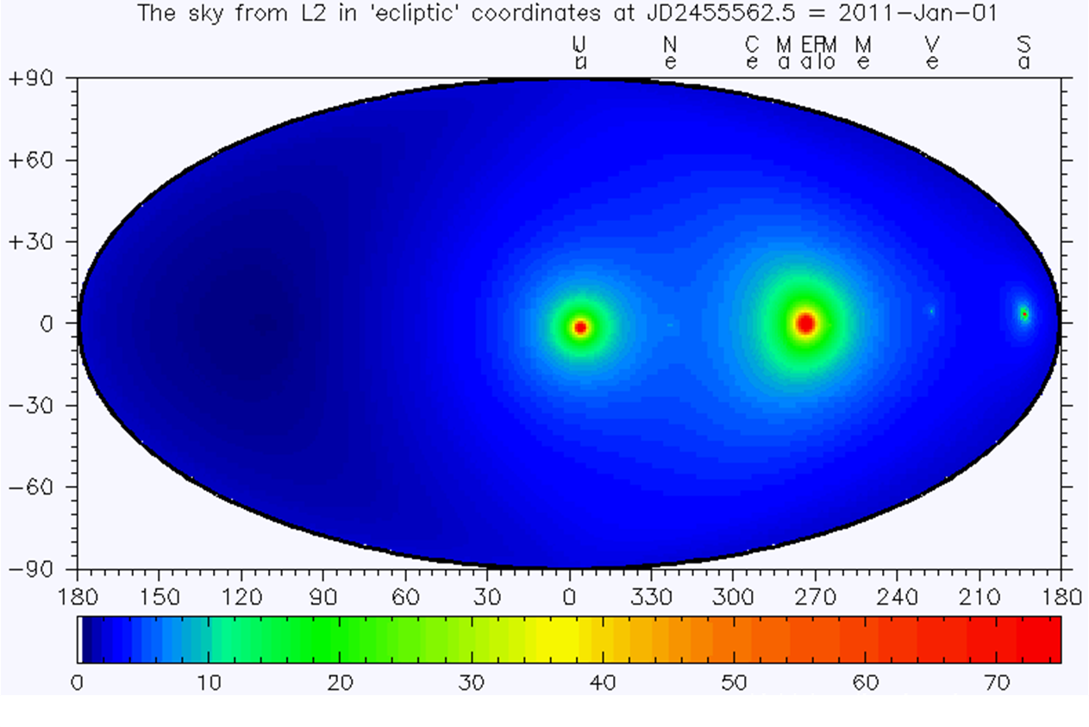
Light Bending in Solar System
Light bending in microarcsec, after subtraction of the much larger effect by the Sun
Movie courtesy Jos de Bruijne

Slide 9
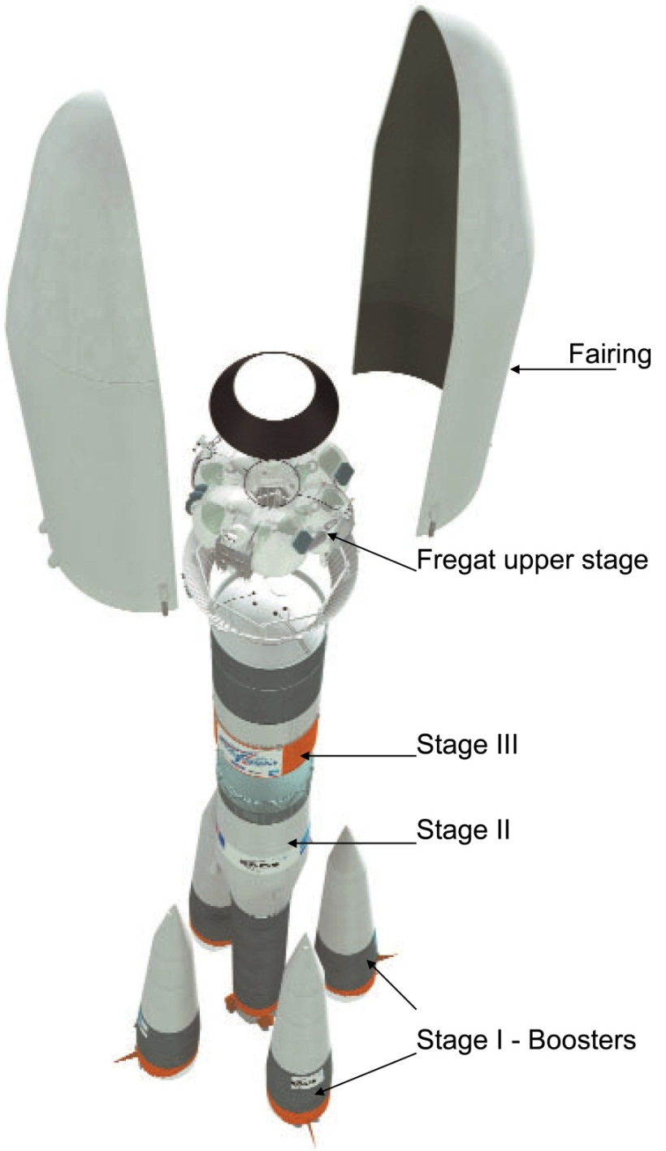
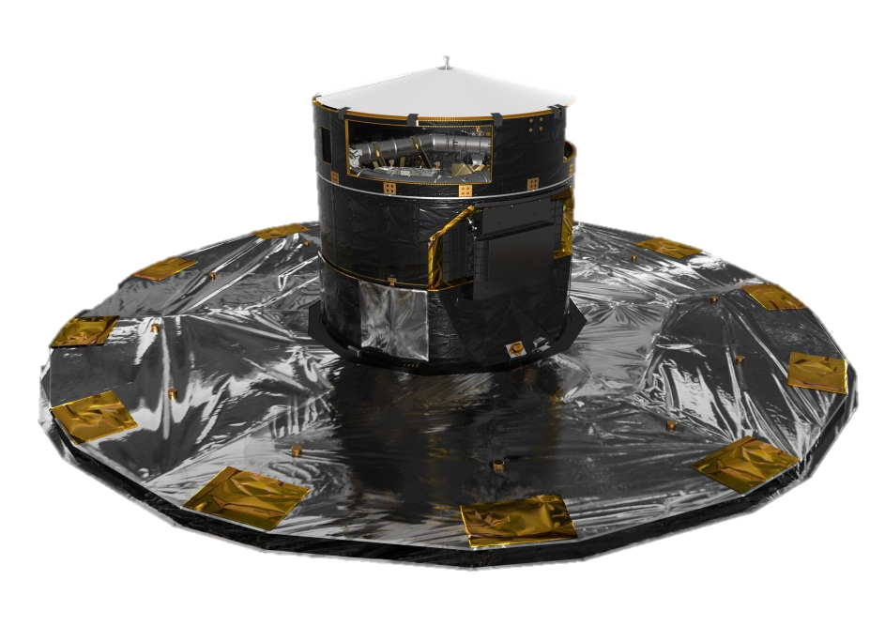
Satellite and System
ESA-only mission
Launch: 19 December 2013
Launcher: Soyuz–Fregat from French Guiana
Orbit: L2 Lissajous orbit
Ground stations: Cebreros, New Norcia + Malargüe
Lifetime: 5 years (1 year potential extension)
Downlink rate: 4 - 8 Mbps
Figure Soyuz: Arianespace; figure Gaia: ESA - C. Carreau

Slide 10
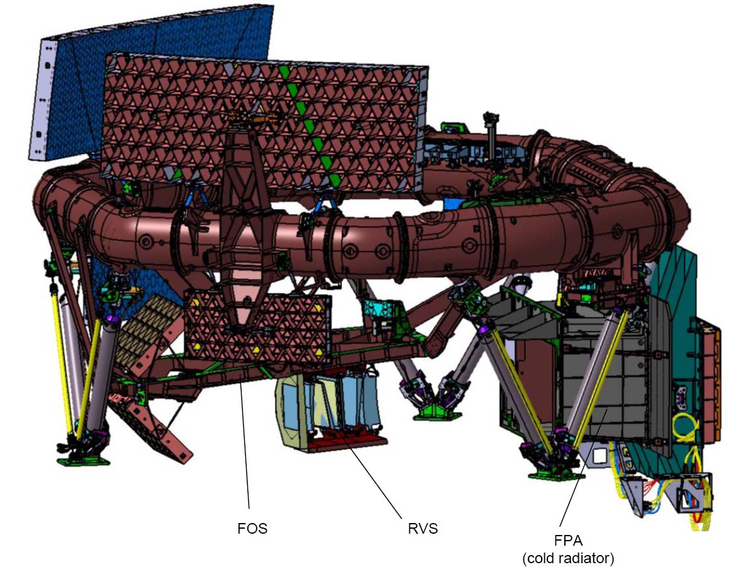
Payload and Telescope
Rotation axis (6h)
Basic-Angle-Monitoring (BAM) system
Two Sic primary mirrors
1.45 × 0.50 m² at 106.5°
SiC torus
(optical bench)
Combined Focal-Plane Assembly (FPA) with 106 CCD detectors
Superposition of two Fields of View (FoV)
Radial-Velocity Spectrometer (RVS)
Figure courtesy EADS-Astrium

Slide 11
Focal Plane
Figure courtesy Alex Short
104.26cm
Wave Front Sensor
Wave Front Sensor
Blue Photometer CCDs
Red Photometer CCDs
42.35cm
Radial-Velocity Spectrometer CCDs
Basic Angle Monitor
Basic Angle Monitor
Star motion in 10 s
Sky Mapper CCDs
Astrometric Field CCDs
Total field:
- active area: 0.75 deg²
- CCDs: 14 + 62 + 14 + 12 (+ 4)
- 4500 x 1966 pixels (TDI)
- pixel size = 10 µm x 30 µm
= 59 mas x 177 mas
Sky mapper:
- detects all objects to G=20 mag
- rejects cosmic-ray events
- field-of-view discrimination
Astrometry:
- total detection noise ~ 4 e⁻
Photometry:
- spectro-photometer
- blue and red CCDs
Spectroscopy:
- high-resolution spectra
- red CCDs

Slide 12
On-Board Object Detection
Requirements:
  unbiased sky sampling (magnitude, colour, resolution)
  all-sky catalogue at Gaia resolution (0.1 arcsec) to G~20 mag does not exist
Solution is on-board detection:
  no input catalogue or observing programme
  good detection efficiency to G~21 mag
Gaia will therefore detect:
  variable stars (eclipsing binaries, Cepheids, etc.)
  supernovae: ~6,000
  gravitational-lensing events: ~1000 photometric and ~100 astrometric
  Solar-system objects, including near-Earth asteroids and Kuiper-Belt objects

Slide 13
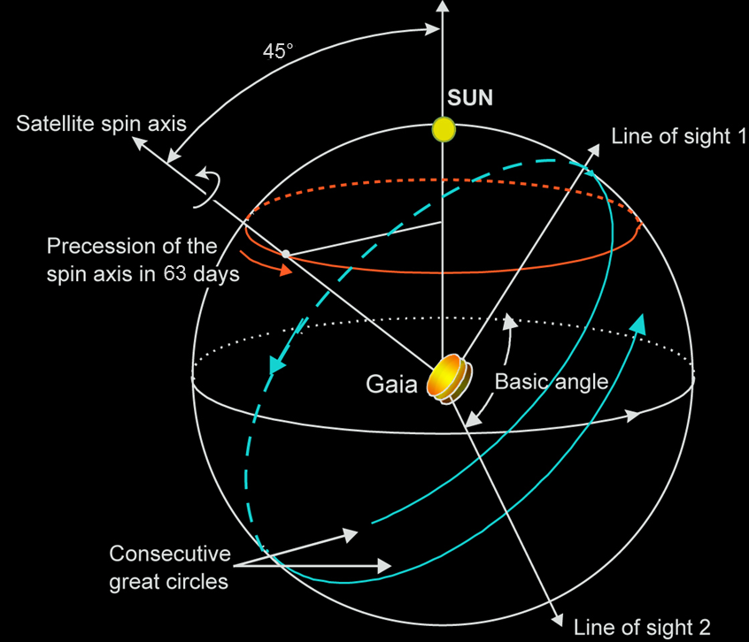
Sky-Scanning Principle
Spin axis 45º to Sun
Scan rate: 60 arcsec s⁻¹
Spin period: 6 hours
Figure ESA

Slide 14
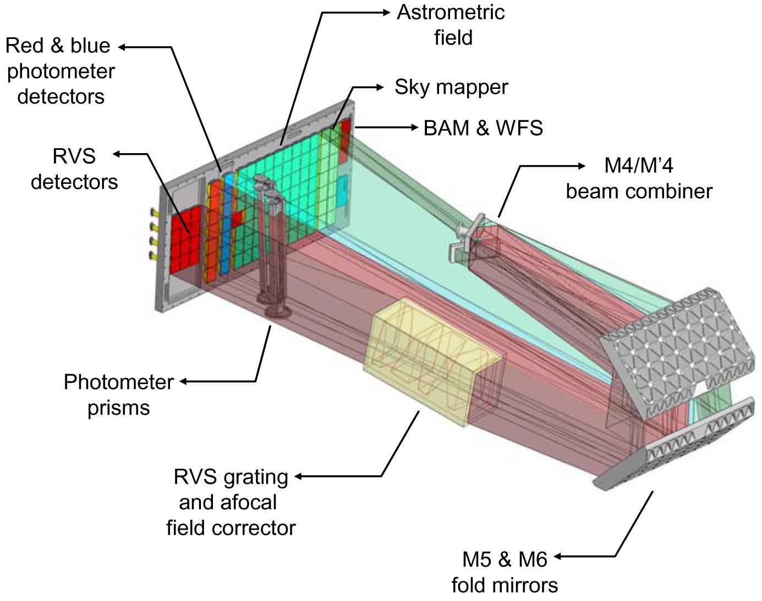
Photometry Measurement Concept (1/2)
Blue photometer:
330 - 680 nm
Red photometer:
640 - 1050 nm
Figure courtesy EADS-Astrium

Slide 15
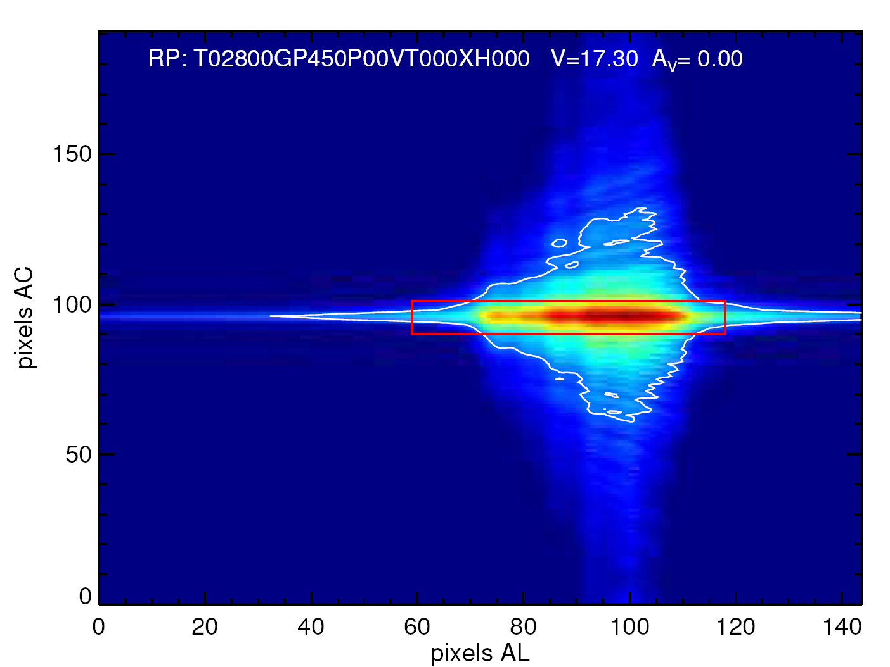
Photometry Measurement Concept (2/2)
RP spectrum of M dwarf (V = 17.3 mag)
Red box: data sent to ground
White contour: sky-background level
Colour coding: signal intensity
Figures courtesy Anthony Brown

Slide 16
Radial-Velocity Measurement Concept (1/2)
Spectroscopy:
845 - 872 nm
(resolution ~10,800)
Figure courtesy EADS-Astrium

Slide 17
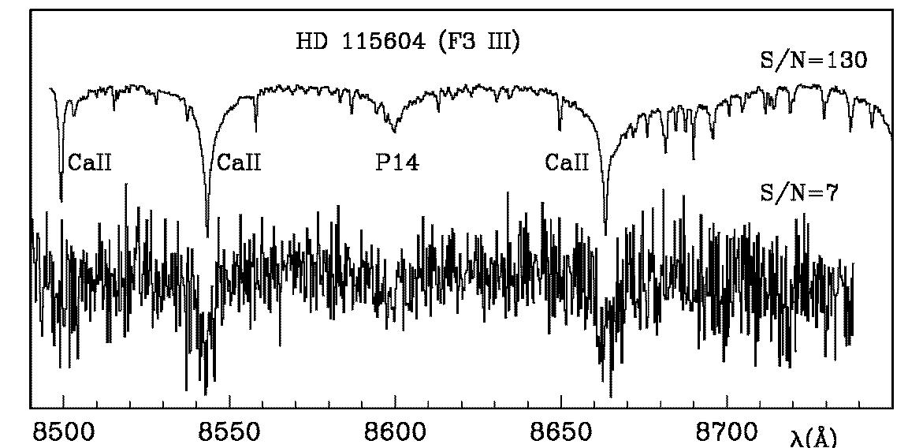
Radial-Velocity Measurement Concept (2/2)
Field of view
RVS spectrograph
CCD detectors
RVS spectra of F3 giant (V = 16 mag)
S/N = 7 (single measurement)
S/N = 130 (summed over mission)
Figures courtesy David Katz

Slide 18
Data-Reduction Principles
Scan width = 0.7°
1. Object matching in successive scans
2. Attitude and calibrations are updated
3. Objects positions etc. are solved
4. Higher-order terms are solved
5. More scans are added
6. System is iterated
Sky scans
(highest accuracy
along scan)
Figure courtesy Michael Perryman

Slide 19
Scientific Organisation
Gaia Science Team (GST):
  7 members + ESA Project Scientist + DPAC Executive Chair
Scientific community:
  organised in Data Processing and Analysis Consortium (DPAC)
  450+ scientists in 20+ countries active at some level
  GREAT network for post-mission science exploitation
Community is active and productive:
  regular Science Team / DPAC meetings
  growing archive of scientific and processing-software reports
  advance of algorithms, calibration models, accuracy models, etc.
Data-distribution policy:
  final catalogue ~2022
  intermediate catalogues defined
    intermediate releases starting 2016 with positions; parallaxes and proper motions will be added in 2017
  science-alerts data released immediately
  no proprietary data rights

Slide 20
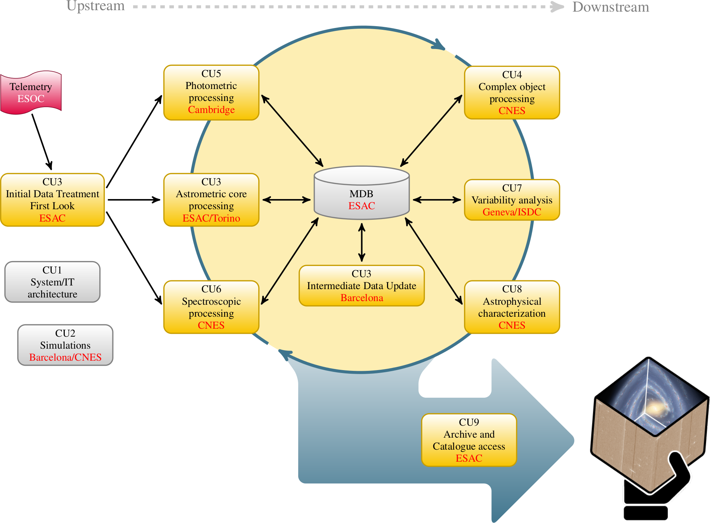
Data Processing Concept

Slide 21
Schedule
1993
1994
1997
1998
1999
2001
2002
2003
2004
2006
2007
2008
2010
2011
2013
2014
2017
2018
1996
2000
2005
2009
2012
2015
2019
2021
1995
2016
2020
2022
Proposal
Concept & Technology Study
Mission Selection
Re-Assessment Study
Phase B1
Definition
Selection of Prime Contractor (EADS Astrium SAS)
Phase B2
Implementation
Phase C/D
Launch December 2013
Scientific operation
Operation
Studies
Software Development (DPAC)
Data Processing
Data Processing
Mission Products
Intermediate
Final
Figure courtesy Michael Perryman and François Mignard
Today

Slide 22
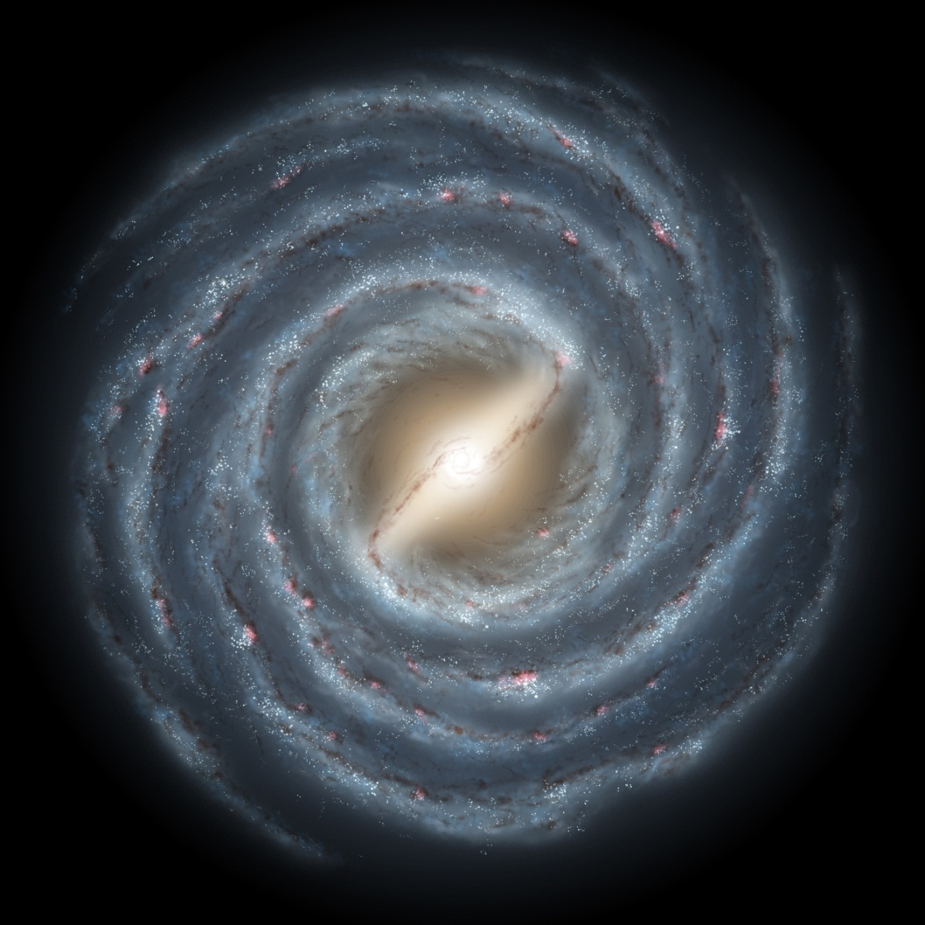
Gaia
Unraveling the chemical and dynamical
history of our Galaxy

