Slide 1
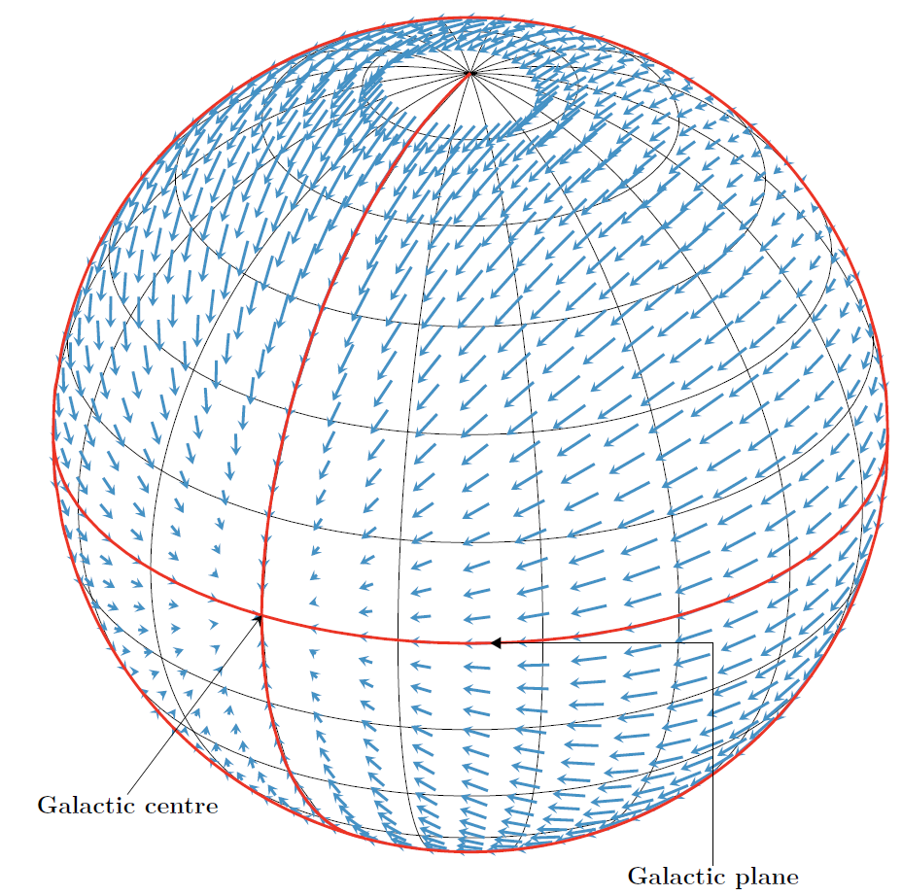
Gaia eDR3:
The acceleration of the solar system

Slide 2
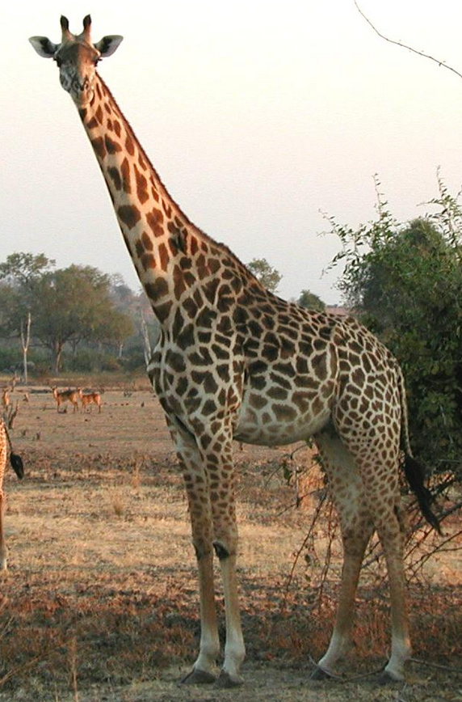

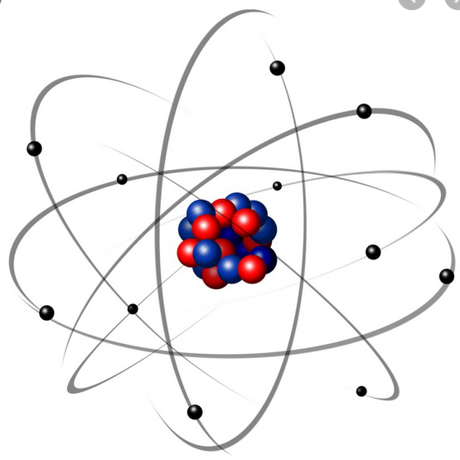
Gravitational acceleration
s = ¹/₂ a t²
Attractor acceleration height of fall in 1 second
Earth: 9.81 m/s² 5 m
Sun: 6mm/s² =0.006 m/s² 3 mm
Milky Way: 0.2nm/s² = 0.0000000002 m/s² 0.1 nm
Fanselow 1983, Bastian 1995

Slide 3
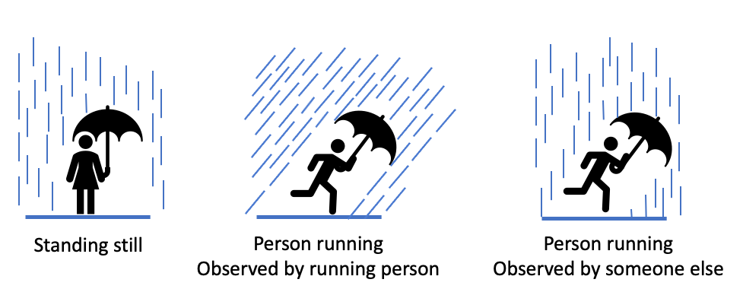

Aberration 1
aka
  Aberration of light
  Aberration of star light
  Annual aberration
  Raindrops analogue:
Credit: T. Roegiers, ESA/Gaia/DPAC

Slide 4
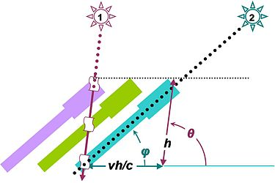
Aberration 2
Photons running through
a moving telescope
Credit:
https://en.wikipedia.org/wiki/Aberration_(astronomy)#/media/File:Stellar_aberration.JPG; freely usable

Slide 5
Aberration 3
Change of aberration when the velocity vector of the observer changes.
The inclination of the umbrella gradually moves towards the “center of attraction”.

Slide 6
Aberration 3
Towards galactic centre
Change of aberration when the velocity vector of the observer changes.
The inclination of the umbrella gradually moves towards the “center of attraction”.

Slide 7
Aberration and
Parallax
41”
August
November
May
February
N
alpha Centauri
O

Slide 8
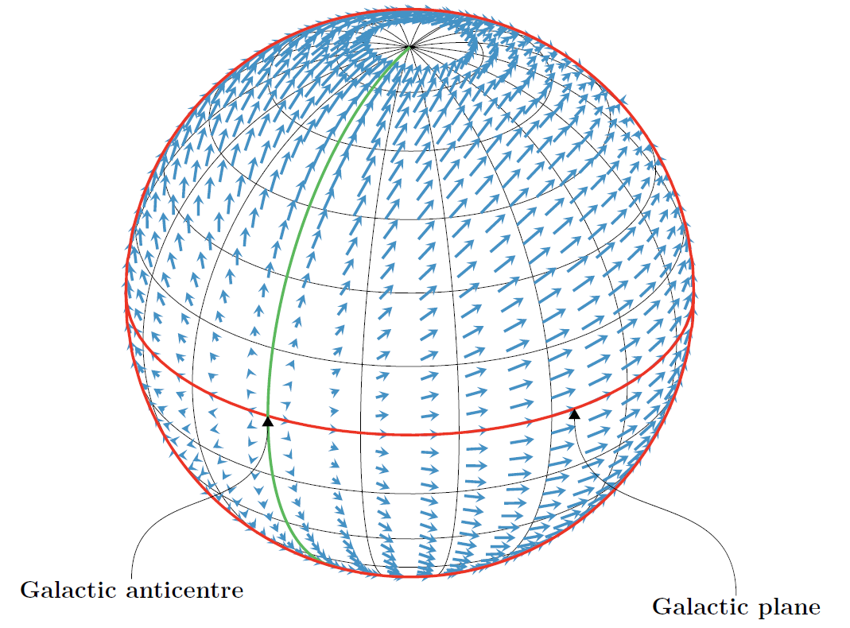
Predicted proper-motion pattern
Orthographic projection,
galactic coordinates
Credit: F. Mignard, OCA, Nice; freely usable

Slide 9
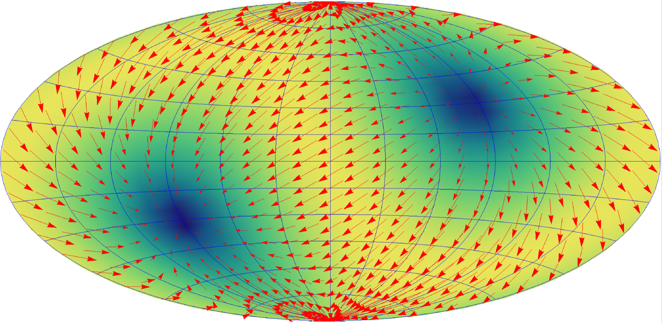
Predicted proper-motion pattern 2/2
Aitoff projection, all sky
equatorial coordinates;
including the actually measured offset from direction to galactic centre.
Coloured background: Absolute value of the motion
Credit: S. Klioner, TU Dresden; freely usable
North up;
RA increasing to the right; RA=0 in the centre

Slide 10
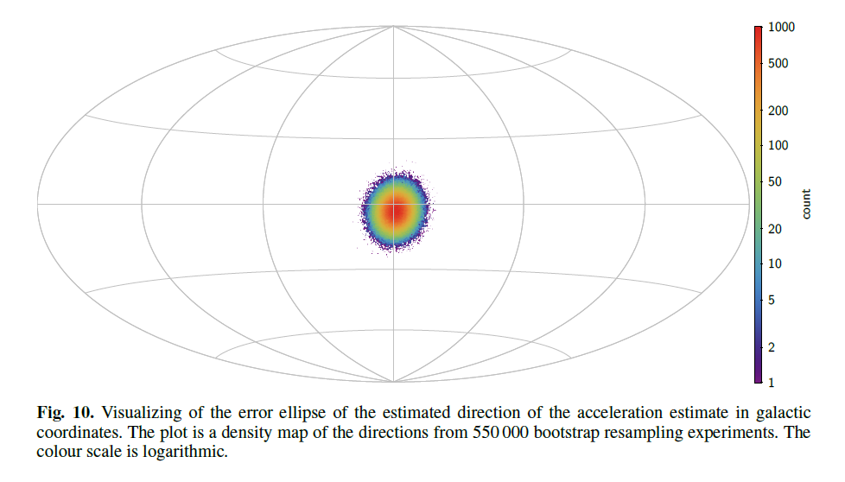
Measurement

Slide 11
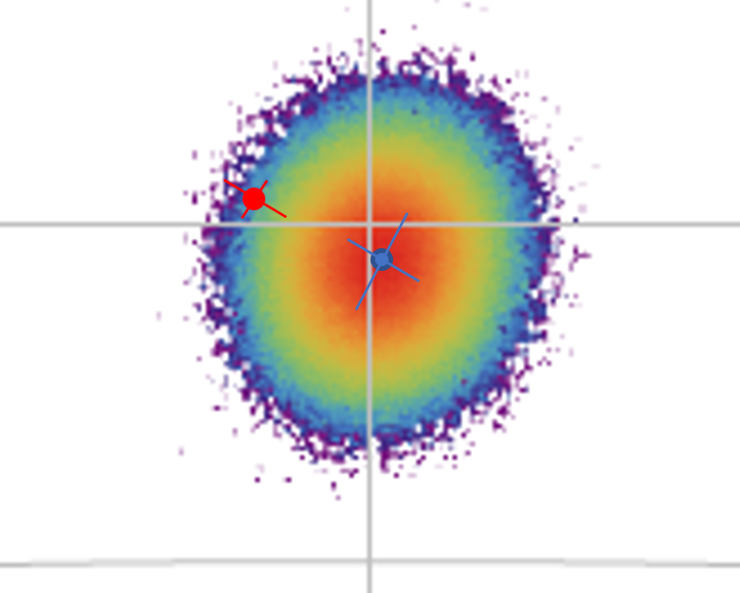

Slide 12
Two semi-philosophical remarks (1/2)
On the one hand,
  the nice agreement of the measurement with the prior expectation is a great success of Gaia.
  It shows that Gaia already now can make significant scientific statements on the level of just a few micro-arcseconds (with much more to come).
  It also is a nice confirmation of our present knowledge about the Milky Way.
On the other hand,
  the nice agreement of the measurement with the prior expectations is a great pity.
  Consider the possibility that the acceleration would grossly differ from the expectation.
  That would be a first-class scientific sensation! In this way, Gaia might have discovered
    either an invisible dozen-solar-mass black hole lurking within a few dozen parsecs from the sun,
    or one of those million-solar-mass dark-matter mini-halos long postulated and sought by cosmologists,
    or even completely new physics
  But alas it fits. Thus still no Nobel prize for Gaia in sight.
a great success
a great pity

Slide 13
Two semi-philosophical remarks (1/2)
On the one hand,
  the nice agreement of the measurement with the prior expectation is a great success of Gaia.
  It shows that Gaia already now can make significant scientific statements on the level of just a few micro-arcseconds (with much more to come).
  It also is a nice confirmation of our present knowledge about the Milky Way.
On the other hand,
  the nice agreement of the measurement with the prior expectations is a great pity.
  Consider the possibility that the acceleration would grossly differ from the expectation.
  That would be a first-class scientific sensation! In this way, Gaia might have discovered
    either an invisible dozen-solar-mass black hole lurking within a few dozen parsecs from the sun,
    or one of those million-solar-mass dark-matter mini-halos long postulated and sought by cosmologists,
    or even completely new physics
  But alas it fits. Thus still no Nobel prize for Gaia in sight.

Slide 14
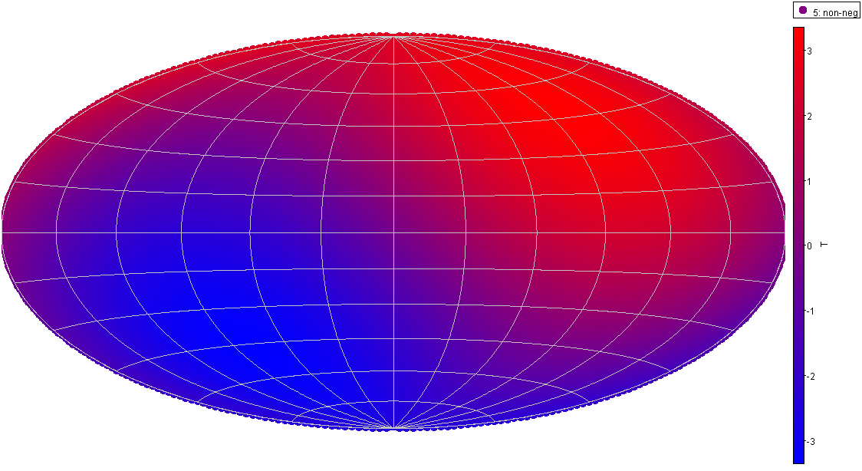
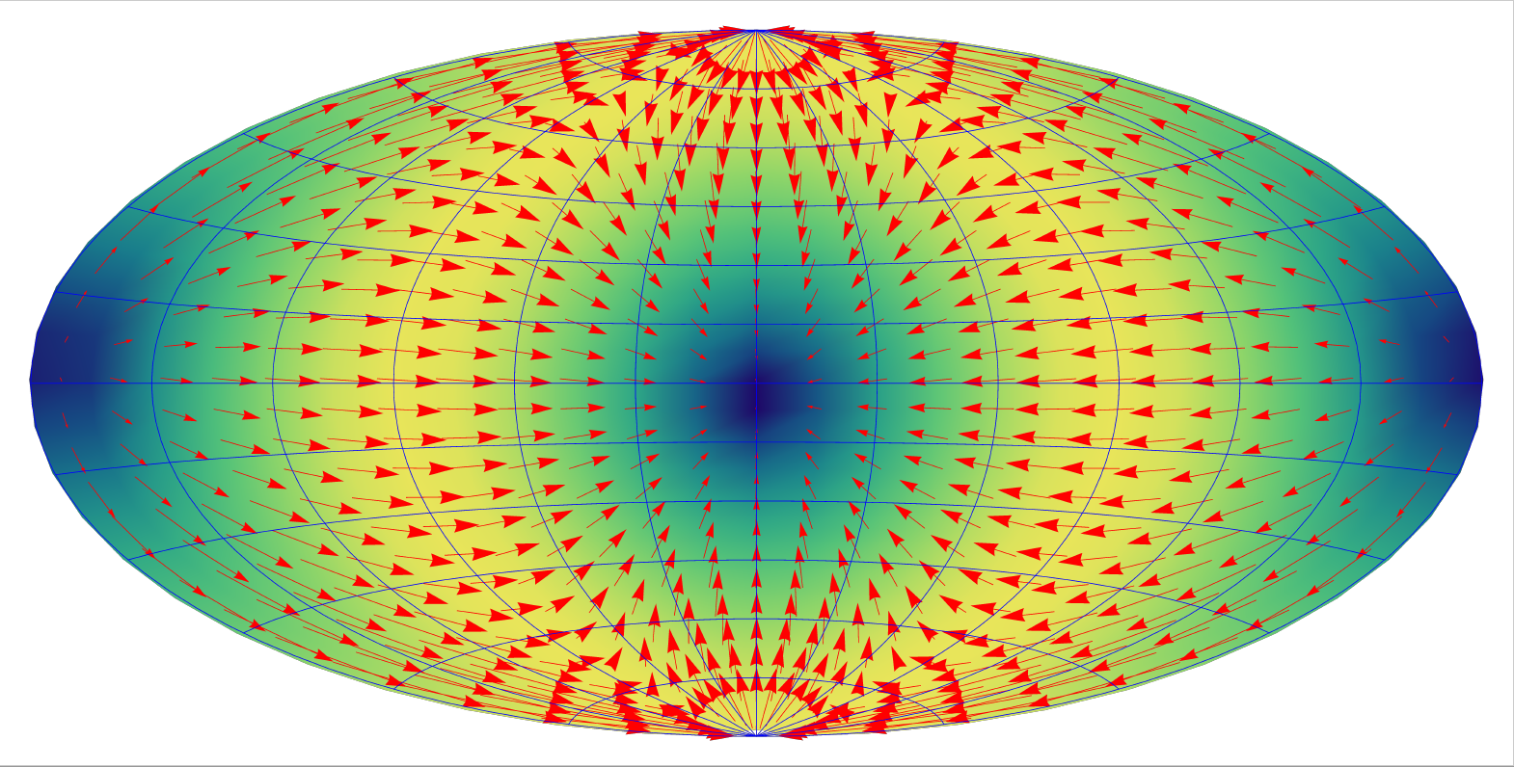
Two semi-philosophical remarks (2/2)
It is an aesthetically appealing thought to realize that nowadays …
the absolute acceleration of the solar system with respect to the “rest of the universe” can be determined by an astrometric measurement,
while
the absolute motion of the solar system with respect to the “rest of the universe” can be determined by a photometric measurement.
Proper-motion field of quasars Intensity dipole of cosmic microwave background
Isn’t this beautiful?

Slide 15
Two semi-philosophical remarks (2/2)
It is an aesthetically appealing thought to realize that nowadays
the absolute acceleration of the solar system with respect to the “rest of the universe” can be determined by an astrometric measurement,
while
the absolute motion of the solar system with respect to the “rest of the universe” can be determined by a photometric measurement.
Proper-motion field of quasars Intensity dipole of cosmic microwave background
Isn’t this beautiful?

Slide 16
And a big compliment to DPAC, ESA and ESOC
So, using Gaia data from the first 3 years, we have measured something to a formal precision of
0.016 nm/sec² = 16 pm/sec², or 0.35 microarcsec/year

Slide 17
And a big compliment to DPAC, ESA and ESOC
So, using Gaia data from the first 3 years, we have measured something to a formal precision of
0.016 nm/sec² = 16 pm/sec², or 0.35 microarcsec/year
That something is
the mean acceleration of the solar system with respect to >1 million quasars over 3 years.
This was only possible because the flight-dynamics people of ESOC have measured
the mean acceleration of Gaia with respect to the barycenter of the solar system over 3 years
with even higher precision
This was only possible because a lot of people within DPAC, including ESAC/SOC have done
fabulous preprocessing and calibration work on the Gaia data
This was only possible because ESA has provided us with
a wonderful instrument

