Slide 1
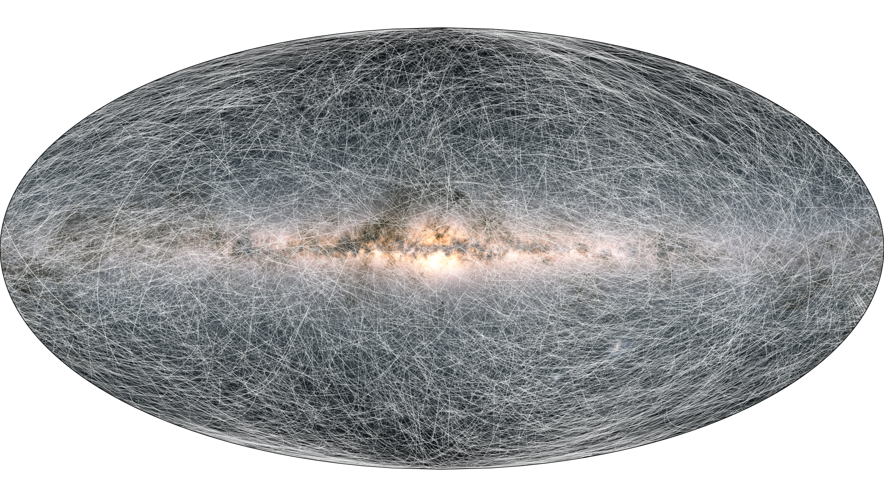
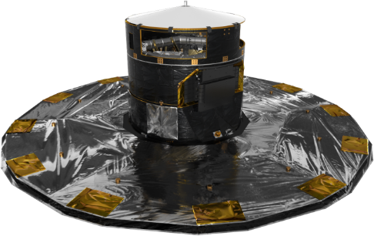
EDR3 Gaia Archive appetizers
Alcione Mora
Support Archive Scientist
Airbus Space
ESA/Gaia/DPAC

Slide 2
Outline
Did you prepare a draft with blanks in advance? ➔ Not here!
Are you proficient in using the Archive? ➔ You might learn new things
Are you new to Gaia? ➔ You might get a starting point
Did you enjoy the Science Demonstration papers? ➔ Some tricks here
How? Real article ADQL queries walkthrough

Slide 3
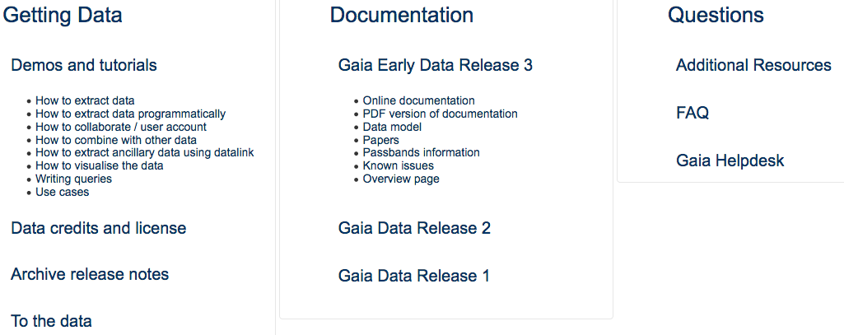
A lot of resources. See Tineke Roegier’s talk
https://www.cosmos.esa.int/web/gaia-users/archive

Slide 4
Retrieve data
Add queries to your paper! Reproducibility, citations
Anticentre
Magellanic Clouds
SELECT * from gaiaedr3.gaia_source WHERE l<190 and
l>170 and b>-10 and b<10
SELECT * FROM gaiaedr3.gaia_source as g
WHERE 1=CONTAINS(POINT('ICRS',g.ra,g.dec),
CIRCLE('ICRS',81.28,-69.78,20))
AND g.phot_g_mean_mag < 20.5

Slide 5
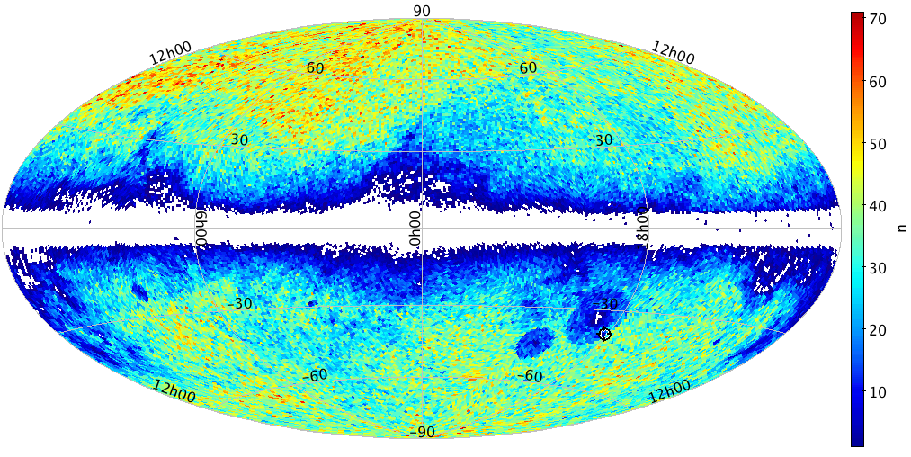
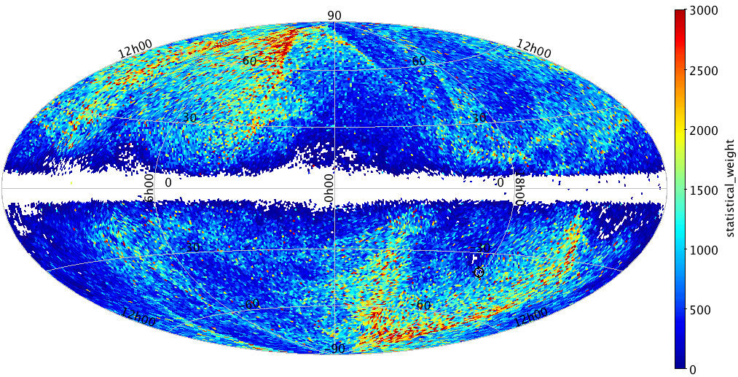
Solar System acceleration: HEALPix histograms
HEALPix: single index equal area tesselation
gaia_source.source_id contains HEALPix information
https://healpix.jpl.nasa.gov/

Slide 6
Solar System acceleration: HEALPix histograms
Create HEALPix index from source_id: gaia_healpix_index()
Use group by to create bins on created column
select
gaia_healpix_index(6, source_id) as healpix_6,
count(*) as n,
sum(power(pmra_error, -2) + power(pmdec_error, -2)) as statistical_weight
from gaiaedr3.gaia_source
join gaiaedr3.agn_cross_id using(source_id)
where astrometric_params_solved = 31
group by healpix_6
Hint: One HEALPix 6 tile covers 0.84 square degrees

Slide 7
Solar System acceleration: HEALPix histograms
Use aggregate functions (count, sum, …) to populate bins
select
gaia_healpix_index(6, source_id) as healpix_6,
count(*) as n,
sum(power(pmra_error, -2) + power(pmdec_error, -2)) as statistical_weight
from gaiaedr3.gaia_source
join gaiaedr3.agn_cross_id using(source_id)
where astrometric_params_solved = 31
group by healpix_6

Slide 8
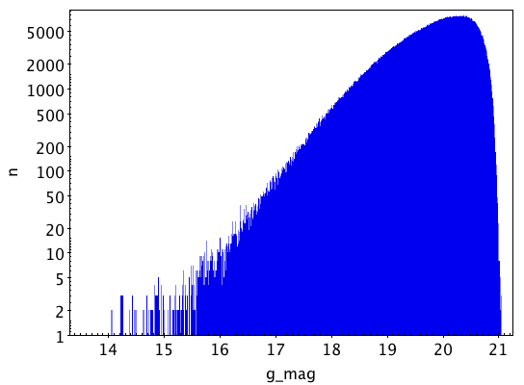
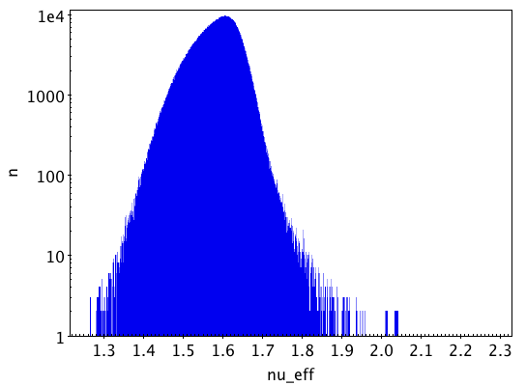
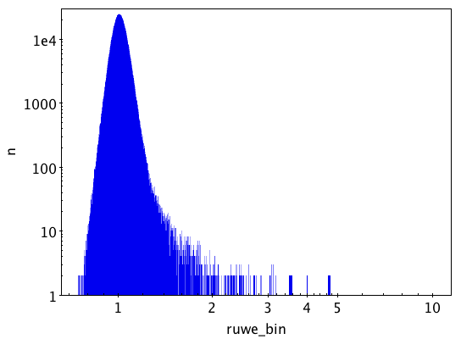
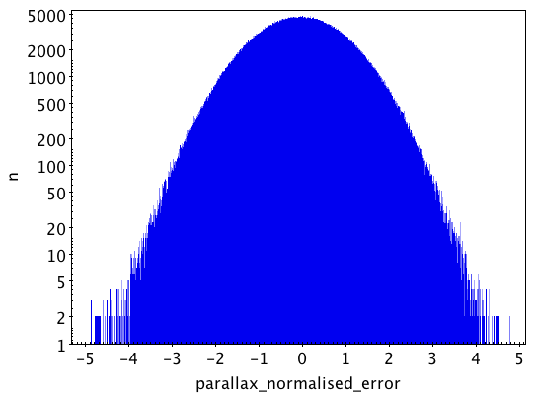

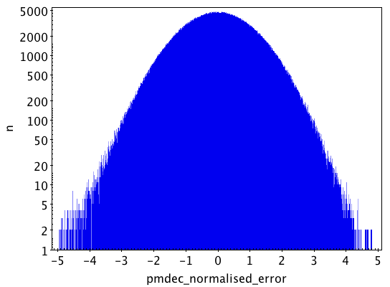
Solar System acceleration: 1D histograms

Slide 9
G mag 1D histogram
Use floor plus scale factor to quantize in bins
  Scale factor = 100 ➔ Sampling = 1 / 100 = 0.01 mag
select
floor(phot_g_mean_mag * 100) / 100 as g_mag,
count(*) as n
from gaiaedr3.gaia_source
join gaiaedr3.agn_cross_id using(source_id)
where astrometric_params_solved = 31
group by g_mag

Slide 10
RUWE 1D log-x histogram
Combine floor , log10, power and scale factor
  Scale factor = 1000 ➔ Sampling = 1/1000 (log); 10^{1/1000} = 1.0023 (real space)
select
power(10, floor(log10(ruwe) * 1000) / 1000.)
as ruwe_bin,
count(*) as n
from gaiaedr3.gaia_source
join gaiaedr3.agn_cross_id using(source_id)
where astrometric_params_solved = 31
group by ruwe_bin

Slide 11
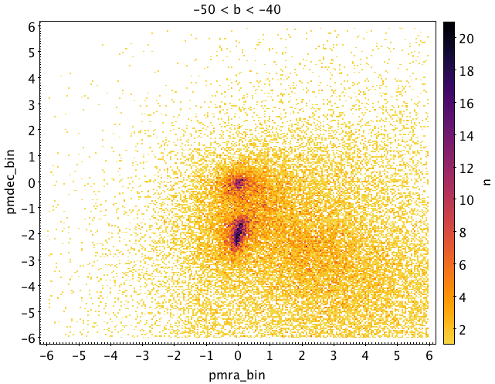
Anticentre: Distant objects 2D histogram
Create two bin indices and group by them
select
floor(pmra * 20) / 20 as pmra_bin,
floor(pmdec * 20) / 20 as pmdec_bin,
count(*) as n
from gaiaedr3.gaia_source
where (l between 170 and 190)
and (b between -50 and -40)
and (parallax < 0.1)
and (pmra between -6 and 6)
and (pmdec between -6 and 6)
and (ruwe < 1.4)
group by pmra_bin, pmdec_bin

Slide 12
Anticentre: Distant objects 2D histogram
Create two bin indices and group by them
select
floor(pmra * 20) / 20 as pmra_bin,
floor(pmdec * 20) / 20 as pmdec_bin,
count(*) as n
from gaiaedr3.gaia_source
where (l between 170 and 190)
and (b between -50 and -40)
and (parallax < 0.1)
and (pmra between -6 and 6)
and (pmdec between -6 and 6)
and (ruwe < 1.4)
group by pmra_bin, pmdec_bin

Slide 13
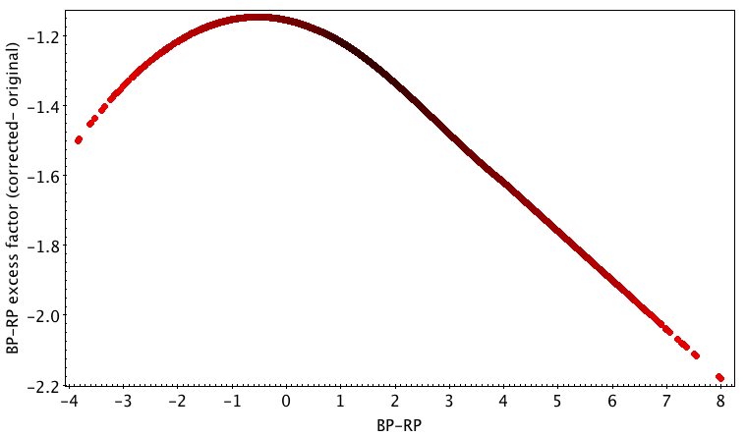
EDR3 summary: Corrected BP-RP excess factor
New functionality as User Defined Functions (UDF)
select source_id, bp_rp, phot_bp_rp_excess_factor,
if_then_else(
bp_rp > -20,
to_real(case_condition(
phot_bp_rp_excess_factor - (1.162004 + 0.011464* bp_rp
+ 0.049255*power(bp_rp,2)
- 0.005879*power(bp_rp,3)),
bp_rp < 0.5,
phot_bp_rp_excess_factor - (1.154360 + 0.033772* bp_rp
+ 0.032277*power(bp_rp,2)),
bp_rp >= 4.0,
phot_bp_rp_excess_factor - (1.057572 + 0.140537*bp_rp)
)),
phot_bp_rp_excess_factor
) as phot_bp_rp_excess_factor_corr
from gaiaedr3.gaia_source
where random_index between 1000000 and 1999999

Slide 14
EDR3 summary: Corrected BP-RP excess factor
Simple conditional branching: if_then_else
select source_id, bp_rp, phot_bp_rp_excess_factor,
if_then_else(
bp_rp > -20,
to_real(case_condition(
phot_bp_rp_excess_factor - (1.162004 + 0.011464* bp_rp
+ 0.049255*power(bp_rp,2)
- 0.005879*power(bp_rp,3)),
bp_rp < 0.5,
phot_bp_rp_excess_factor - (1.154360 + 0.033772* bp_rp
+ 0.032277*power(bp_rp,2)),
bp_rp >= 4.0,
phot_bp_rp_excess_factor - (1.057572 + 0.140537*bp_rp)
)),
phot_bp_rp_excess_factor
) as phot_bp_rp_excess_factor_corr
from gaiaedr3.gaia_source
where random_index between 1000000 and 1999999

Slide 15
EDR3 summary: Corrected BP-RP excess factor
Multiple conditions: case_condition, case_expression
select source_id, bp_rp, phot_bp_rp_excess_factor,
if_then_else(
bp_rp > -20,
to_real(case_condition(
phot_bp_rp_excess_factor - (1.162004 + 0.011464* bp_rp
+ 0.049255*power(bp_rp,2)
- 0.005879*power(bp_rp,3)),
bp_rp < 0.5,
phot_bp_rp_excess_factor - (1.154360 + 0.033772* bp_rp
+ 0.032277*power(bp_rp,2)),
bp_rp >= 4.0,
phot_bp_rp_excess_factor - (1.057572 + 0.140537*bp_rp)
)),
phot_bp_rp_excess_factor
) as phot_bp_rp_excess_factor_corr
from gaiaedr3.gaia_source
where random_index between 1000000 and 1999999

Slide 16
EDR3 summary: Corrected BP-RP excess factor
Type casting: to_real, to_integer, to_boolean, …
select source_id, bp_rp, phot_bp_rp_excess_factor,
if_then_else(
bp_rp > -20,
to_real(case_condition(
phot_bp_rp_excess_factor - (1.162004 + 0.011464* bp_rp
+ 0.049255*power(bp_rp,2)
- 0.005879*power(bp_rp,3)),
bp_rp < 0.5,
phot_bp_rp_excess_factor - (1.154360 + 0.033772* bp_rp
+ 0.032277*power(bp_rp,2)),
bp_rp >= 4.0,
phot_bp_rp_excess_factor - (1.057572 + 0.140537*bp_rp)
)),
phot_bp_rp_excess_factor
) as phot_bp_rp_excess_factor_corr
from gaiaedr3.gaia_source
where random_index between 1000000 and 1999999

Slide 17

Thank you for your attention!

